Slide 1
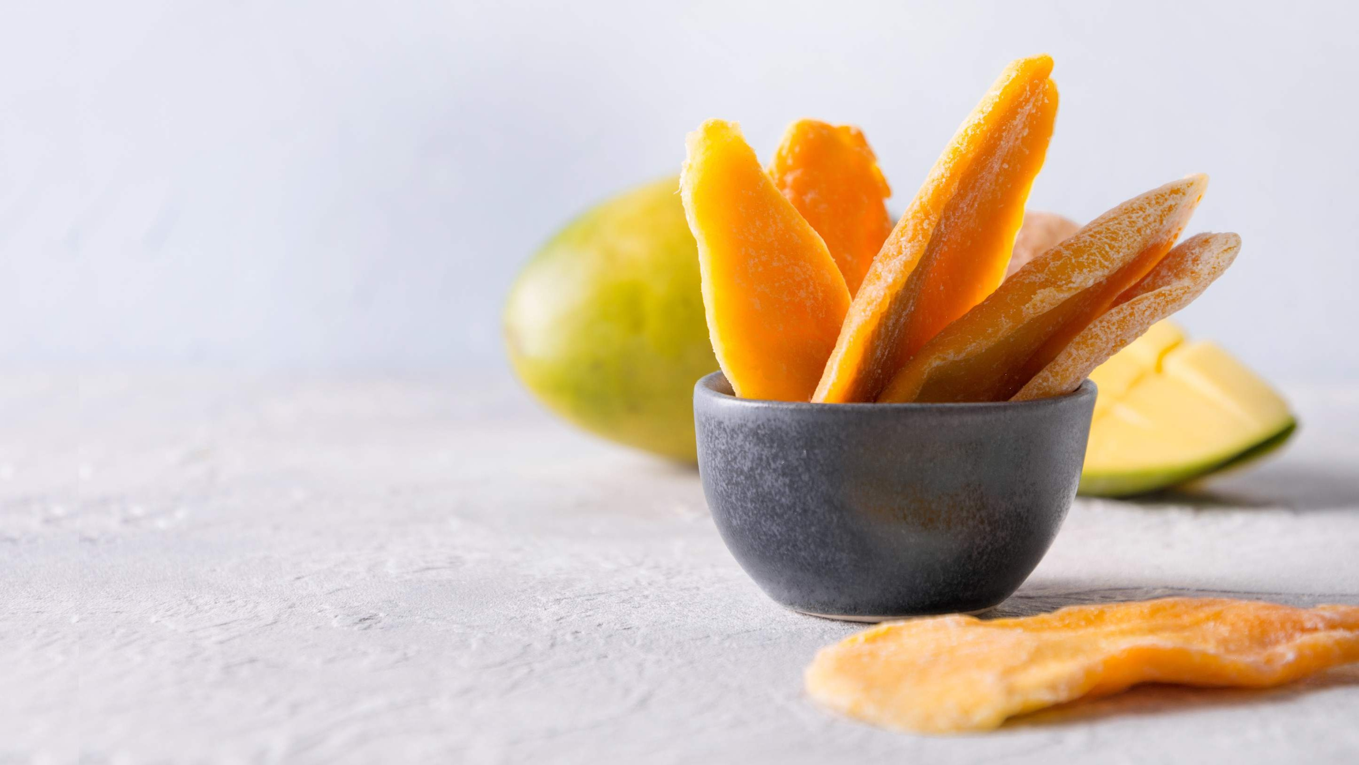
GLOBAL
DRIED MANGO
MARKET REPORT 2024
Global,Regional,CountryAnalysis

Slide 2
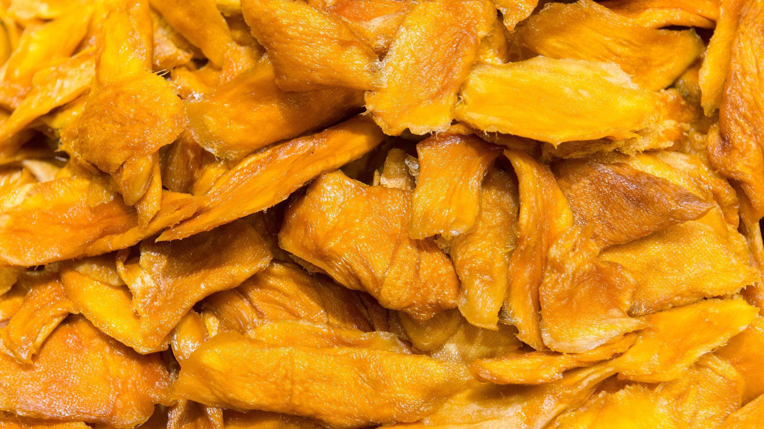
INTRODUCTION
The growing consumer preference for healthy snacking, increasing awareness of nutritional benefits, considered as a convenient and portable snack option, growth in vegan and vegetarian diets, availability of dried mango products in various retail channels, introduction of new flavors and product variants, globalization of food markets, increased use in various culinary applications, rising adoption by parents as a healthy snack option, increasing consumer concerns about the environmental and ethical aspects of food production, and effective marketing campaigns and promotions by manufacturers and retailers are the major factors driving the growth of the Dried Mango market.

Slide 3
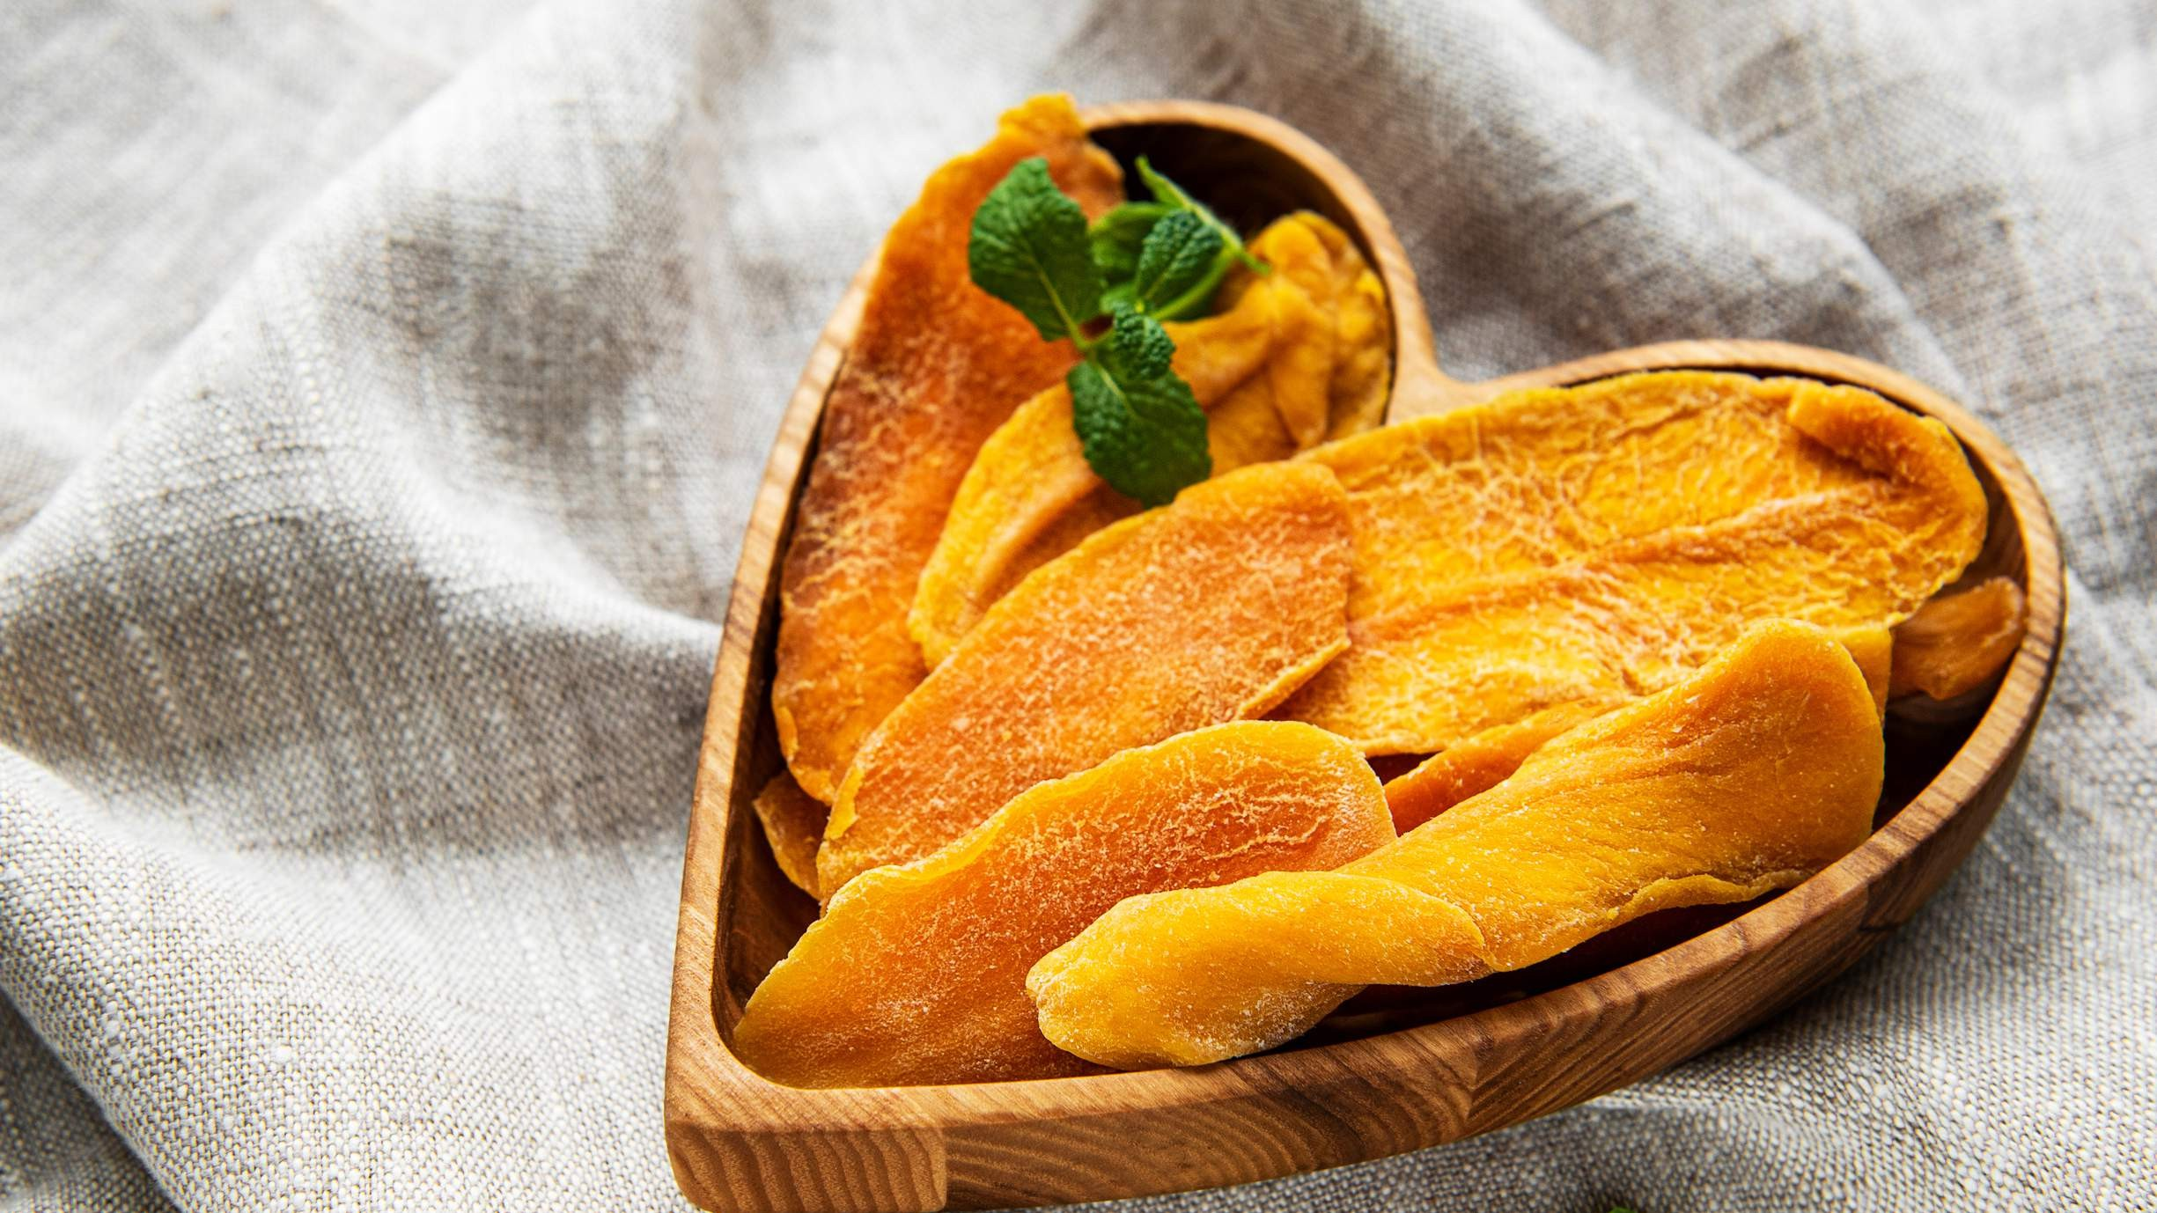

KEY INSIGHTS
20₋23
CAGR 6.98%
2030

Slide 4
REVENUE MARKET SHARE BY SEGMENTS 2022
No Sugar Add Type Low Sugar Type Traditional Sugar Add Type
Type Segment
Sun-dried Freeze-dried
Dehydrator-dried
Drying Process
Candy & Snacks Bakery Products Dairy Products Beverages
Application Segment
Supermarkets & Hypermarkets Online Retail Convenience Stores
Distribution Channel
Slices Chunks Powder
Form Segment

Slide 5
Global Dried Mango Market Revenue share for 2022
Asia Pacific 36%

Slide 6
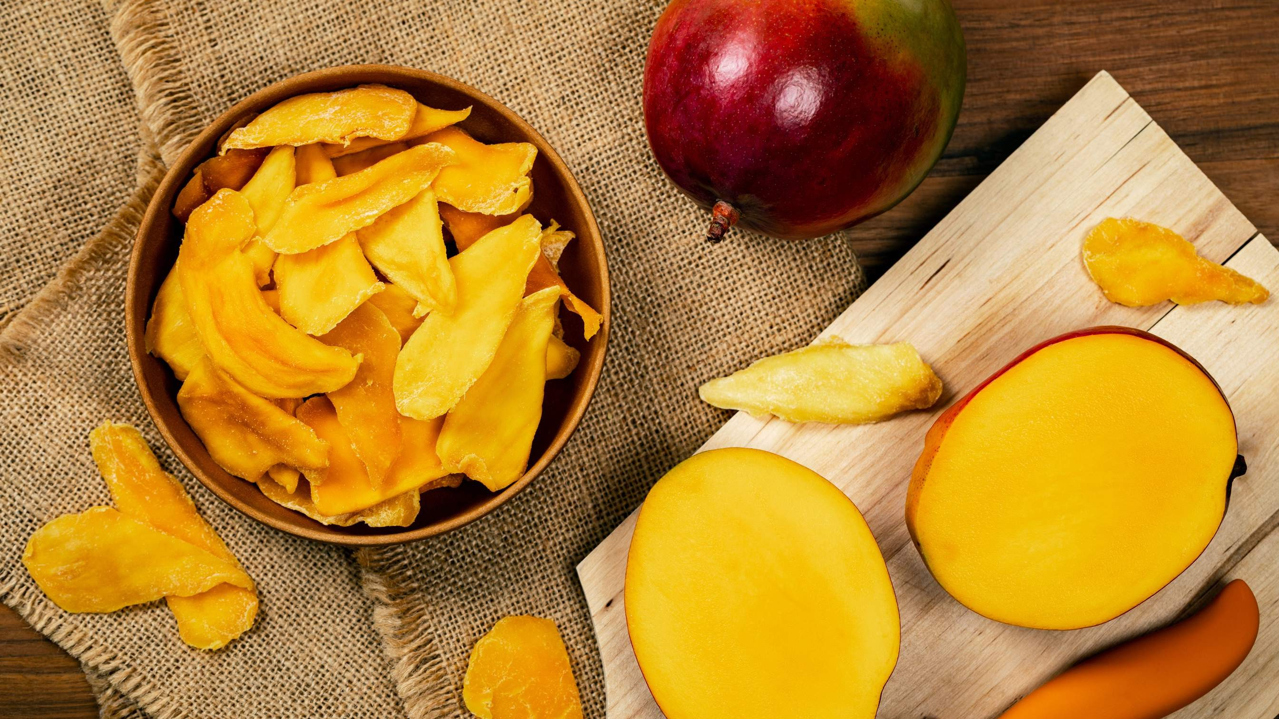
Introduction of new flavors and product variants to Propel Market Growth
Drivers
Changing Consumer Preferences to Hinder Market Growth
Restraints

Slide 7
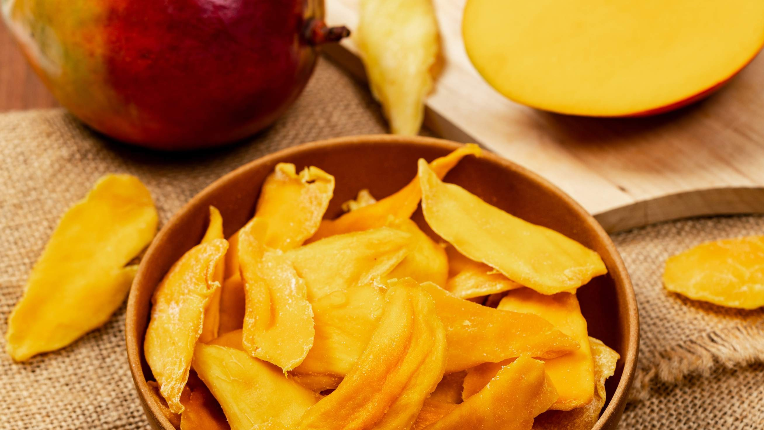
AUTHOR'S PERSPECTIVE
The Global Dried mango Market is witnessing significant growth in the near future.
The inherent sweetness and chewy texture of dried Mango make it an ideal inclusion in candies and snacks, providing a tropical and fruity flavor to these products.
Dried mango slices retain the fruit's natural shape and flavor, making them a convenient and sweet alternative to fresh Mango.
Dried mango chunks are often used in trail mixes, cereal, or as an ingredient in various recipes, providing a burst of tropical flavor.
Sun-dried mangoes are more readily available and cost-effective compared to freeze- dried mangoes.
Supermarkets and hypermarkets provide a physical shopping experience, allowing consumers to examine product quality and packaging before purchasing.

Slide 8
KEY PLAYERS

Slide 9


Contact us
For Full Report
COGNITIVE MARKET RESEARCH
Tel: + 1 312 - 376 - 8303 | + 44 020 - 8123 - 0732
India: ( + 91 ) 983 - 496 - 8611
sales@ cognitivemarketresearch. com
Access the Full Report : http://tinyurl.com/eyyw7et7
Please visit our website:
https://www.cognitivemarketresearch.com

