Slide 1
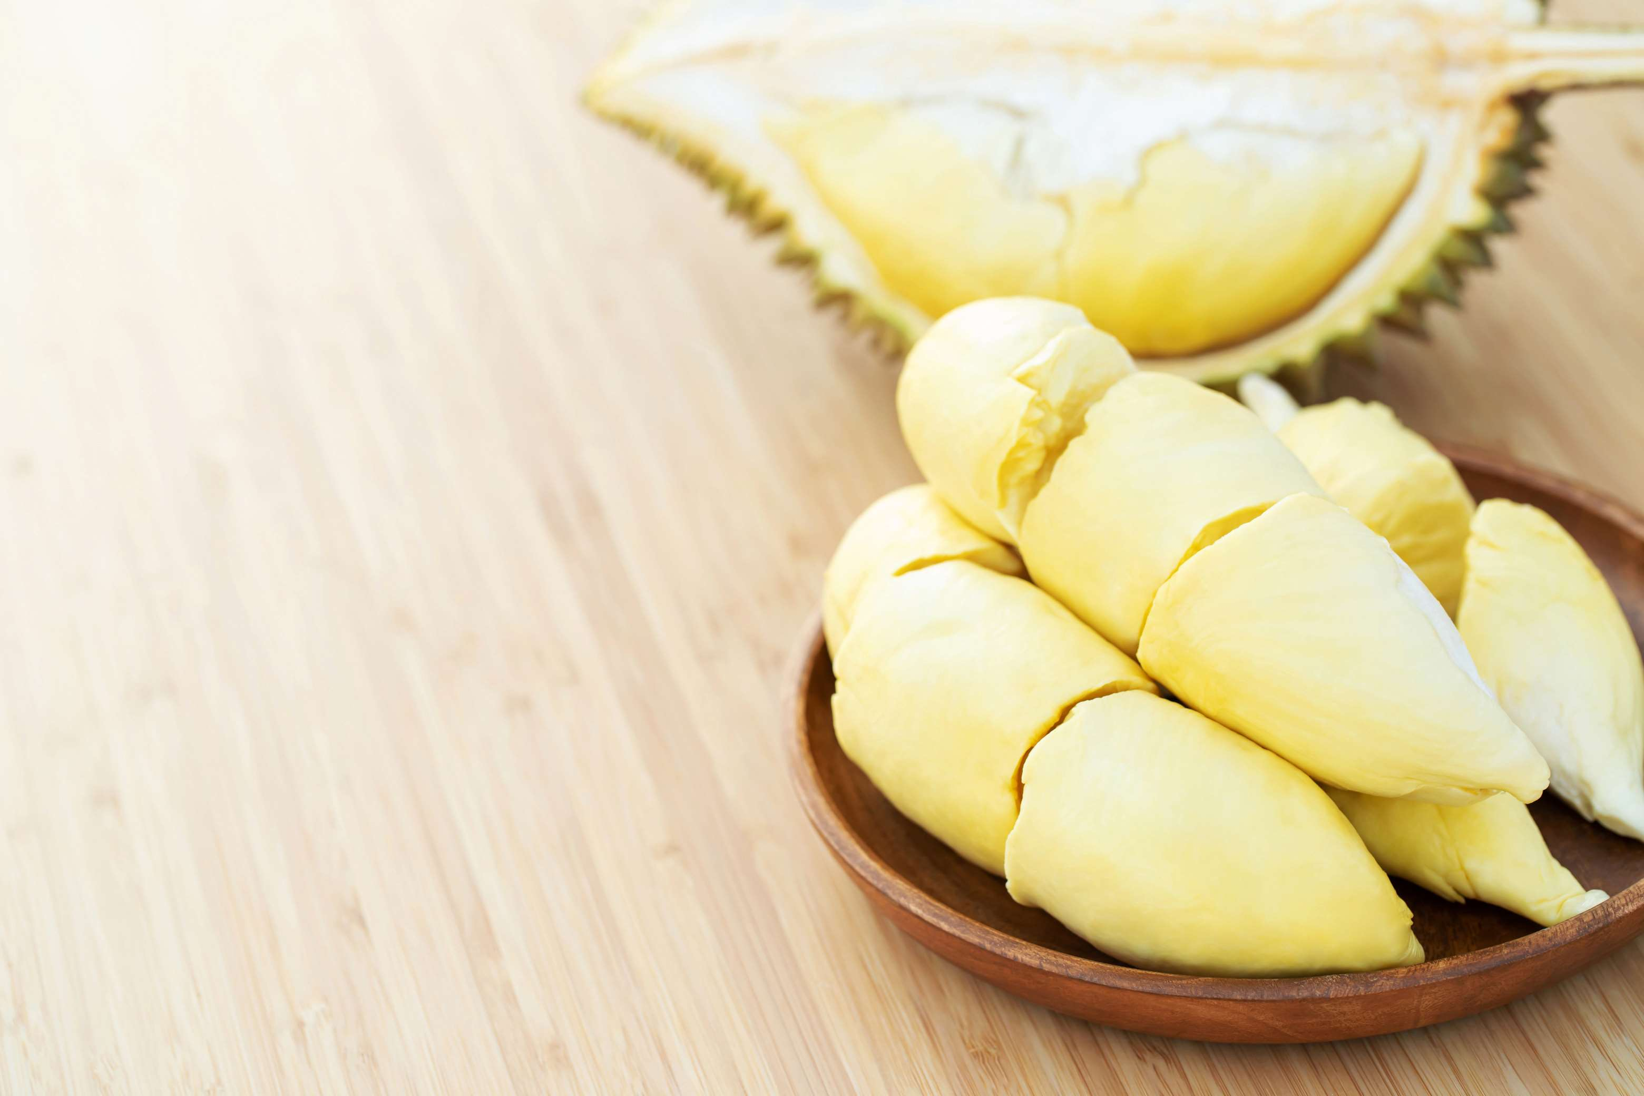

DRIED DURIAN
MARKET REPORT
2024
Qualitative Analysis + Quantitative Analysis

Slide 2
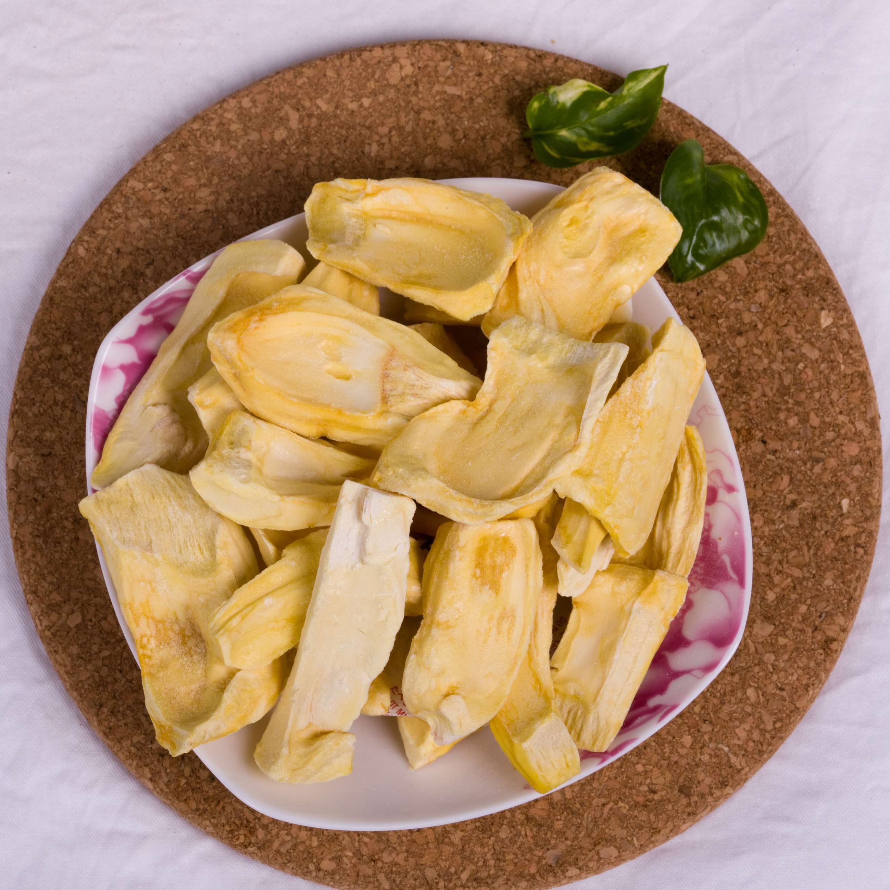
INTRODUCTION
The Dried Durian market combines the trade and consumption of durian fruit that is processed by drying the result being preservation and stability of product. Durian is called 'the king of fruits' in many Southeast Asian countries due to its unique smell and taste. Drying Duran preserves its unique flavor while making it last longer, so many customers opt for it as a convenient and exotic snack or ingredient for a variety of culinary applications.

Slide 3


KEY INSIGHTS
MARKET SIZE
5.00%
2024- 2031

Slide 4
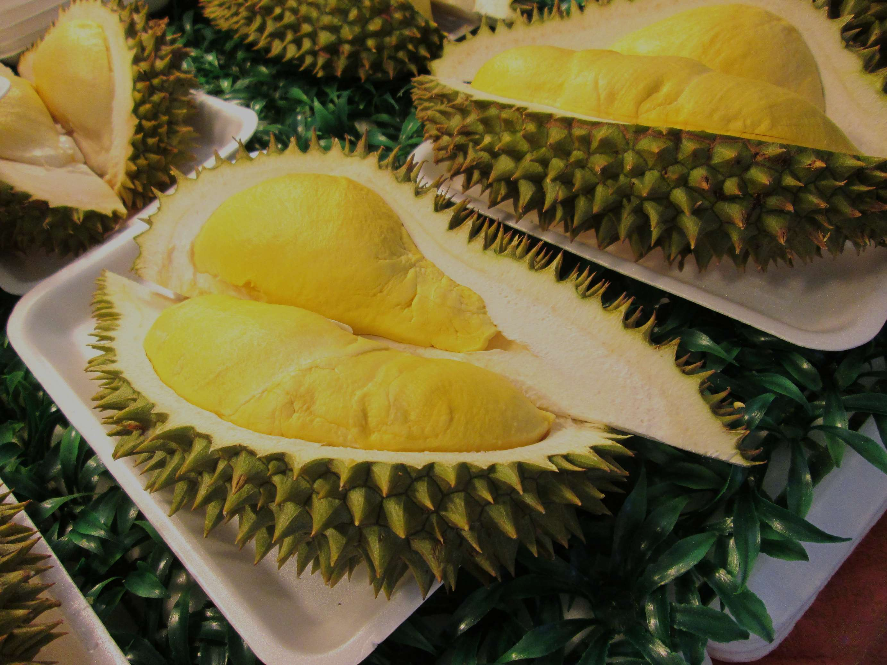
REVENUE MARKET SHARE BY SEGMENTS 2024
  Dried Durian market, it is via the segment of vacuum-dried durian that stands out most magnificently.
  Among all segments of the dried durian market, it is the freeze-dried segment which develops most rapidly as of late.
Type Segment
  End User Outlook category of the dried durian market, the direct consumption segment is the market leader.
  Candy and snacks are the most rapidly growing segments in the End User Outlook category.
End User Segment

Slide 5

REGION ANALYSIS
NORTH AMERICA
Europe
Asia Pacific
Latin America
MIDDLE EAST AFRICA
40%
30%
23%
5%
2%
North America Dried Durian Market Revenue share for 2024 is 40%

Slide 6
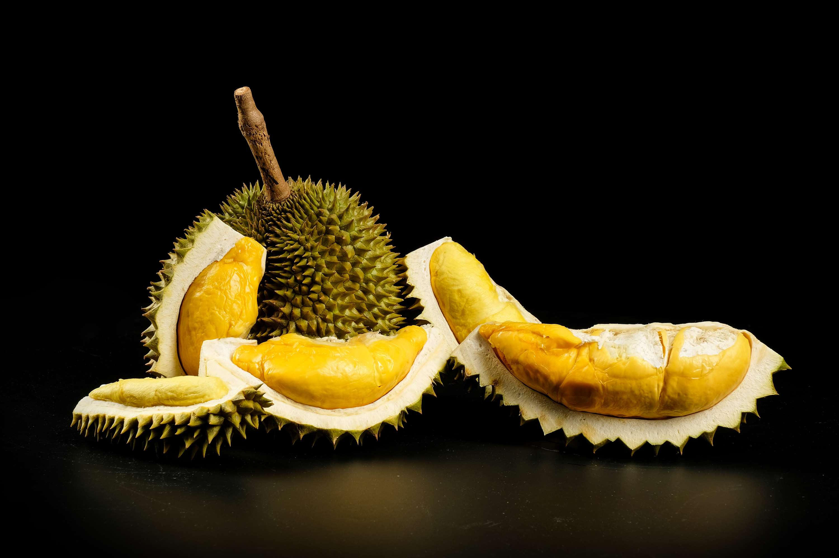
  Growing Consumer Awareness Regarding Health Benefits of Dried Durian
  Increasing Adoption of E-commerce Platforms for Purchasing Dried Durian Products
Drivers
Limited Shelf Life and Susceptibility to Spoilage of Dried Durian Products
Restraints

Slide 7
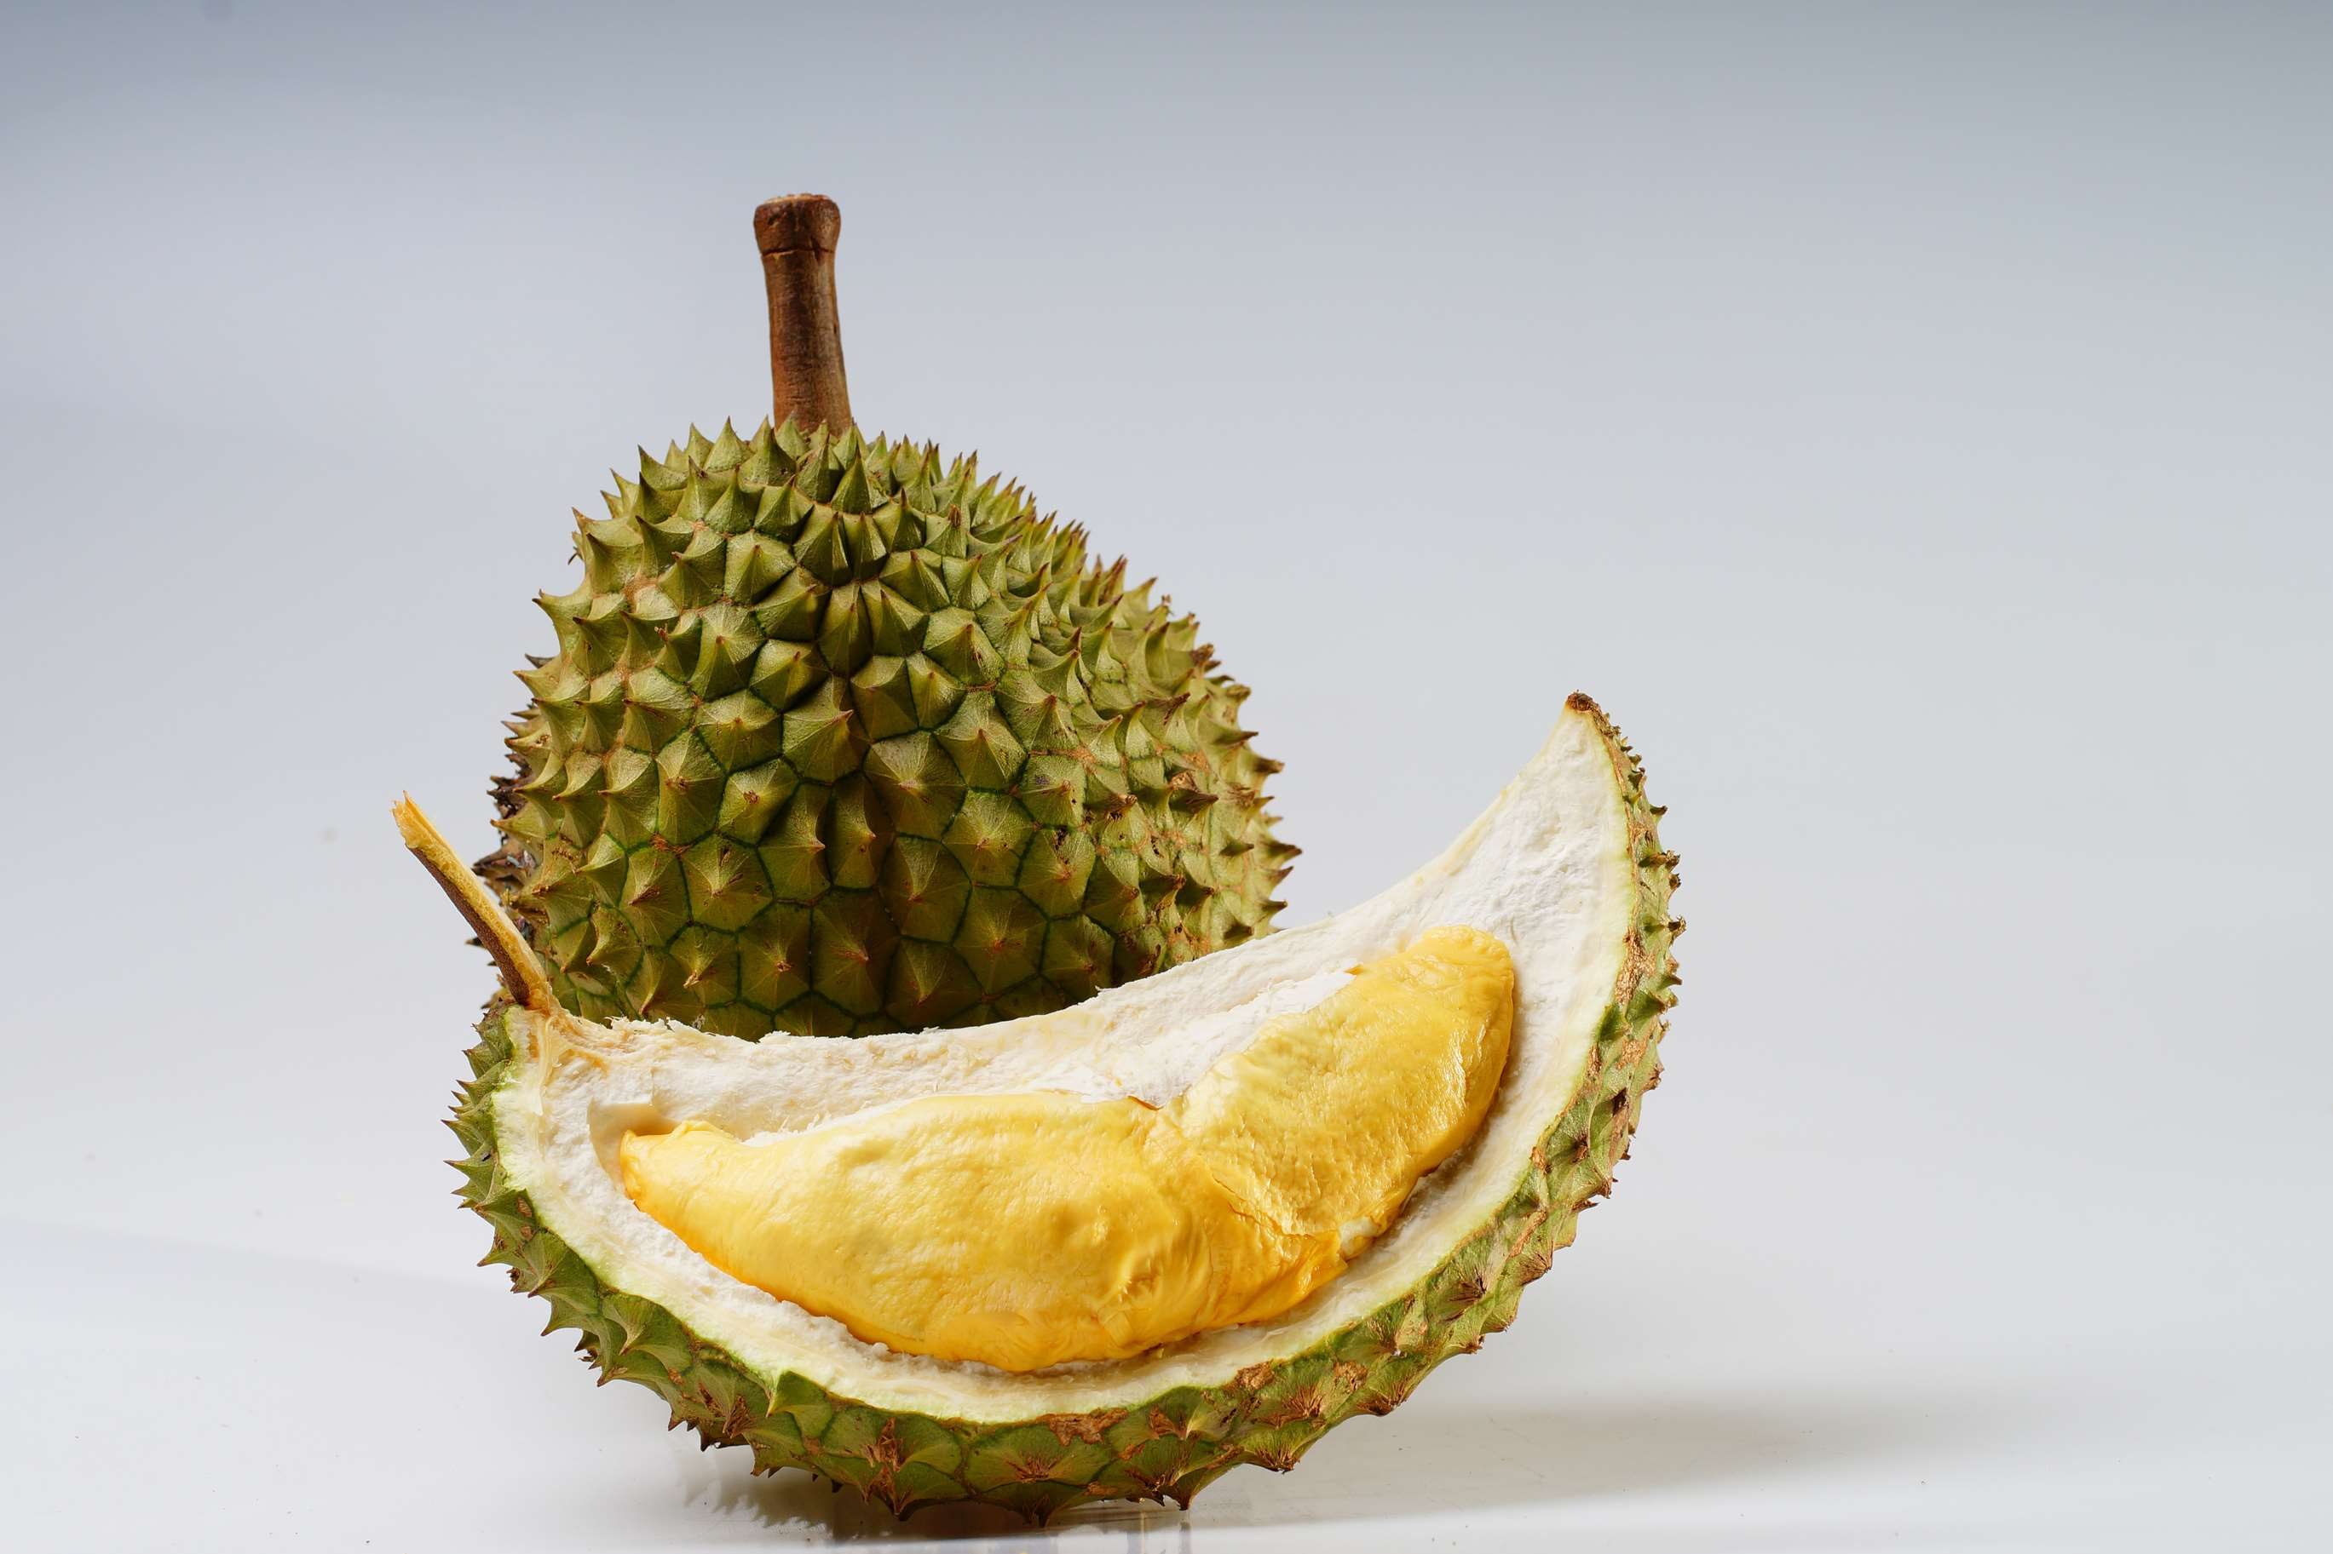
AUTHOR'S PERSPECTIVE
  The global Dried durian market will expand significantly by 5.00% CAGR between 2024 to 2031.
  We especially benefit from online channels because they give us convenience, choice and wide range of product types.
  And this has given us significant sales and market share.
  Dried durian is both a standalone snack and a popular ingredient in many dishes because of its unique flavor and health benefits. Therefore, this category is leading the pack.

Slide 8





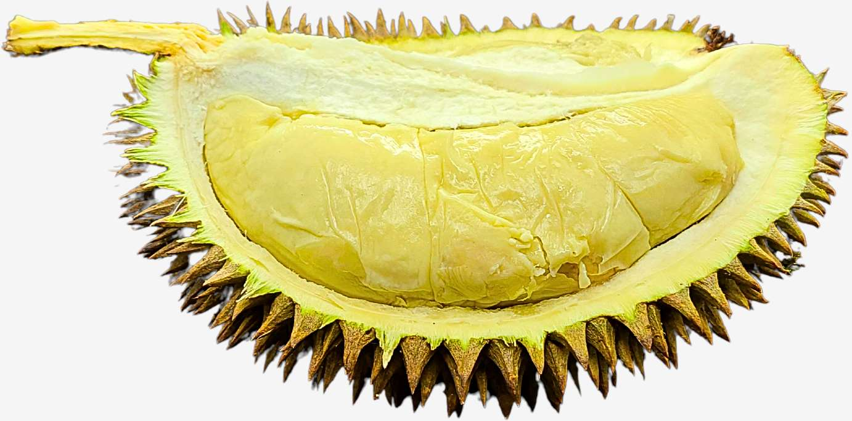


KEY PLAYERS

Slide 9


For Full Report
Contact us
COGNITIVE MARKET RESEARCH
Tel: +1 312-376-8303 | +44 020-8123-0732
India: (+91) 983-496-8611
sales@cognitivemarketresearch.com
Access the Full Report : https://tinyurl.com/f9k26pn3
Please visit our website:
https://www.cognitivemarketresearch.com

