Slide 1
GLOBAL DRAWING PENCIL MARKET REPORT 2024
Global,Regional,CountryAnalysis

Slide 2

INTRODUCTION
The expansion of the art and creative industry, growth of the education sector, innovations in pencil manufacturing, rise of e-commerce platforms, rising consumer preferences for quality, development of environmentally friendly drawing pencils, increased use of pencils as art therapy for reducing stress, increased hobbyist participation, rising demand of customizations and personalization, rise in global art exhibitions and events, increased sharing of artwork on social media platforms, the presence and expansion of art supply retailers, the rise in aging population looking for creative hobbies, government initiatives that promote art and culture, and increased interest in creative hobbies during pandemic.

Slide 3


KEY INSIGHTS
MARKET SIZE
USD 15.5 billion
2023
CAGR 3.50%
2023
-
2030

Slide 4

REVENUE MARKET SHARE BY SEGMENTS 2022
Graphite Pencil Colored Pencil Charcoal Pencil Watercolour Pencil Mechanical Pencil
Type Segment
Commercial School Professional Artists Hobbyists
Application Segment
Distribution Channel
Online Offline

Slide 5
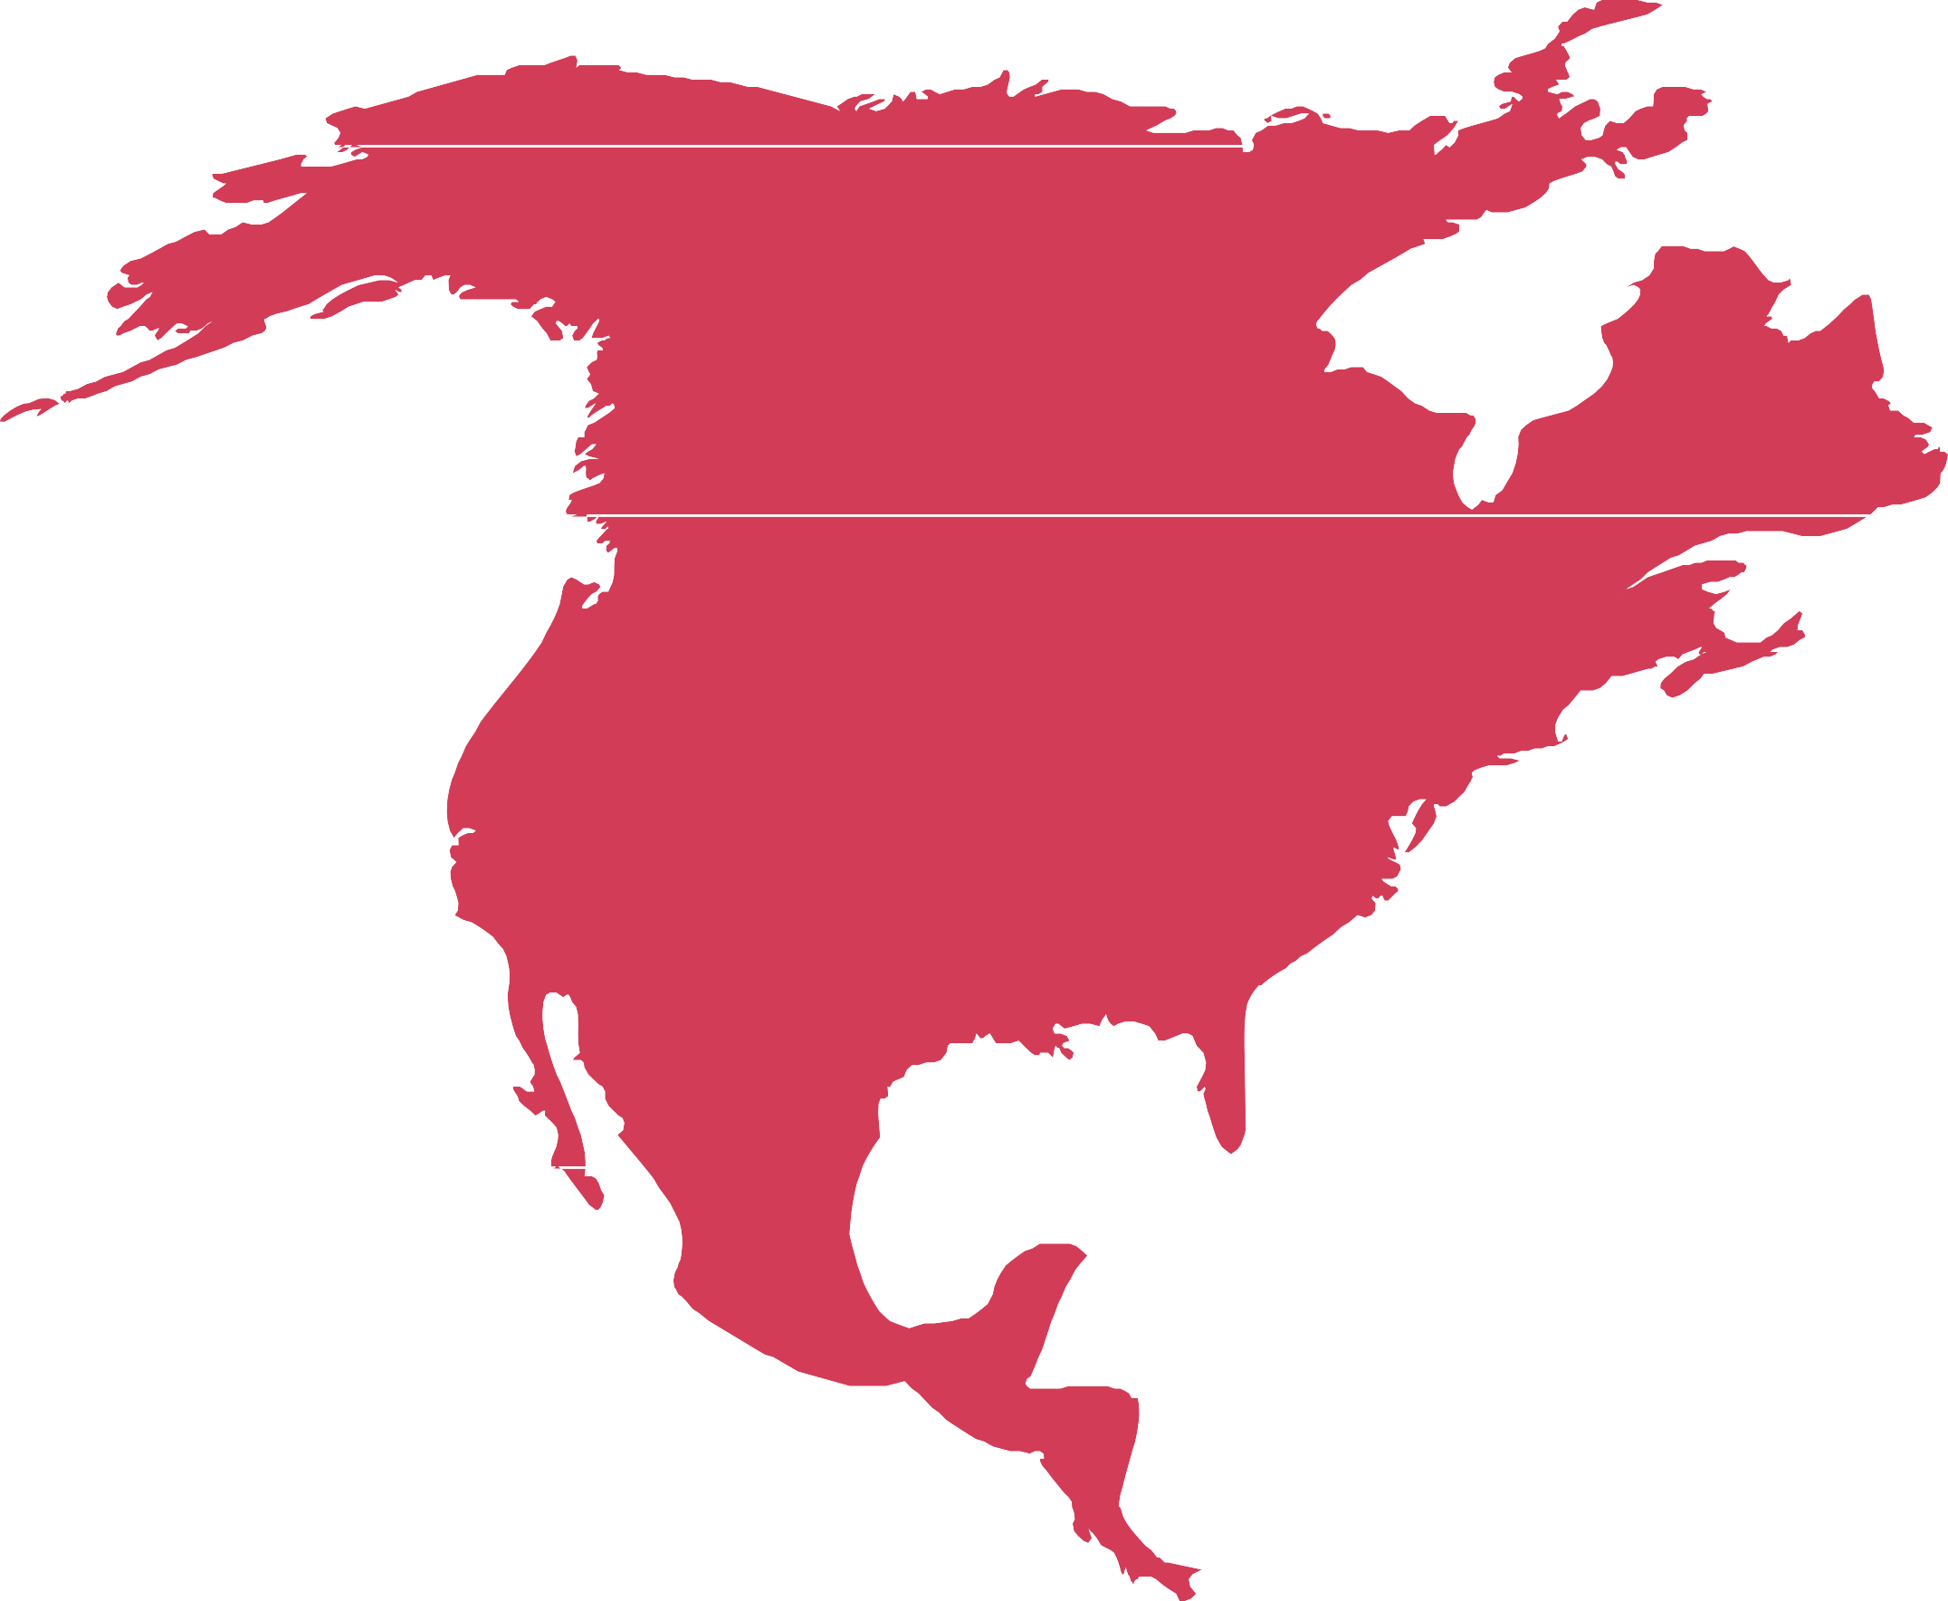
Global Drawing Pencil Market Revenue share for 2022
North America
46%

Slide 6

Expansion of Art and Creative industry to Provide Viable Market Output
Drivers
Increase in digitalization of art to Hinder Market Growth.
Restraints

Slide 7

AUTHOR'S PERSPECTIVE
The Global Drawing Pencil Market is witnessing significant growth in the near future.
Graphite pencils are versatile and suitable for sketching, shading, and detailed drawing.
Artists appreciate their precision and the ability to achieve a wide range of tones.
Colored pencils are often used for coloring books, fine art, and architectural drawings.
Drawing pencils are essential in the educational sector, especially in art classes and drawing courses.

Slide 8
KEY PLAYERS

Slide 9


Contact us
For Full Report
COGNITIVE MARKET RESEARCH
Tel: + 1 312 - 376 - 8303 | + 44 020 - 8123 - 0732
India: ( + 91 ) 983 - 496 - 8611
sales@ cognitivemarketresearch. com
Access the Full Report : http://tinyurl.com/58s7jb66
Please visit our website:
https://www.cognitivemarketresearch.com

