Slide 1
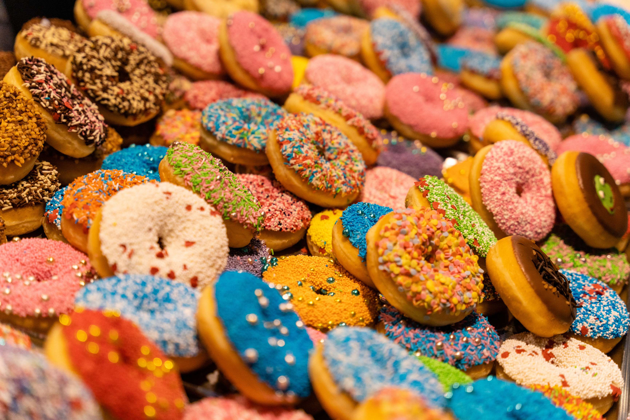
GLOBAL
DOUGHNUTS
MARKET REPORT 2024
Global,Regional,CountryAnalysis

Slide 2
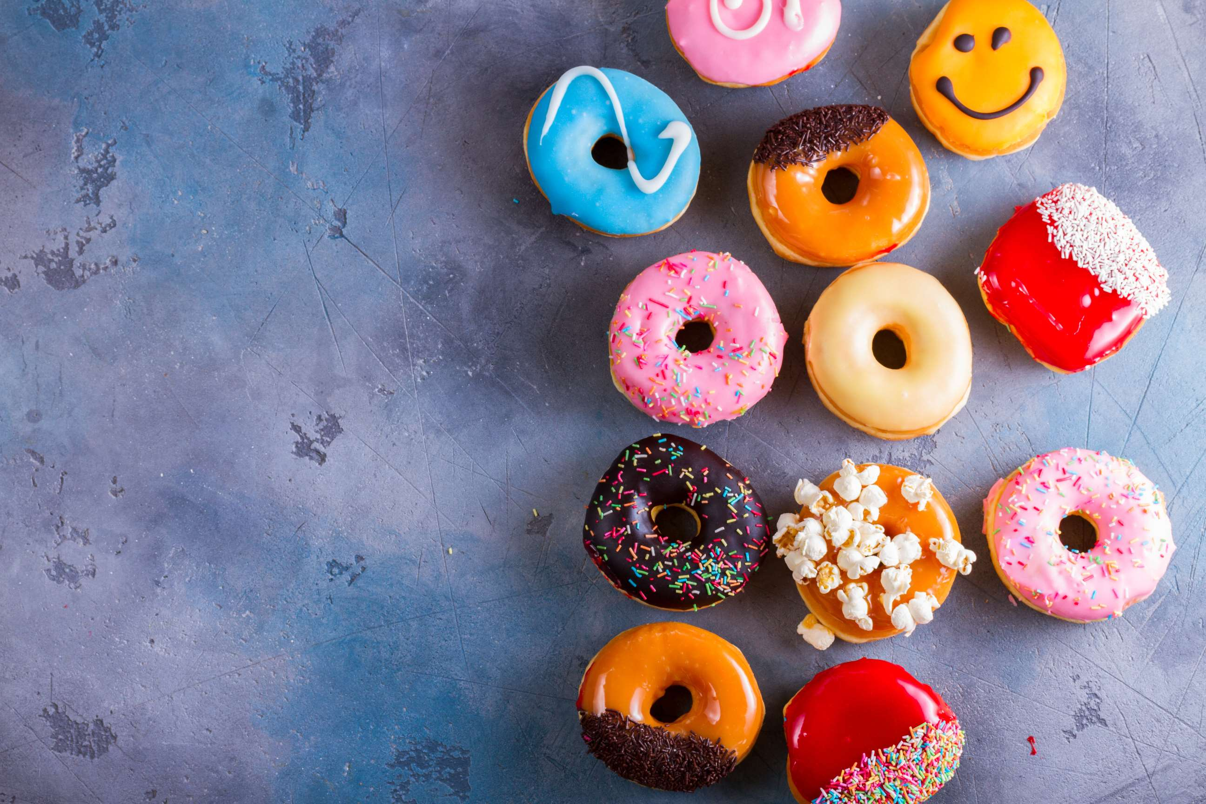
INTRODUCTION
A doughnut is a type of fried pastry popular in many parts of the world. It is made from flour, sugar, Yeast, eggs, and milk. Doughnuts can be either cake or yeast style. They are typically round and have a hole in the center. Growth is fueled by rising disposable income, changing food preferences, and growing demand for convenience foods.

Slide 3
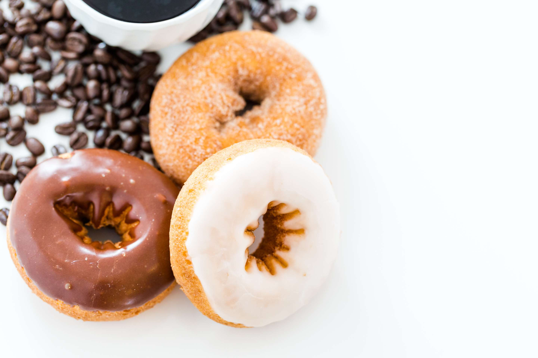

KEY INSIGHTS
MARKET SIZE
USD 12 billion
2022
CAGR
7.00%
2023- 2030

Slide 4
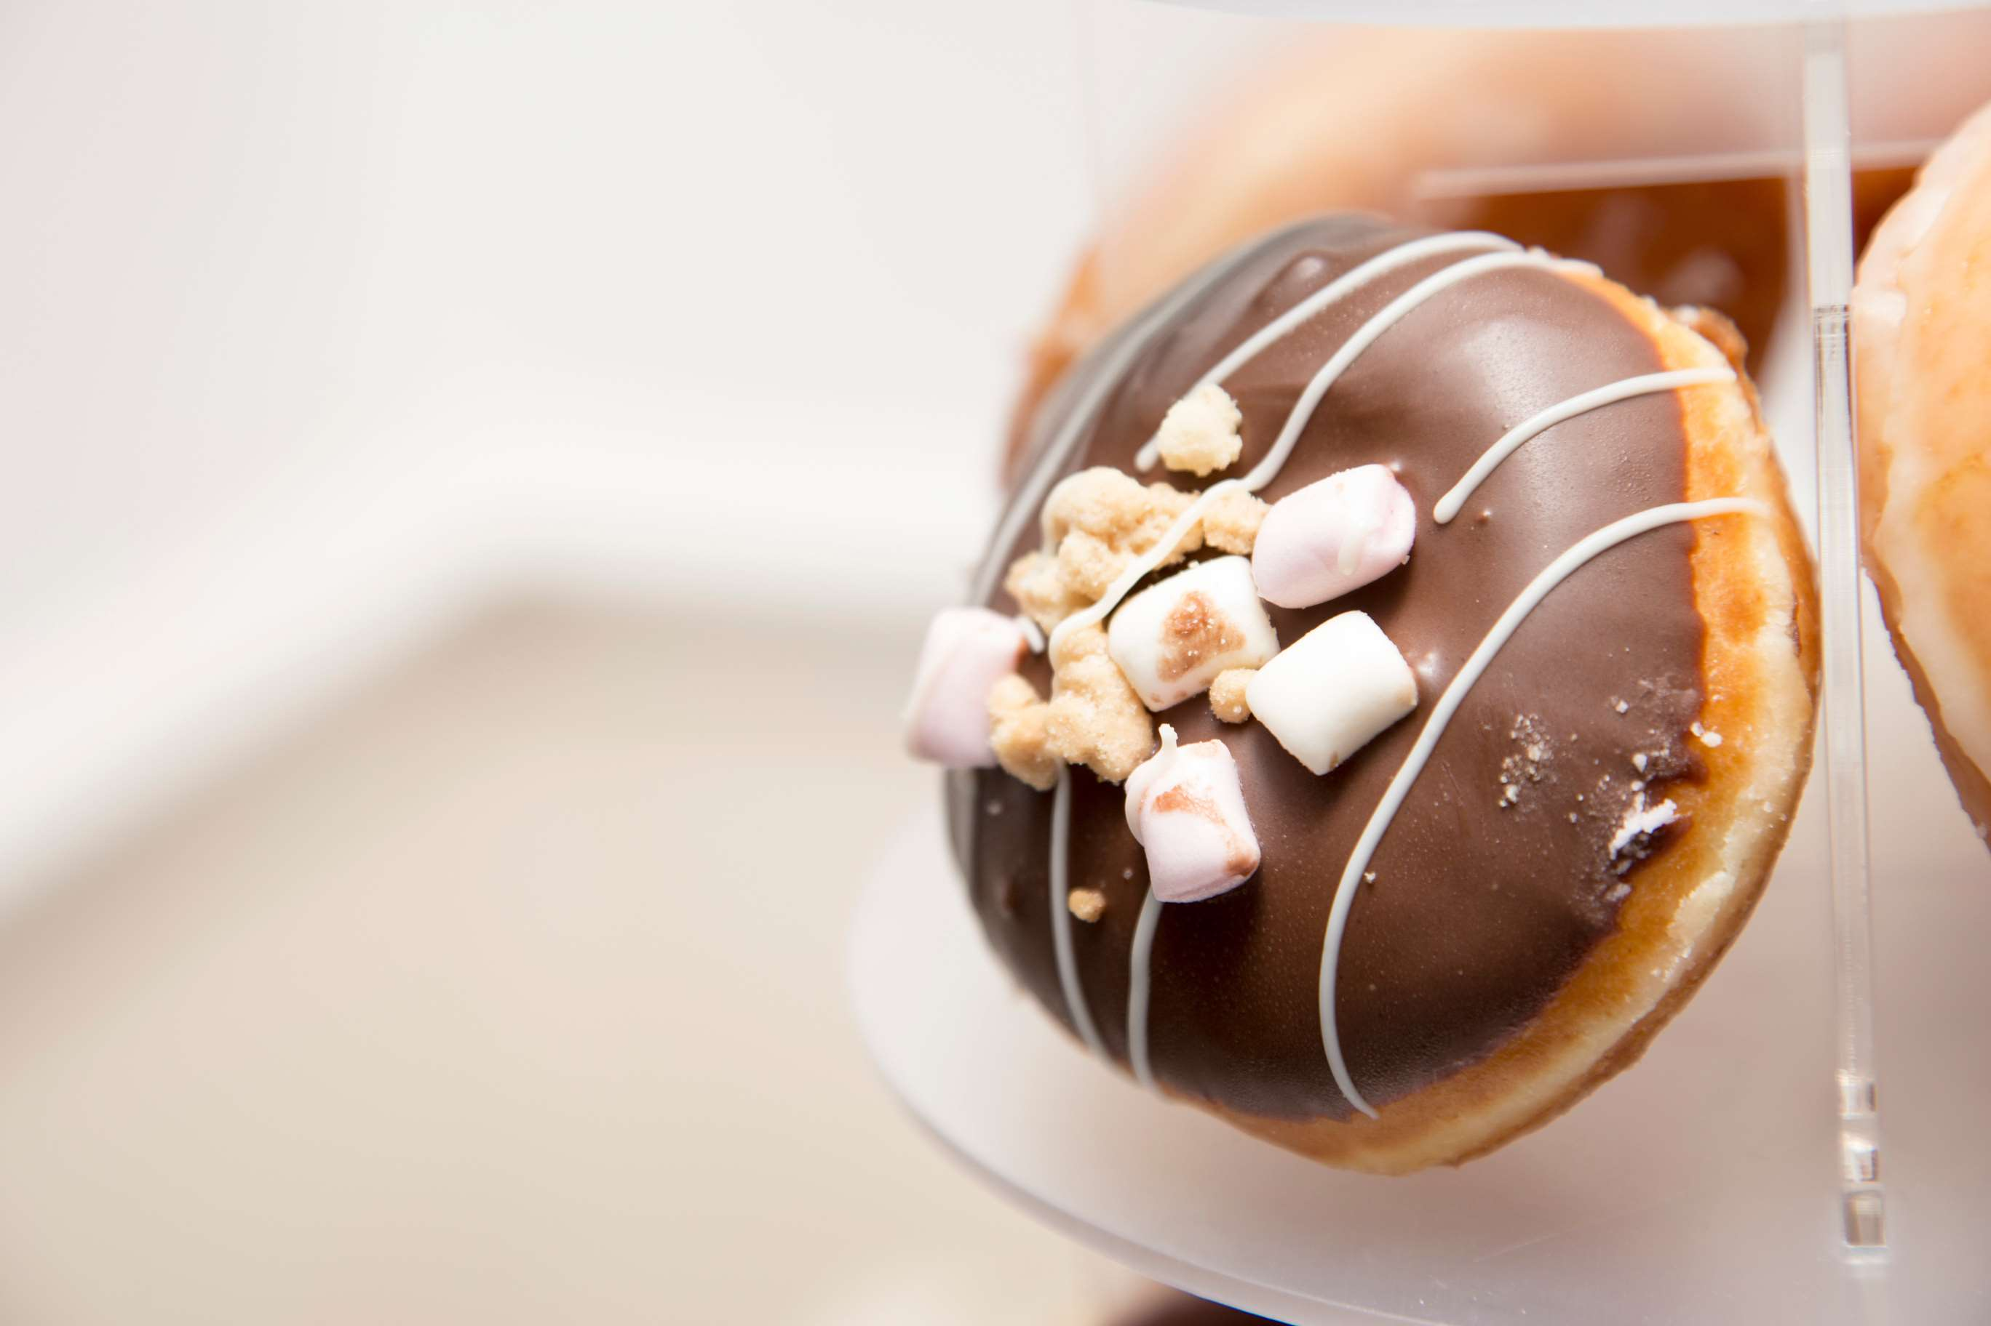
REVENUE MARKET SHARE BY SEGMENTS 2022
  Cake Style
  Yeast Stylel
Type Segment
Application segment
  Food Service
  Retail Stores

Slide 5

Global Doughnuts Market Revenue share for 2022
North America
38%

Slide 6
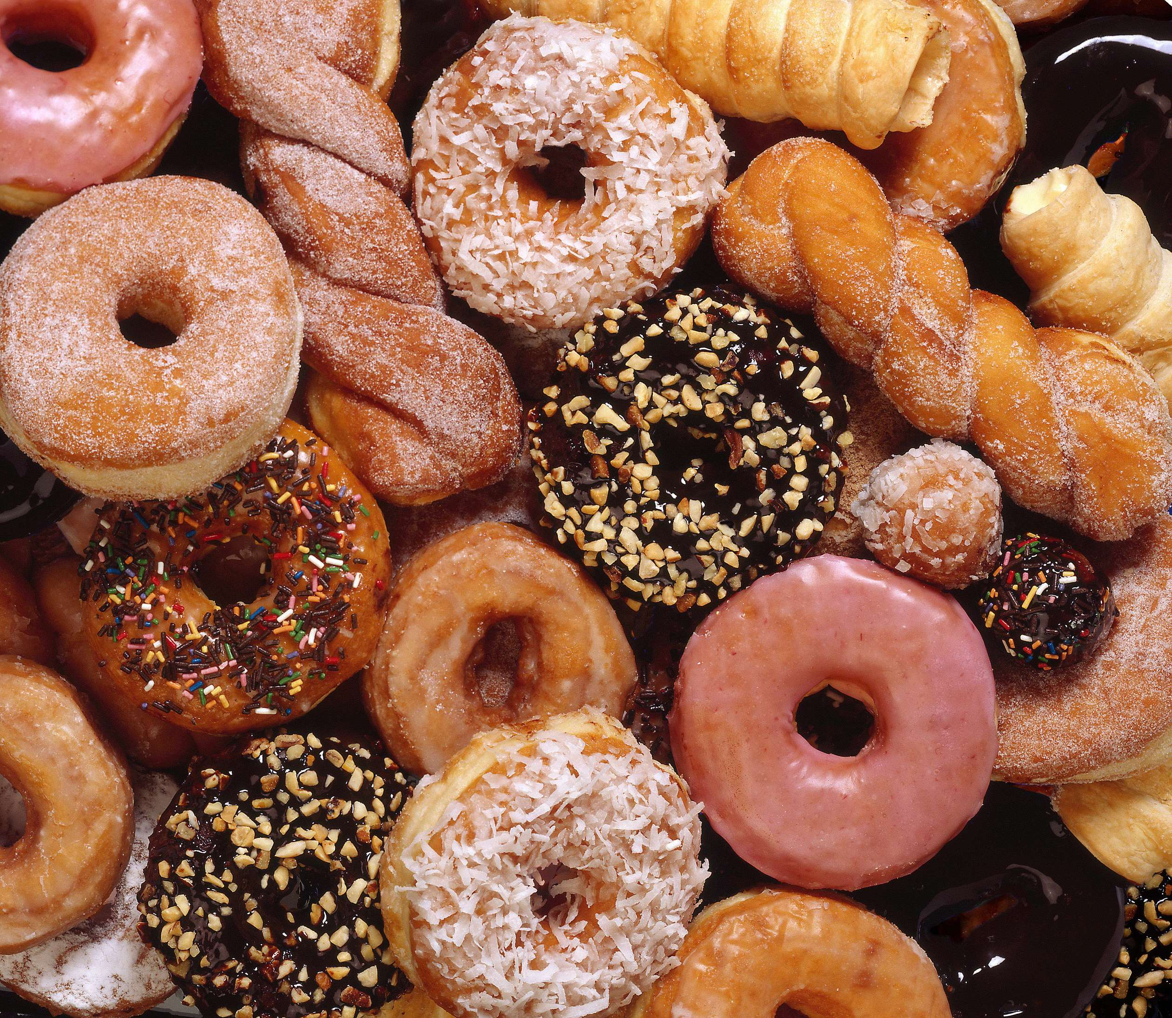
Rising Health Consciousness and Demand for Healthier Doughnut Alternatives to Propel Market Growth
Drivers
Intense Competition and Saturation in the Market to Hinder Market Growth
Restraints

Slide 7

AUTHOR'S PERSPECTIVE
  The Global Doughnuts Market is witnessing significant growth in the near future.
  Cake Style Doughnuts often come in various flavors, coatings, and toppings, appealing to a wide range of tastes
  The growth of doughnut sales in retail stores can be attributed to consumer demand for packaged and ready-to-eat doughnut products
  Retail stores include supermarkets, grocery stores, convenience stores, and specialized doughnut retail outlets. .
  In 2023, the Cake Style segment accounted for noticeable share of global Doughnuts Market and is projected to experience significant growth in the near future.
  The Food Service segment is expected to expand at the significant CAGR retaining position throughout the forecast period.

Slide 8














KEY PLAYERS

Slide 9


For Full Report
Contact us
COGNITIVE MARKET RESEARCH
Tel: +1 312-376-8303 | +44 020-8123-0732
India: (+91) 983-496-8611
sales@cognitivemarketresearch.com
Access the Full Report : https://tinyurl.com/cb4r9e29
Please visit our website:
https://www.cognitivemarketresearch.com

