Slide 1

GLOBAL
DOG TRAINING SERVICES
MARKET REPORT
2024
Global,Regional,CountryAnalysis

Slide 2

INTRODUCTION
The professional services that are given to pets to teach them how to act in a particular way in response to a particular scenario or stimulus. Pet training encourages the animals' socialization and safety, eliminates undesirable pet behaviour, and builds a closer link between pet parents and their pets. Growing awareness of the value of pet training and increased local and regional pet training service penetration are driving the growth of the worldwide pet training services market. The benefits and benefits of training pets are numerous for pet owners. Dogs, for instance, are trained for a variety of purposes, including security, companionship, entertainment, bomb detection, and many others. The canines must be properly taught in order to carry out their tasks.

Slide 3


KEY INSIGHTS
MARKET SIZE
USD 27.6 billion
2022
CAGR
9.8%
2023- 2030

Slide 4

REVENUE MARKET SHARE BY SEGMENTS 2022
  Dogs
  Cats
  Horses
  Single
  Multiple
Type Segment
Branch Segment
  Standard
  Specific
  Service
  Virtual
  Offline
Purpose Segment
Training Method

Slide 5

Global Dog Training Services Market Revenue share for 2024
North America
35%

Slide 6

  People's Increasing Preference For Pet Companions is Driving the Market
  Need to Establish Effective Communication Between Pets and Owners is Boosting Market Growth
Drivers
Difficulty of Adopting and Raising Pets is Limiting Market Expansion
Restraints

Slide 7

AUTHOR'S PERSPECTIVE
  The Global Dog Training Services Market is witnessing significant growth in the near future.
  Dogs can be trained to carry out a larger range of tasks, including guarding, finding explosives and drugs, helping the disabled, and search and rescue.
  Training fosters self-assurance, cerebral stimulation, and a close relationship between humans and dogs.
  The majority of people in the present period outsource training services, which puts a greater load on trainers
  Virtual pet training services include a range of activities that owners may engage in with their pets, and they can be a terrific way to keep pets entertained and interested.

Slide 8


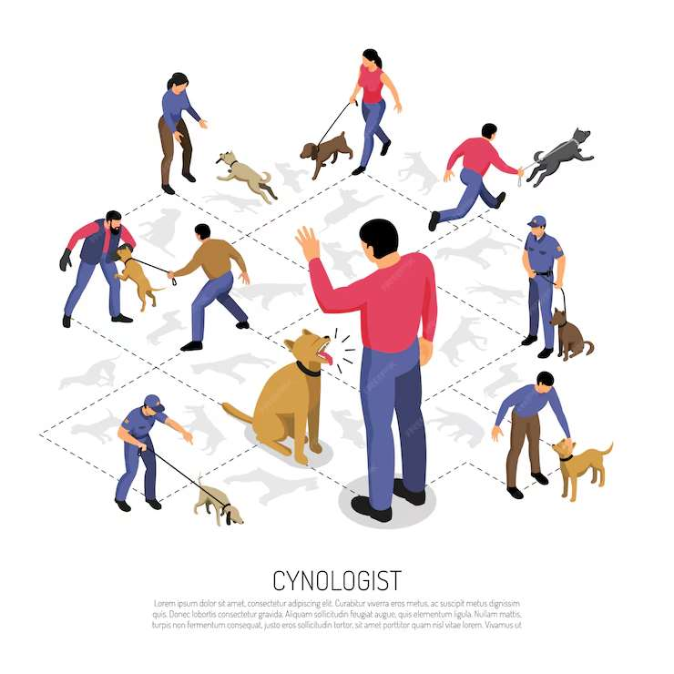






KEY PLAYERS

Slide 9


For Full Report
Contact us
COGNITIVE MARKET RESEARCH
Tel: +1 312-376-8303 | +44 020-8123-0732
India: (+91) 983-496-8611
sales@cognitivemarketresearch.com
Access the Full Report : https://tinyurl.com/32znz747
Please visit our website:
https://www.cognitivemarketresearch.com

