Slide 1

GLOBAL
DOG LEASH
MARKET REPORT 2024
Global,Regional,CountryAnalysis

Slide 2

INTRODUCTION
A dog leash is a device made of a rope, strap, or chain that connects to a dog's collar and enables the owner to control the movement of the animal. Leashes are also utilized for dog training and to keep them from straying away from their owners. The Nylon rope leash is the most popular type of leash used. The demand for high-quality pet leashes is on the rise due to the increasing trend of pet ownership, higher disposable income, and the desire for premium products in this category.

Slide 3


KEY INSIGHTS
CAGR 7.00%
20₋23
2030

Slide 4

REVENUE MARKET SHARE BY SEGMENTS 2022
Nylon Dog Leash Leather Dog Leash Others
Type Segment
Up to 300 Yard Range 300-500 Yard Range
500-800 Yard Range
800-1000 Yard Range
Range Segment
Supermarkets and Hypermarkets Specialty Stores Online Retail
Distribution Channel

Slide 5
Global Dog Leash Market Revenue share for 2022
North America

Slide 6

E-commerce Boom and Convenience to Propel Market Growth
Drivers
Market Saturation and Price Wars to Hinder Market Growth
Restraints

Slide 7
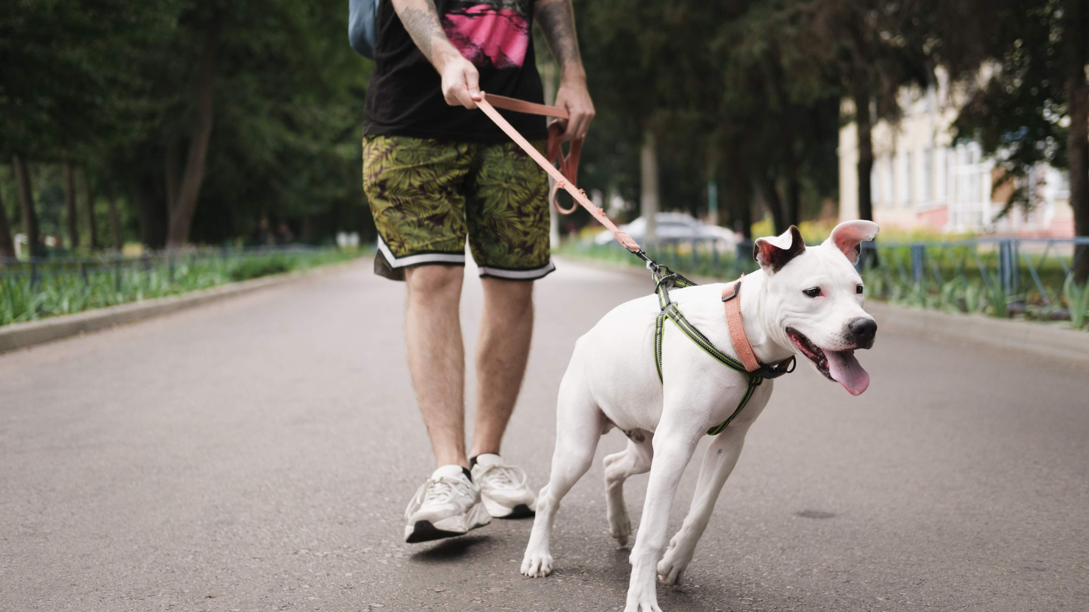
AUTHOR'S PERSPECTIVE
The Global Flute Market is witnessing significant growth in the near future.
Pet owners appreciate the freedom retractable leashes offer, allowing dogs to explore their surroundings while still under control.
Customers who prefer hands-on shopping experience often rely on local pet stores where they can physically examine the leashes, ensuring the right fit, material, and style for their dogs.
In 2023, the Nylon Dog Leash segment accounted for noticeable share of global Dog Leash Market and is projected to experience significant growth in the near future.

Slide 8

KEY PLAYERS

Slide 9


Contact us
For Full Report
COGNITIVE MARKET RESEARCH
Tel: + 1 312 - 376 - 8303 | + 44 020 - 8123 - 0732
India: ( + 91 ) 983 - 496 - 8611
sales@ cognitivemarketresearch. com
Access the Full Report : http://tinyurl.com/9wx7neay
Please visit our website:
https://www.cognitivemarketresearch.com

