Slide 1
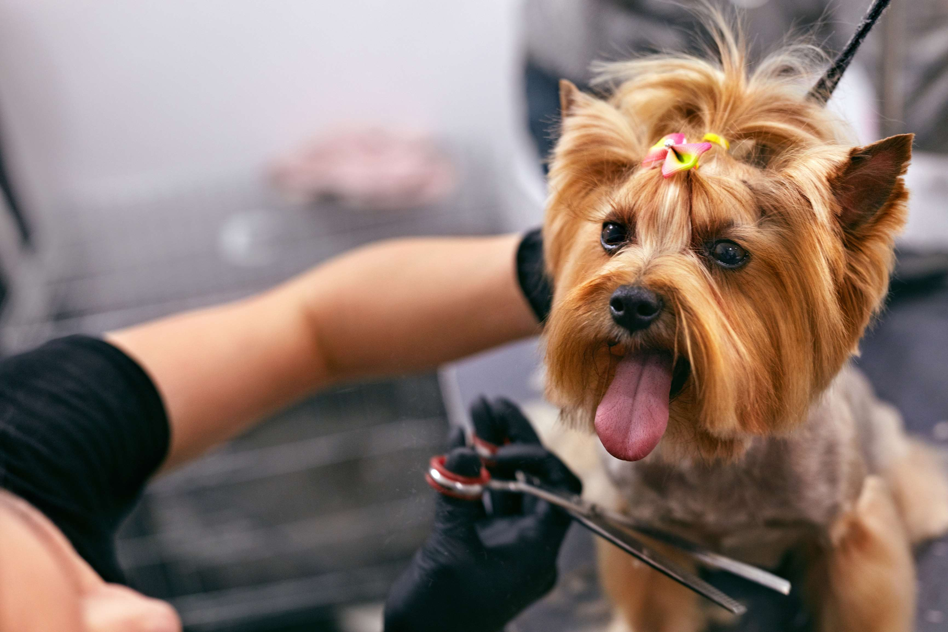
GLOBAL
DOG GROOMING SERVICES
MARKET REPORT
2024
Global,Regional,CountryAnalysis

Slide 2
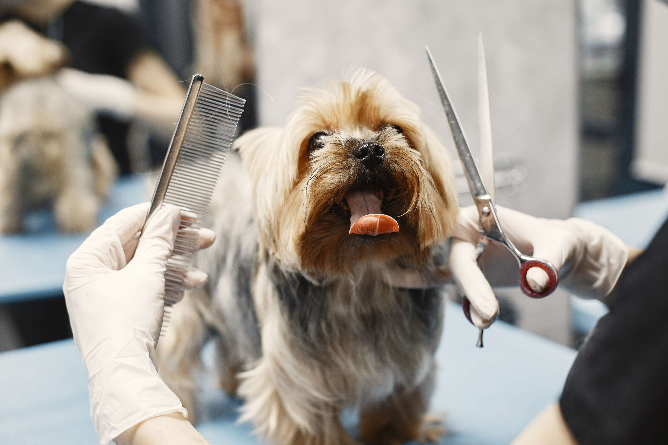
INTRODUCTION
Pet owners these days regard their pets as family members and not just as pets and therefore spend large amounts on pet care. This growing pet humanization trend is leading to large utilization of pet grooming services in order to make sure the good health of pets and also pet owners. Grooming considerably prevents pets from infections that can occur in the ears, nails and another delicate part of the body.

Slide 3
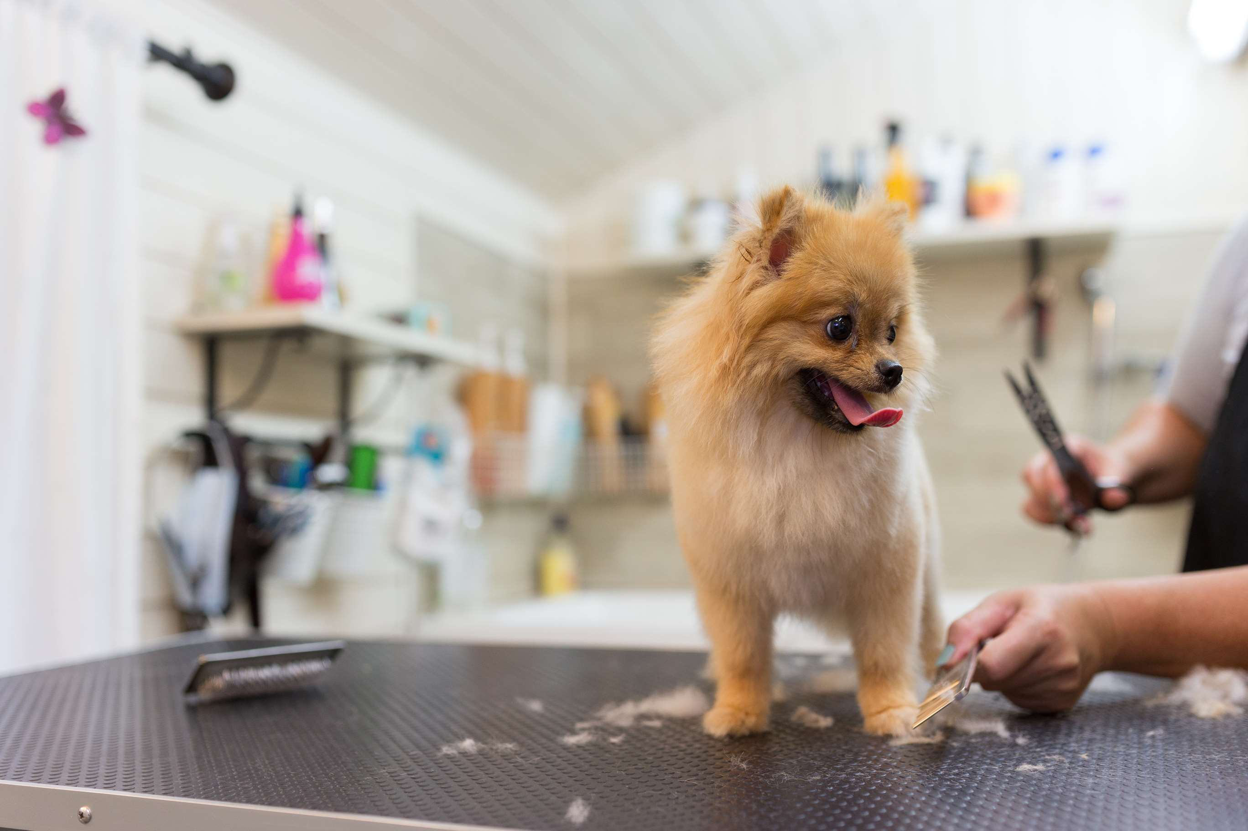

KEY INSIGHTS
MARKET SIZE
USD 2.2 billion
2023
CAGR
7.00%
2023- 2030

Slide 4
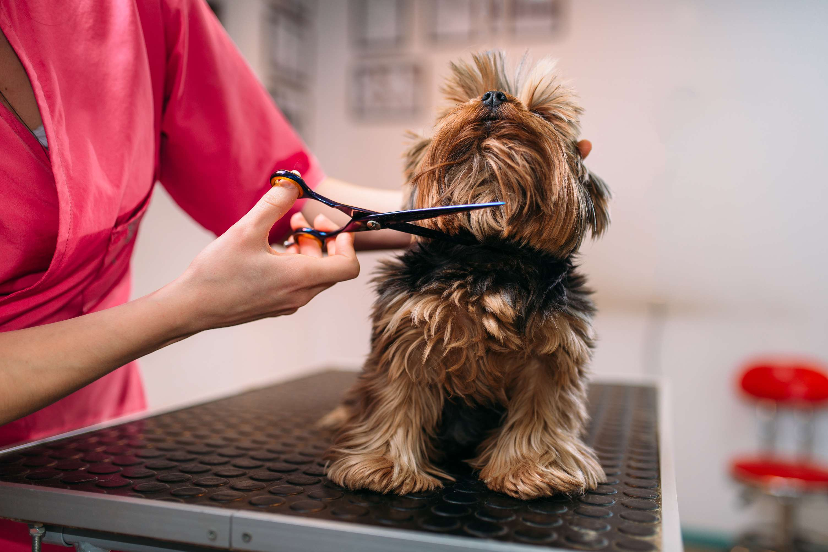
REVENUE MARKET SHARE BY SEGMENTS 2022
  Massage/Spa & Others
  Shear & Trimming
Type Segment
  Commercial Facilities
  Others
Application Segment

Slide 5

Global Dog Grooming Services Market Revenue share for 2024
North America

Slide 6
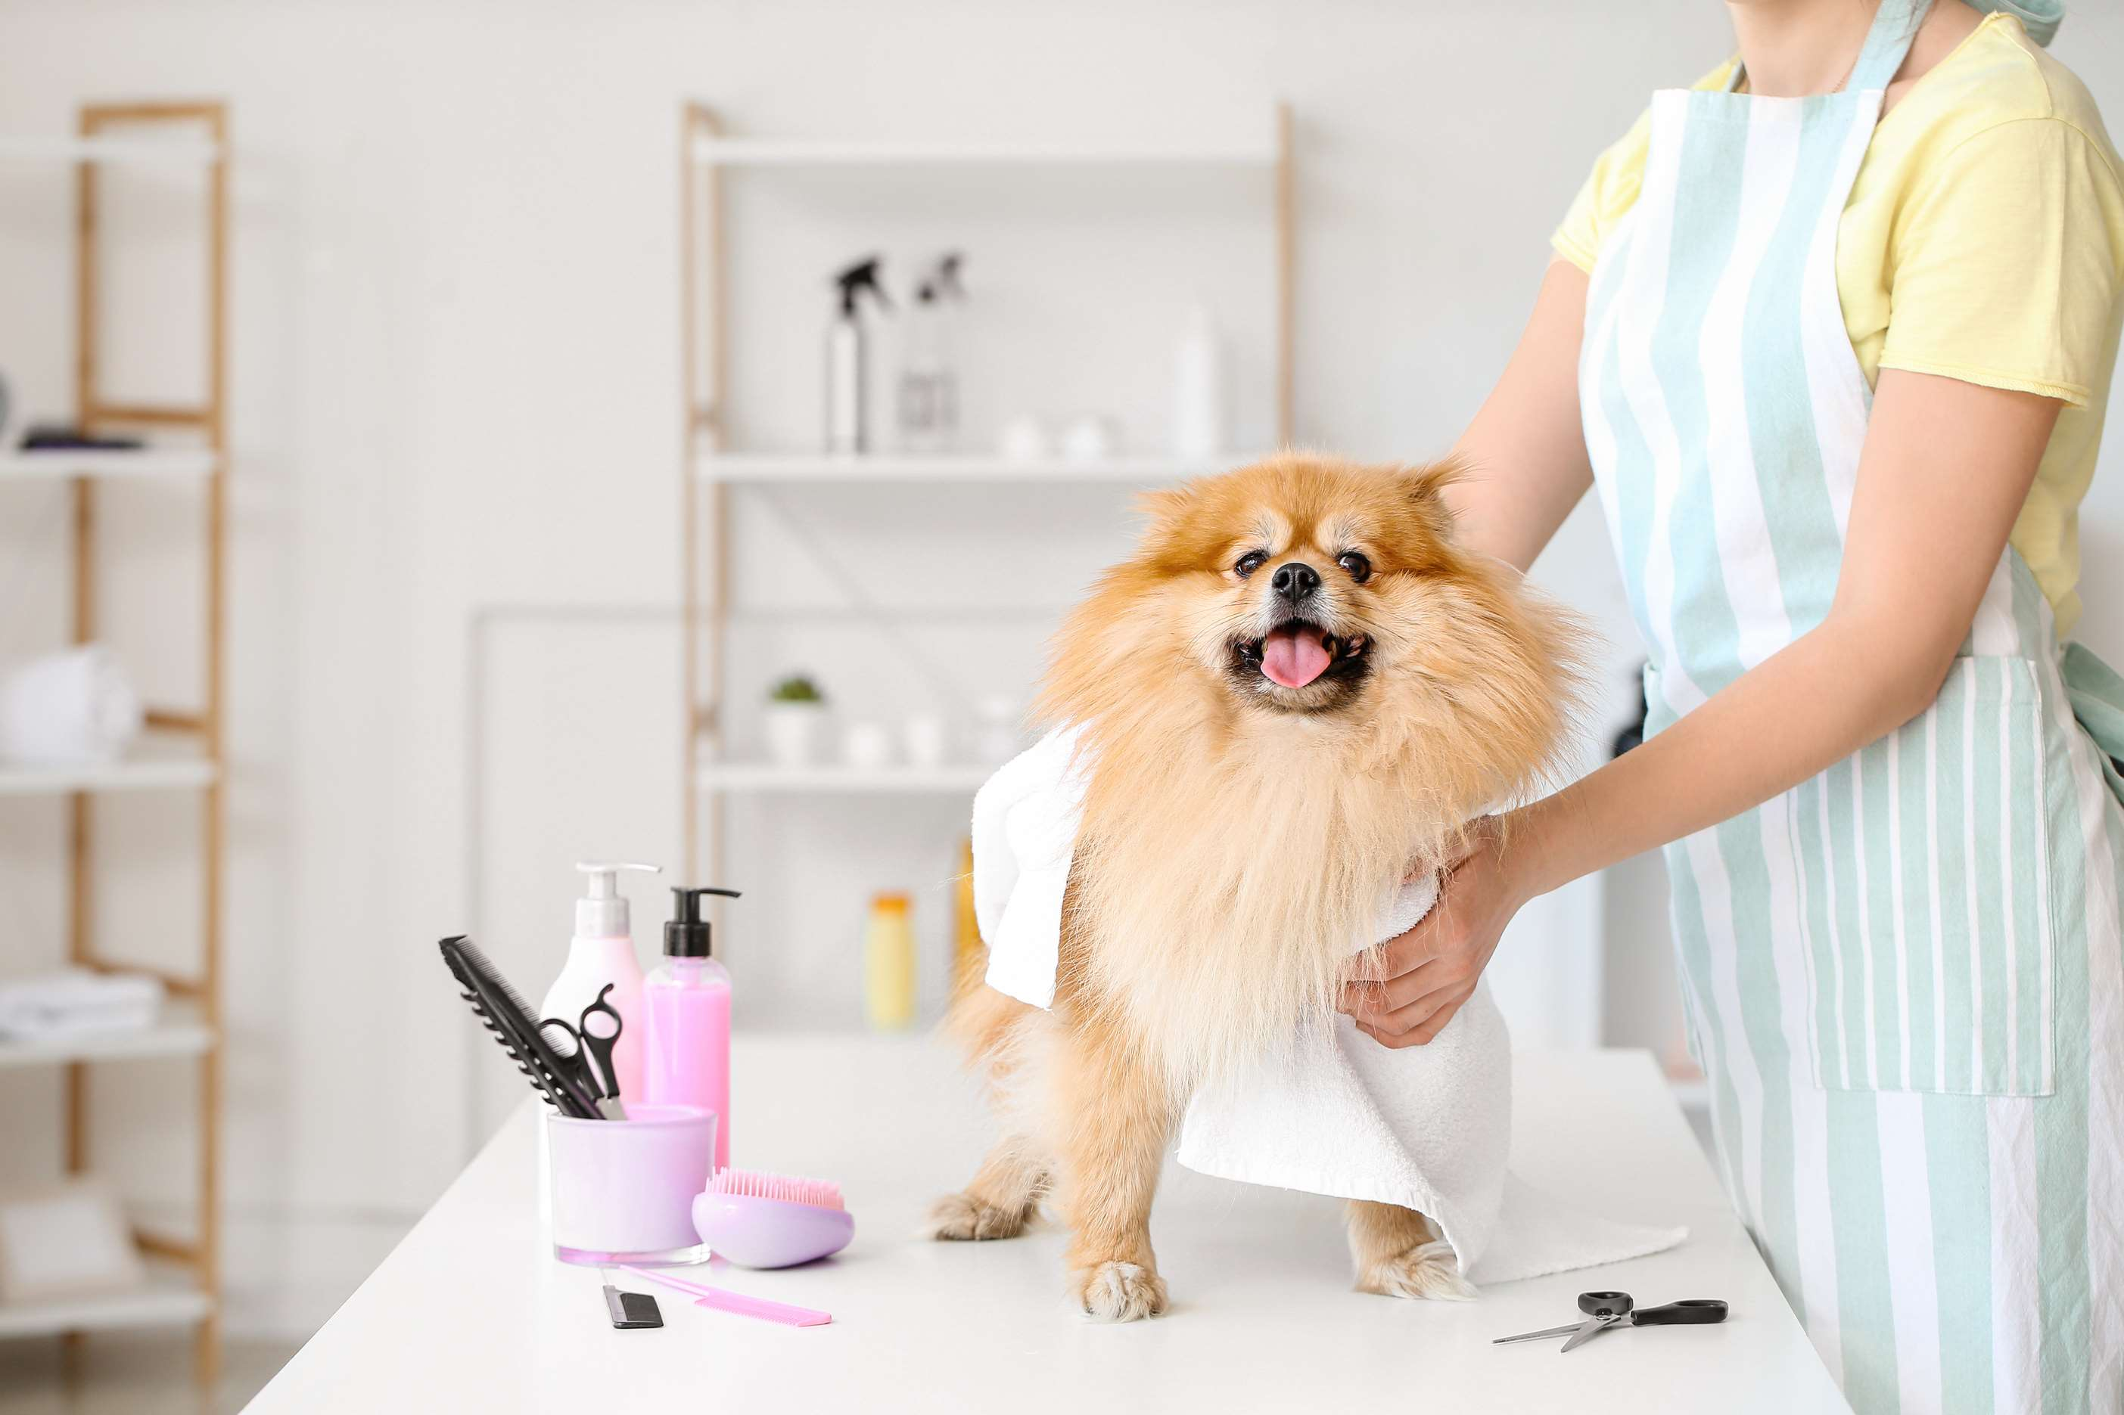
Increasing Preference for Organic Pet Grooming to Boost the Market Output
Drivers
High Cost and lack of knowledge about the Dog Grooming to Hinder Market Growth
Restraints

Slide 7
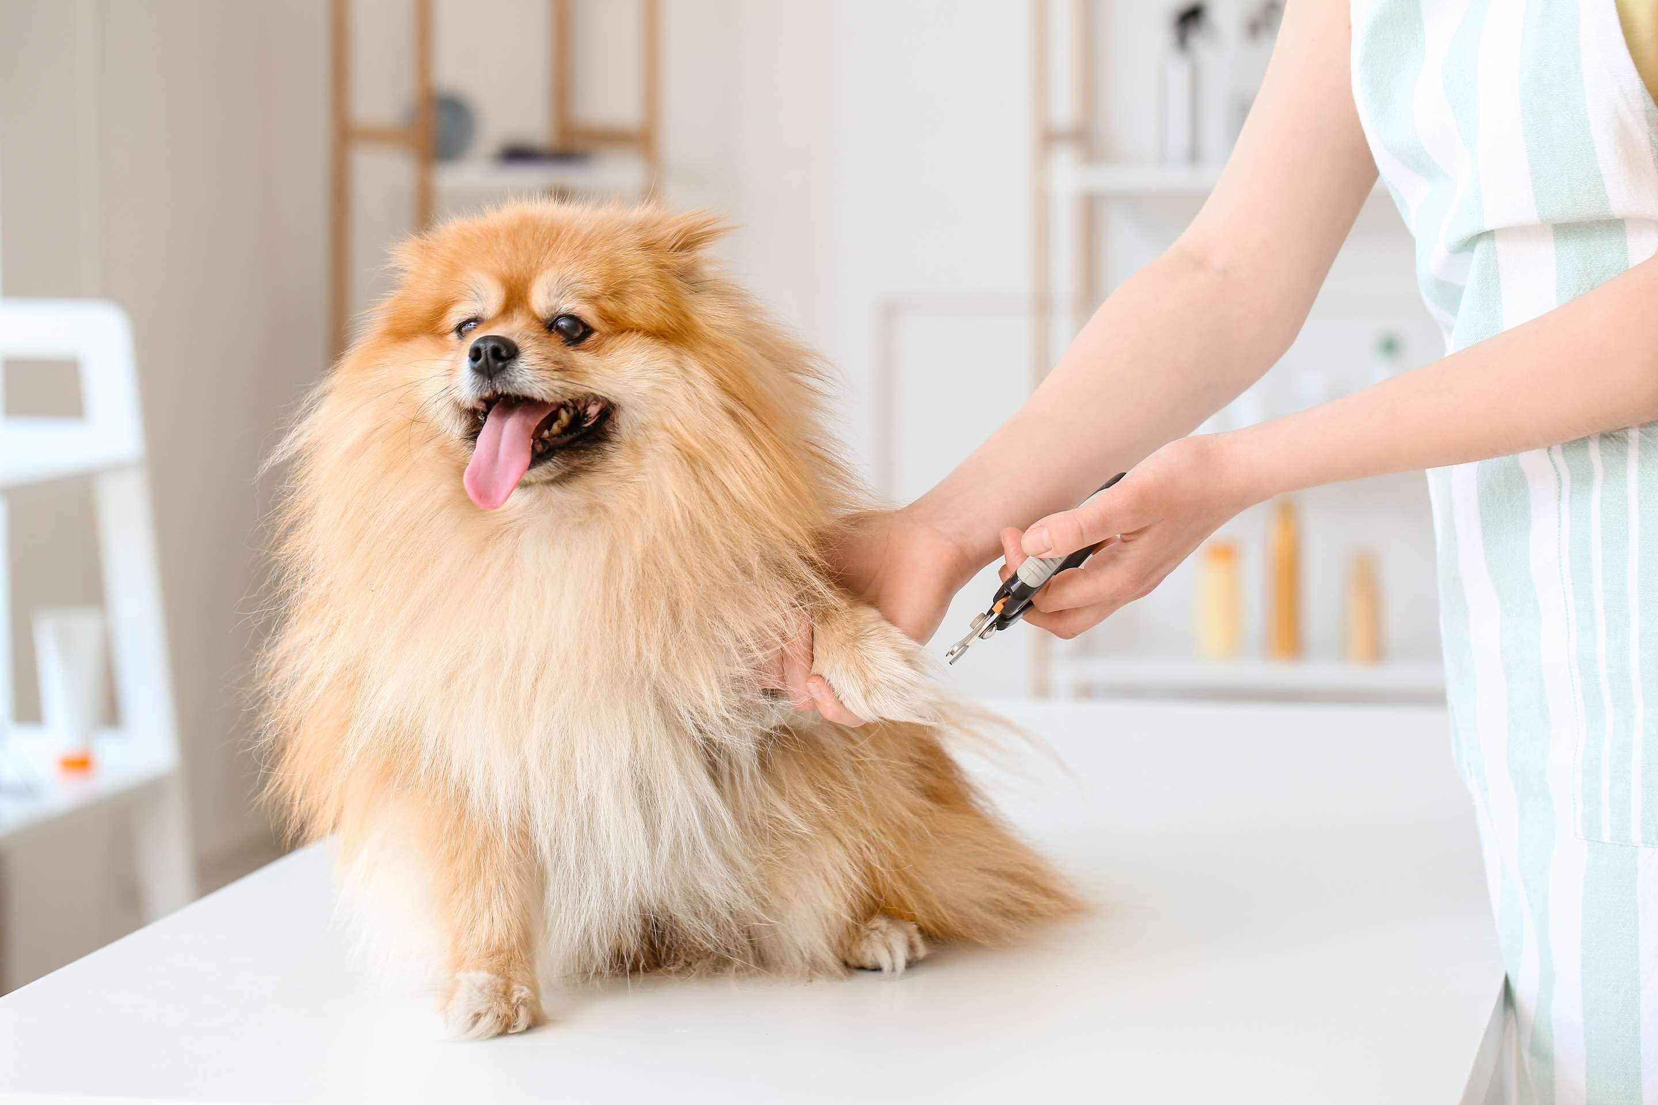
AUTHOR'S PERSPECTIVE
  The Global Dog Grooming Services Market is witnessing significant growth in the near future.
  Bathing cleans the bacteria, allergens, and dirt that are trapped in the hair and skin of pets, hence, preventing infection.
  Shear and trimming play an important role in grooming services for pets as their nails & hair grow rapidly.
  The growth of the segment is backed by increasing preferences for professional grooming sessions in order to eliminate the dirt from pet hairs, early detection of medical conditions and undesirable skin cell removal.

Slide 8











KEY PLAYERS

Slide 9


For Full Report
Contact us
COGNITIVE MARKET RESEARCH
Tel: +1 312-376-8303 | +44 020-8123-0732
India: (+91) 983-496-8611
sales@cognitivemarketresearch.com
Access the Full Report : https://tinyurl.com/yxfktn8s
Please visit our website:
https://www.cognitivemarketresearch.com

