Slide 1
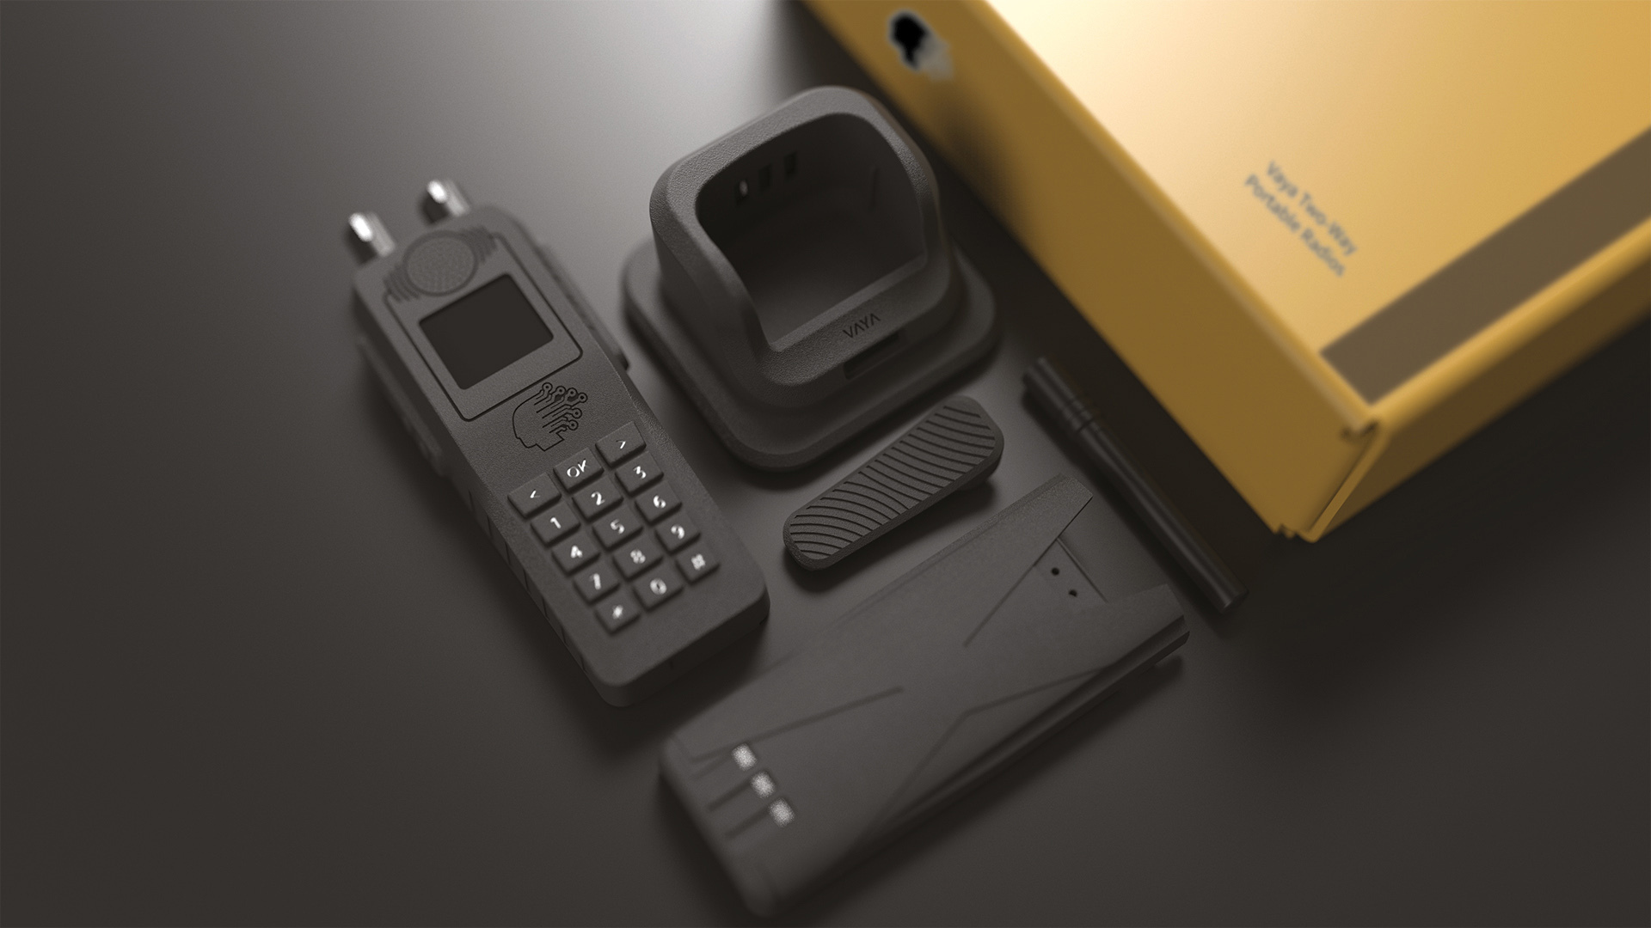
DIGITAL MOBILE RADIO
MARKET REPORT

Slide 2
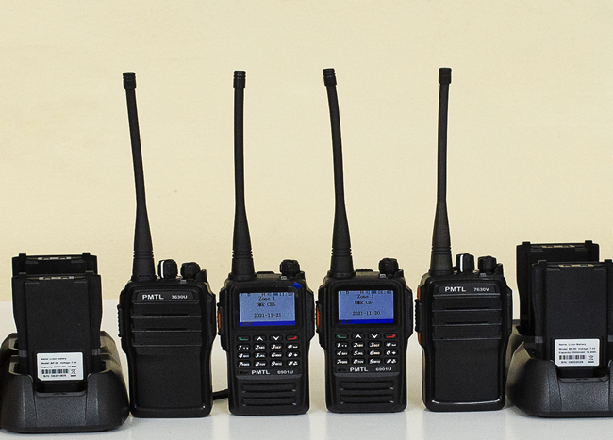
INTRODUCTION
DMR is a digital mobile radio standard created by ETSI for two-way communication. It optimizes spectrum utilization and operates from 30 MHz to 1 GHz. DMR has three tiers and uses technologies like TETRA, PM25, DMR, and dPMR. It is used in various industries worldwide for voice and data communication, remote monitoring, and emergency calls.

Slide 3
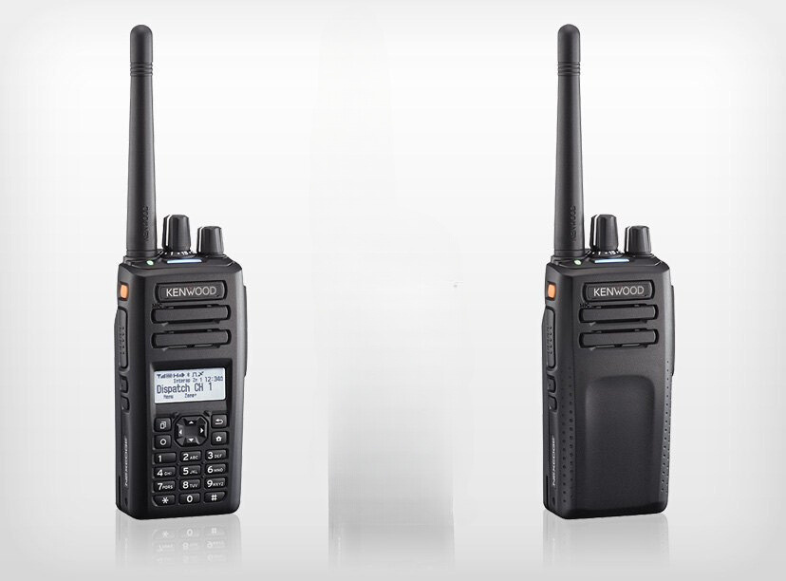
KEY INSIGHTS
2028
MARKET SIZE
USD 17,489.55 Million
2023-
2030
CAGR
10.32%

Slide 4
REVENUE MARKET SHARE BY SEGMENTS 2022
TYPE SEGMENT
APPLICATION SEGMENT
Tier 1
USD 4,657.88 Million
Aerospace & Defense
USD 4,449.3 Million
TECHNOLOGY SEGMENT
P25
USD 3,477.03 Million
PRODUCT TYPE
FREQUENCY SEGMENT
Hand Portable
USD 12,439.13 Million
25-174 MHz
USD 4,694.51 Million

Slide 5
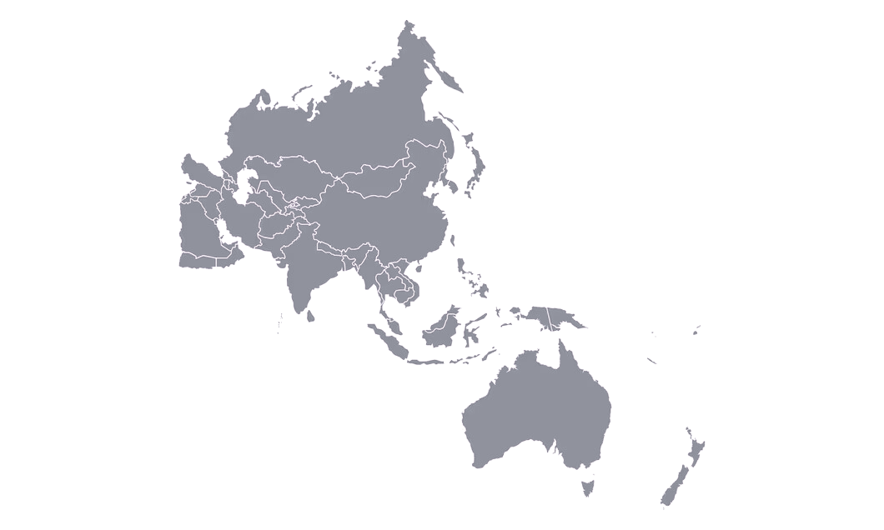
Global Digital Mobile Radio Market Revenue share for 2022
Asia Pacific
USD 4,764.85 Million

Slide 6
Rise in instances of crime, terrorism, and natural disasters
Drivers
Increasing errors and bandwidth limitations
Restraints

Slide 7
AUTHOR'S PERSPECTIVE
  The Global Digital Mobile Radio Market revenue in 2016: USD 6,876.25 Million
  Hand Portable held for largest share of total revenue generated in 2019
  Tier 3 held the maximum share of total revenue generated in 2019
  Aerospace & Defense held the maximum share of total revenue generated in 2019
  200-512 MHz held the maximum share of total revenue generated in 2019
  DMR held the maximum share of total revenue generated in 2019

Slide 8
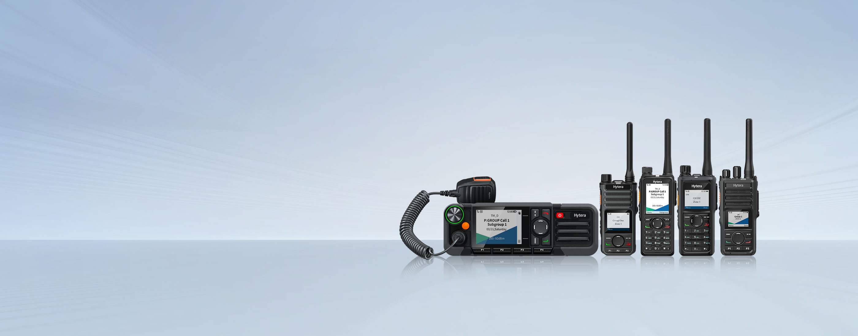
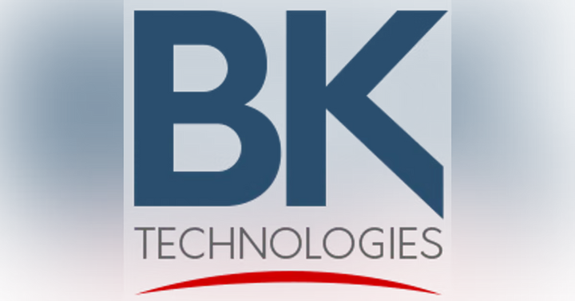






KEY PLAYERS

Slide 9


For Full Report
Contact us
COGNITIVE MARKET RESEARCH
Tel: +1 312-376-8303 | +44 020-8123-0732
India: (+91) 983-496-8611
sales@cognitivemarketresearch.com
Access the Full Report : https://tinyurl.com/y59k39hk
Please visit our website:
https://www.cognitivemarketresearch.com

