Slide 1

DIGITAL FOOD DELIVERY
MARKET REPORT
2024

Slide 2
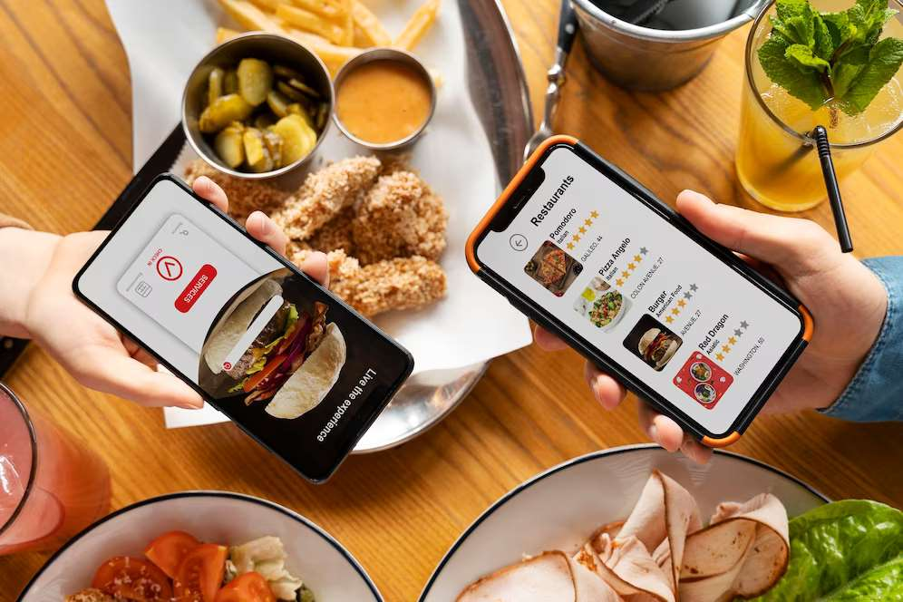
INTRODUCTION
Food delivery facilitated by digital apps has emerged as one of the e-commerce space's fastest-growing advancements. Customers can now simply buy food online and have it delivered to their homes in the quickest time possible due to digital food delivery.

Slide 3
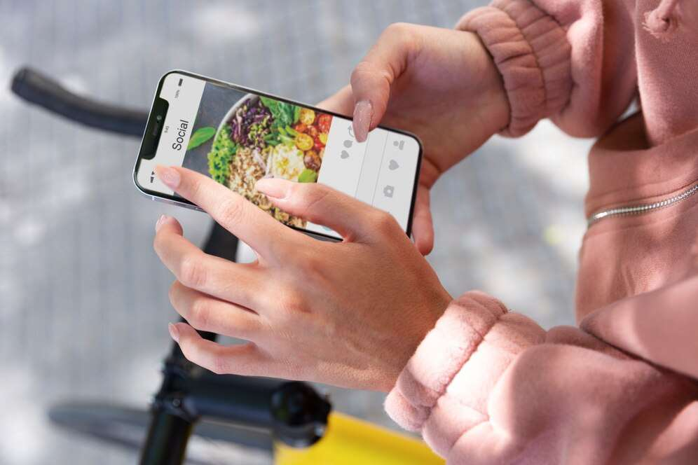

KEY INSIGHTS
MARKET SIZE
886.1 billion
2022
FORECAST
278.82 Billion
2030
2023-
2030
CAGR
11.27%

Slide 4
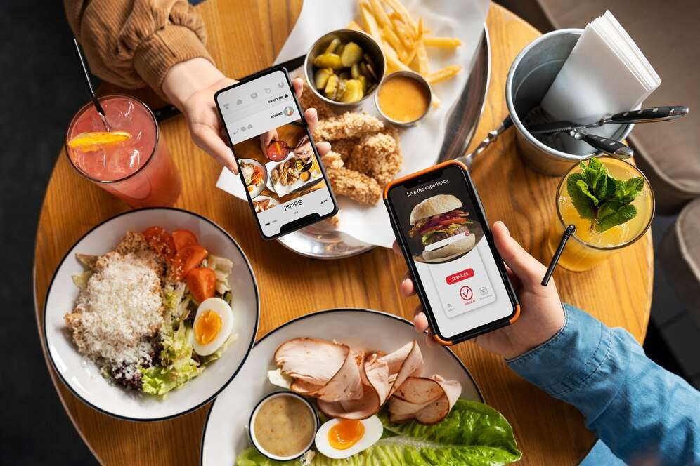
REVENUE MARKET SHARE BY SEGMENTS 2022
BY TYPE
AGGREGATOR MODEL : USD 51.05 BILLION
BY APPLICATION
WEBSITES USD 94.51 BILLION
PAYMENT METHOD
ONLINE TRANSACTIONS : USD 193.98 BILLION

Slide 5

GLOBAL DIGITAL FOOD DELIVERY MARKET REVENUE SHARE FOR 2022
North America
92.71 Billion

Slide 6

Growing adoption of smartphones coupled with rising internet connectivity
Drivers
High cost associated with digital food delivery
Restraints

Slide 7
AUTHOR'S PERSPECTIVE
  The Global Digital Food Delivery Market is witnessing significant growth in the near future.
  In 2023, the Aggregator Model segment accounted for noticeable share of global Digital Food Delivery Market and is projected to experience significant growth in the near future.
  The Websites segment is expected to expand at the significant CAGR retaining position throughout the forecast period.
  Some of the key companies Ele.me, Just-eat and others are focusing on its strategy building model to strengthen its product portfolio and expand its business in the global market.

Slide 8





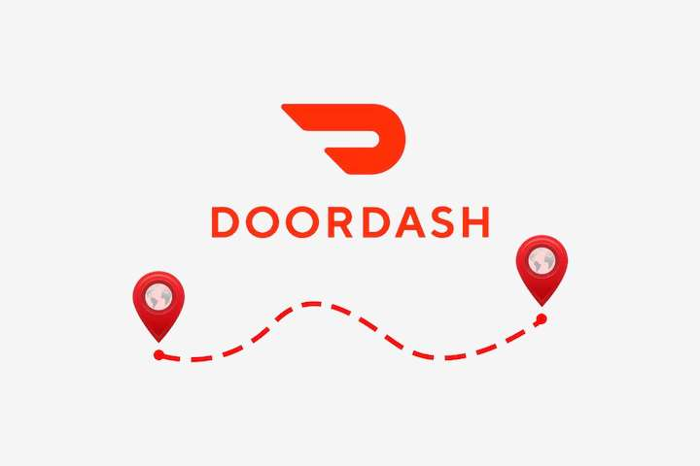



KEY PLAYERS

Slide 9


For Full Report
Contact us
COGNITIVE MARKET RESEARCH
Tel: +1 312-376-8303 | +44 020-8123-0732
India: (+91) 983-496-8611
sales@cognitivemarketresearch.com
Access the Full Report : https://shorturl.at/hoqu7
Please visit our website:
https://www.cognitivemarketresearch.com

