Slide 1

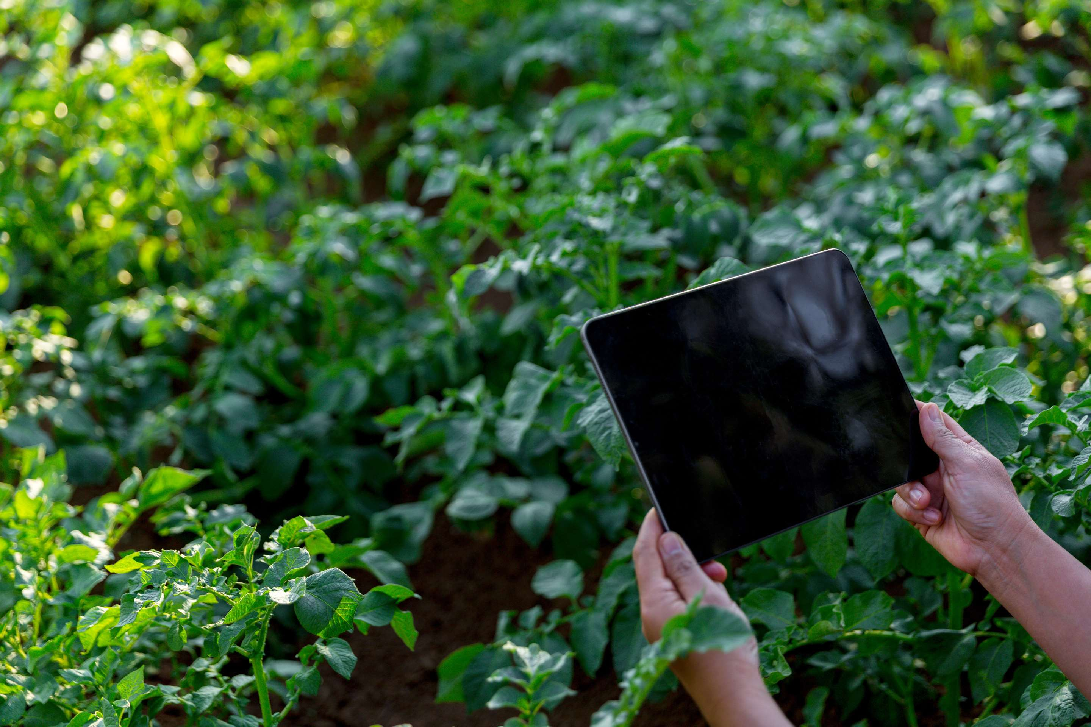

DIGITAL FARMING SOLUTION
MARKET REPORT
2024
Qualitative Analysis + Quantitative Analysis

Slide 2
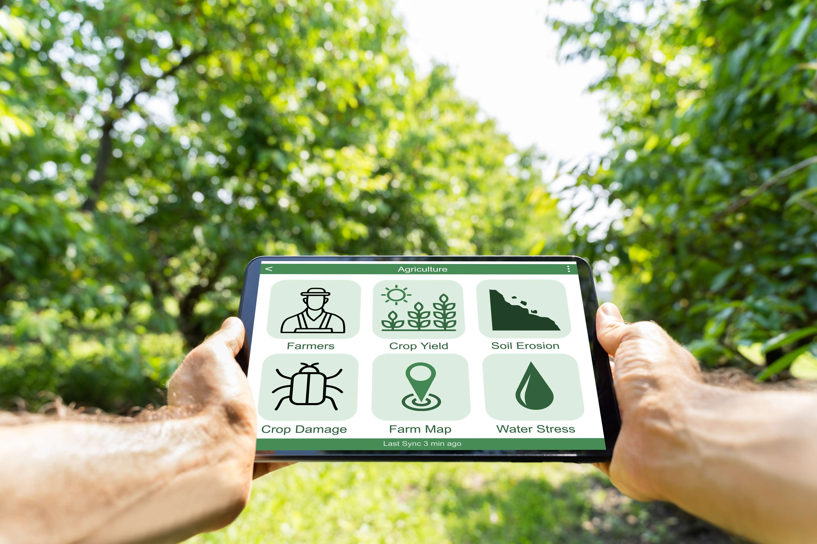
INTRODUCTION
The Digital Farming Solution Market has emerged as a transformative force within the agricultural sector, revolutionizing traditional farming practices through the integration of cutting-edge technologies. By leveraging advancements in precision agriculture, data analytics, the Internet of Things (IoT), and artificial intelligence (AI), digital farming solutions offer farmers unprecedented insights and control over their operations. These solutions encompass a wide array of offerings, including precision crop monitoring, soil analysis, weather forecasting, automated machinery, and crop management software. By utilizing sensors and drones, farmers can gather real-time data on crop health, soil conditions, and environmental factors, enabling them to make data-driven decisions to optimize yields, reduce input costs, and minimize environmental impact.

Slide 3
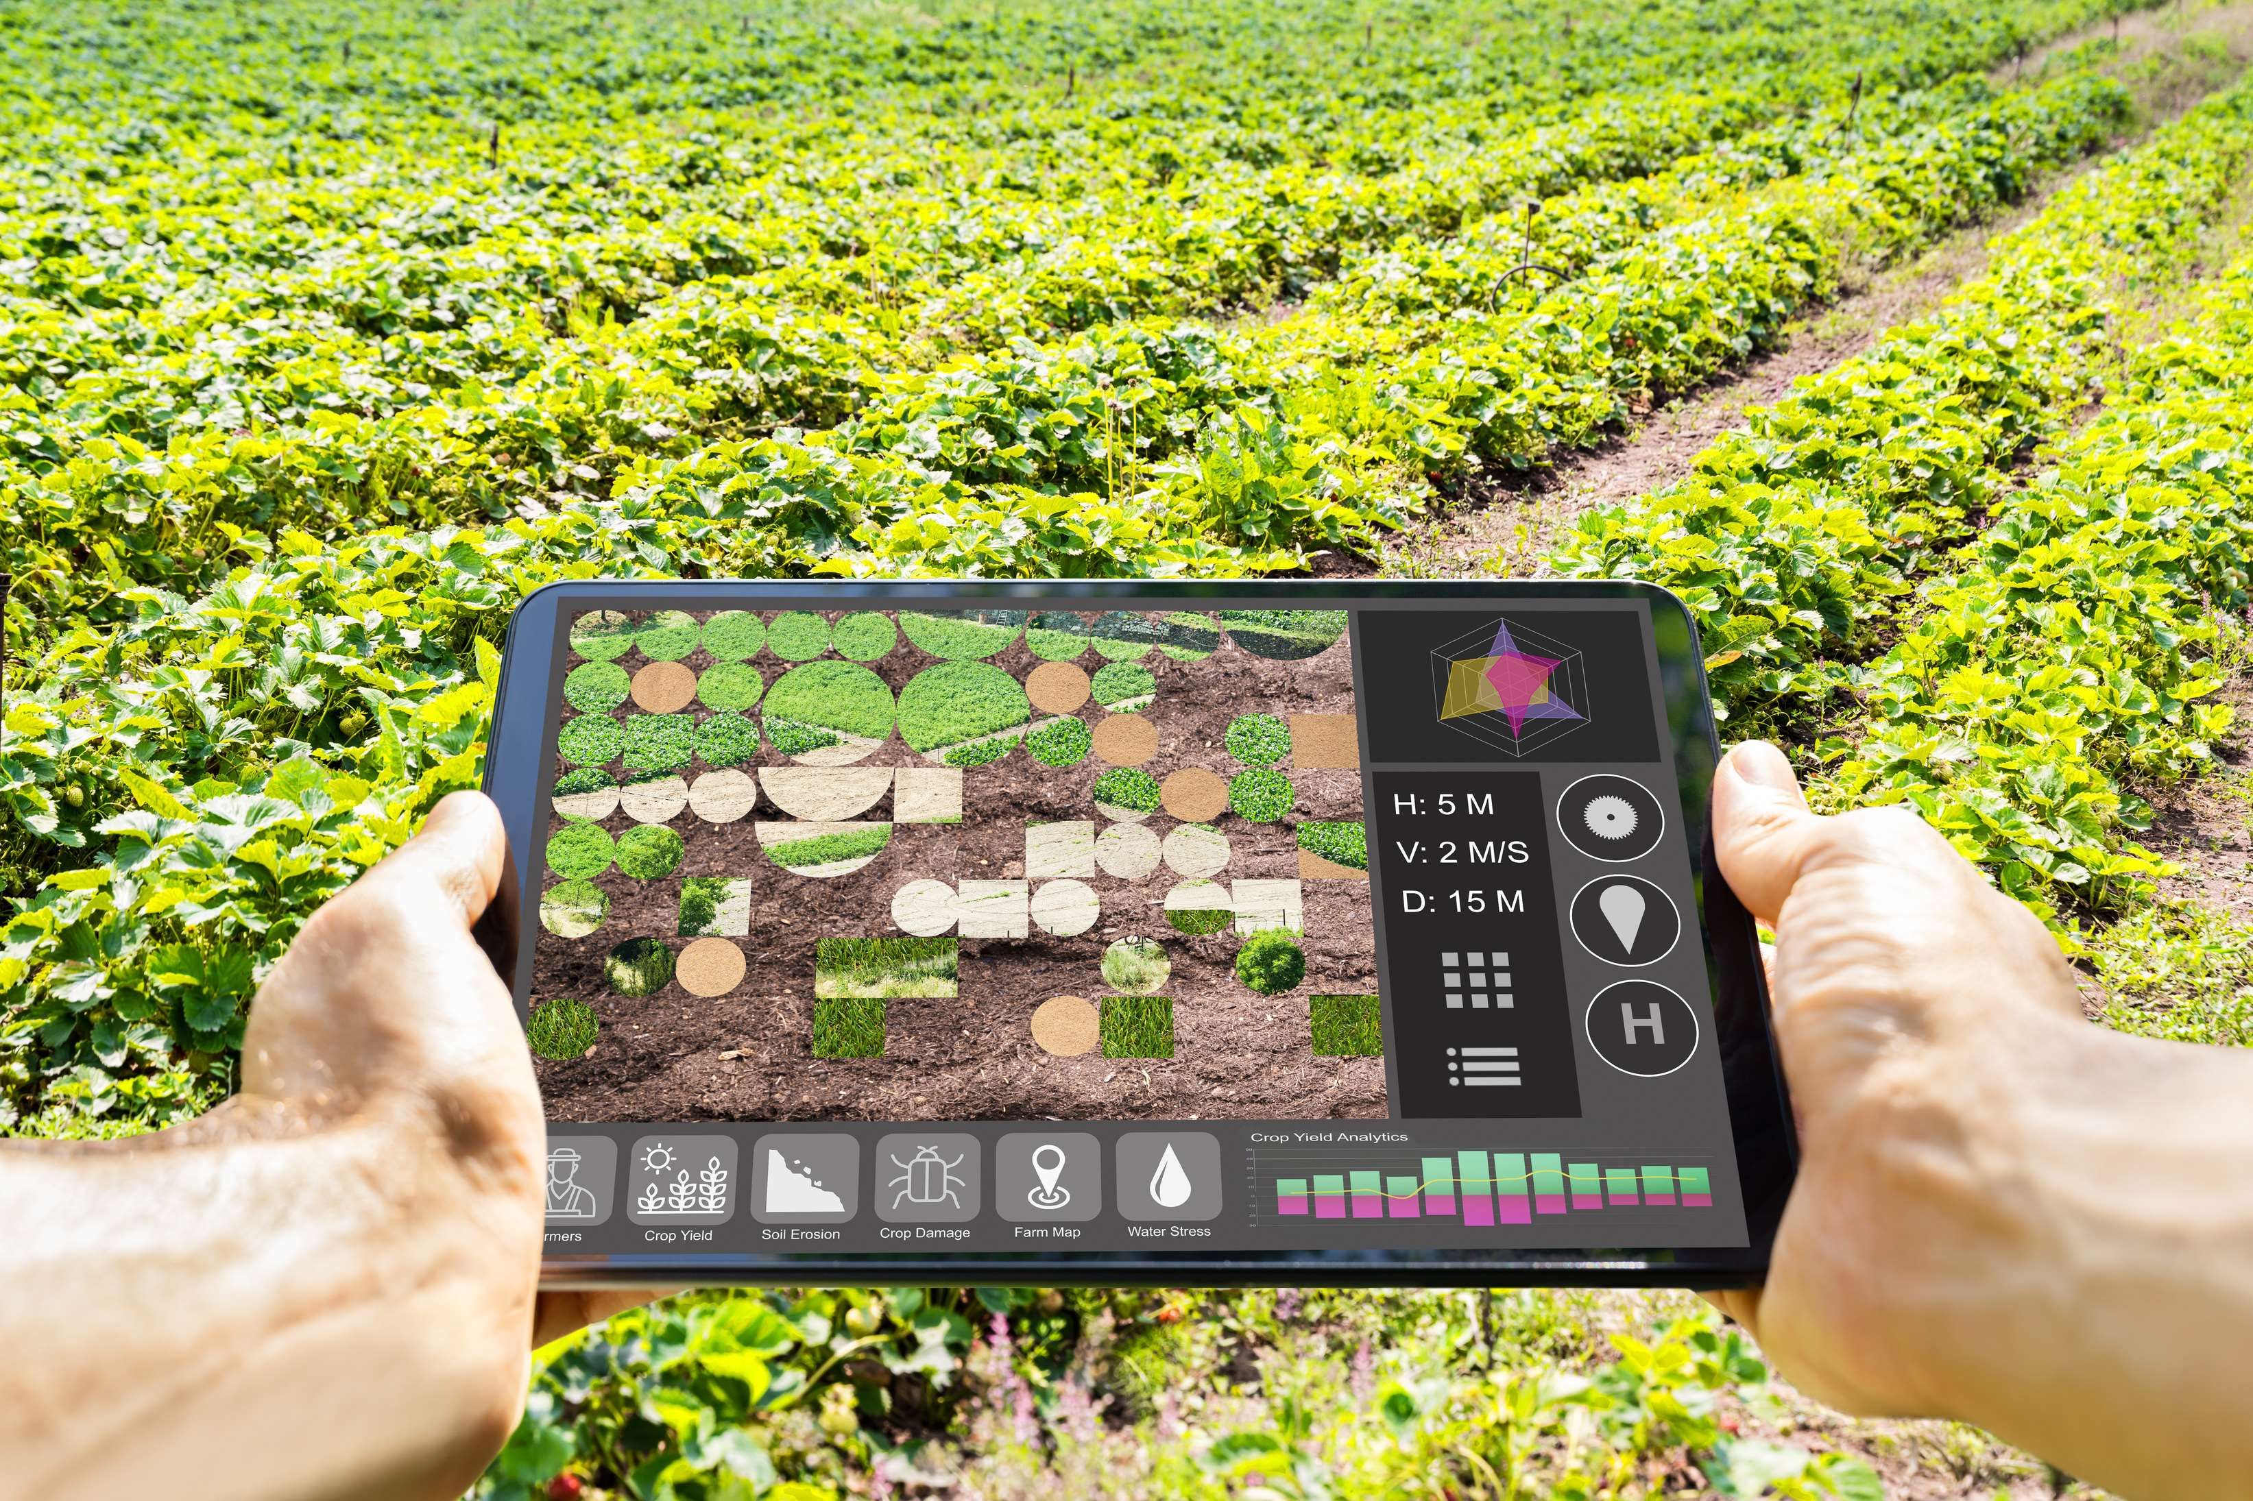

KEY INSIGHTS
MARKET SIZE
USD 24581.2 million
2024
CAGR
14.20%
2024- 2031

Slide 4
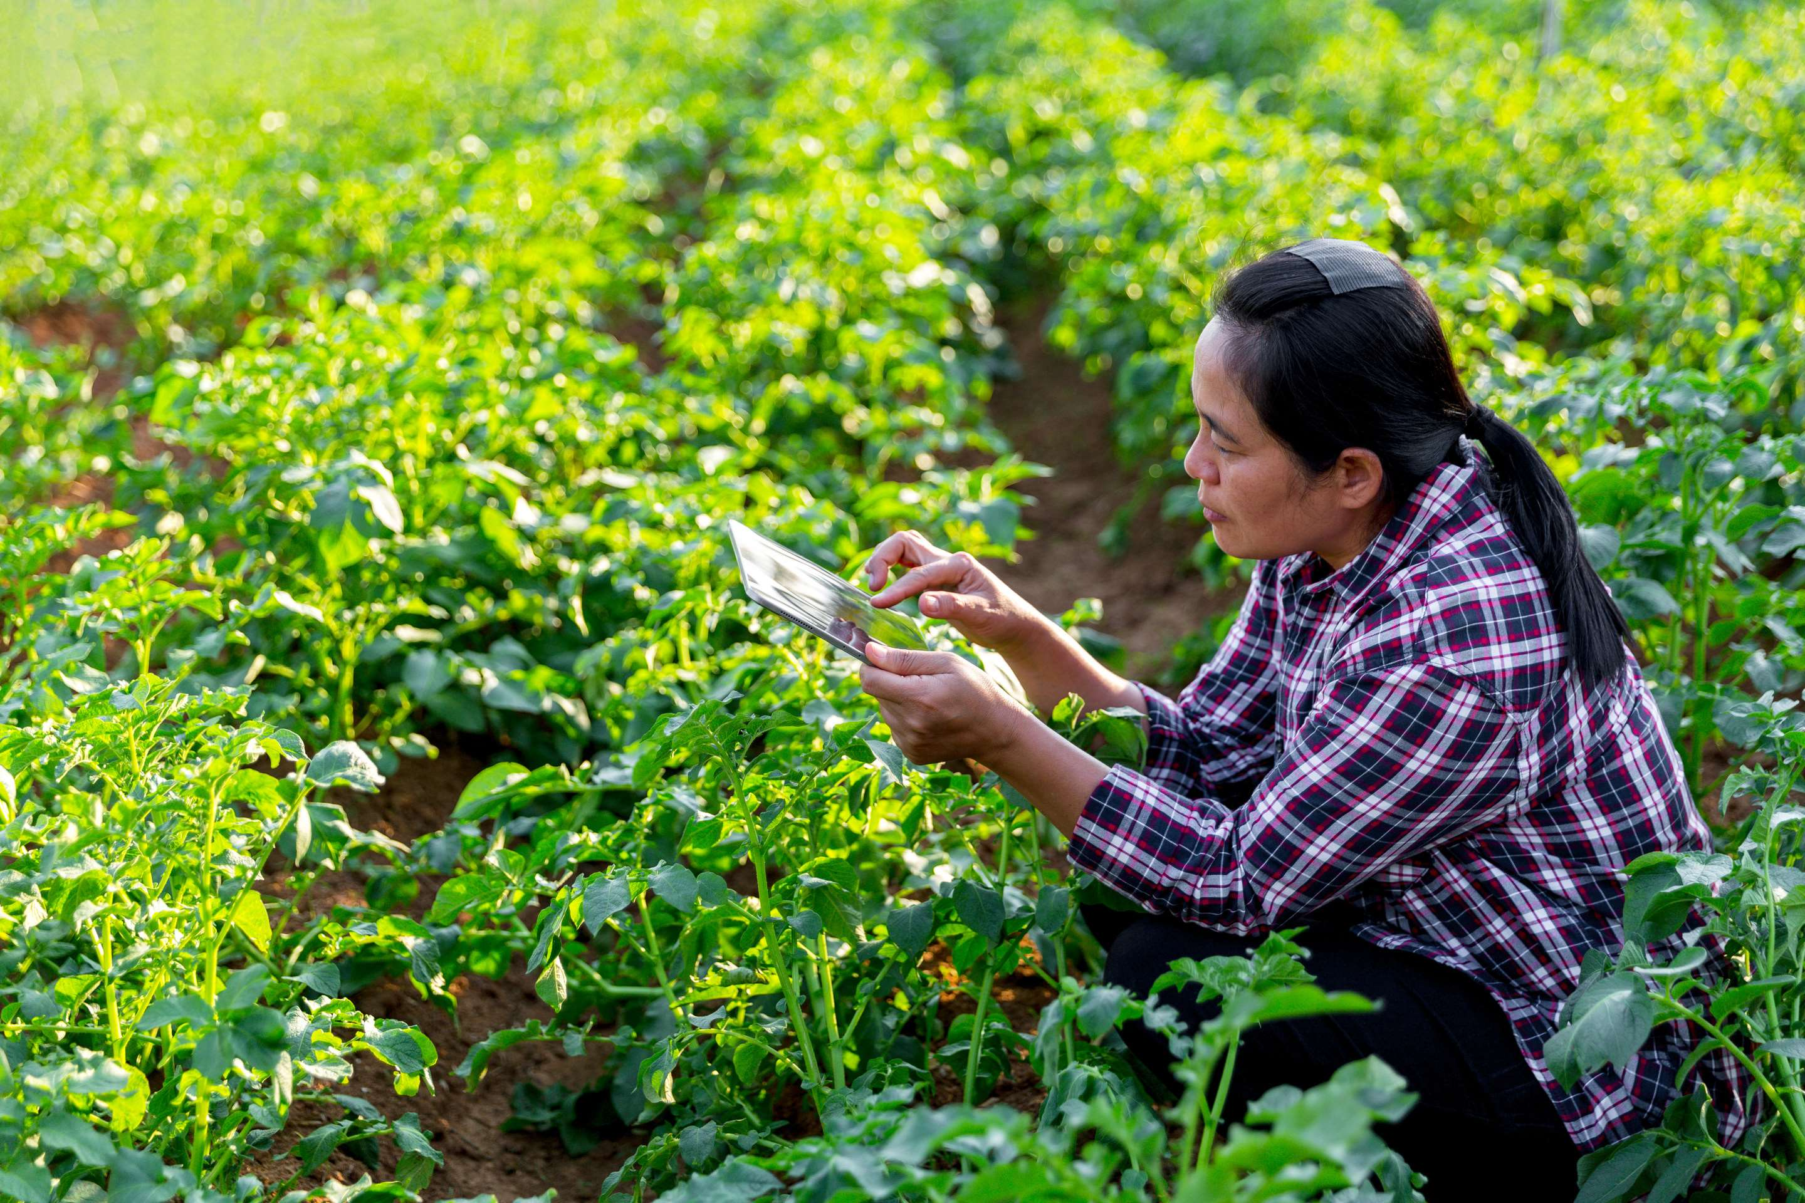
REVENUE MARKET SHARE BY SEGMENTS 2024
  Advisory Services
  Precision Agriculture & Farm Management
  Quality Management & Traceability
  Digital Procurement
  Agri e-Commerce
  Financial Services
  Hardware
  Software
  Services
Type Segment
Offering Segment
  Peripheral Technology
  Platforms
  Apps
  Core Technology
  Automation
  Drones
  Robotics
  AMY
  Farming & Feeding
  Precision Agriculture
  Precision Animal Rearing & Feeding
  Precision Aquaculture
  Precision Forestry
  Smart Greenhouse
Technology Segment
Operation Segment

Slide 5

REGION ANALYSIS
NORTH AMERICA
Europe
Asia Pacific
Latin America
MIDDLE EAST AFRICA
40%
30%
23%
Latin America
5%
2%
North America Digital Farming Solution Market Revenue share for 2024 is 40%

Slide 6

  Rising Penetration of AI and IOT Technologies to Increase the Demand Globally
  Increasing Pressure for Higher Productivity and Improved Crop Health to Propel Market Growth
Drivers
Skills and Training Gap to Limit the Sales
Restraints

Slide 7
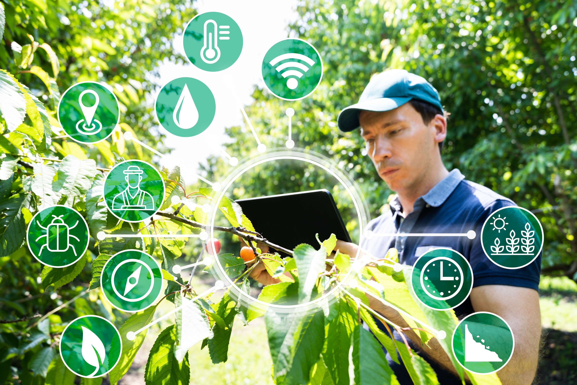
AUTHOR'S PERSPECTIVE
  The global Digital Farming Solution market will expand significantly by 14.20% CAGR between 2024 to 2031.
  Hardware Type stands out as the dominating category. Hardware evaluation, examining the technological components such as sensors, drones, and IoT devices crucial for modern agricultural practices, facilitating data-driven decision-making.
  The dominating category is Peripheral Technology. Peripheral Technologies such as drones, sensors, and satellite imaging are vital for data collection, monitoring, and analysis, enhancing precision agriculture practices and maximizing crop yields efficiently.

Slide 8



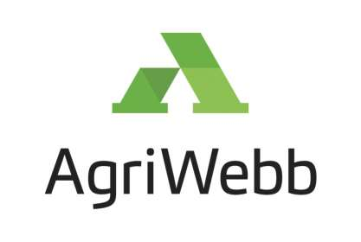


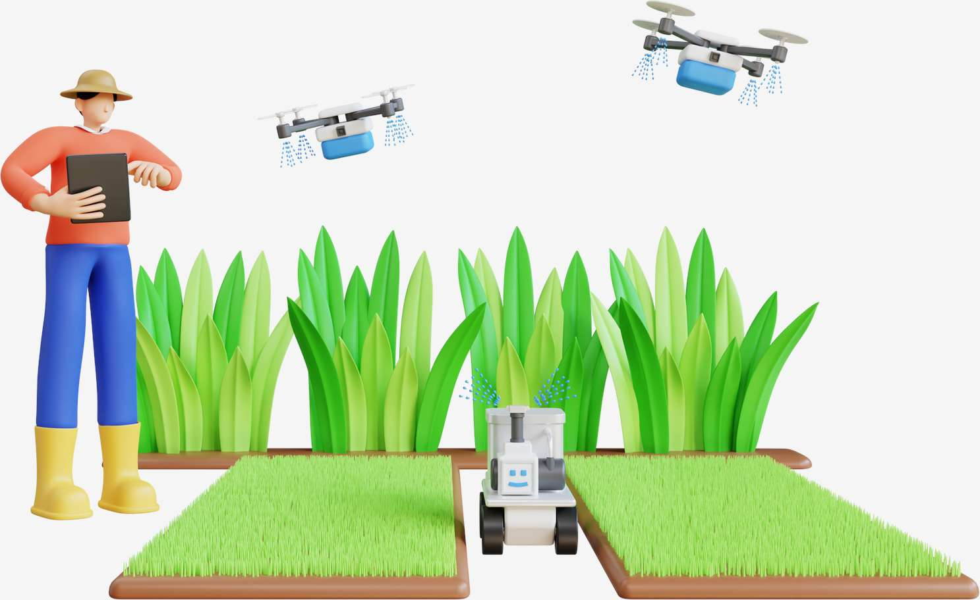




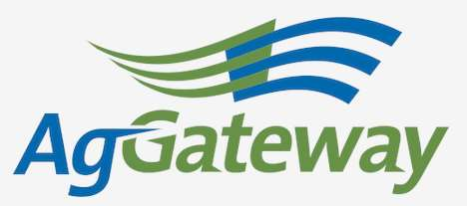

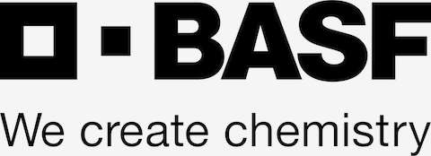
KEY PLAYERS

Slide 9


For Full Report
Contact us
COGNITIVE MARKET RESEARCH
Tel: +1 312-376-8303 | +44 020-8123-0732
India: (+91) 983-496-8611
sales@cognitivemarketresearch.com
Access the Full Report : https://tinyurl.com/vmht9utz
Please visit our website:
https://www.cognitivemarketresearch.com

