Slide 1

GLOBAL
DIGITAL CAMERA
MARKET REPORT
2024
Global,Regional,CountryAnalysis

Slide 2
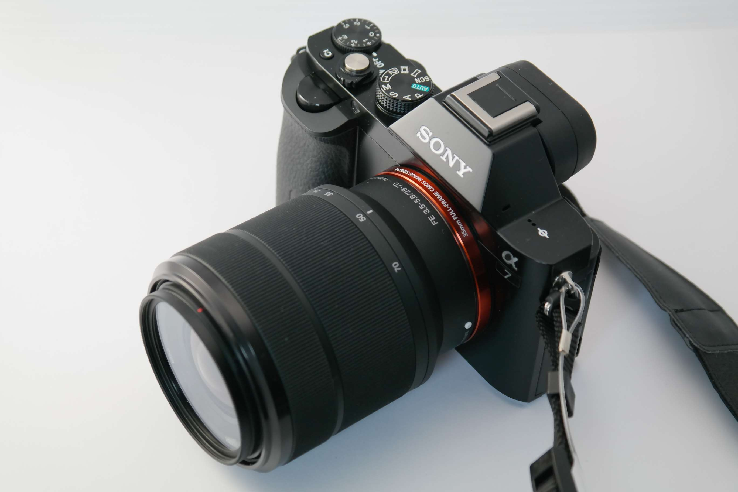
INTRODUCTION
The digital camera market encompasses the production, distribution, and consumption of devices that capture and store digital images electronically. These cameras utilize digital sensors to convert optical images into digital data, allowing for easy storage, manipulation, and sharing of photographs. Digital cameras have evolved significantly since their inception, offering a wide range of features and functionalities catering to various consumer needs and preferences.

Slide 3
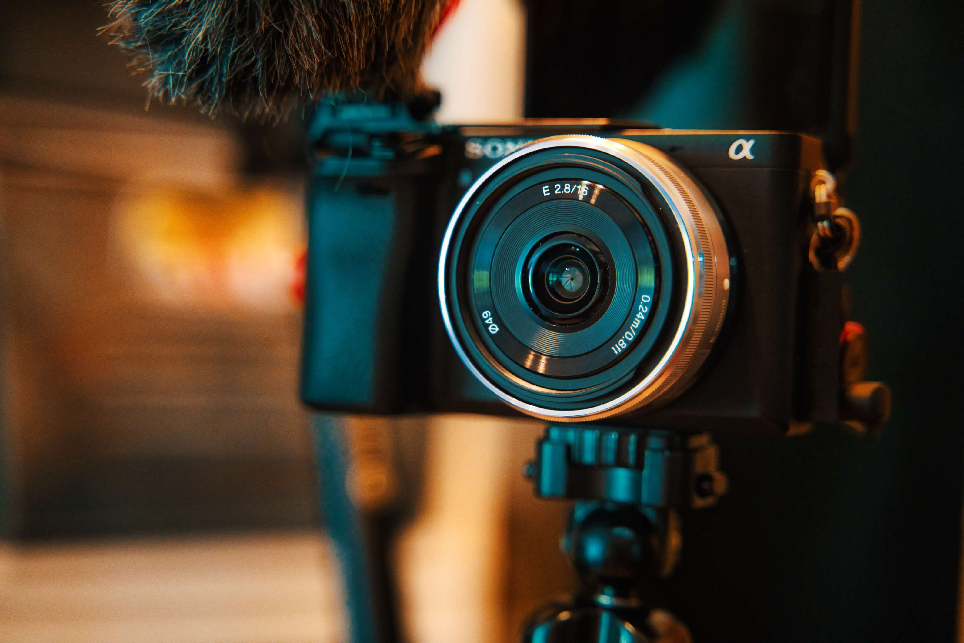

KEY INSIGHTS
MARKET SIZE
USD 7851.2 million
2024
CAGR
4.50%
2024- 2031

Slide 4

REVENUE MARKET SHARE BY SEGMENTS 2022
  Digital Single-Lens Reflex (DSLR) Cameras
  Compact Digital Cameras
  Bridge Compact Digital Cameras
  Mirrorless Interchangeable Lens Cameras
  CCD Sensor
  CMOS Sensor
  FOVEON X3 Sensor
  Live MOS Sensor
Product Segment
Sensor Type Segment
  Lenses
  Sensors
  LCD Screen
  Memory Card
  Personal
  Profession
End-User Segment
Component Segment

Slide 5

Global Digital Camera Market Revenue share for 2024
North America
40%

Slide 6
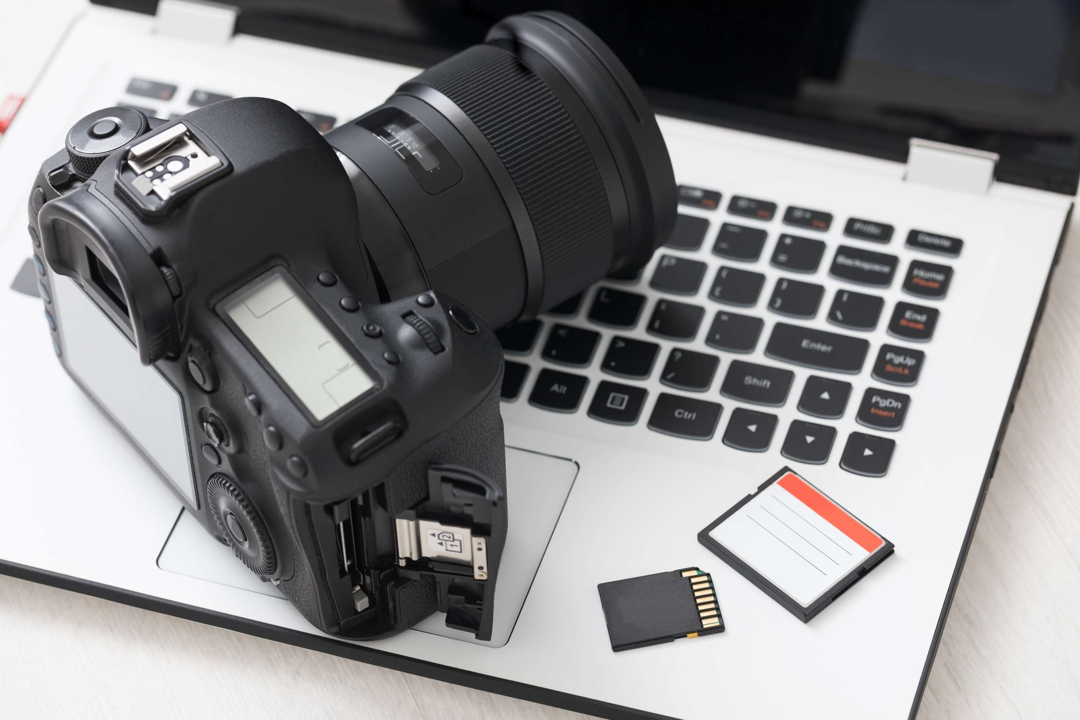
  High Adoption of Digital Cameras in various Media Publications To Boost Market Growth
  Adoption of Camera as a Profession and Mainstream Career To Boost Market Growth
Drivers
Rapid Technological Obsolescence Necessitates Frequent Product Upgrades To Limit Market Growth
Restraints

Slide 7
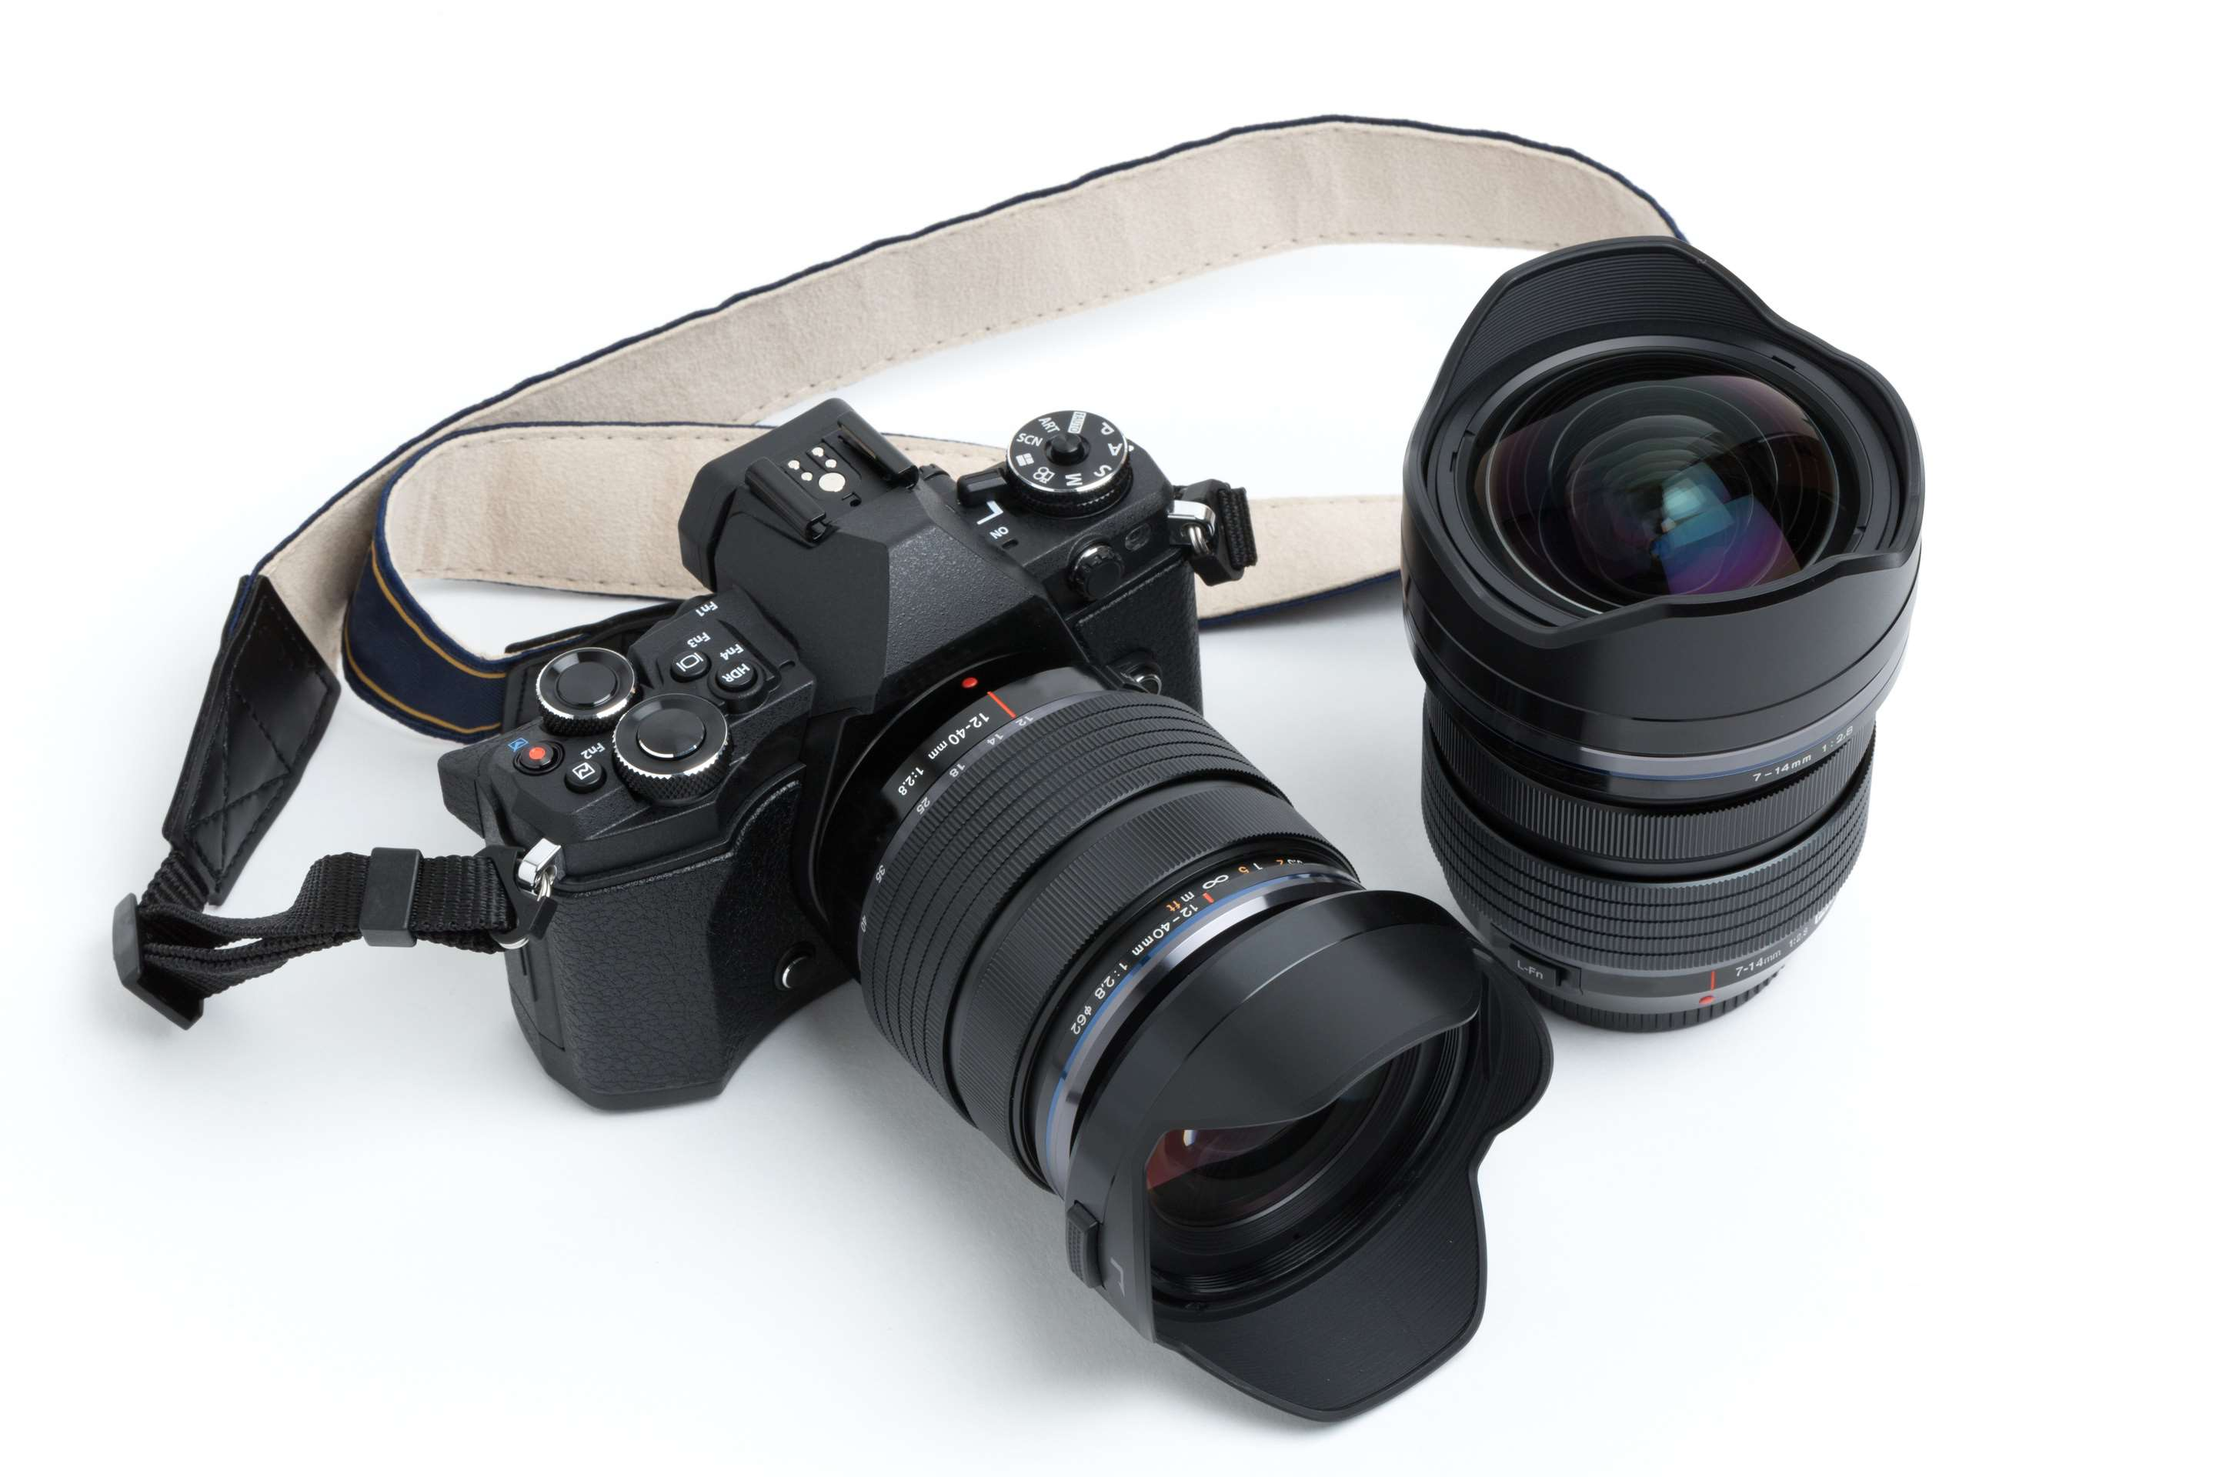
AUTHOR'S PERSPECTIVE
  The global Digital Camera Market will expand significantly by 4.50% CAGR between 2024 and 2031.
  The digital camera market can be segmented by digital sensor type, with the main categories being CMOS (Complementary Metal-Oxide-Semiconductor) and C.C.D. (Charge-Coupled Device). CMOS sensors are more prevalent due to their lower power consumption, faster readout speeds, and better performance in low light. C.C.D. sensors offer superior image quality but are rare due to higher costs and power requirements.
  Technological advancements driving innovation, increasing demand for high-quality imaging in smartphones, the rise of social media influencing content creation, growing interest in vlogging and video streaming, expanding applications in industries like healthcare and security.

Slide 8


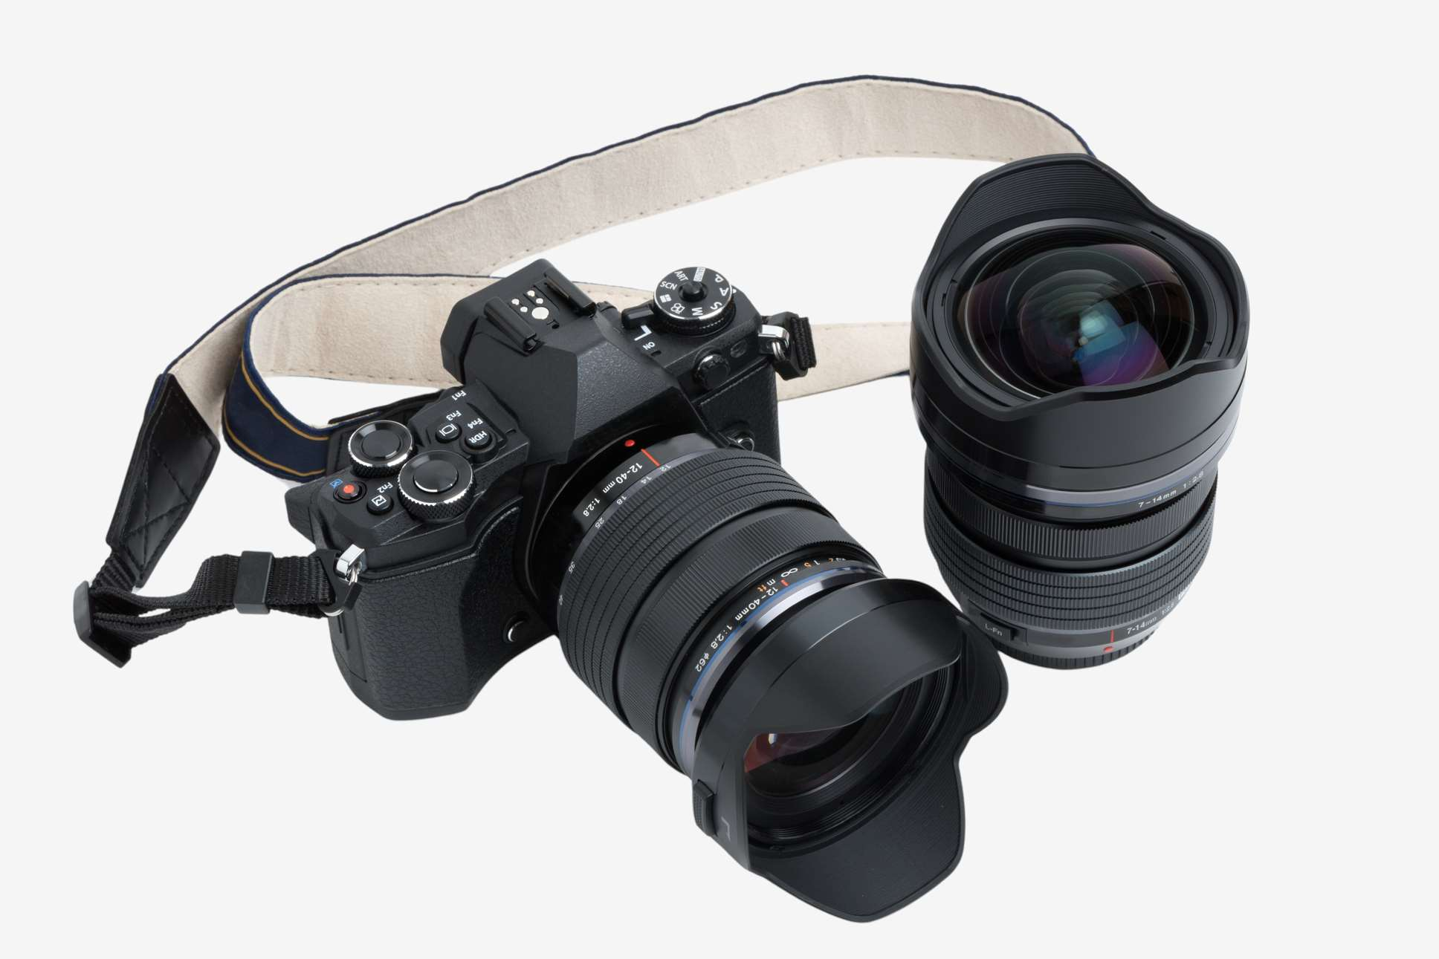



KEY PLAYERS

Slide 9


For Full Report
Contact us
COGNITIVE MARKET RESEARCH
Tel: +1 312-376-8303 | +44 020-8123-0732
India: (+91) 983-496-8611
sales@cognitivemarketresearch.com
Access the Full Report : https://tinyurl.com/ys8akpus
Please visit our website:
https://www.cognitivemarketresearch.com

