Slide 1
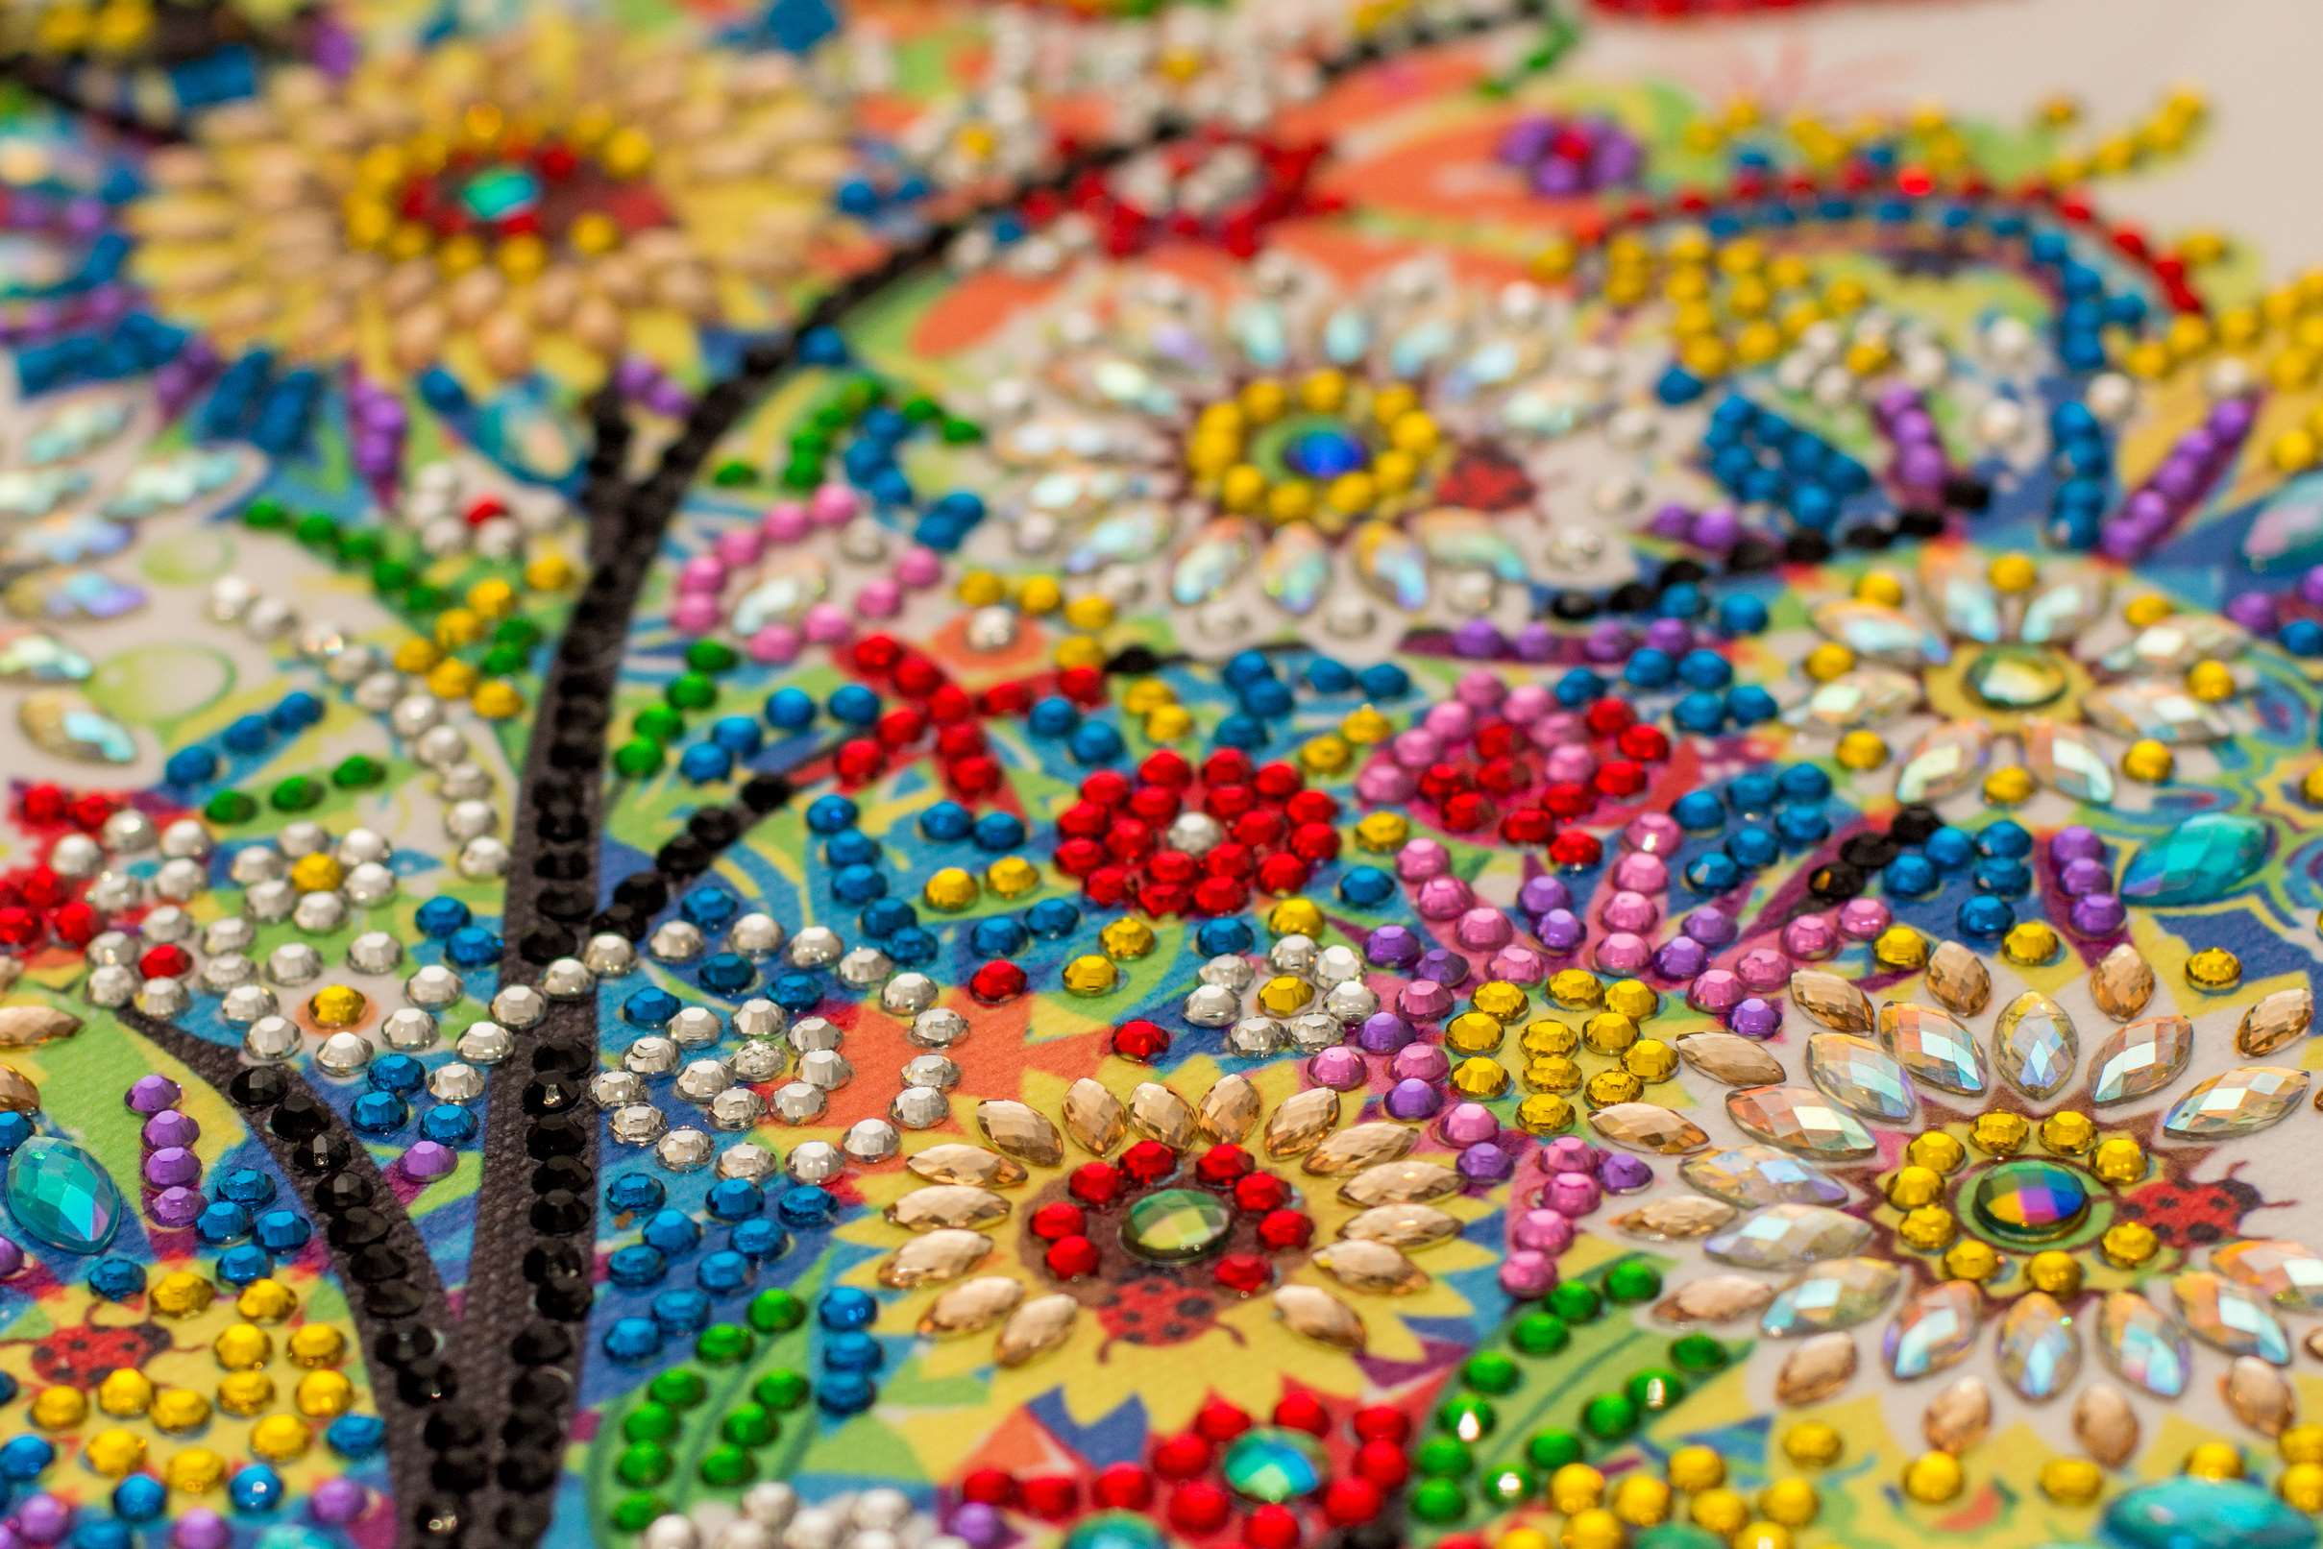
GLOBAL
DIAMOND PAINTING
MARKET REPORT
2024
Global,Regional,CountryAnalysis

Slide 2
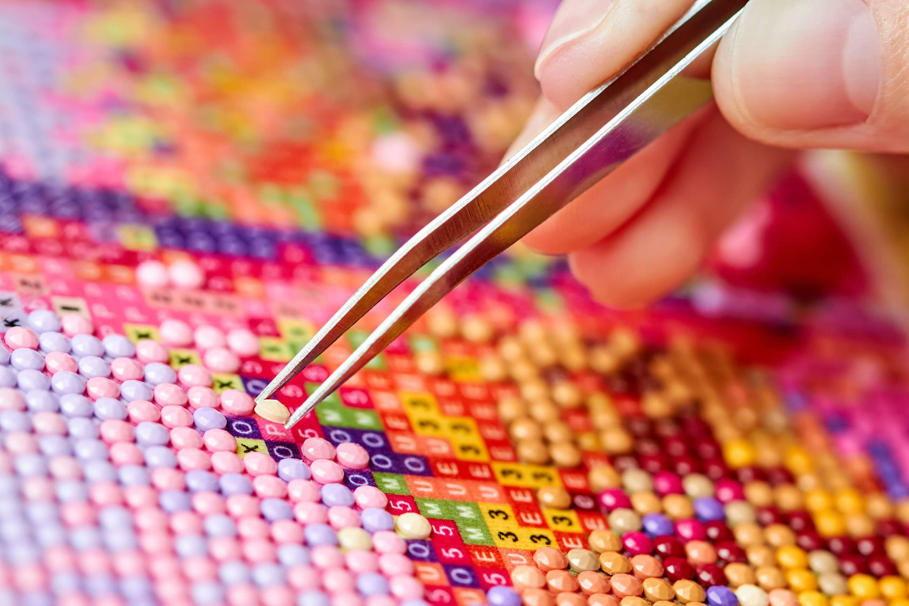
INTRODUCTION
Diamond painting is a craft and art industry segment that has grown tremendously in popularity in recent years. It involves adhering tiny resin "diamonds" on an adhesive canvas in a coded pattern to produce elaborate mosaic-like designs. This imaginative and calming hobby has drawn admirers of all ages because it offers a special synthesis of artistic expression and relaxation. Both novice and expert artists can find many kits on the market with different designs, degrees of intricacy, and sizes. Diamond Painting has developed a devoted following, fueling rising demand for kits and accessories and a sense of artistic achievement as a means of creative self-expression and stress reduction.

Slide 3
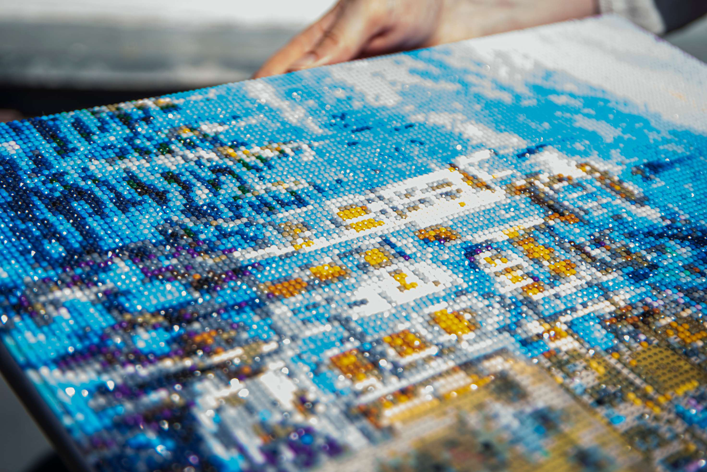

KEY INSIGHTS
CAGR
5.30%
2024- 2031

Slide 4
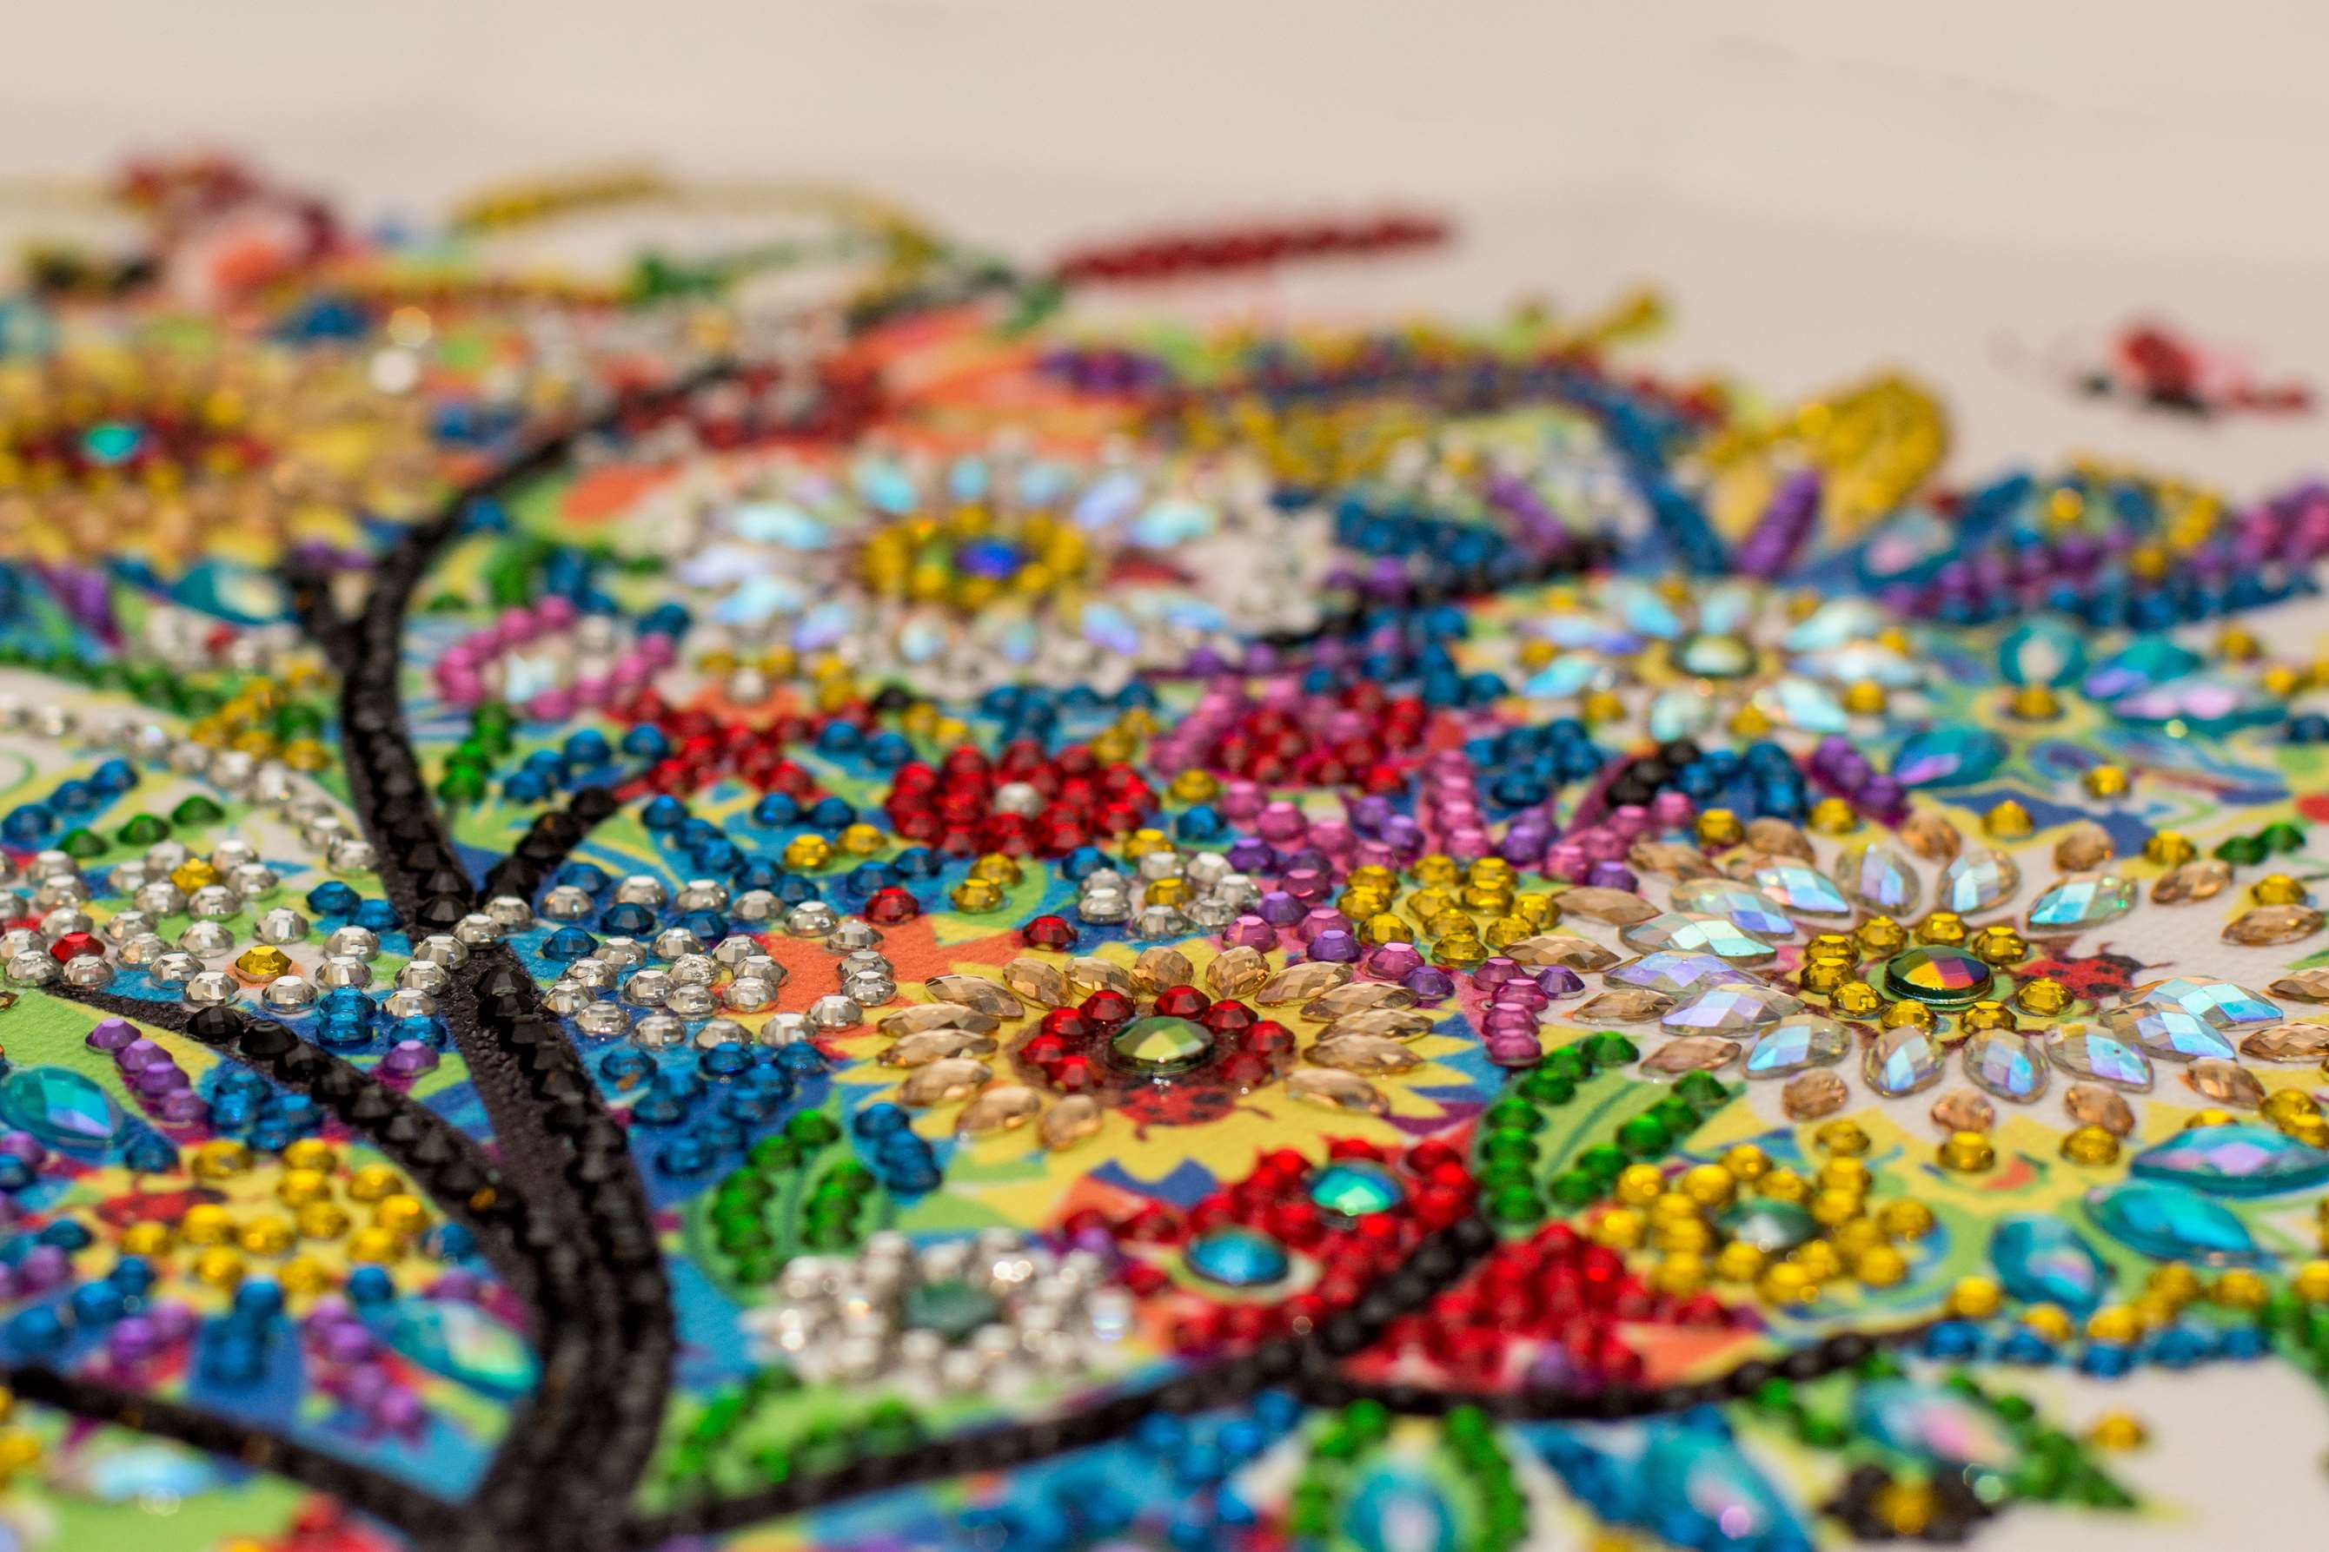
REVENUE MARKET SHARE BY SEGMENTS 2022
  3D Diamond Painting
  5D Diamond Painting
Type Segment
  Home Decoration
  Gift
Sales Channel Segment

Slide 5
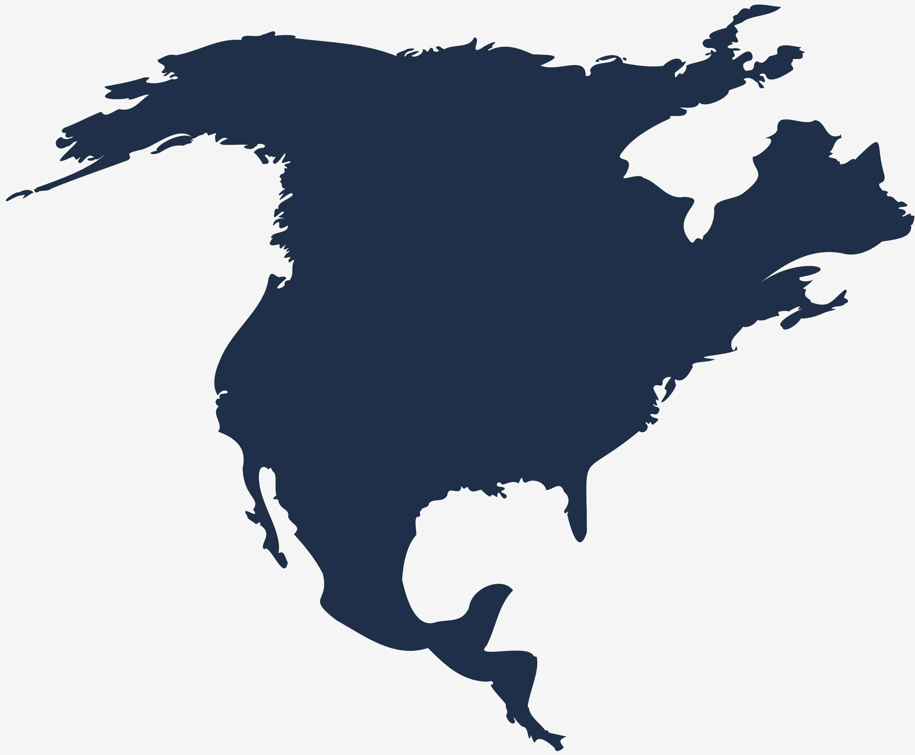
Global Diamond Painting Market Revenue share for 2024
North America
38%

Slide 6
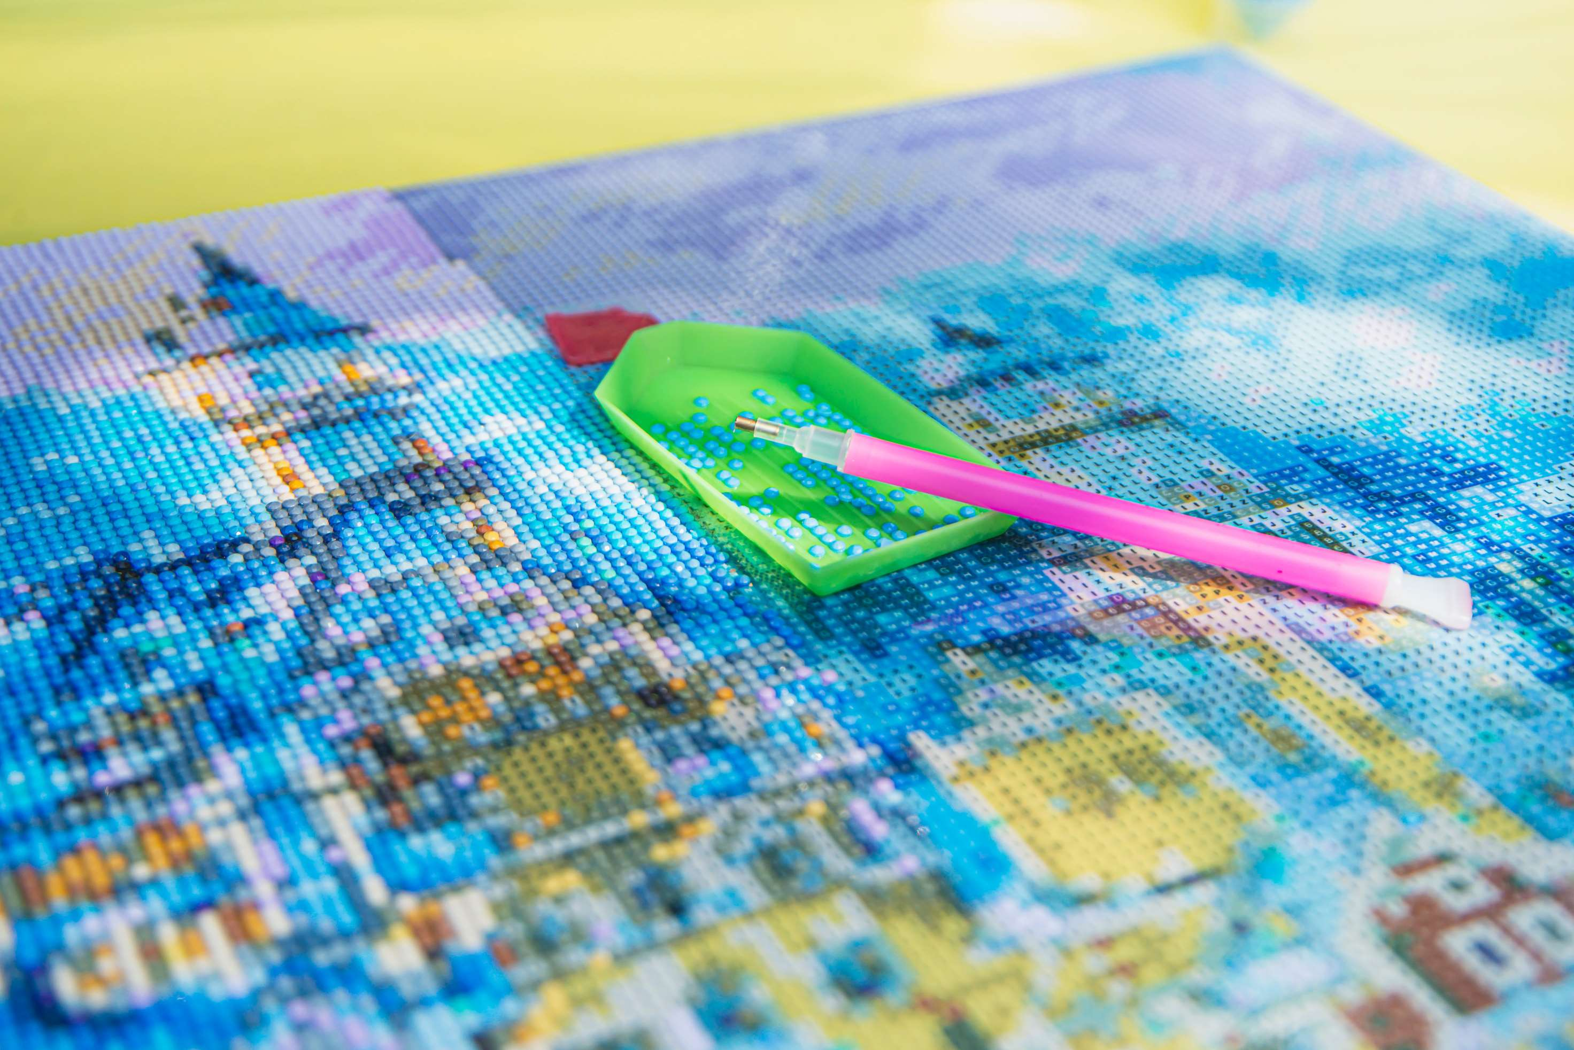
Wide Range of Products to Propel Market Growth
Drivers
Time-Consuming Procedure to Hinder Market Growth
Restraints

Slide 7
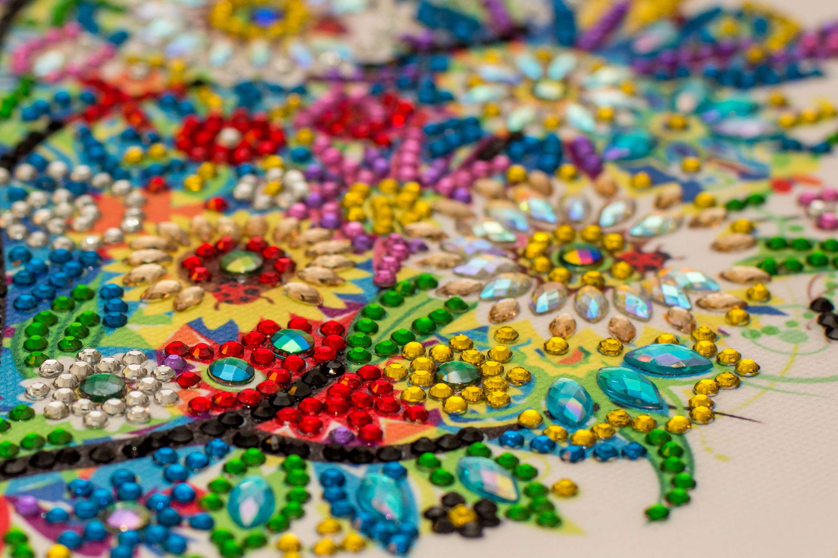
AUTHOR'S PERSPECTIVE
  The Global Diamond Painting Market is witnessing significant growth in the near future.
  Curved layer objects produced through 5D printing are more robust and long-lasting than flat layer ones.
  Necklaces, bracelets, and earrings with diamond prints are common presents for loved ones.
  People can personalize diamond-printed jewelry with the recipient's name, initials, birthstone, or any meaningful statement.

Slide 8
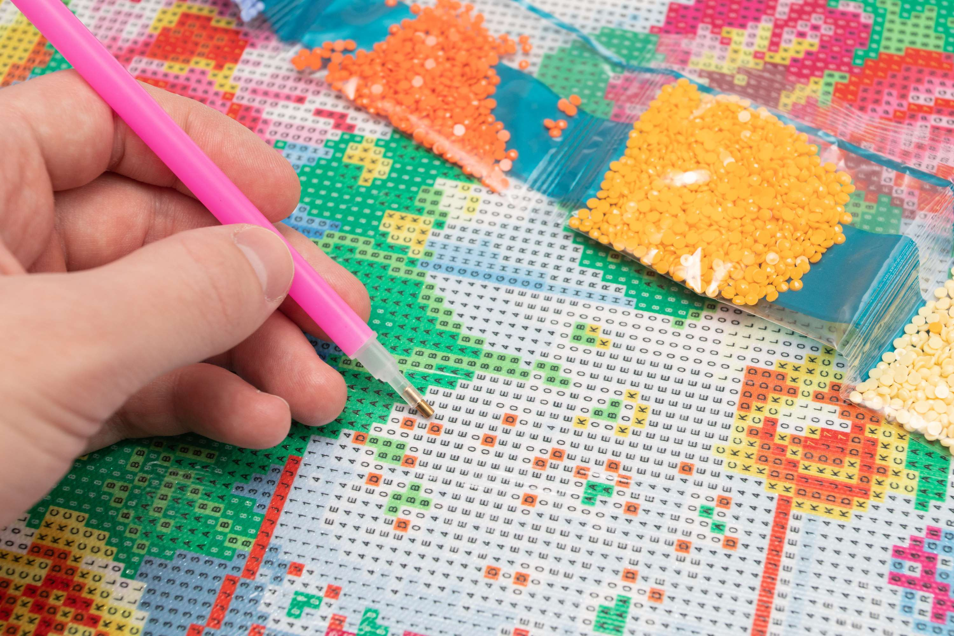



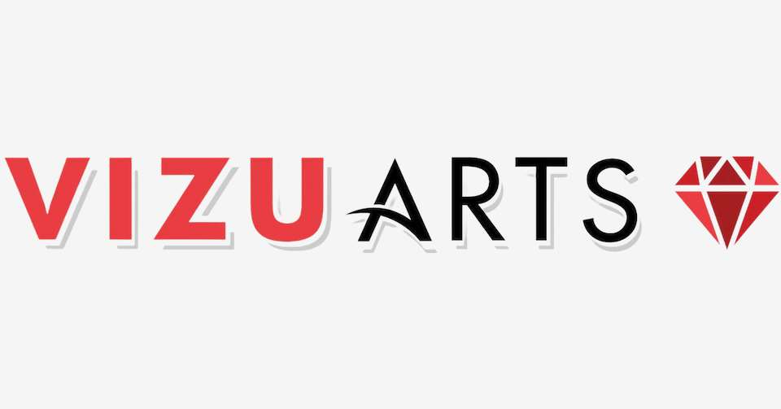
KEY PLAYERS

Slide 9


For Full Report
Contact us
COGNITIVE MARKET RESEARCH
Tel: +1 312-376-8303 | +44 020-8123-0732
India: (+91) 983-496-8611
sales@cognitivemarketresearch.com
Access the Full Report : https://tinyurl.com/3v28svjy
Please visit our website:
https://www.cognitivemarketresearch.com

