Slide 1
GLOBAL DENTAL MARKET REPORT 2024
Global,Regional,CountryAnalysis

Slide 2

INTRODUCTION
Dental items are tools and supplies to diagnose, treat, and prevent various conditions, including cavities, gum disease, and periodontitis. Implants, periodontics, endodontics, prostheses, and whitening creams are just a few items available today. The acceptance of these items has expanded due to the numerous benefits connected with periodontics and endodontics, which include practically painless operations and cost-effectiveness.
Dental services offered by dentists and other dental specialists include diagnosing, preventing, and treating dental problems. The key factors influencing the market share are growing public knowledge of dentistry, the rise in periodontal diseases and dental cavities, technical advancements in dentistry, and the growing demand for laser and cosmetic dentistry.

Slide 3


KEY INSIGHTS
MARKET SIZE
USD 36.8 billion
2023
CAGR 8.2%
2023
-
2030

Slide 4

REVENUE MARKET SHARE BY SEGMENTS 2022
Dental Consumables
Dental Equipment
Type Segment
Solo Practices
DSO/ Group Practices
End User Segment

Slide 5
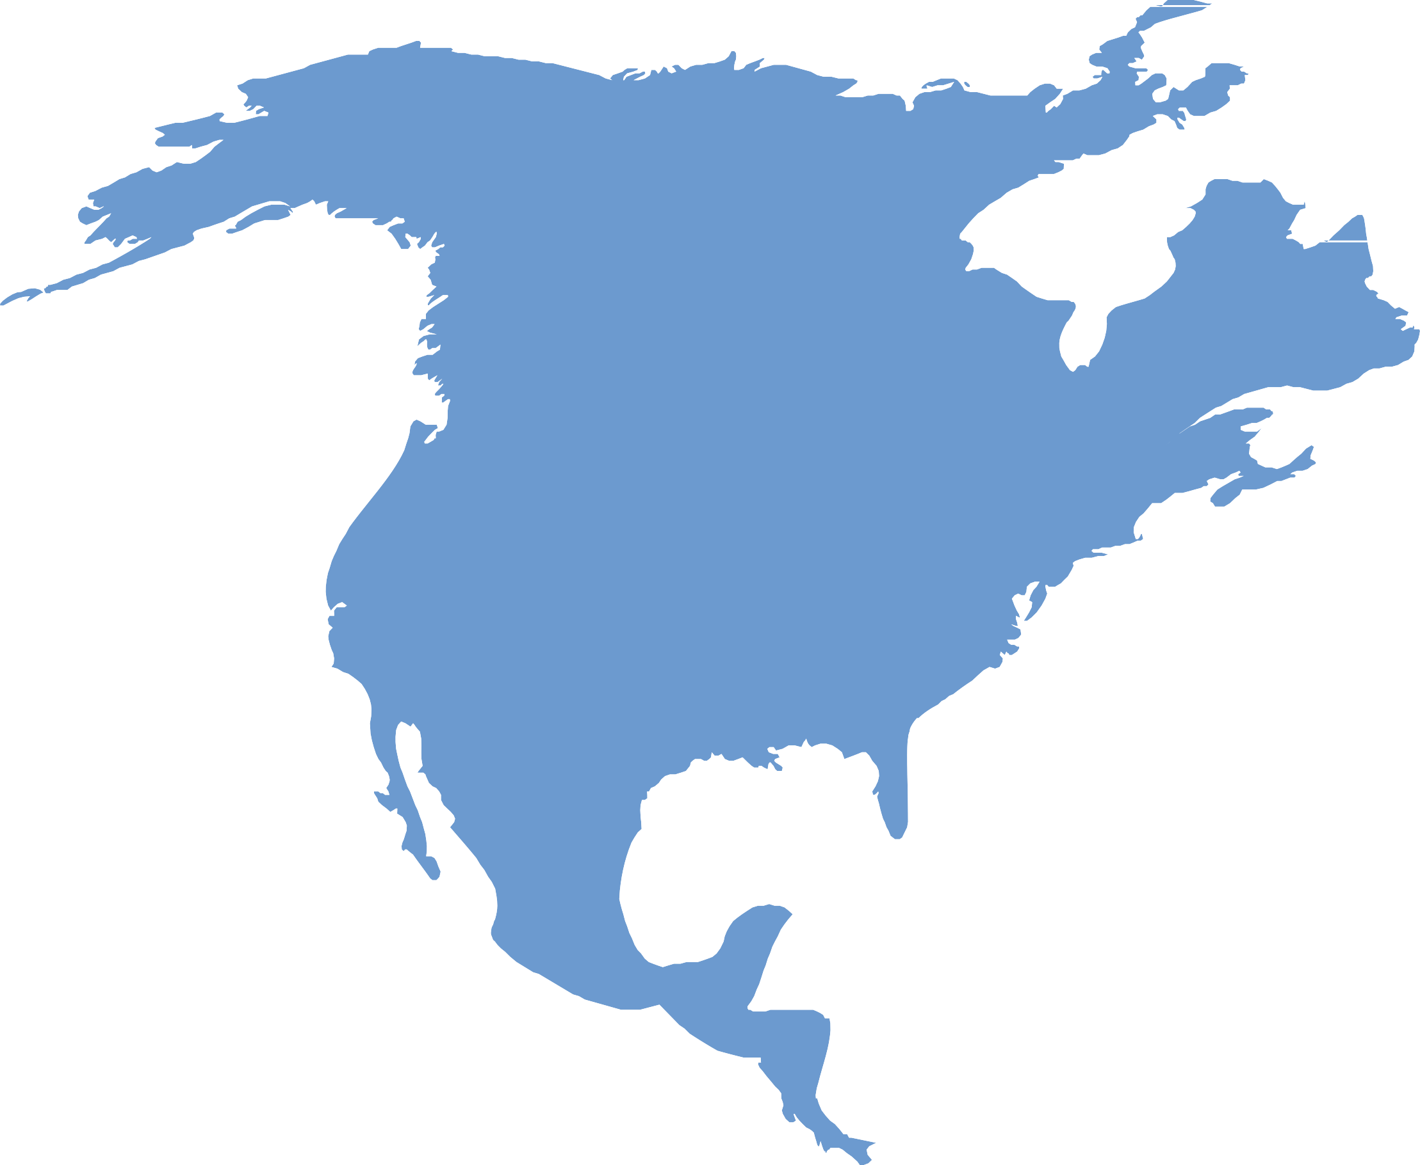
Global Dental Market Revenue share for 2022
North America 45%

Slide 6
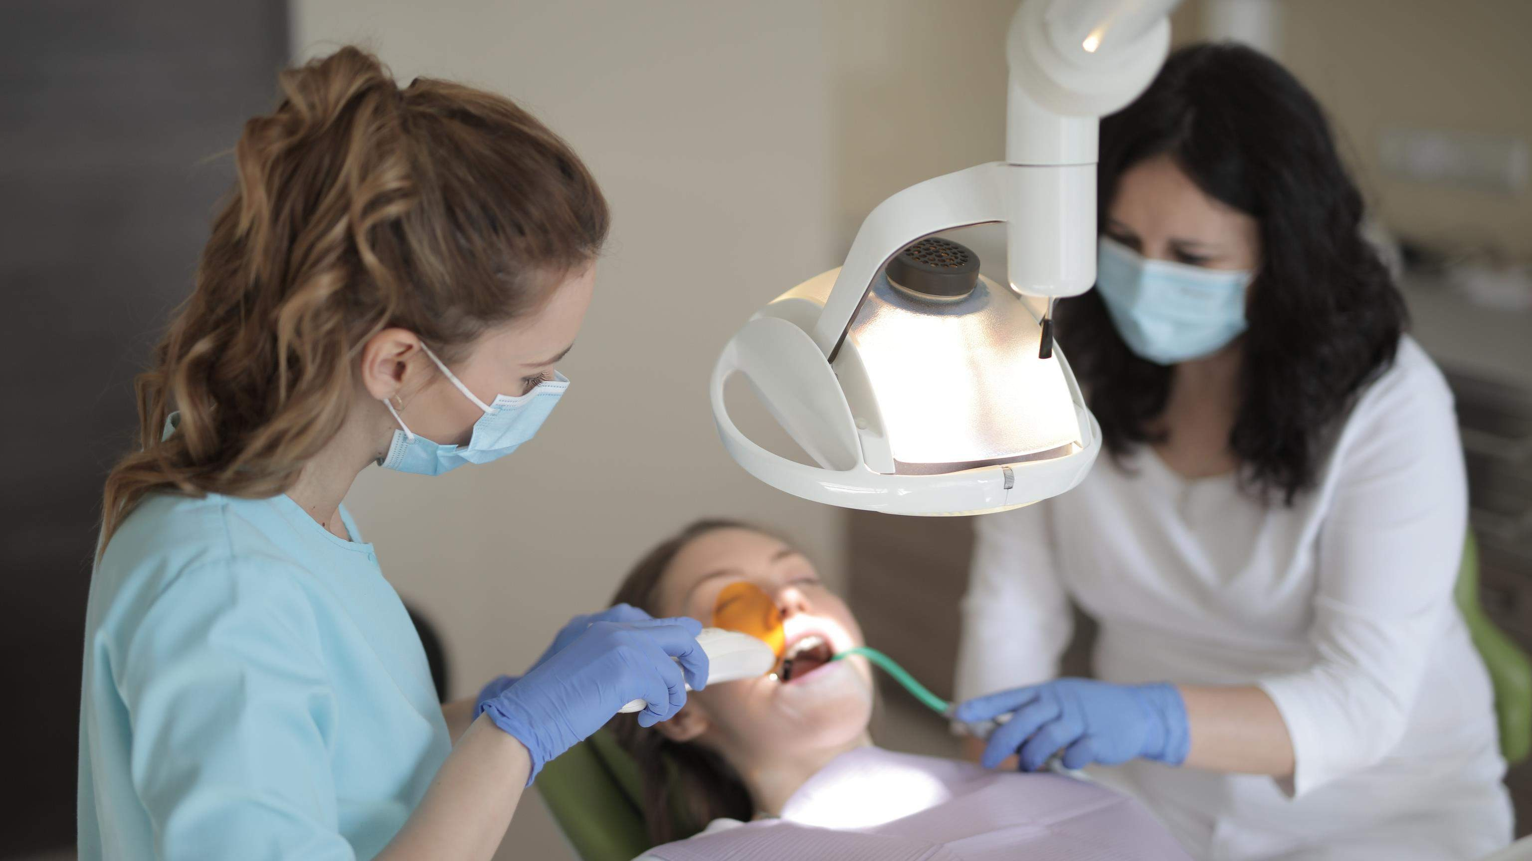


Technological Advancements to Propel Market Growth
High Cost of Dental Treatment to Hinder Market Growth

Slide 7

AUTHOR'S PERSPECTIVE
The Global Dental Market is witnessing significant growth in the near future.
Artificial intelligence and neural networks-based machine translation software have significantly increased translation accuracy and efficiency.
The sector is predicted to be driven by several factors, including the growing number of older adults who suffer from oral disorders, the evolution of dental treatment-related medical tourism, and the introduction of several government initiatives for oral health care.
End Users are available using simultaneous, consecutive, or whispered interpretation techniques.

Slide 8
KEY PLAYERS

Slide 9


Contact us
For Full Report
COGNITIVE MARKET RESEARCH
Tel: + 1 312 - 376 - 8303 | + 44 020 - 8123 - 0732
India: ( + 91 ) 983 - 496 - 8611
sales@ cognitivemarketresearch. com
Access the Full Report : http://tinyurl.com/5fe9pynt
Please visit our website:
https://www.cognitivemarketresearch.com

