Slide 1

GLOBAL
DENIM SKIRT
MARKET REPORT
2024
Global,Regional,CountryAnalysis

Slide 2

INTRODUCTION
Denim is a sturdy textile in which the weft passes under two or more warp threads. This twill weaving creates a diagonal ribbing that differs it from cotton duck. The denim fabric has become so ubiquitous worldwide that they have become almost synonymous with the American style. Market fueled by rising population, rapid urbanization in developing countries and an increase in disposable per capita income. These strategies help key players capture a significant market share and remain competitive in the dynamic Denim Skirt market.

Slide 3


KEY INSIGHTS
CAGR
5.00%
2023- 2030

Slide 4

REVENUE MARKET SHARE BY SEGMENTS 2022
  Open skirt
  Not open skirt
Type Segment
  Girl
  Adult female
Application Segment

Slide 5

Global Denim Skirt Market Revenue share for 2024
North America
40%

Slide 6

Sustainability and Ethical Practices to Propel Market Growth
Drivers
Supply Chain Disruptions and Raw Material Costs Impact to Restrict Market Growth
Restraints

Slide 7

AUTHOR'S PERSPECTIVE
  The global Denim Skirt market will expand significantly by 5.00% CAGR between 2023 and 2030.
  The demand for Denim Skirts is rising due to the rising population, rapid urbanization in developing countries.
  Demand for Not open skirt remains higher in the Denim Skirt market.
  North American Denim Skirt will continue to lead, whereas the Asia Pacific Denim Skirt market will experience the most substantial growth until 2030.

Slide 8


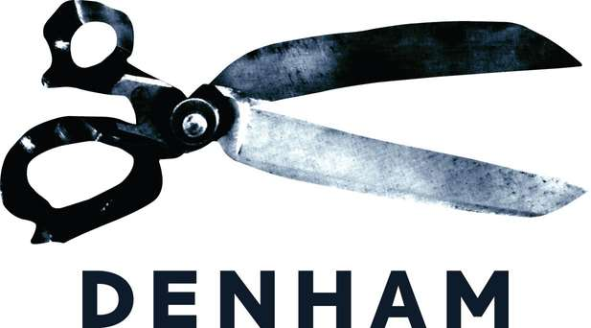


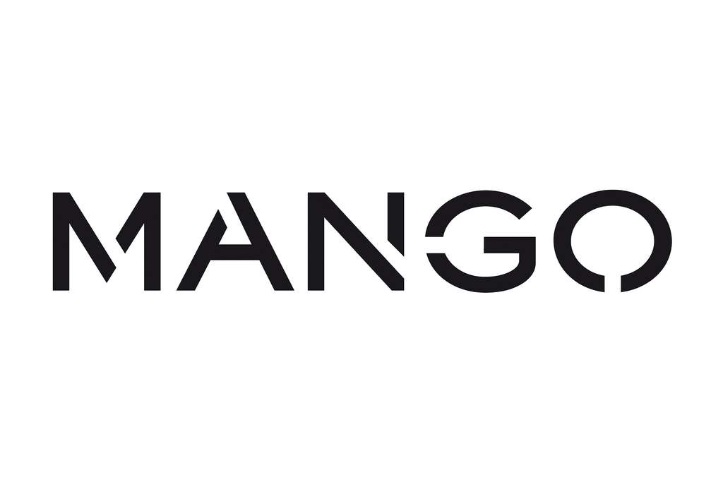







KEY PLAYERS

Slide 9


For Full Report
Contact us
COGNITIVE MARKET RESEARCH
Tel: +1 312-376-8303 | +44 020-8123-0732
India: (+91) 983-496-8611
sales@cognitivemarketresearch.com
Access the Full Report : https://tinyurl.com/2s43uwpp
Please visit our website:
https://www.cognitivemarketresearch.com

