Slide 1
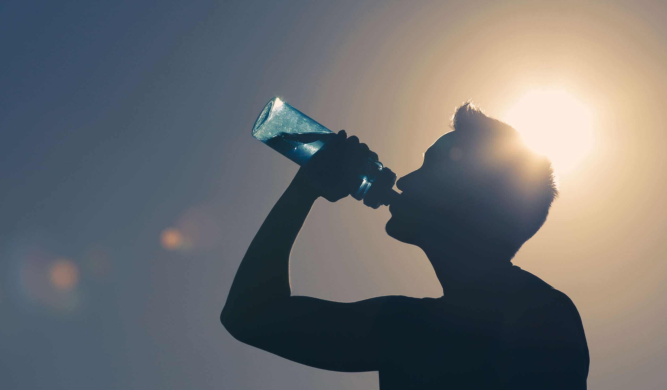
GLOBAL
DEIONIZED WATER
MARKET REPORT
2024
Global,Regional,CountryAnalysis

Slide 2

INTRODUCTION
When water is boiled into vapor and then condensed into liquid in a separate vessel, it creates distilled water. The impurities and minerals that do not boil at the same temperature as water are left behind in the original container. Distilled water is a type of purified water. The increased use of distilled water in automotive cooling systems and lead-acid batteries, as well as the rising demand for medical purposes, is driving its growth.

Slide 3
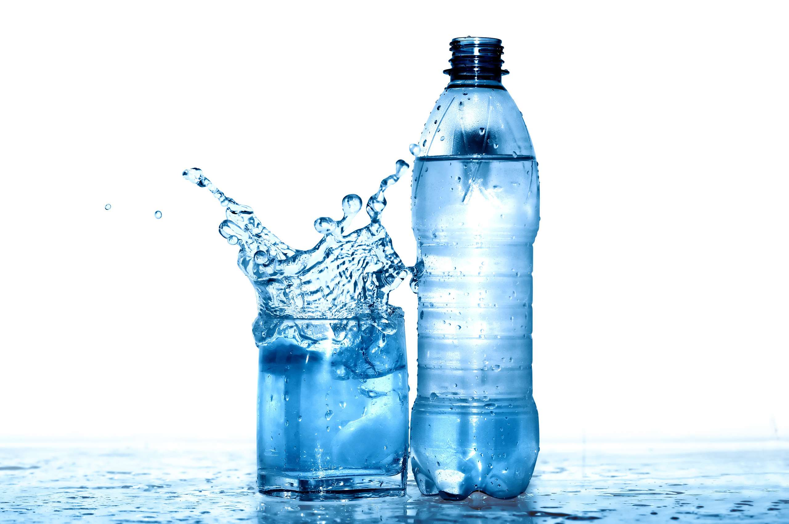

KEY INSIGHTS
MARKET SIZE
USD 0.4 billion
2023
CAGR
7.80%
2023- 2030

Slide 4

REVENUE MARKET SHARE BY SEGMENTS 2022
  CLRW
  ASTM
  USP
  AAMI
Type Segment
  Clinical Laboratory
  Medical Research Colleges
  Consumer Goods Manufacturing
  Pharmaceutical Industry
  Hospitals and Clinics
Application Segment

Slide 5
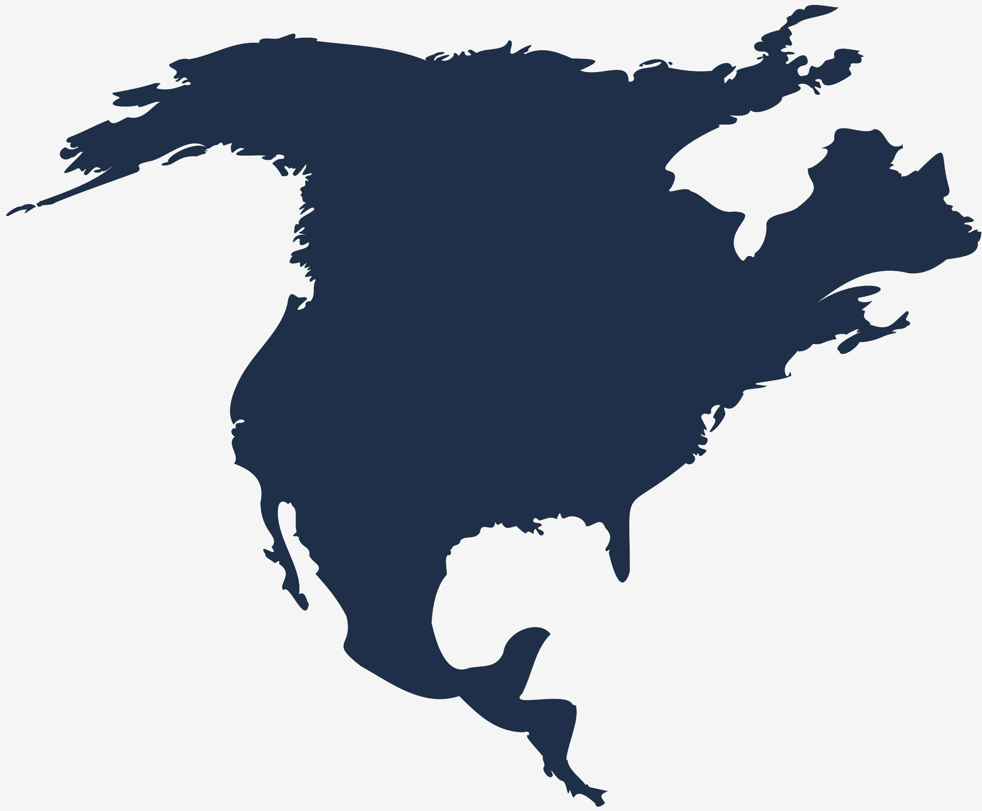
Global Deionized Water Market Revenue share for 2024
North America
40%

Slide 6
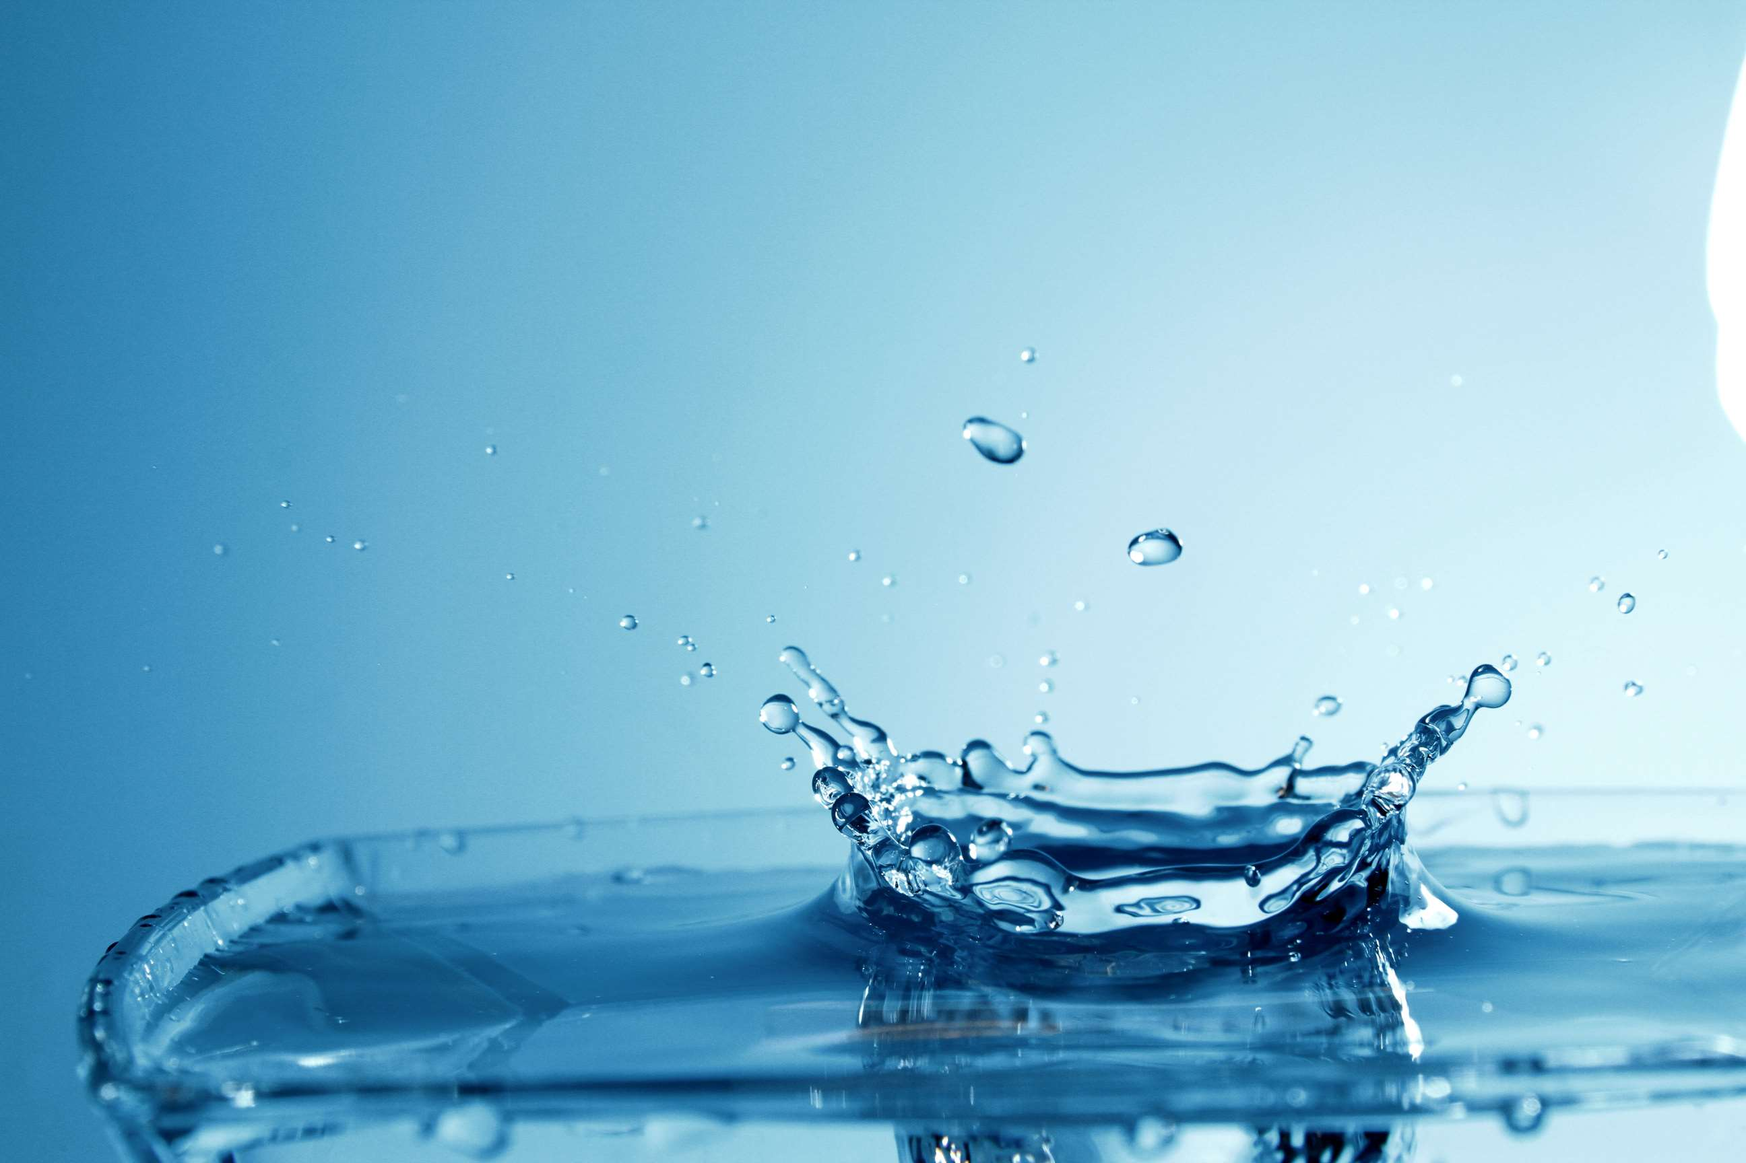
Stringent Regulations Driving Water Purity Standards to Propel Market Growth
Drivers
Environmental Impact of Deionization Processes to Restrict Market Growth
Restraints

Slide 7

AUTHOR'S PERSPECTIVE
  The Global Deionized Water Market is witnessing significant growth in the near future.
  Laboratories across industries such as healthcare, pharmaceuticals, and research heavily rely on CLRW for accurate and reproducible results in experiments, testing, and analytical processes.
  AAMI deionized water is essential for medical equipment and device manufacturing, ensuring the integrity and reliability of medical instruments.
  Deionized water plays a critical role in pharmaceutical manufacturing processes, where purity and quality are non-negotiable.

Slide 8
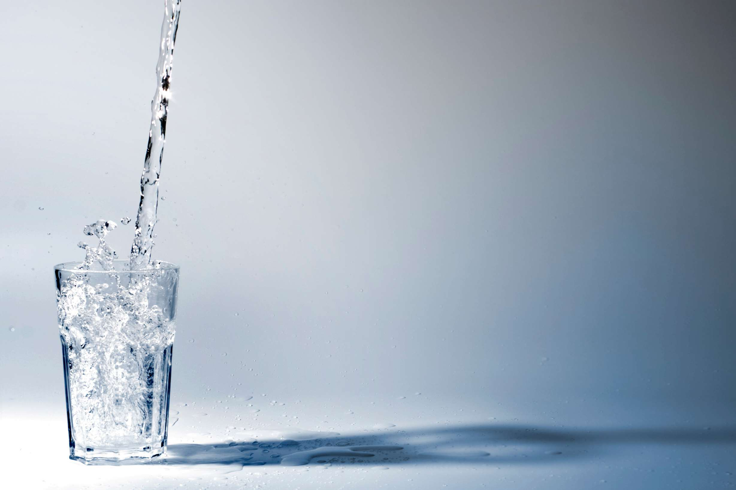
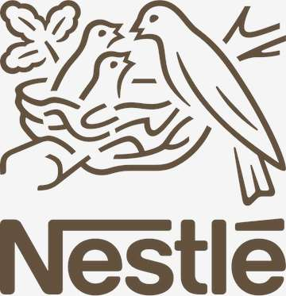
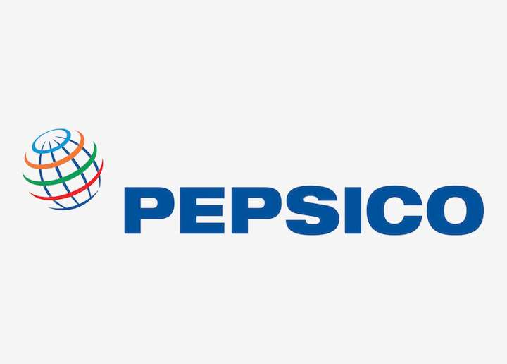


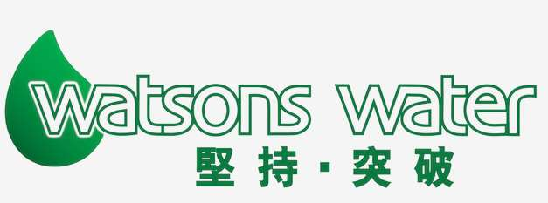

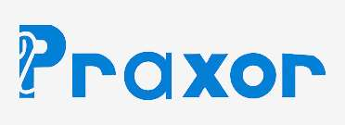

KEY PLAYERS

Slide 9


For Full Report
Contact us
COGNITIVE MARKET RESEARCH
Tel: +1 312-376-8303 | +44 020-8123-0732
India: (+91) 983-496-8611
sales@cognitivemarketresearch.com
Access the Full Report : https://tinyurl.com/mrxupa53
Please visit our website:
https://www.cognitivemarketresearch.com

