Slide 1

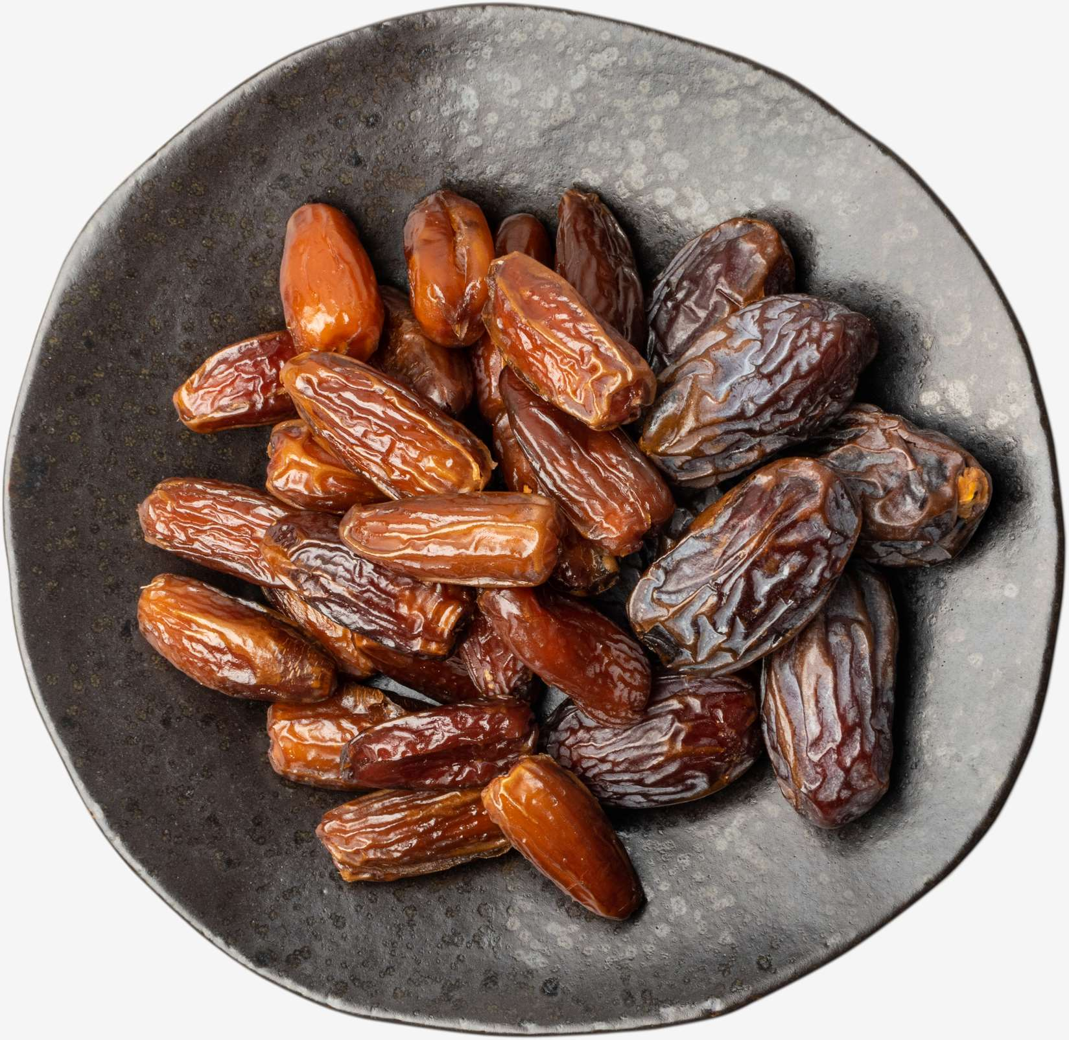
DATE PALM
MARKET REPORT
2024
Qualitative Analysis + Quantitative Analysis

Slide 2
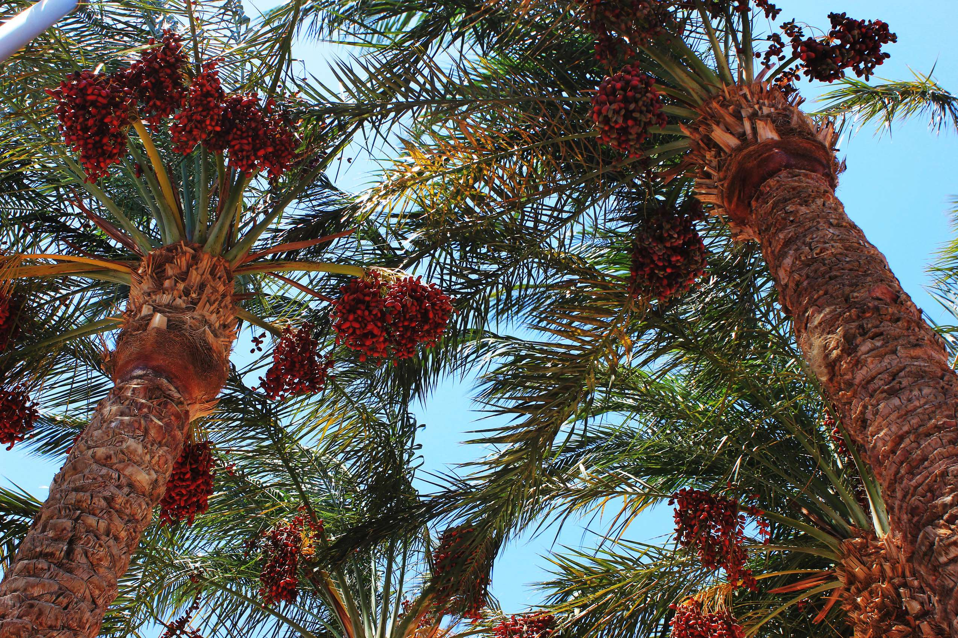
INTRODUCTION
The date palm (Phoenix dactylifera) is a flowering plant cultivated for its edible sweet fruits called dates. Believed to have originated in the Middle East, it thrives in arid climates and sandy soil. Valued for its fruit's nutritional richness and versatility, the date palm holds cultural and economic significance worldwide. The changes in climatic conditions, changes in consumer preferences, growth in population, increase in international trade, advances in cultivation practices and technology, changing economic conditions, growing awareness of the nutritional benefits of dates, changes in retail channels, rising competition from alternative fruits, government initiatives, and policies, management of diseases and pests, cultural and religious significance, increasing focus on sustainable agriculture and ongoing research & development are the major factors influencing the growth of the Date Palm Market.

Slide 3
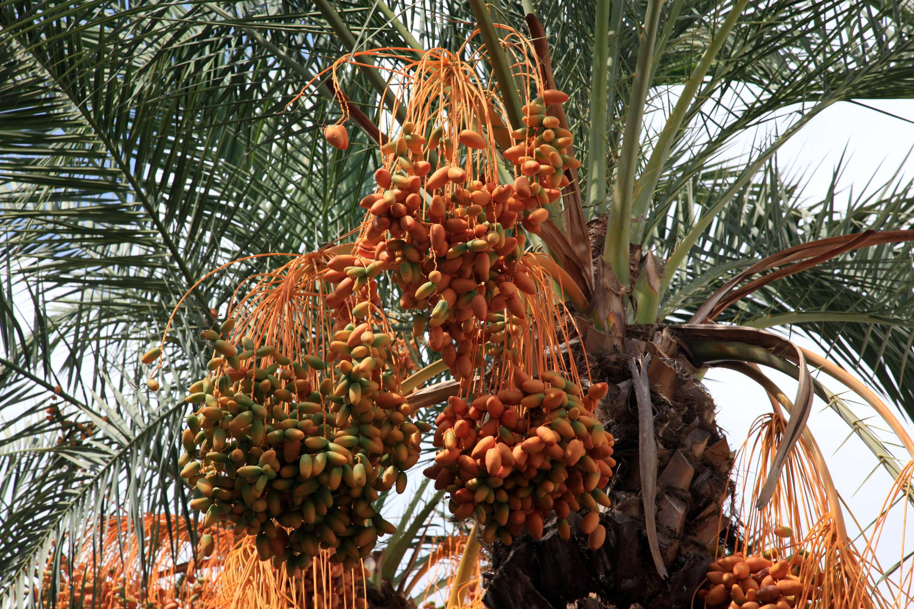

KEY INSIGHTS
MARKET SIZE
USD 11512.2 million
2024
CAGR
5.60%
2024- 2031

Slide 4
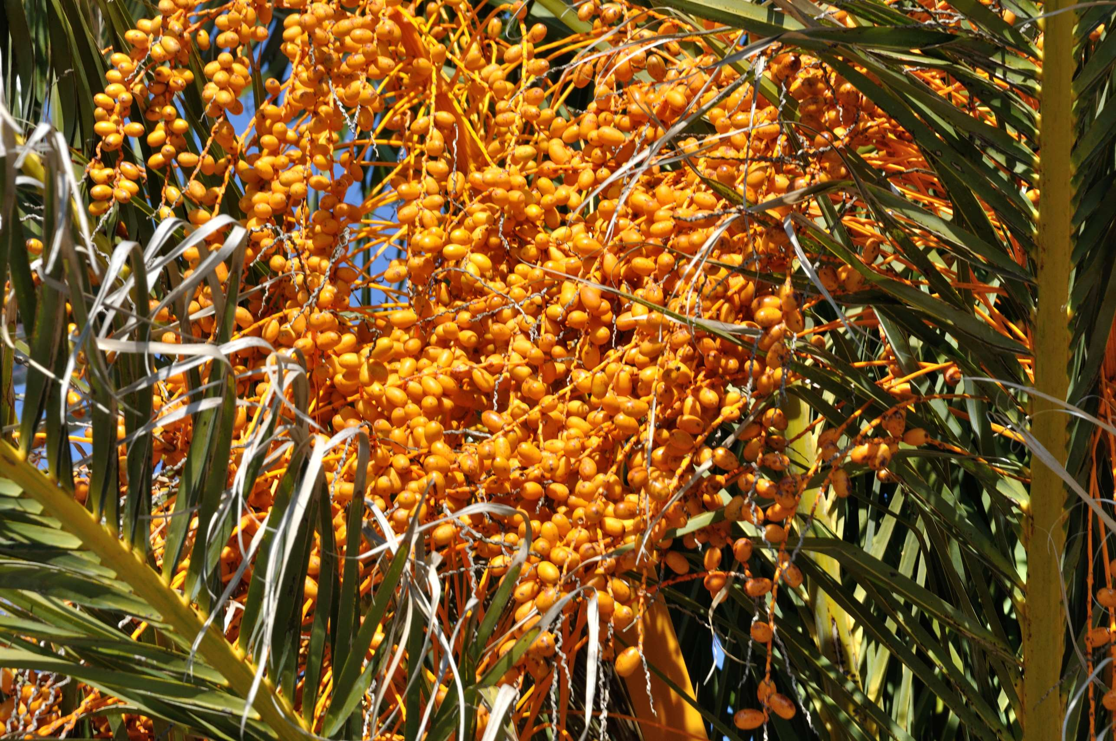
REVENUE MARKET SHARE BY SEGMENTS 2024
  Raw
  Processed
  Paste
  Dried
  Puree & Syrup
  Organic
  Conventional
Nature Segment
Form Segment
  Whole Date product
  Date Syrup
  Date Paste
  Deglet Noor
  Medjool
  Barhi
  Zahidi
Application Segment
Variety Segment

Slide 5


North America
40%
North America Date Palm Market Revenue share for 2024 is 40%

Slide 6
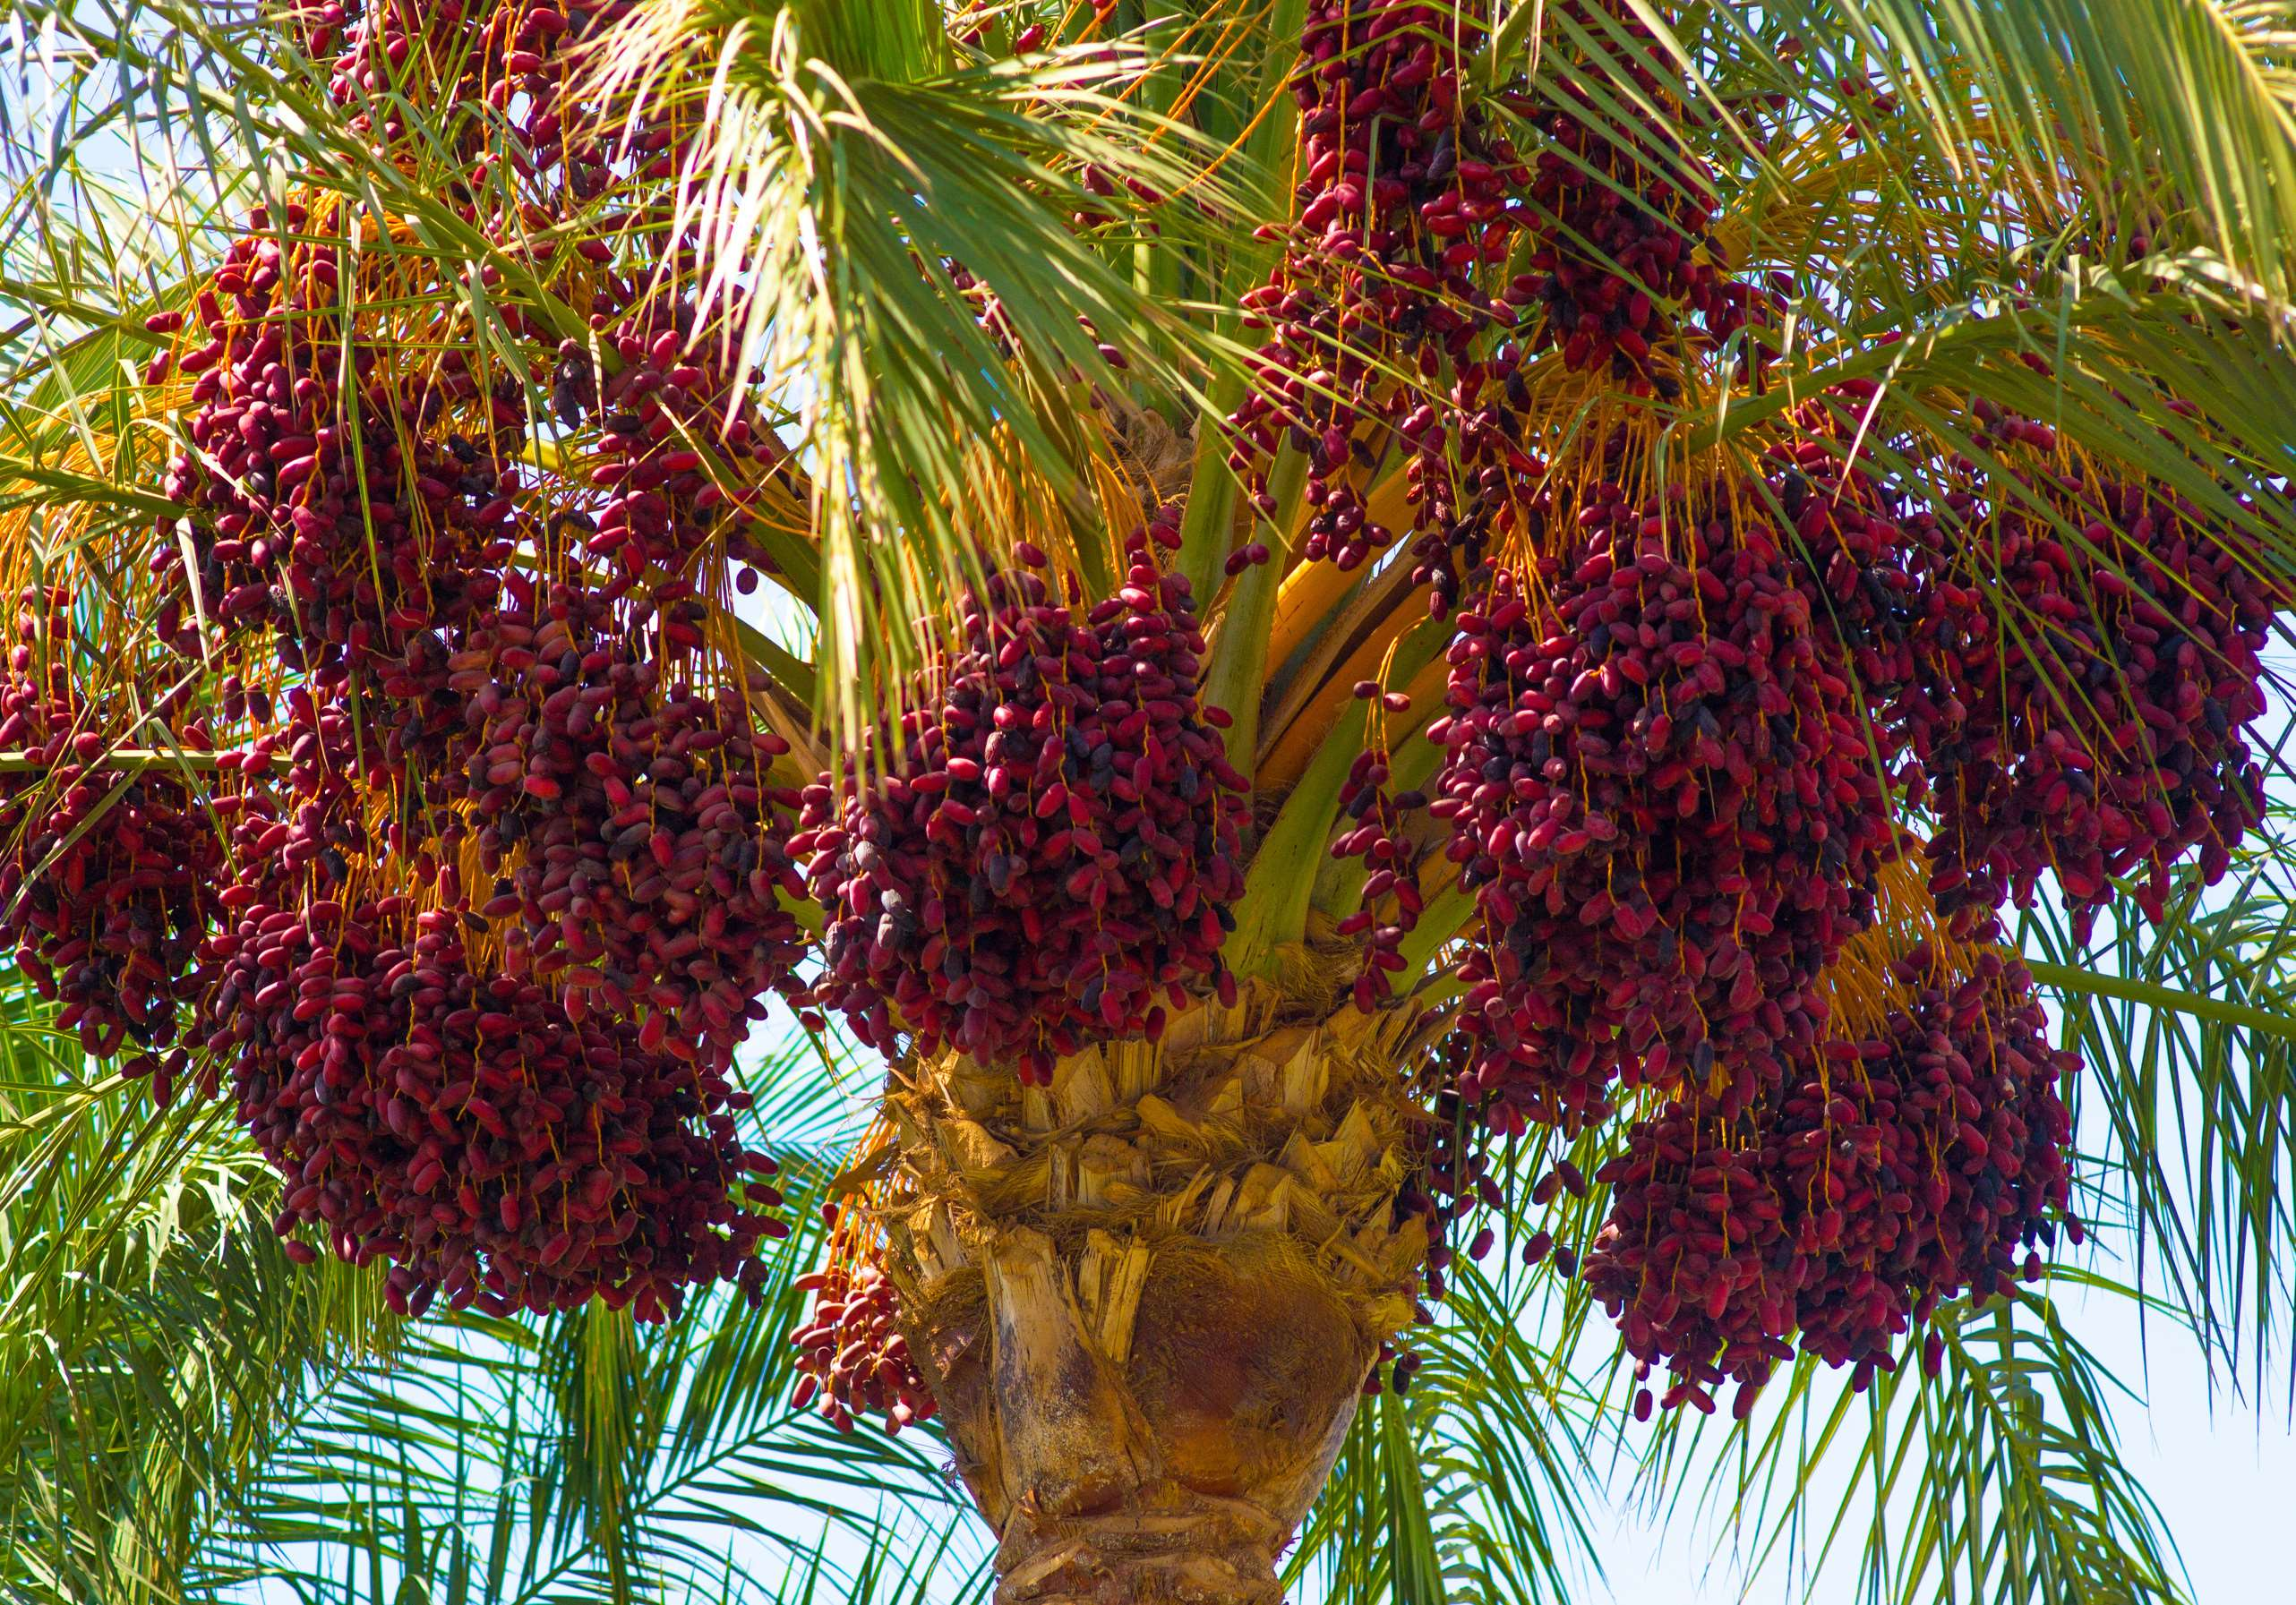
  Increase in International Trade to Provide Viable Market Output
  Increasing Demand for Organic Products Propels Market Growth
Drivers
Water Scarcity to Restrict Market Growth
Restraints

Slide 7
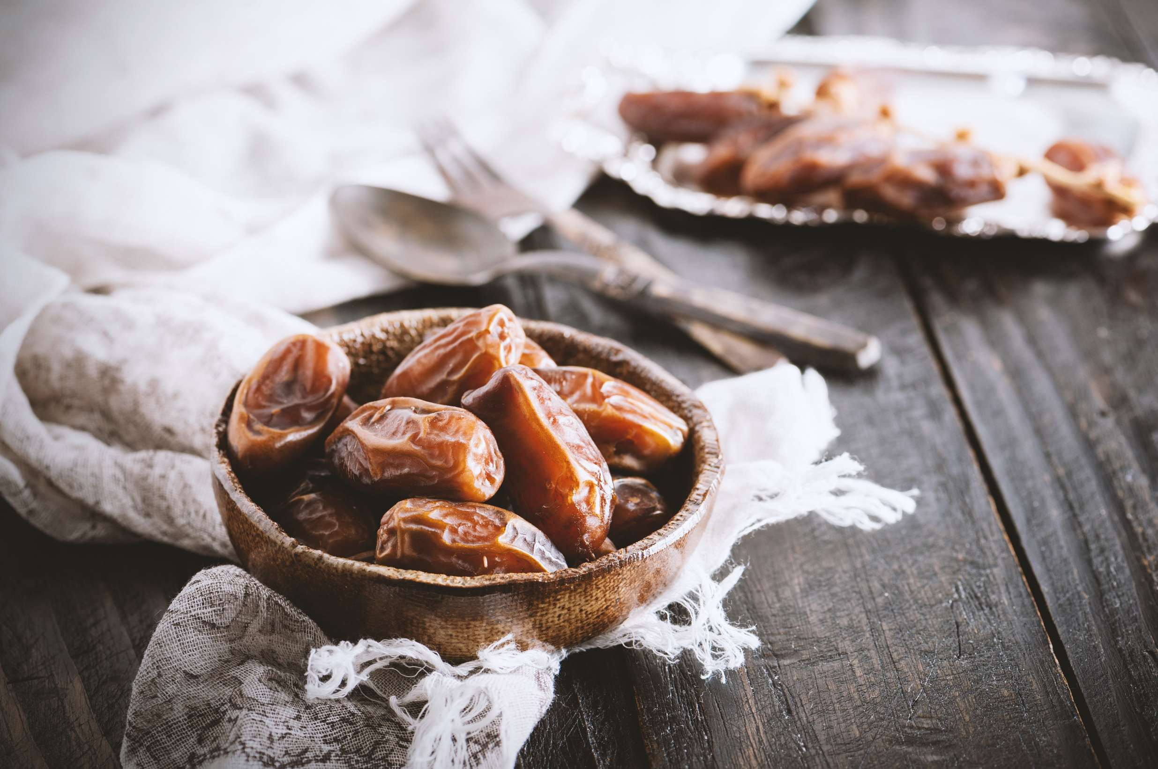
AUTHOR'S PERSPECTIVE
  The global Date Palm market will expand significantly by 5.60% CAGR between 2024 and 2031.
  Sales of the organic segment are set to rise as it emphasizes sustainability, soil health, and biodiversity conservation.
  The increasing adoption of renewable energy sources, the expansion of the electric vehicle market, and advancements in Date Palm technology are fueling market growth.

Slide 8











KEY PLAYERS

Slide 9


For Full Report
Contact us
COGNITIVE MARKET RESEARCH
Tel: +1 312-376-8303 | +44 020-8123-0732
India: (+91) 983-496-8611
sales@cognitivemarketresearch.com
Access the Full Report : https://tinyurl.com/ynk5rtr7
Please visit our website:
https://www.cognitivemarketresearch.com

