Slide 1

GLOBAL
DATE FRUIT
MARKET REPORT
2024
Global,Regional,CountryAnalysis

Slide 2
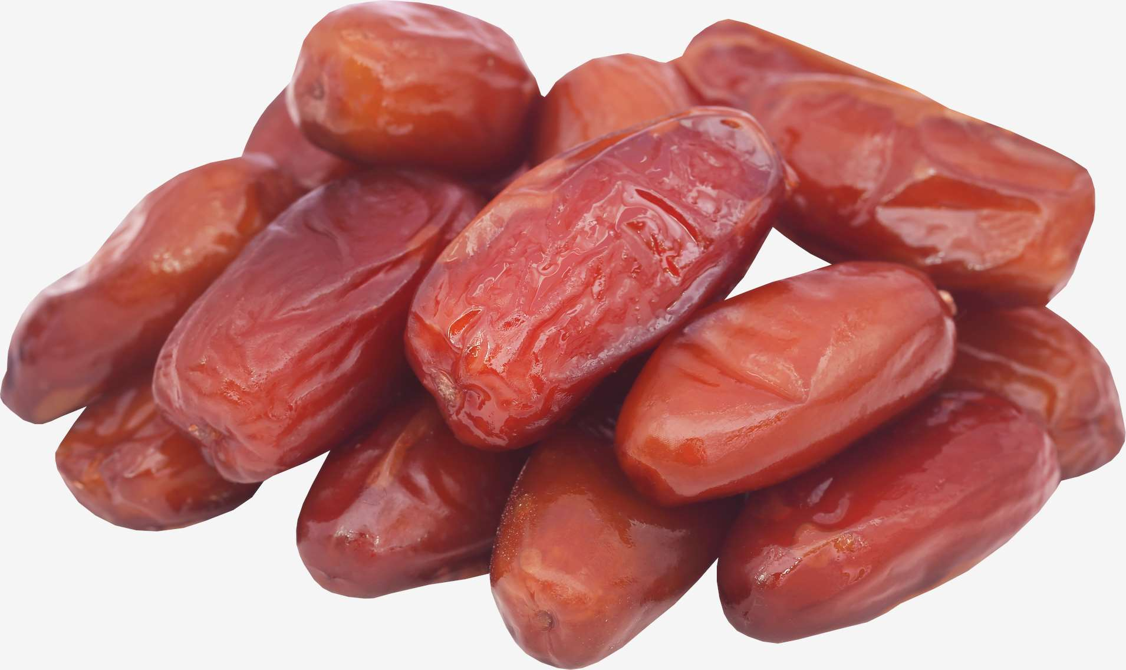
INTRODUCTION
Growing consumer knowledge of the many health benefits of dates, soaring demand in the food and beverage sector, and expanding imports and exports worldwide are some of the major factors driving the expansion of the global market. Other significant factors anticipated to drive date fruit market growth over the forecast period include growing demand among fitness-oriented consumers, rising use of date fruit as a quality ingredient in functional foods and nutritional bars, and rising demand for confectionery and bakery goods, particularly among younger consumers. Due to their numerous health benefits, date fruit market growth is anticipated to be further aided by the increasing use of dates in personal care products, such as body lotions, facial sheet masks, and moisturizing face creams.

Slide 3
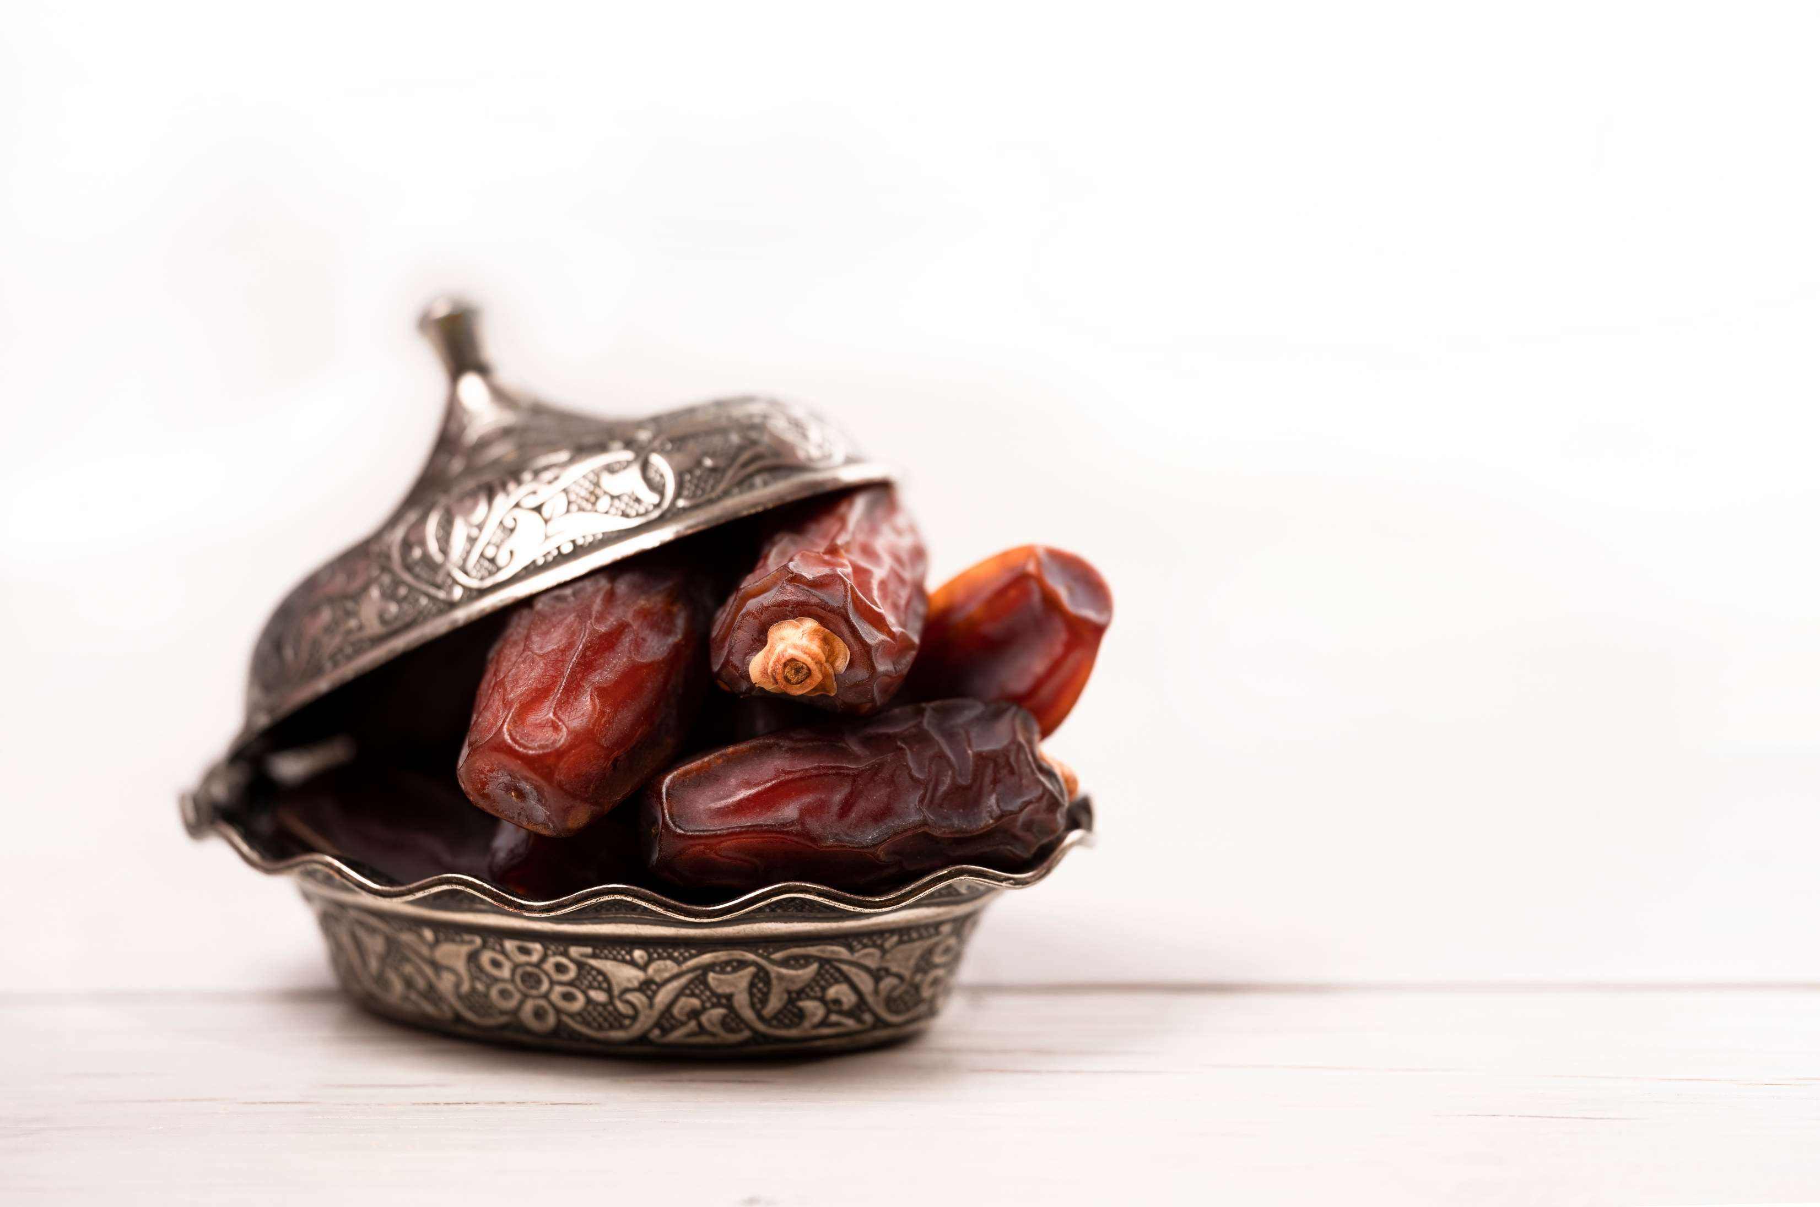

KEY INSIGHTS
MARKET SIZE
USD 14215.2 million
2024
CAGR
5.50%
2024- 2031

Slide 4
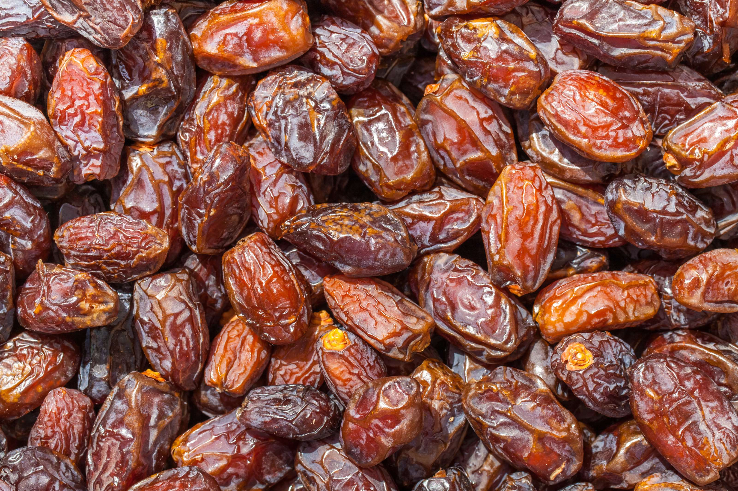
REVENUE MARKET SHARE BY SEGMENTS 2022
  Organic
  Conventional
Type Segment
  Raw
  Processed
  Dried
  Paste
  Purees
  Syrups
Form Segment
  Household
  Food & Beverages Industry
  Bakery & Desserts
  Confectionery
  Dietary Supplements
  Functional Food & Nutritional bar
End Use Segment

Slide 5

Global Date Fruit Market Revenue share for 2024
North America
40%

Slide 6
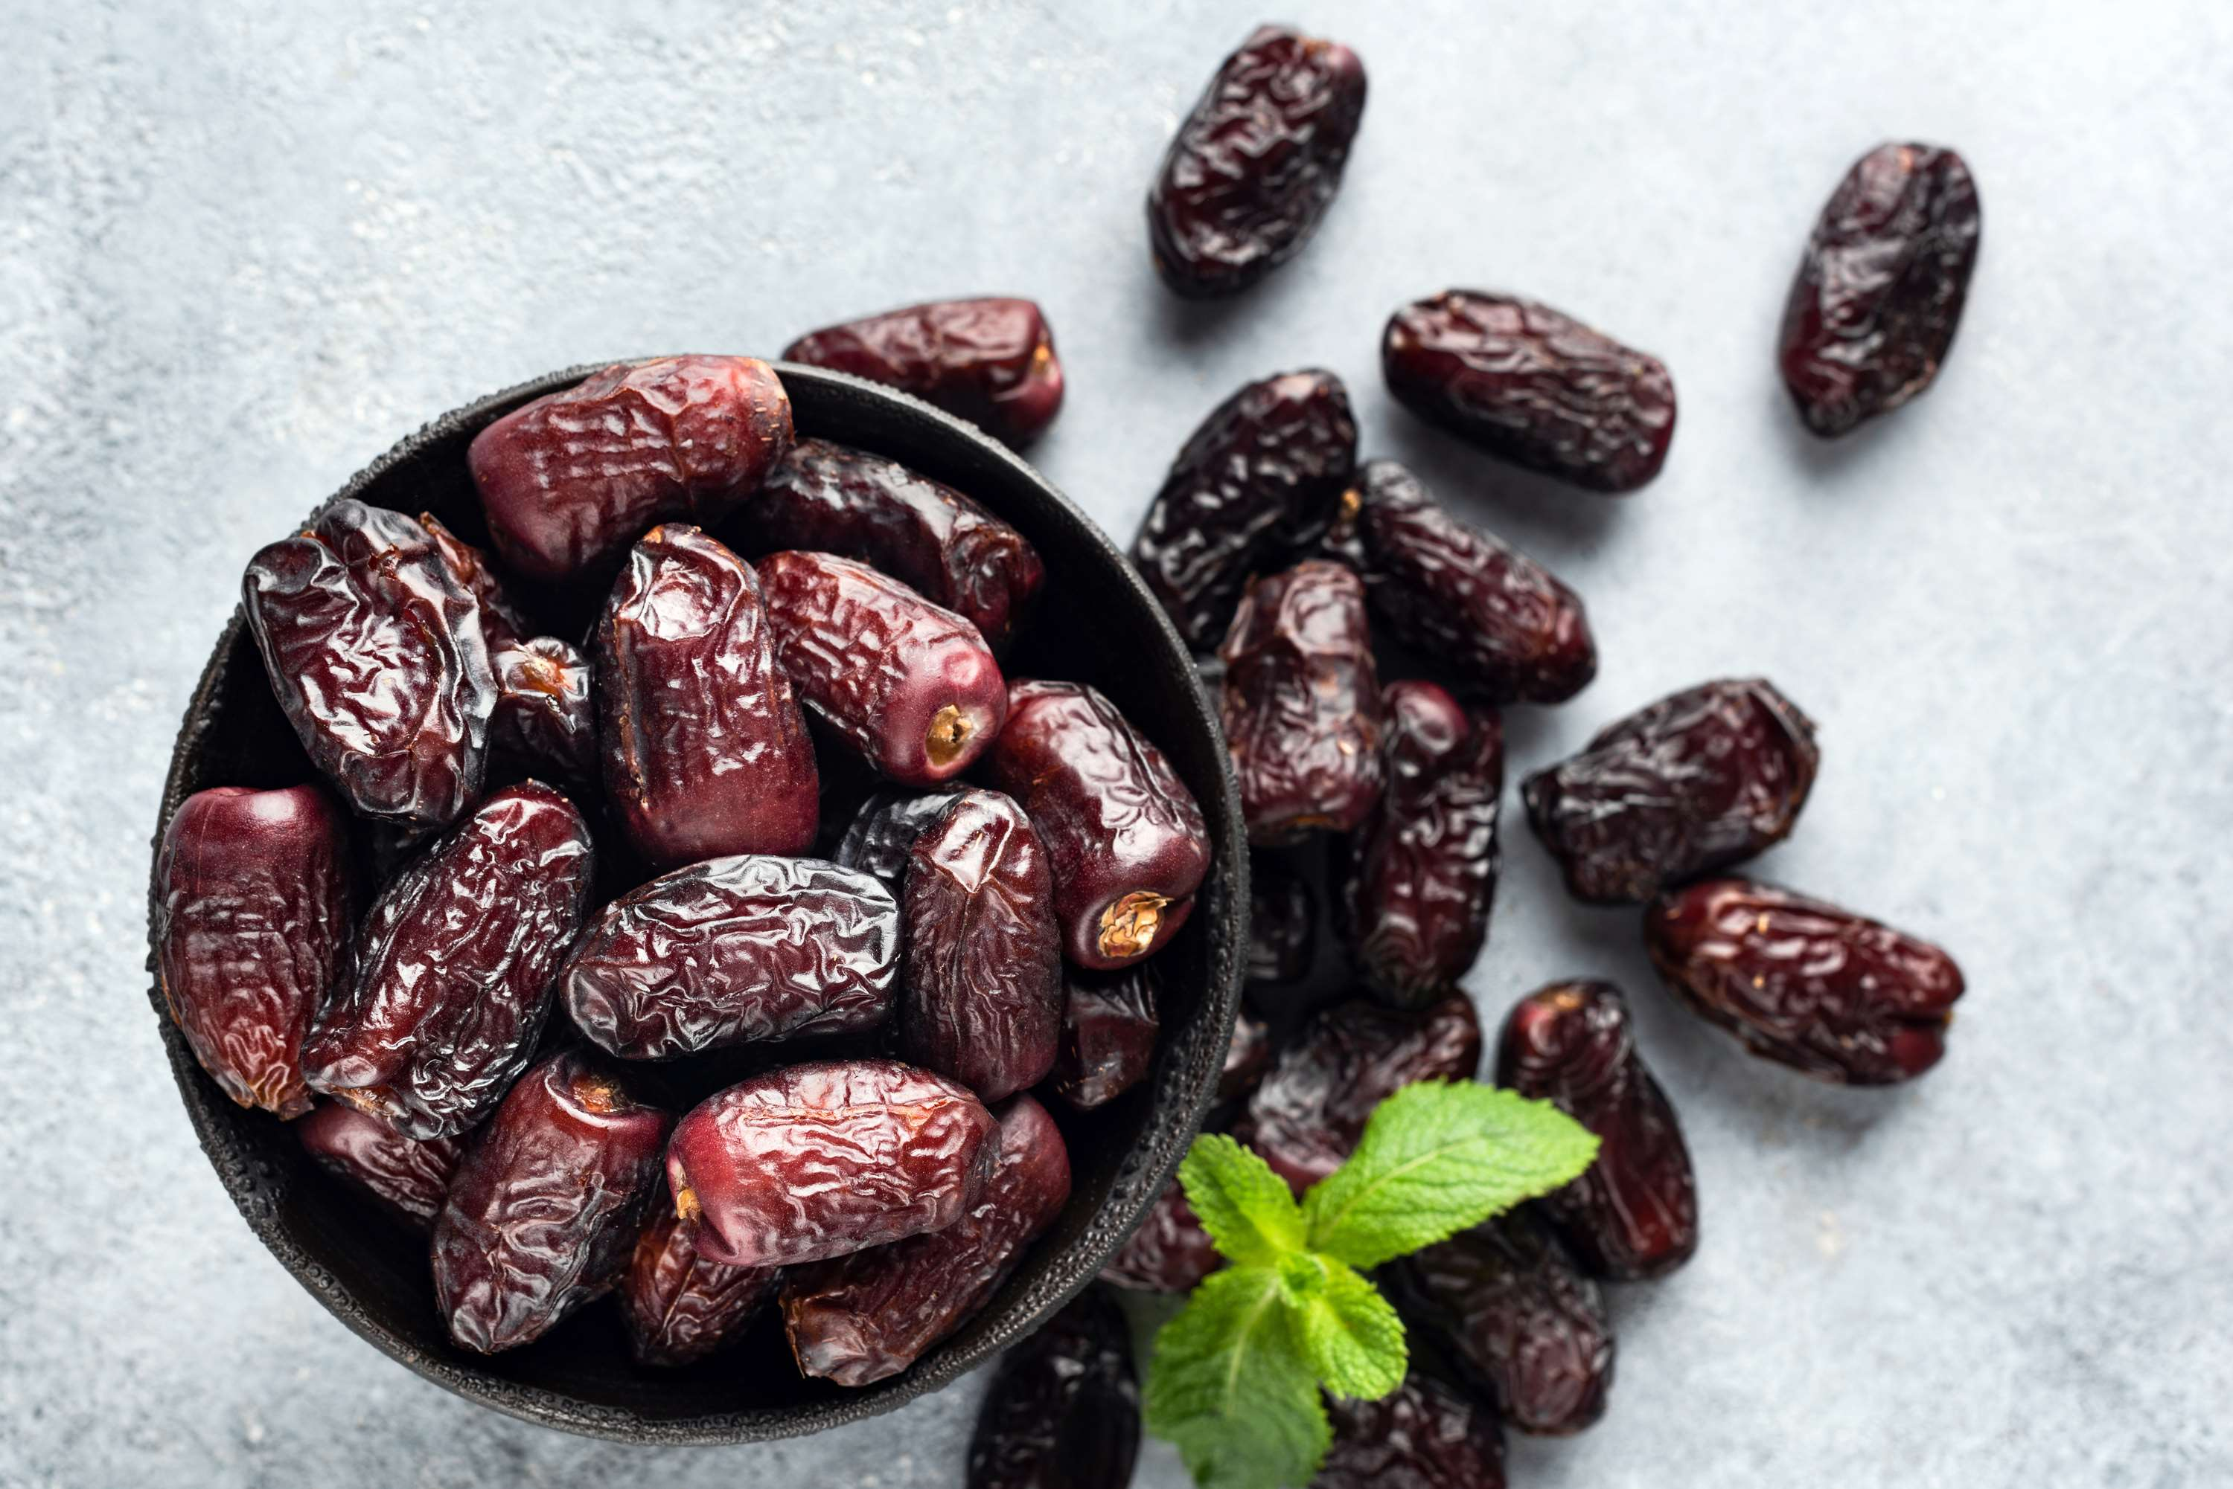
  Several Health Advantages of Eating Dates to Increase the Demand Globally
  Increasing Consumption of Nutritious Snacks to Propel Market Growth
Drivers
Severe Pest Infestation and Losses of Biodiversity to Limit the Sales
Restraints

Slide 7
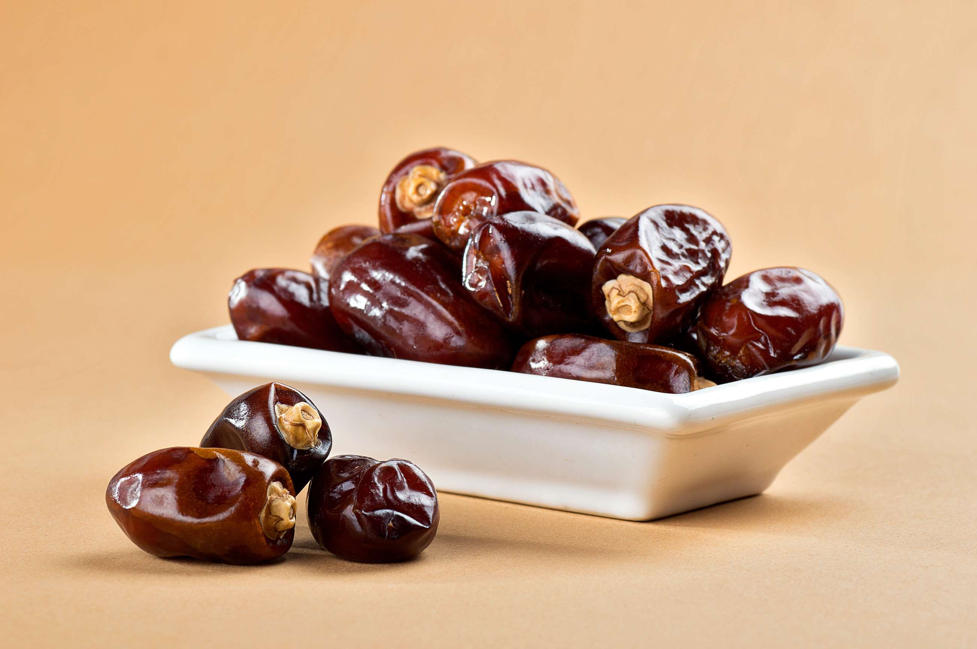
AUTHOR'S PERSPECTIVE
  The global date fruit market will expand significantly by 5.50% CAGR between 2024 to 2031.
  The sales in the conventional segment are set to rise because conventional farming methods have lower production costs, and conventional dates are typically more inexpensive than their organic counterparts.
  In addition to offering households a wholesome and adaptable food choice, the date fruit market also covers some areas' potential agriculture and cultural components, propelling sales in the household segment.

Slide 8
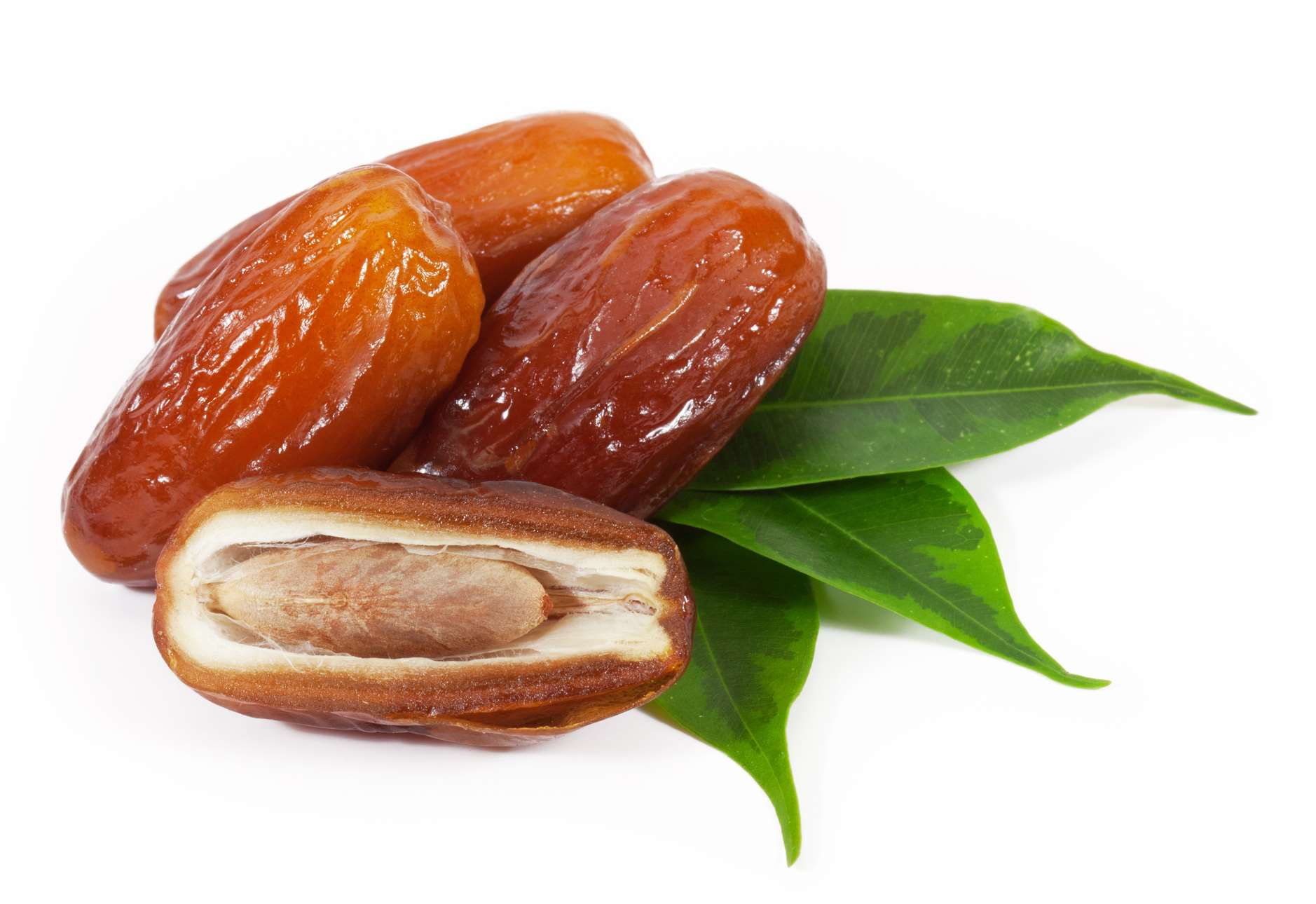








KEY PLAYERS

Slide 9


For Full Report
Contact us
COGNITIVE MARKET RESEARCH
Tel: +1 312-376-8303 | +44 020-8123-0732
India: (+91) 983-496-8611
sales@cognitivemarketresearch.com
Access the Full Report : https://tinyurl.com/33j9uxk8
Please visit our website:
https://www.cognitivemarketresearch.com

