Slide 1
DATA LOSS PREVENTION
MAR K E T R E P ORT

Slide 2
INTRODUCTION OF DATA LOSS PREVENTION?
Data loss prevention software is designed to detect and prevent data breaches by monitoring the data. Data loss Prevention software prevents the accidental loss or transfer of critical data of organization. It provides data security and protects data from data theft and cyber-attack.

Slide 3



MARKET SIZE (2022)
MARKET SIZE
11.9 BILLION
FORECAST (2030)
56.2 BILLION
CAGR (2023-2030)
56.2 BILLION

Slide 4
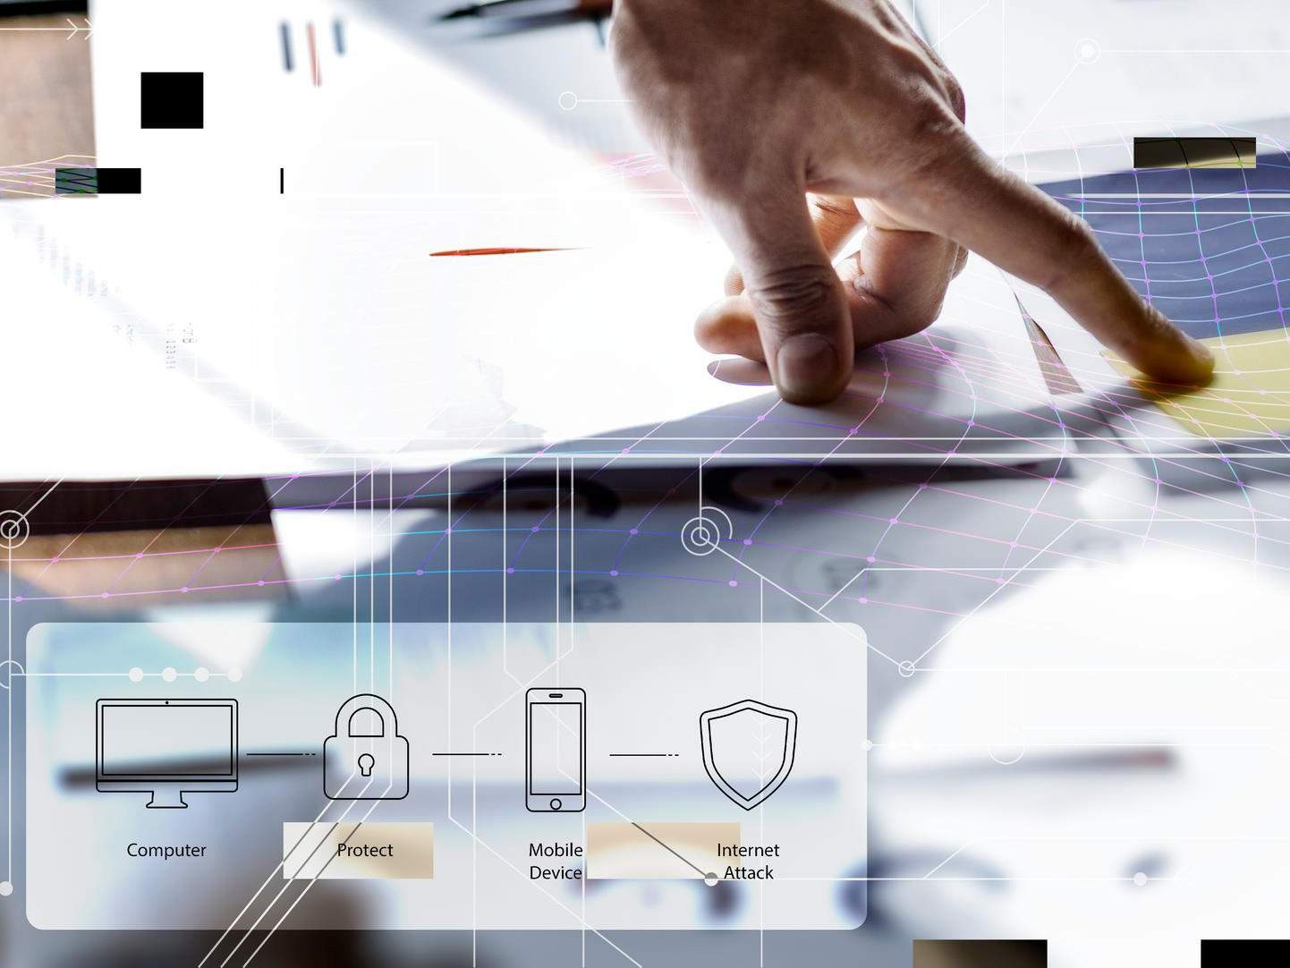






REVENUE MARKET SHARE BY SEGMENTS 2022
Type
Data Center DLP
45.3%%
Services
Managed Security Services
32.4%
Organization Size Large Enterprises 68.2%%
Deployment Type
Cloud Data Loss Protection
65.7%
Application Cloud Storage 36.2%
End Use Industry BFSI
24.3%

Slide 5

GLOBAL DATA LOSS PREVENTION MARKET REVENUE SHARE FOR 2022
North America 35.8%
North America is expected to be the largest market in terms of revenue because of large adoption of big data and cloud technologies while Asia-Pacific is estimated to be highest growing region.

Slide 6

Restraints
Drivers
Lack of awareness of full solution adoption Deployment challenges related to access, scalability, encryption, and integration.
Rising data breaches and cyber- attacks across the globe
Increased data importance and
vulnerability

Slide 7
Author's Perspective
The cloud storage segment is estimated to dominate the global market, due to helps an organization's sensitive or serious information safe from cyber-attacks, insider threats and accidental exposure.
The BFSI segment is expected to dominate in terms of revenue contribution to the global market. This growth is attributed to keep data safe, prevent it from leaks, loss, and theft and reach compliance with different data privacy laws.
The small and medium-sized enterprises segment is expected to register highest CAGR in the global market, due to need to improve operational productivity and maximize profits and to compete with large organizations.
The cloud data loss protection segment is expected to dominate in the global market, due to perceived benefits such as scalability and growing penetration of smart mobile devices.

Slide 8
KEY PLAYERS

Slide 9


Contact us
For Full Report
COGNITIVE MARKET RESEARCH
Tel: + 1 312 - 376 - 8303 | + 44 020 - 8123 - 0732
India: ( + 91 ) 983 - 496 - 8611
sales@ cognitivemarketresearch. com
Access the Full Report : http://tinyurl.com/4n7zmekt
Please visit our website:
https://www.cognitivemarketresearch.com

