Slide 1

GLOBAL
CUSTOM PACKAGING
MARKET REPORT
2024
Global,Regional,CountryAnalysis

Slide 2

INTRODUCTION
Custom packaging refers to products or items created specifically for clients. A custom-packaged product fits the package according to demand, reducing the requirement for extra packing material. This packaging option also enhances client experience, which boosts a company's brand image and market value. This sort of packaging meets the demands of the client for safety while also playing an important part in branding. This industry is rapidly expanding because of various advantages, including improved product protection, an eco-friendly alternative to traditional packaging, and a good option for subscription products. During the projected period, the growing trend of sustainability would provide profitable chances for the custom packaging market growth.

Slide 3


KEY INSIGHTS
MARKET SIZE
USD 41.98 billion
2022
CAGR
5.60%
2022- 2030

Slide 4

REVENUE MARKET SHARE BY SEGMENTS 2022
  Boxes
  Bottles
  Containers & Jars
  Bags & Pouches
  Corks
  Cartons
  Mailers
Packaging Type
  Paper & Paperboard
  Plastic
  Metal
  Glass
Custom Packaging
  Food & Beverages
  Electrical & Electronics
  Healthcare
  Personal Care & Cosmetics
  Consumer Goods
  Fashion Accessories & Apparel
End User Segment

Slide 5

Global Custom Packaging Market Revenue share for 2024
North America

Slide 6

Increasing Focus on Product Safety and Brand Identity Drives Market Growth
Drivers
High Initial Costs and Additional Requirements are Impeding Market Growth
Restraints

Slide 7

AUTHOR'S PERSPECTIVE
  The Global Custom Packaging Market is witnessing significant growth in the near future.
  Customized boxes can capture the consumer's attention and help the product stand out from the crowd.
  Containers and jars are commonly used to package a wide range of items, including cosmetics, skincare, food, and drinks.
  Custom packaging increases brand awareness and food and beverage sales, resulting in the segment's rapid expansion.
  Custom packaging enables firms to exhibit their products in distinctive and eye-catching ways, while also providing consumers with safety and convenience.

Slide 8



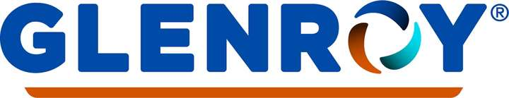




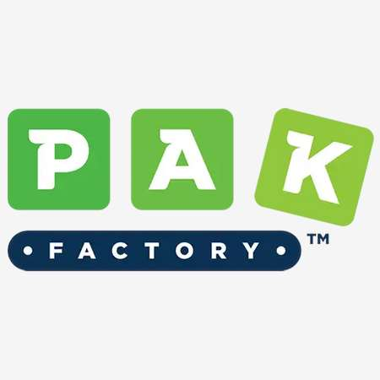

KEY PLAYERS

Slide 9


For Full Report
Contact us
COGNITIVE MARKET RESEARCH
Tel: +1 312-376-8303 | +44 020-8123-0732
India: (+91) 983-496-8611
sales@cognitivemarketresearch.com
Access the Full Report : https://tinyurl.com/2cew6dfr
Please visit our website:
https://www.cognitivemarketresearch.com

