Slide 1

GLOBAL CRICKET BALLS MARKET REPORT 2024
Global,Regional,CountryAnalysis

Slide 2
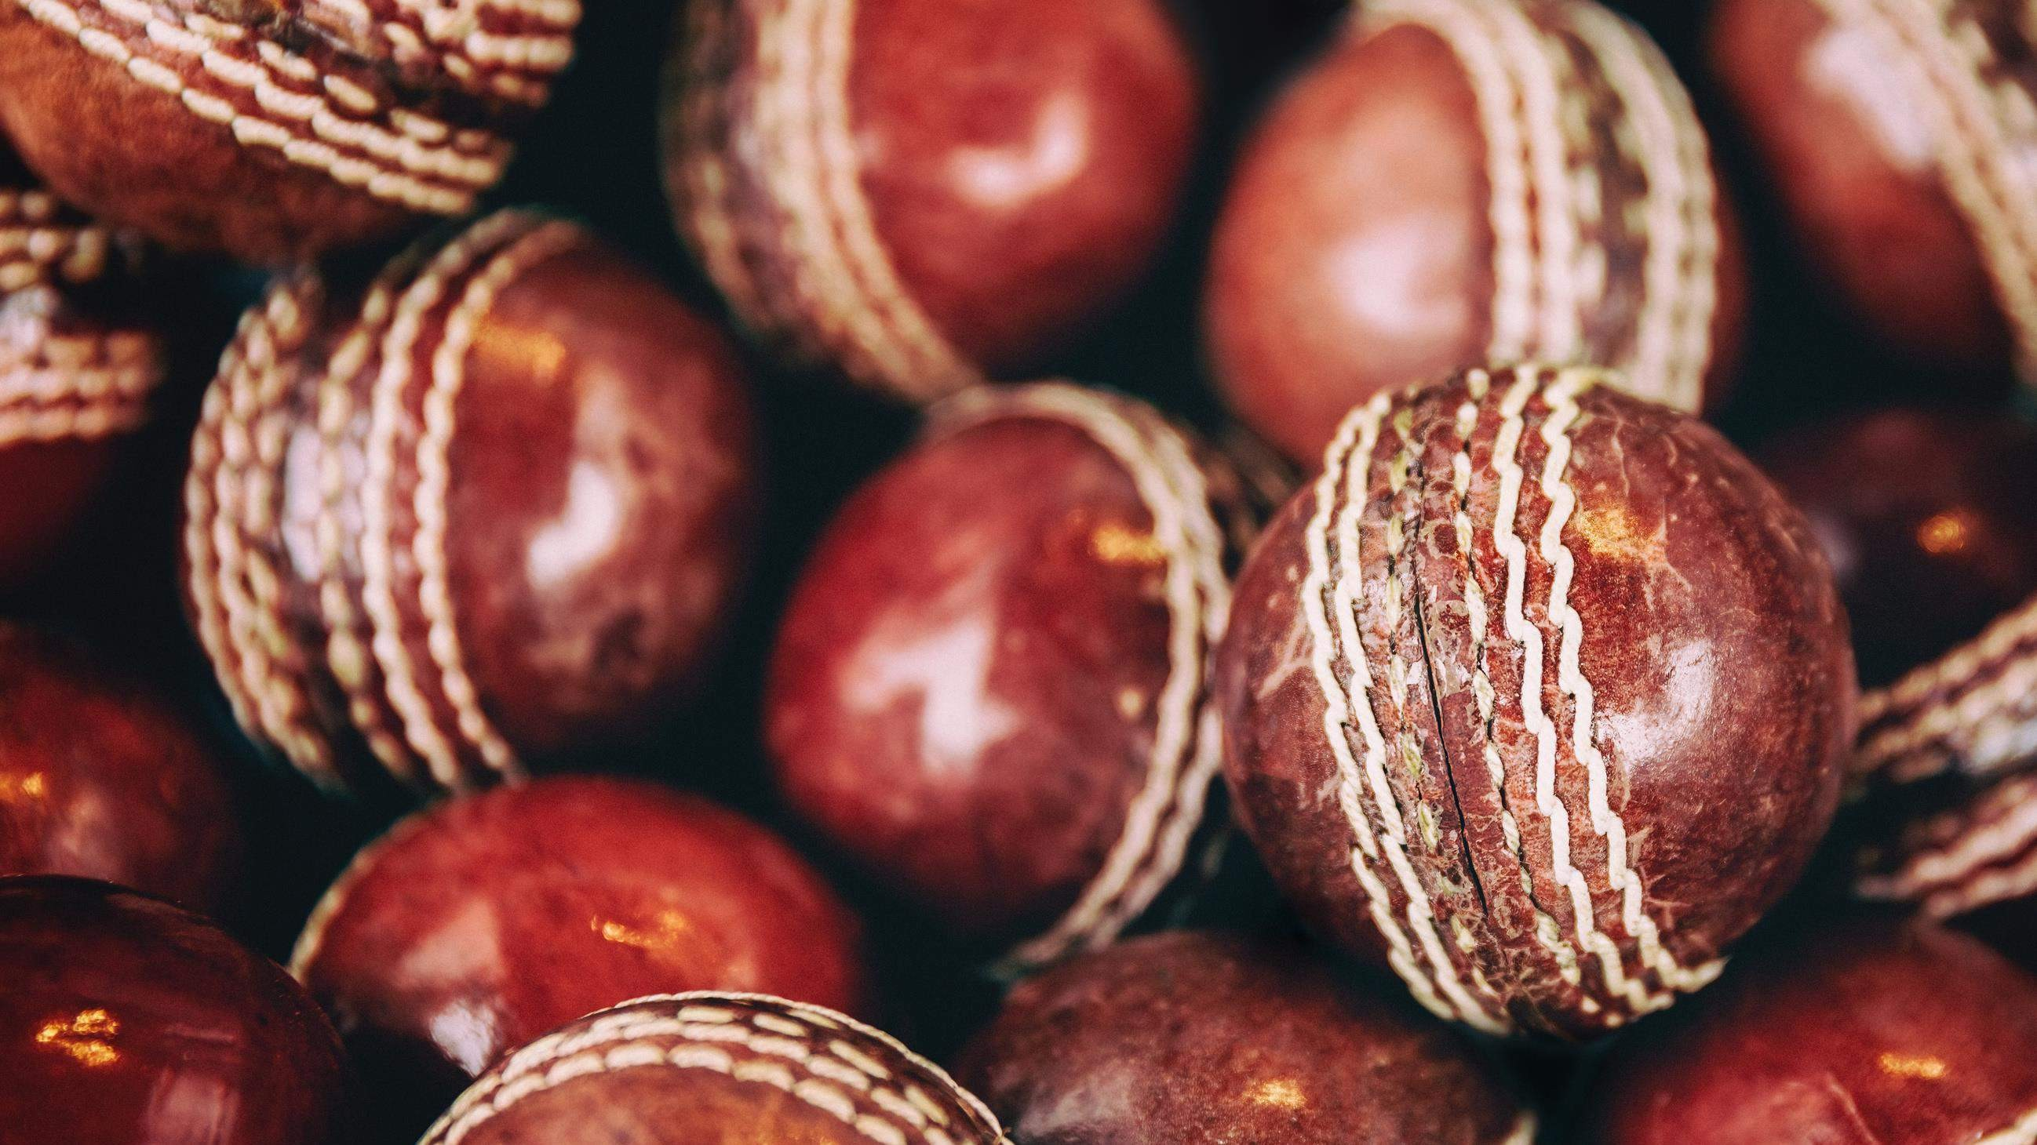
INTRODUCTION
A cricket ball is a spherical solid body ball used to play cricket. This ball is made of several material such as plastic rubber and many other. This ball consists of cork which has layered with tightly wound string and covered by the leather case. This ball comes in different colors, generally in white, red and pink. Market growth is fueled by increasing number of young participant, surging number of female cricketer and government initiatives for cricket. These strategies help key players capture a significant market share and remain competitive in the dynamic Cricket Balls market.

Slide 3
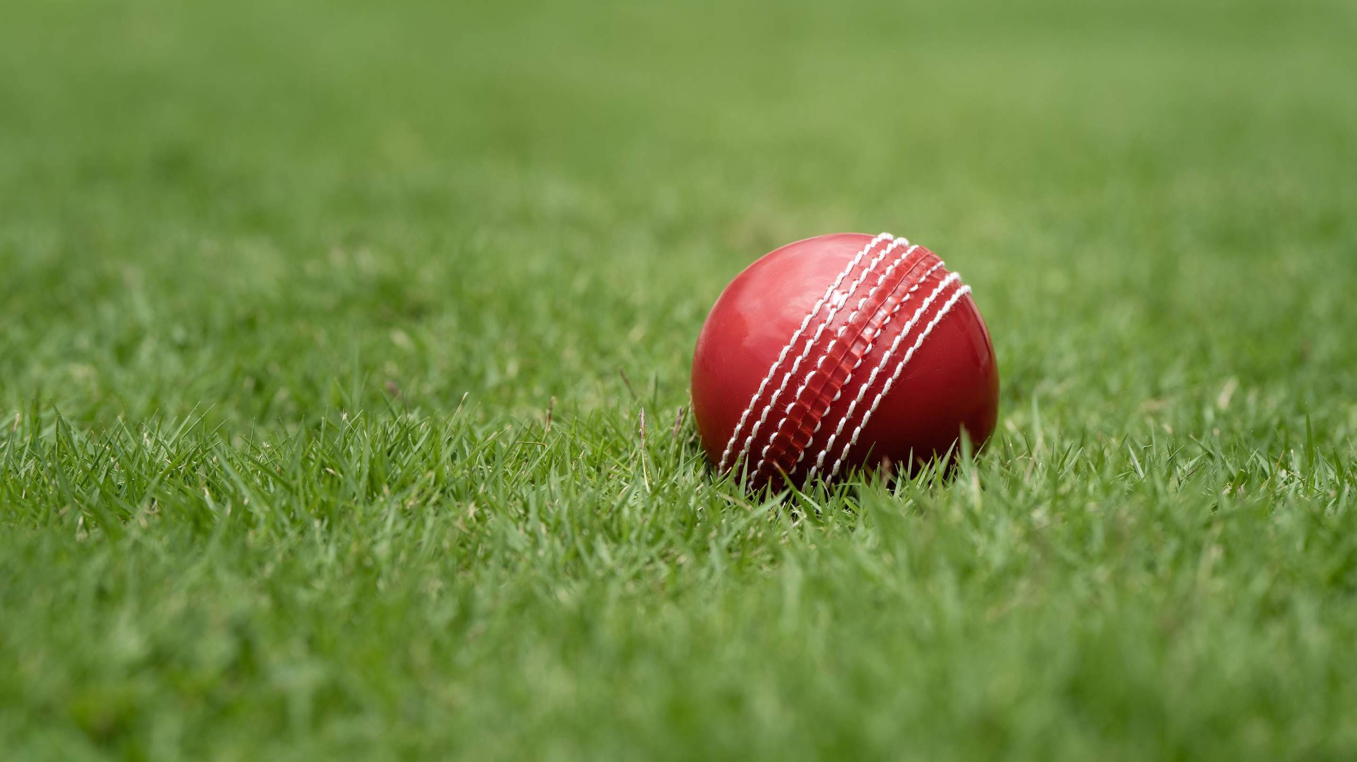

KEY INSIGHTS
MARKET SIZE
USD 255.2 million
2024
CAGR 5.80%
2024
-
2031

Slide 4
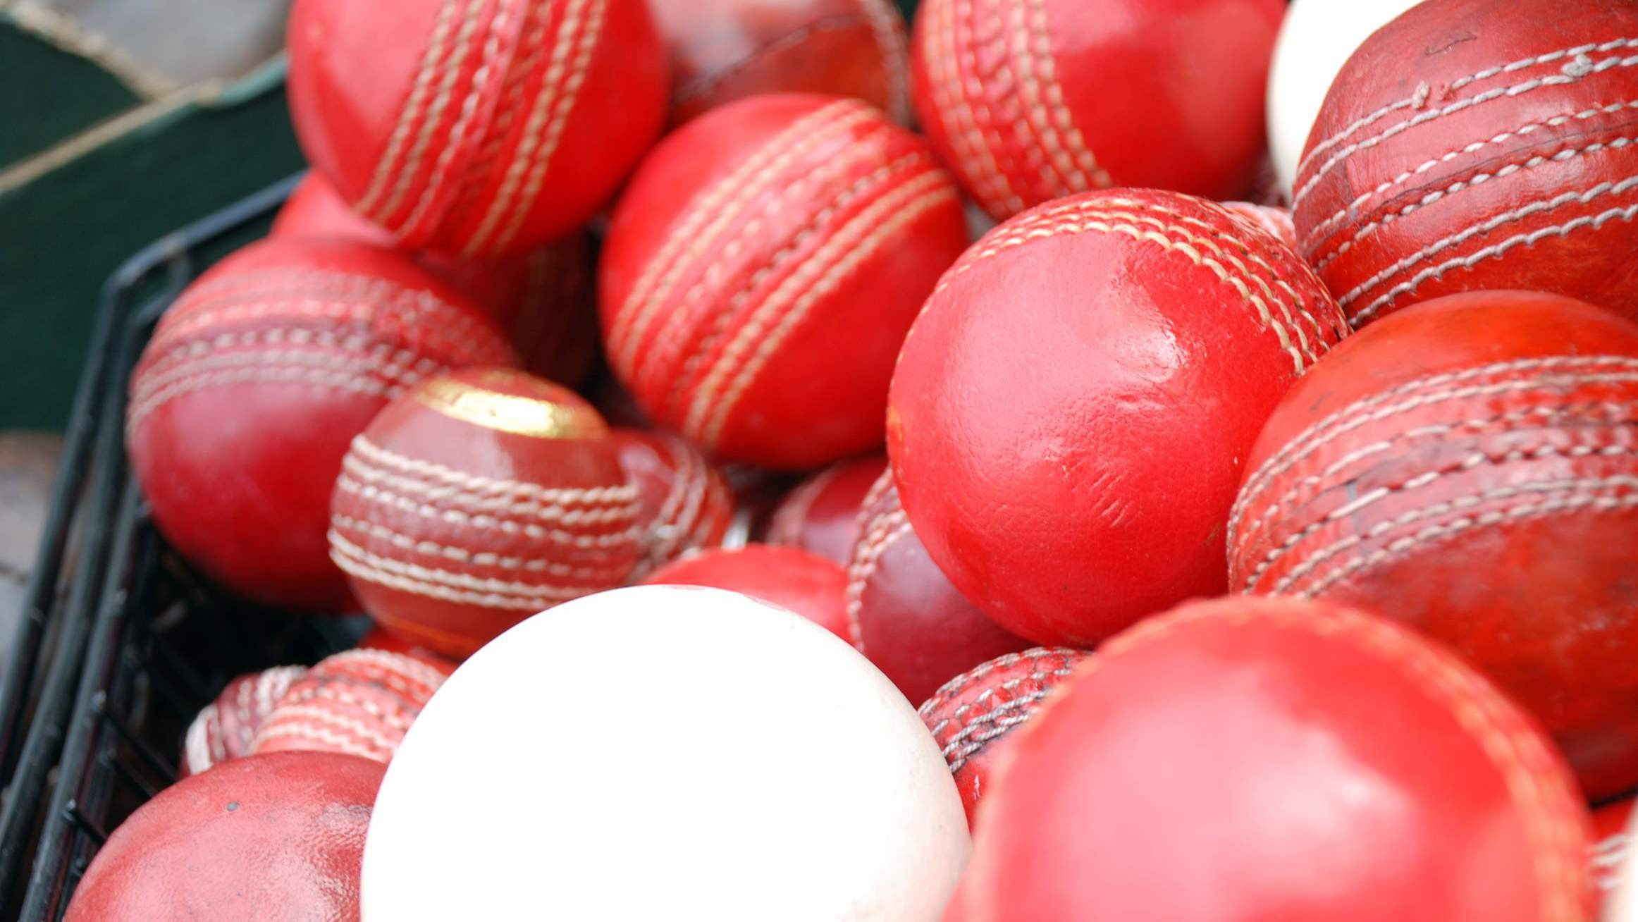
REVENUE MARKET SHARE BY SEGMENTS 2022
Online Channel
Offline channel
Distribution channel

Slide 5

Global Cricket Balls Market Revenue share for 2024
North America 30%

Slide 6
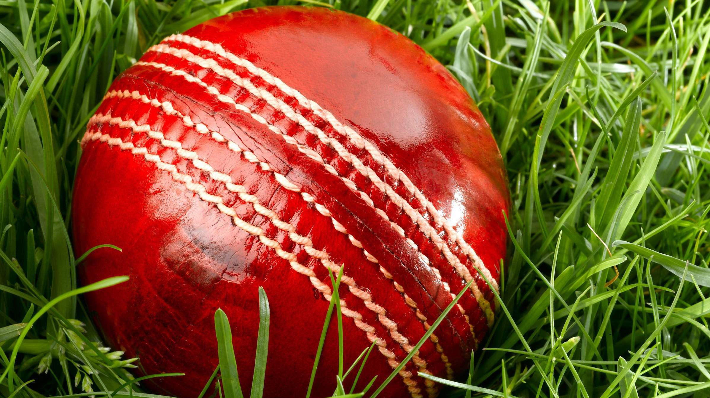


Technological Advancements in Cricket Ball Manufacturing to Propel Market Growth
Challenges in Cricket Balls Market Amidst Quality Concerns to Restrict Market Growth

Slide 7

AUTHOR'S PERSPECTIVE
The global Cricket Balls market will expand significantly by 5.80% CAGR between 2023 and 2030.
Plastic balls are known for their lightweight nature, affordability, and suitability for casual cricket enthusiasts.
As cricket programs for kids gain momentum, parents and schools are investing in cricket equipment, including balls designed specifically for young players.
Physical sports equipment stores, specialty cricket shops, and sporting goods retailers play a crucial role in providing customers the opportunity to assess the quality, feel, and specifications of cricket balls in person.
The demand for Cricket Balls is rising due to the increasing number of young participant, surging number of female cricketer.
Demand for rubber remains higher in the Cricket Balls market.

Slide 8

KEY PLAYERS

Slide 9


Contact us
For Full Report
COGNITIVE MARKET RESEARCH
Tel: + 1 312 - 376 - 8303 | + 44 020 - 8123 - 0732
India: ( + 91 ) 983 - 496 - 8611
sales@ cognitivemarketresearch. com
Access the Full Report : http://tinyurl.com/mw32ewz2
Please visit our website:
https://www.cognitivemarketresearch.com

