Slide 1

GLOBAL
CRAYFISH
MARKET REPORT
2024
Global,Regional,CountryAnalysis

Slide 2
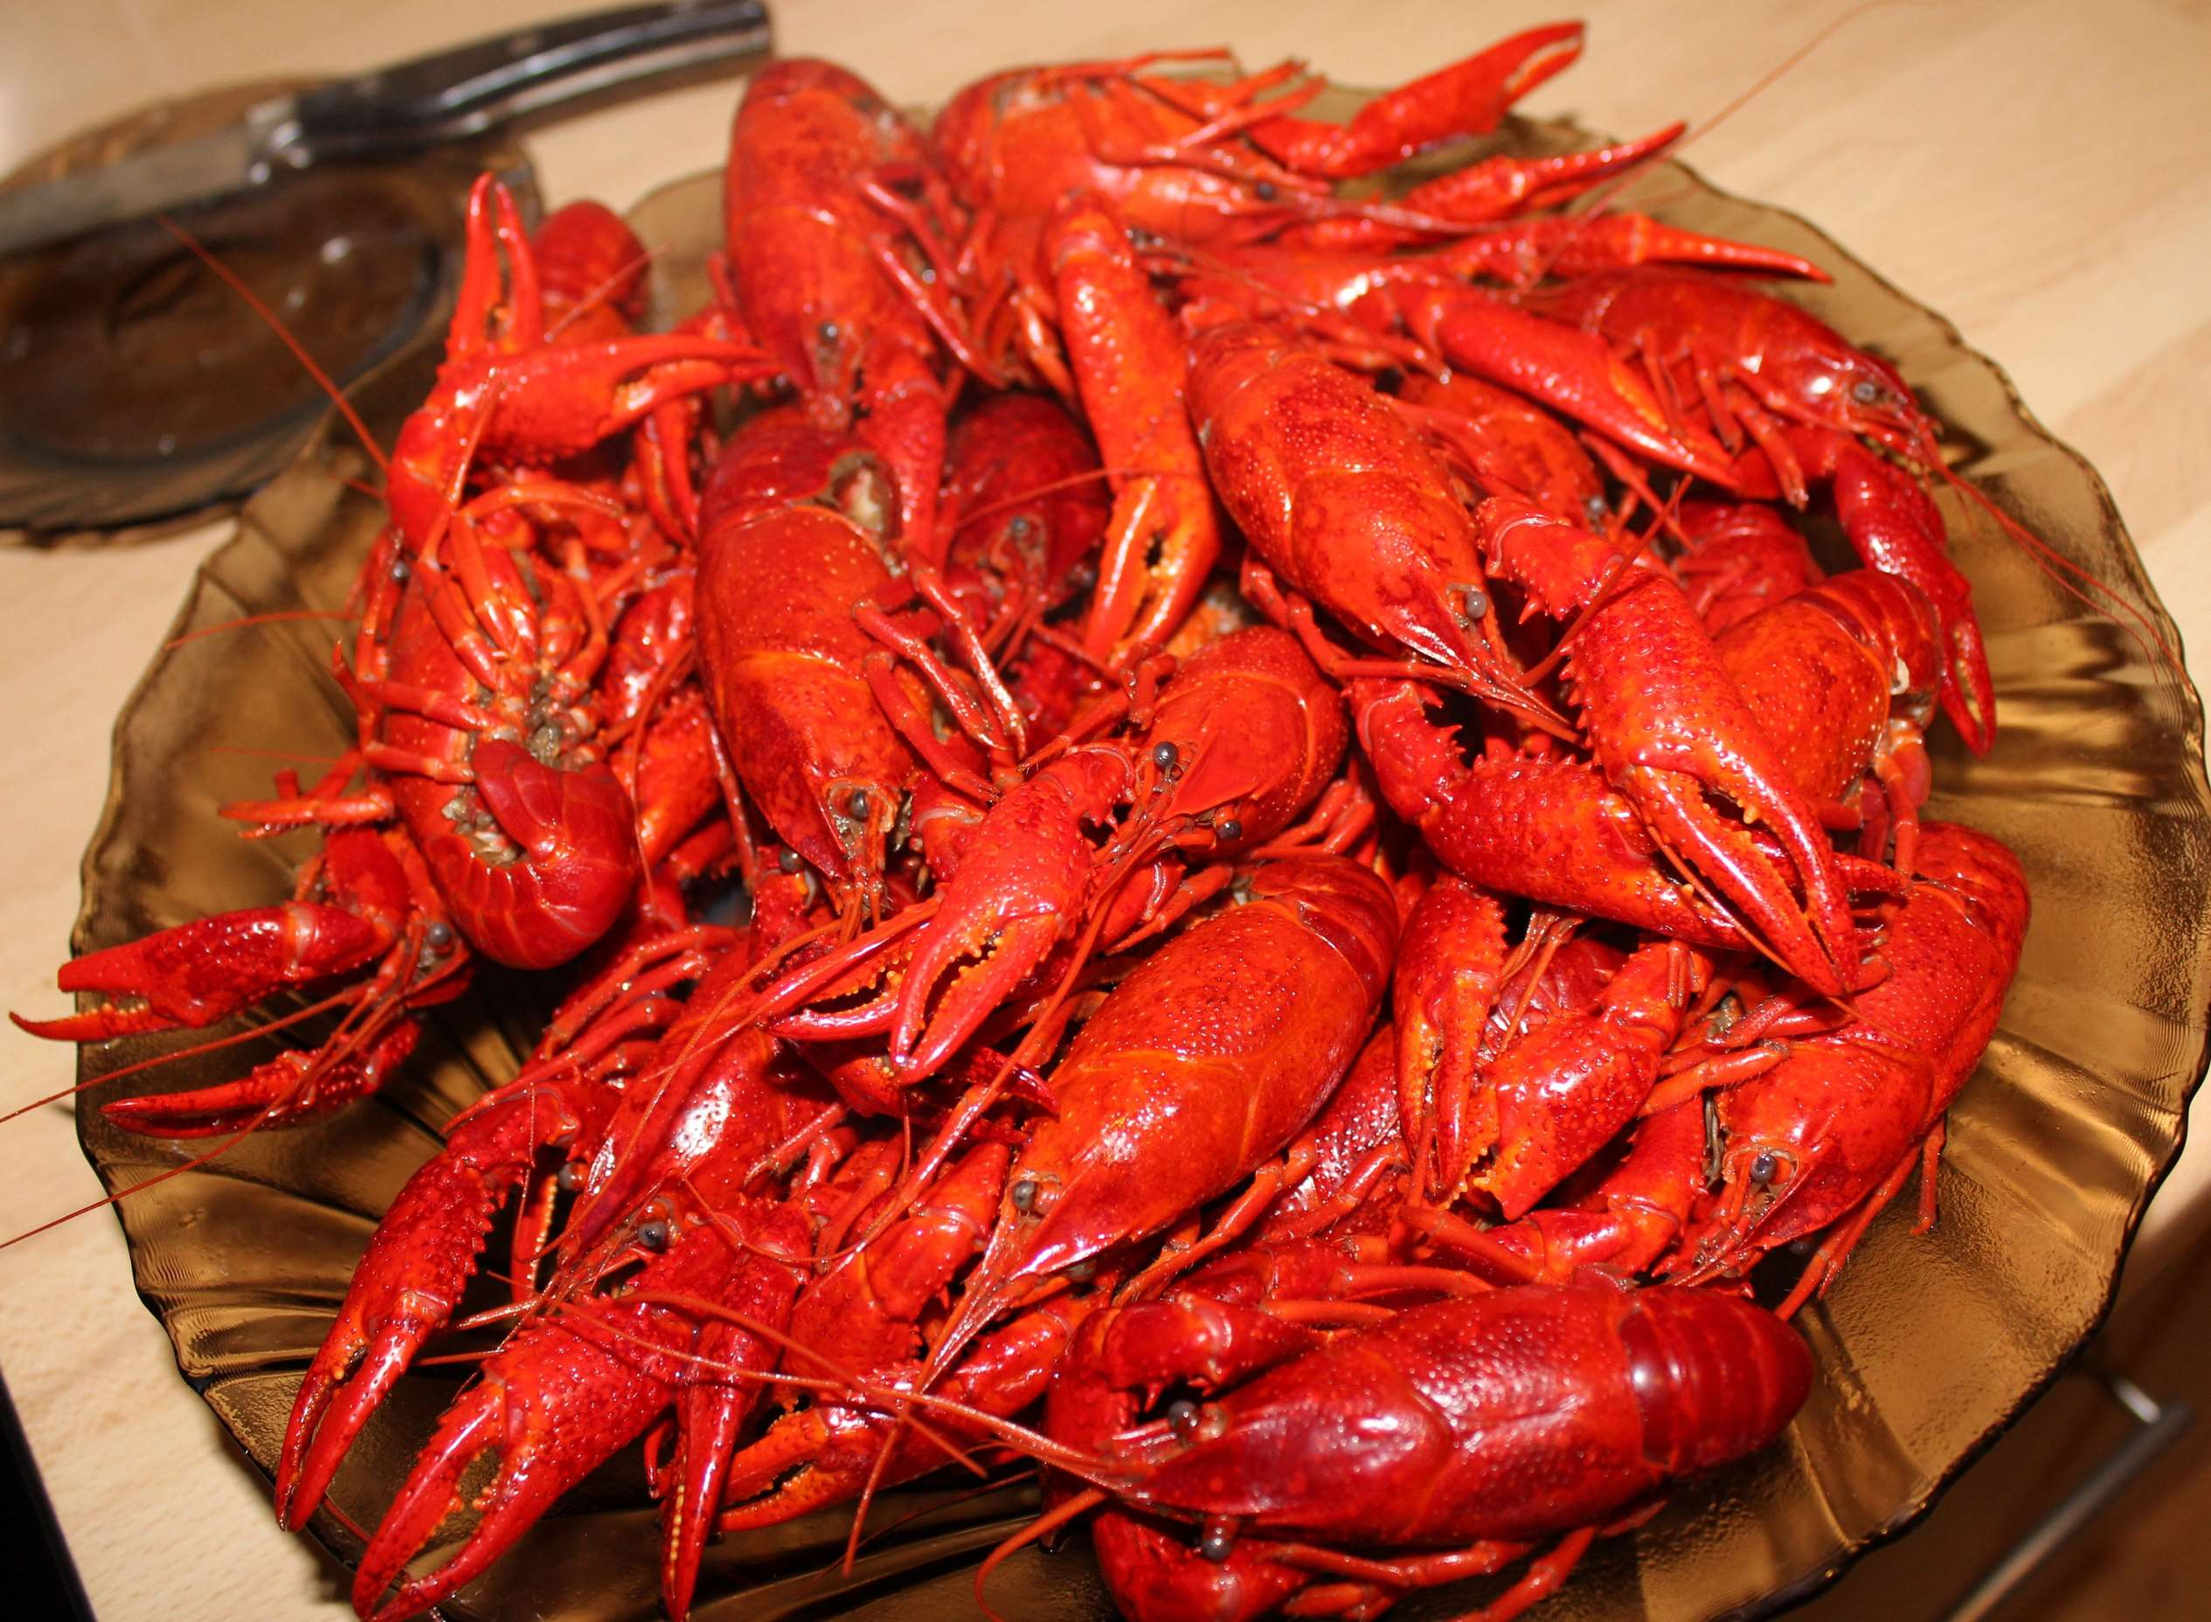
INTRODUCTION
The crayfish market refers to the economic ecosystem centered around the production, distribution, and consumption of crayfish, a freshwater crustacean species widely consumed for both culinary and bait purposes. This market encompasses various stakeholders, including crayfish farmers, fishermen, seafood wholesalers, retailers, restaurants, and consumers. Crayfish are valued for their tender meat and unique flavor, making them a sought-after delicacy in many cuisines worldwide. As a result, the market for crayfish as food is significant, with demand influenced by factors such as consumer preferences, culinary trends, and cultural traditions.

Slide 3


KEY INSIGHTS
MARKET SIZE
USD 9981.58 million
2024
CAGR
13.20%
2024- 2030

Slide 4

REVENUE MARKET SHARE BY SEGMENTS 2022
  Red Swamp Crayfish
  Virile Crayfish
  Ringed Crayfish
  Rusty Crayfish
Type Segment
  Food
  Bait
  Pets
Product Segment

Slide 5

Global Crayfish Market Revenue share for 2024
North America
40%

Slide 6
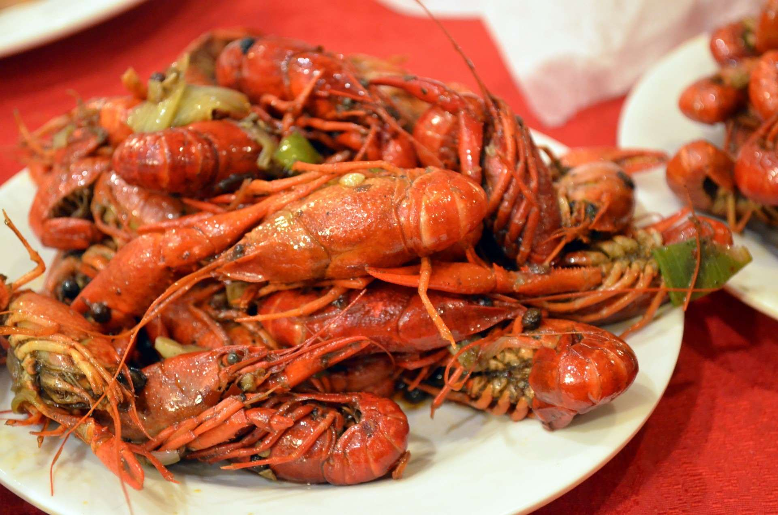
  Advancements in Crayfish Aquaculture Techniques Enhance Production Efficiency
  Growing Awareness of the Nutritional Benefits of Crayfish to Boost Market Growth
Drivers
High Transportation Costs Hinder Market Expansion
Restraints

Slide 7
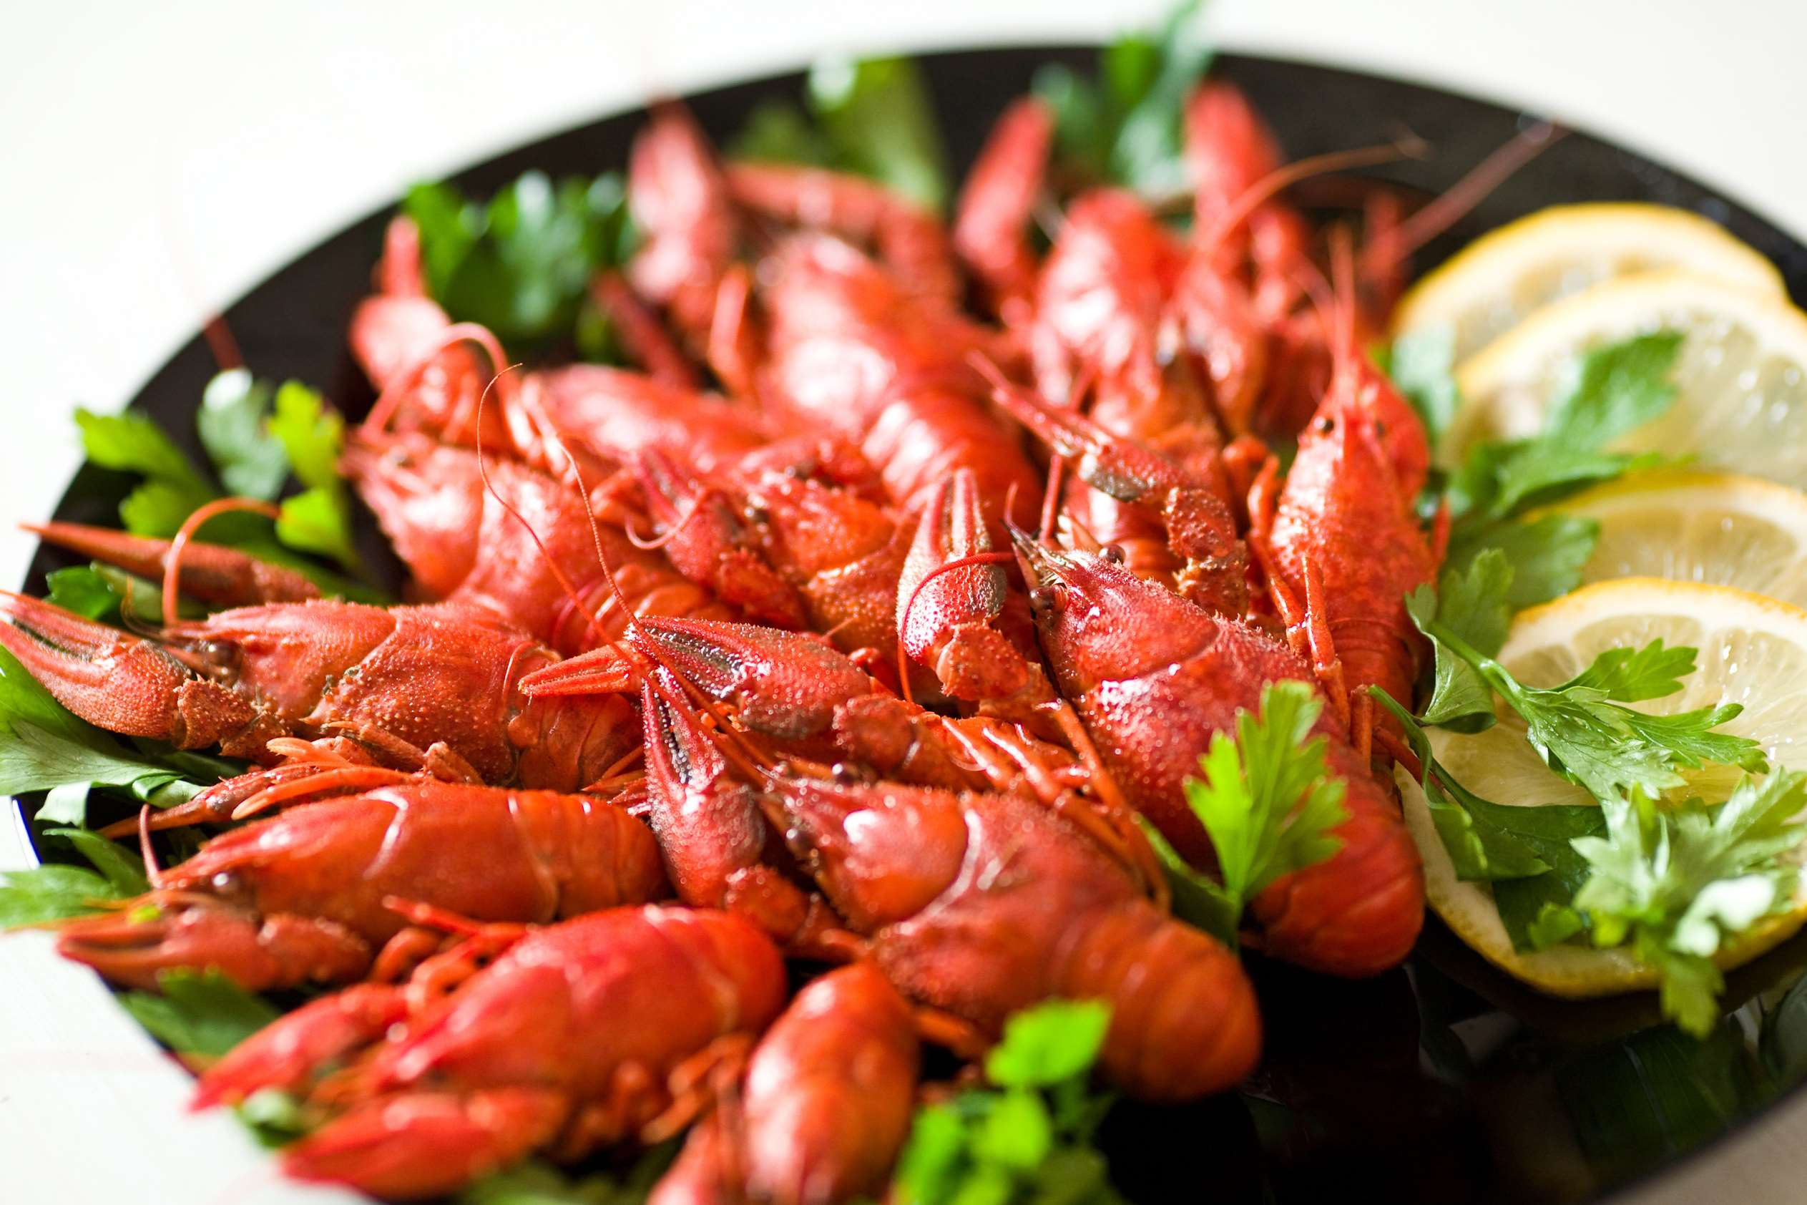
AUTHOR'S PERSPECTIVE
  The global Crayfish market will expand significantly by 13.20% CAGR between 2024 to 2031.
  The Red Swamp Crayfish market segment primarily targets both food and bait industries. As a popular culinary delicacy, it caters to restaurants and seafood wholesalers. Additionally, it serves as effective bait for anglers, appealing to fishing enthusiasts aiming to attract freshwater game fish like bass and trout.
  Consumer demand for seafood delicacies, regulatory policies governing fishing and aquaculture practices, environmental sustainability concerns, technological advancements in aquaculture techniques, fluctuations in supply due to natural factors

Slide 8










KEY PLAYERS

Slide 9


For Full Report
Contact us
COGNITIVE MARKET RESEARCH
Tel: +1 312-376-8303 | +44 020-8123-0732
India: (+91) 983-496-8611
sales@cognitivemarketresearch.com
Access the Full Report : https://tinyurl.com/3pvn5t22
Please visit our website:
https://www.cognitivemarketresearch.com

