Slide 1

GLOBAL
CANE
MARKET REPORT 2024
Global,Regional,CountryAnalysis

Slide 2
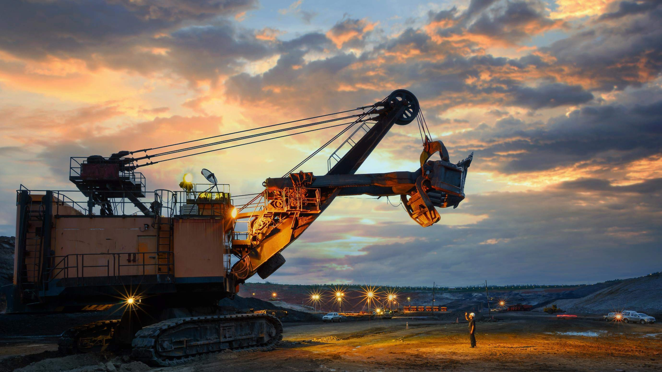
INTRODUCTION
The construction, industrial, and logistics sectors depend heavily on the global crane industry as vital equipment for heavy lifting and material handling operations. Various crane types distinguish it, each created to fulfill the demands of a particular industry, such as mobile cranes, tower cranes, crawler cranes, and overhead cranes.These developments empower businesses to offer better-tailored solutions and services, which, in turn, contribute to the growth of the crane industry.

Slide 3
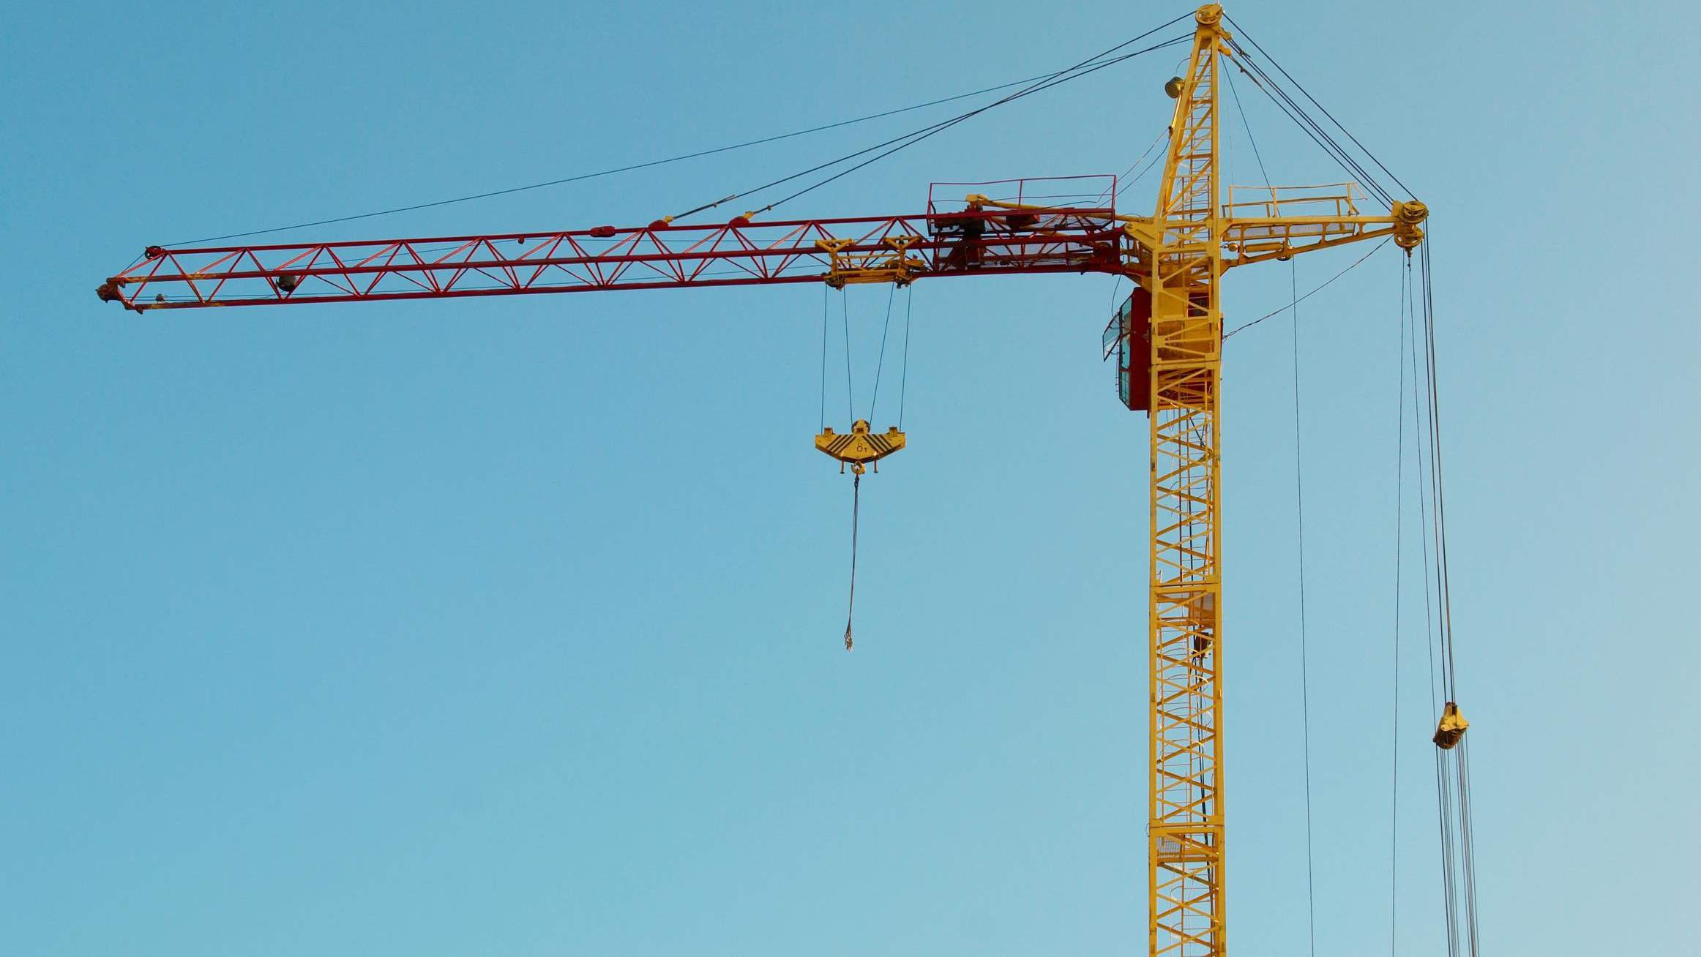

KEY INSIGHTS
MARKET SIZE
USD 39.3 billion
2023
20₋23
CAGR 6.80%
2030

Slide 4

REVENUE MARKET SHARE BY SEGMENTS 2022
Rough Terrain Cranes (RTCs)
All Terrain Cranes (ATCs)
Truck Cranes
Mobile Harbons
Off-shore Ship Cranes
Loader Cranes
Railroad Cranes
Crawler Cranes
Tower Cranes
Up to 5 MT
5 to 50 MT
50 to 250 MT
250 to 500 MT
500 to 1500 MT
1500 to 3000 MT
Type Segment
Capacity Segment
Aerospace and Defence
Automotive & Railways
Heavy Engineering
General Engineering
Mining
Construction
Marine
Shipping & Material Handling
Energy (Power & Gas)
Application Segment
Stiff Boom
Knuckle Boom/Telescopic Boom
Design Segment

Slide 5
Global Crane Market Revenue share for 2022
North America 40%

Slide 6





Slide 7
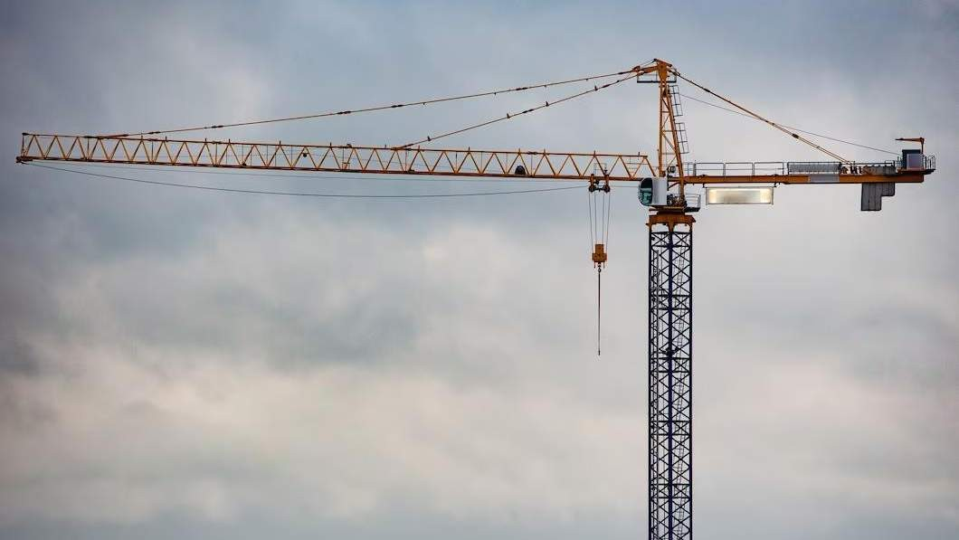
AUTHOR'S PERSPECTIVE
The Global Crane Market is witnessing significant growth in the near future.
All terrain cranes (ATCs) are the second-most used segment. Because ATCs are made to be driven on public highways, they give you the freedom to move between job sites.
Heavy construction materials like steel beams, concrete blocks, pre-fabricated buildings, and others are frequently lifted and moved by cranes
The Aerospace and Defence segment is expected to expand at the significant CAGR retaining position throughout the forecast period.

Slide 8
















KEY PLAYERS

Slide 9


Contact us
For Full Report
COGNITIVE MARKET RESEARCH
Tel: + 1 312 - 376 - 8303 | + 44 020 - 8123 - 0732
India: ( + 91 ) 983 - 496 - 8611
sales@ cognitivemarketresearch. com
Access the Full Report : http://tinyurl.com/3hc35rab
Please visit our website:
https://www.cognitivemarketresearch.com

