Slide 1
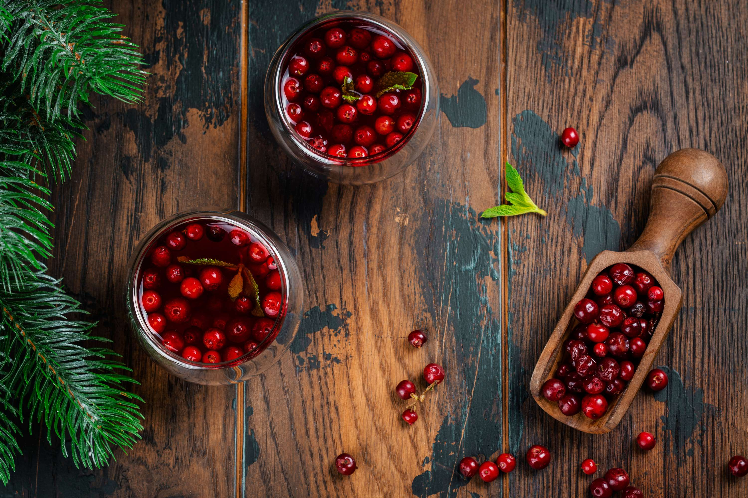
CRANBERRY JUICE MARKET REPORT

Slide 2
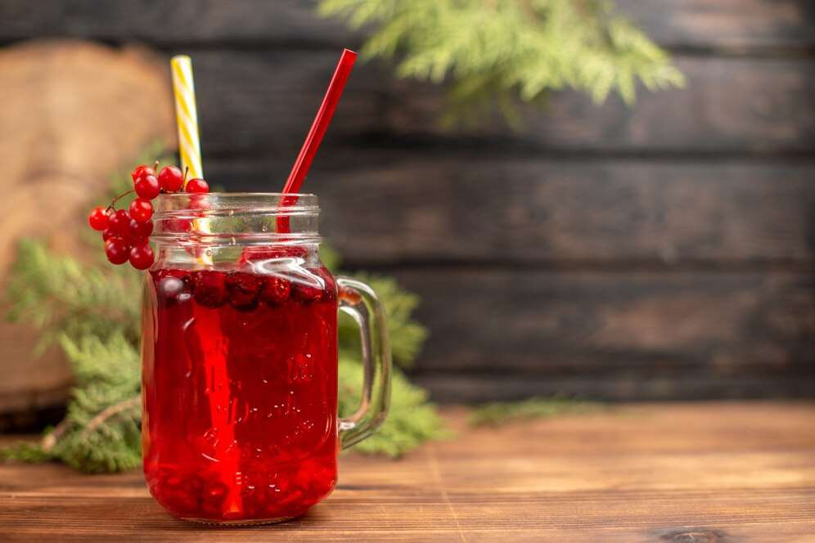
INTRODUCTION
Cranberry Juice is the liquid juice of cranberry, which is a native to North America recognized for its red colour, tart taste, versatility. Cranberry products include cranberry juice, dried cranberry, cranberry sauce, frozen cranberry, cranberry powder, and dietary supplements containing cranberry extracts.

Slide 3
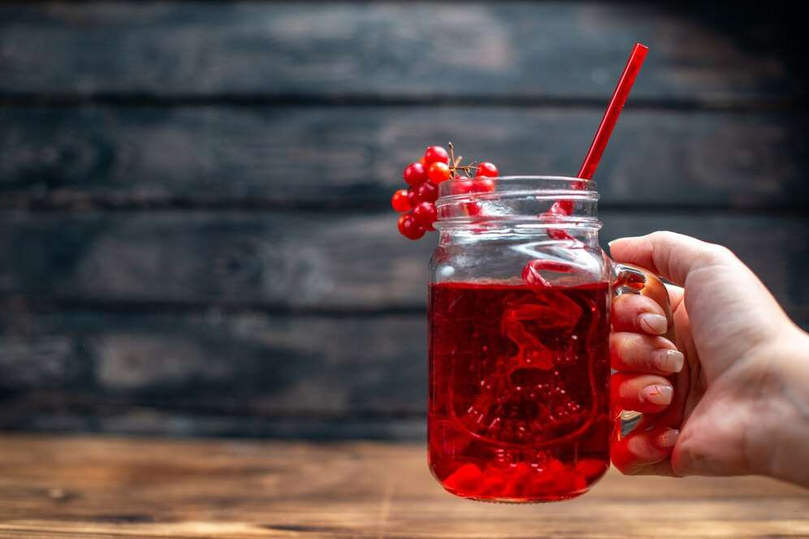

KEY INSIGHTS
MARKET SIZE
2,712.30 Million
2016
FORECAST
3,735.76 Million
2028
2023-
2030
CAGR
2.98%

Slide 4
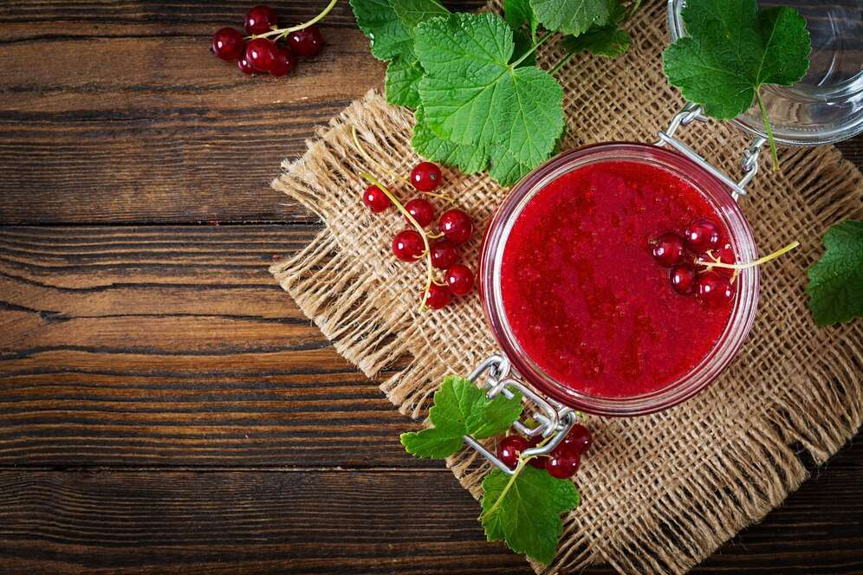
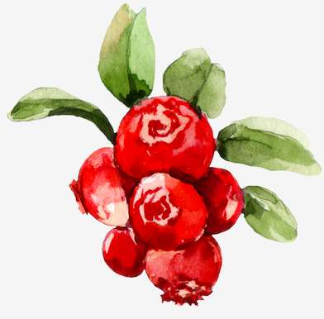
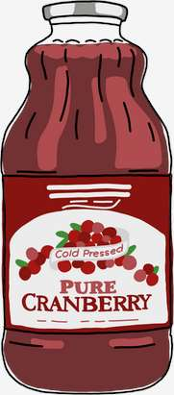
REVENUE MARKET SHARE BY SEGMENTS 2022
  by Type
General :
USD 2,907.07 Million
  Distributional Channel
Retail :
USD 2,364.48 Million

Slide 5

GLOBAL CRANBERRY JUICE MARKET REVENUE SHARE FOR 2022
Asia Pacific
USD 1,039.29 Million

Slide 6
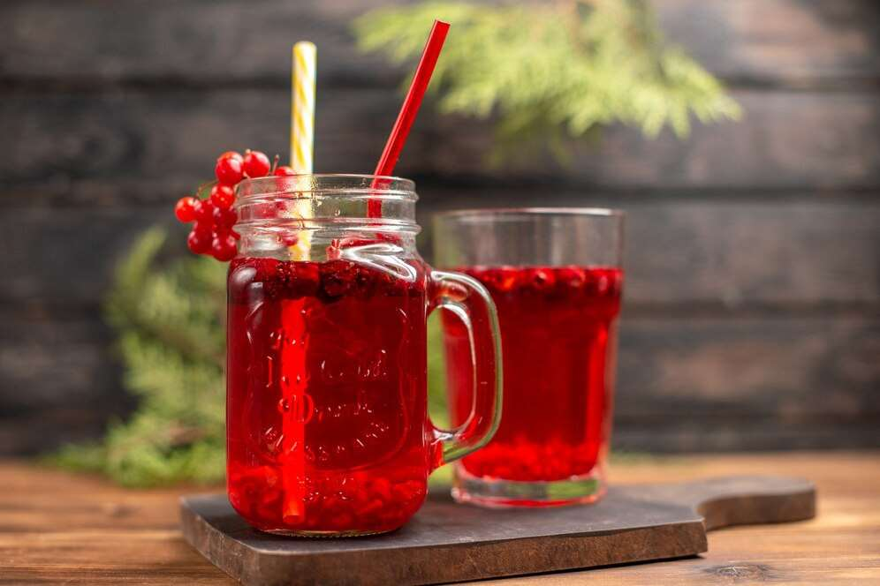
Rising demand for food & beverages industry
Drivers
Shortage of raw materials and huge competition
Restraints

Slide 7
AUTHOR'S PERSPECTIVE
  The Global Cranberry Juice Market is witnessing significant growth in the near future.
  In 2023, the General segment accounted for noticeable share of global Cranberry Juice Market and is projected to experience significant growth in the near future.
  The Retail segment is expected to expand at the significant CAGR retaining position throughout the forecast period.

Slide 8


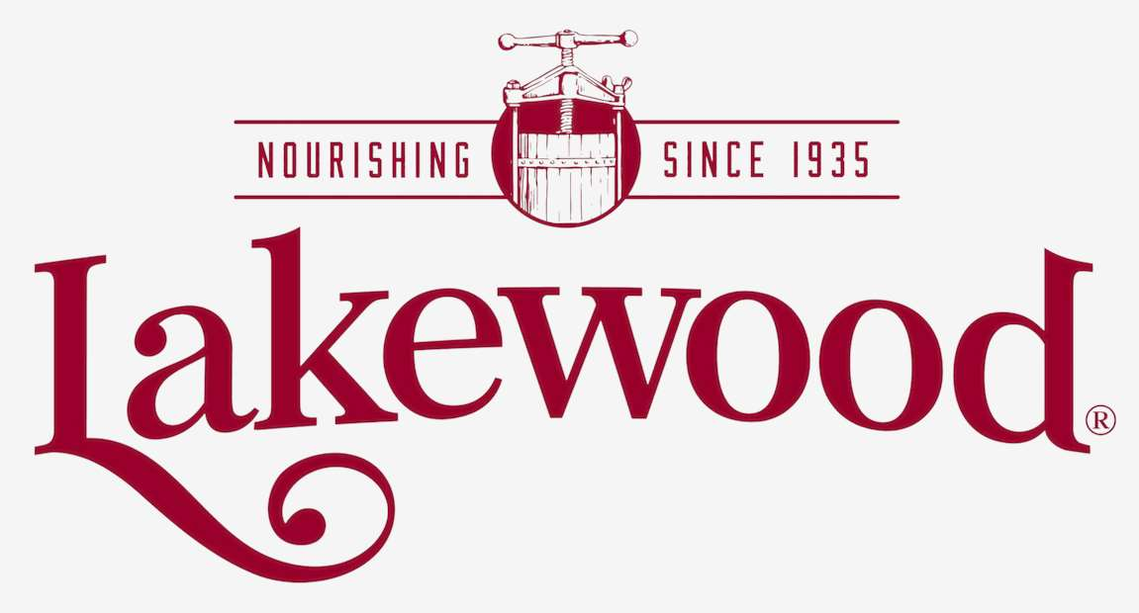
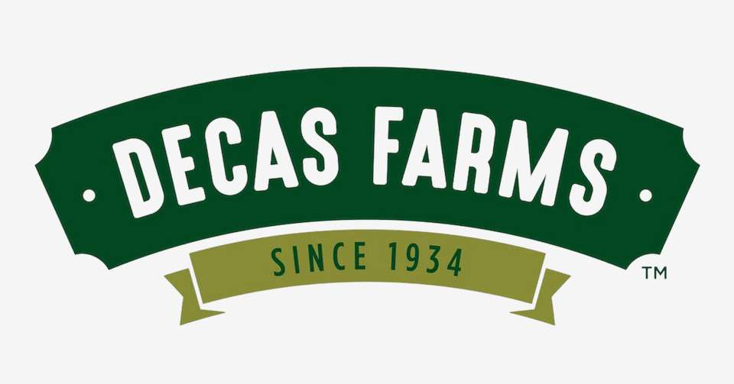
KEY PLAYERS

Slide 9


Contact us
For Full Report
COGNITIVE MARKET RESEARCH
Tel: +1 312-376-8303 | +44 020-8123-0732
India: (+91) 983-496-8611
sales@cognitivemarketresearch.com
Access the Full Report :https://shorturl.at/yBW25
Please visit our website:
https://www.cognitivemarketresearch.com

