Slide 1
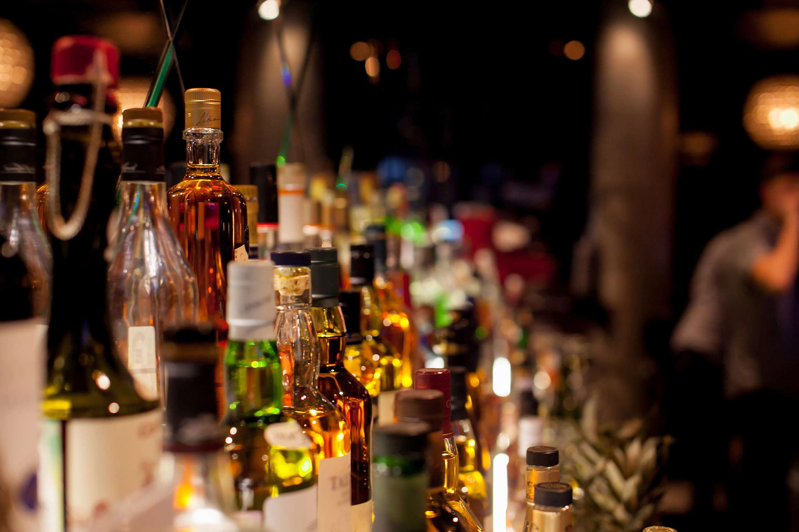
GLOBAL
CRAFT SPIRITS
MARKET REPORT 2024
Global,Regional,CountryAnalysis

Slide 2
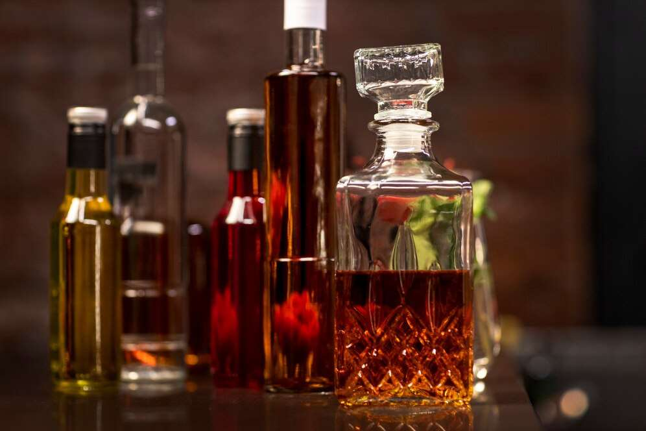
INTRODUCTION
Craft spirits, according to the American Craft Spirits Association, are a product made by a distillery that prioritizes transparency in distillation and is open about the spirit's components, distilling location, and aging and bottling process.Craft spirits are handcrafted and usually manufactured by a small distillery that uses ingredients and resources found locally. Craft spirits are made in tiny batches, and some of the most well-known examples are gin, vodka, and rum.

Slide 3
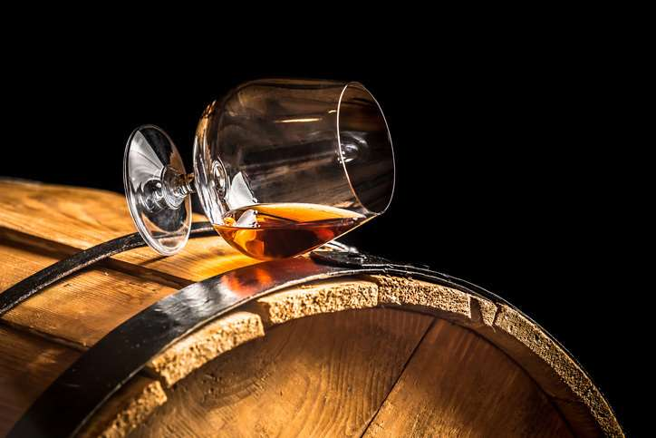

KEY INSIGHTS
MARKET SIZE
USD 8,990.45 Million
2016
FORECAAST
45,689.13 Million
2028
CAGR
18.23%
2023- 2030

Slide 4
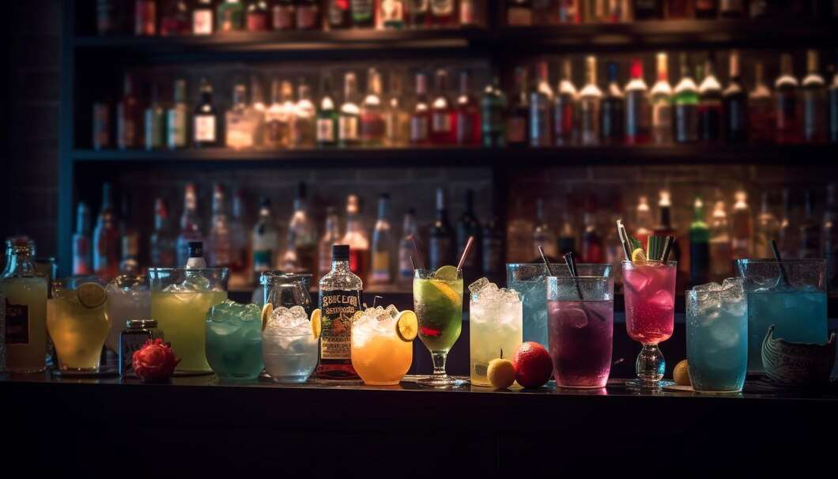
REVENUE MARKET SHARE BY SEGMENTS 2022
Type Segment
Whiskey
USD 17,514.90 Million
Distribution Channel
On-trade Channel
USD 26,499.69 Million
by Application
Bottle Stores
USD 12,465.26 Million

Slide 5
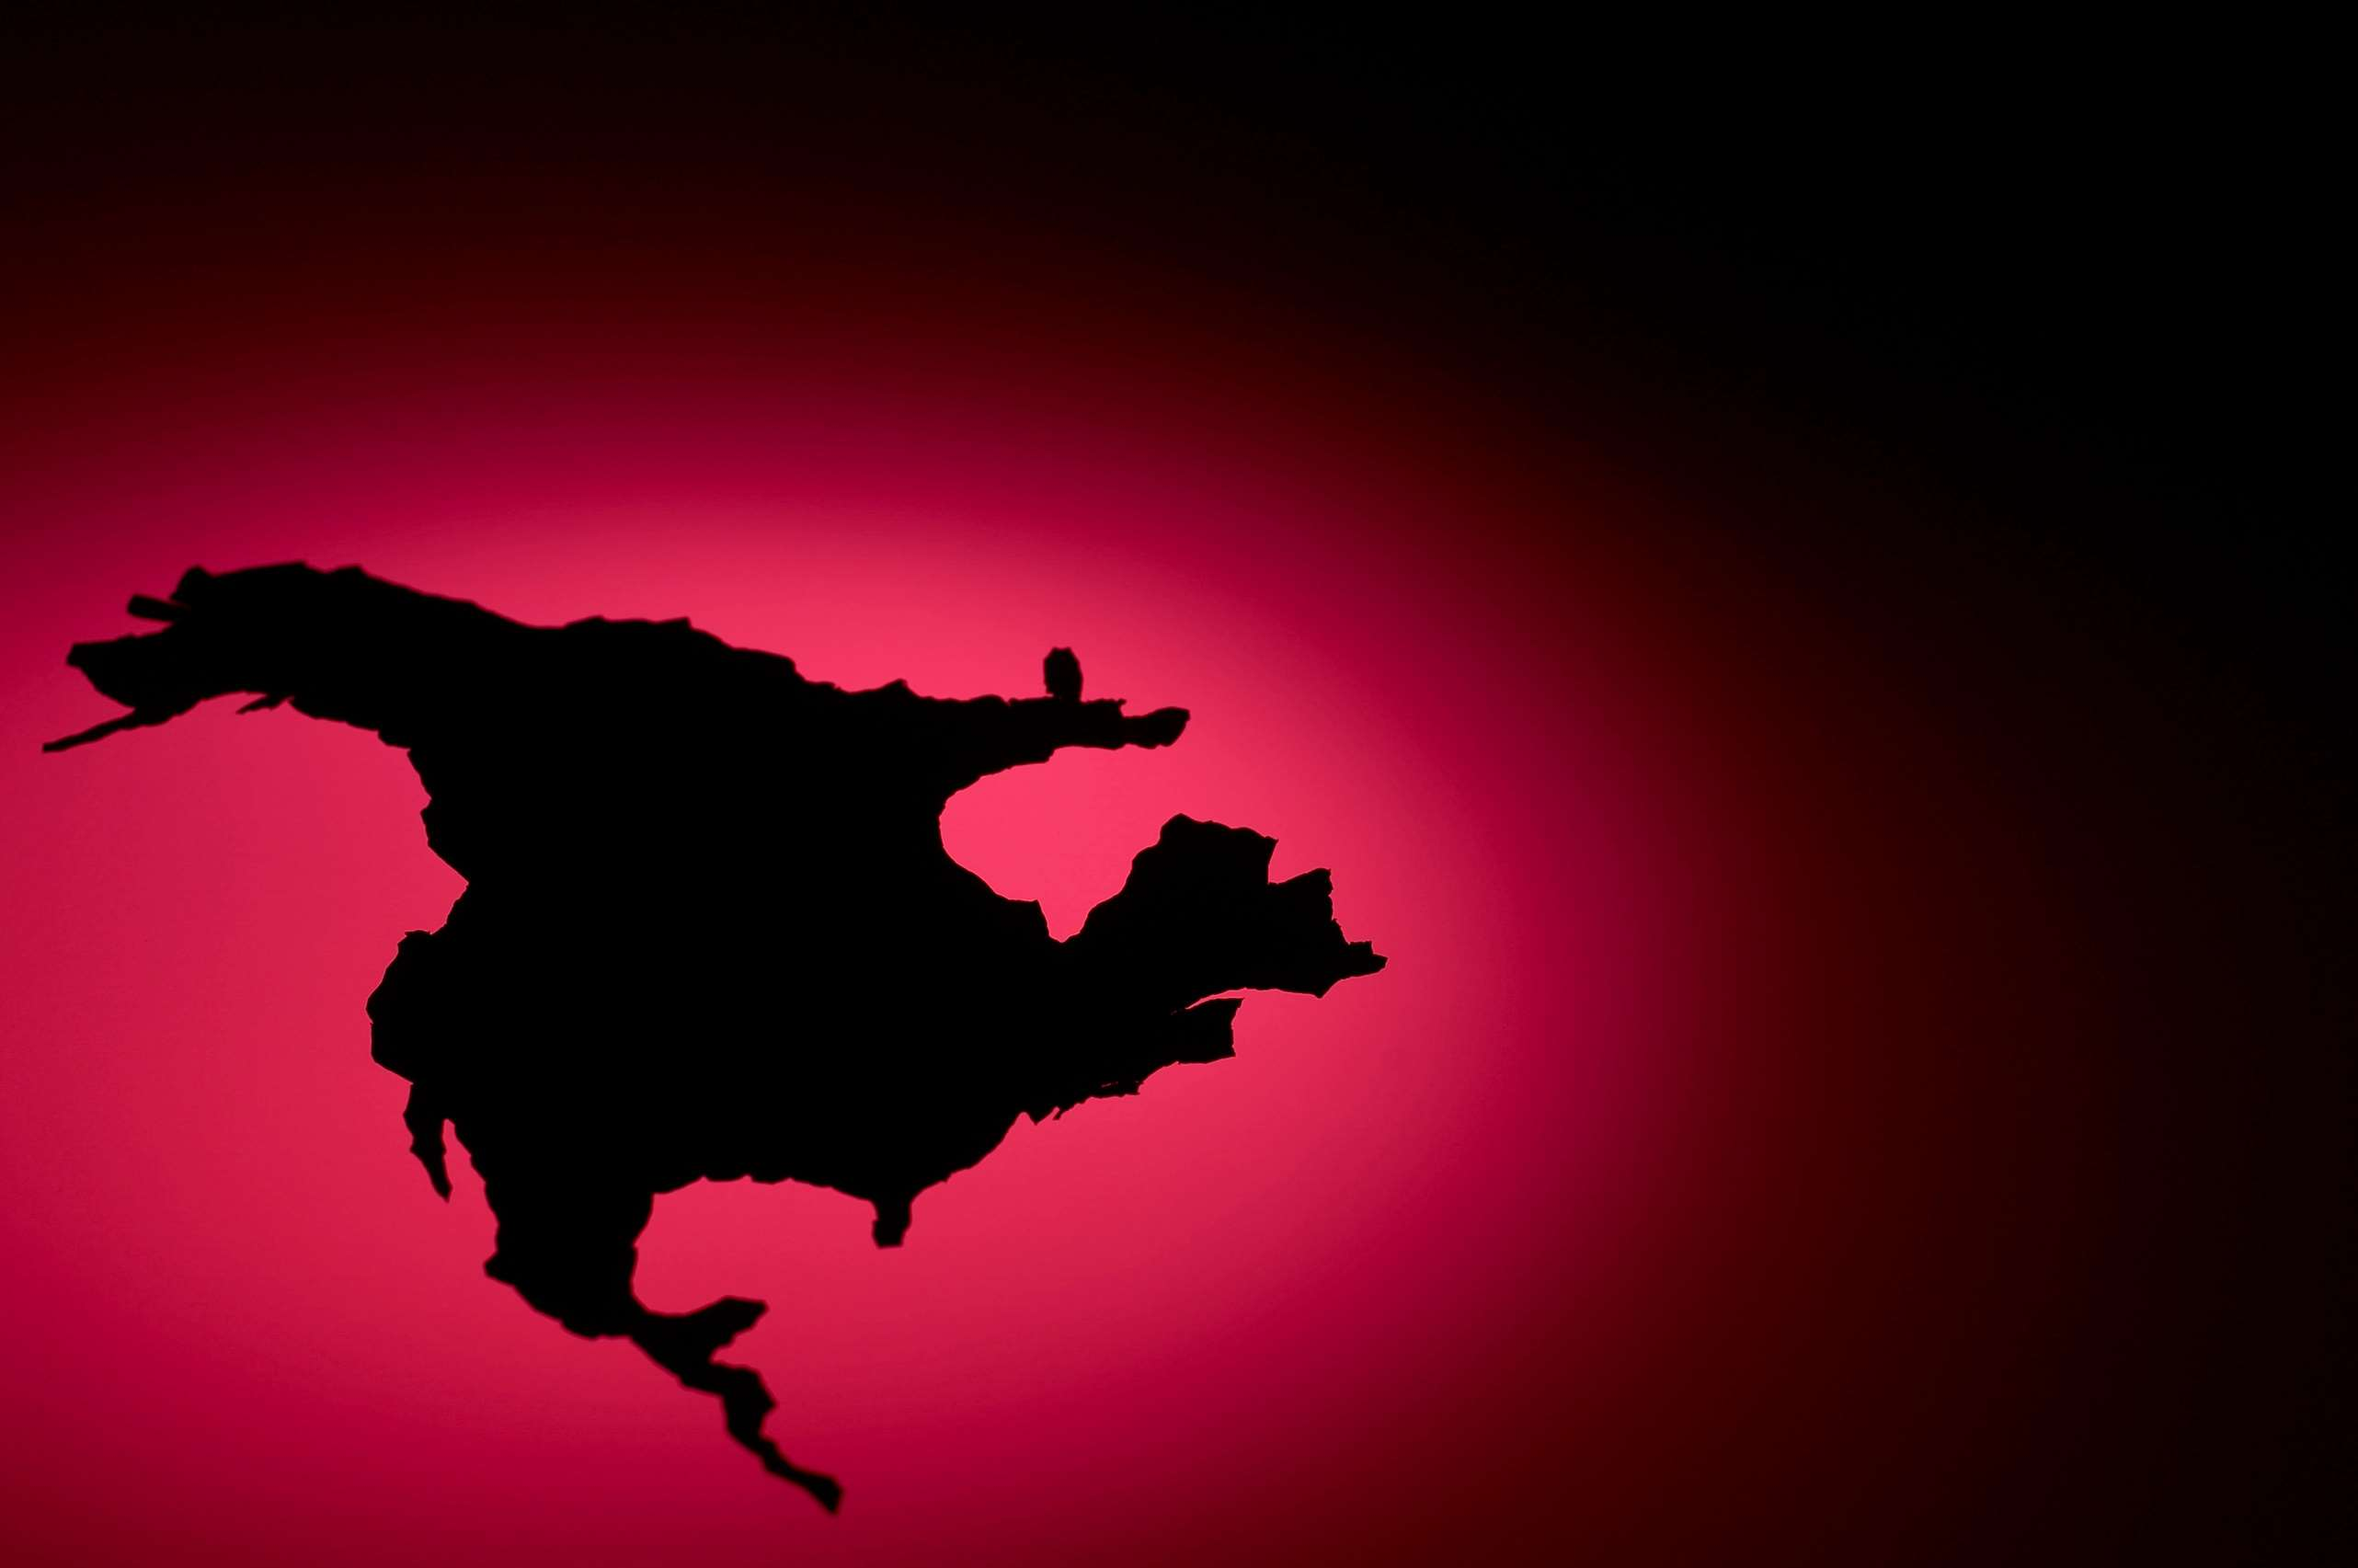
Global Craft Spirits Market Revenue share for 2022
North America
USD 16,482.35 Million

Slide 6
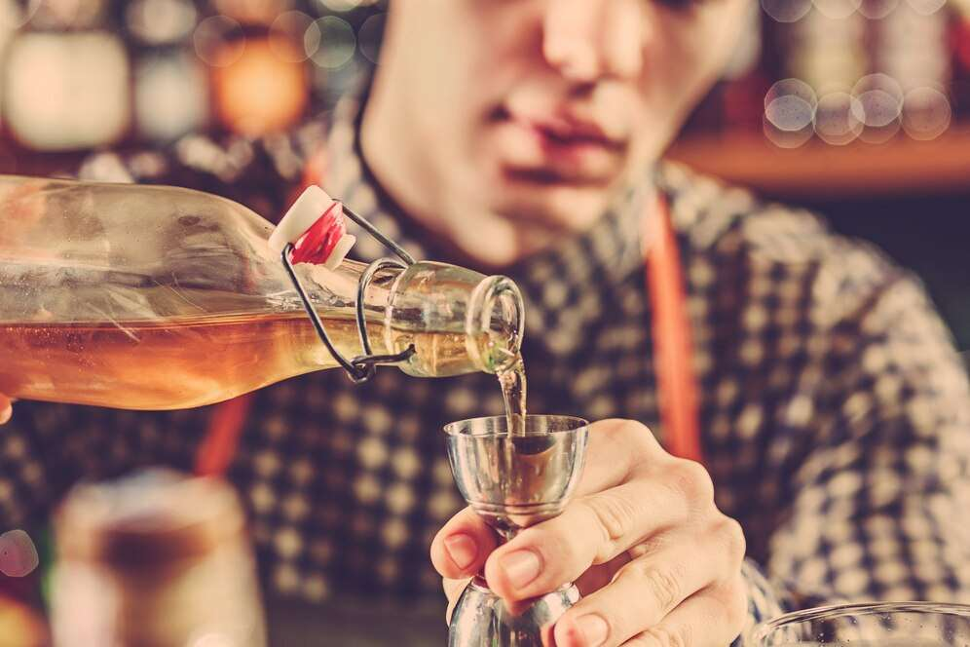
Increase in the number of restaurants and bars across the globe
Drivers
Health risk associated with high consumption of craft spirit
Restraints

Slide 7
AUTHOR'S PERSPECTIVE
  Craft whiskey is made by small, independently owned distilleries that acquire ingredients from local farmers, according to most knowledgeable whiskey aficionados.
  Craft booze and spirits packaged in unusual bottles will assist draw attention to the product and set it apart from the competition.
  The on-trade market comprises establishments such as pubs, restaurants, coffee shops, nightclubs, and motels, among others.

Slide 8
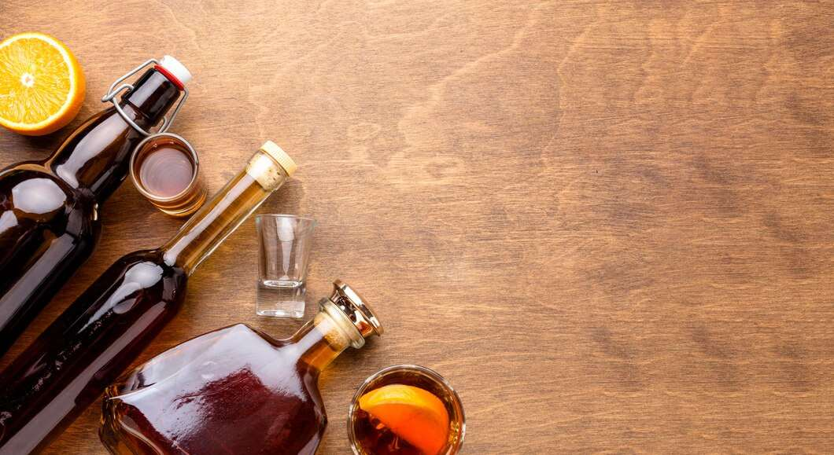






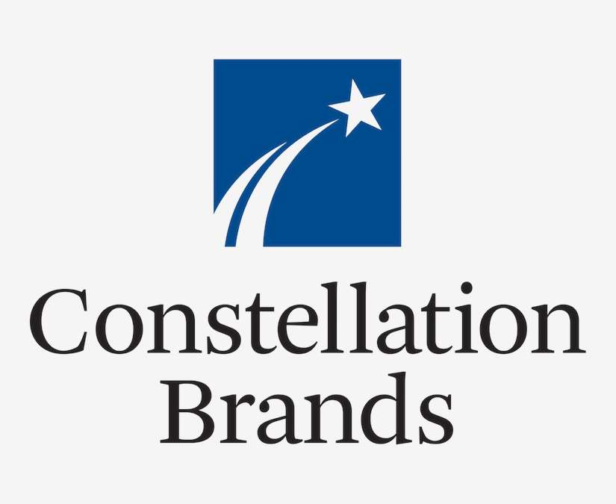


KEY PLAYERS

Slide 9


For Full Report
Contact us
COGNITIVE MARKET RESEARCH
Tel: +1 312-376-8303 | +44 020-8123-0732
India: (+91) 983-496-8611
sales@cognitivemarketresearch.com
Access the Full Report : https://tinyurl.com/2mzzbvwx
Please visit our website:
https://www.cognitivemarketresearch.com

