Slide 1
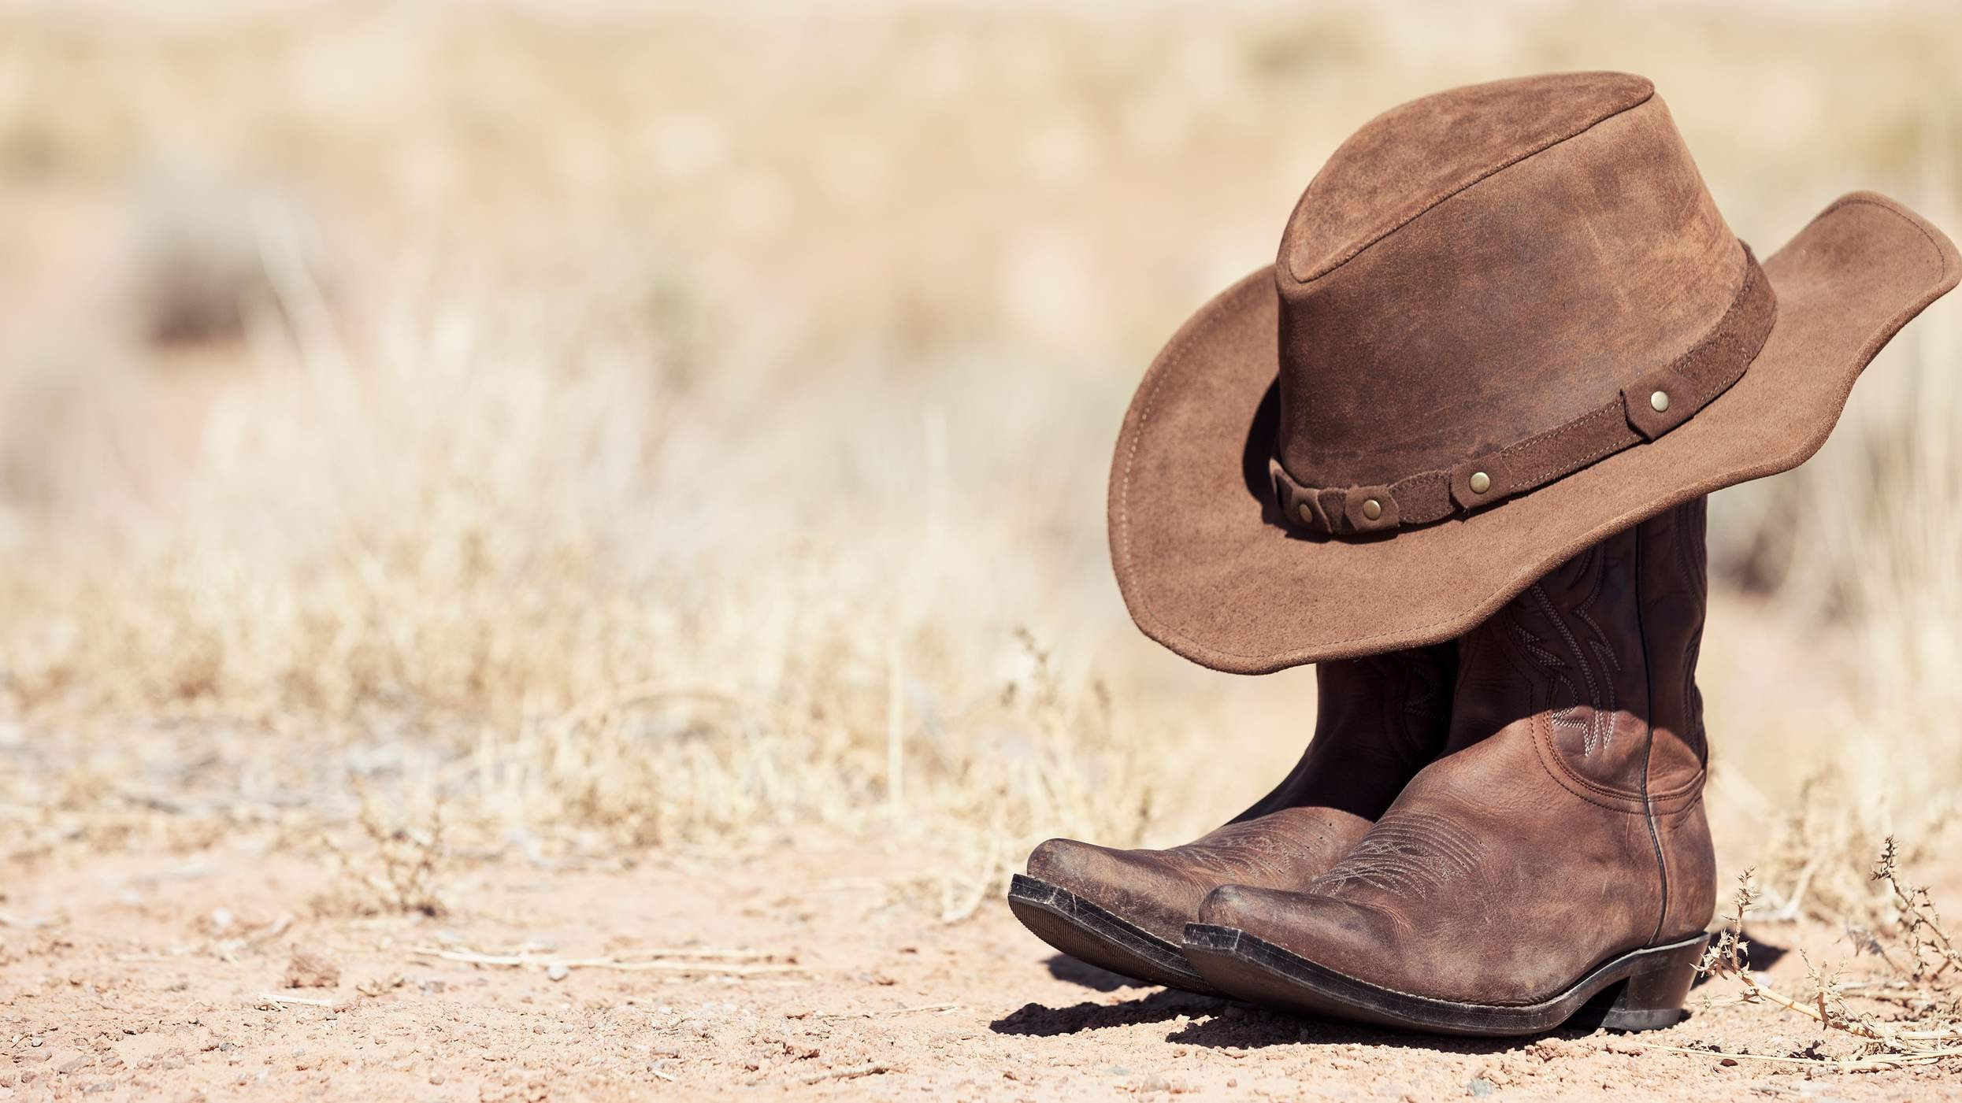
GLOBAL
COWBOY BOOTS
MARKET REPORT 2024
Global,Regional,CountryAnalysis

Slide 2
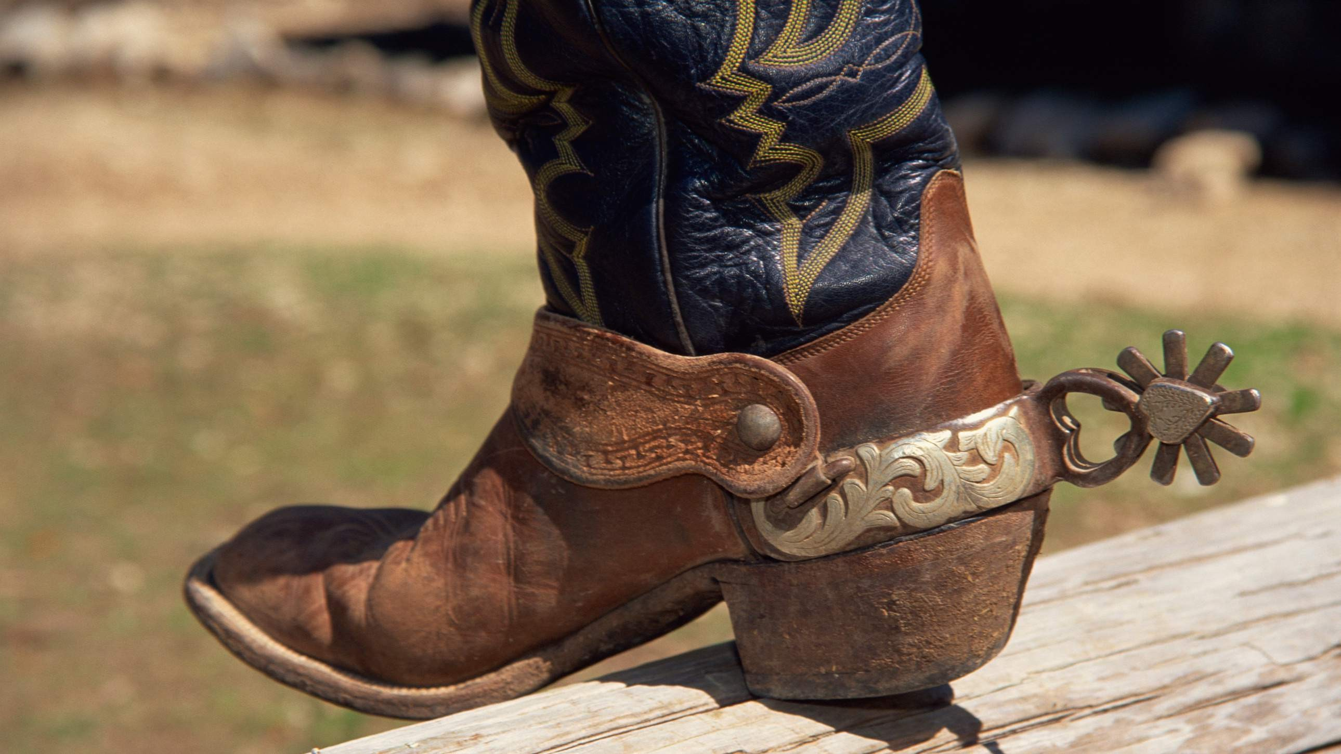
INTRODUCTION
Cowboy boots are a type of riding boot, traditionally worn by cowboys and cowgirls in the Western United States, Mexico, and Canada. The boots are usually made of cowhide leather and have a high heel, pointed toe, and a decorative stitching pattern along the shaft. Growth driven by increasing demand from the fashion industry for western inspired clothing and accessories and growing popularity of country music and cowboy culture.

Slide 3
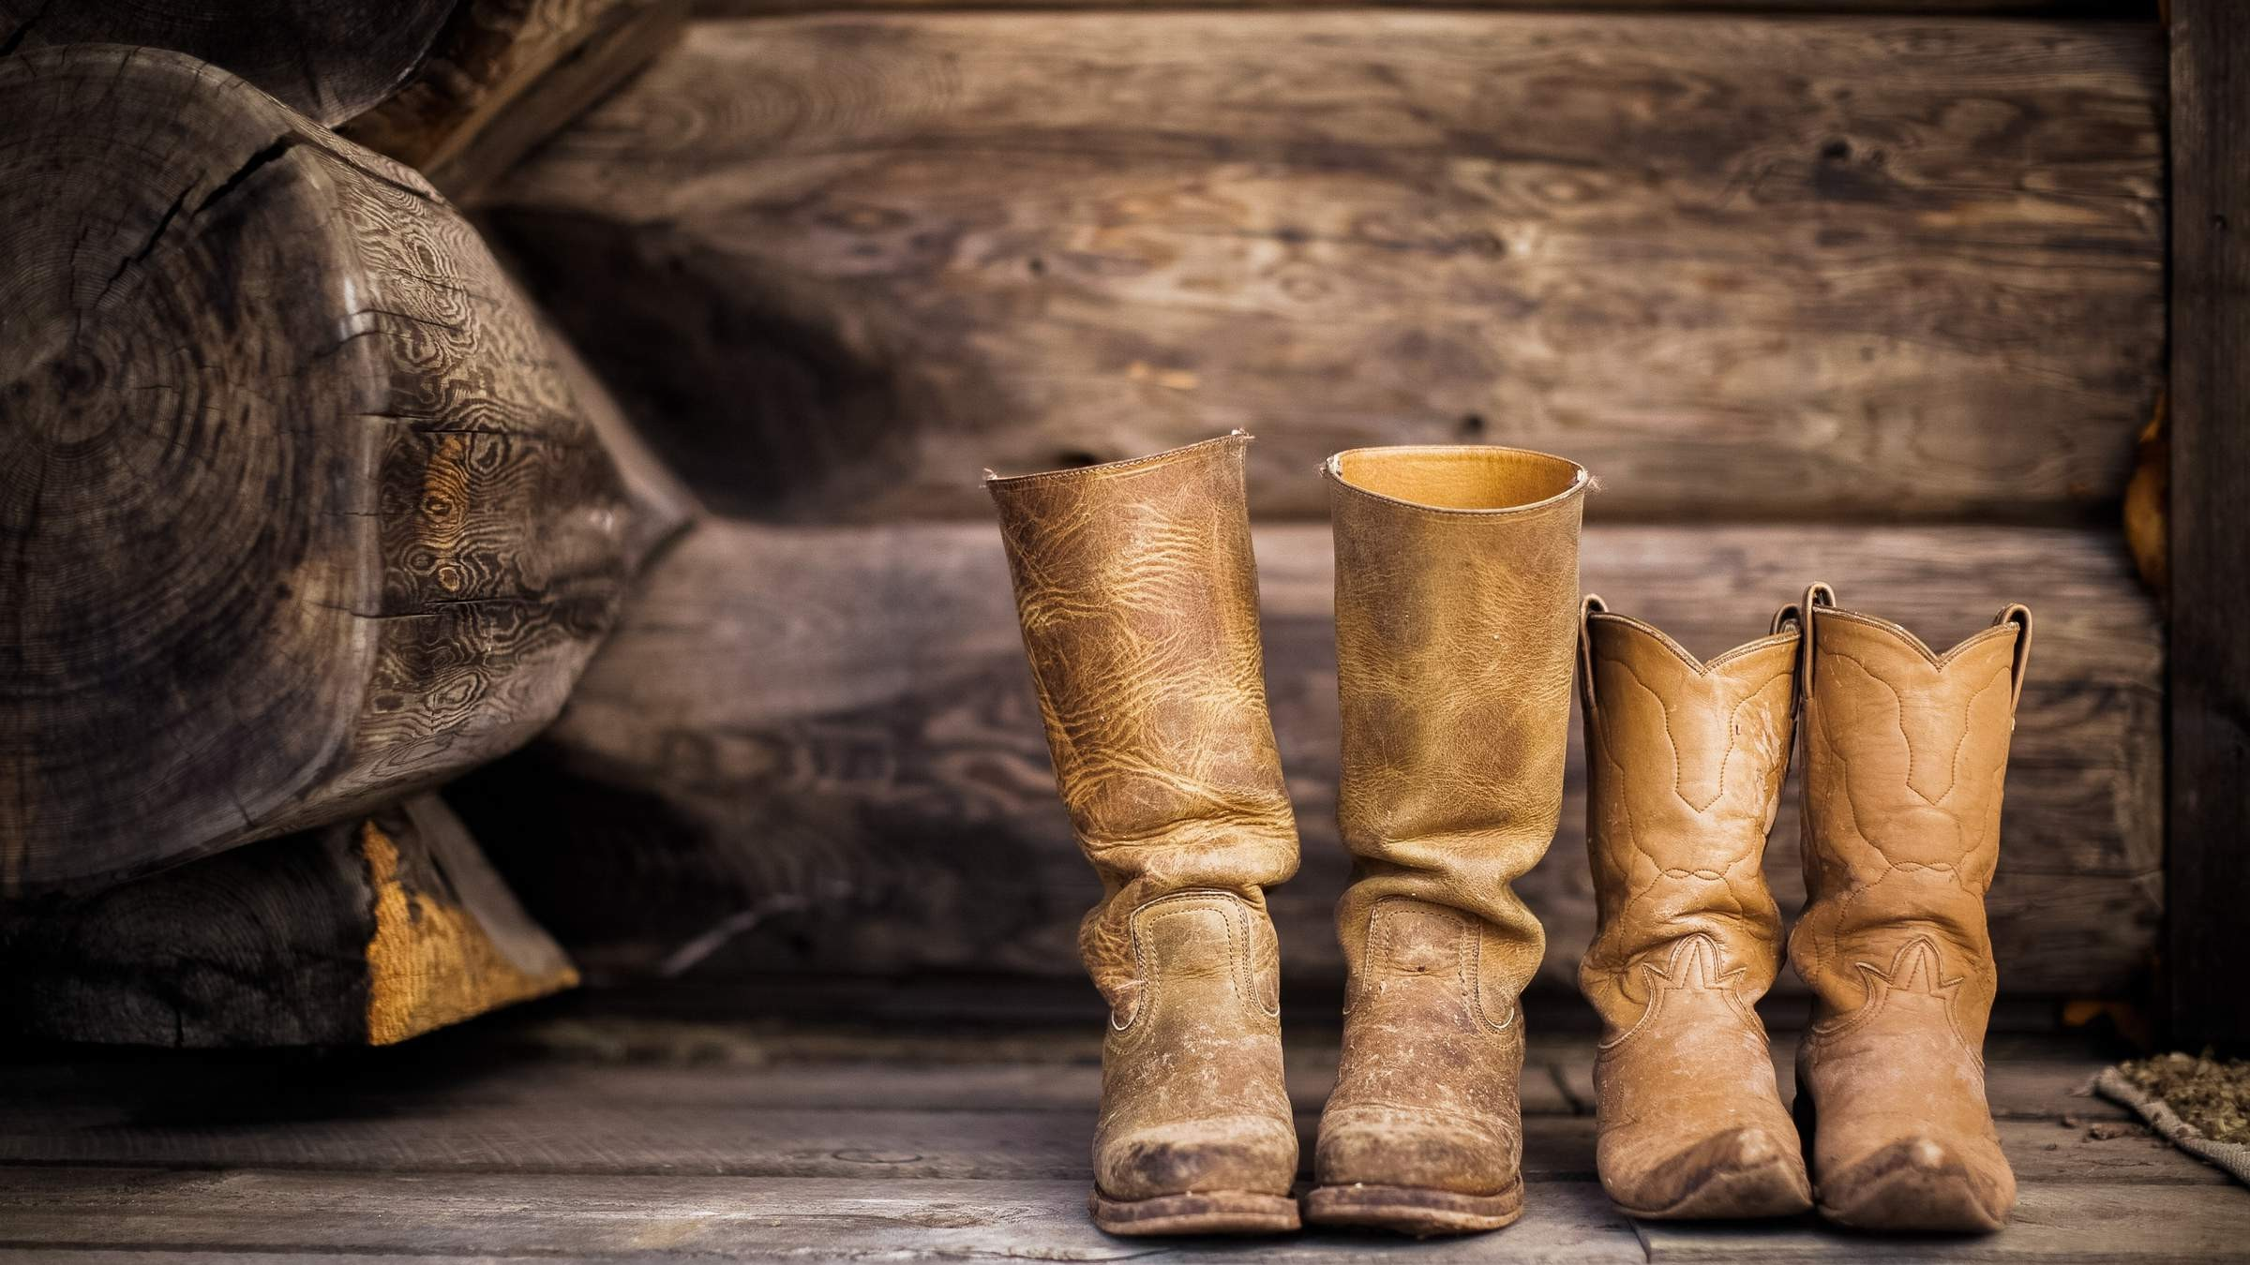

KEY INSIGHTS
MARKET SIZE
USD 0.285 billion
2023
CAGR 6.90%
20₋23
2030

Slide 4




REVENUE MARKET SHARE BY SEGMENTS 2022
Western Boots Work Boots Riding Boots Walking Boots
Type Segment
Men Women
Application Segment

Slide 5
Global Cowboy Boots Market Revenue share for 2022
Asia Pacific USD 0.10 billion

Slide 6
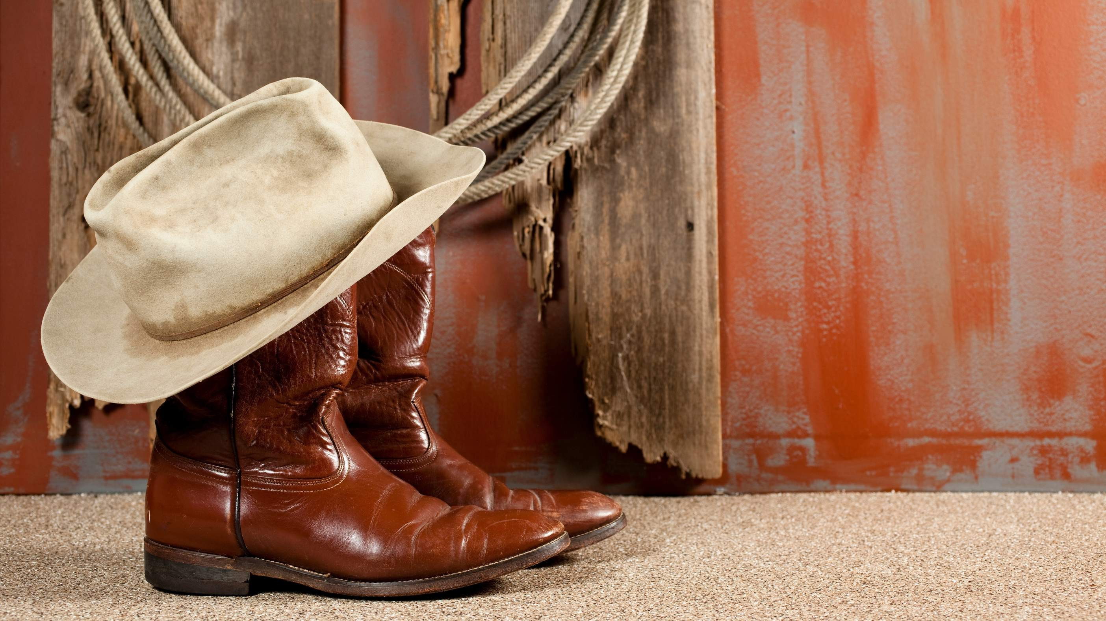
Craftsmanship and Quality Materials to Propel Market Growth
Drivers
Market Saturation and Niche Appeal to Restrict Market Growth
Restraints

Slide 7
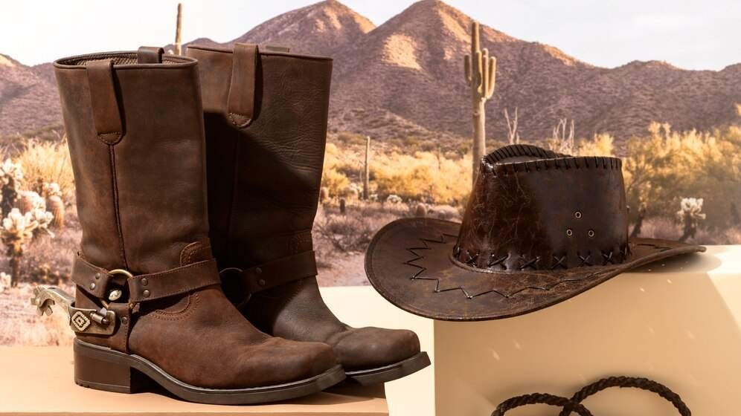

AUTHOR'S PERSPECTIVE
The Global Cowboy Boots Market is witnessing significant growth in the near future. Riding Boots have witnessed increased demand due to the growing popularity of equestrian activities, horseback riding, and their crossover appeal into mainstream fashion.
The rise of equestrian sports, coupled with the fashion-forward designs of Riding Boots, positions this category as the fastest-growing segment in the cowboy boots market.
Women's cowboy boots, characterized by diverse designs, colors, and embellishments, have become a fashion statement beyond their functional aspects.

Slide 8
KEY PLAYERS

Slide 9


Contact us
For Full Report
COGNITIVE MARKET RESEARCH
Tel: + 1 312 - 376 - 8303 | + 44 020 - 8123 - 0732
India: ( + 91 ) 983 - 496 - 8611
sales@ cognitivemarketresearch. com
Access the Full Report : http://tinyurl.com/y5fssbrw
Please visit our website:
https://www.cognitivemarketresearch.com

