Slide 1

GLOBAL COTTON BALLS MARKET REPORT 2024
Global,Regional,CountryAnalysis

Slide 2
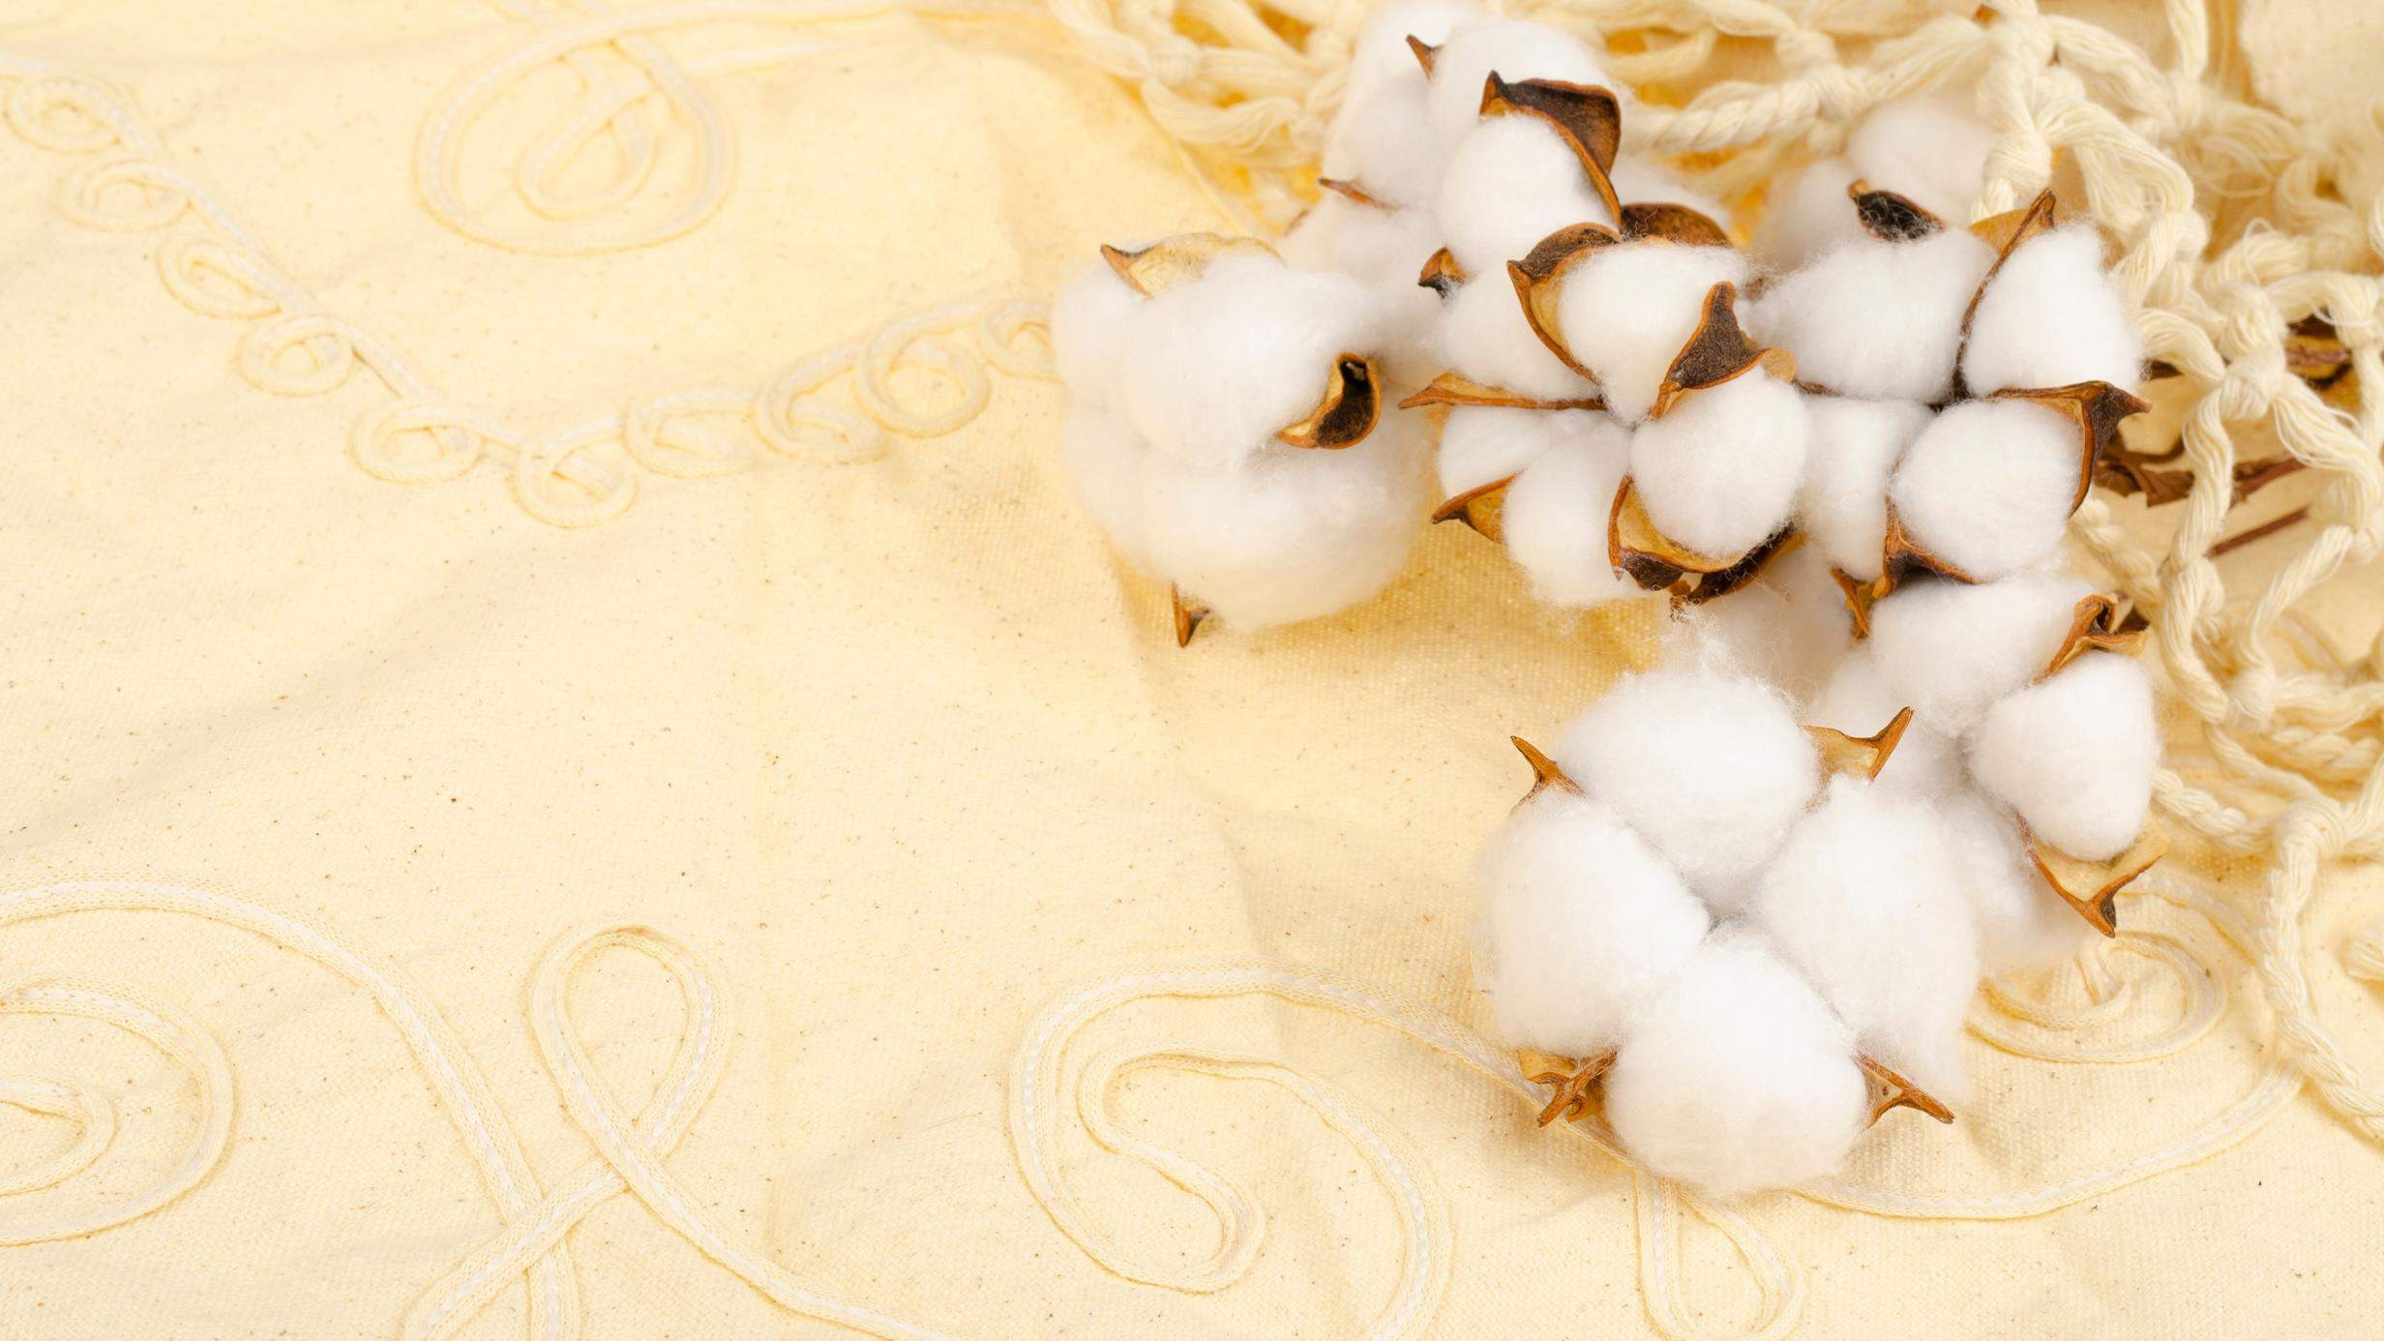
INTRODUCTION
Cotton ball products refer to items
typically crafted from cotton, including cotton swabs, cotton cosmetic pads,
cotton wet wipes, and similar products.
Furthermore, these products are gaining significance in the l ives of
consumers. People are becoming more mindful of their well- being, especially when it comes to cleanliness and
aesthetics. This shift in attitude can be
attributed to heightened awareness
about sanitation, higher income levels, and the impact of celebrities and social media on fashion and health.

Slide 3


KEY INSIGHTS
20₋23
CAGR 5.60%
2030

Slide 4
REVENUE MARKET SHARE BY SEGMENTS 2022
Cotton Balls
Cotton Swabs
Type Segment
Home
Hospital
Clinic
Application Segment

Slide 5
Global Cotton Balls Market Revenue share for 2022
North America 40 %

Slide 6
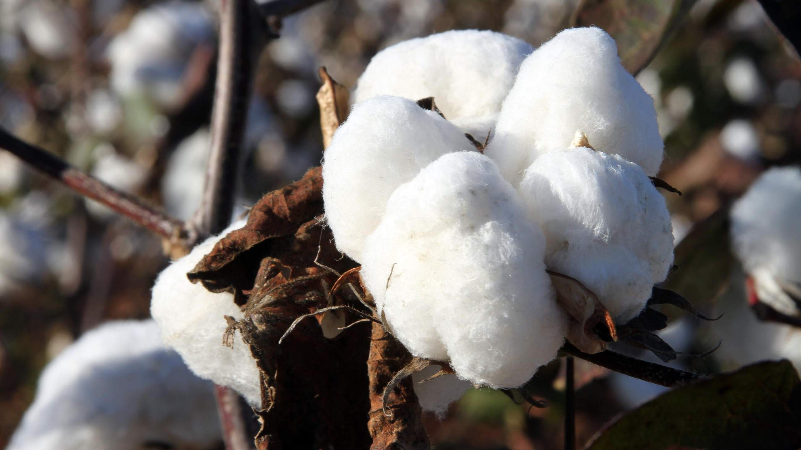




Slide 7

AUTHOR'S PERSPECTIVE
The Global Cotton Balls Market is witnessing significant growth in the near future.
Cotton swabs, also known as Q - t ips, have gained popularity due to their precision in application.
The soft texture and versatility of cotton balls make them popular among consumers for various cosmetic
and personal care applications.
Additionally, the trend of DIY skincare treatments and home spa experiences has further accelerated the
demand for cotton balls in home settings.
In 2023 , the Cotton Balls segment accounted for
noticeable share of global Cotton Balls Market and is projected to experience significant growth in the near future.
The Home segment is expected to expand at the
significant CAGR retaining position throughout the forecast period.

Slide 8

KEY PLAYERS

Slide 9


Contact us
For Full Report
COGNITIVE MARKET RESEARCH
Tel: + 1 312 - 376 - 8303 | + 44 020 - 8123 - 0732
India: ( + 91 ) 983 - 496 - 8611
sales@ cognitivemarketresearch. com
Access the Full Report : http://tinyurl.com/k6en7rcr
Please visit our website:
https://www.cognitivemarketresearch.com

