Slide 1


COPPER KITCHENWARE
MARKET REPORT
2024
Qualitative Analysis + Quantitative Analysis

Slide 2
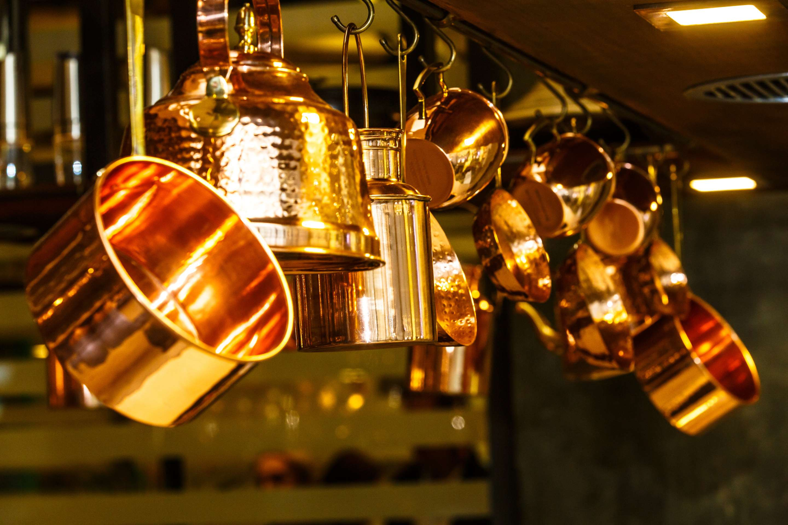
INTRODUCTION
The copper kitchenware market encompasses a range of cookware and utensils made from copper, renowned for its first-rate warmth, conductivity, and aesthetic enchantment. Copper kitchenware consists of pots, pans, bowls, and utensils, prized by chefs and cooking lovers alike for his or her superior overall performance in culinary responsibilities, which include sautéing, simmering, and caramelizing. Beyond capability, copper kitchenware adds a touch of beauty to any kitchen with its lustrous look and timeless appeal. While commonly more expensive than opportunity substances, the sturdiness and excellent heat distribution of copper kitchenware make it a profitable investment for discerning home chefs and expert cooks searching for the highest quality cooking results and culinary sophistication.

Slide 3


KEY INSIGHTS
MARKET SIZE
USD 31581.2 million
2024
CAGR
7.80%
2024- 2031

Slide 4
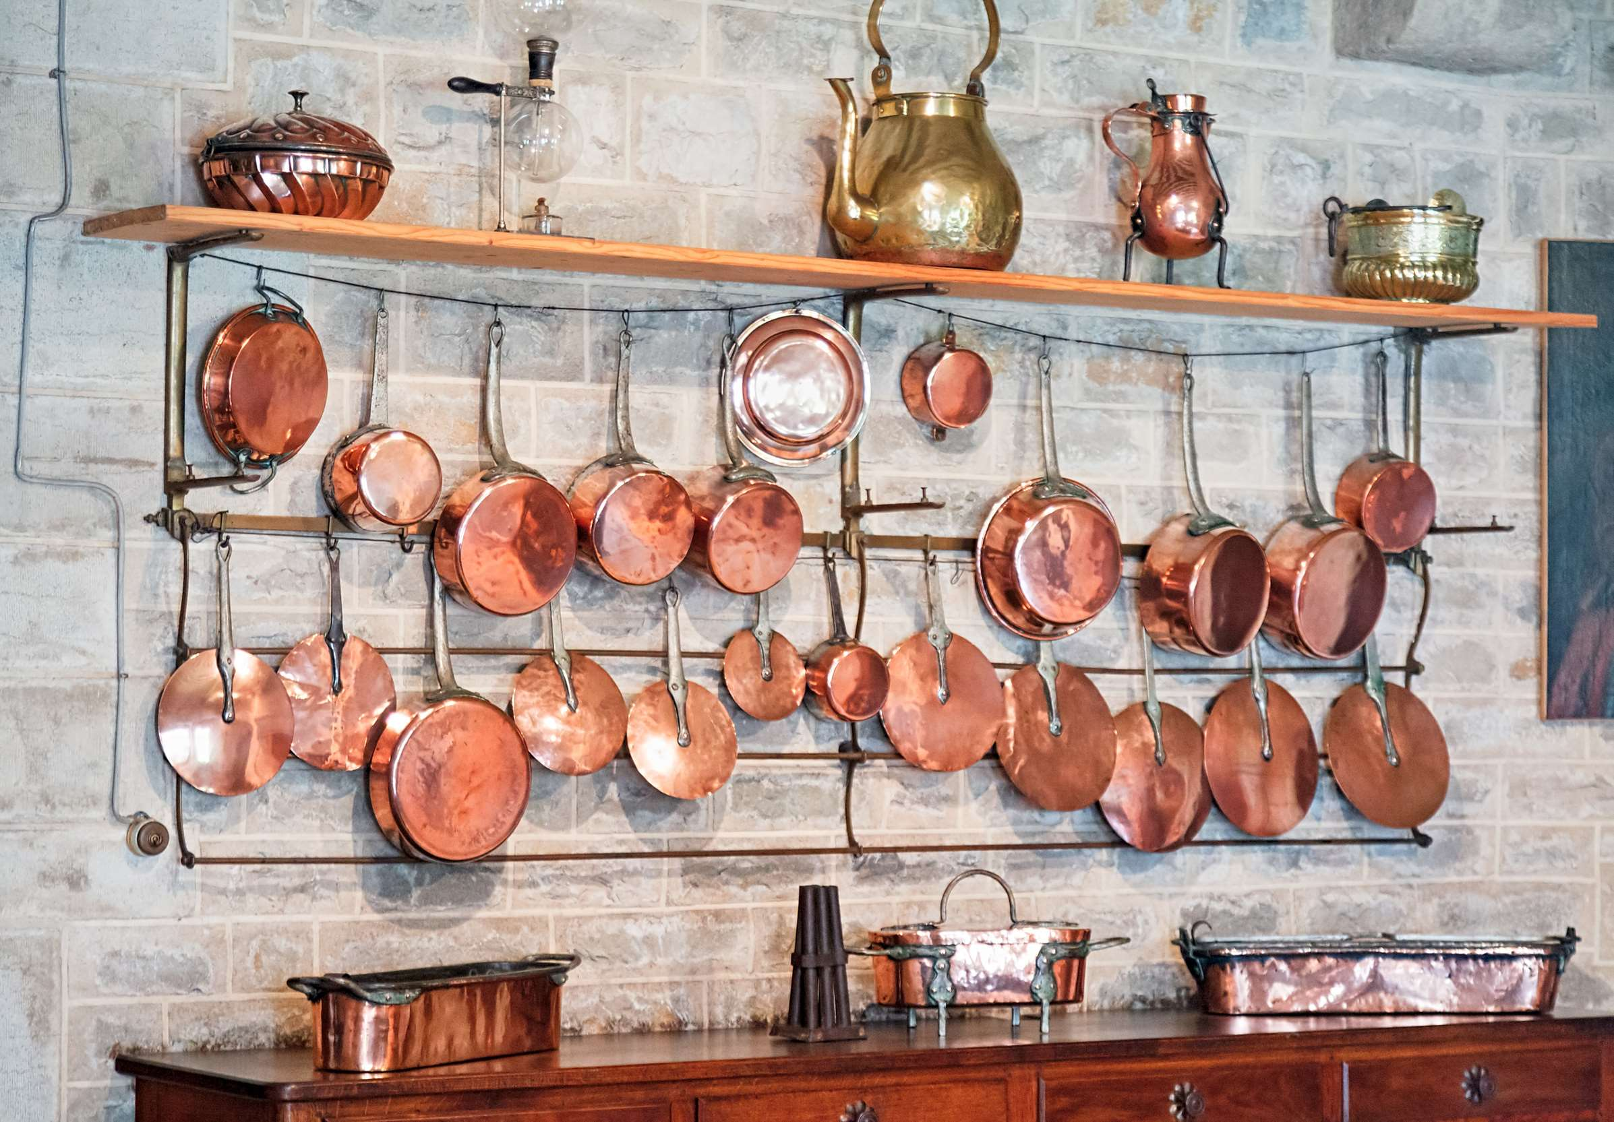
REVENUE MARKET SHARE BY SEGMENTS 2024
  Copper Oven
  Copper Skillet
  Copper Saucepan
Type Segment
  Mid-Range
  Premium
  Luxury
Price Range Segment
Application Segment
  Cooking
  Baking
  Food Storage
  Online Retail
  Specialty Stores
  Department Stores
  Supermarkets/Hypermarkets
Distribution Channel
End User Segment
  Domestic Use
  Commercial Use

Slide 5

North America
40%
North America Copper Kitchenware Market Revenue share for 2024 is 40%

Slide 6
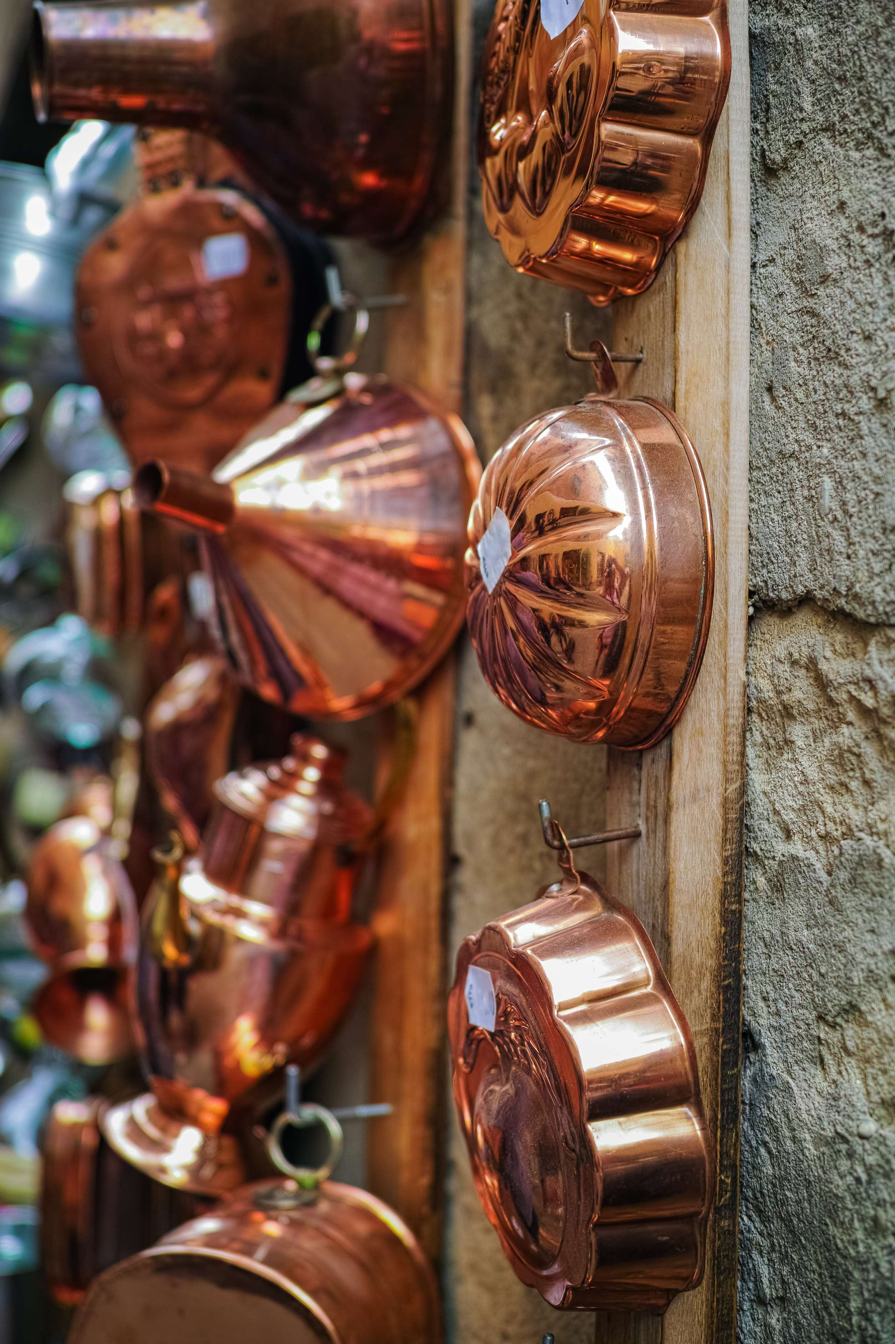
  Superior Heat Distribution to Increase the Demand Globally
  Enhanced Cooking Performance to Propel Market Growth
Drivers
Maintenance Requirements to Limit the Sales
Restraints

Slide 7
AUTHOR'S PERSPECTIVE
  The global Copper Kitchenware market will expand significantly by 7.80% CAGR between 2024 to 2031.
  Copper cookware has a lovely, warm color that provides an air of refinement to any kitchen. Copper's timeless look matches a wide range of design styles, making it a popular choice among homeowners who value aesthetics as well as practicality.
  People are increasingly interested in investing in high-quality cookware to improve their cooking experience. Copper cookware responds to this goal by providing higher performance and a long lifespan.

Slide 8
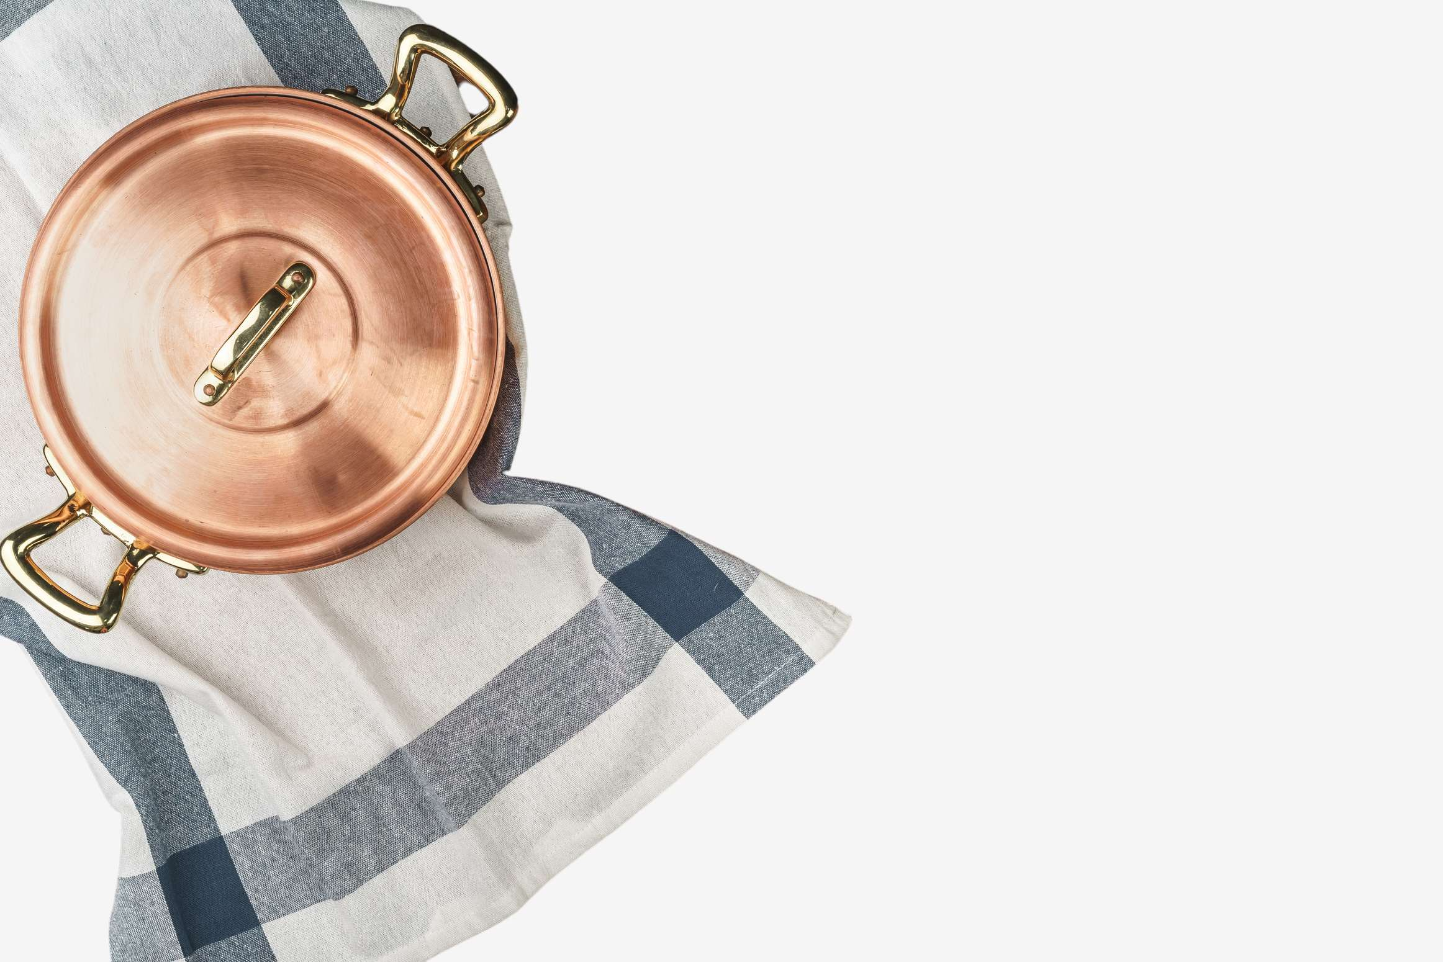











KEY PLAYERS

Slide 9


For Full Report
Contact us
COGNITIVE MARKET RESEARCH
Tel: +1 312-376-8303 | +44 020-8123-0732
India: (+91) 983-496-8611
sales@cognitivemarketresearch.com
Access the Full Report : https://tinyurl.com/39rh85bh
Please visit our website:
https://www.cognitivemarketresearch.com

