Slide 1




COOLERS & INSULATED BAGS
MARKET REPORT
2024
Qualitative Analysis + Quantitative Analysis

Slide 2
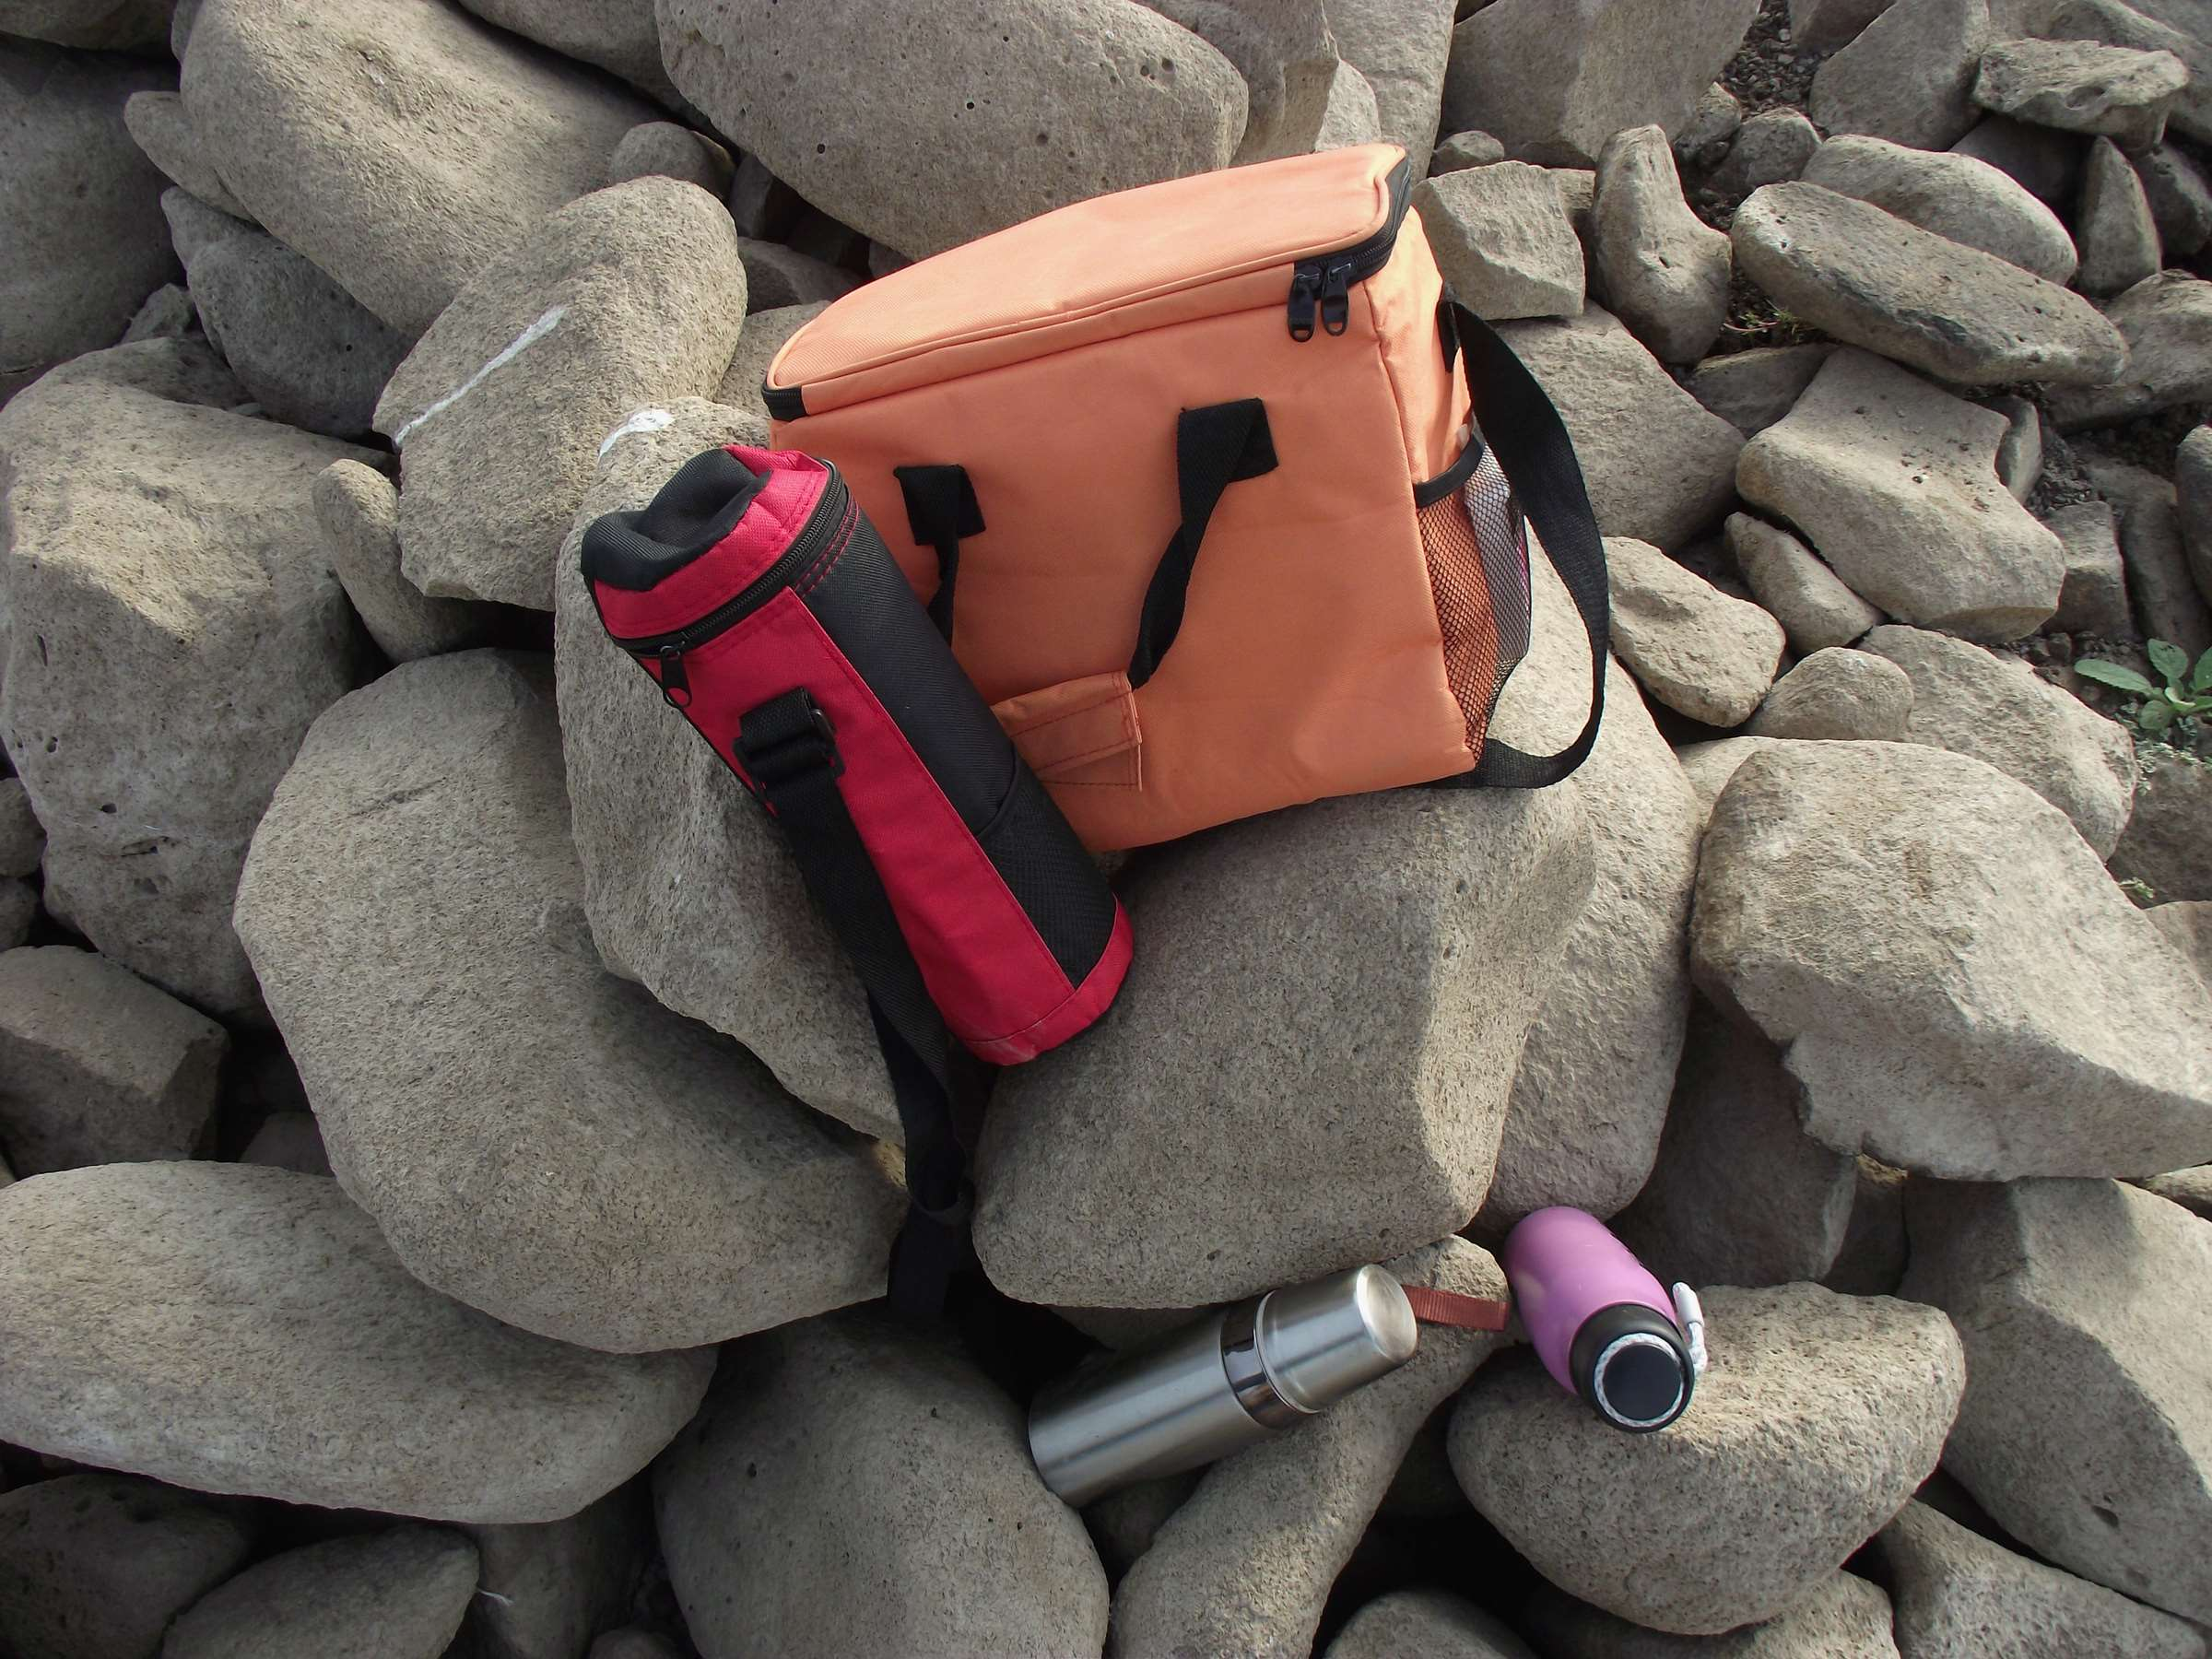
INTRODUCTION
Coolers & insulated bags are portable containers designed to maintain the temperature of their contents, keeping items cold or hot for extended periods. Typically used for storing food, beverages, and perishable items during outdoor activities, picnics, camping trips, or while traveling. They feature insulation materials such as foam, vacuum insulation, or gel, which provide thermal resistance to external temperatures, preserving the freshness and integrity of the stored items. Coolers & insulated bags come in various sizes, designs, and materials, offering versatility and convenience for users seeking reliable solutions for temperature-sensitive storage needs.

Slide 3
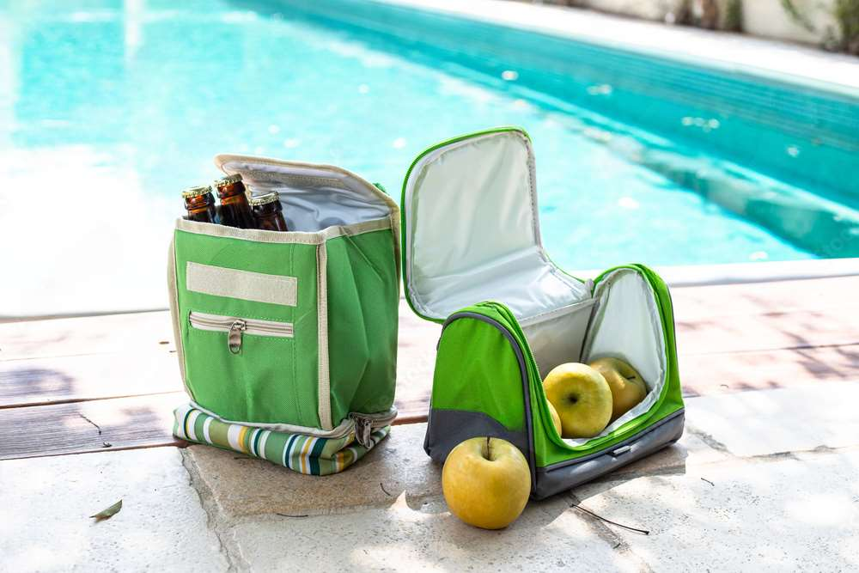

KEY INSIGHTS
CAGR
6.90%
2024- 2031

Slide 4

REVENUE MARKET SHARE BY SEGMENTS 2024
  Hard Coolers & Insulated Bags
  Soft Coolers & Insulated Bags
  Online
  Offline
Type Segment
Sales Channel Segment
  Fishing/Marine
  Hunting
  Camping
  School
  Plastic
  Metal
  Fabric
Application
Segment
Material Segment
  Up to 10 Liters
  10-30 Liters
  30-50 Liters
  More than 50 Liters
  Foam
  Vacuum
  Gel
Volume Segment
Insulation Segment

Slide 5

North America
40%
North America Coolers And Insulated Bags Market Revenue share for 2024 is 40%

Slide 6
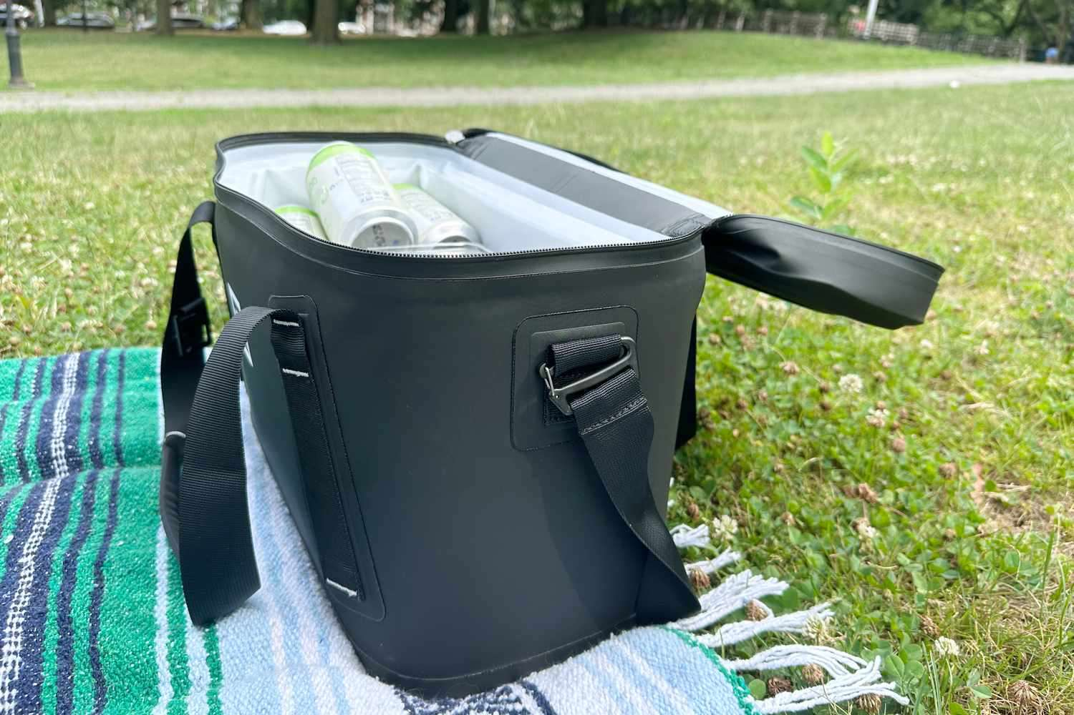
Shifts Towards Healthier Eating Habits to Propel Market Growth
Drivers
Fluctuations in Demand due to Seasonal Factors can Lead to Limit the Sales
Restraints

Slide 7
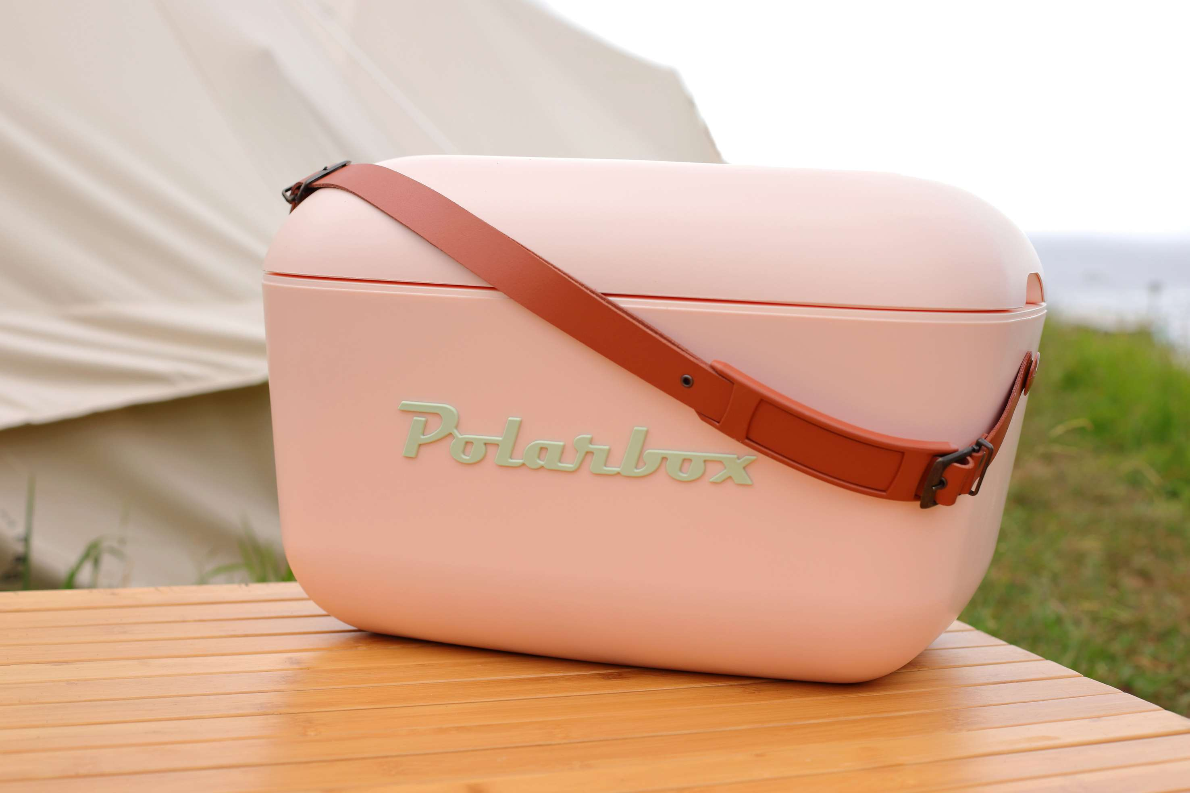
AUTHOR'S PERSPECTIVE
  The global coolers & insulated bags market will expand significantly by 6.90% CAGR between 2024 to 2031.
  The sales of soft coolers & insulated bags are expected to increase due to their lightweight, portable design, versatility for various outdoor activities, and increasing consumer preference for convenient and durable cooling solutions.
  Camping sales are on the rise due to growing interest in outdoor recreation, desire for immersive nature experiences, and increased emphasis on wellness and disconnecting from technology for relaxation.
  The soft coolers & insulated bags held the highest coolers & insulated bags market revenue share in 2024.

Slide 8
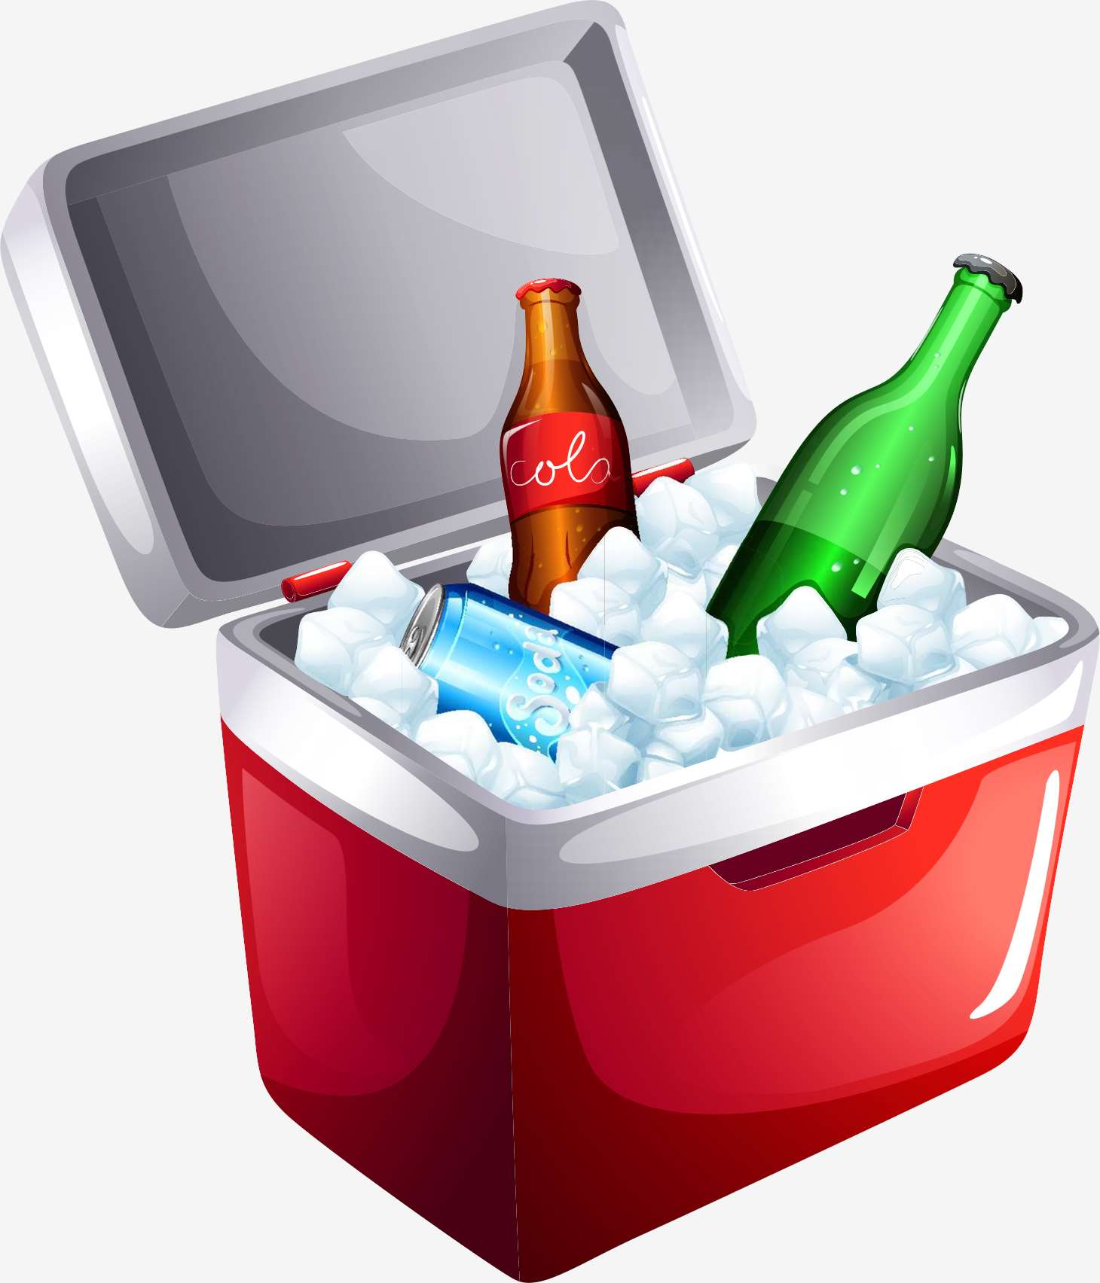
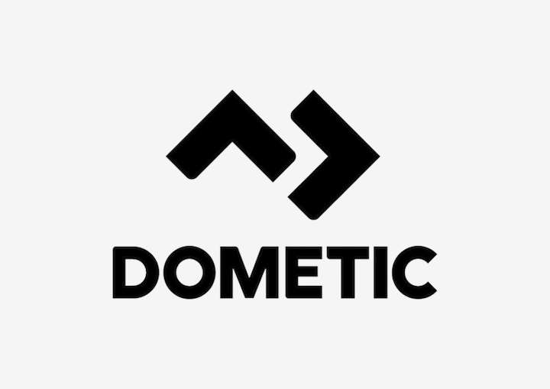
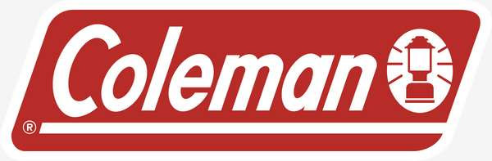




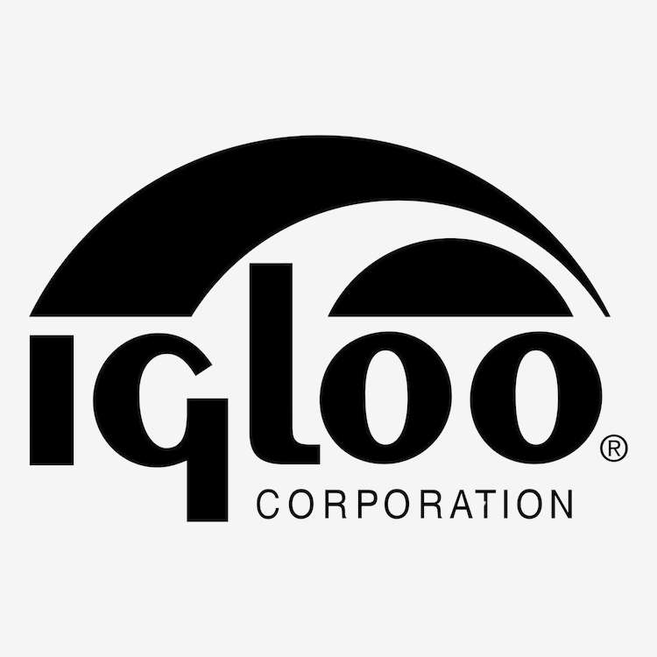

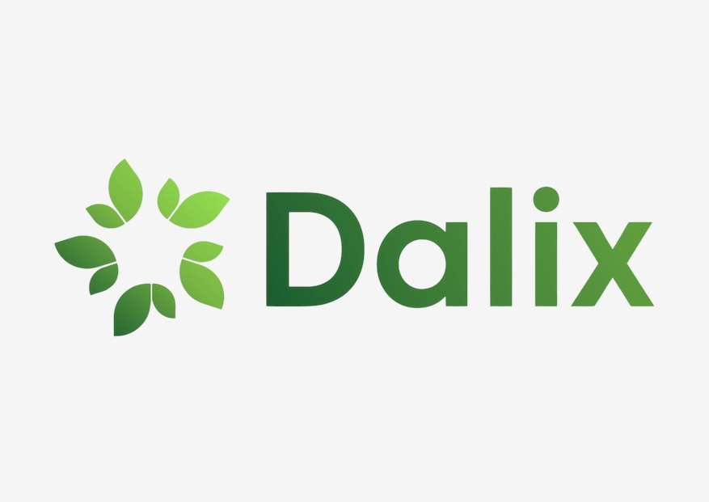
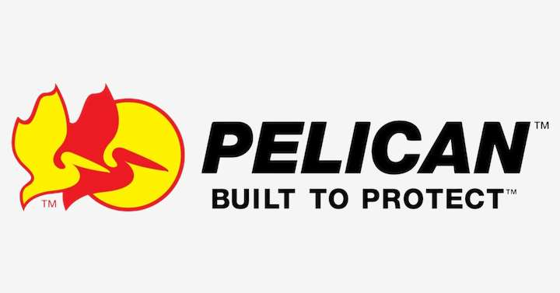
KEY PLAYERS

Slide 9


For Full Report
Contact us
COGNITIVE MARKET RESEARCH
Tel: +1 312-376-8303 | +44 020-8123-0732
India: (+91) 983-496-8611
sales@cognitivemarketresearch.com
Access the Full Report : https://tinyurl.com/2yak2zz9
Please visit our website:
https://www.cognitivemarketresearch.com

