Slide 1

GLOBAL
CONVENIENCE FOODS
MARKET REPORT
2024
Global,Regional,CountryAnalysis

Slide 2
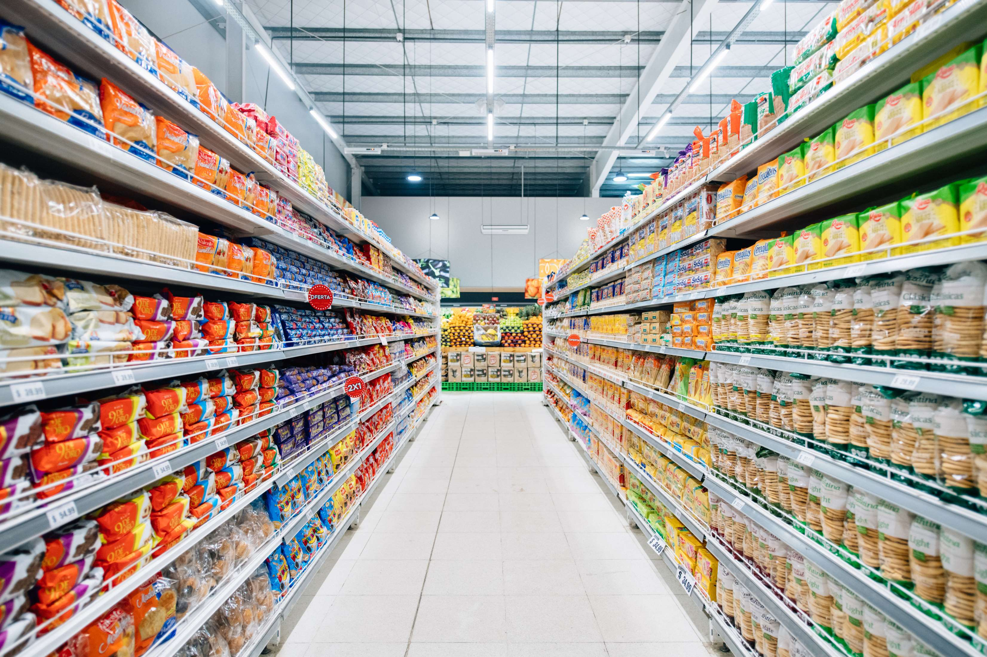
INTRODUCTION
Increasing demand for ready-to-eat snacks, strong demand from developing countries, rising discretionary income, a busy lifestyle, and an increasing working population are the primary reasons for expanding the convenience food industries. It is anticipated that the industry will have a chance to grow thanks to new goods in the natural ingredient, convenience, and organic food categories, as well as advancements in packaging development. Because ready-to-eat meals are more expensive, high disposable income and a rising standard of living are predicted to fuel the desire for convenience food even more. Because they work long hours, the millennial generation, which is rapidly rising, is following the trend of consuming convenience food. Similarly, customer demand is anticipated to be driven by the quick and simple preparation of convenience meals.

Slide 3


KEY INSIGHTS
MARKET SIZE
USD 621.5 billion
2023
CAGR
7.60%
2023- 2030

Slide 4

REVENUE MARKET SHARE BY SEGMENTS 2022
  Meat/Poultry Products
  Cereal Based Products
  Vegetables Based Products
Type Segment
  Frozen Foods
  Canned Foods
  Chilled Foods
  Ready-to-Eat Foods
Packaging Segment
  Supermarkets/Hypermarkets
  Specialty Stores
  Convenience Stores
  Online Stores
Distribution Channel

Slide 5

Global Convenience Foods Market Revenue share for 2024
North America

Slide 6
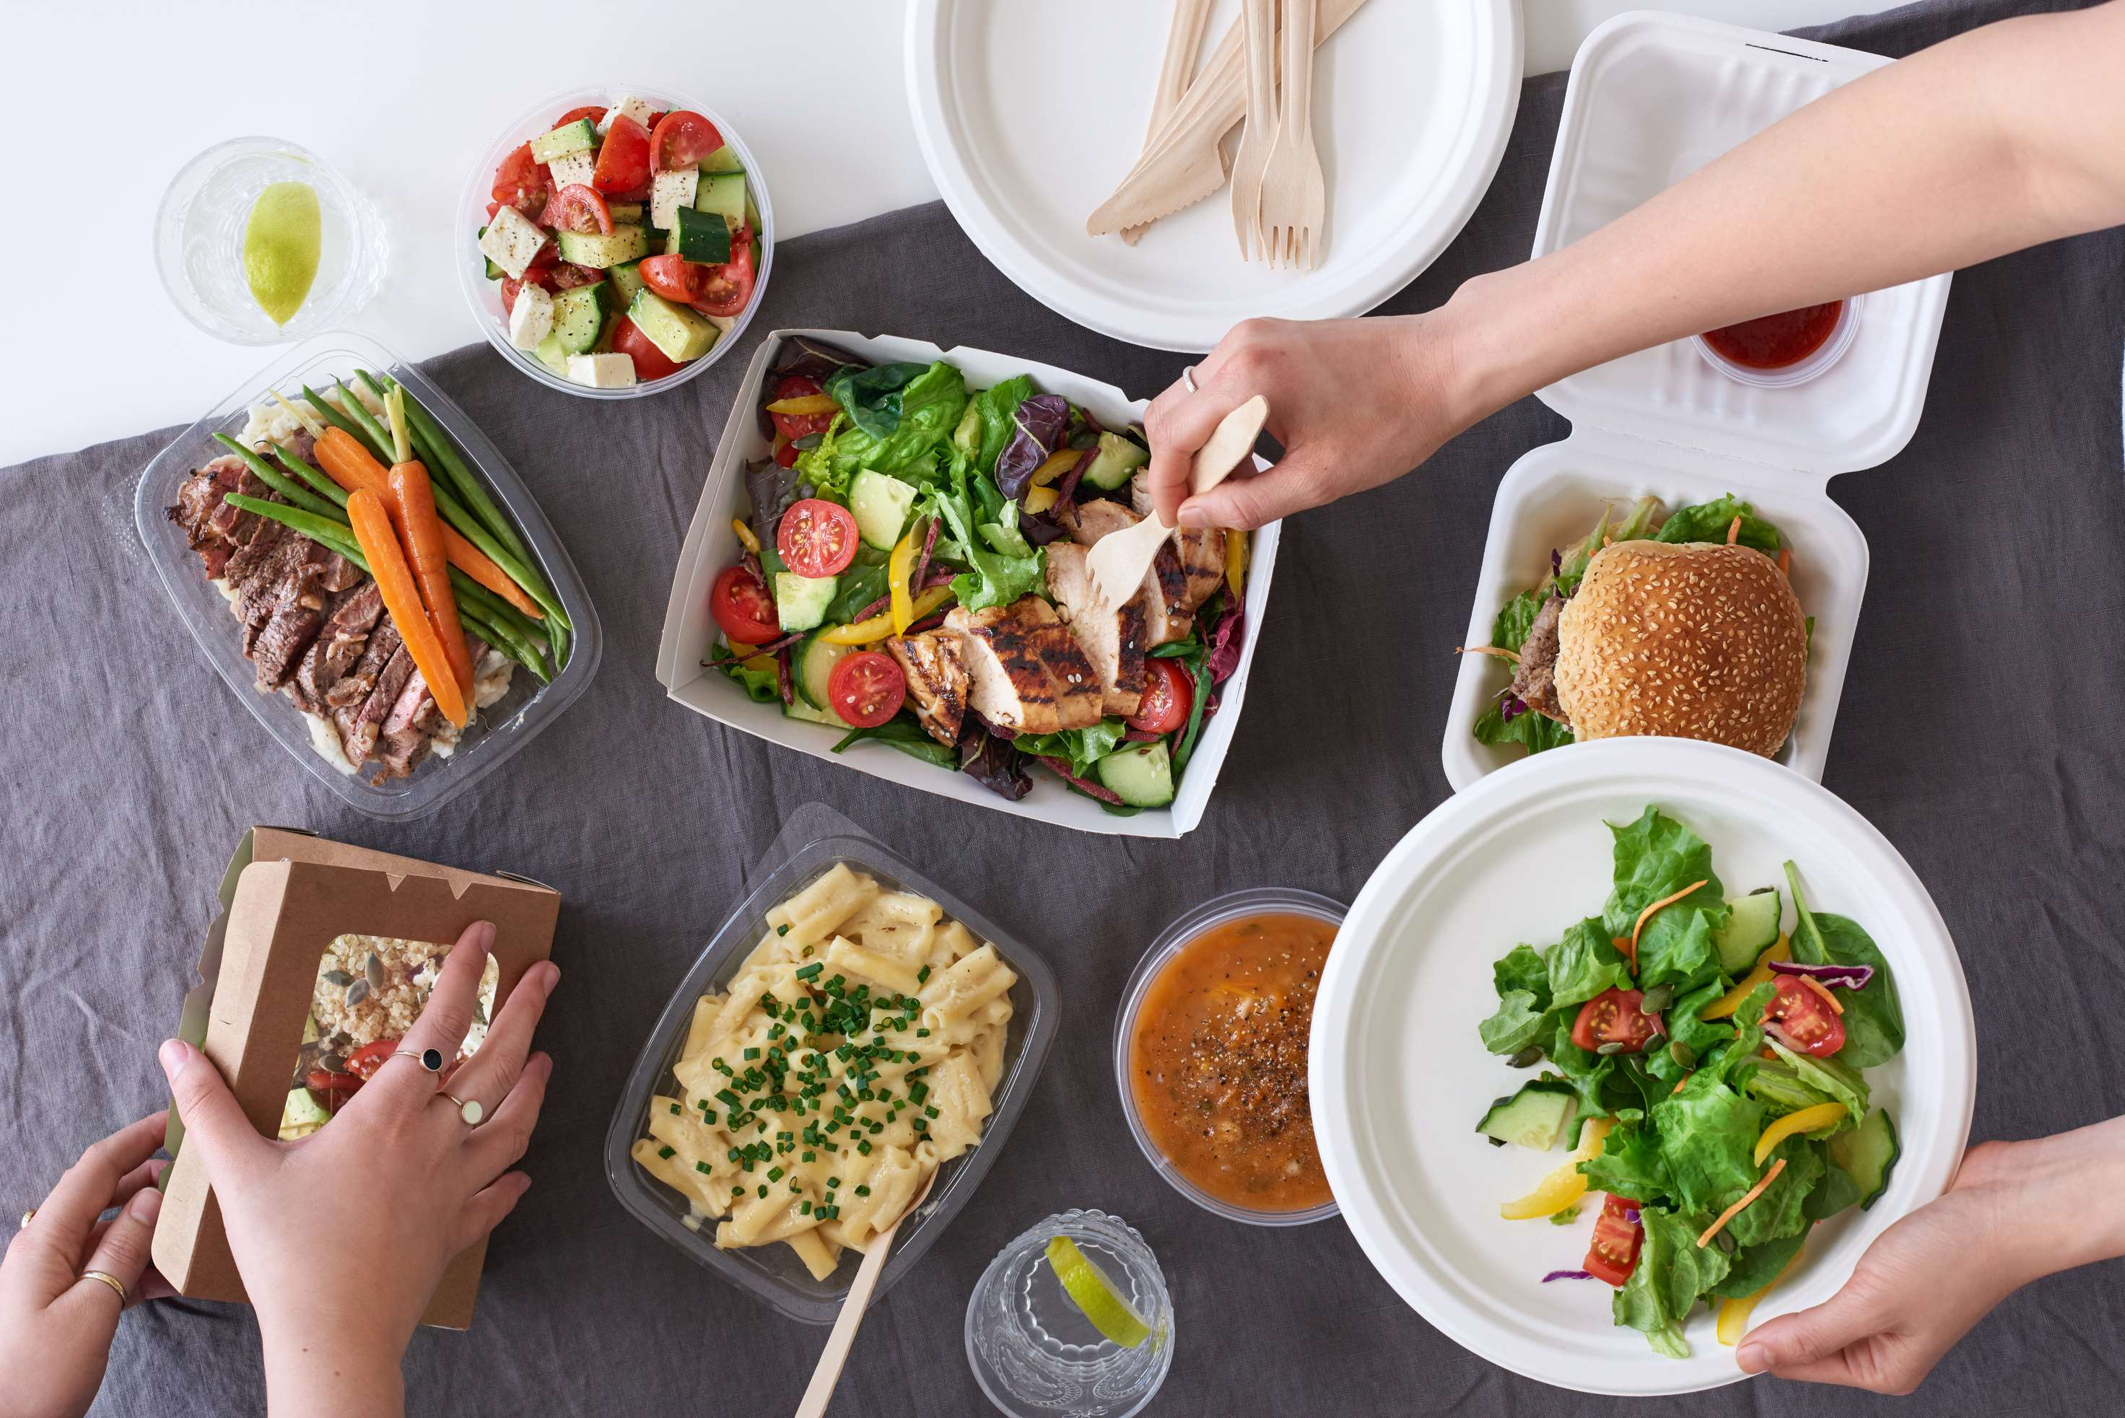
Rising Popularity of Immediate Food Demand is Expected to Propel Market Growth
Drivers
Rising Number of Stringent Regulations to Hinder Market Growth
Restraints

Slide 7
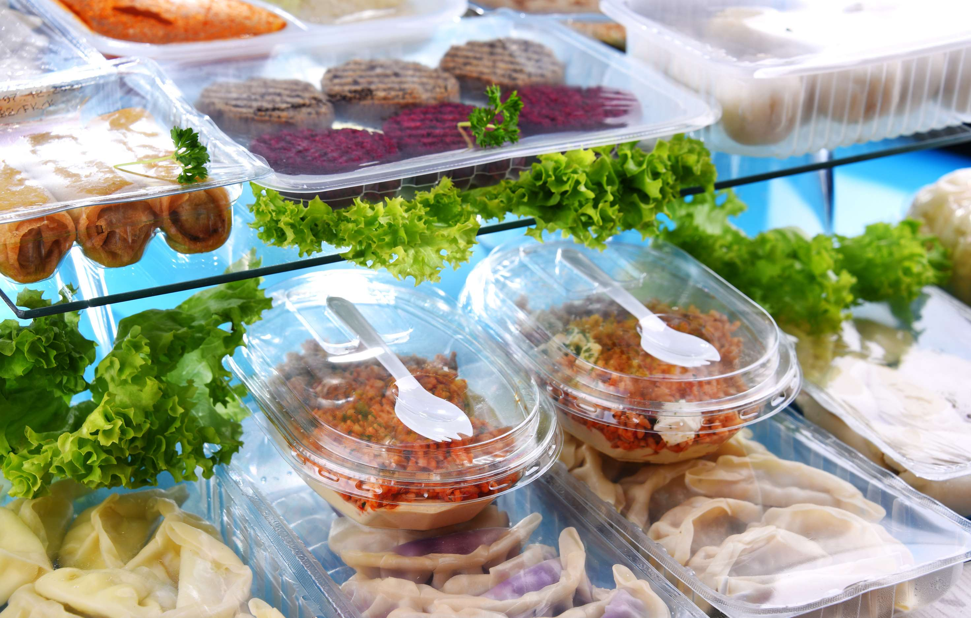
AUTHOR'S PERSPECTIVE
  The Global Convenience Foods Market is witnessing significant growth in the near future.
  Vegetables-based products, such as convenience foods, were the most popular category, accounting for more than 50% of the overall revenue.
  Consuming lots of fruits and vegetables can lower blood pressure, reduce the chance of cardiac problems and prevent some cancers, cut the risk of digestive and ocular issues, and improve blood sugar regulation, which can help control appetite.
  Convenience foods for convenience stores rank second most popular segment because convenience stores are a terrific place to find fantastic food at affordable costs because they frequently offer discounts and promotions.

Slide 8





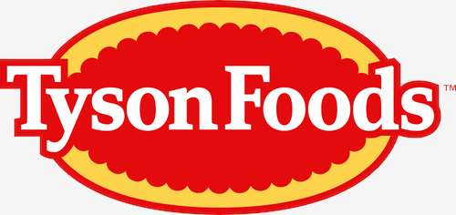







KEY PLAYERS

Slide 9


For Full Report
Contact us
COGNITIVE MARKET RESEARCH
Tel: +1 312-376-8303 | +44 020-8123-0732
India: (+91) 983-496-8611
sales@cognitivemarketresearch.com
Access the Full Report : https://rb.gy/q8spyo
Please visit our website:
https://www.cognitivemarketresearch.com

