Slide 1
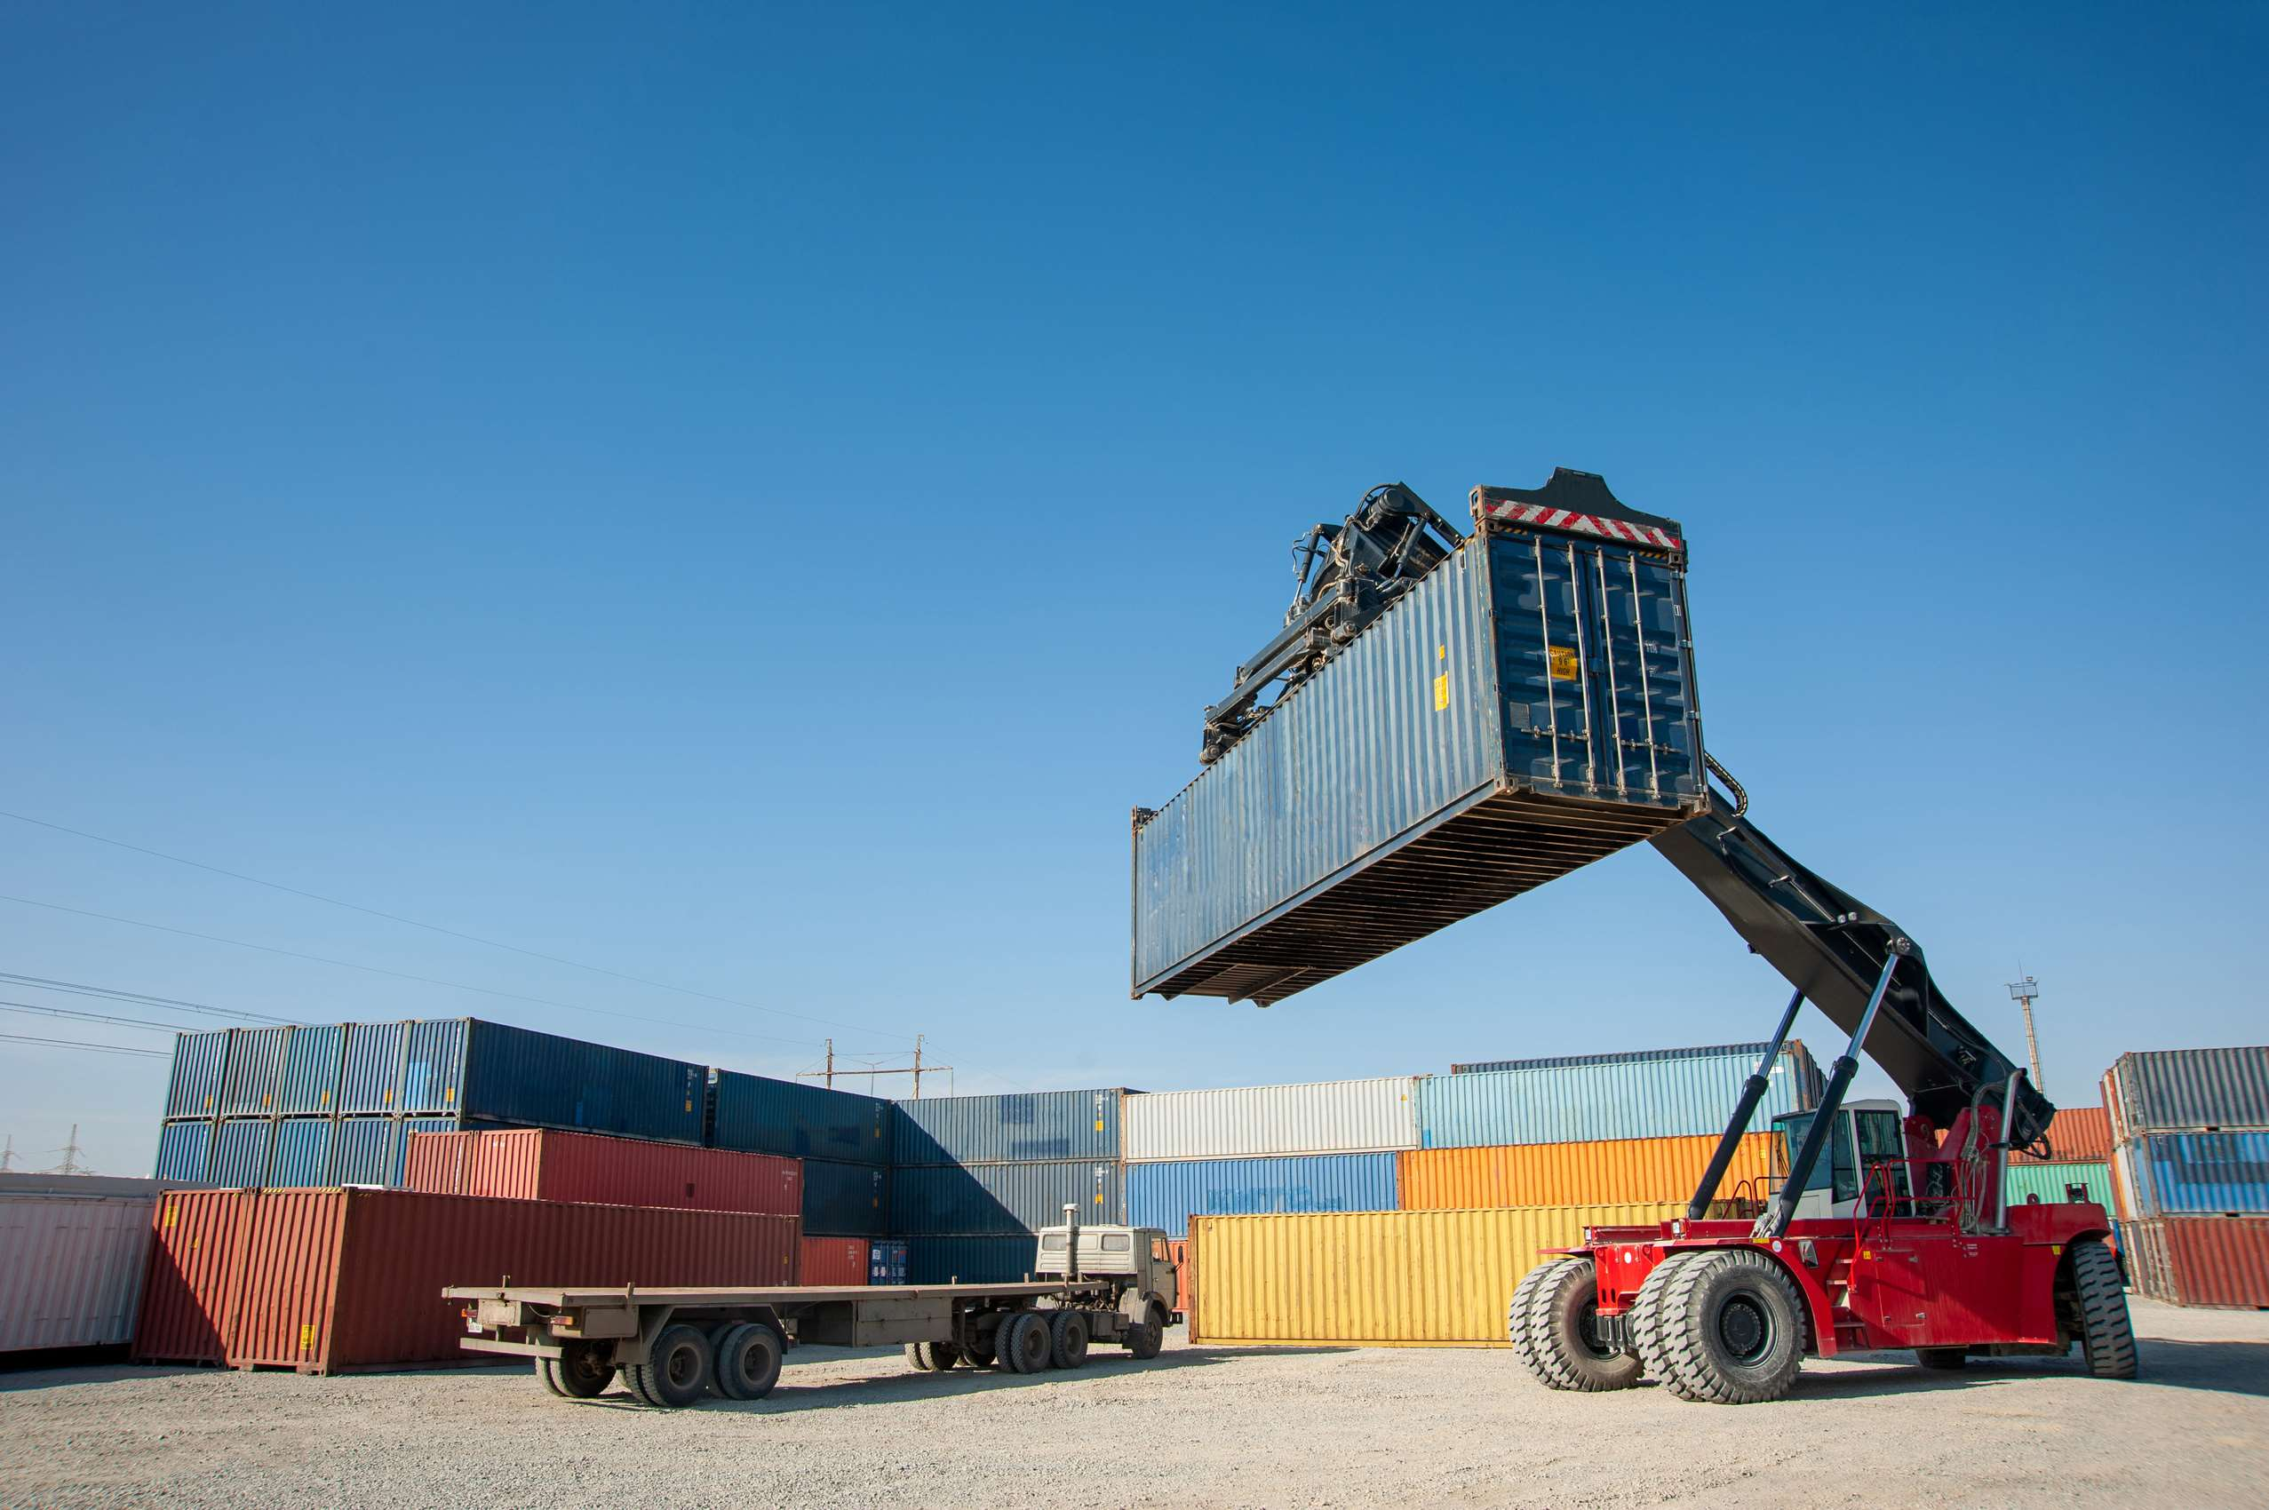
GLOBAL
CONTAINER HANDLER
MARKET REPORT 2024
Global,Regional,CountryAnalysis

Slide 2
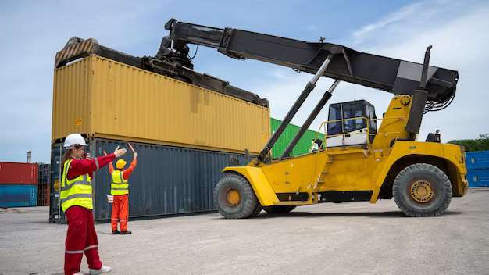
INTRODUCTION
A container handler is a specialized forklift that can stack empty containers as well as lift and move heavy full containers. Their movement and operation are smooth and accurate, and they come in a variety of functions and designs to fit any container handling need. They are made to maximize productivity, with ergonomics and safety at the forefront of the design and usage.

Slide 3
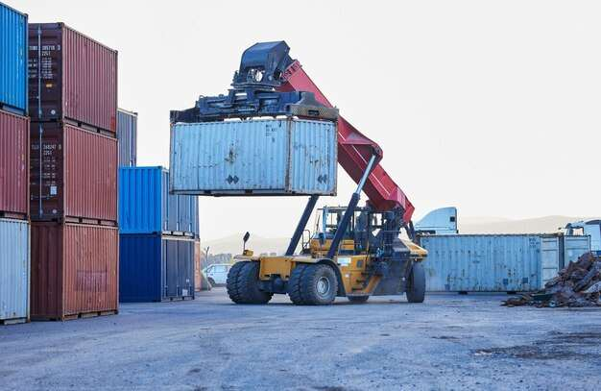

KEY INSIGHTS
MARKET SIZE
USD 1,452.75 Million
2016
FORECAAST
USD 2,085.94 Million
2028
CAGR
5.74%
2023- 2030

Slide 4
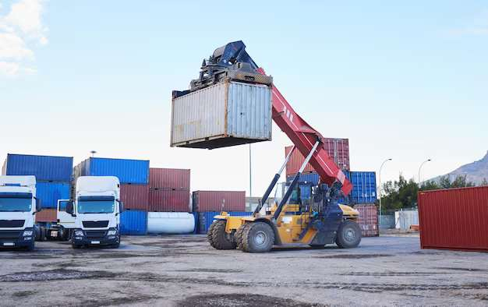
REVENUE MARKET SHARE BY SEGMENTS 2022
Type Segment
Tonnage Segment
End-User
Empty container handler
USD 825.65 Million
Below 30 Ton
USD 431.20 Million
Port & Dock
USD 1,140.32 Million

Slide 5

Global Container Handler Market Revenue share for 2022
North America
USD 543.18 Million

Slide 6
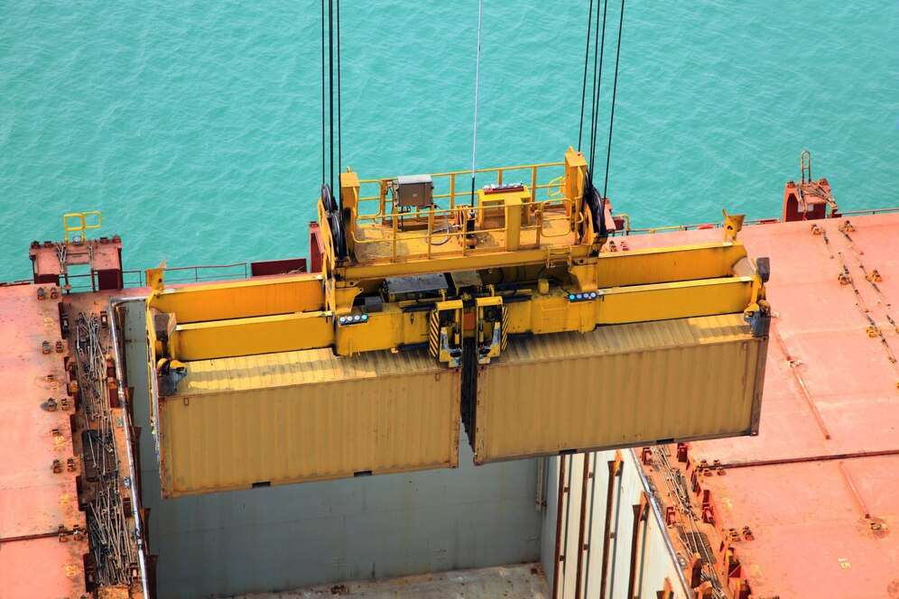
Rising international trades owing to globalization and industrialization
Drivers
Higher cost associated with use of container handler
Restraints

Slide 7
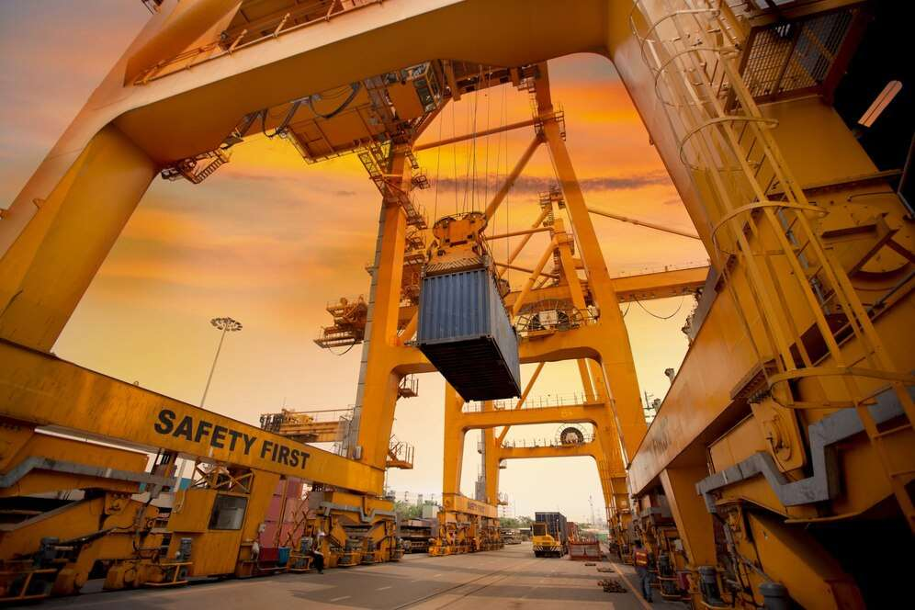
AUTHOR'S PERSPECTIVE
  Global Container Handler Market Report 2023 talks about crucial market insights with the help of segments and sub-segments analysis.
  Empty container handlers have outstanding agility and mobility.
  Container handlers with a lifting capacity of up to 30 tonnes are commonly used for light-duty applications.
  Shipping containers revolutionized the movement of goods, driving change and efficiency throughout the global supply chain.

Slide 8














KEY PLAYERS

Slide 9
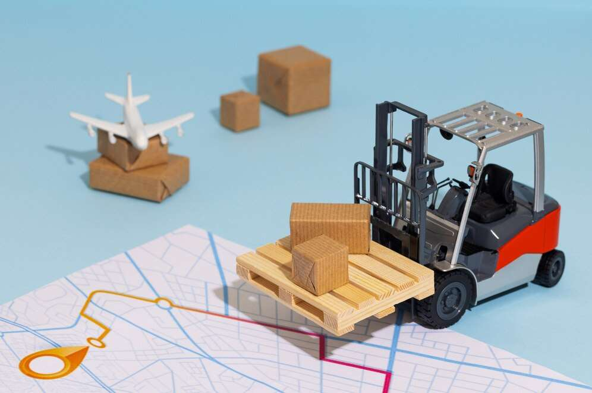

For Full Report
Contact us
COGNITIVE MARKET RESEARCH
Tel: +1 312-376-8303 | +44 020-8123-0732
India: (+91) 983-496-8611
sales@cognitivemarketresearch.com
Access the Full Report : https://tinyurl.com/mrx27pdk
Please visit our website:
https://www.cognitivemarketresearch.com

