Slide 1
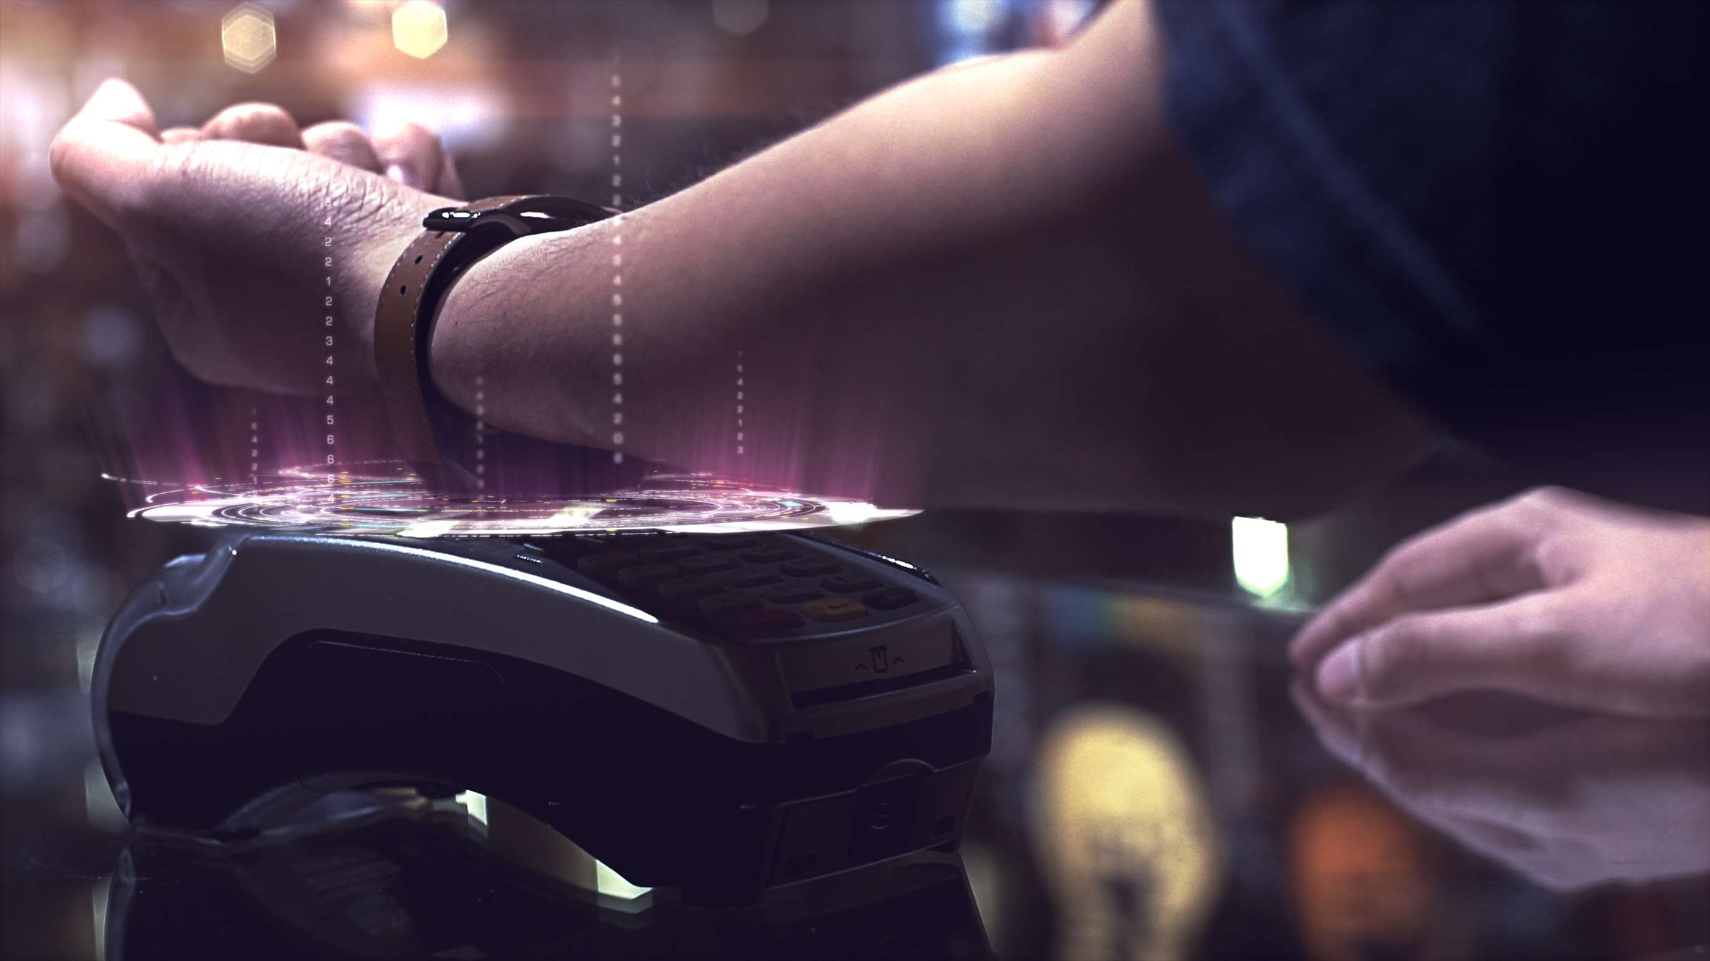
CONTACTLESS BIOMETRICS TECHNOLOGY MARKET REPORT

Slide 2
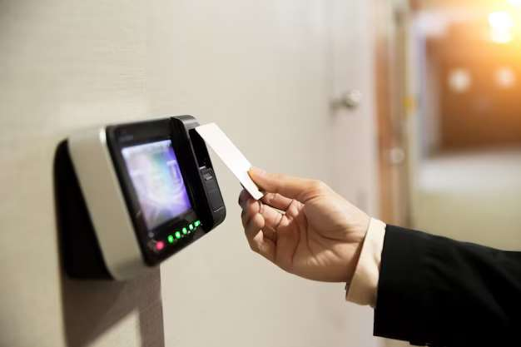
INTRODUCTION
Contactless Biometrics technology is gaining traction due increase awareness about this technology among smartphone users followed by growing penetration of internet users. This technology includes a secured layer of verification through fingerprint and facia & voice recognition activities.

Slide 3
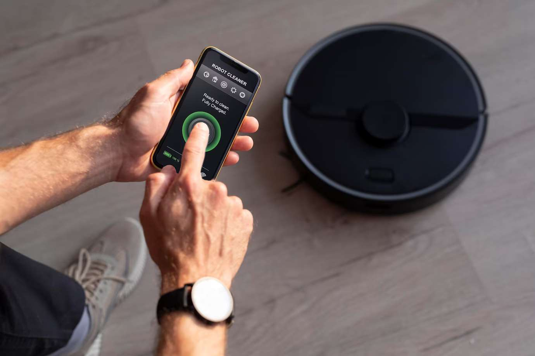

KEY INSIGHTS
MARKET SIZE
$11.93 Bn
2022
FORECAST
$ 48.23 Bn
2030
CAGR
19.1%
2030

Slide 4
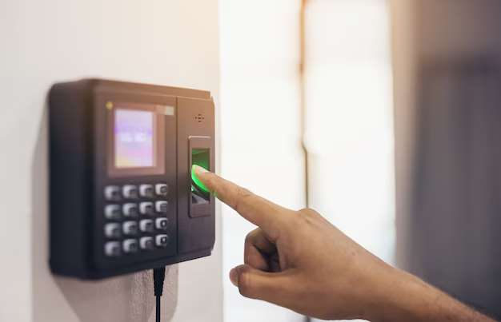


REVENUE MARKET SHARE BY SEGMENTS 2022
  Component
Software-
45.24%
  End-use
Government: 28.23%

Slide 5
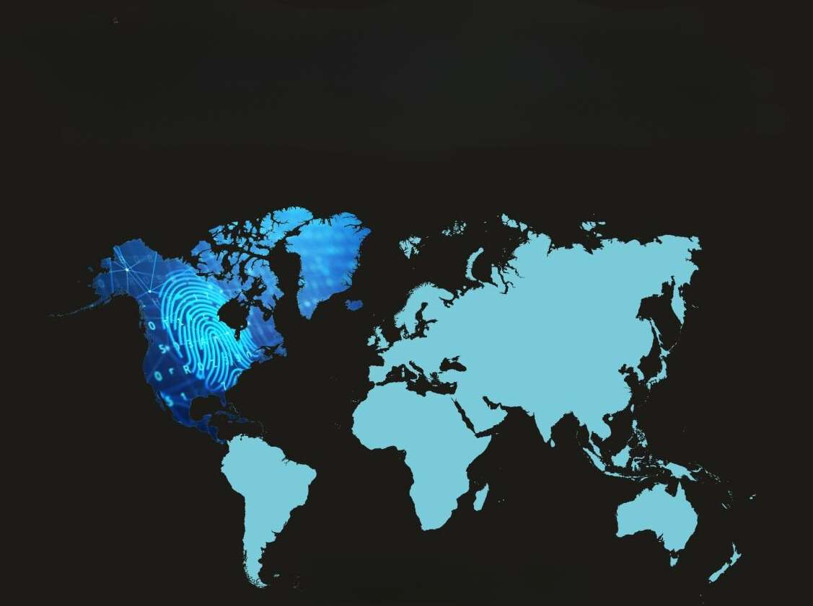
GLOBAL CONTACTLESS BIOMETRICS TECHNOLOGY MARKET REVENUE SHARE FOR 2022
North America:
31.62%

Slide 6
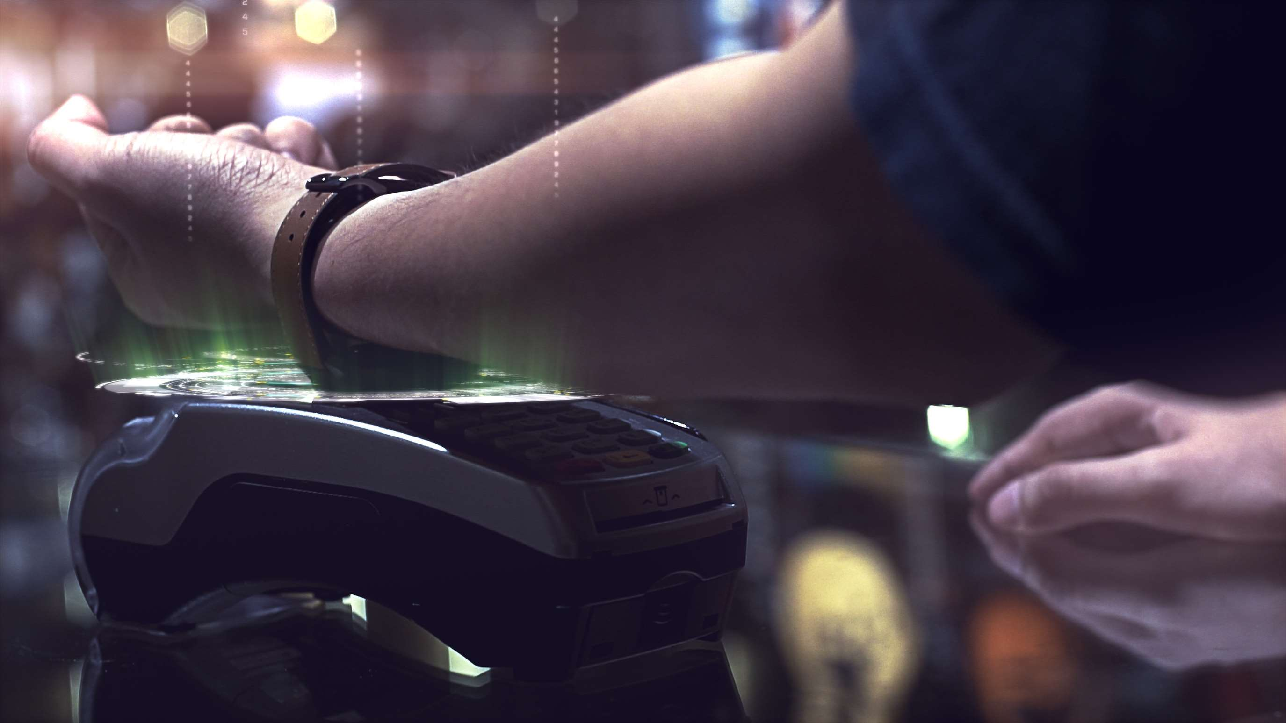
Increasing need for more secure and advanced identification
Drivers
Restraints
High cost of contactless biometric technology

Slide 7
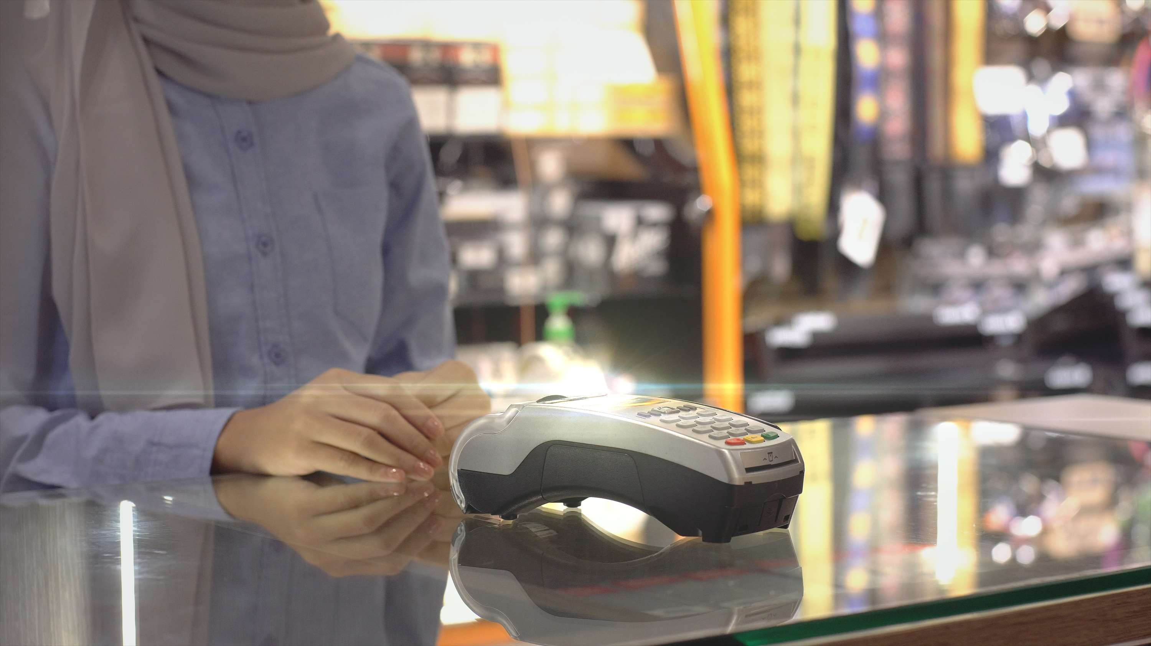
  The software segment dominated the market, in 2022 and is anticipated to retain its dominance in the coming years.
Author's Perspective
  The Corona pandemic has fueled the rapid adoption of contactless biometrics devices.
  Face recognition and IRIS have been majorly adopted by several businesses for building a robust access control system to prevent the spread of COVID-19.

Slide 8








KEY PLAYERS

Slide 9


For Full Report
Contact us
COGNITIVE MARKET RESEARCH
Tel: +1 312-376-8303 | +44 020-8123-0732
India: (+91) 983-496-8611
sales@cognitivemarketresearch.com
Access the Full Report : https://shorturl.at/gvzCT
Please visit our website:
https://www.cognitivemarketresearch.com

