Slide 1
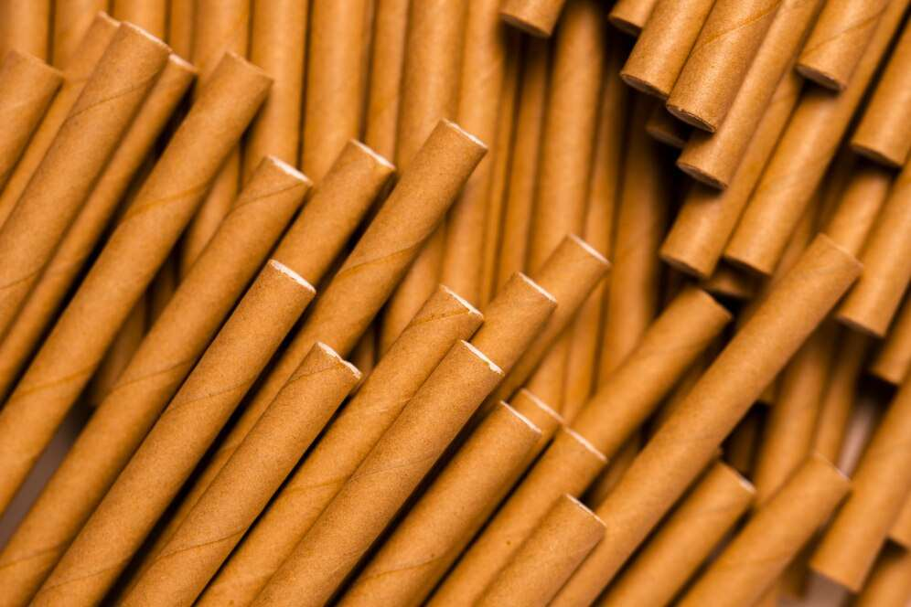
GLOBAL
COMPOSTABLE STRAW
MARKET REPORT 2024
Global,Regional,CountryAnalysis

Slide 2

INTRODUCTION
Compostable straws are considered to be eco-friendly straws which requires commercial or home composters for its proper degradation. These are made from the plant material which are compostable and can be fully compost in commercial compost facilities to produce useful end product such as fertilizers.

Slide 3


KEY INSIGHTS
MARKET SIZE
USD 157.78 Million
2017
FORECAAST
USD 354.48 Million
2028
CAGR
11.04%
2023- 2030

Slide 4

REVENUE MARKET SHARE BY SEGMENTS 2022
Type Segment
Size Segment
PLA
USD 295.91 Million
7.75”
USD 85.03 Million
Application Segment
Distribution channel
Drinks
USD 222.08 Million
Online
USD 154.15 Million

Slide 5

Global Compostable Straw Market Revenue share for 2022
North America
USD 121.69 Million

Slide 6

A Rising concern associated with plastic waste generation
Drivers
Requirement of proper management
Restraints

Slide 7
AUTHOR'S PERSPECTIVE
  Global Compostable Straw Market Report 2023 talks about crucial market insights with the help of segments and sub-segments analysis.
  PLA straws are referred to corn-based bioplastic made of a biodegradable resin obtain from corn starch and are 100% compostable.
  As the drinking product are being widely made available in the restaurant, hotels, and in the form of packaged drinking products, the market of compostable drinking straw has significant share in drinks application.
  Several others sizes straw such as 4-5inch cocktail straws, and straw with different width are available in market which includes slims straw for cocktail (0.15inch), super jumbo straw with 0.25inch and bubble tea straw with 0.4inch, among others.

Slide 8

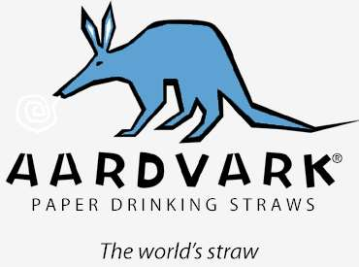

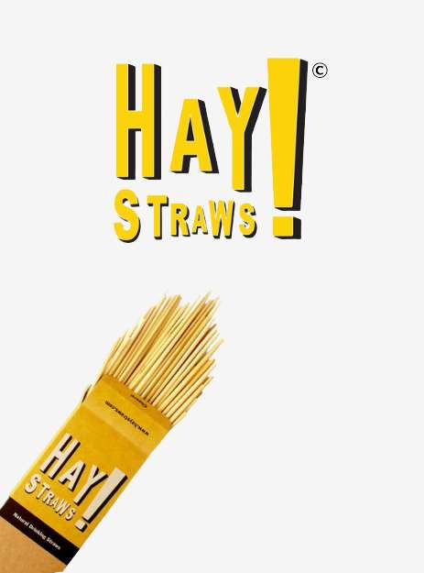






KEY PLAYERS

Slide 9


For Full Report
Contact us
COGNITIVE MARKET RESEARCH
Tel: +1 312-376-8303 | +44 020-8123-0732
India: (+91) 983-496-8611
sales@cognitivemarketresearch.com
Access the Full Report :https://tinyurl.com/2ecbdvfx
Please visit our website:
https://www.cognitivemarketresearch.com

