Slide 1
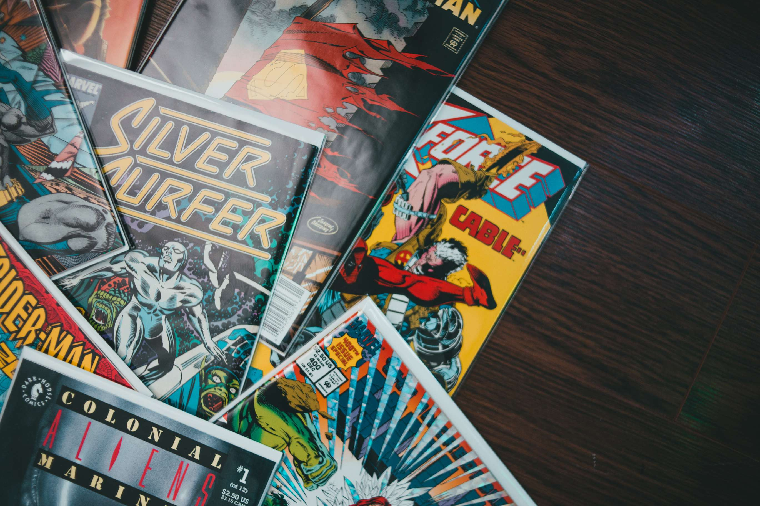
GLOBAL
COMIC BOOK
MARKET REPORT
2024
Global,Regional,CountryAnalysis

Slide 2

INTRODUCTION
The comic book market encompasses buying, selling, and collecting comic books, including physical and digital formats. It involves enthusiasts, collectors, publishers, and retailers engaging in commerce and fandom surrounding sequential art storytelling. The comic book market is witnessing dynamic growth as key players release diverse new titles to bolster their market presence. With an influx of creative content, companies aim to engage existing fans while attracting new audiences. This strategy drives innovation and competition, fostering a vibrant storytelling and artistic expression ecosystem. Expanding comic book offerings reflects a commitment to cater to evolving tastes and demographics, ensuring the industry remains relevant and thriving.

Slide 3
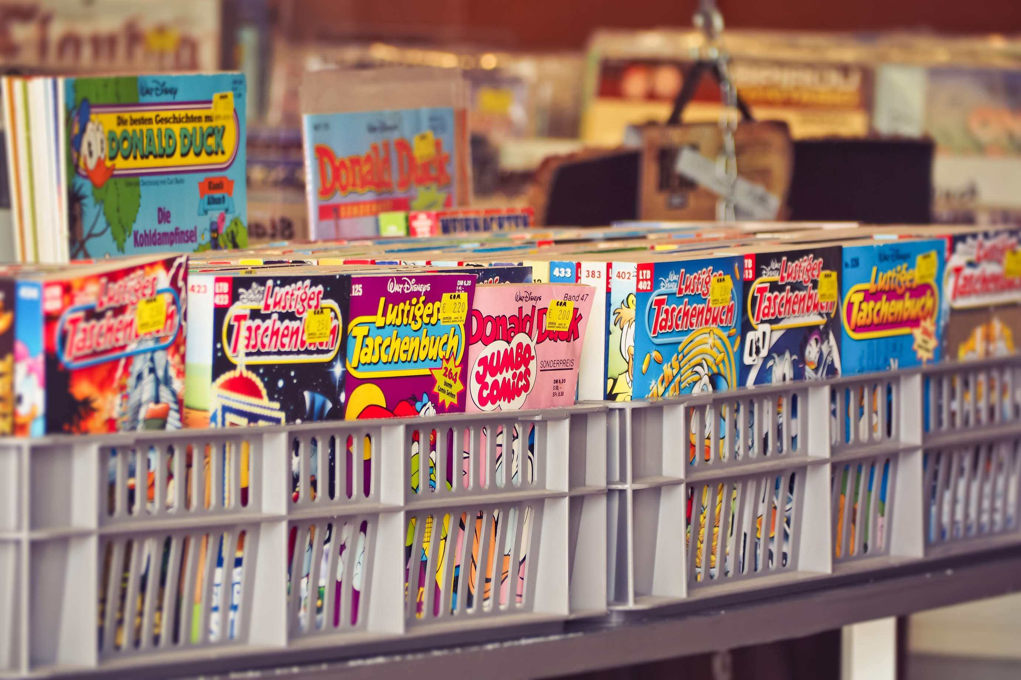

KEY INSIGHTS
CAGR
5.20%
MARKET SIZE
USD 15214.2 million
2024
2024- 2031

Slide 4
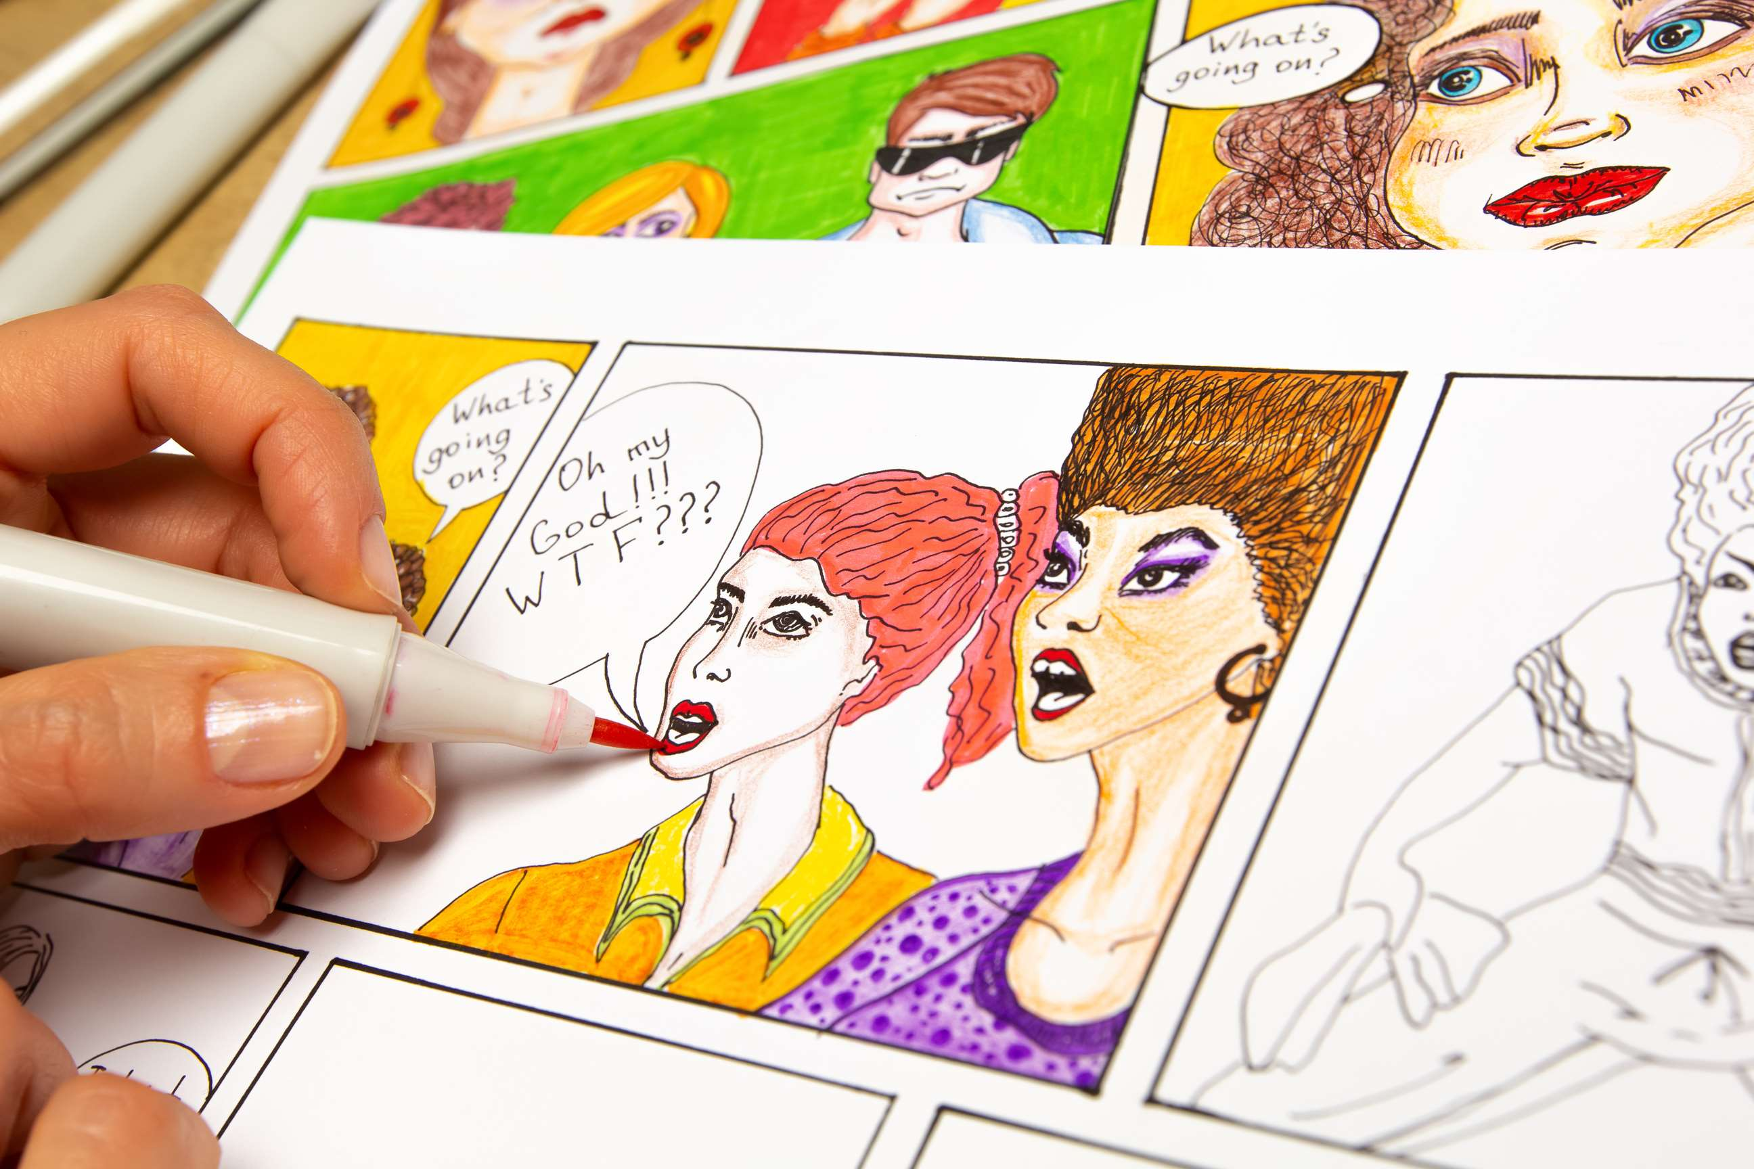
REVENUE MARKET SHARE BY SEGMENTS 2022
  Book Stores
  Comic Stores
  Online Stores
  Physical Comic Book
  Digital Comic Book
Distribution Channel
Type Segment
  Science-Fiction
  Manga
  Superhero
  Non-Fiction
  Male
  Female
  Children
End-User Segment
Genre Segment

Slide 5

Global Comic Book Market Revenue share for 2024
North America
40%

Slide 6
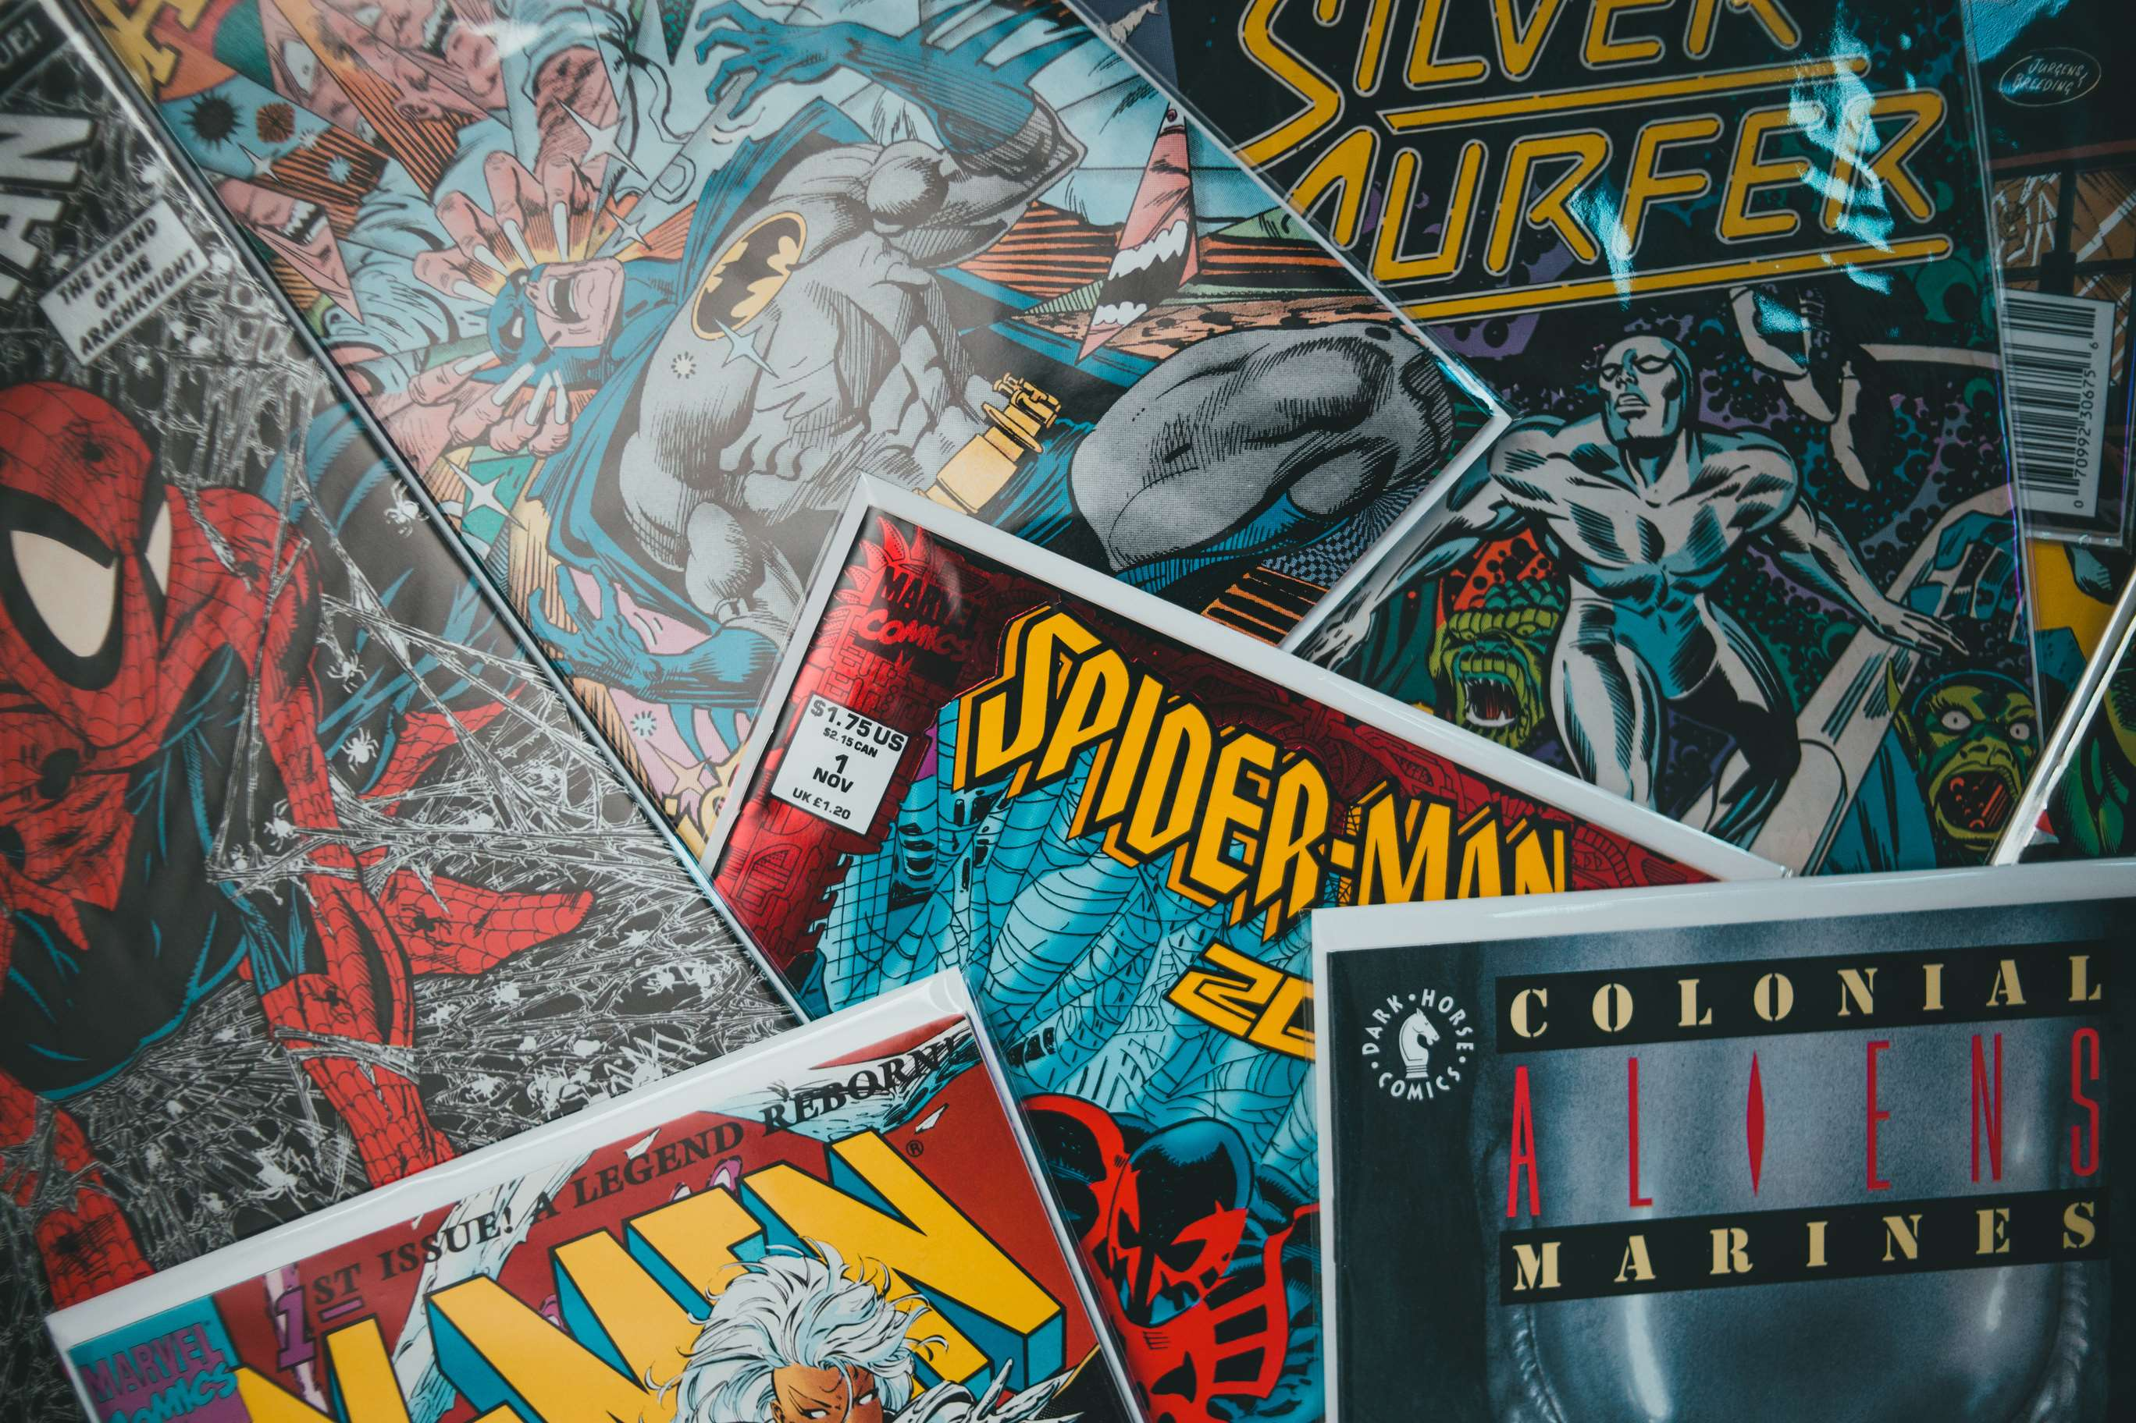
Rising Demand for Comic Books among Adults to Propel Market Growth
Drivers
Increased interest in Online Series and Movies on Over-The-Top (OTT) Platforms to Restrict Market Growth
Restraints

Slide 7
AUTHOR'S PERSPECTIVE
  The global comic book market will expand significantly by 5.20% CAGR between 2024 to 2031.
  The non-digital segment is set to rise over the projected period. The printed word has numerous compelling advantages over reading on a screen. It is easier on the eyes, comfortable to browse, and comes with a certain durability that the moderately impermanent and effortlessly edited digital text does not have.
  The growth is attributed to the rising income and interest and continuing outcomes in the format that have improved the overall reading experience. Moreover, comic books are increasingly prevalent in developed and developing nations. In addition, a majority of people in the US read these books every month.

Slide 8









KEY PLAYERS

Slide 9


For Full Report
Contact us
COGNITIVE MARKET RESEARCH
Tel: +1 312-376-8303 | +44 020-8123-0732
India: (+91) 983-496-8611
sales@cognitivemarketresearch.com
Access the Full Report : https://tinyurl.com/49eha8jr
Please visit our website:
https://www.cognitivemarketresearch.com

