Slide 1

GLOBAL
COKING COAL
MARKET REPORT
2024
Global,Regional,CountryAnalysis

Slide 2

INTRODUCTION
The growing steel demand is an important factor driving the global coking coal market share growth. Coking coal is one of the main elements necessary for steel production. Steel is generally produced through the BF-BOF and EAF, whereas coking coal is required in both production methods. The increase in electricity production through renewable sources is still insufficient to meet the increase in electricity demand. It has forced utilities to opt for coal to bridge the gap between supply and demand, thereby increasing the demand for coking coal in the market.

Slide 3


KEY INSIGHTS
CAGR
5.00%
2024- 2031

Slide 4
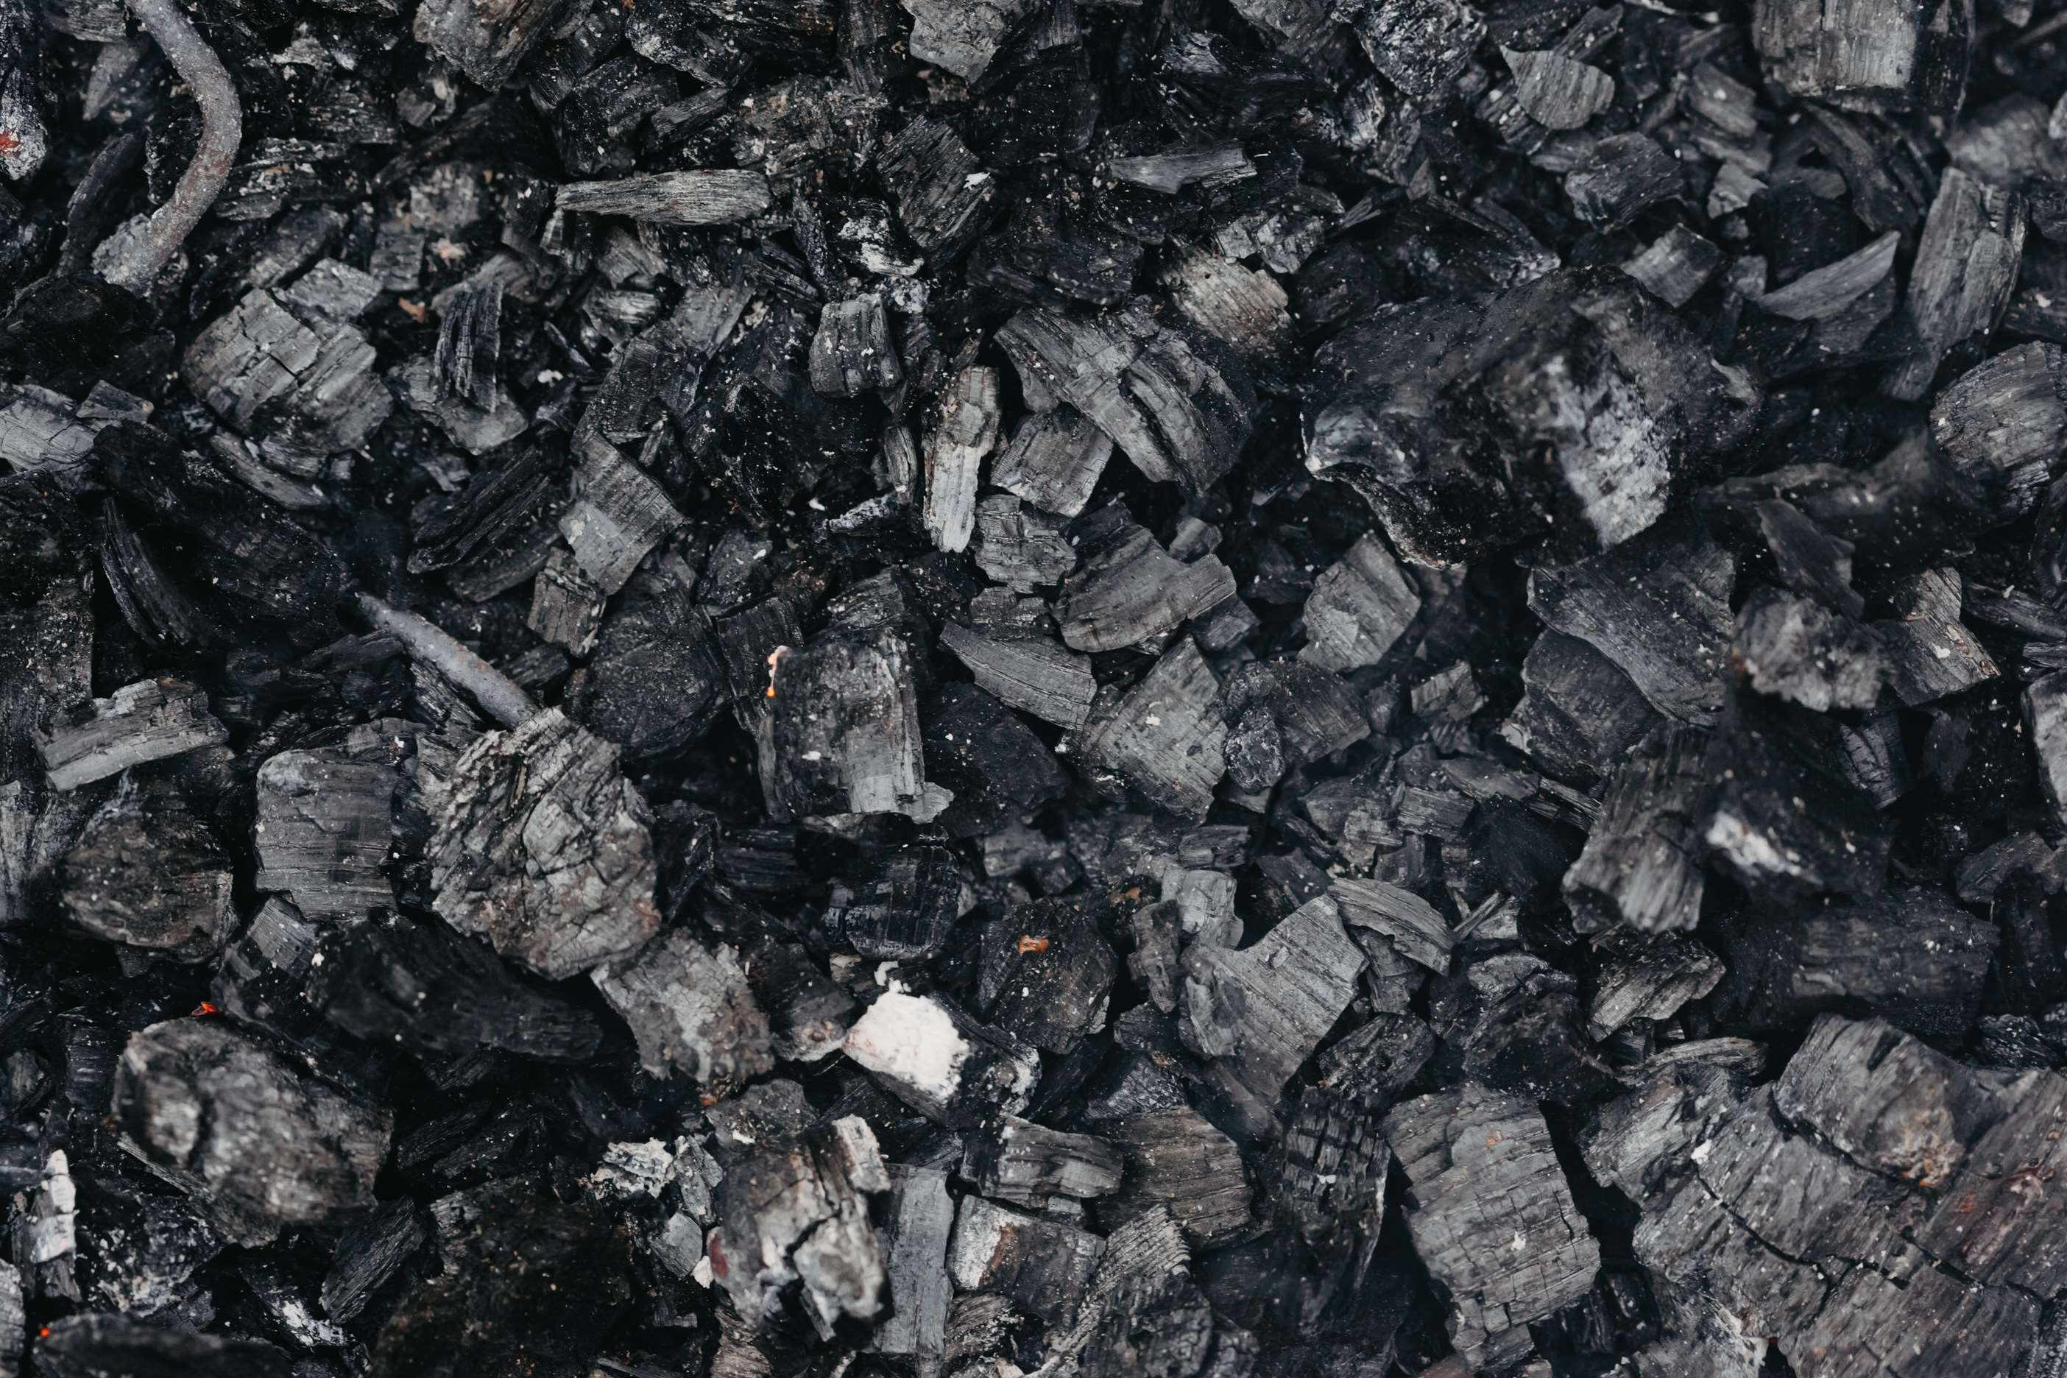
REVENUE MARKET SHARE BY SEGMENTS 2022
  Crushing
  Washing
  Screening
  Underground
  Surface
Material Segment
Refining Process Segment
  Steel Production
  Smelting
  Sintering
  Anthracite
  Bituminous
  Sub-bituminous
Coal Type Segment
Application Segment

Slide 5

Global Coking Coal Market Revenue share for 2024
North America
40%

Slide 6

  Growing Demand from Steel Industry to Increase the Demand Globally
  Growing Urbanization and Industrialization to Propel Market Growth
Drivers
Environmental Concerns and Regulations to Limit the Sales
Restraints

Slide 7

AUTHOR'S PERSPECTIVE
  The global Coking Coal market will expand significantly by 5.00%CAGR between 2024 to 2031.
  Surface mining is the dominant method. Surface mining, also known as open-pit mining, involves the extraction of coal from the surface of the earth.
  Bituminous coal is the dominant coal type. Bituminous coal is widely used in steel production due to its high carbon content, which makes it ideal for producing coke, a key ingredient in the steelmaking process.

Slide 8
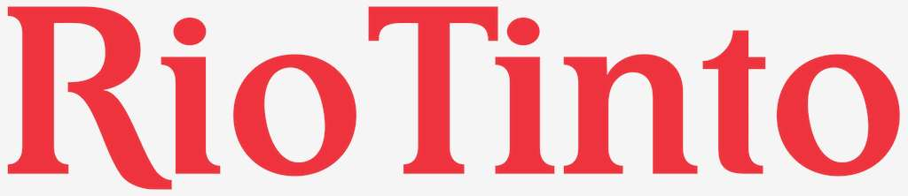




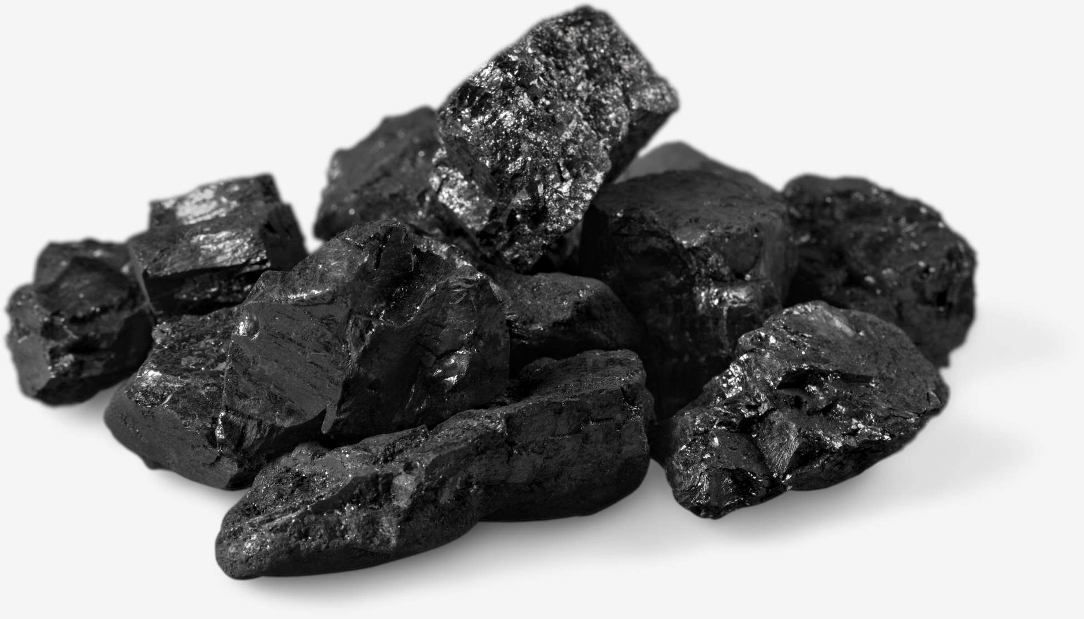
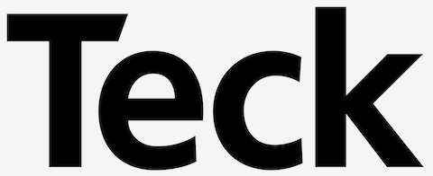


KEY PLAYERS

Slide 9


For Full Report
Contact us
COGNITIVE MARKET RESEARCH
Tel: +1 312-376-8303 | +44 020-8123-0732
India: (+91) 983-496-8611
sales@cognitivemarketresearch.com
Access the Full Report : https://tinyurl.com/bx8c4mj7
Please visit our website:
https://www.cognitivemarketresearch.com

