Slide 1
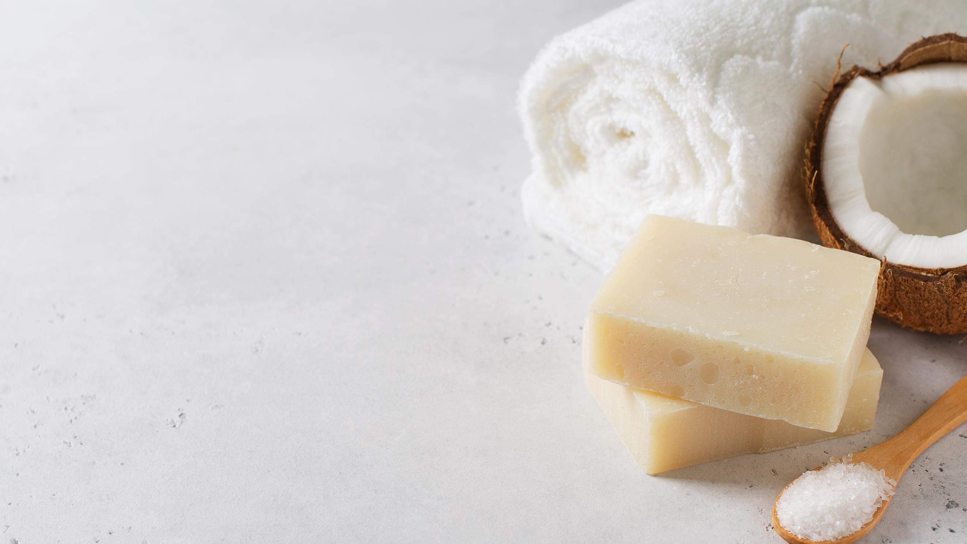
GLOBAL
Coconut Soap
MARKET REPORT 2024
Global,Regional,CountryAnalysis

Slide 2

INTRODUCTION
Coconut soap blends coconut oil, a versatile natural ingredient celebrated for its moisturizing and nourishing properties. This type of soap usually contains coconut oil as a primary ingredient, delivering a mild and hydrating cleansing experience. The popularity of coconut soap stems from its potential to benefit the skin by providing hydration, antimicrobial properties, and a delightful tropical scent. The increasing demand for natural and organic skincare products, along with growing awareness of the advantageous properties of coconut oil like its anti-inflammatory and antioxidant qualities, is driving the growth of this market.

Slide 3
KEY INSIGHTS
20₋23
CAGR 5.00%
2030

Slide 4
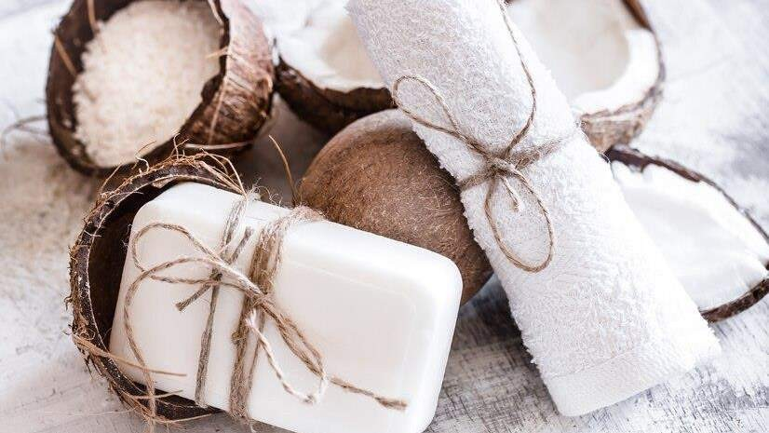
REVENUE MARKET SHARE BY SEGMENTS 2022
Eyebrow Powder
Eyebrow Pencil
Eyebrow Cream
Eyebrow Gel
Type Segment
Application Segment
Household
Commercial
Teenagers
Adults
Elderly
Age Group Segment
Premium
Economy
Price Range

Slide 5
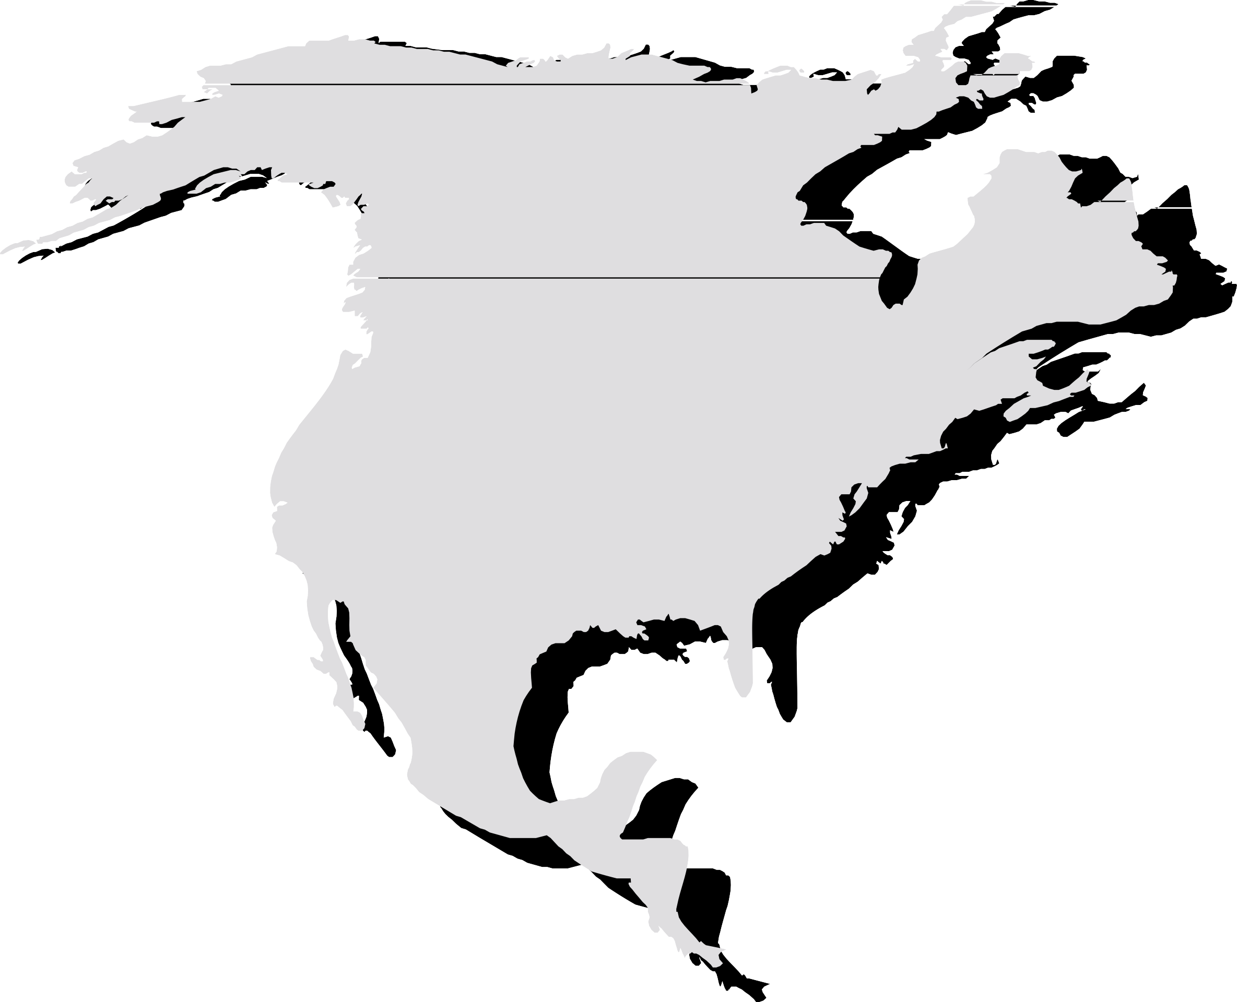
Global Coconut Soap Market Revenue share for 2022
North America 40%

Slide 6
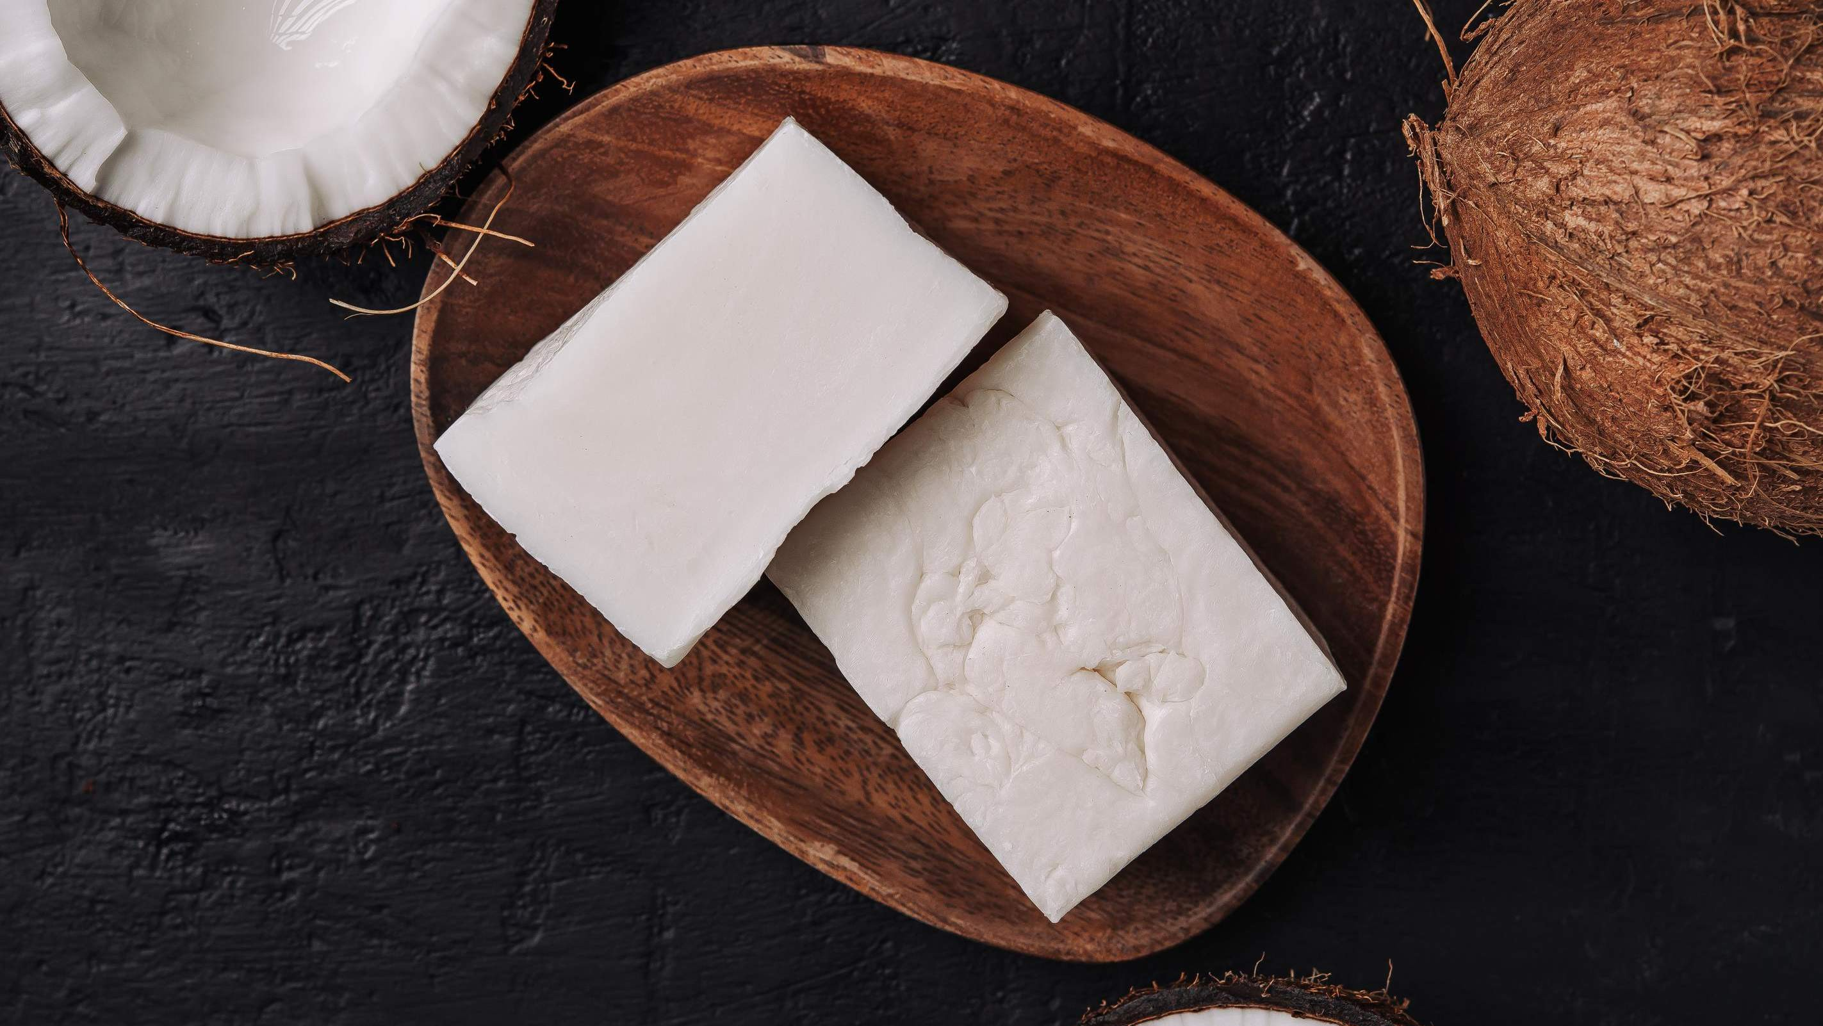




Slide 7

AUTHOR'S PERSPECTIVE
The Global Coconut Soap Market is witnessing significant growth in the near future.
Consumers seeking a classic, straightforward cleansing routine often prefer the familiarity and convenience offered by bar soaps, making them a staple in the coconut soap market.
Coconut soaps, with their natural and organic positioning, find a significant
presence on the shelves of these large retail outlets.

Slide 8

KEY PLAYERS

Slide 9


Contact us
For Full Report
COGNITIVE MARKET RESEARCH
Tel: + 1 312 - 376 - 8303 | + 44 020 - 8123 - 0732
India: ( + 91 ) 983 - 496 - 8611
sales@ cognitivemarketresearch. com
Access the Full Report : http://tinyurl.com/bdh8fsw7
Please visit our website:
https://www.cognitivemarketresearch.com

