Slide 1
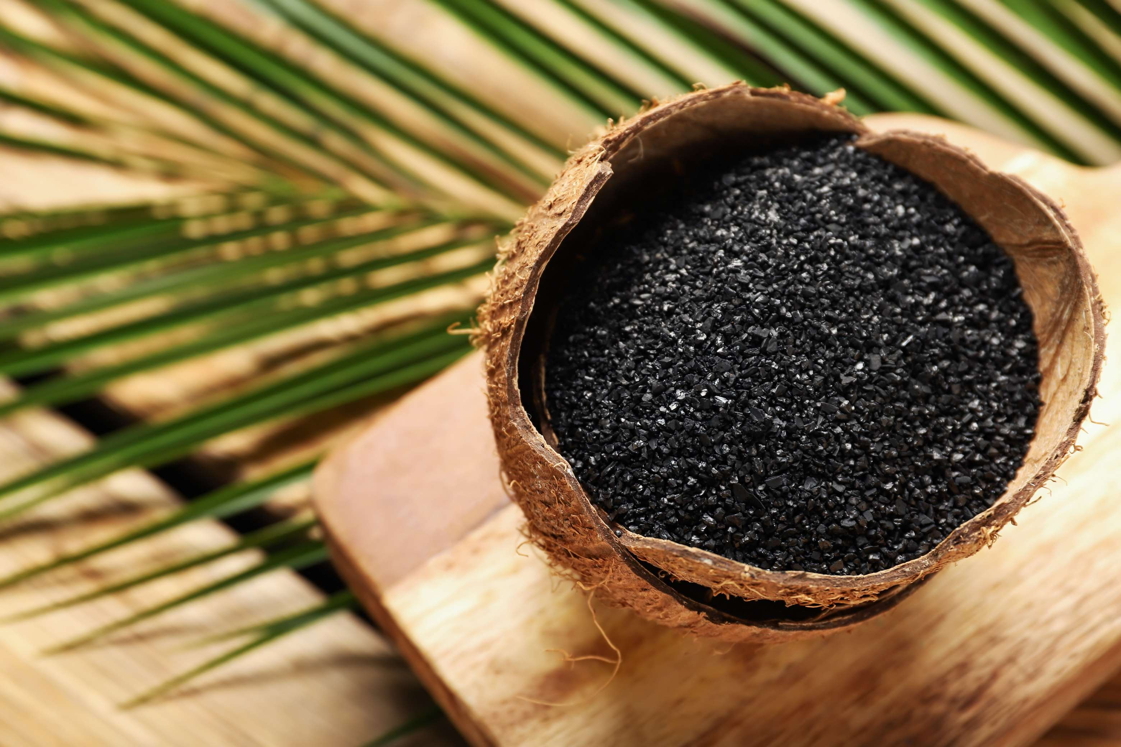
GLOBAL
COCONUT CHARCOAL
MARKET REPORT
2024
Global,Regional,CountryAnalysis

Slide 2

INTRODUCTION
The coconut charcoal market is a dynamic sector within the broader industry, characterized by the production, distribution, and consumption of charcoal derived from coconut shells. Coconut charcoal, known for its natural and sustainable attributes, has gained popularity as an eco-friendly alternative to traditional charcoal sourced from hardwood trees. This market encompasses various products catering to diverse consumer segments, including grilling enthusiasts, barbecue lovers, industrial applications, and eco-conscious consumers seeking clean-burning fuel options.

Slide 3
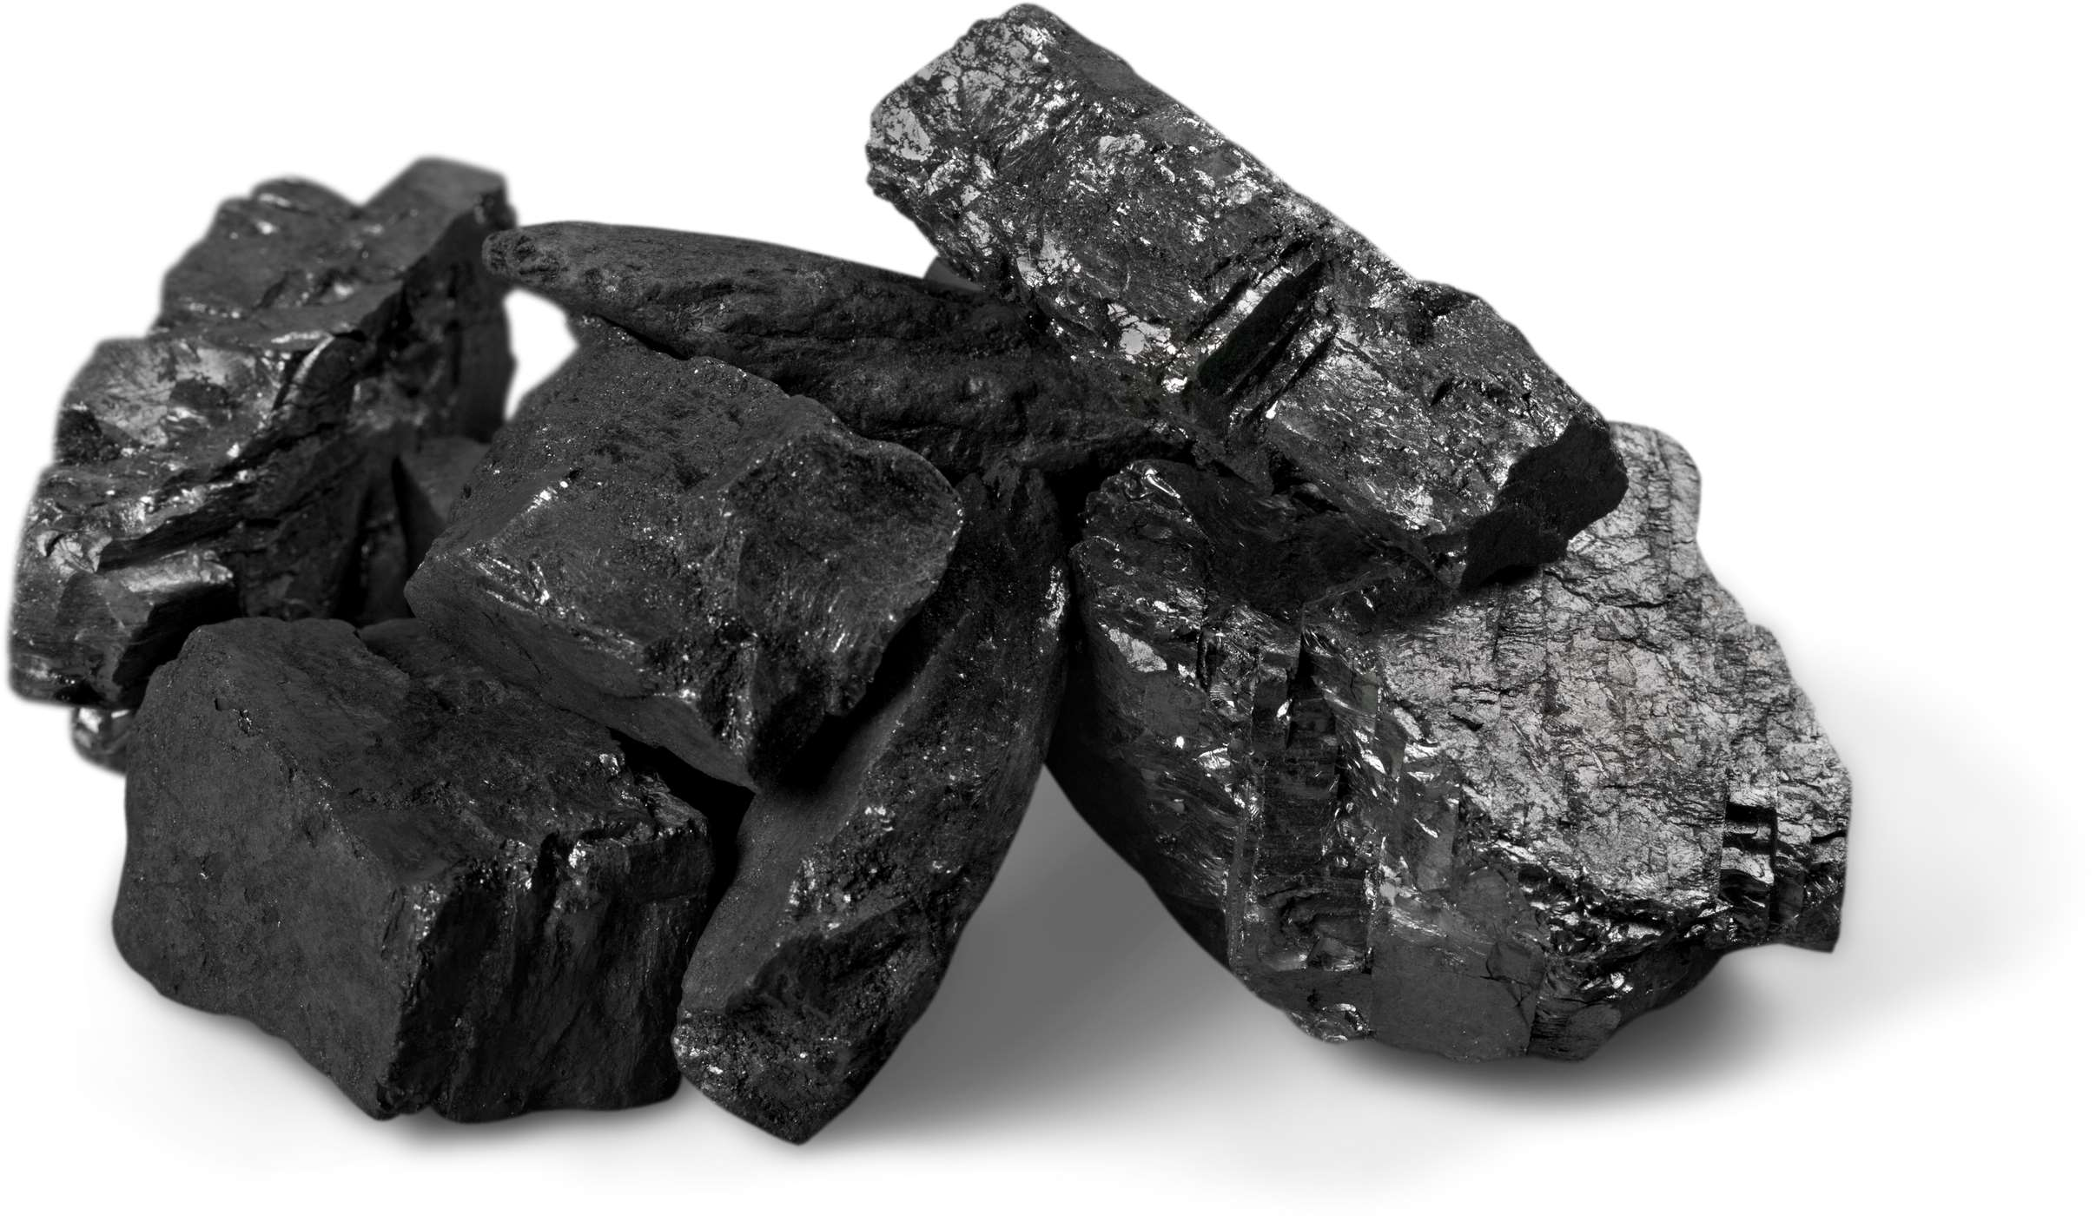

KEY INSIGHTS
MARKET SIZE
USD 421.5 million
2024
CAGR
6.10%
2024- 2031

Slide 4
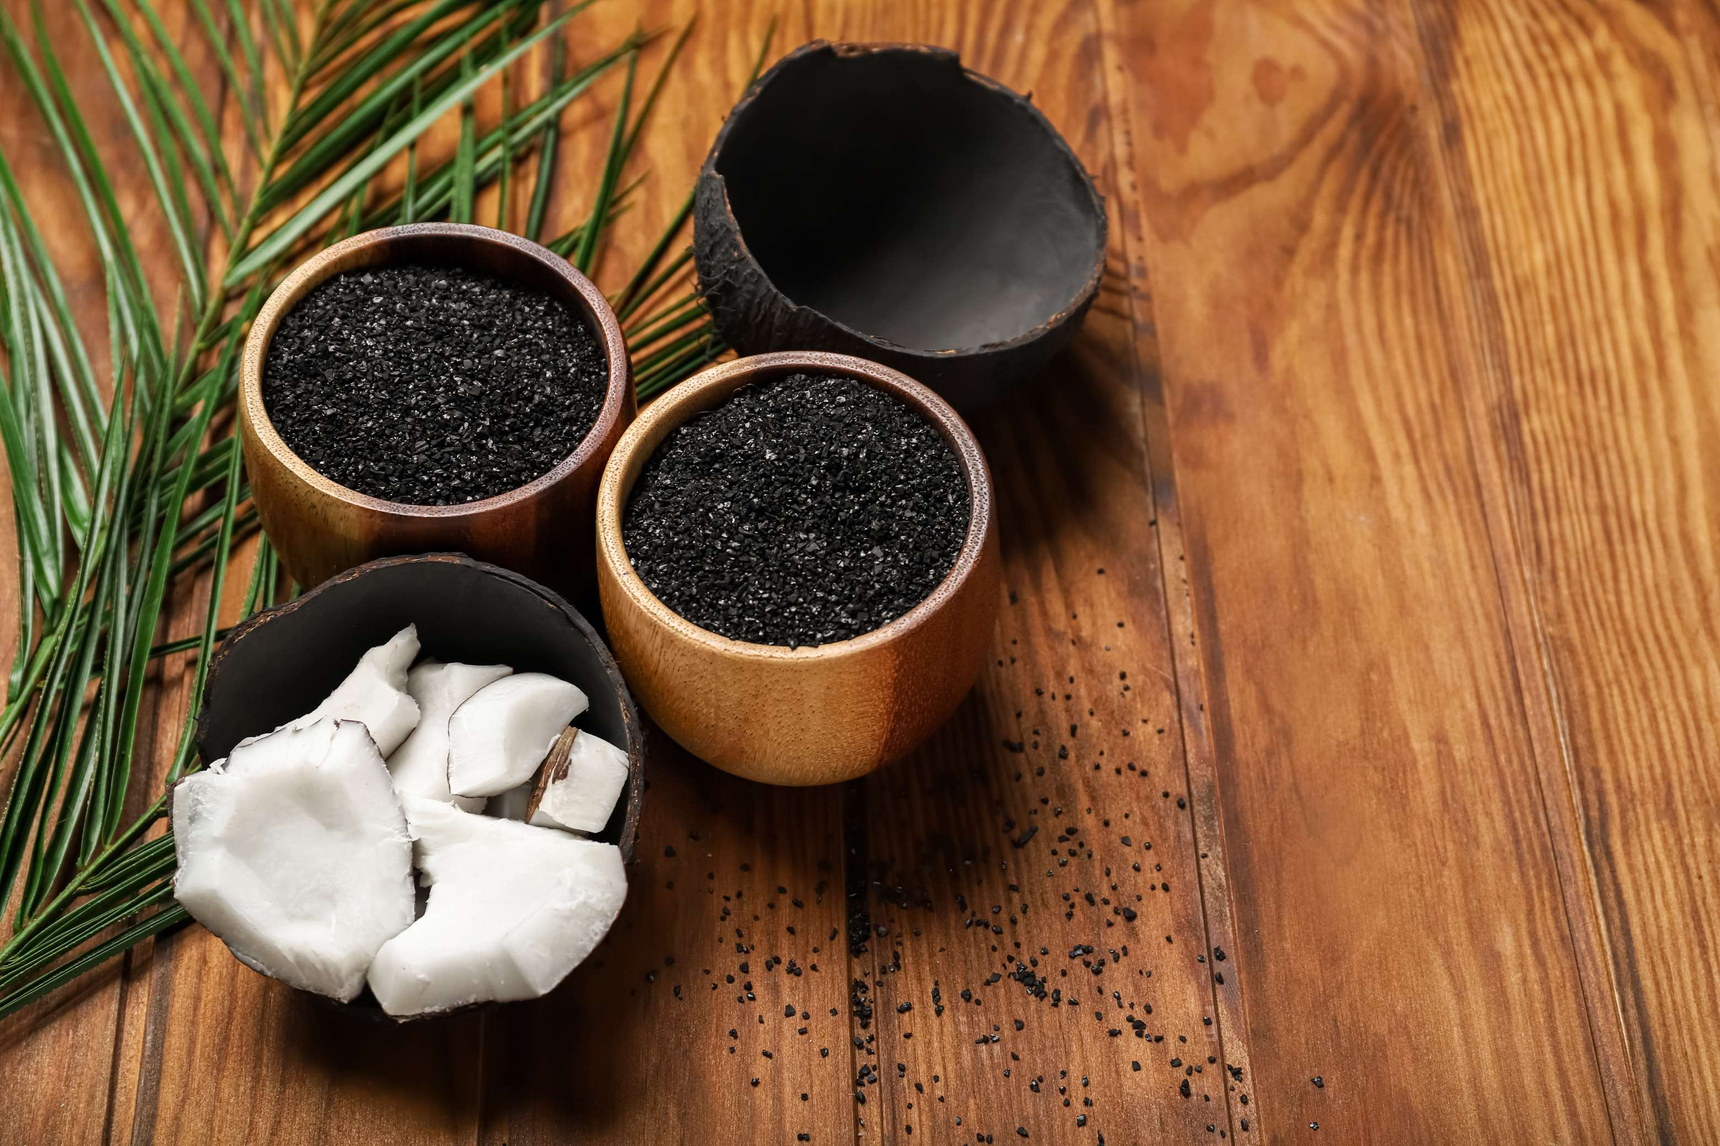
REVENUE MARKET SHARE BY SEGMENTS 2022
  Supermarkets
  Speciality Stores
  Online Retailers
  Lump
  Granulate
Type Segment
Sales Channel
  Metallurgical Fuel
  Barbecue (BBQ)
  Sorbent
Application Segment
  HoReCa
  Household
End User Segment

Slide 5

Global Coconut Charcoal Market Revenue share for 2024
North America
40%

Slide 6

Increasing Demand for Natural and Sustainable Products to Propel Market Growth
Drivers
Stringent Government Regulations to Restraint Market Growth
Restraints

Slide 7

AUTHOR'S PERSPECTIVE
  The global Coconut Charcoal market will expand significantly by 6.10% CAGR from 2024 to 2031.
  The sales in the lump charcoal segment are set to rise due to grilling and barbecuing purposes with its larger pieces, longer burning time, and ability to reach high temperatures quickly, propelling the market growth.
  The increasing use of powder charcoal in various industrial applications such as filtration, cosmetics, pharmaceuticals, and as an ingredient in products like toothpaste and skincare makes it a fast-growing segment.
  The fuel held the highest coconut charcoal market revenue share in 2024.

Slide 8
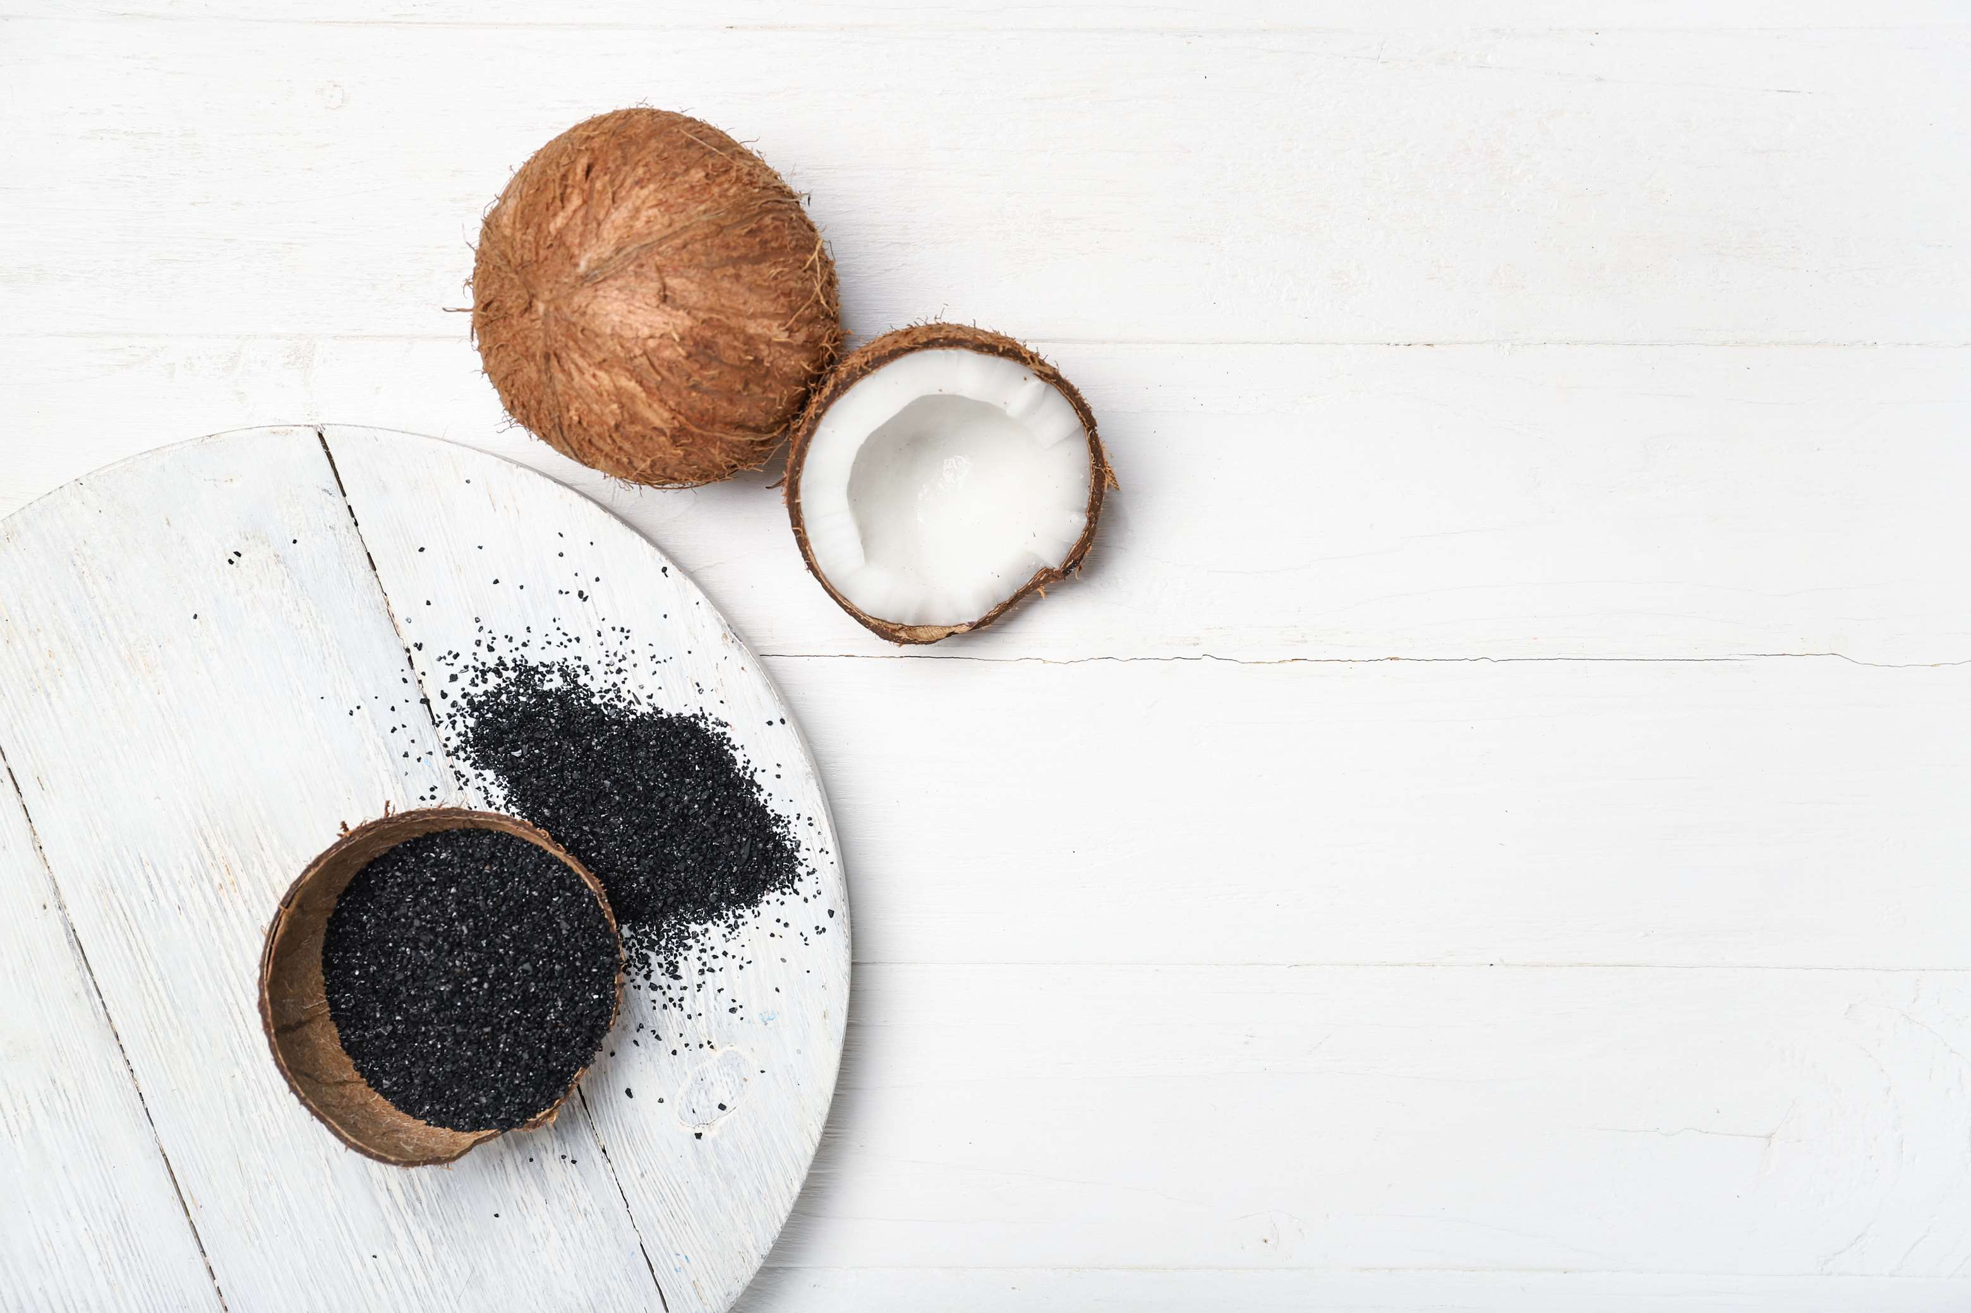



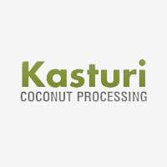


KEY PLAYERS

Slide 9


For Full Report
Contact us
COGNITIVE MARKET RESEARCH
Tel: +1 312-376-8303 | +44 020-8123-0732
India: (+91) 983-496-8611
sales@cognitivemarketresearch.com
Access the Full Report : https://tinyurl.com/ye27epmt
Please visit our website:
https://www.cognitivemarketresearch.com

