Slide 1
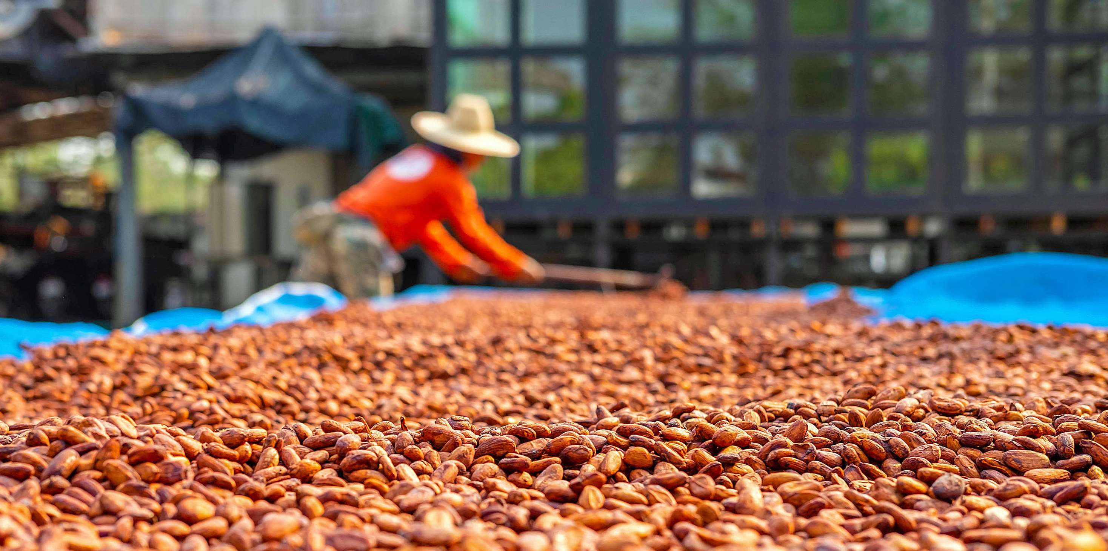
GLOBAL
COCOA PROCESSING
MARKET REPORT 2024
Global,Regional,CountryAnalysis

Slide 2
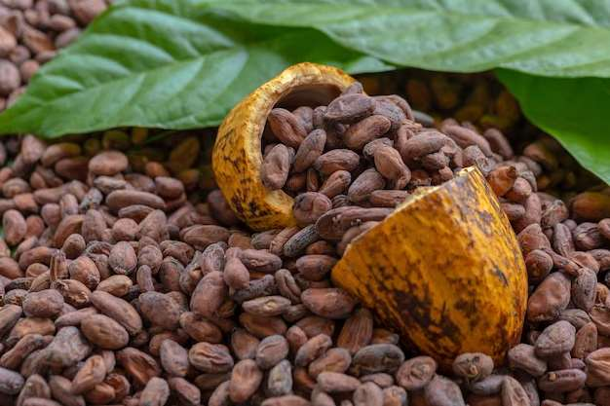
INTRODUCTION
Cocoa processing is the method of transforming cocoa beans into a variety of products, including cocoa butter, cocoa powder, and chocolate. It involves several steps: sorting, roasting, winnowing, grinding, refining, and conching. The rising cocoa consumption leads to increased product adoption across the food and beverage industry. Additionally, cocoa powder is also widely used in preparing numerous food items, such as hot chocolate drinks, cakes, and other baked goods, which is acting as a growth-inducing factor.

Slide 3
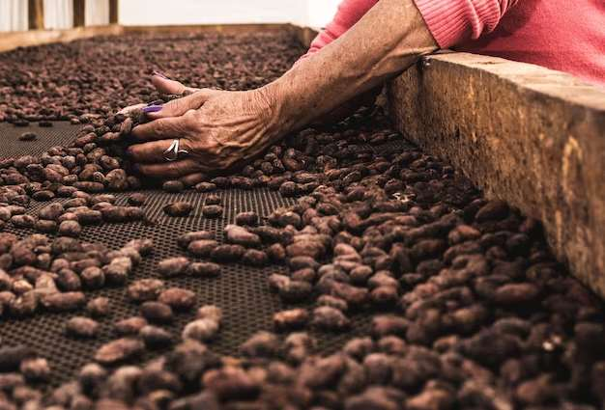

KEY INSIGHTS
MARKET SIZE
USD 15.1 billion
2022
CAGR
1.50%
2023- 2030

Slide 4
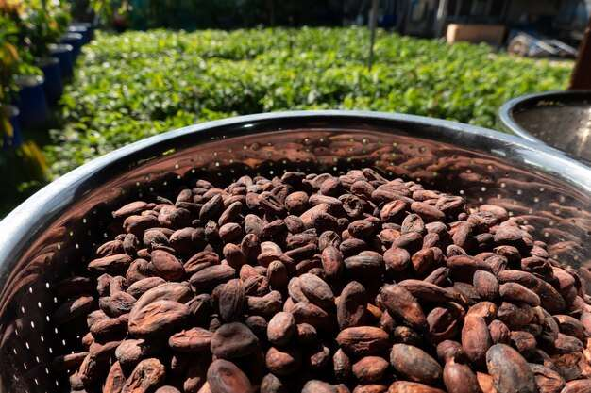
REVENUE MARKET SHARE BY SEGMENTS 2022
  Forastero
  Criollo
  Trinitario
Bean Type
  Confectionary
  Bakery
  Beverages
  Pharmaceuticals
Application segment
  Cocoa Butter
  Cocoa Liquor
  Cocoa Powder
Product Type

Slide 5

Global Cocoa Processing Market Revenue share for 2022
North America

Slide 6
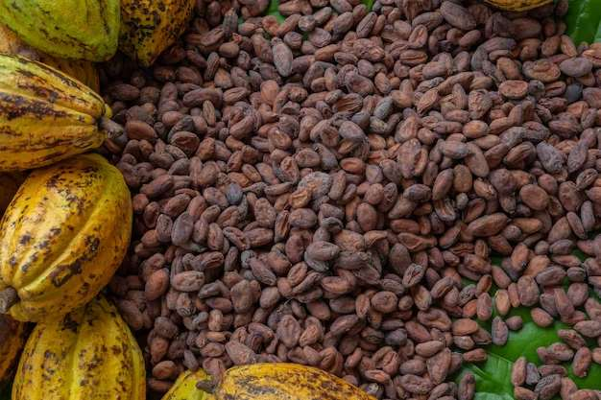
Rising Number of Health Benefits to Provide Viable Market Output
Drivers
Availability of Substitutes to Hinder Market Growth
Restraints

Slide 7
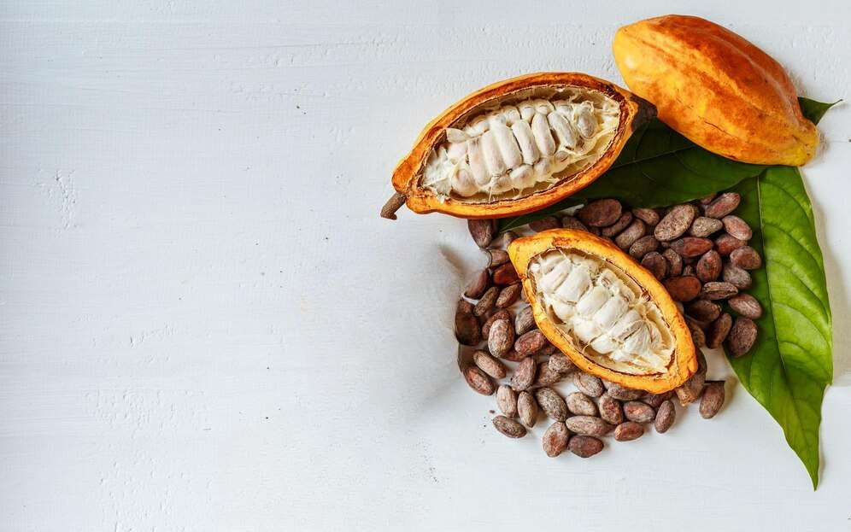
AUTHOR'S PERSPECTIVE
  The Global Cocoa Processing Market is witnessing significant growth in the near future.
  Cocoa is a key ingredient in various beverages, including hot chocolate, chocolate milk, and chocolate-flavored coffee.
  Cocoa butter is a vital ingredient in producing chocolates, confectionery items, and bakery goods, contributing to its strong chocolate and sweets industry demand.
  In 2023, the Forastero segment accounted for noticeable share of global Cocoa Processing Market and is projected to experience significant growth in the near future.
  The Confectionary segment is expected to expand at the significant CAGR retaining position throughout the forecast period.

Slide 8
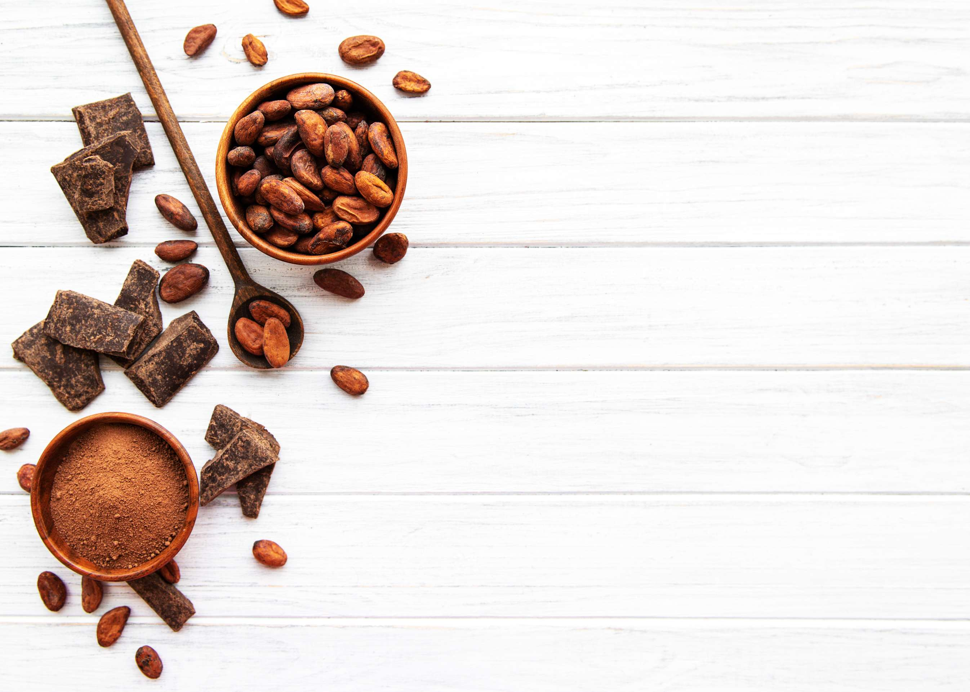













KEY PLAYERS
Blommer

Slide 9


For Full Report
Contact us
COGNITIVE MARKET RESEARCH
Tel: +1 312-376-8303 | +44 020-8123-0732
India: (+91) 983-496-8611
sales@cognitivemarketresearch.com
Access the Full Report : http://tinyurl.com/2zhmuf9r
Please visit our website:
https://www.cognitivemarketresearch.com

