Slide 1
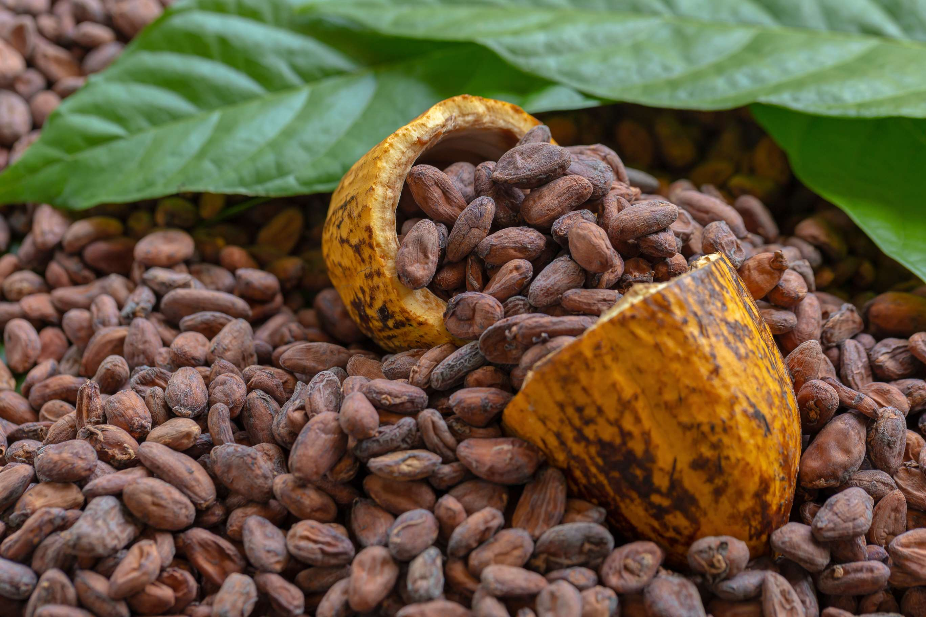
GLOBAL
COCOA BEANS
MARKET REPORT
2024
Global,Regional,CountryAnalysis

Slide 2
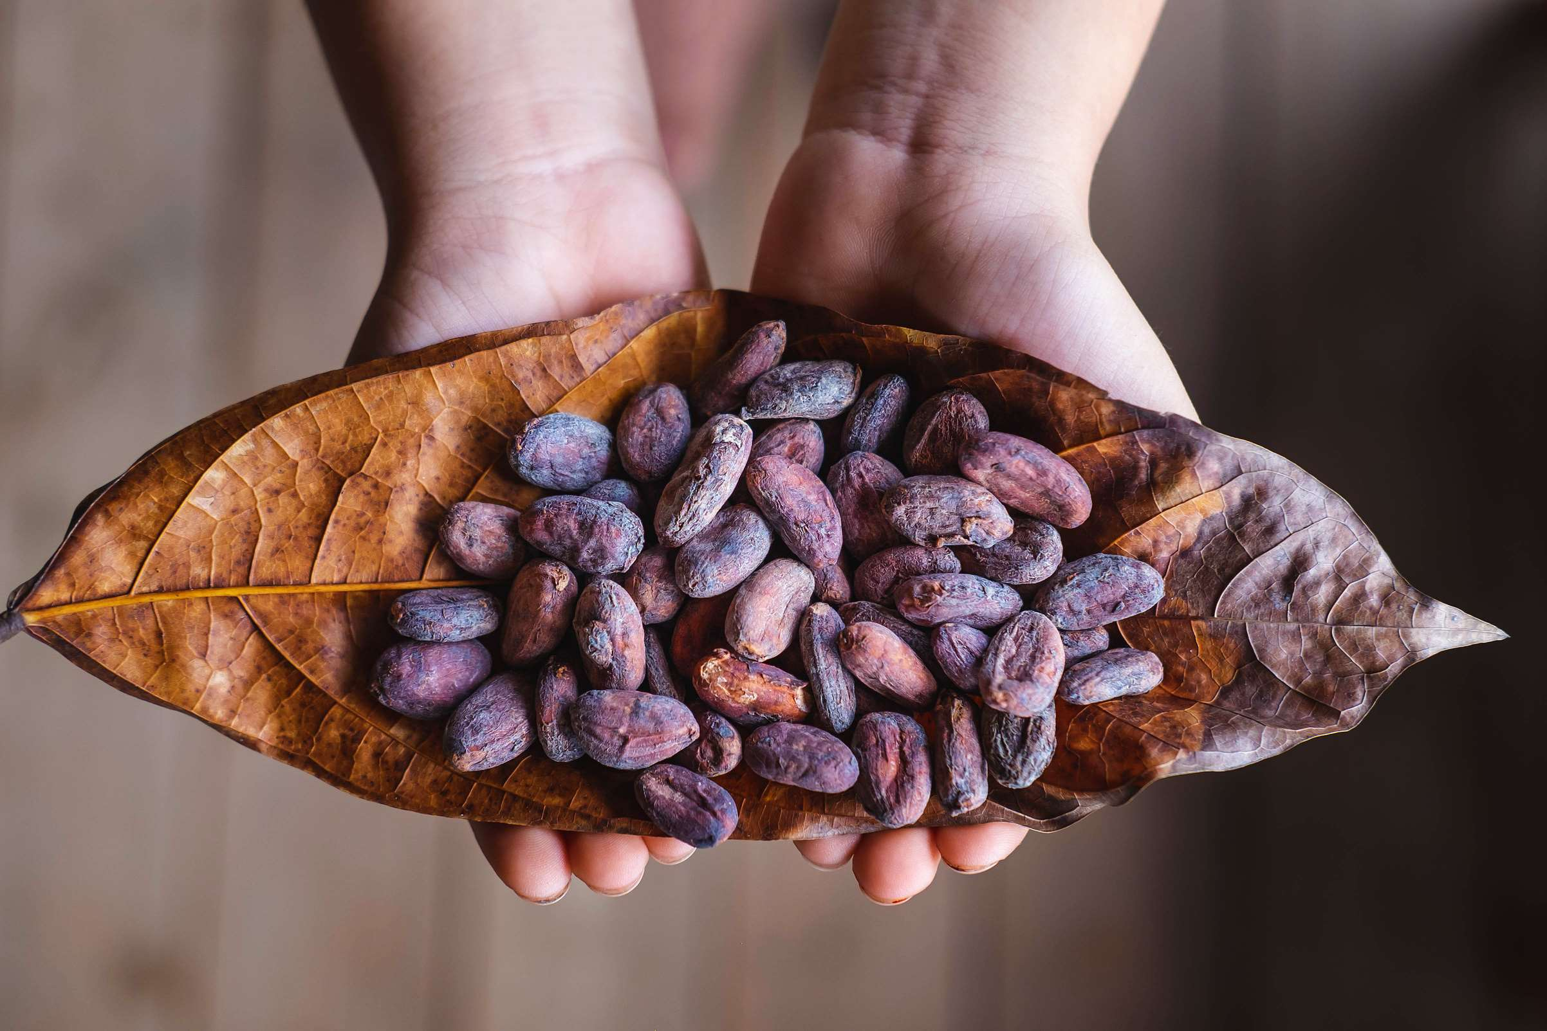
INTRODUCTION
The cocoa beans market encompasses the global trade and production of cocoa beans, the primary raw material used in the production of chocolate and other cocoa-based products. Cocoa beans are seeds harvested from the cacao tree, primarily grown in tropical regions. Once harvested, cocoa beans undergo a series of processing steps, including fermentation, drying, roasting, and grinding, to produce cocoa liquor, cocoa butter, and cocoa powder, which are essential ingredients in various food and beverage applications. One key driver in the cocoa beans market is the increasing demand for chocolate products globally. Chocolate consumption continues to rise as consumer preferences shift towards indulgent and premium treats, driven by factors such as growing disposable incomes, changing lifestyles, and evolving taste preferences. This rising demand for chocolate products translates into higher demand for cocoa beans, as they are the primary ingredient in chocolate production.

Slide 3
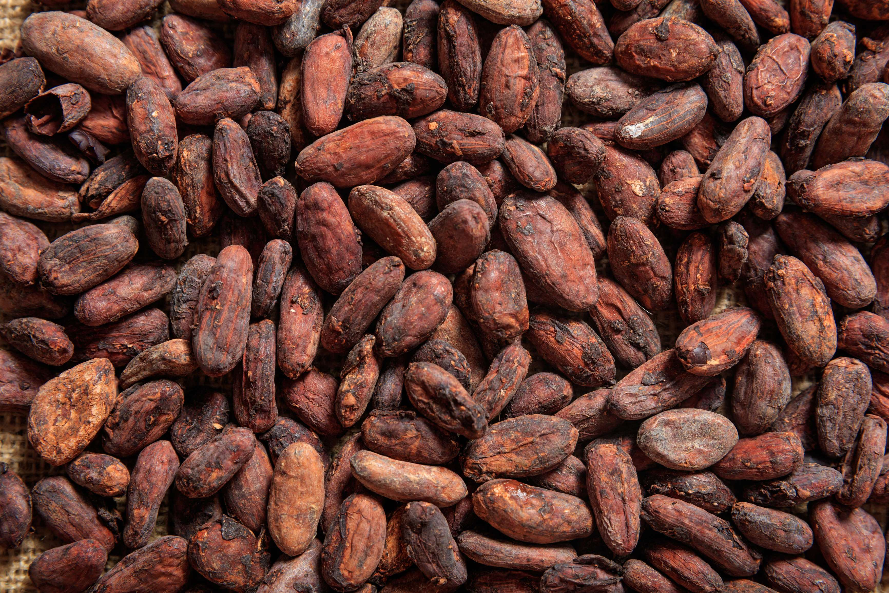

KEY INSIGHTS
MARKET SIZE
USD 13814.2 million
2024
CAGR
7.00%
2024- 2031

Slide 4
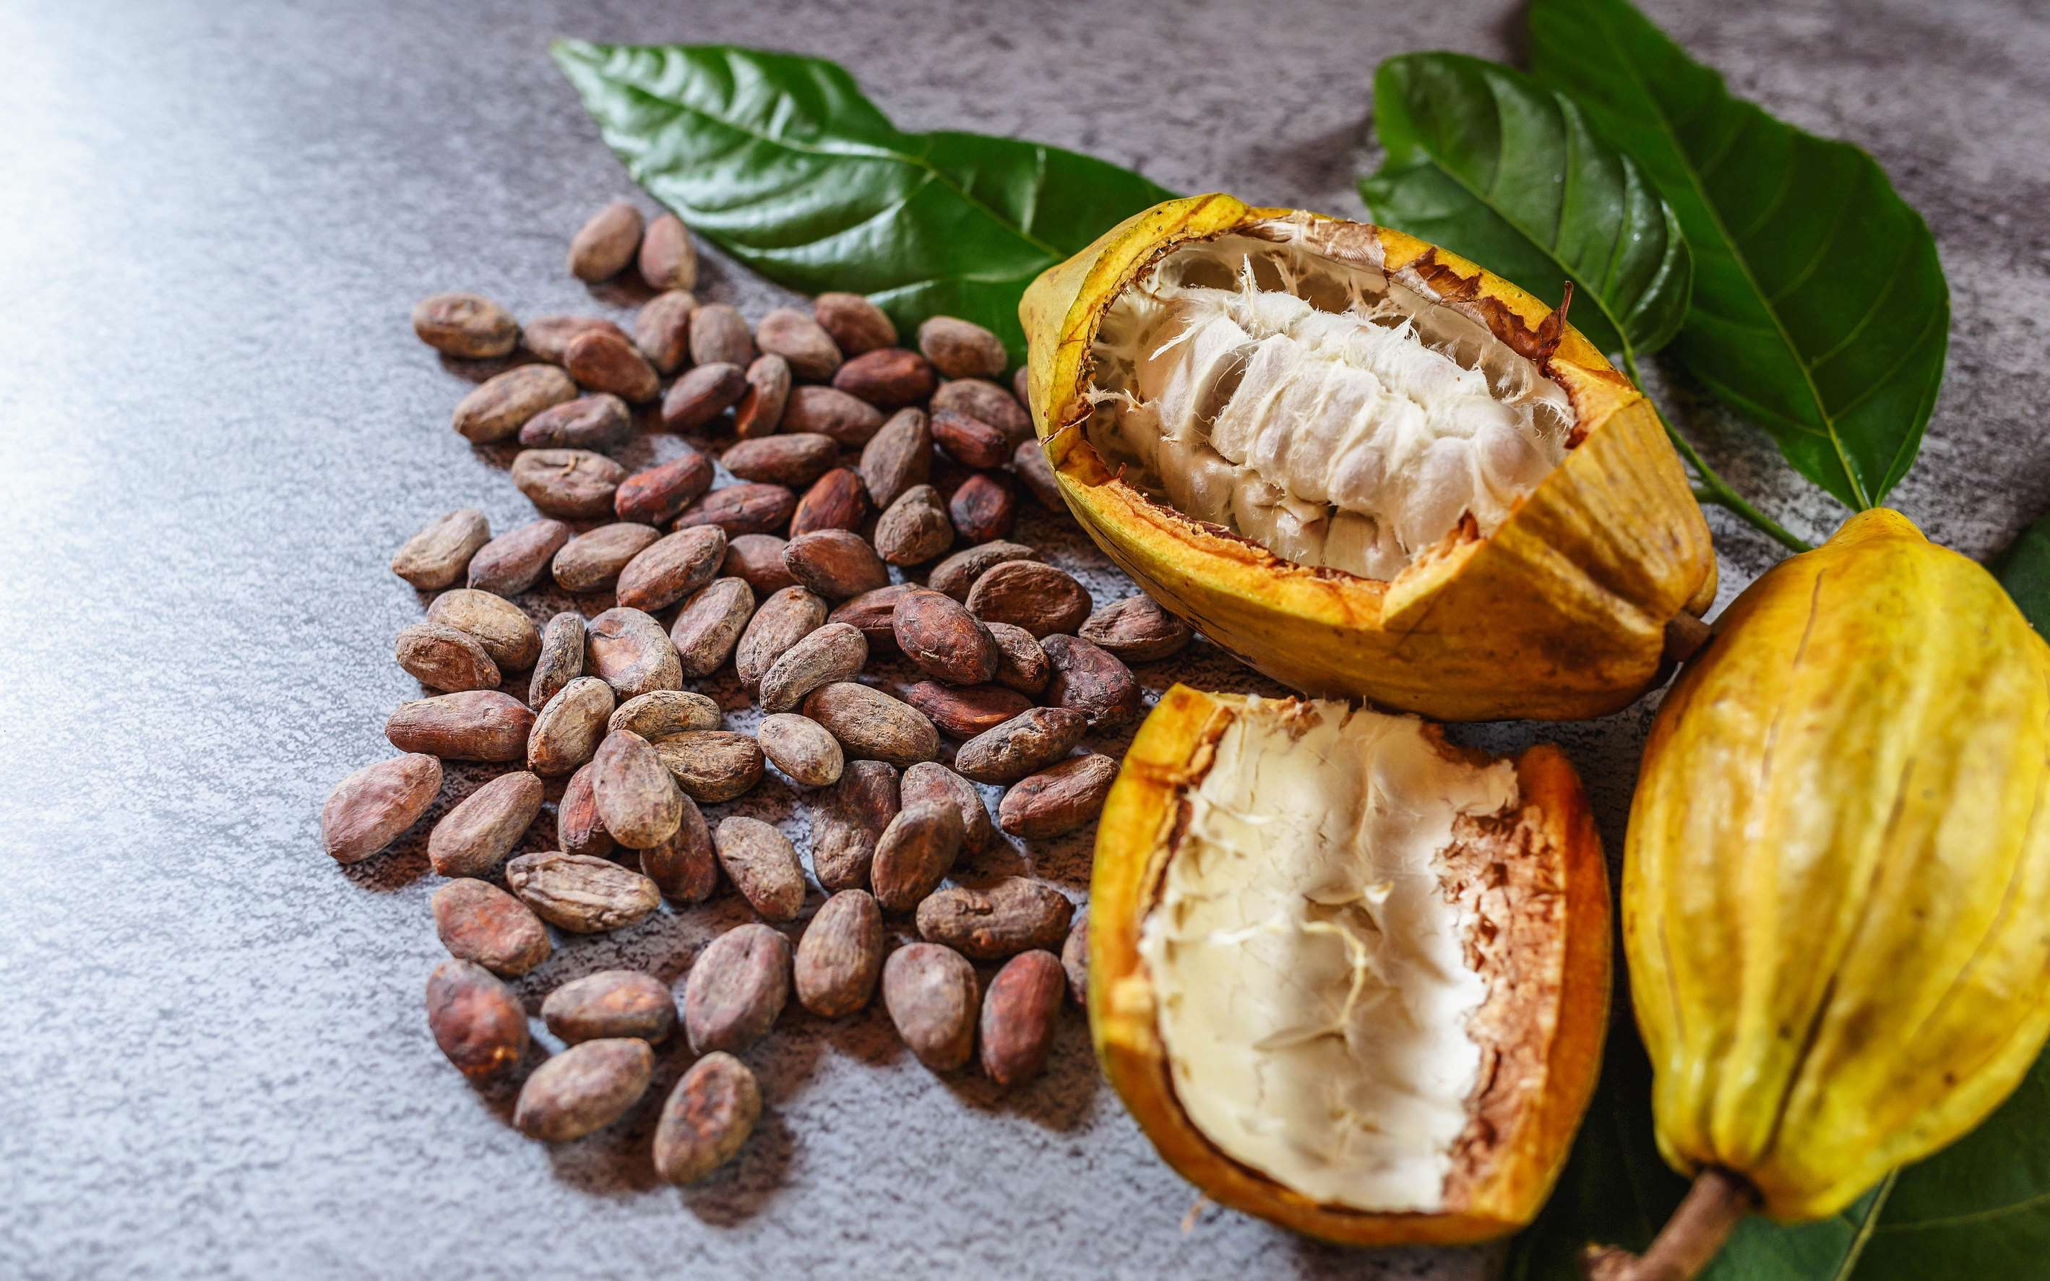
REVENUE MARKET SHARE BY SEGMENTS 2022
  Criollo Cocoa Beans
  ForasteroCocoa Beans
  Trinitario Cocoa Beans
  Cocoa Powder
  Cocoa Butter
  Cocoa Beverages
Product Type Segment
Type Segment
  Confectionery
  Functional Food & Beverage
  Pharmaceuticals
  Cosmetics
  Online
  Offline
Application Segment
Distribution Channel

Slide 5

Global Cocoa Beans Market Revenue share for 2024
North America
40%

Slide 6
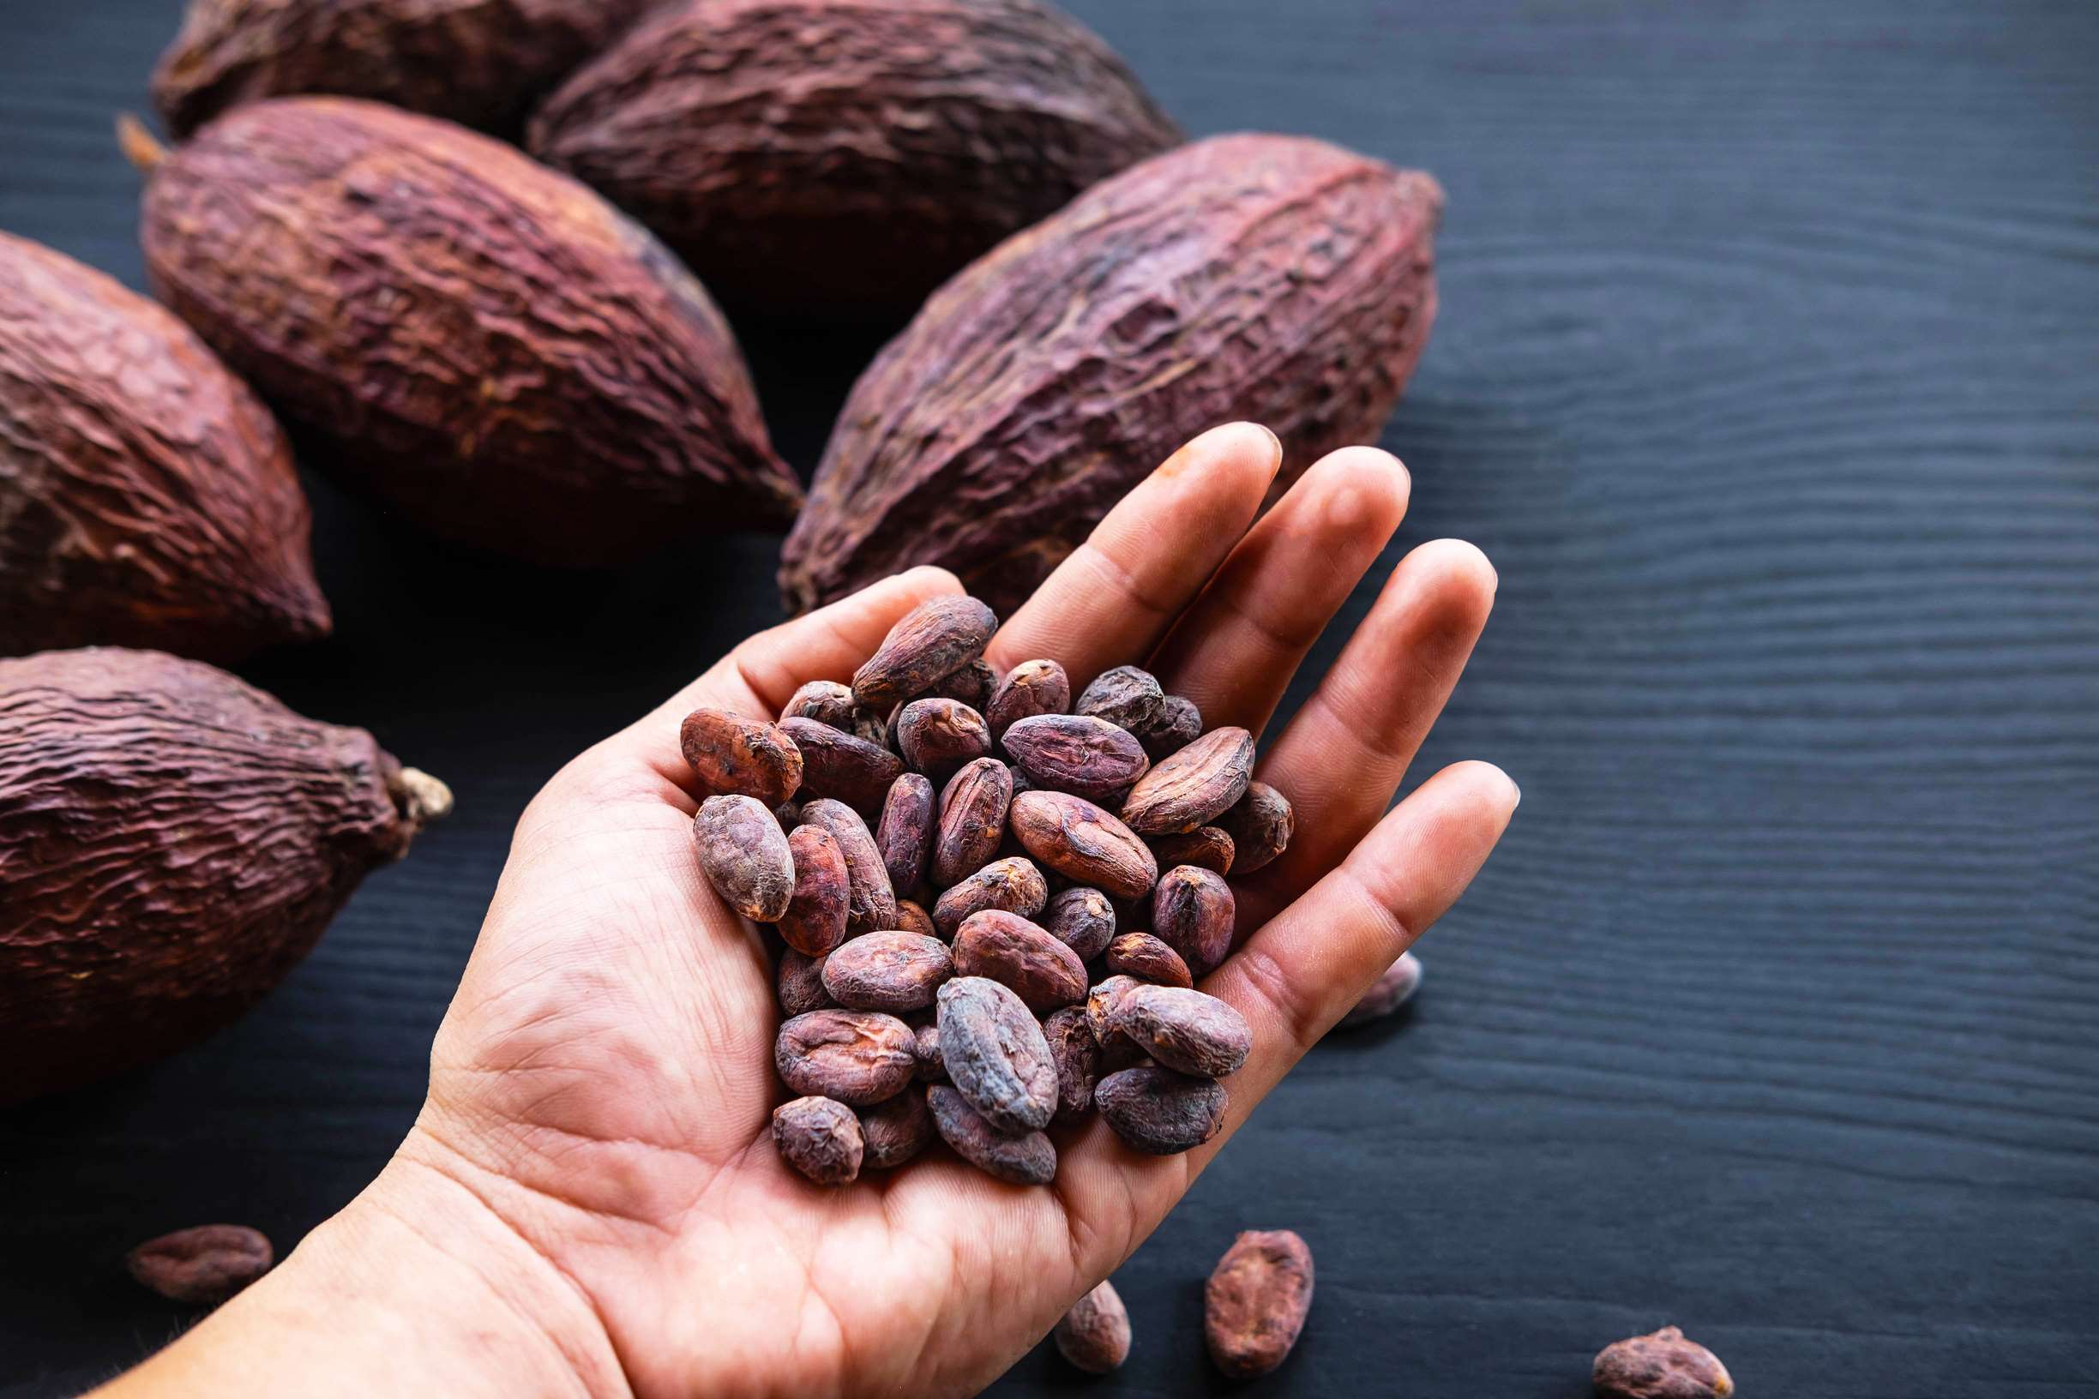
  Growing Demand for Chocolate Products to Increase the Demand Globally
  Shift Towards Sustainable and Ethical Sourcing Practices to Propel Market Growth
Drivers
Climate Change and Environmental Factors to Limit the Sales
Restraints

Slide 7
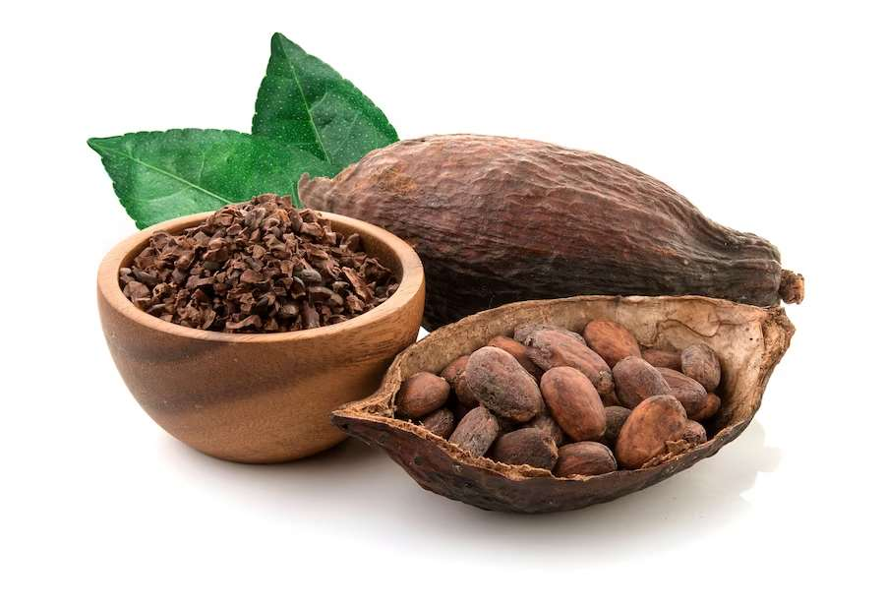
AUTHOR'S PERSPECTIVE
  Cocoa Beans market size is USD 13814.2million in 2024 and will expand at a compound annual growth rate (CAGR) of 7.00% from 2024 to 2031
  Forastero cocoa beans dominate as the most prevalent type. Forastero beans account for the majority of global cocoa production due to their high yield, disease resistance, and suitability for mass production.
  The dominating category is confectionery applications. Confectionery remains the largest consumer of cocoa beans globally, accounting for a significant portion of cocoa bean utilization.

Slide 8
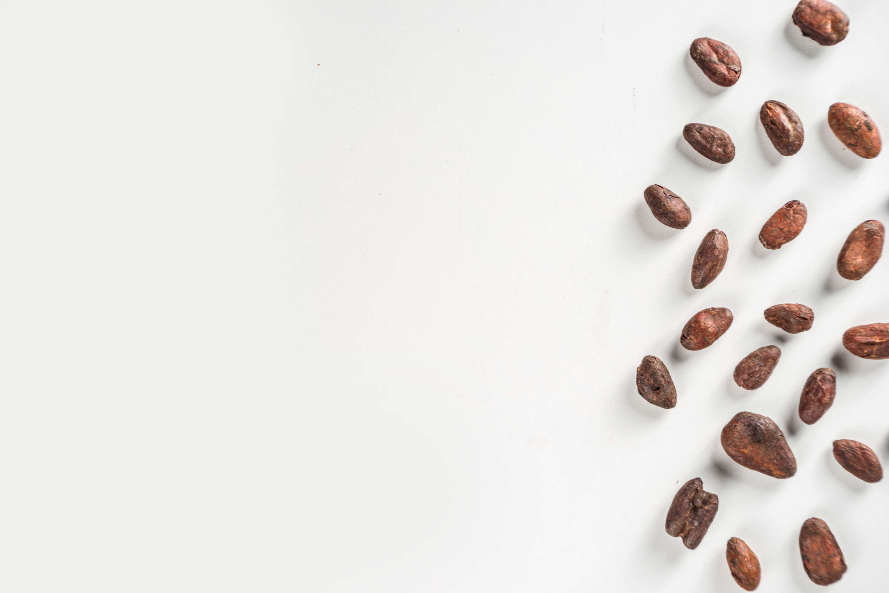






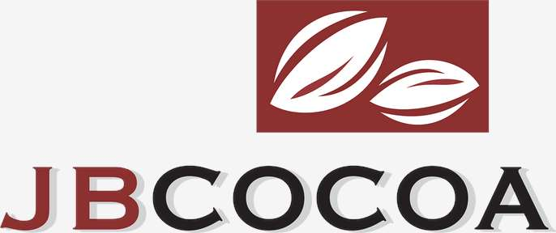


KEY PLAYERS

Slide 9


For Full Report
Contact us
COGNITIVE MARKET RESEARCH
Tel: +1 312-376-8303 | +44 020-8123-0732
India: (+91) 983-496-8611
sales@cognitivemarketresearch.com
Access the Full Report : https://tinyurl.com/bdfup2j6
Please visit our website:
https://www.cognitivemarketresearch.com

