Slide 1
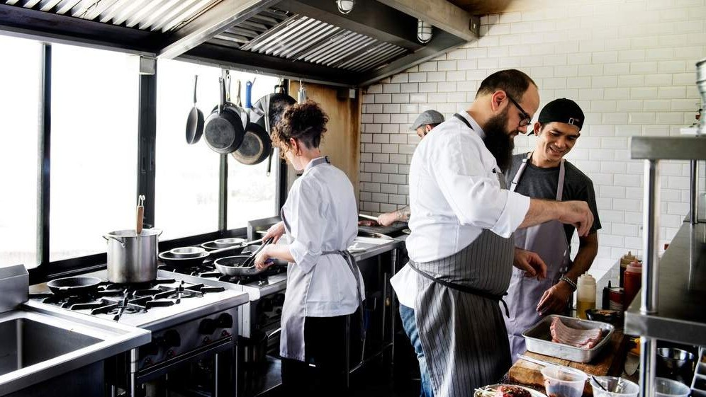
GLOBAL
CLOUD KITCHEN FOODSERVICE
MARKET REPORT 2024
Global,Regional,CountryAnalysis

Slide 2

INTRODUCTION
Virtual Restaurants and Ghost Kitchens are pivotal forces transforming the Cloud Kitchen Foodservice Market, driven by evolving consumer preferences and pandemic- induced restrictions. Restaurants, motivated by the need for operational flexibility and cost-effectiveness, have embraced the virtual model, eliminating the reliance on physical dining spaces. This paradigm shift has given rise to virtual brands and specialized culinary concepts, allowing businesses to extend their reach. Operating within cloud kitchens, virtual restaurants serve as strategic hubs for culinary experimentation, deftly adapting to the dynamic shifts in market trends. The resulting landscape reflects an industry agile in navigating challenges and seizing opportunities amid the evolving culinary and consumer landscape.

Slide 3
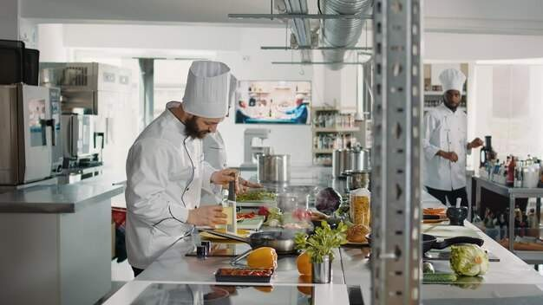

KEY INSIGHTS
CAGR 13.5%
20₋23
2030

Slide 4


REVENUE MARKET SHARE BY SEGMENTS 2022
Food Fresh Other
Type Segment
Office Workers Home and Residential Students
Application Segment

Slide 5
Global Cloud Kitchen Foodservice Market Revenue share for 2022
Asia-Pacific

Slide 6

Drivers
Rise of Virtual Restaurants and Ghost Kitchens to Drive the Cloud Kitchen Foodservice Market
Influence on the Entry, Operations, and Scalability of Cloud Kitchen Markets to Limit its Growth
Restraints

Slide 7

AUTHOR'S PERSPECTIVE
The Global Cloud Kitchen Foodservice Market is witnessing significant growth in the near future.
The fastest-growing segment is "fresh & other," underscoring a rising consumer preference for health-conscious and specialized culinary offerings.
Cloud Kitchen Foodservice Market is witnessing a notable expansion in the "Fresh & Other" category, shaping the industry's evolving landscape. Cloud kitchens catering to the residential segment benefit from the convenience and safety of dining at home.

Slide 8

KEY PLAYERS

Slide 9


Contact us
For Full Report
COGNITIVE MARKET RESEARCH
Tel: + 1 312 - 376 - 8303 | + 44 020 - 8123 - 0732
India: ( + 91 ) 983 - 496 - 8611
sales@ cognitivemarketresearch. com
Access the Full Report : http://tinyurl.com/5aa9ba6t
Please visit our website:
https://www.cognitivemarketresearch.com

