Slide 1
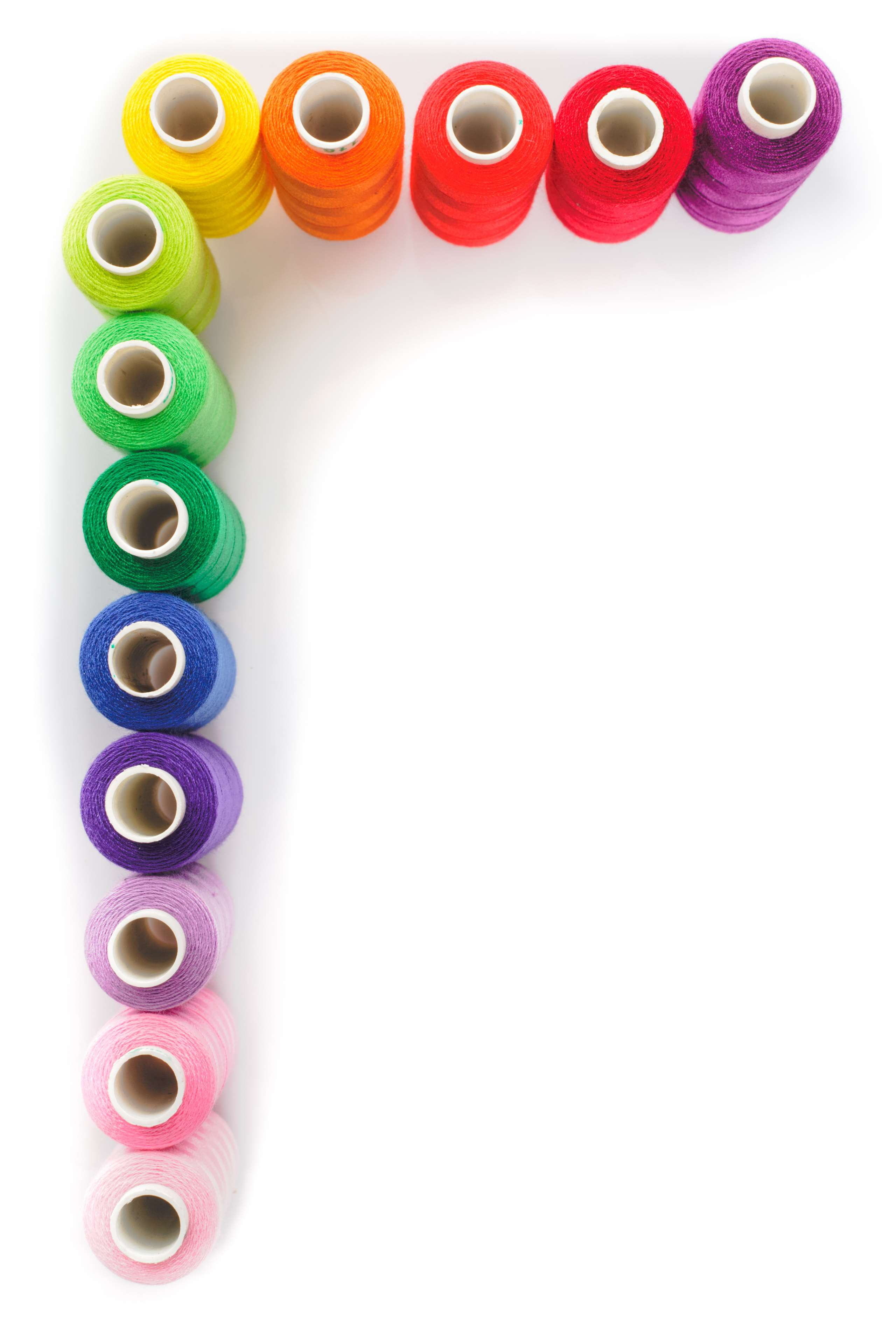
GLOBAL
CLOTHING SEWING THREADS
MARKET REPORT
2024
Global,Regional,CountryAnalysis

Slide 2
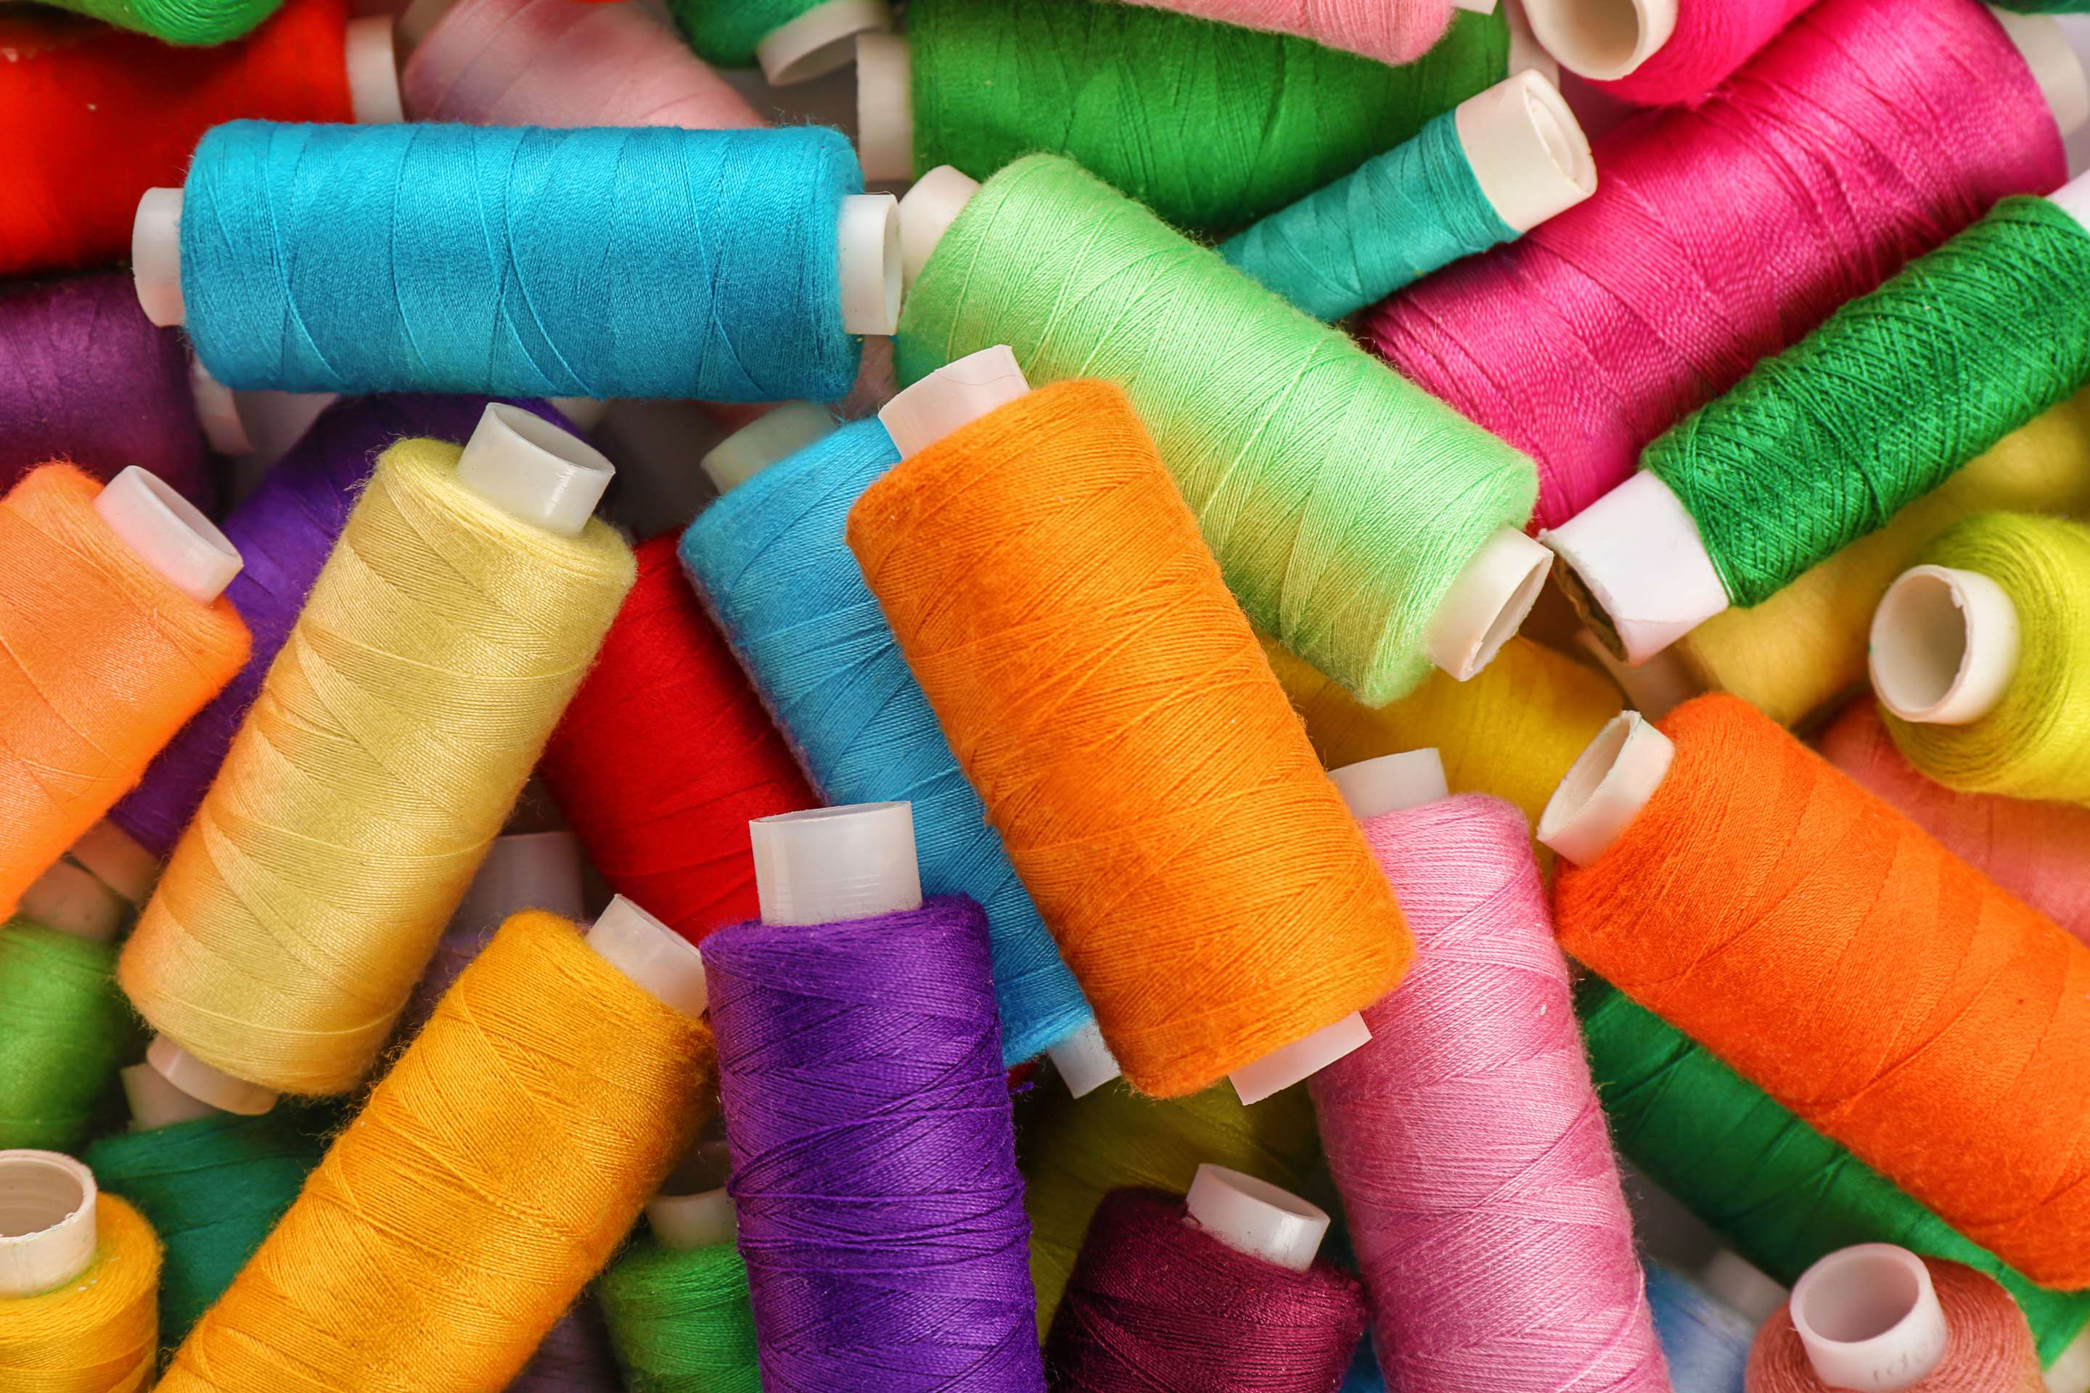
INTRODUCTION
The sewing threads market encompasses threads employed to connect fabric pieces, available in various materials like cotton, silk, wool, rayon, polyester, nylon, and other fibers. It presents a chance for users to improve their products, with growth driven by rising population, disposable income, and demand for fast fashion items like dresses, jeans, and T-shirts.

Slide 3
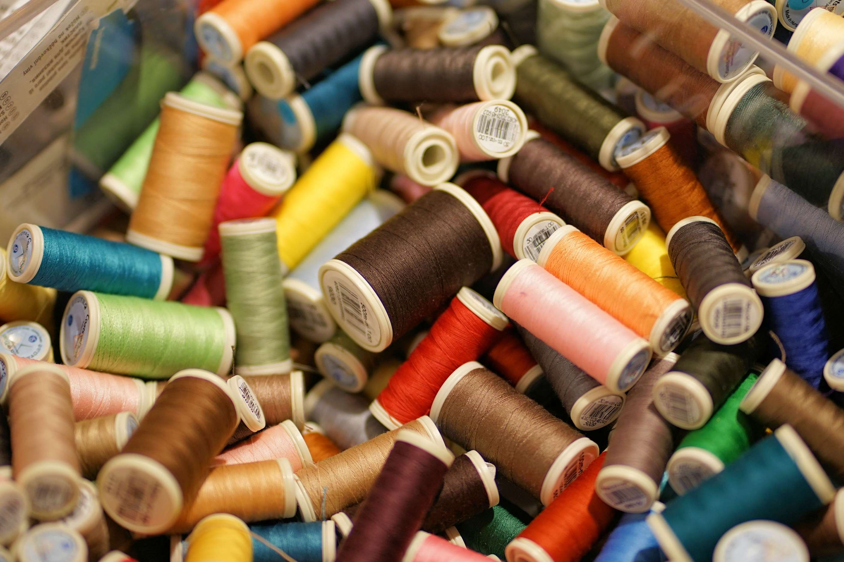

KEY INSIGHTS
CAGR
6.00%
2023- 2030

Slide 4
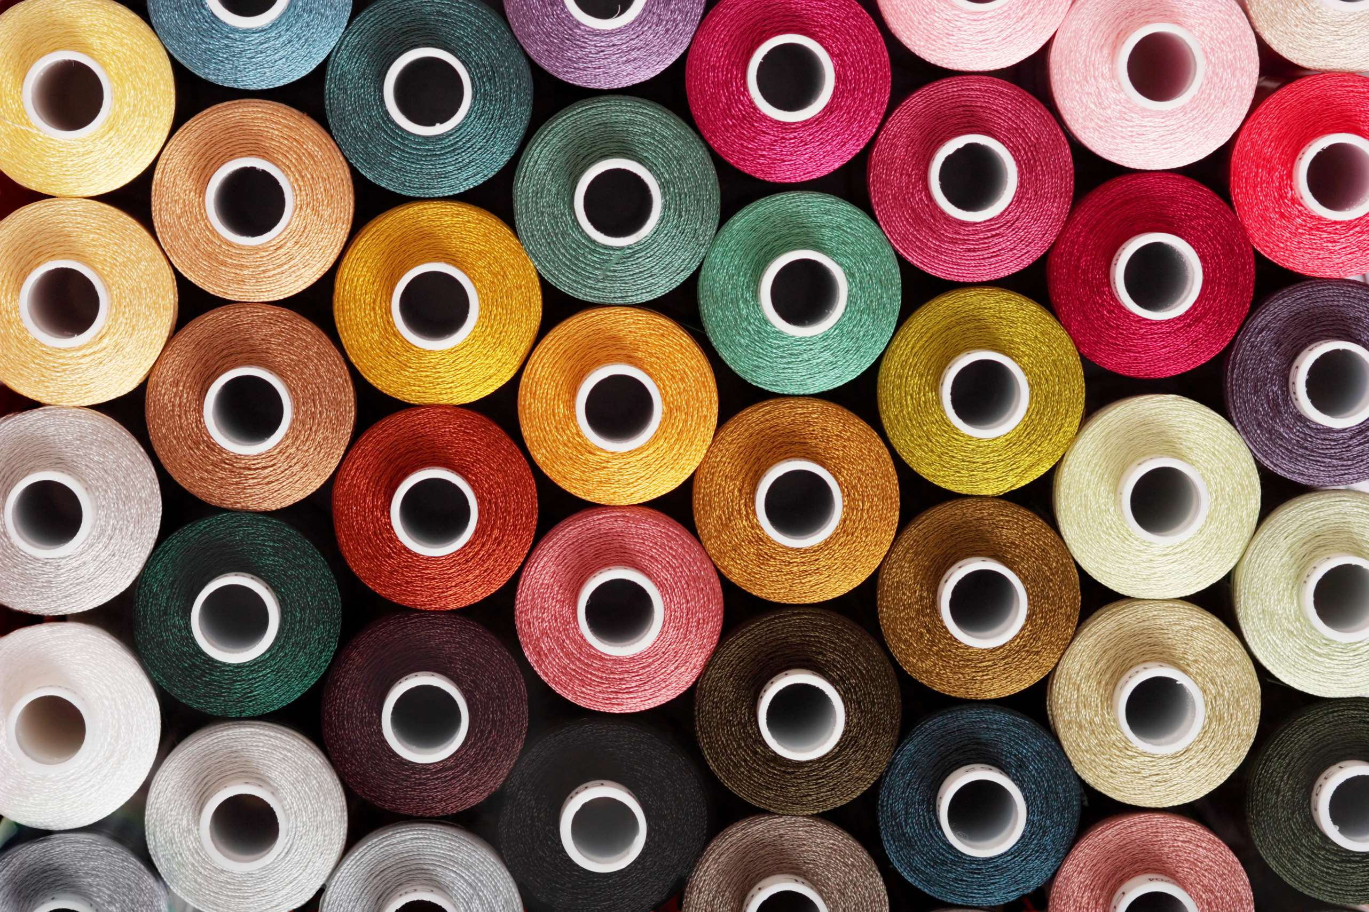
REVENUE MARKET SHARE BY SEGMENTS 2022
  Natural
  Synthetic
Type Segment
  Apparel
  Footwear
  Bedding and Mattress
  Luggage and Bags
Application Segment

Slide 5
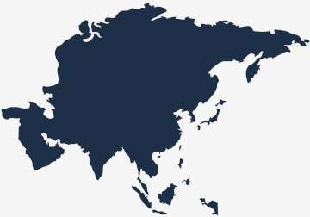
Global Clothing Sewing Threads Market Revenue share for 2024
Asia Pacific
35%

Slide 6
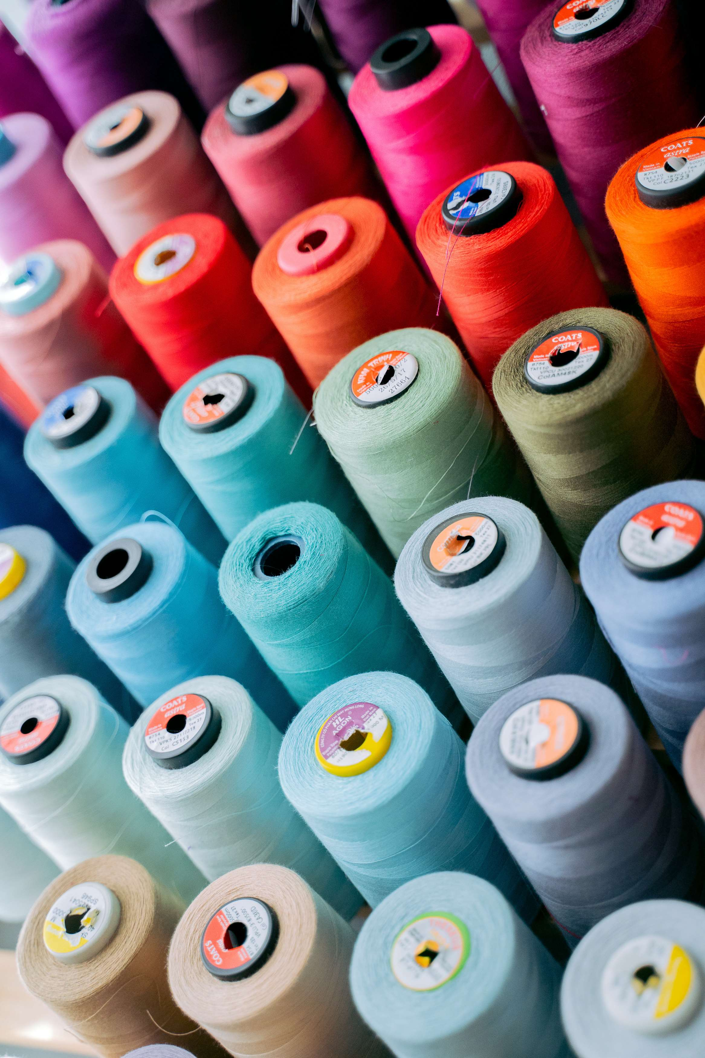
Rising Emphasis on Sustainable Textile Practices to Propel Market Growth
Drivers
Raw Material Price Volatility to Restrict Market Growth
Restraints

Slide 7

AUTHOR'S PERSPECTIVE
  The Global Clothing Sewing Threads Market is witnessing significant growth in the near future.
  Synthetic threads offer several advantages, including high durability, resistance to environmental factors, and a diverse range of colors.
  Apparel manufacturers, encompassing casual wear, formal attire, and sportswear, heavily rely on sewing threads for stitching and embellishments.
  The versatile nature of sewing threads in the apparel industry solidifies their dominance, making this category a cornerstone of the market.

Slide 8
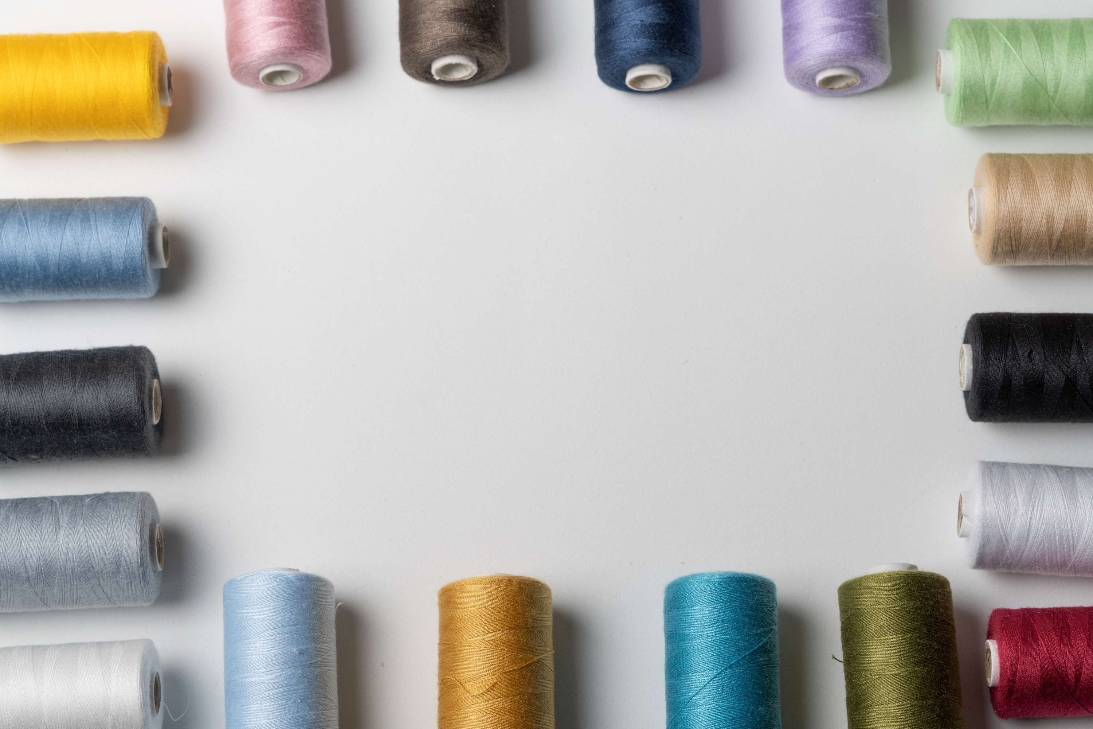







KEY PLAYERS

Slide 9


For Full Report
Contact us
COGNITIVE MARKET RESEARCH
Tel: +1 312-376-8303 | +44 020-8123-0732
India: (+91) 983-496-8611
sales@cognitivemarketresearch.com
Access the Full Report : https://tinyurl.com/fzpnvyzb
Please visit our website:
https://www.cognitivemarketresearch.com

