Slide 1
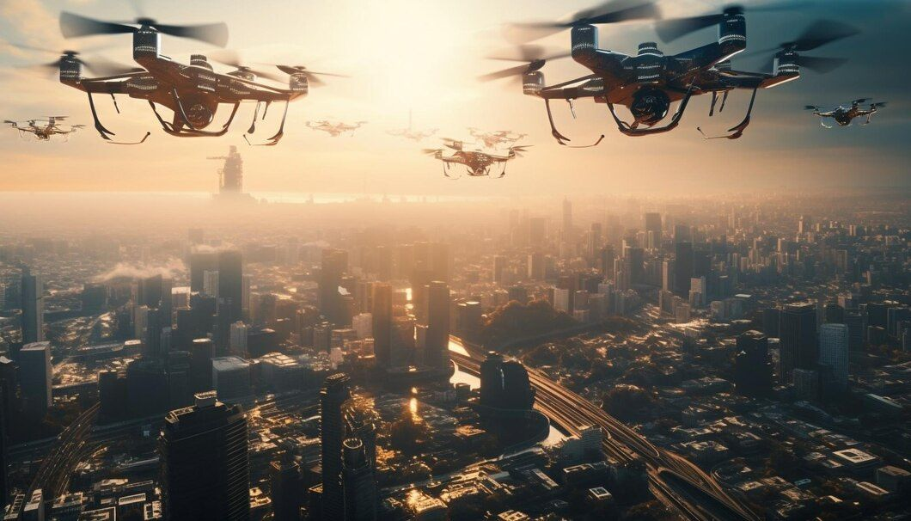
GLOBAL CIVIL DRONE
MARKET REPORT 2024
Global,Regional,CountryAnalysis

Slide 2
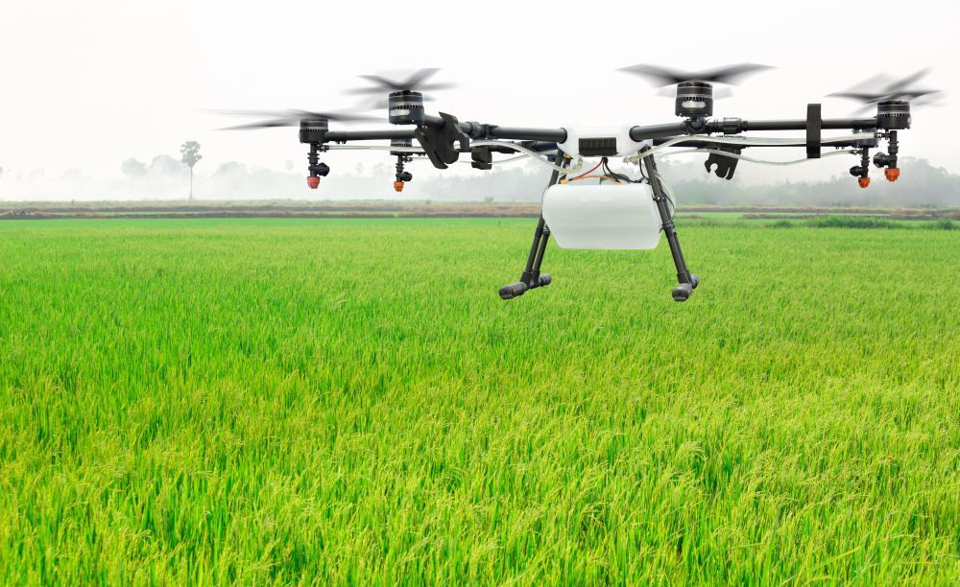
INTRODUCTION
Drones are evolving beyond their military applications and are becoming powerful business tools in consumer market. The global market for civil/commercial drones is increasing at an exponential rate with more and more organizations using this technology for different purposes. Drone is an aircraft without any human pilot, crew, or passengers on board. It consists of an unmanned aircraft system (UAS), which includes adding a ground-based controller and a system of communications.

Slide 3
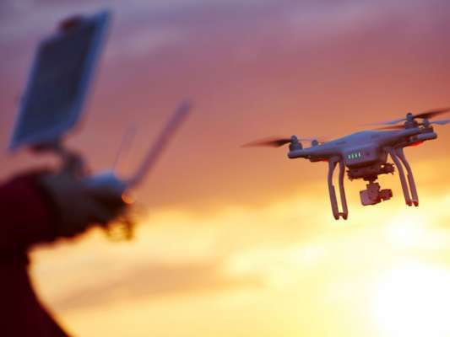

KEY INSIGHTS
FORECAST
$72.41 Billion
2028
2023-
2030
CAGR
24.41%

Slide 4
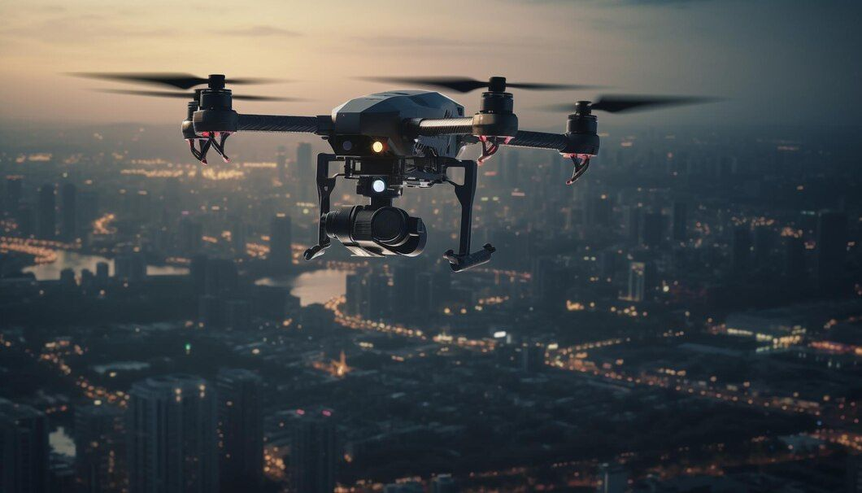
REVENUE MARKET SHARE BY SEGMENTS 2022
REVENUE
SIZE SEGMENT
Films and Television
27.54%
Medium Size
42.17%

Slide 5

GLOBAL CIVIL DRONE MARKET REVENUE SHARE FOR 2022
North America
36.56%

Slide 6
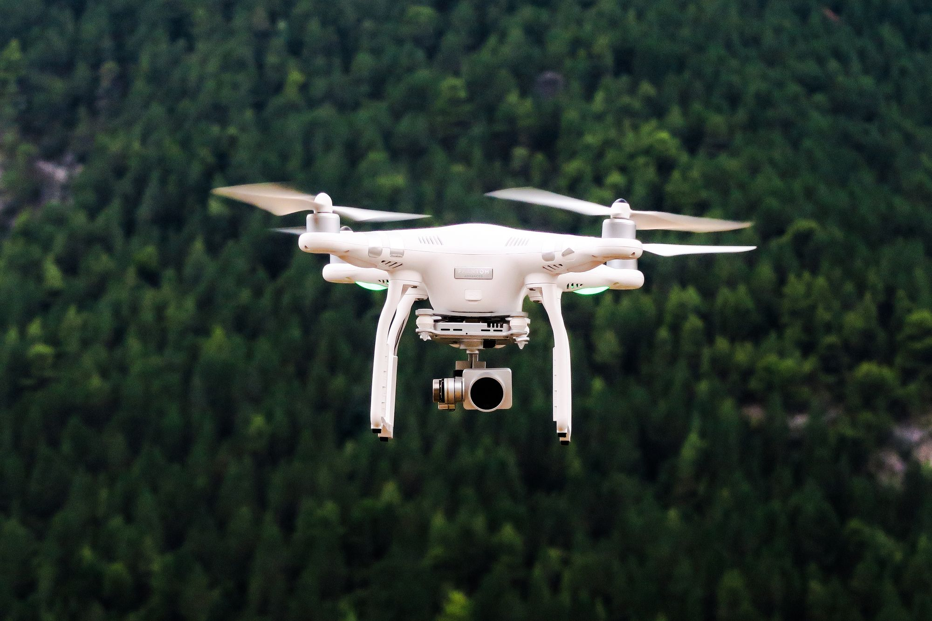
Rise in the use of civil drones in agricultural sector
Drivers
  Regulatory Restrictions
  Privacy and Security Concerns
Restraints

Slide 7
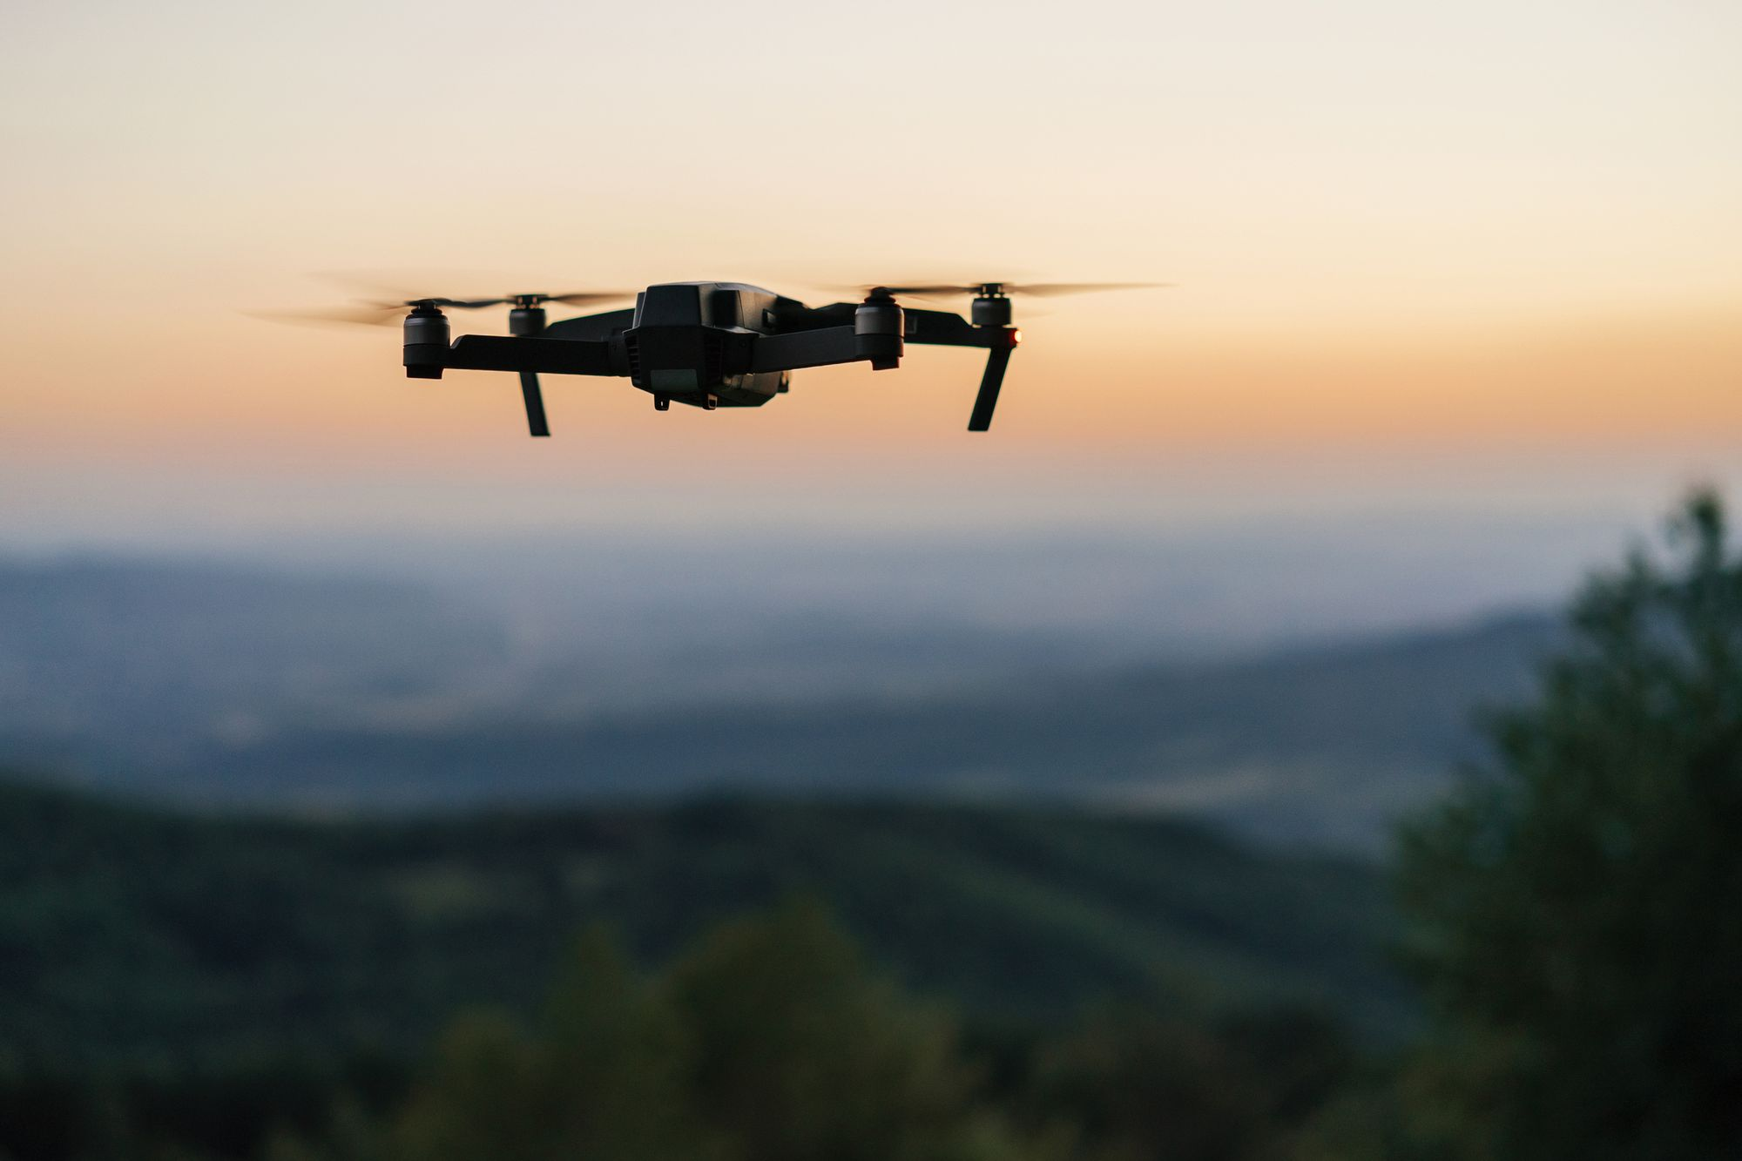
AUTHOR'S PERSPECTIVE
  In the near future, civil drones will be providing jobs for 100,000 Americans
  Microdrones has updated the md4-1000 and md4-3000 platforms and received an official Remote ID Declaration of Compliance from the FAA.
  Multi-rotor drones are one of the easiest and cheapest options for aerial photography and surveillance.
  This can be attributed owing to the high adoption of usage of drones in entertainment sector. Further, rising demand from clients and owners for advertising resorts, hotels, tourist spots, public places, and amusement parks through aerial photography is awaited to boost the segment’s growth.

Slide 8
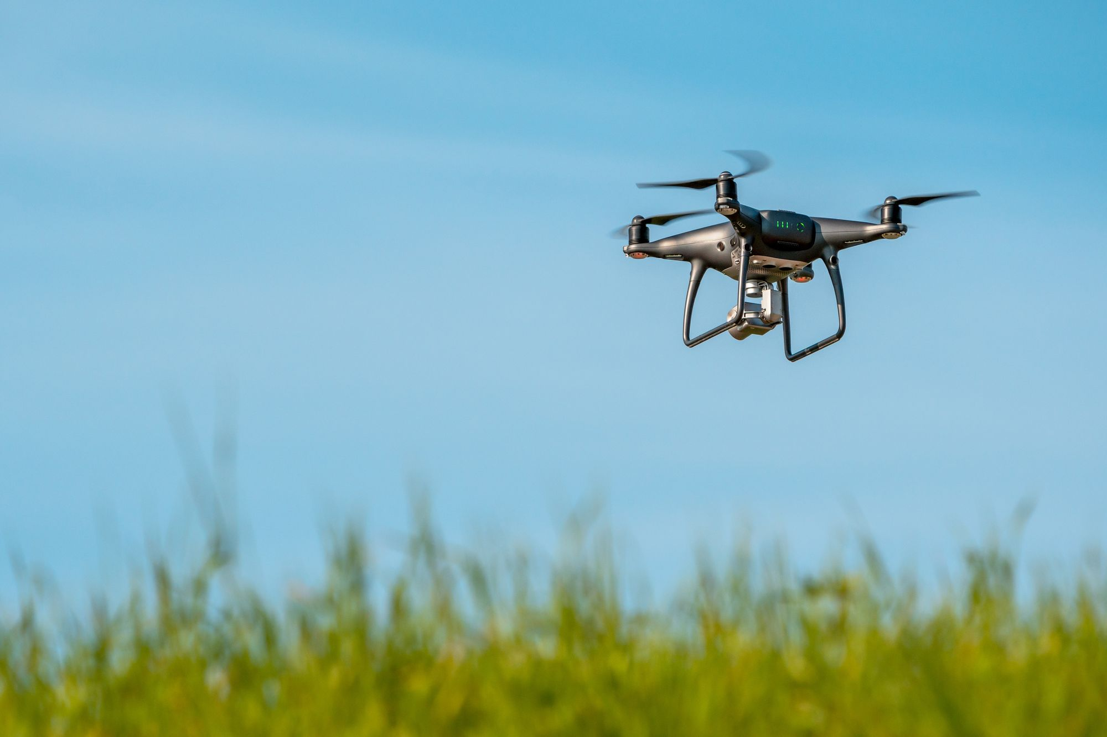








KEY PLAYERS

Slide 9
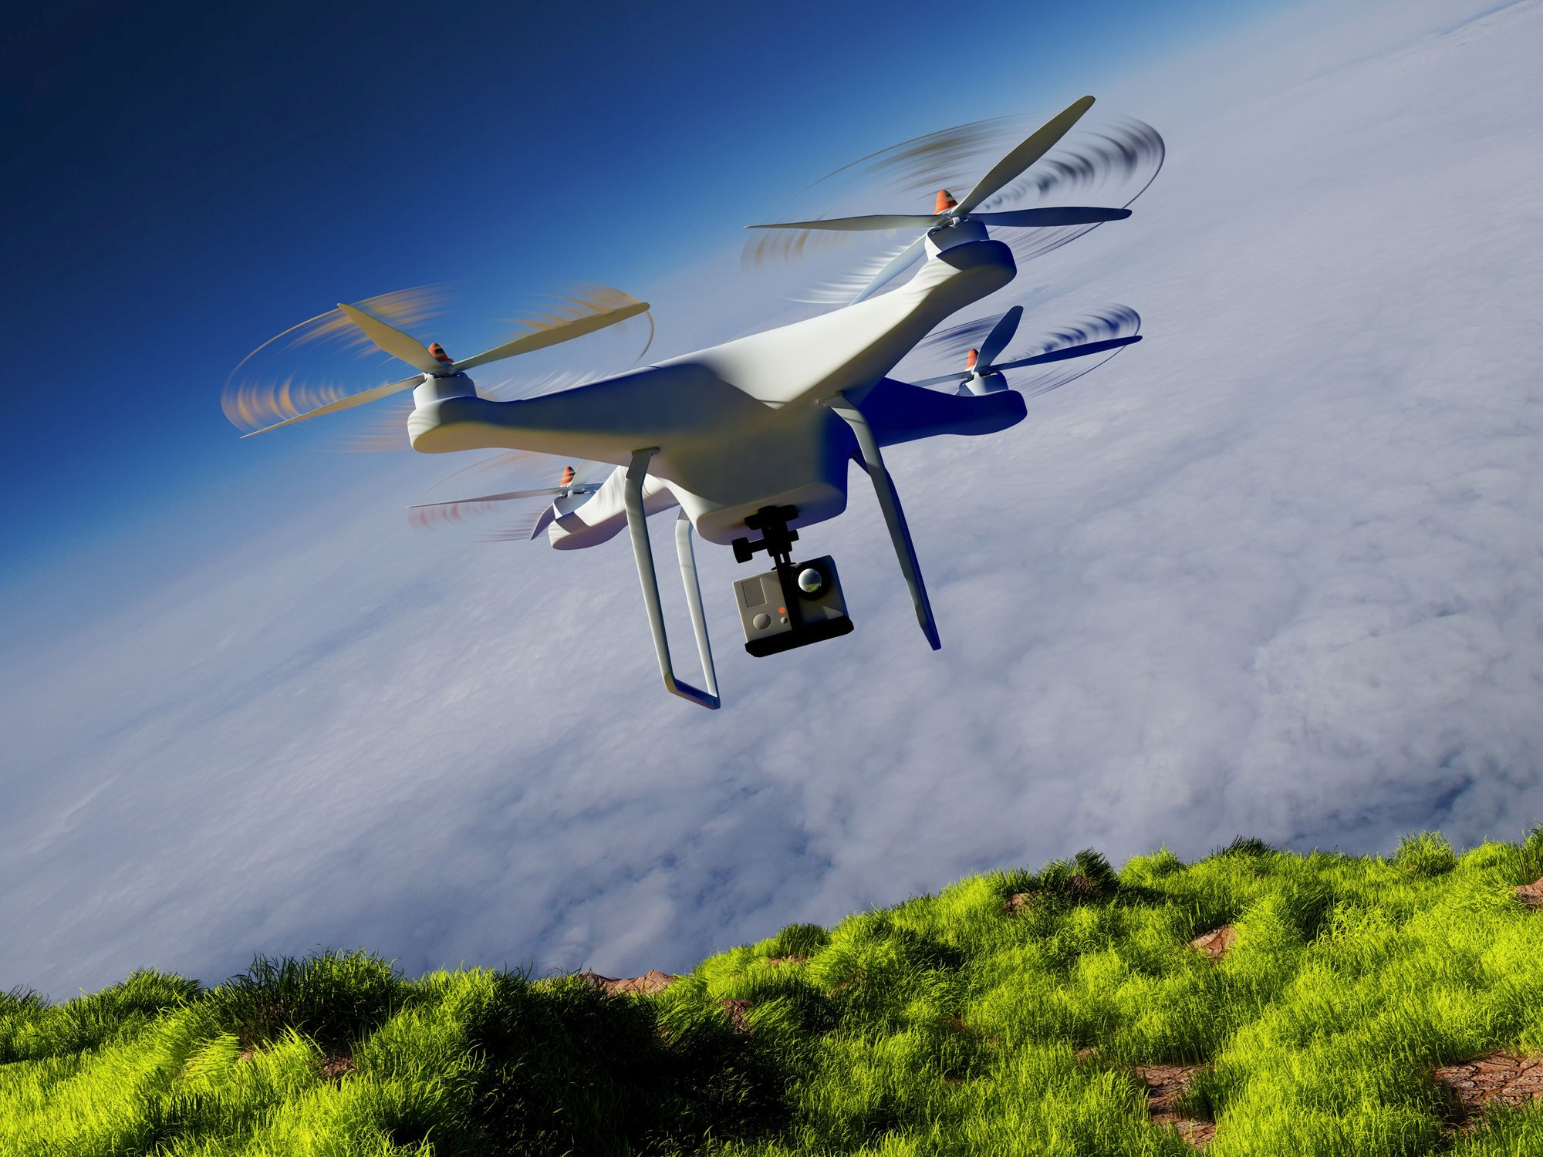

For Full Report
Contact us
COGNITIVE MARKET RESEARCH
Tel: +1 312-376-8303 | +44 020-8123-0732
India: (+91) 983-496-8611
sales@cognitivemarketresearch.com
Access the Full Report : https://tinyurl.com/2kn48dtx
Please visit our website:
https://www.cognitivemarketresearch.com

