Slide 1

GLOBAL
CINEMA CAMERA
MARKET REPORT 2024
Global,Regional,CountryAnalysis

Slide 2

INTRODUCTION
Cinema cameras are specialized cameras used for professional filmmaking and video production. These cameras are designed to capture high-quality, high- resolution video footage with superior color accuracy and dynamic range. They are used in a variety of applications, including feature films, television shows, documentaries, commercials, and music videos. The cinema cameras market has been experiencing significant growth in recent years due to cumulative demand for high-quality video content across various industries. Additionally, camera manufacturers are constantly innovating and introducing new features and technologies to improve the quality and functionality of cinema cameras. This has led to an increase in demand for newer and more advanced camera models.

Slide 3
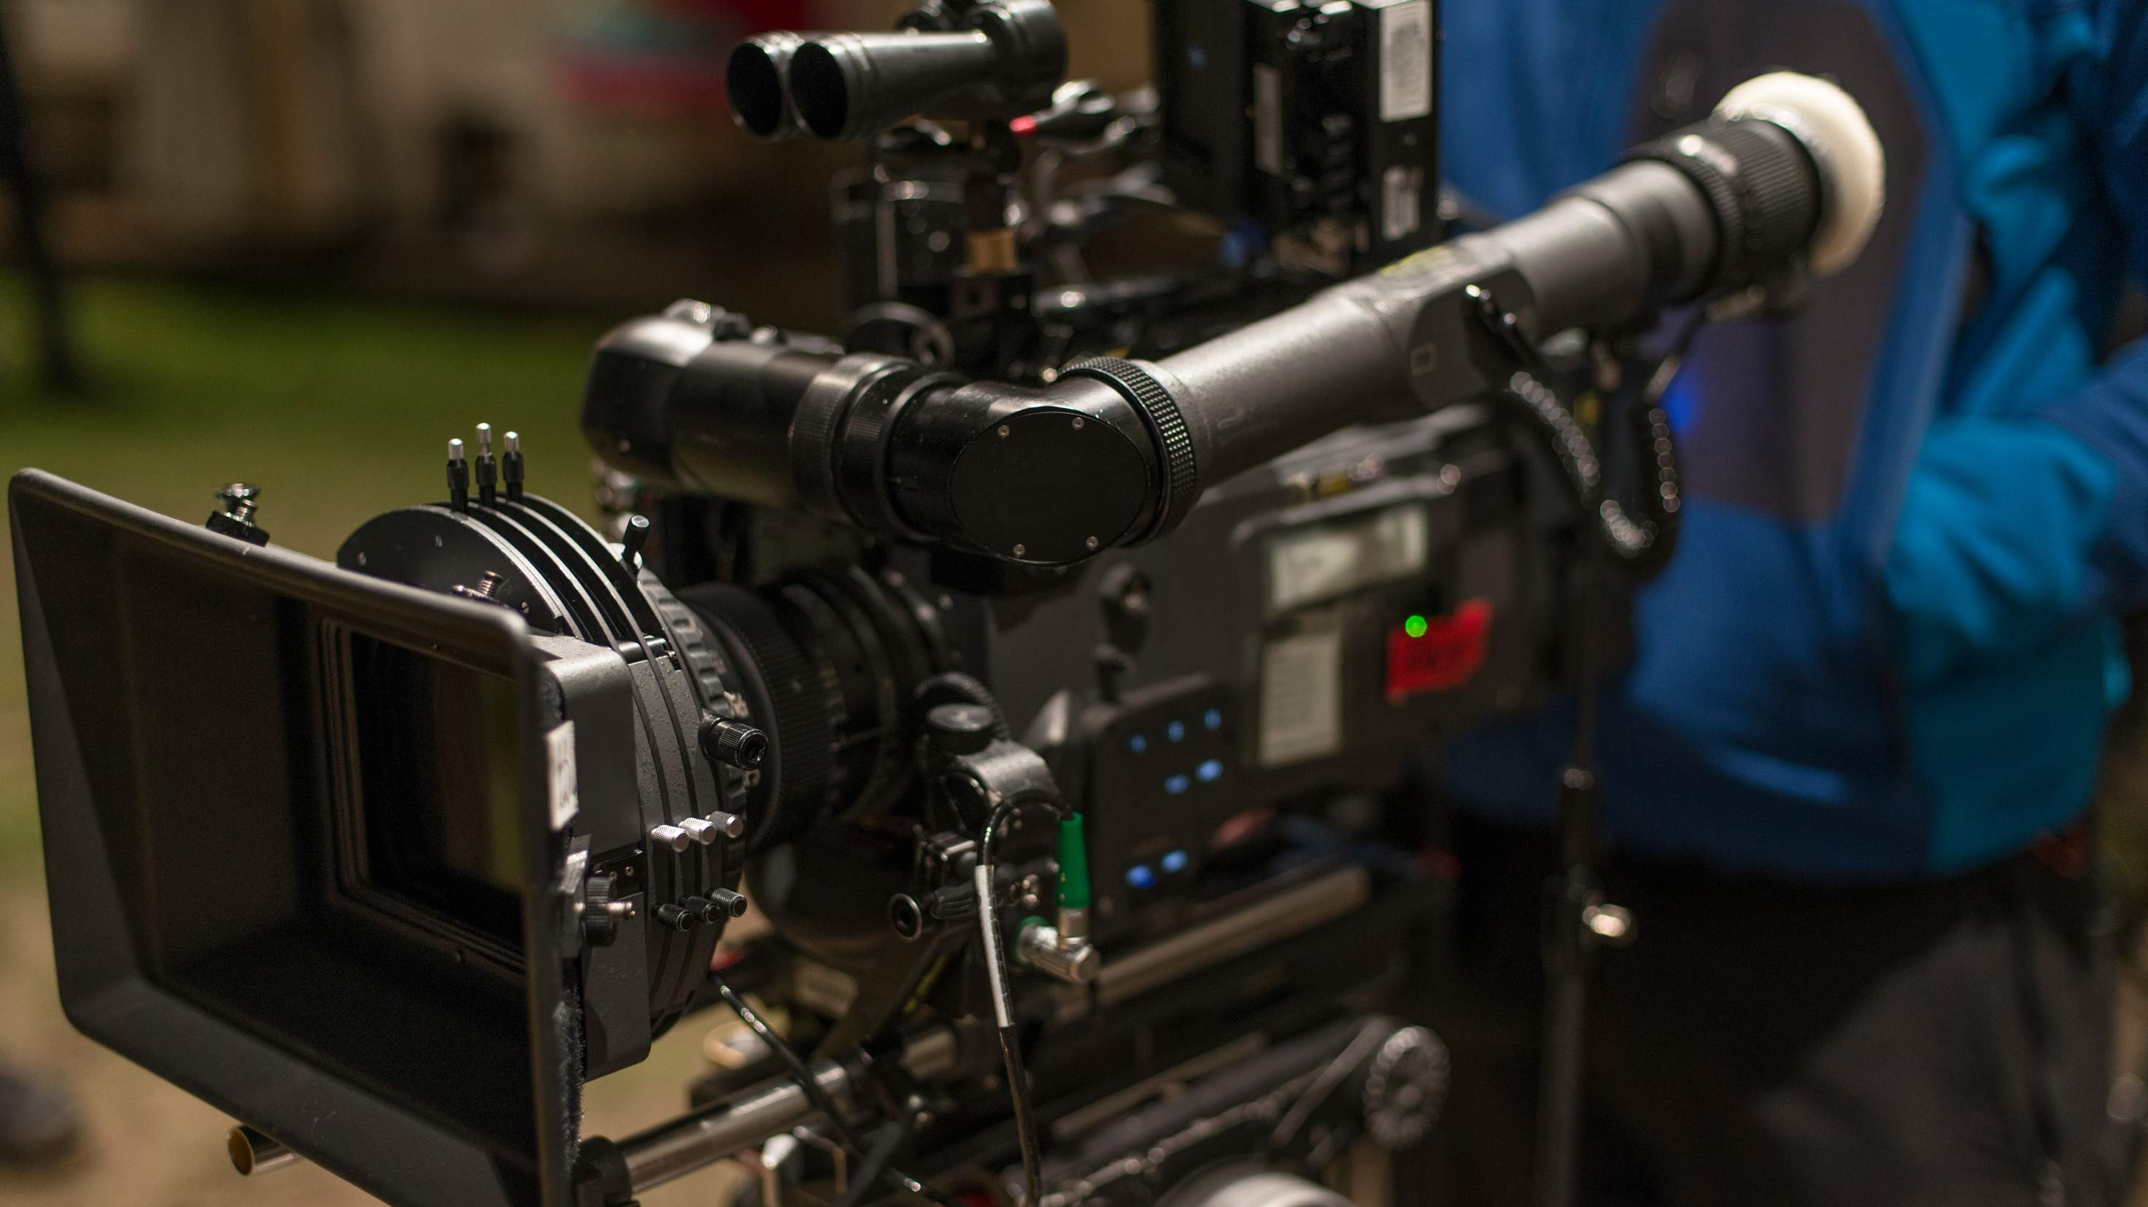

KEY INSIGHTS
MARKET SIZE
USD 315.6 million
2023
2023
CAGR 6.50%
-
2030

Slide 4
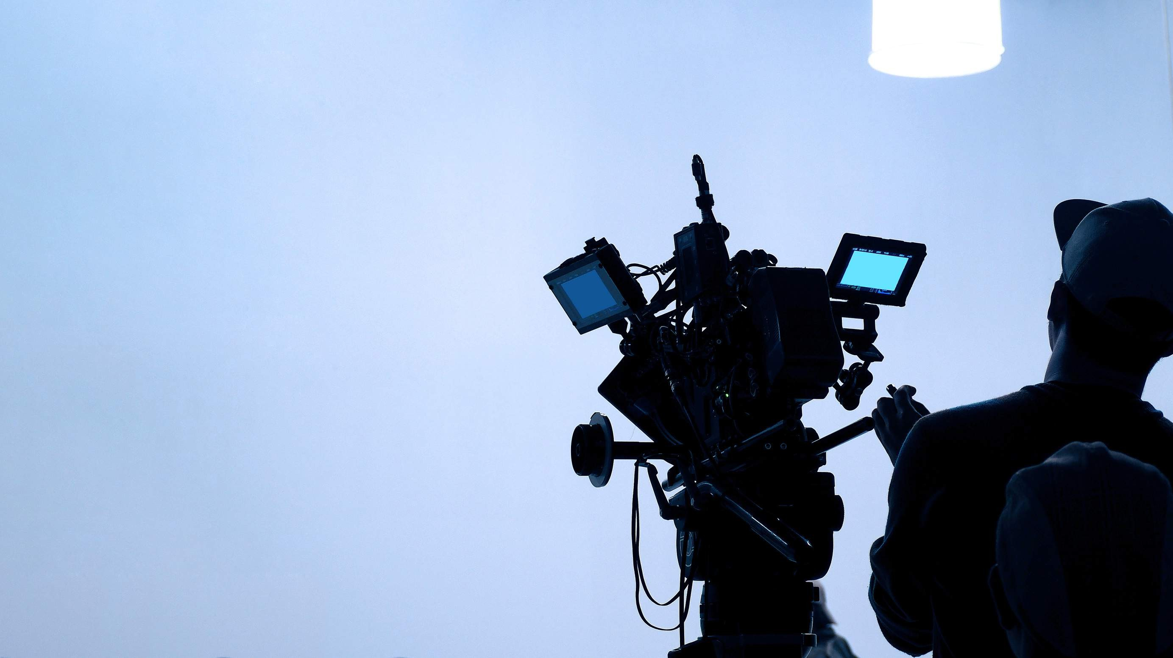
REVENUE MARKET SHARE BY SEGMENTS 2022
CMOS
Full Frame
Sensor Type Segment
Dual Pixel Super 35mm
Charged-Coupled Device (CCD)
Lens Type Segment
PL Mount EF Mount
4K/8K Resolution Full-HD Resolution (1080)
Video Resolution Segment

Slide 5
Global Cinema Camera Market Revenue share for 2022
North America 40%

Slide 6

Increasing Adoption of Digital Filmmaking and Rise of Online Streaming Platforms to Propel Market Growth
Drivers
High Cost of Cinema Cameras, Limited Market Size, and Impact of Covid-19 Pandemic to Restrict Market Growth
Restraints

Slide 7
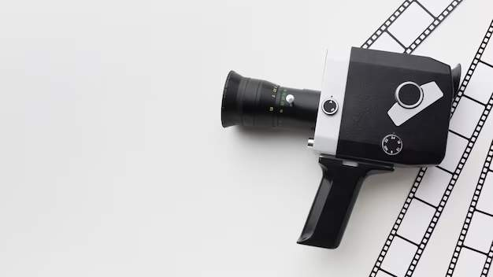
AUTHOR'S PERSPECTIVE
CMOS is the fastest-growing category over the forecast period. CMOS sensors have several advantages over CCD sensors, including lower power consumption, faster readout speeds, and higher resolution.
PL mount hold a prominent market share as it is used in professional cinema cameras and is compatible with a wide range of high-quality cinema lenses.
The EF mount is a more consumer-friendly lens mount, and it is typically used in consumer- grade cameras, such as DSLRs.
Full-HD Resolution (1080) is the fastest-growing category over the forecast period as they are more affordable than 4K and 8K resolution cameras.
Full-HD resolution cameras are compatible with a wider range of equipment, including lenses, monitors, and editing software.

Slide 8
KEY PLAYERS

Slide 9


Contact us
For Full Report
COGNITIVE MARKET RESEARCH
Tel: + 1 312 - 376 - 8303 | + 44 020 - 8123 - 0732
India: ( + 91 ) 983 - 496 - 8611
sales@ cognitivemarketresearch. com
Access the Full Report : http://tinyurl.com/yt6hkwc3
Please visit our website:
https://www.cognitivemarketresearch.com

