Slide 1
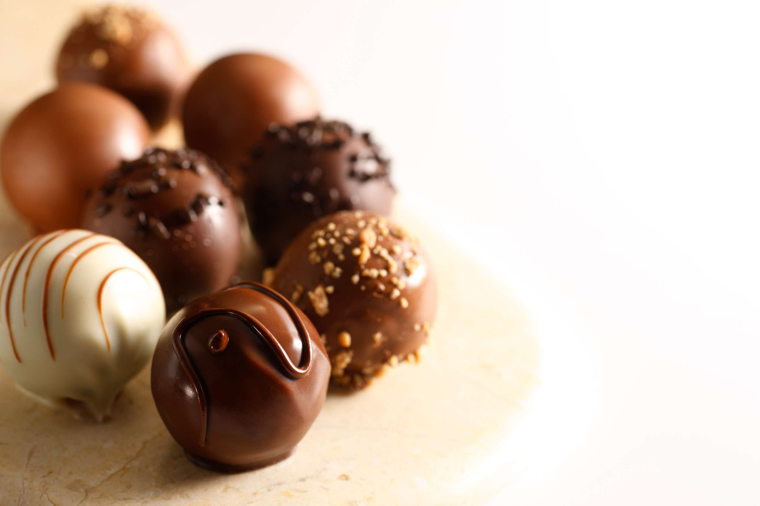

CHOCOLATE TRUFFLE
MARKET REPORT
2024
Qualitative Analysis + Quantitative Analysis

Slide 2

INTRODUCTION
Chocolate truffles are exquisite confections renowned for their rich, indulgent taste and velvety texture. Typically crafted from a blend of high-quality chocolate, cream, and occasionally butter, they are meticulously hand-rolled into small, bite-sized spheres. These delectable treats often feature a smooth outer coating of cocoa powder, chopped nuts, or chocolate shavings, enhancing their luxurious appearance. While traditional truffles boast a classic cocoa flavor, modern variations offer a myriad of creative combinations, including infused liqueurs, spices, or fruit essences. Regarded as a symbol of elegance and sophistication, chocolate truffles are beloved as luxurious gifts, decadent desserts, or gourmet indulgences for any occasion.

Slide 3
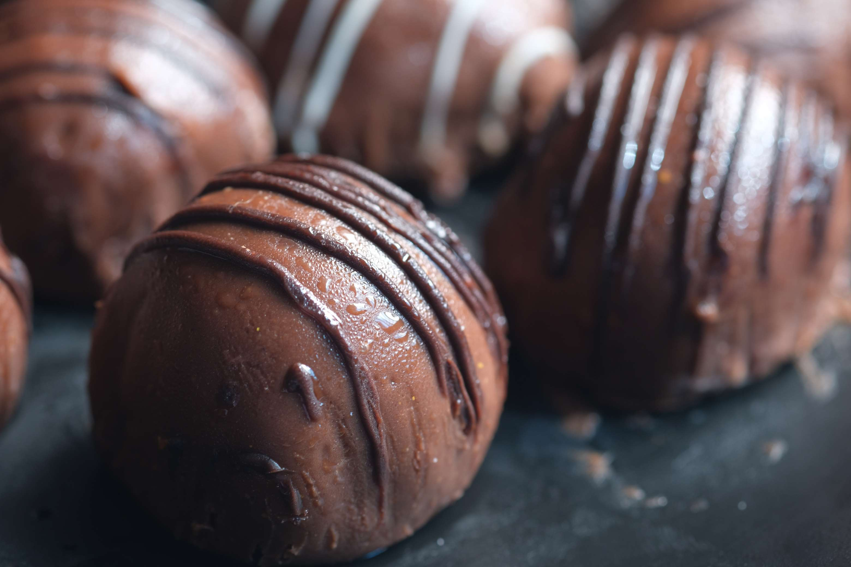

KEY INSIGHTS
MARKET SIZE
USD 1525.2 million
2024
CAGR
4.30%
2024- 2031

Slide 4
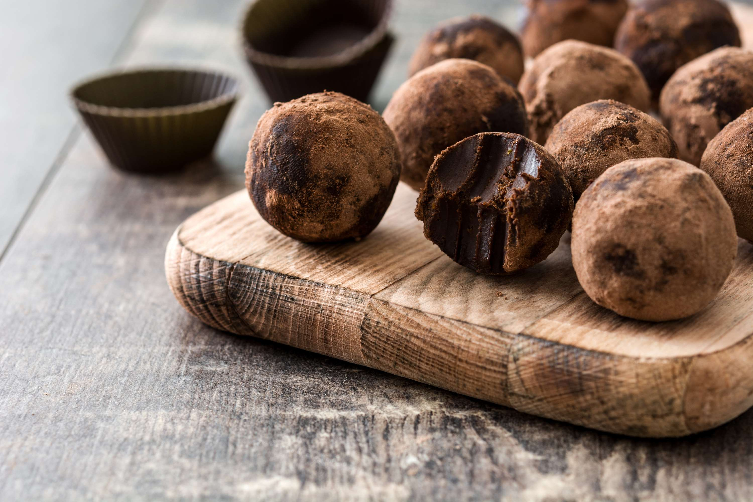
REVENUE MARKET SHARE BY SEGMENTS 2024
  Online Stores
  Hypermarket/Supermarket
  Offline Retail Stores
  Other Convenience Stores Packaging Industry
Distribution Channels
  Dark
  Milk
  White
Chocolate Segment

Slide 5
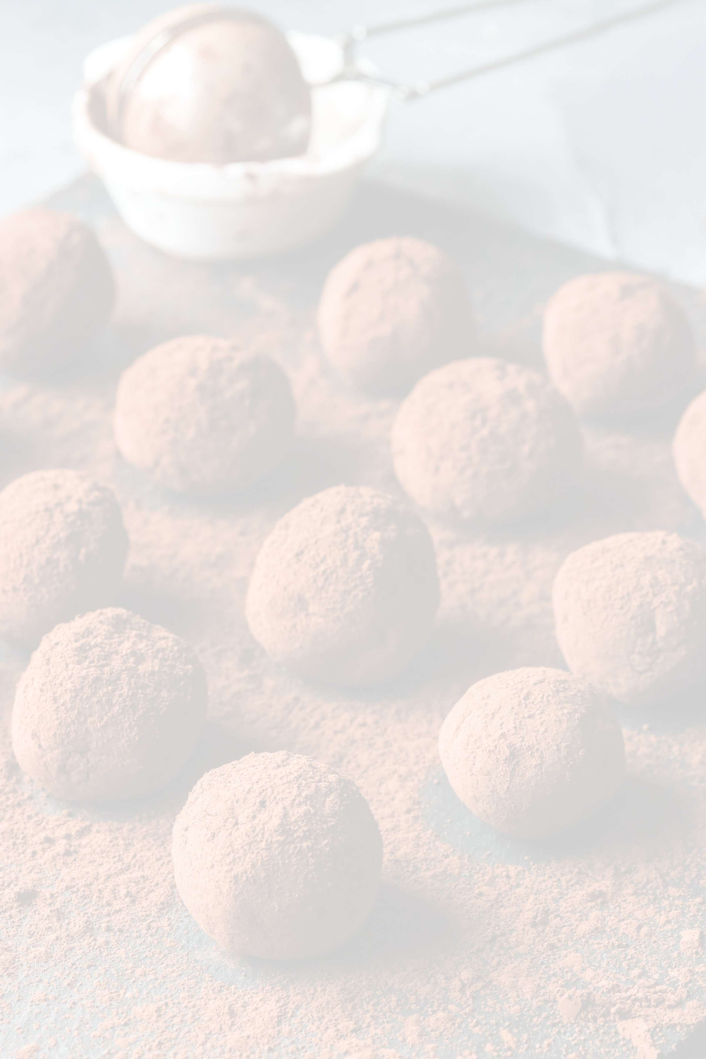


North America
40%
North America Chocolate Truffle Market Revenue share for 2024 is 40%

Slide 6
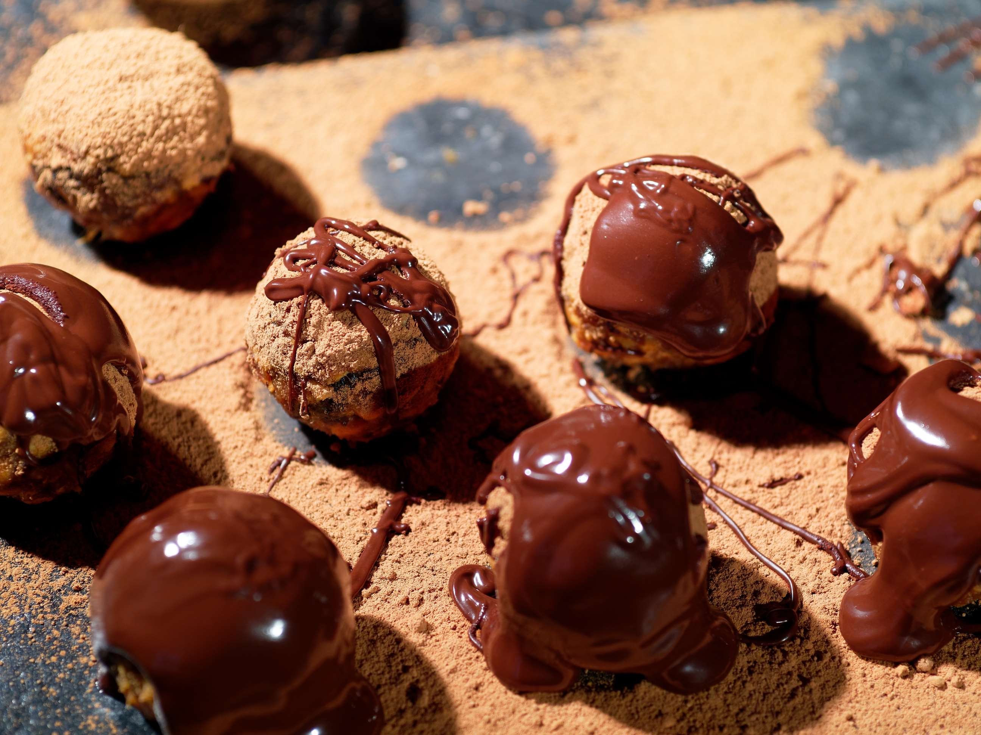
  Gifting Culture to Increase the Demand Globally
  Changing Consumer Preferences to Propel Market Growth
Drivers
Restraints
Competition from Substitutes to Limit the Sales

Slide 7
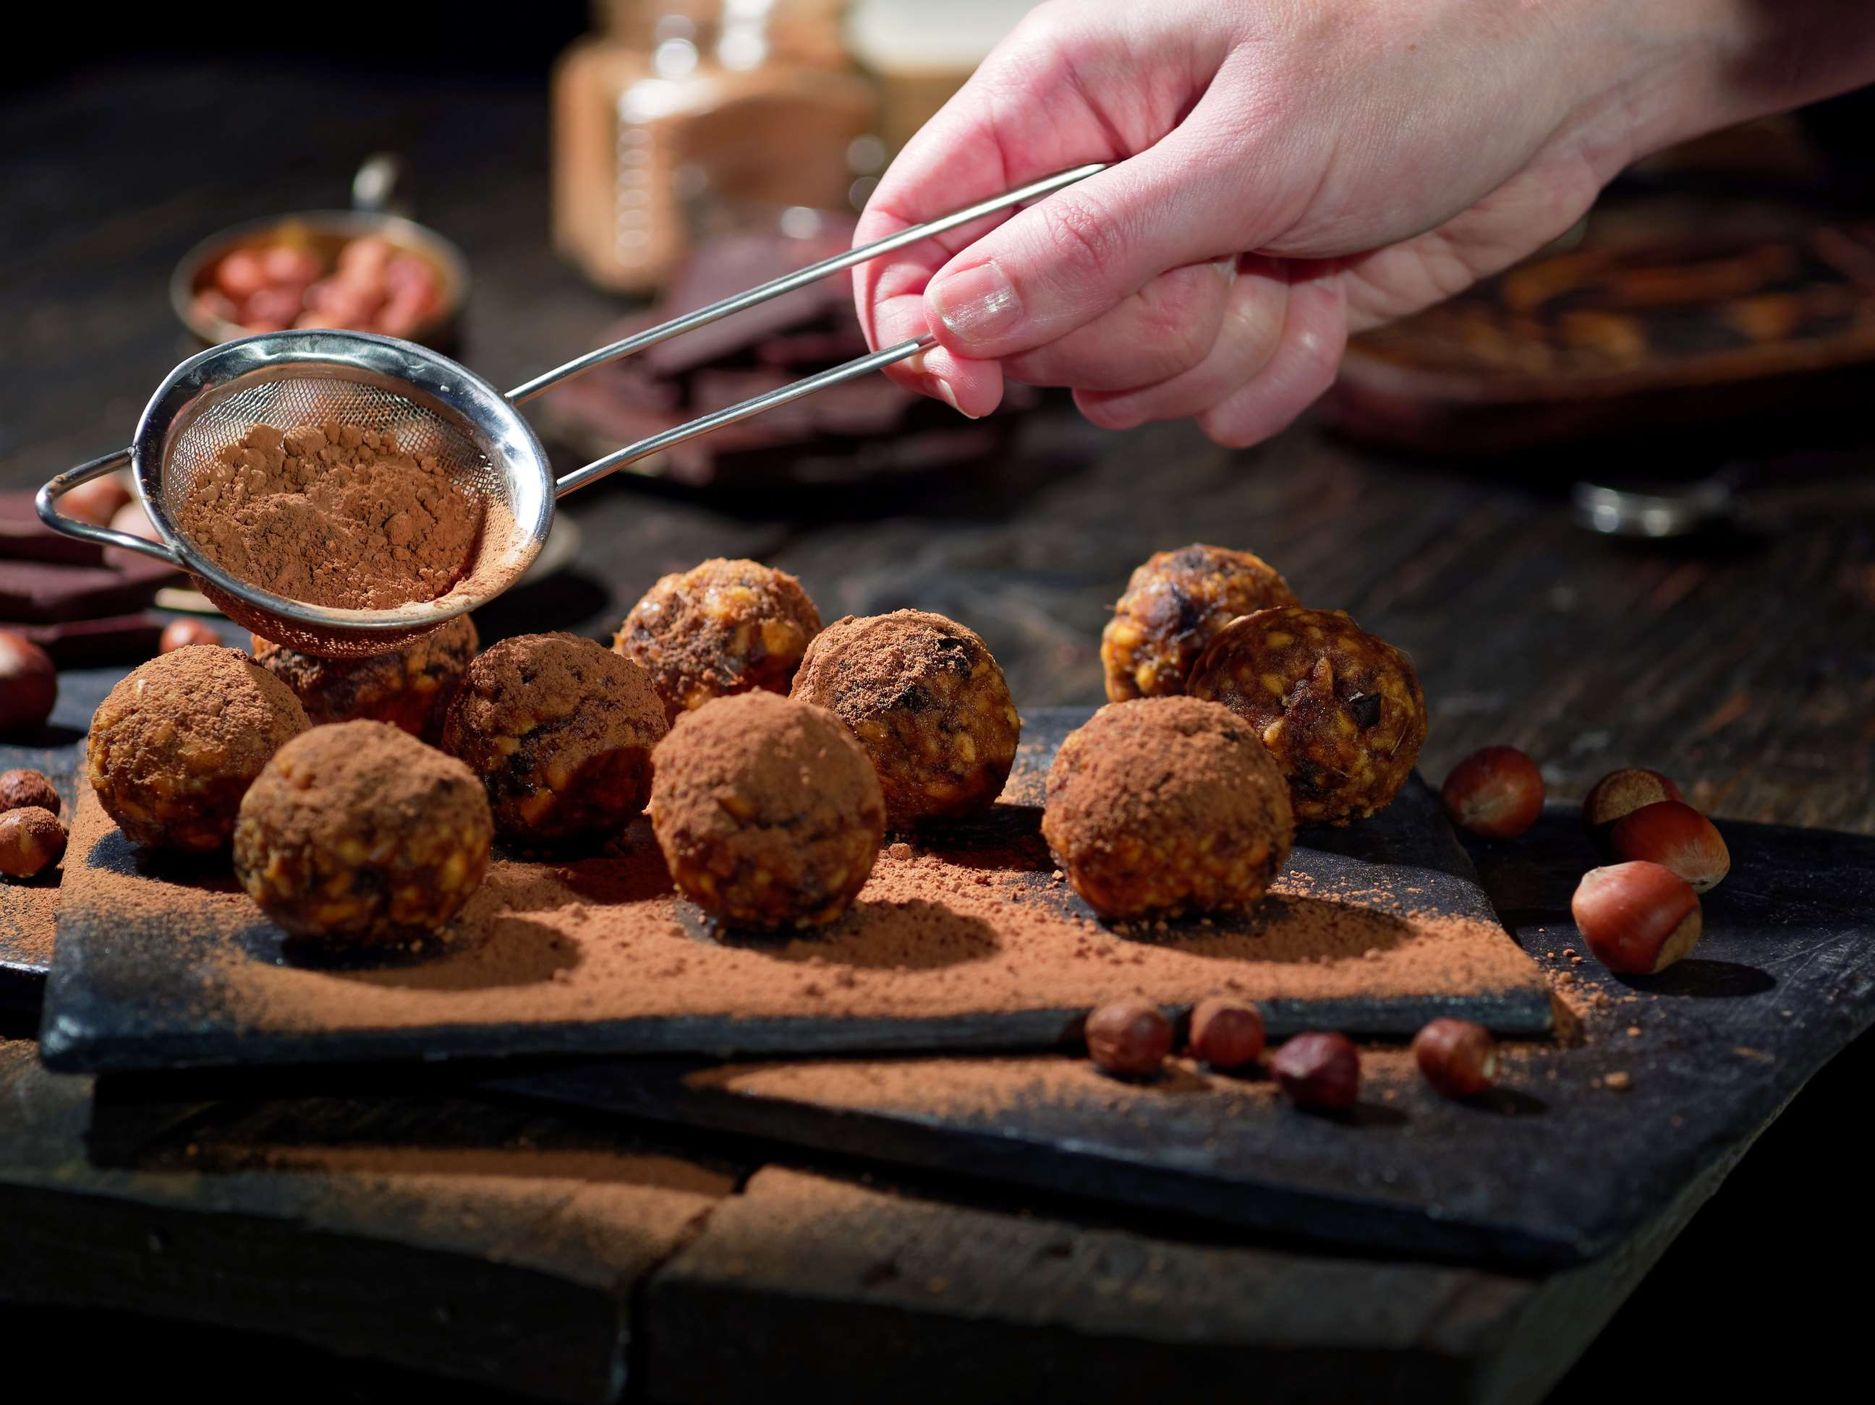
AUTHOR'S PERSPECTIVE
  The global chocolate truffle market will expand significantly by 4.30% CAGR between 2024 to 2031.
  Factors such as convenience, extensive product variety, and doorstep delivery contribute to the surge in online chocolate truffle sales, especially among tech-savvy and busy consumers seeking hassle-free shopping experiences.
  Sales of American truffle are set to increase due to its widespread popularity and recognition, supported by innovative flavor profiles, premium quality ingredients, and effective marketing strategies targeting diverse consumer preferences.
  Sales of conventional chocolate truffles are poised to increase due to their affordability, widespread availability, and familiarity among consumers, catering to a broader market segment seeking indulgent treats.

Slide 8







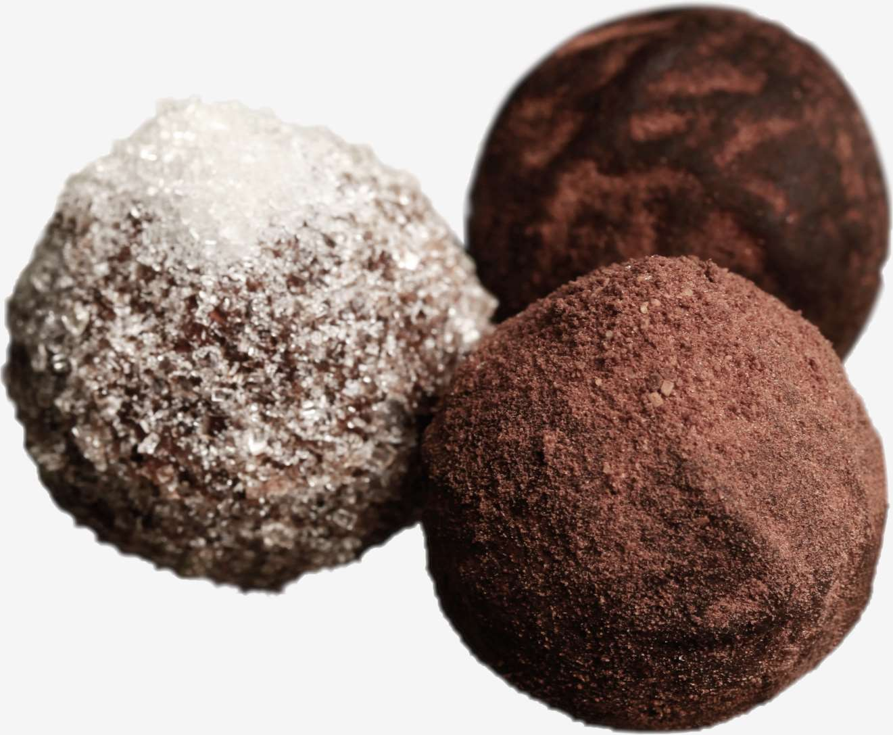




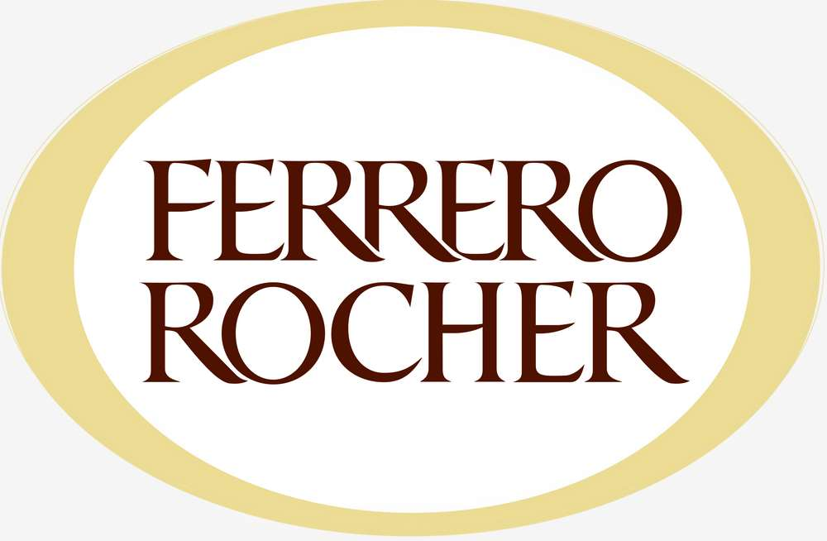


KEY PLAYERS

Slide 9


For Full Report
Contact us
COGNITIVE MARKET RESEARCH
Tel: +1 312-376-8303 | +44 020-8123-0732
India: (+91) 983-496-8611
sales@cognitivemarketresearch.com
Access the Full Report : https://tinyurl.com/ehju5kd2
Please visit our website:
https://www.cognitivemarketresearch.com

