Slide 1
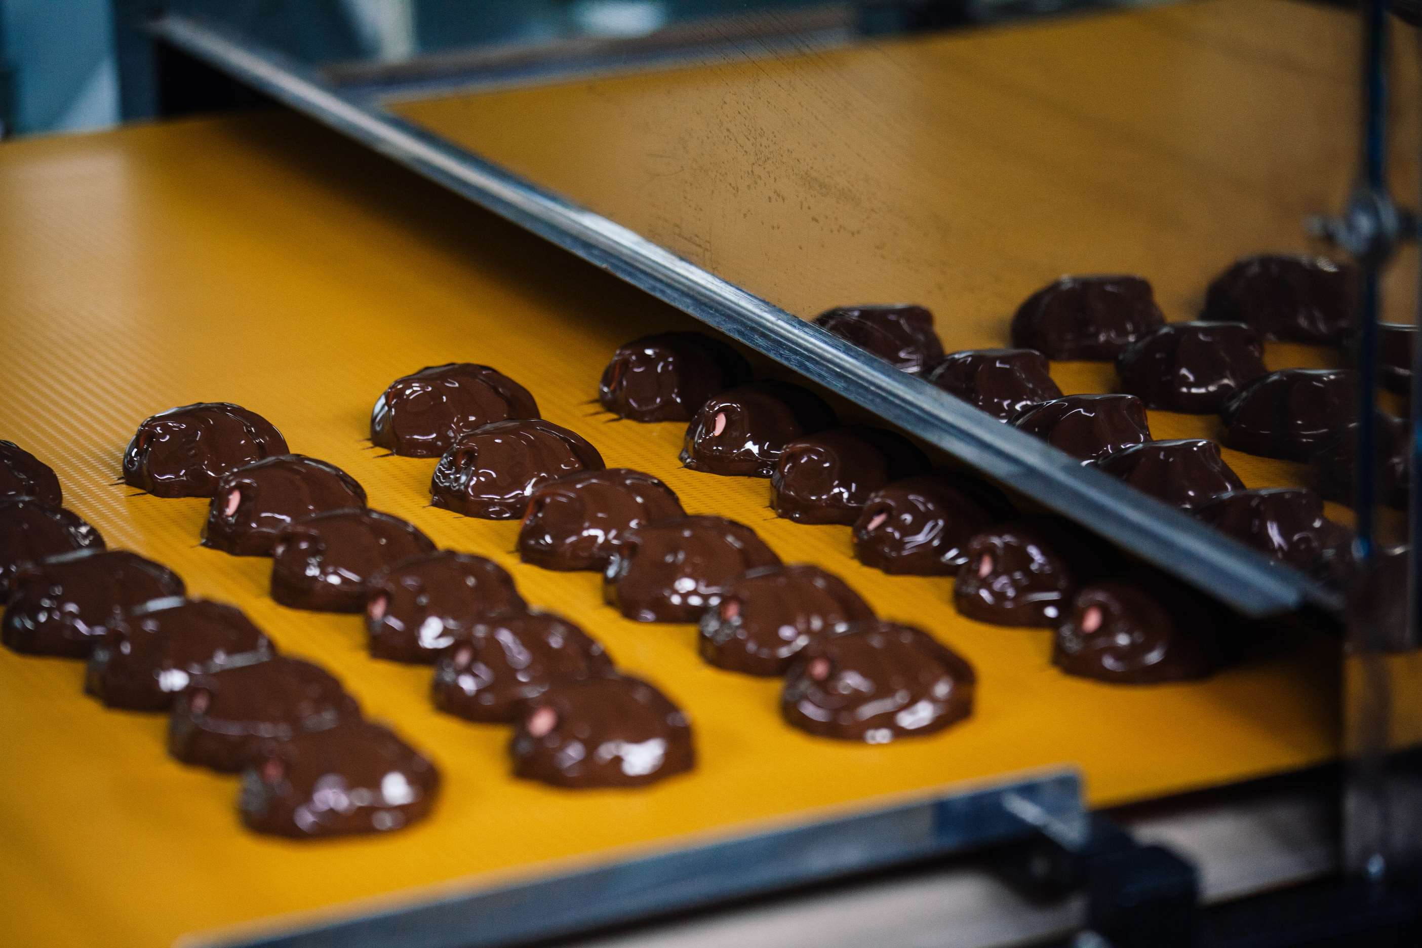
GLOBAL
CHOCOLATE TEMPERING MACHINE
MARKET REPORT
2024
Global,Regional,CountryAnalysis

Slide 2
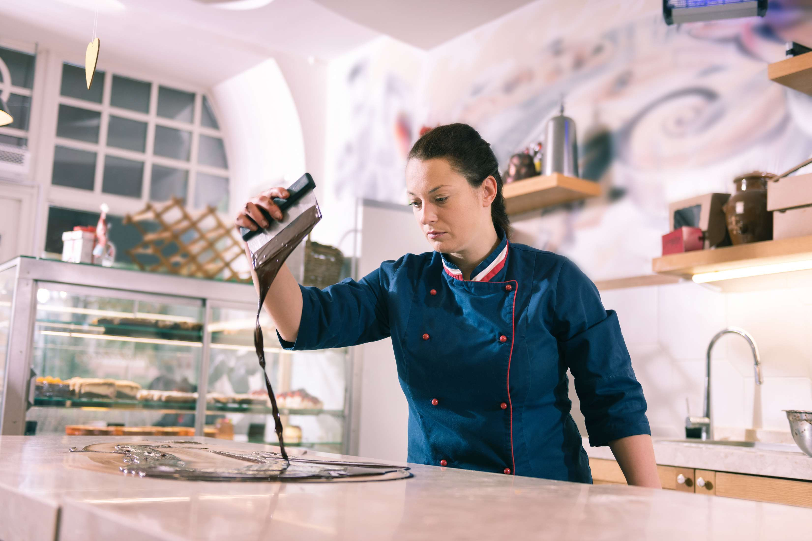
INTRODUCTION
The main factors driving the market for chocolate tempering machines are the rising demand for premium chocolate goods, the popularity of artisanal chocolates, and the requirement for efficient and uniform tempering of chocolate in mass production. The development of cutting-edge technology in chocolate tempering machines, as well as the growth of the confectionery sector, are additional significant drivers propelling market expansion. Additionally, it is anticipated that rising disposable income, shifting consumer tastes, and the growing world population would increase demand for chocolate and, consequently, for chocolate tempering equipment. Additionally, industry 4.0 technologies like the Internet of Things (IoT) and implementing automated tempering machines are anticipated to fuel market expansion in the following years.

Slide 3
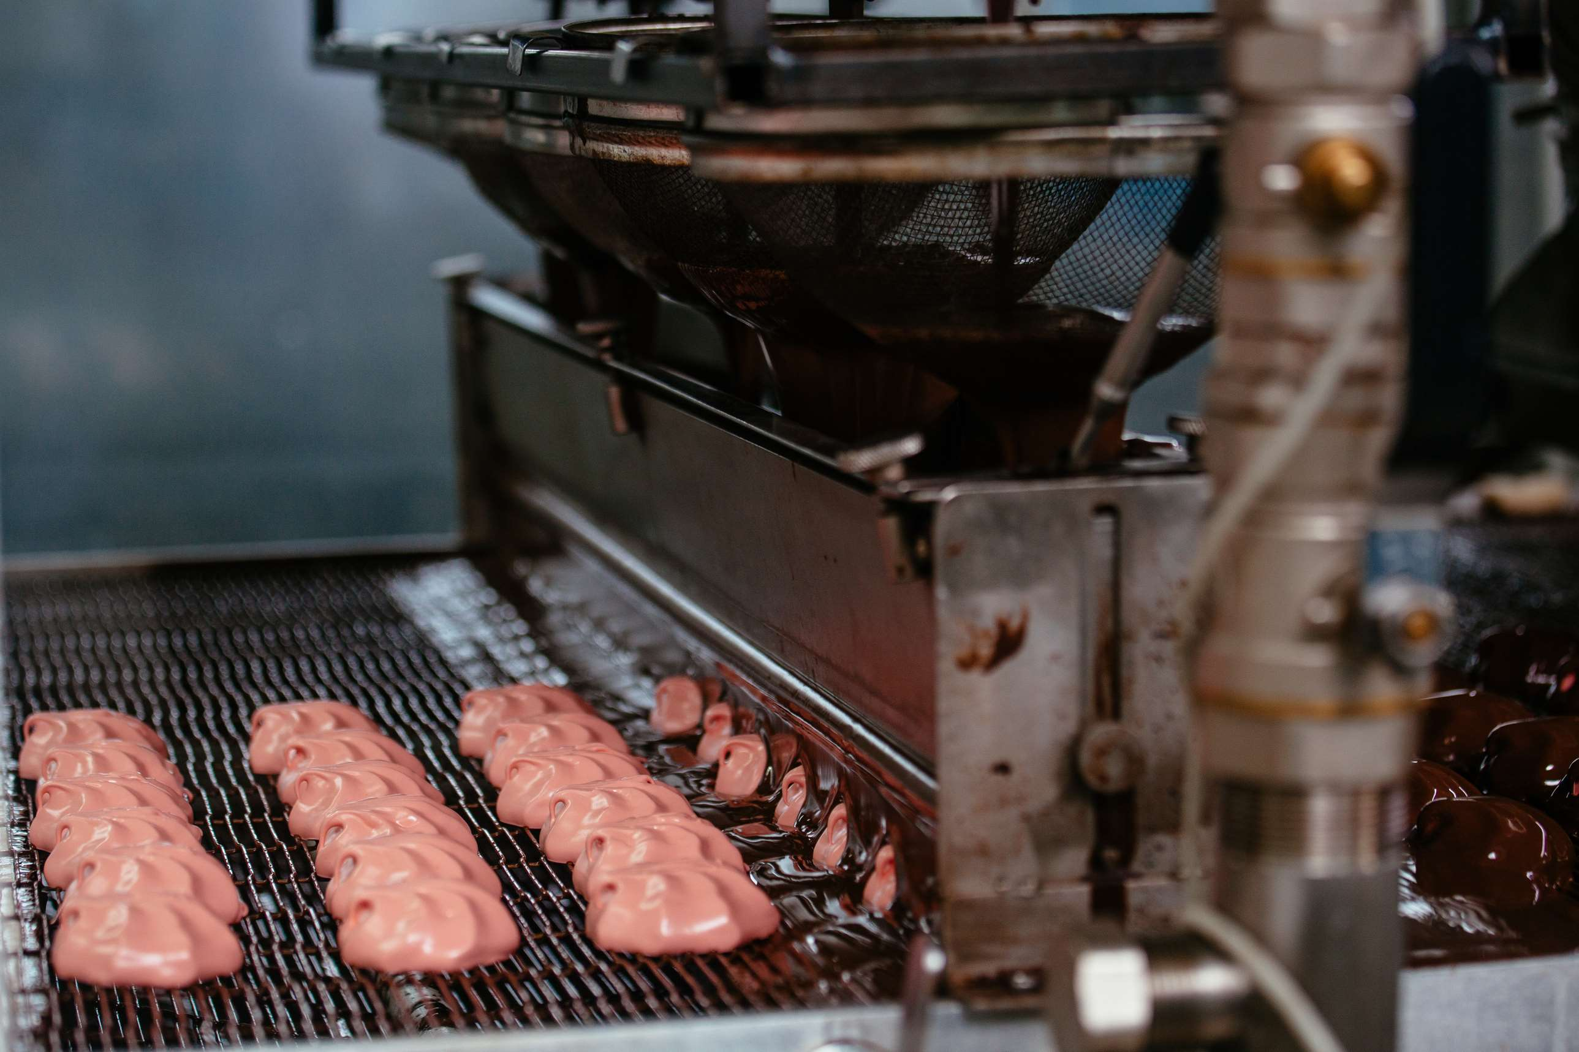

KEY INSIGHTS
MARKET SIZE
USD 0.845 billion
2023
CAGR
5.90%
2023- 2030

Slide 4
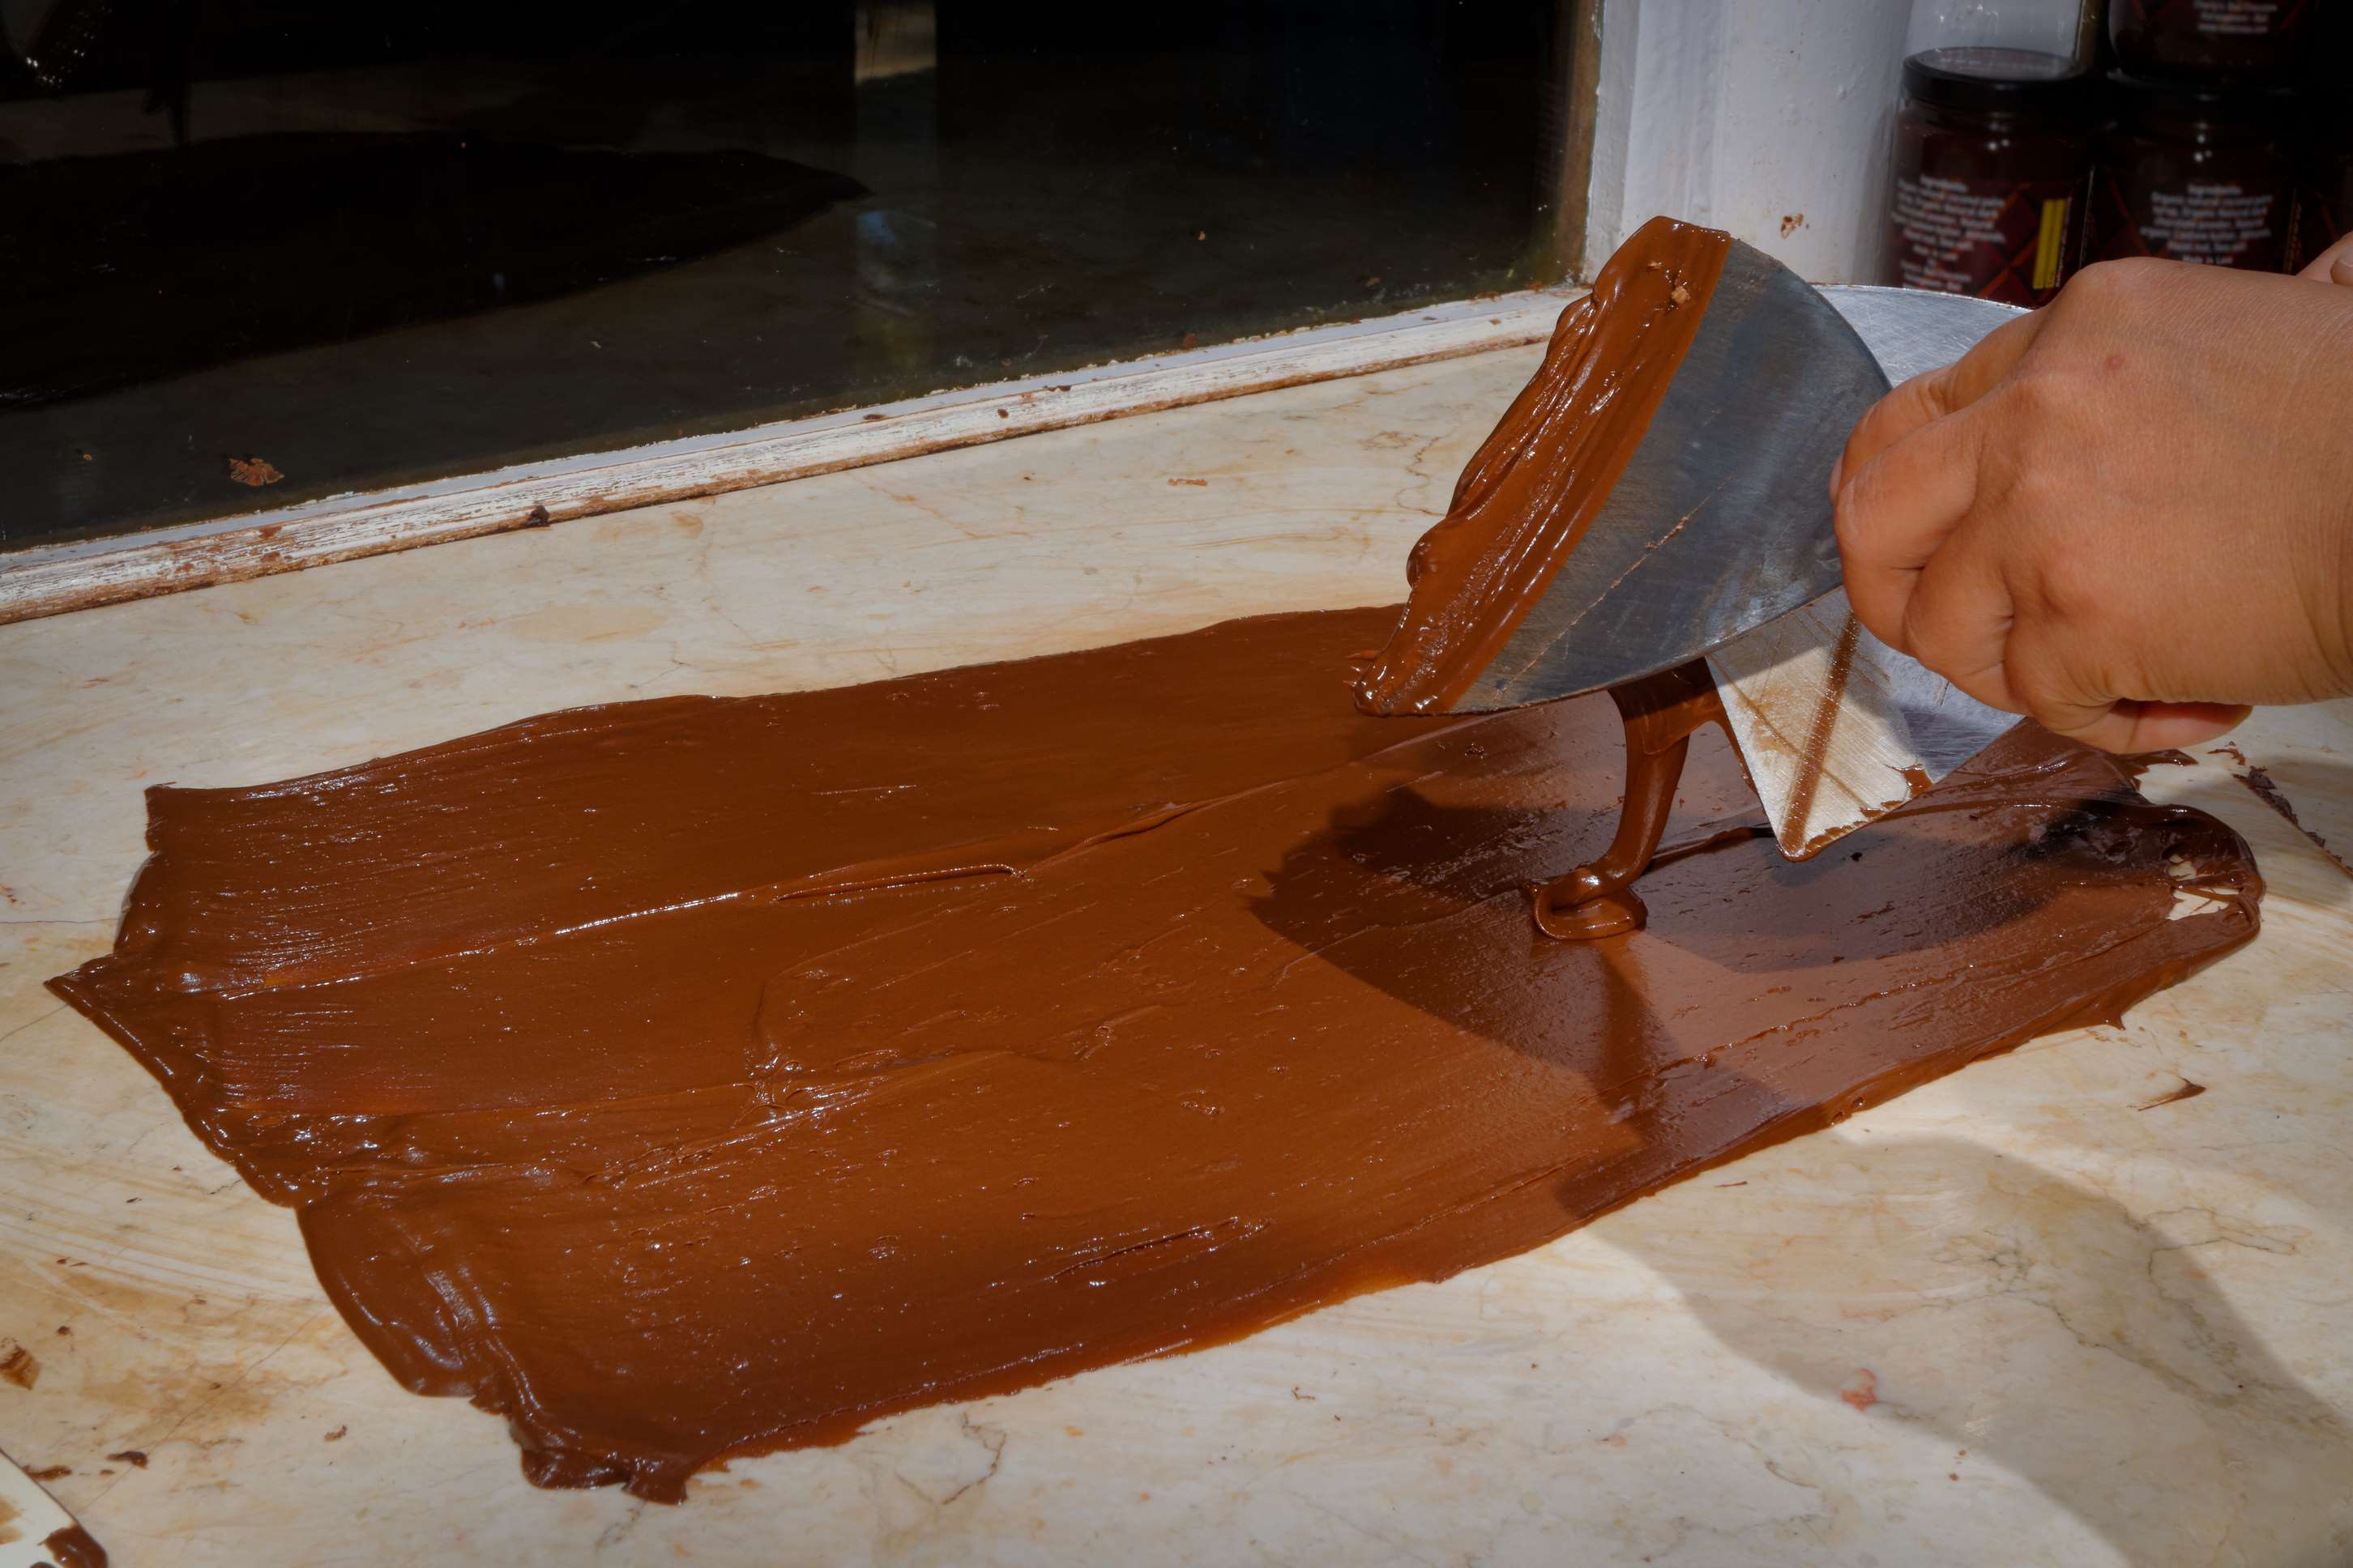
REVENUE MARKET SHARE BY SEGMENTS 2022
  Stationary Chocolate Tempering Machine
  Portable Chocolate Tempering Machine
Type Segment
  Semisweet Chocolate
  Dark Chocolate
  White Chocolate
Application Segment

Slide 5

Global Chocolate Tempering Machine Market Revenue share for 2024
North America

Slide 6
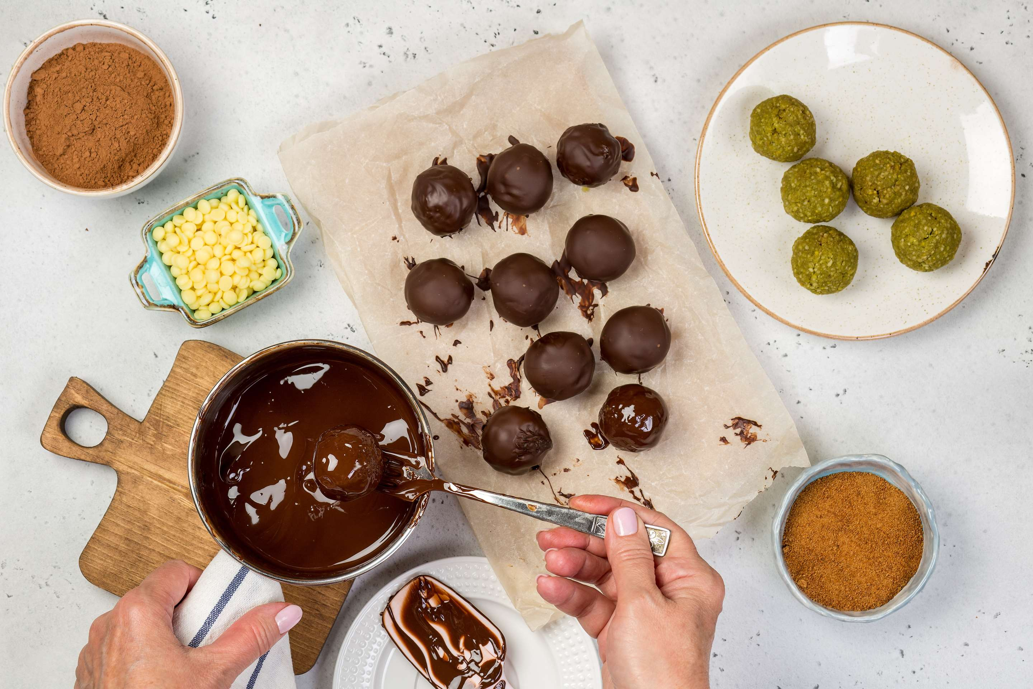
Increasing Dark Chocolate Consumption Due to Health Benefits Boost Market Expansion
Drivers
High Initial Investment to Hinder Market Growth
Restraints

Slide 7
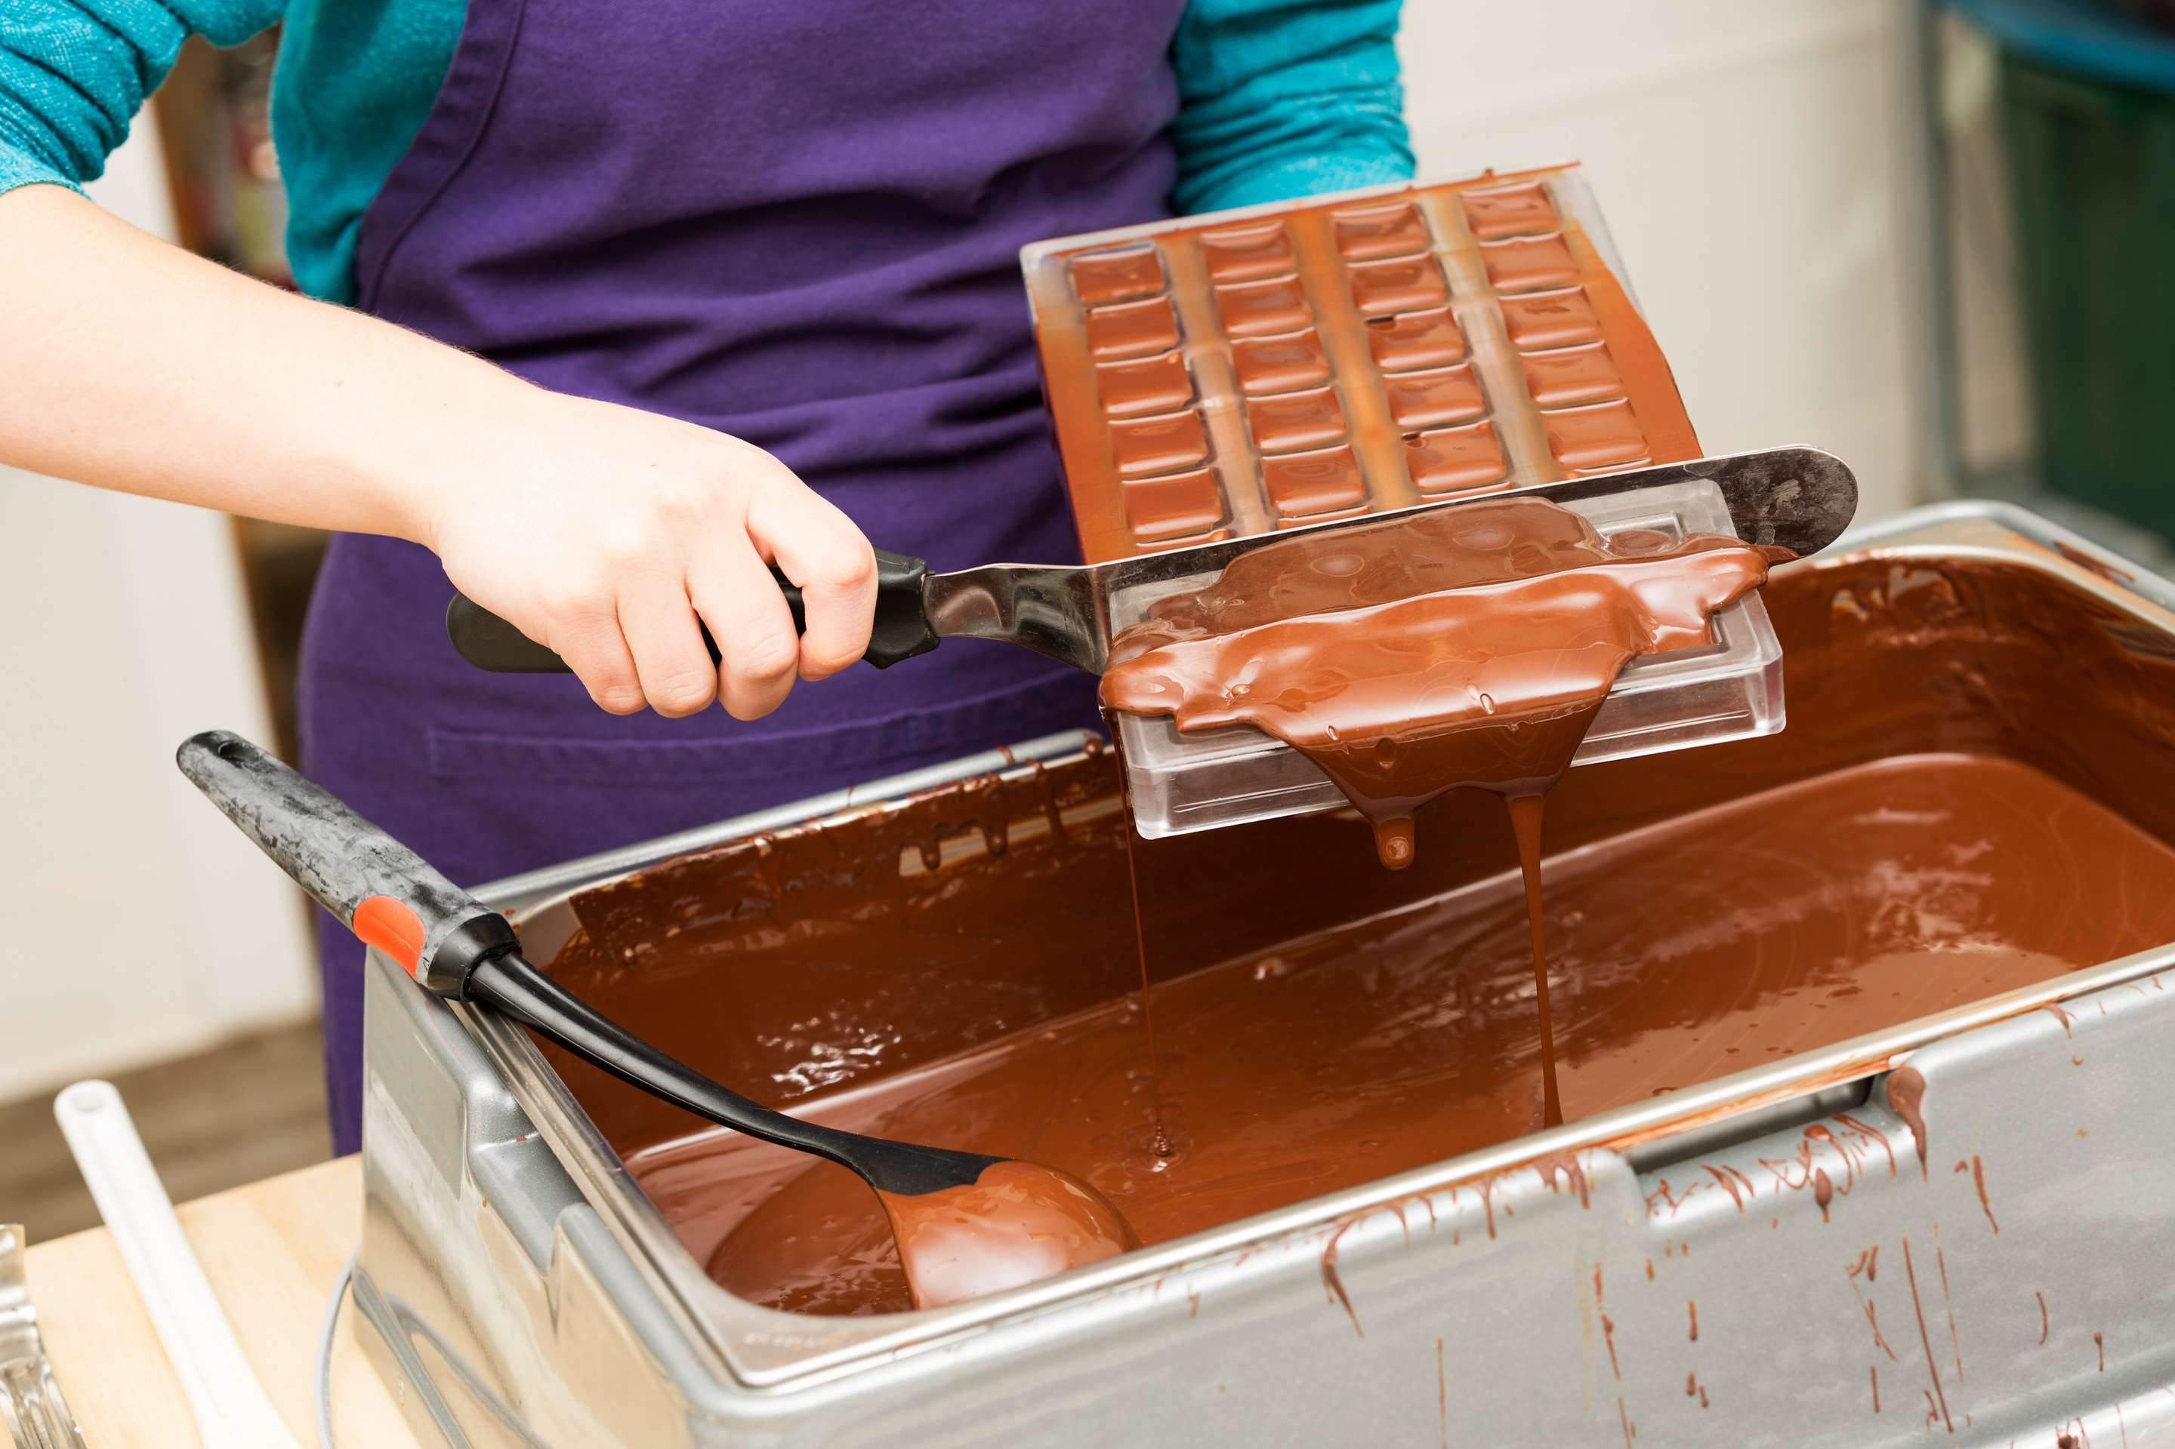
AUTHOR'S PERSPECTIVE
  The Global Chocolate Tempering Machine Market is witnessing significant growth in the near future.
  The portable chocolate tempering machine is a smaller and more mobile form of chocolate tempering equipment.
  Dark chocolate may be made by blending cocoa butter, cacao, and other dry ingredients at a temperature just below that of traditional milk or white chocolate but high enough to make the mixture liquid.
  Portable tempering machines are typically designed to be user-friendly.
  Semisweet Chocolate holds a significant share of the market; the flavor of semisweet and dark chocolate is enhanced by ensuring that all flavorings are evenly distributed throughout the final product.

Slide 8
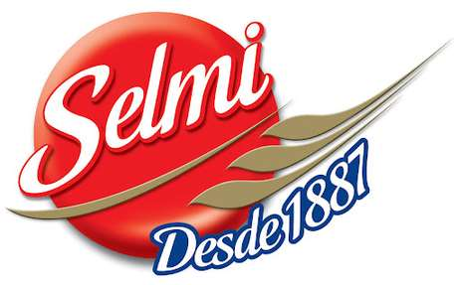


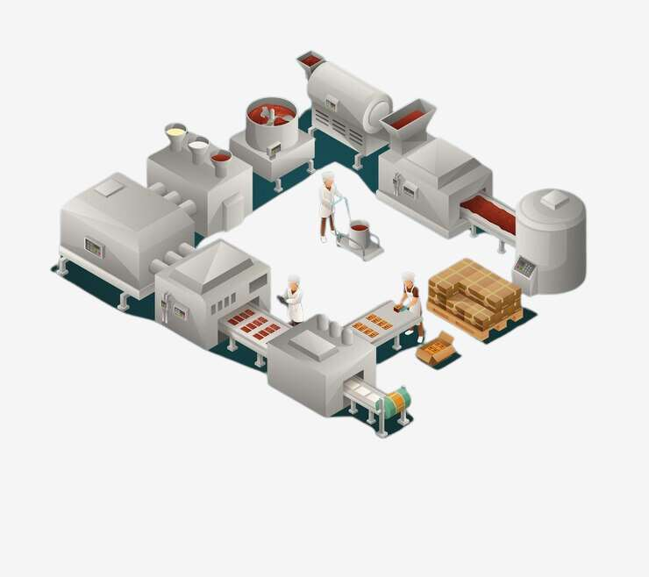





KEY PLAYERS

Slide 9


For Full Report
Contact us
COGNITIVE MARKET RESEARCH
Tel: +1 312-376-8303 | +44 020-8123-0732
India: (+91) 983-496-8611
sales@cognitivemarketresearch.com
Access the Full Report : https://tinyurl.com/22y4cckp
Please visit our website:
https://www.cognitivemarketresearch.com

