Slide 1

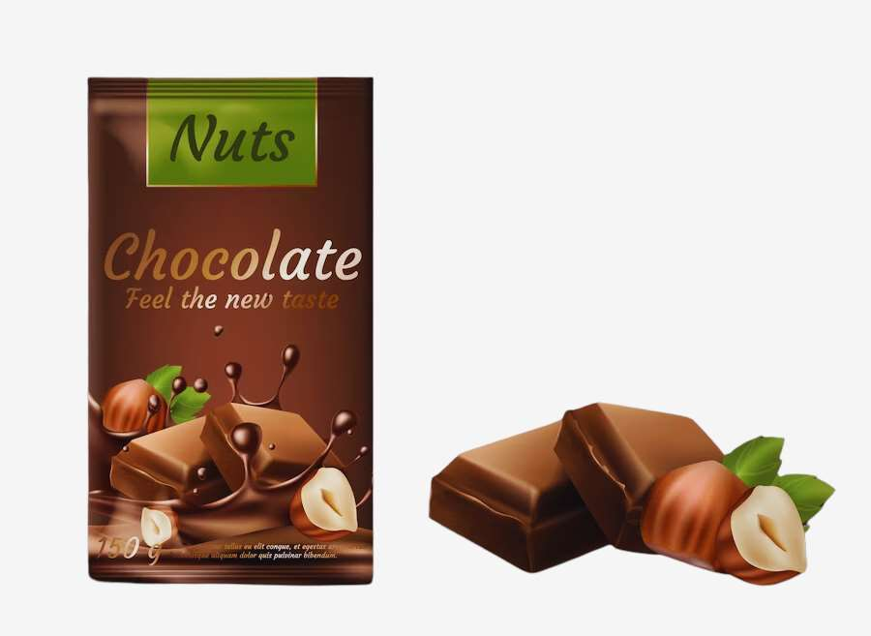
GLOBAL
CHOCOLATE BAR PACKAGING
MARKET REPORT
2024
Global,Regional,CountryAnalysis

Slide 2

INTRODUCTION
The growing need for sustainable and eco-friendly packaging has been a major factor in expanding the chocolate bar industry. Technological advancements in packaging contribute to a contemporary and engaging customer experience, while advances in digital printing technology provide personalized and adjustable packaging. The chocolate bar industry seeks affordable packaging solutions that don't sacrifice quality or aesthetics. The chocolate bar packaging industry is being propelled by rising demand for eco-friendly materials, recyclable packaging, and products with less environmental impact. This is expected to fuel growth in the chocolate bar packaging market over the next few years.

Slide 3
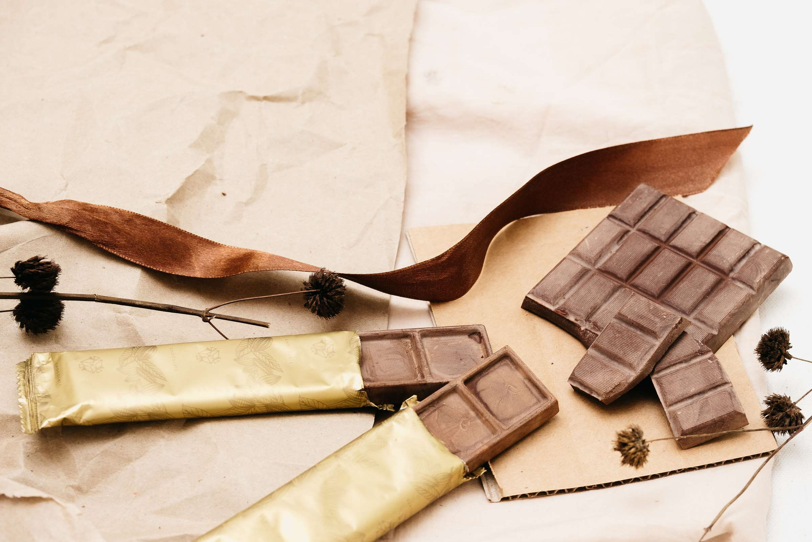

KEY INSIGHTS
MARKET SIZE
USD 48.8 billion
2023
CAGR
6.50%
2023- 2030

Slide 4
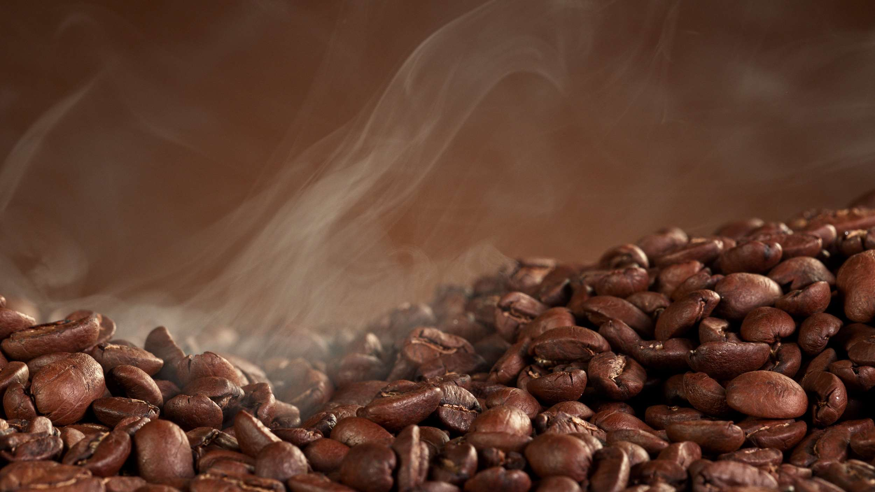
REVENUE MARKET SHARE BY SEGMENTS 2022
  Rigid Packaging
  Flexible Packaging
Type Segment
  Food Packaging Industry
  Chocolate Factory
  Retail & Supermarkets
Application Segment
  Plastics
  Paper & Paperboard
  Metal
  Glass
Material
Segment

Slide 5

Global Chocolate Bar Packaging Market Revenue share for 2022
Asia Pacific

Slide 6
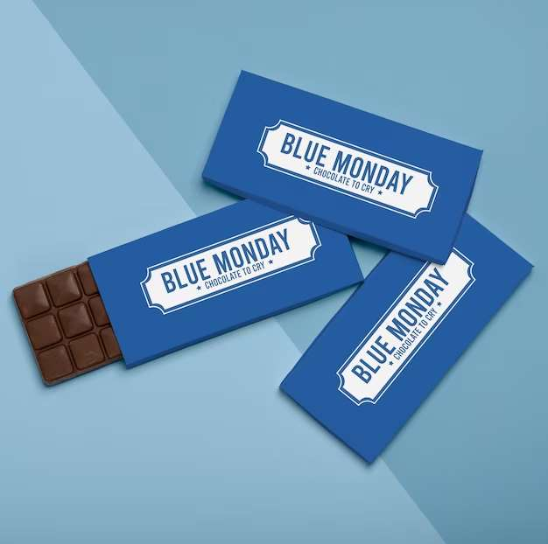
Issues for the Environment and Long-Term Sustainability to Propel Market Growth
Drivers
Difficulty with Recycling to Restrict Market Growth
Restraints

Slide 7
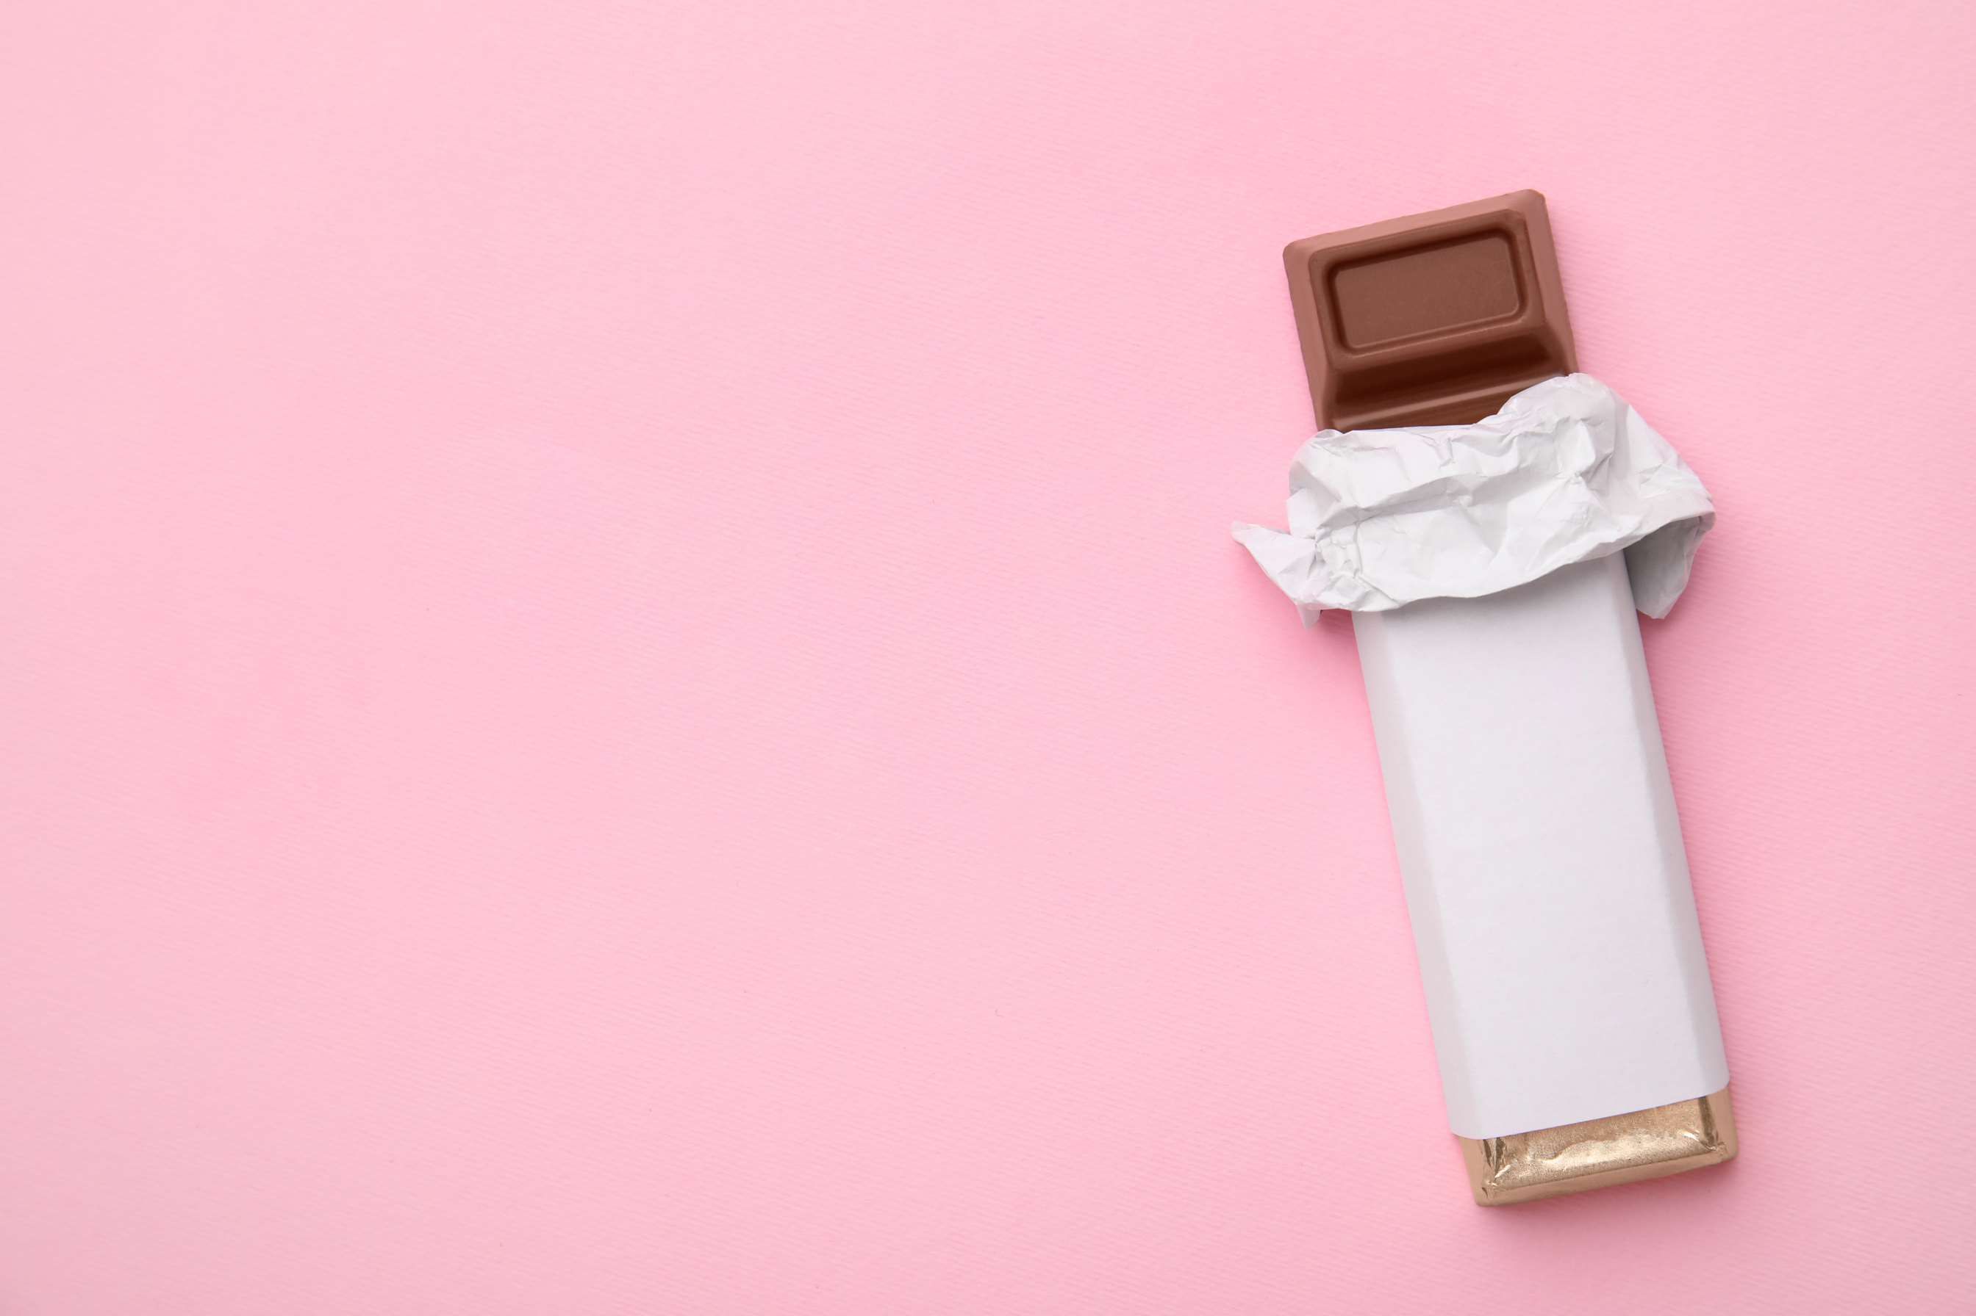
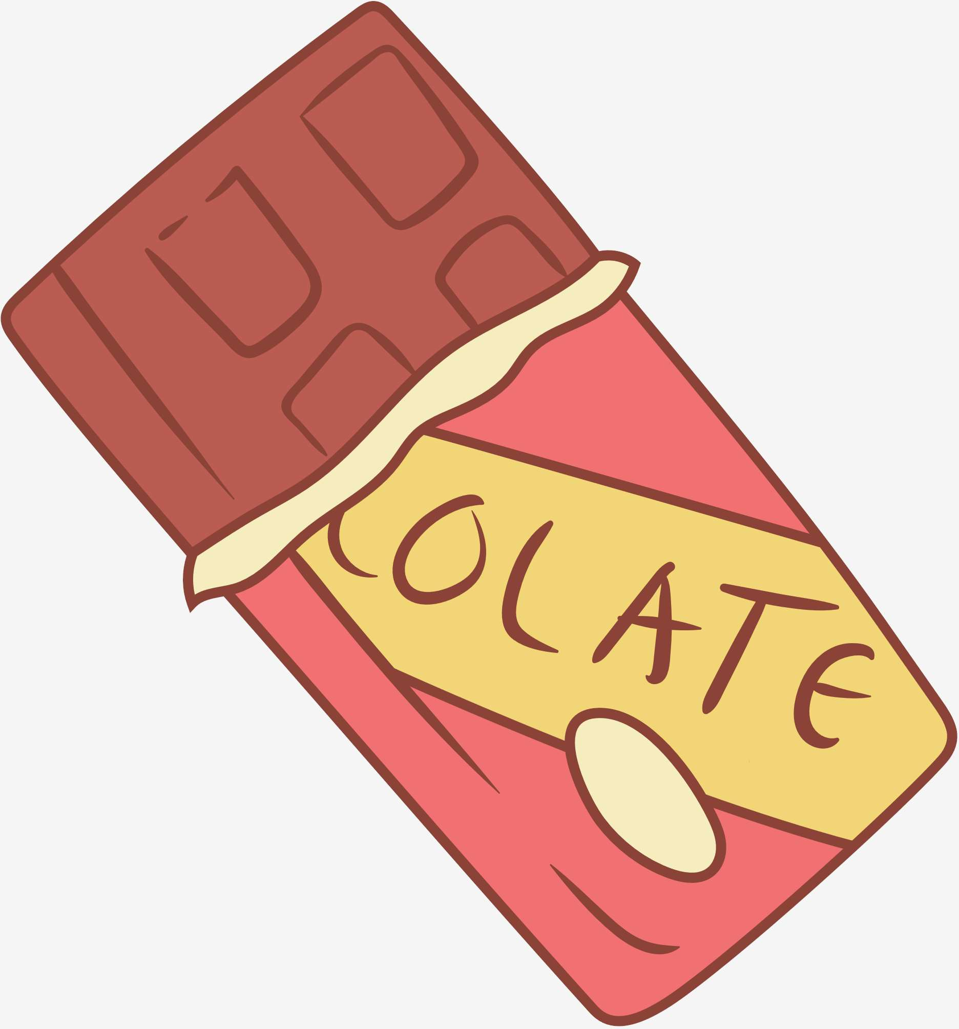
AUTHOR'S PERSPECTIVE
  The Global Chocolate Bar Packaging Market is witnessing significant growth in the near future.
  Flexible packaging is the fastest-growing category over the forecast period because even chocolate bars with non-standard dimensions or forms can be safely packaged in flexible containers. Its versatility makes it ideal for packaging various chocolate bar items.
  The food packaging industry is the fastest-growing category over the forecast period, as the food packaging industry is always coming up with new and inventive ways to package food, so your chocolate bars will stay fresh and taste great, contributing to the market's overall growth.
  Metal is the fastest-growing category over the forecast period, as metal packaging provides a strong barrier that prevents dust, microbes, and pollutants from penetrating chocolate bars.

Slide 8
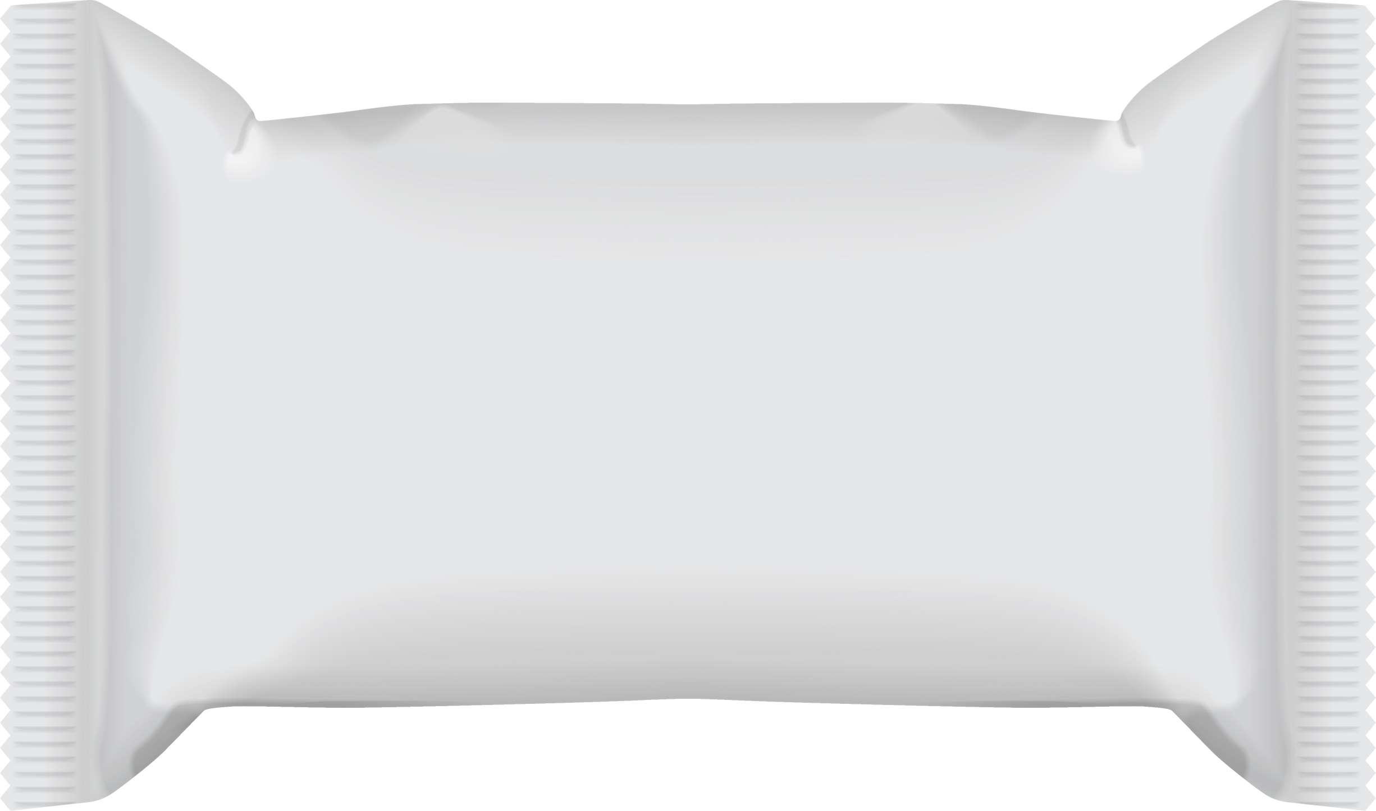
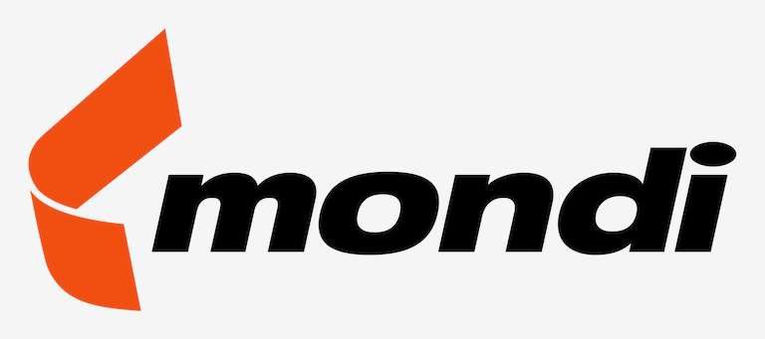
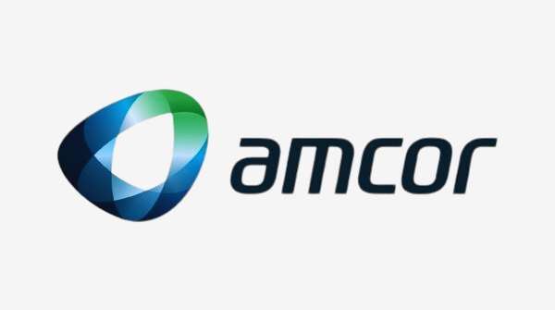



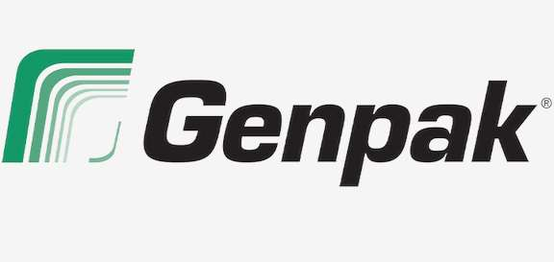
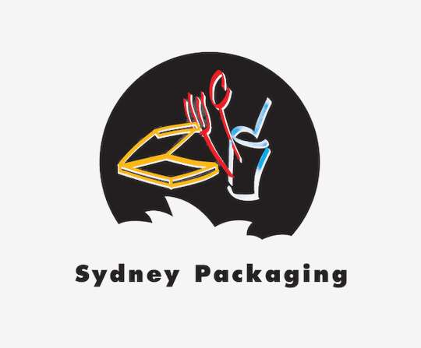
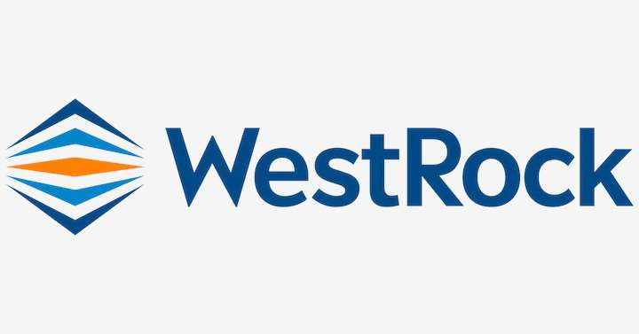
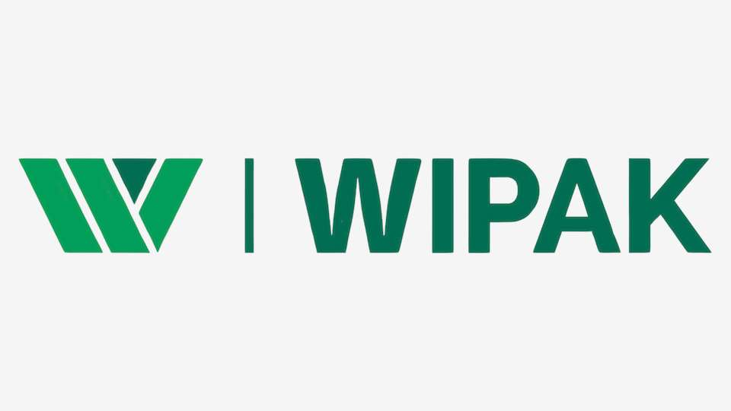
KEY PLAYERS

Slide 9


For Full Report
Contact us
COGNITIVE MARKET RESEARCH
Tel: +1 312-376-8303 | +44 020-8123-0732
India: (+91) 983-496-8611
sales@cognitivemarketresearch.com
Access the Full Report : http://tinyurl.com/4vwu8cxd
Please visit our website:
https://www.cognitivemarketresearch.com

