Slide 1
GLOBAL
CHINESE TAKEOUT MARKET REPORT 2024
Global,Regional,CountryAnalysis

Slide 2

INTRODUCTION
The Chinese takeout market refers to the industry segment that involves the preparation and sale of Chinese cuisine for consumption outside the restaurant premises. This market primarily encompasses the delivery and takeout services provided by Chinese restaurants, allowing customers to enjoy authentic Chinese dishes in the comfort of their homes or at other location.
Growth fuelled by digitalization and online ordering and changing consumer preferences.

Slide 3
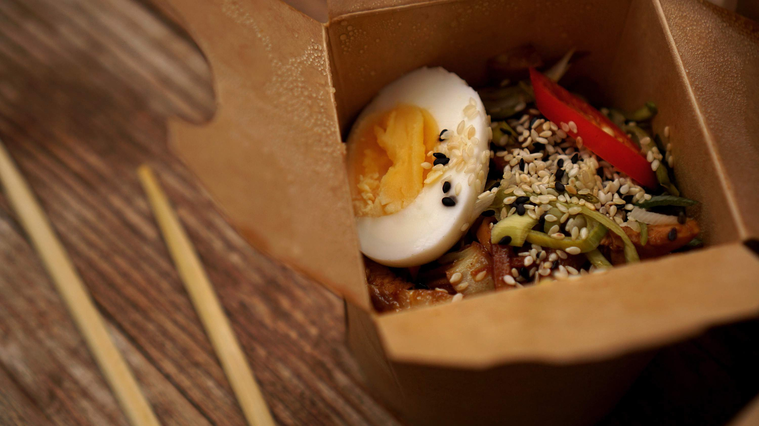

KEY INSIGHTS
MARKET SIZE
USD 63.3 billion
2023
2023
CAGR 7.60%
-
2030

Slide 4
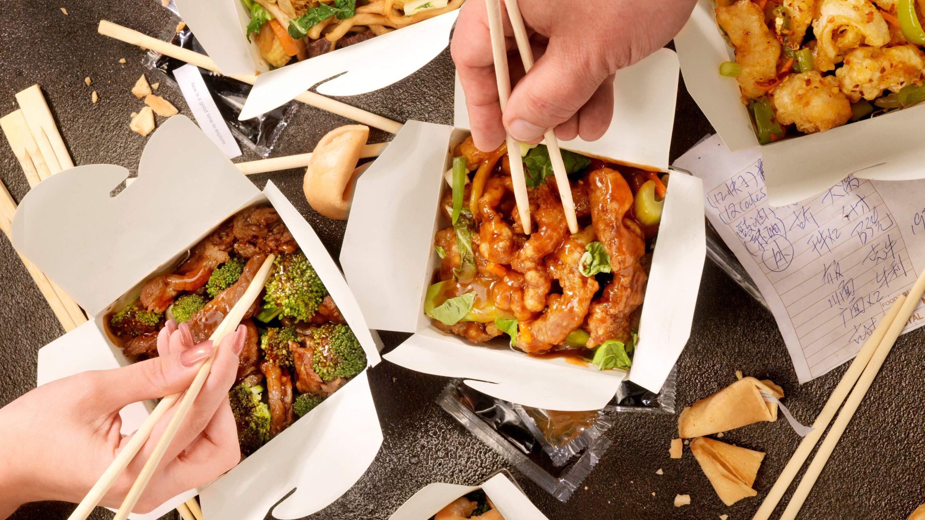
REVENUE MARKET SHARE BY SEGMENTS 2022
Full-service Restaurants Quick-service Restaurants Fast Food
Cafe and Bars
100% Home Delivery Restaurants
Type Segment
Independent Consumer Foodservice
Chained Consumer Foodservice
Structure Segment

Slide 5
Global Chinese Takeout Market Revenue share for 2022
Asia-Pacific 35%

Slide 6
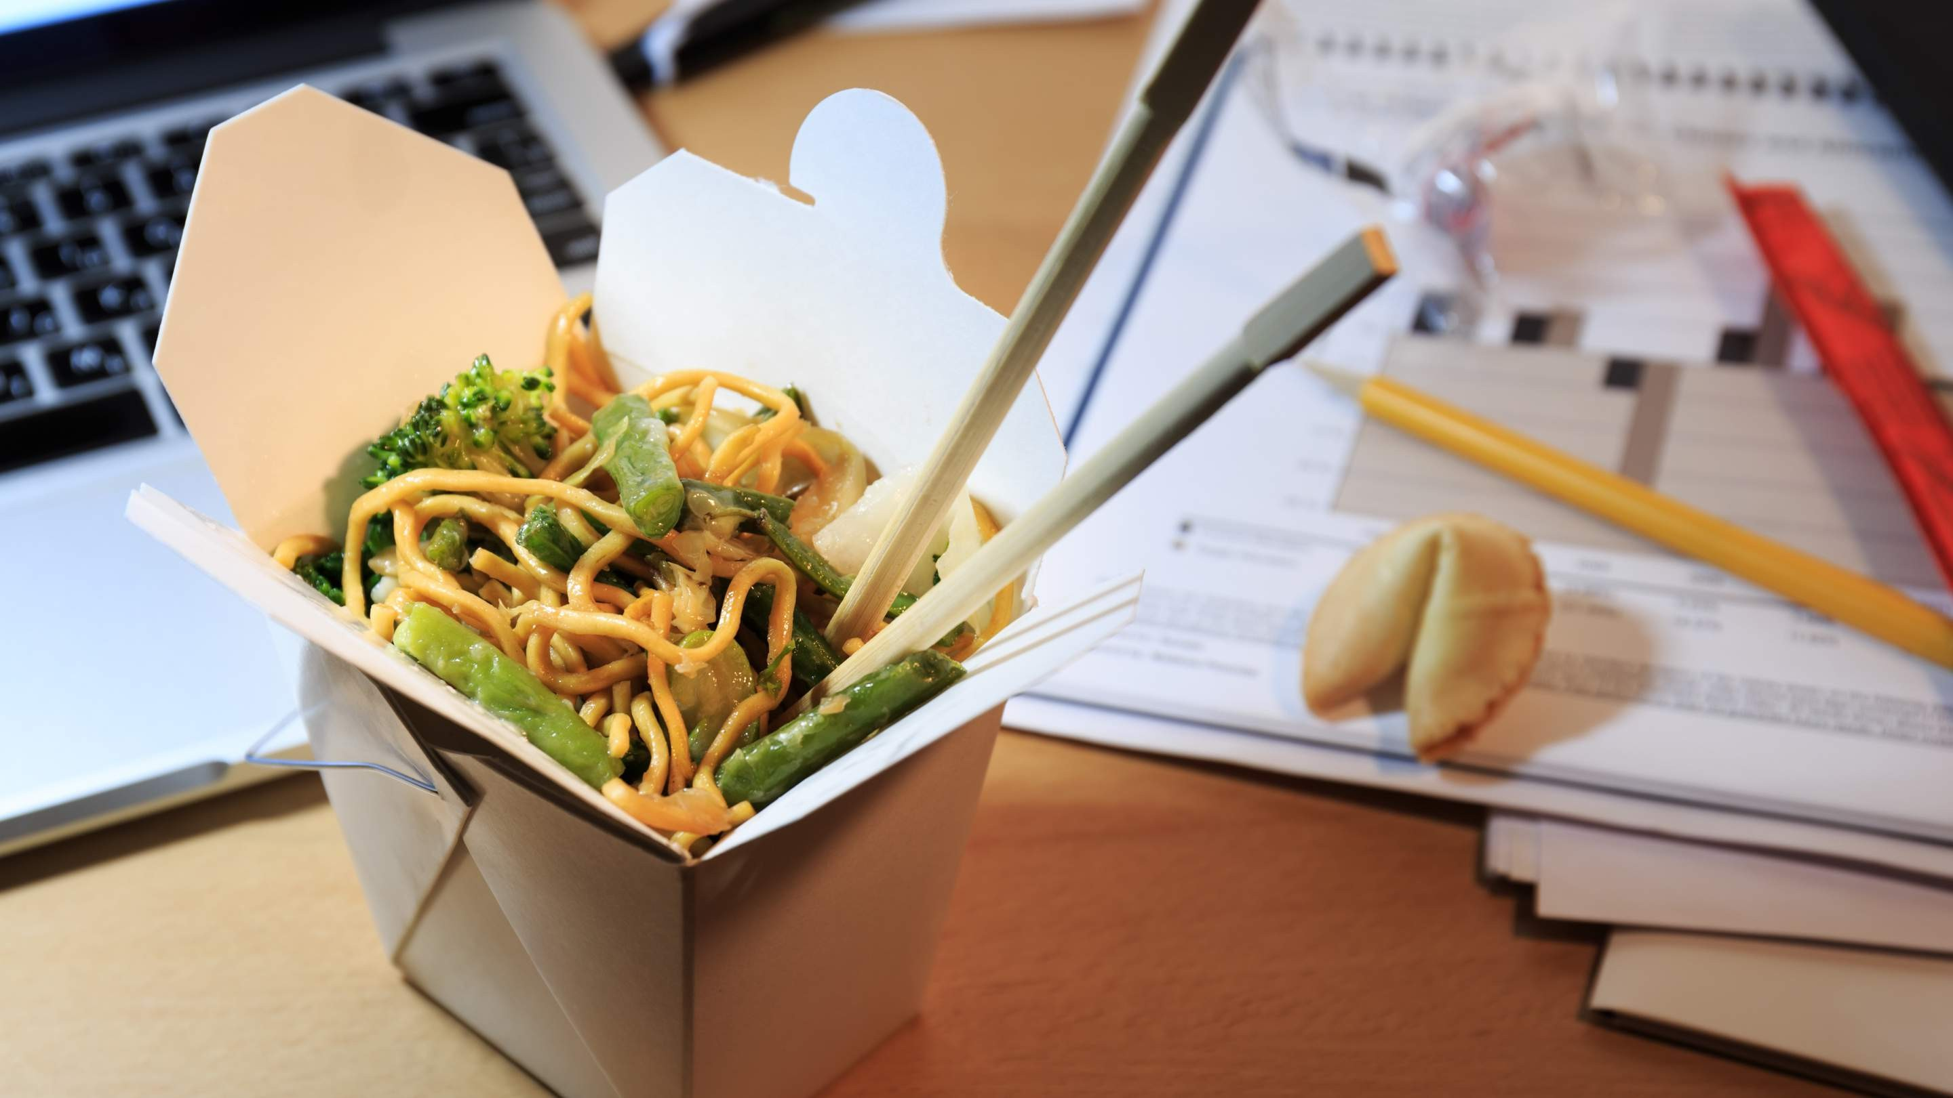
Changing Consumer Lifestyles and Urbanization to Propel Market Growth
Drivers
Regulatory Challenges and Compliance to Restrict Market Growth
Restraints

Slide 7
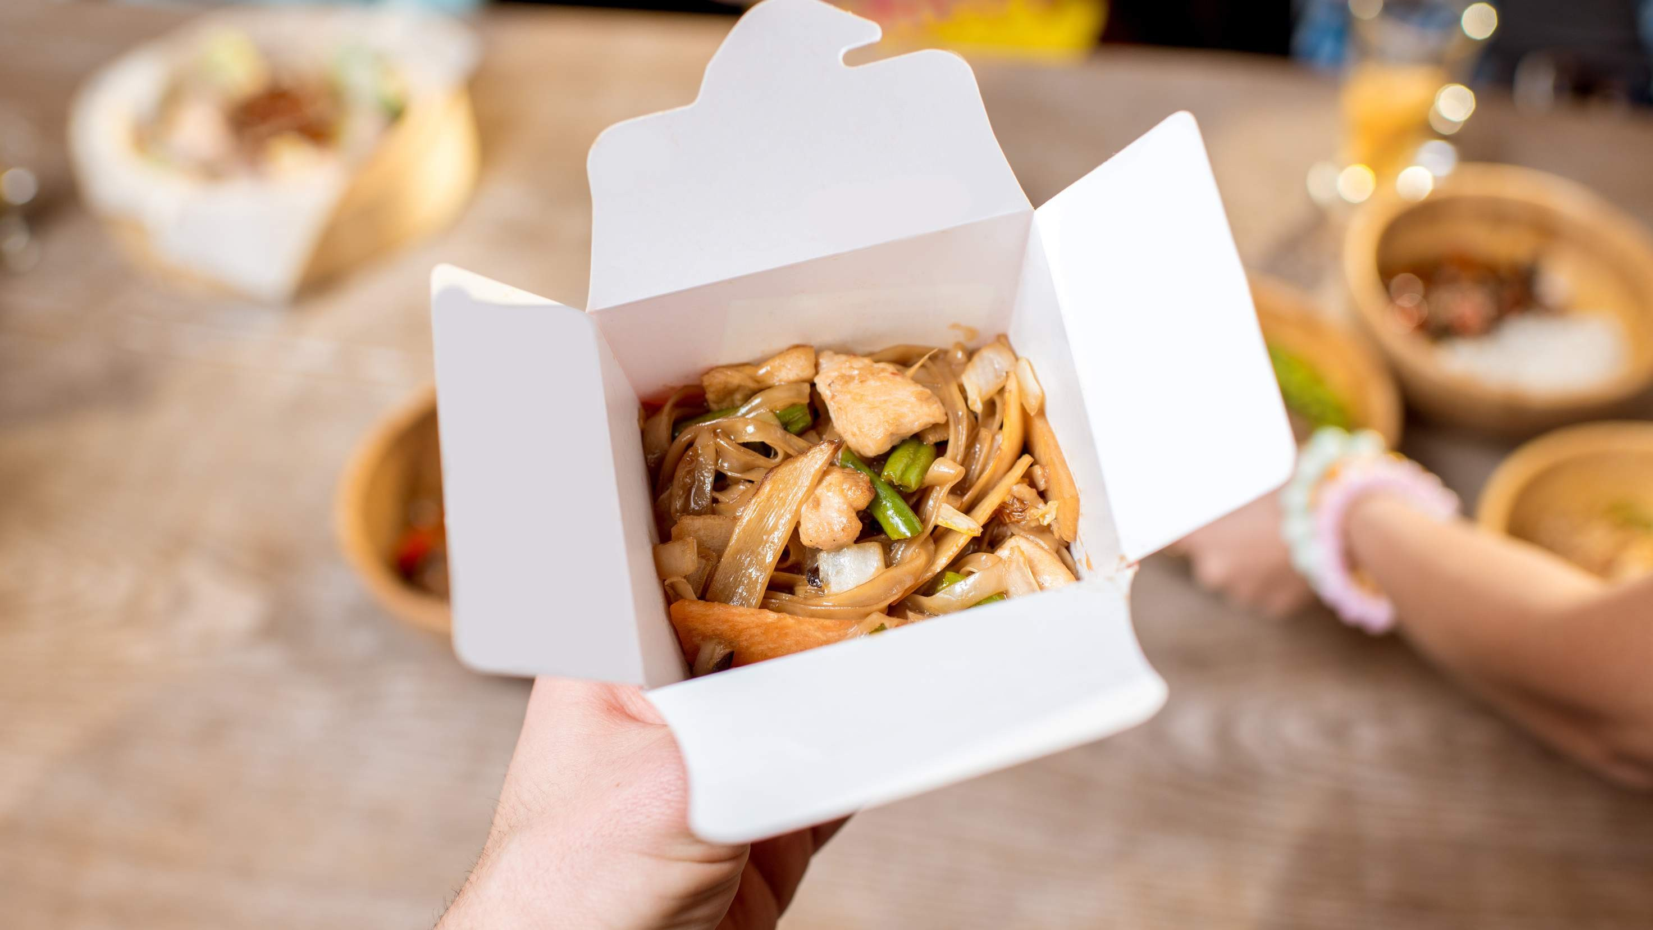
AUTHOR'S PERSPECTIVE
The Global Chinese Takeout Market is witnessing significant growth in the near future.
Quick-service restaurants cater to this need by offering a diverse range of dishes that can be prepared swiftly and picked up or delivered promptly.
Renowned for their established brands, standardized processes, and widespread presence, chained consumer foodservice outlets, including well- known restaurant chains, hold a substantial market share.
Consumers are increasingly drawn to the authenticity and personalized touch offered by independent establishments, making this category the fastest-growing as it captures the dynamic shifts in consumer preferences and culinary trends.

Slide 8

KEY PLAYERS

Slide 9


Contact us
For Full Report
COGNITIVE MARKET RESEARCH
Tel: + 1 312 - 376 - 8303 | + 44 020 - 8123 - 0732
India: ( + 91 ) 983 - 496 - 8611
sales@ cognitivemarketresearch. com
Access the Full Report : http://tinyurl.com/3xh6utsr
Please visit our website:
https://www.cognitivemarketresearch.com

