Slide 1
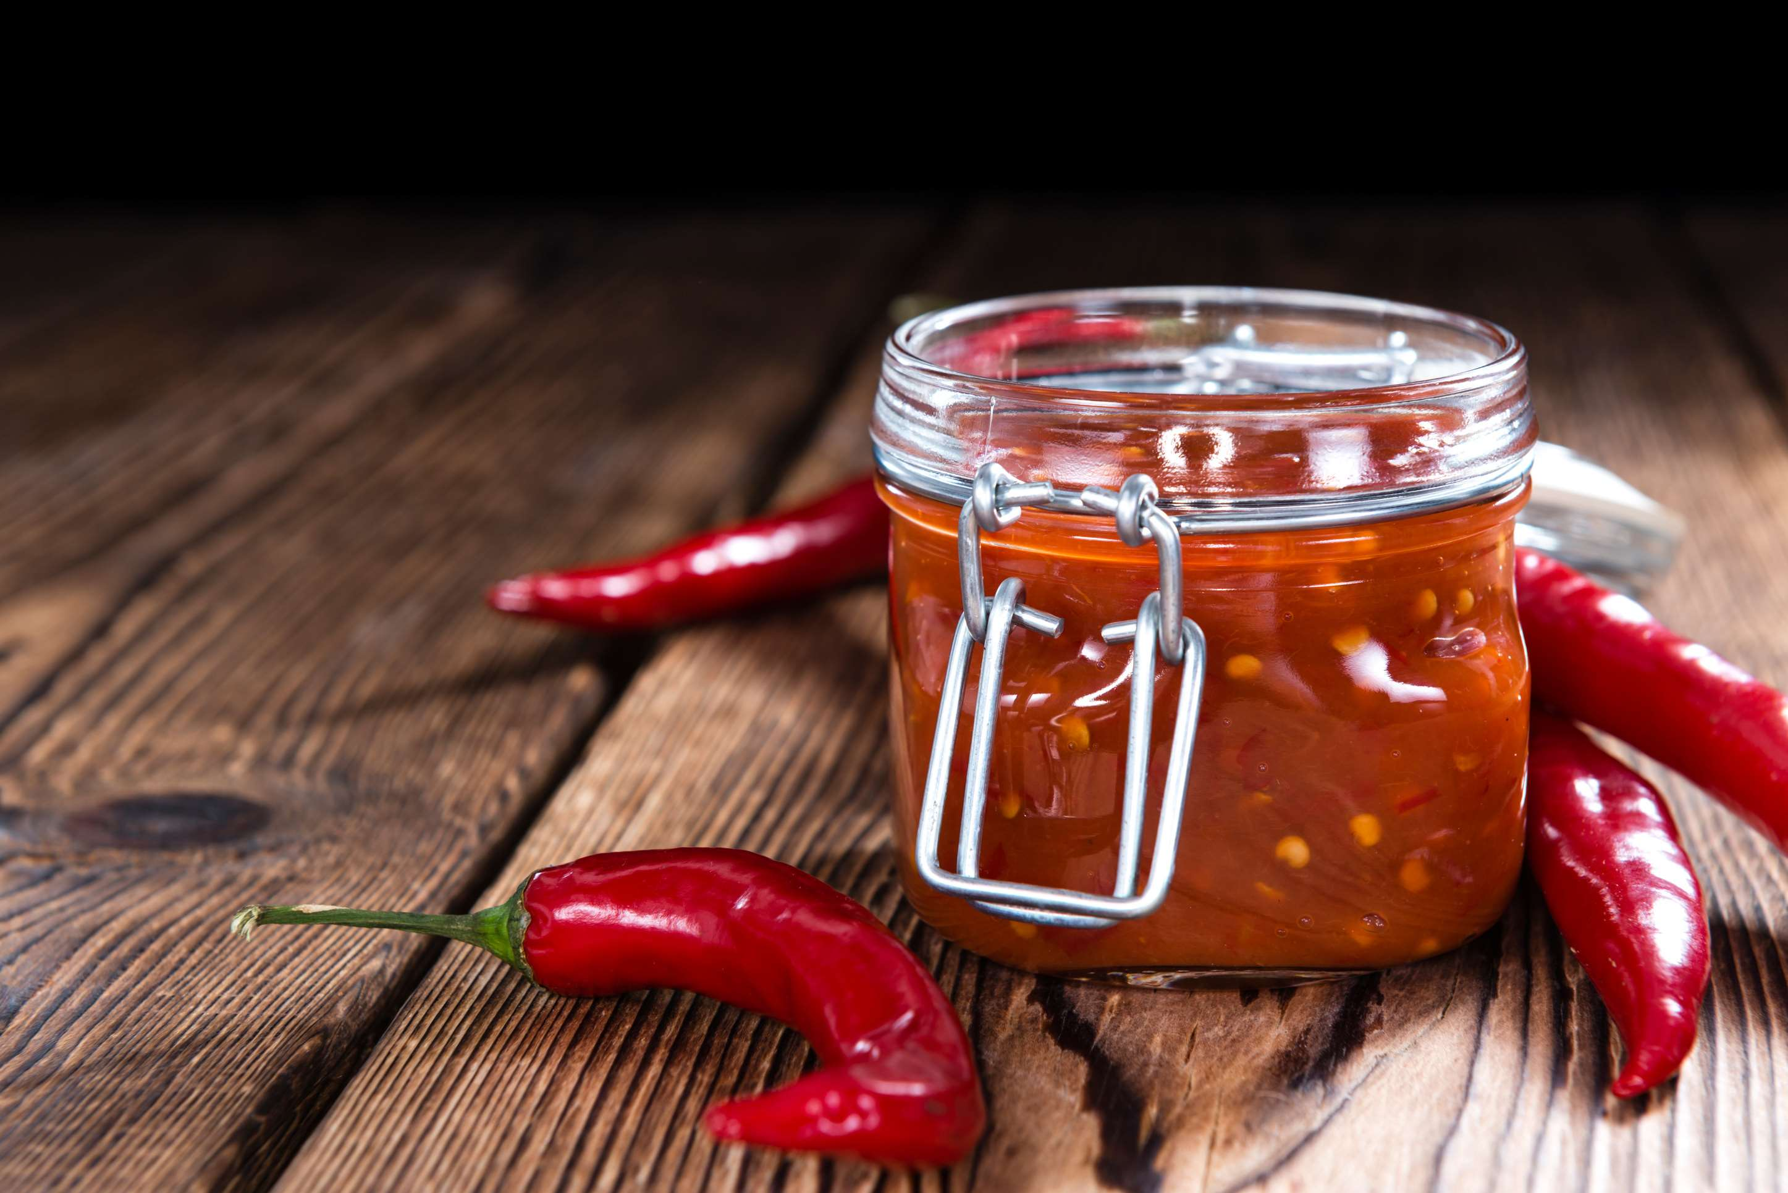
GLOBAL
CHILI SAUCE
MARKET REPORT
2024
Global,Regional,CountryAnalysis

Slide 2
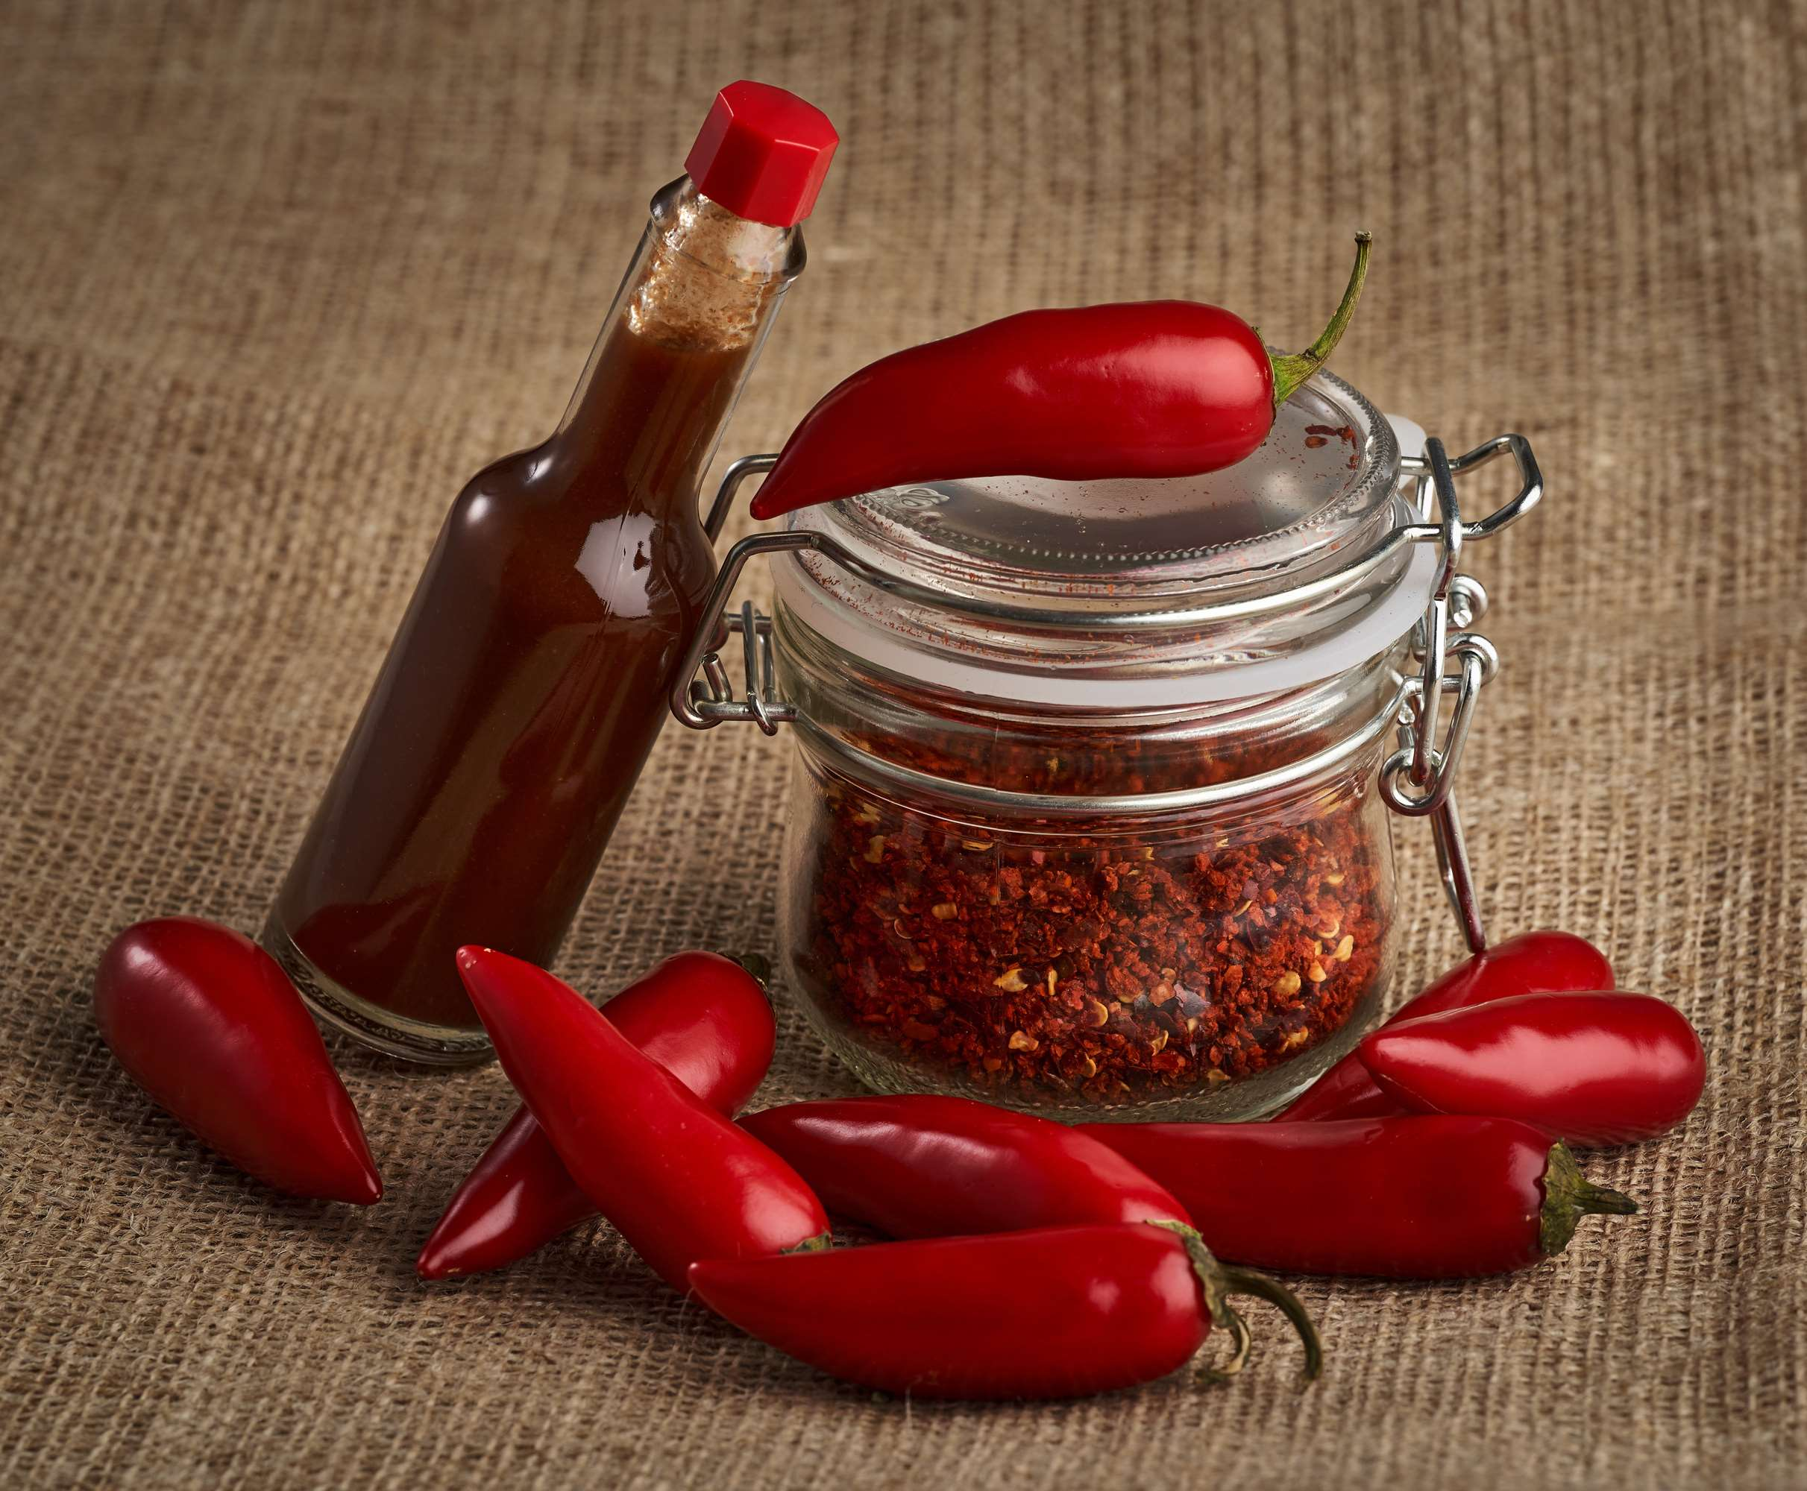
INTRODUCTION
The manufacturing, distribution, and consumption of condiments derived mostly from chili peppers and additional components like vinegar, sugar, and spices are all included in the market for chili sauces. The flavor profiles of chili sauces vary, catering to a wide spectrum of palates from mild to intensely hot. Chili sauce is a widely used flavor enhancer and condiment in many different cuisines worldwide. It adds complexity, tanginess, and heat to foods such as meats, seafood, vegetables, and snacks. The market is defined by many consumers looking for rich and bold culinary experiences, traditional, regionally-specific recipes, and inventive, globally-inspired blends. The market for chili sauce is expected to develop and diversify further as consumers' desire for hot and daring cuisine keeps rising.

Slide 3
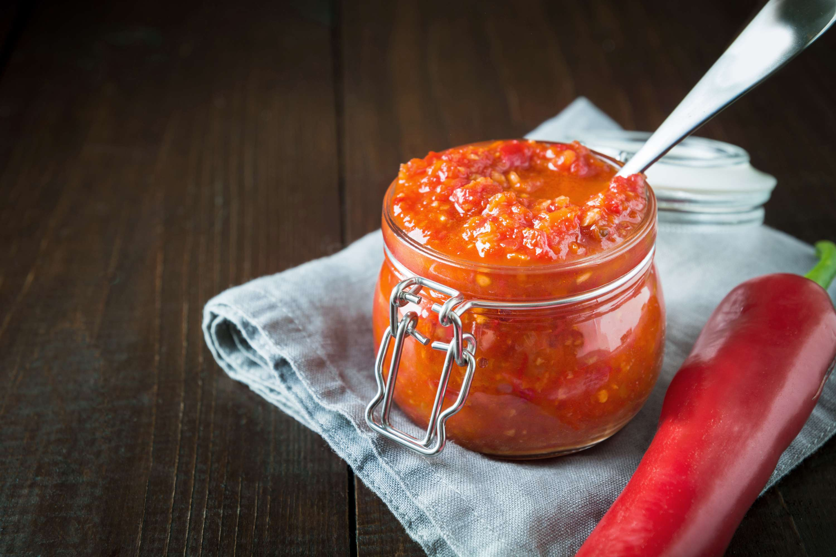

KEY INSIGHTS
MARKET SIZE
USD 2915.2 million
2024
CAGR
6.80%
2024- 2031

Slide 4
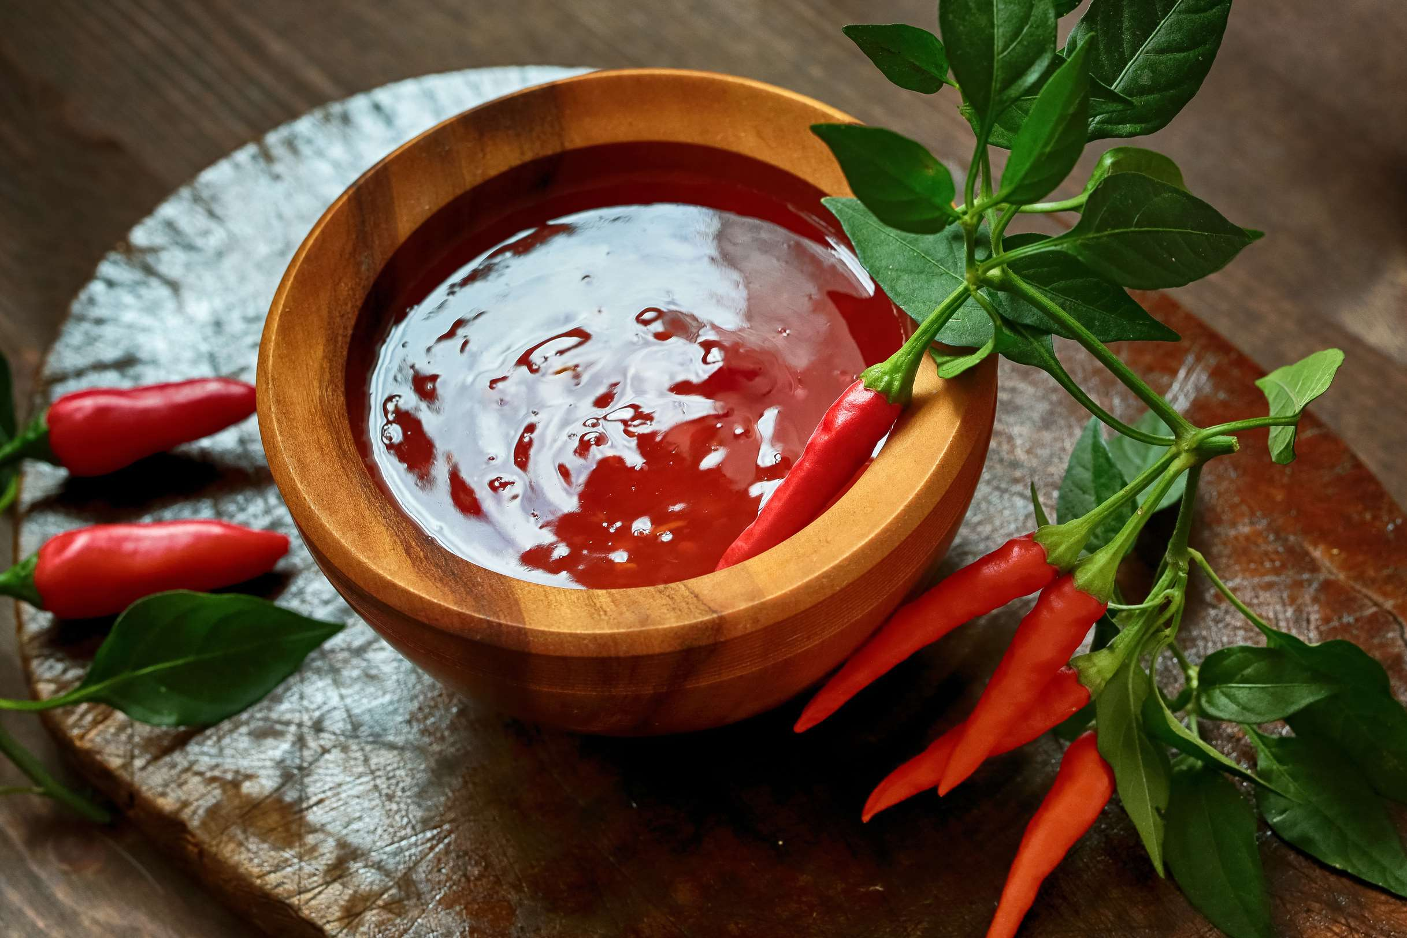
REVENUE MARKET SHARE BY SEGMENTS 2022
  Mild
  Medium
  Hot
  Very Hot
  Extra Hot
Type Segment
  B2B
  B2C
  Direct Sales
Distribution Channel
  Convenience Stores
  Independent Retailers
  Online Sales
  Specialty Stores
  Foodservice
Sales Channel
  Households
  Restaurants
  Hotels
  Cafes
End-user Segment
  Bottles
  Jars
  Pouches
  Cans
Packaging Segment

Slide 5

Global Chili Sauce Market Revenue share for 2024
North America
40%

Slide 6
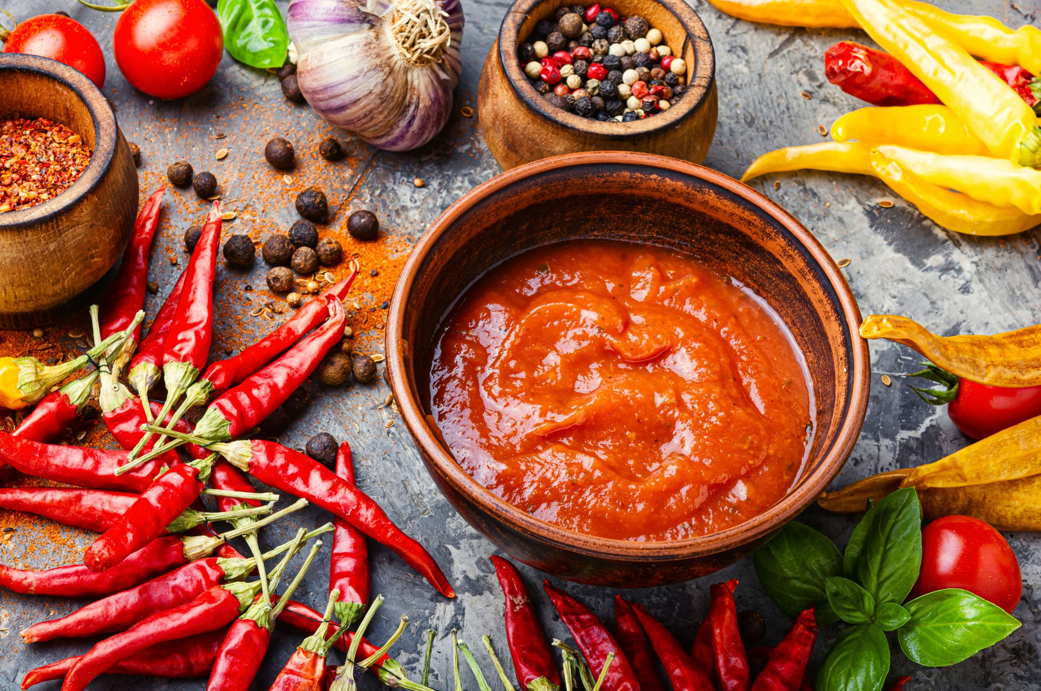
Growing Ethnic and Fusion Cuisine Popularity to Propel Market Growth
Drivers
Raw Material Price Fluctuations to Limit the Sales
Restraints

Slide 7
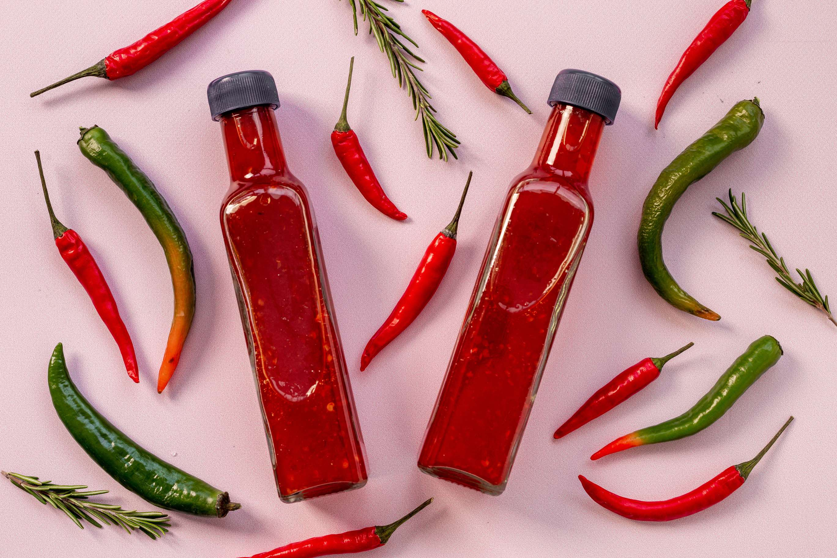
AUTHOR'S PERSPECTIVE
  The global Chili Sauce market will expand significantly by 6.80% CAGR between 2024 to 2031.
  Hot chili sauces are becoming more popular worldwide due to a growing desire for extreme heat levels across various culinary preferences.
  The chili sauce market is expanding due to the growing emphasis on carrying a wide variety of food items, including sauces, in convenience stores.
  Jars are popular among consumers because they provide convenient serving and storage choices.
  Restaurants have a major role in expanding the chili sauce industry since they use these condiments in various cuisines to satisfy customers' cravings for hot and tasty food.

Slide 8




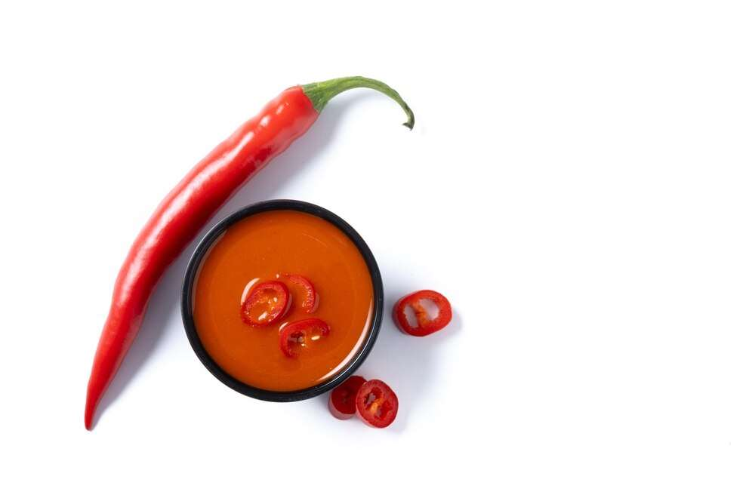








KEY PLAYERS

Slide 9


For Full Report
Contact us
COGNITIVE MARKET RESEARCH
Tel: +1 312-376-8303 | +44 020-8123-0732
India: (+91) 983-496-8611
sales@cognitivemarketresearch.com
Access the Full Report : https://tinyurl.com/5auuk3vn
Please visit our website:
https://www.cognitivemarketresearch.com

