Slide 1
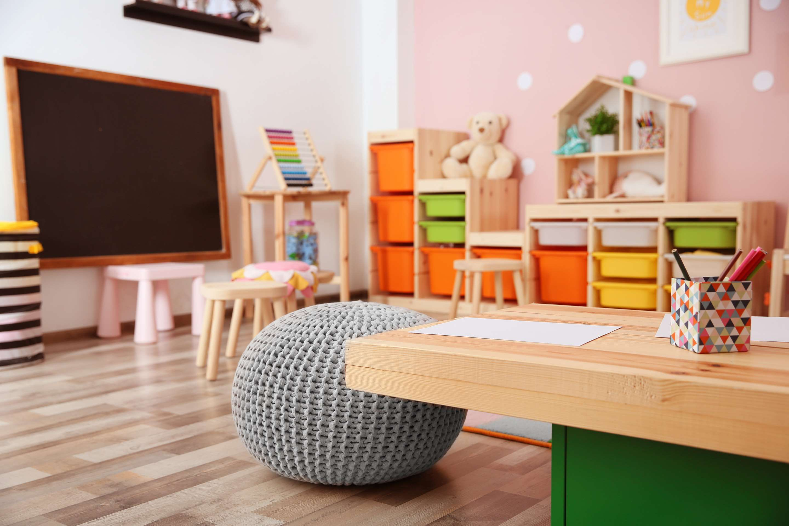
GLOBAL
CHILDREN FURNITURE
MARKET REPORT
2024
Global,Regional,CountryAnalysis

Slide 2
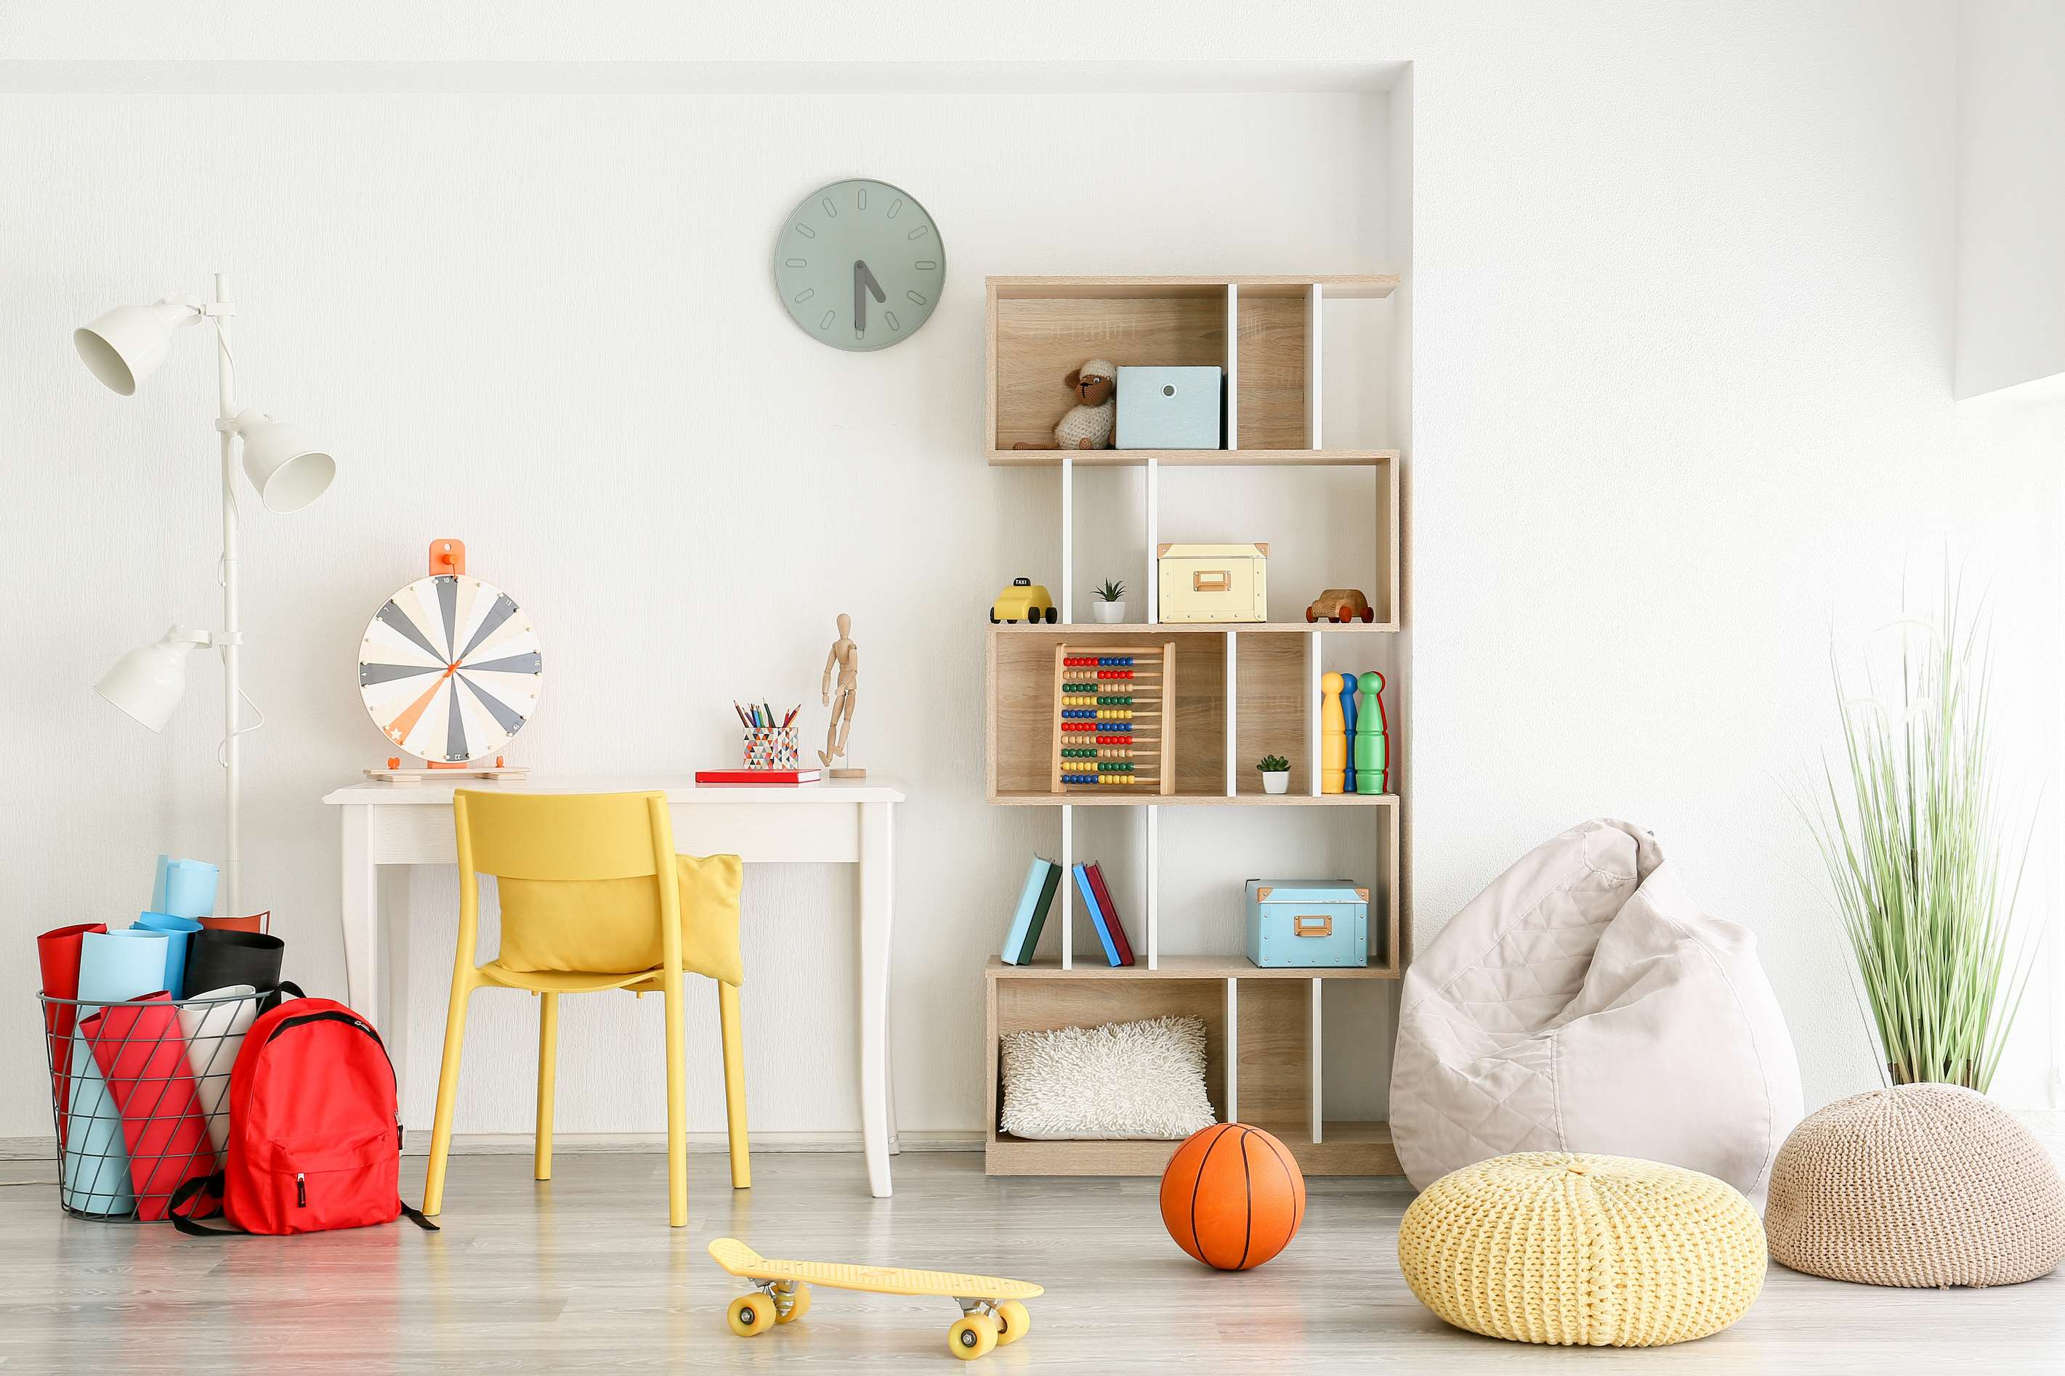
INTRODUCTION
Important companies in the children’s furniture business use a variety of tactics to keep and grow their market share. Product innovation, such as long-lasting formulas and a wide variety of color options, aggressive marketing efforts that make use of social media and influencer relationships, growing e-commerce channels, and highlighting sustainability with eco-friendly packaging are some of these tactics. They also spend money on research to learn about consumer trends and preferences, which helps them, make sure their products meet changing standards for fashion and beauty. In the competitive and ever-changing children’s furniture market, these tactics assist major competitors in snatching up a substantial market share.

Slide 3
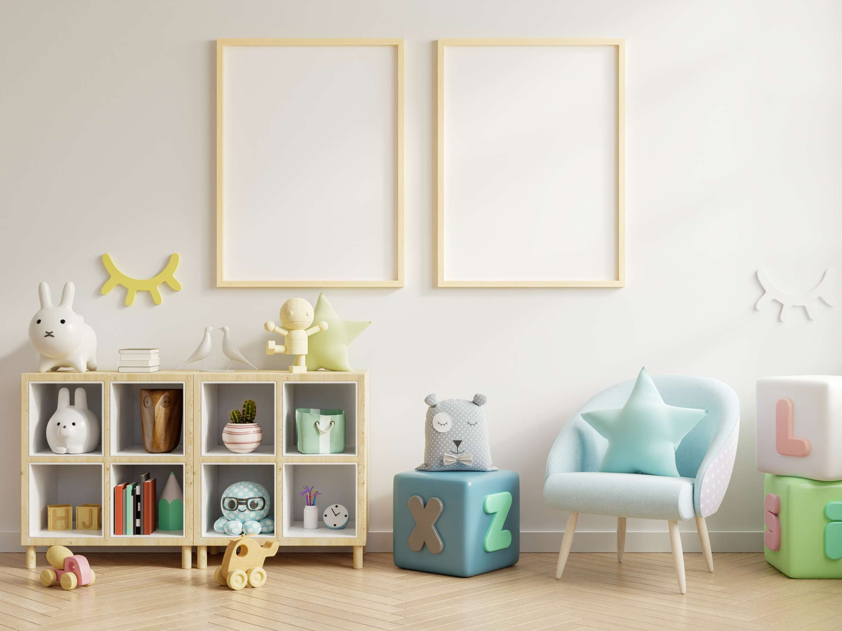

KEY INSIGHTS
MARKET SIZE
USD 37.9 billion
2023
CAGR
19.30%
2023- 2030

Slide 4
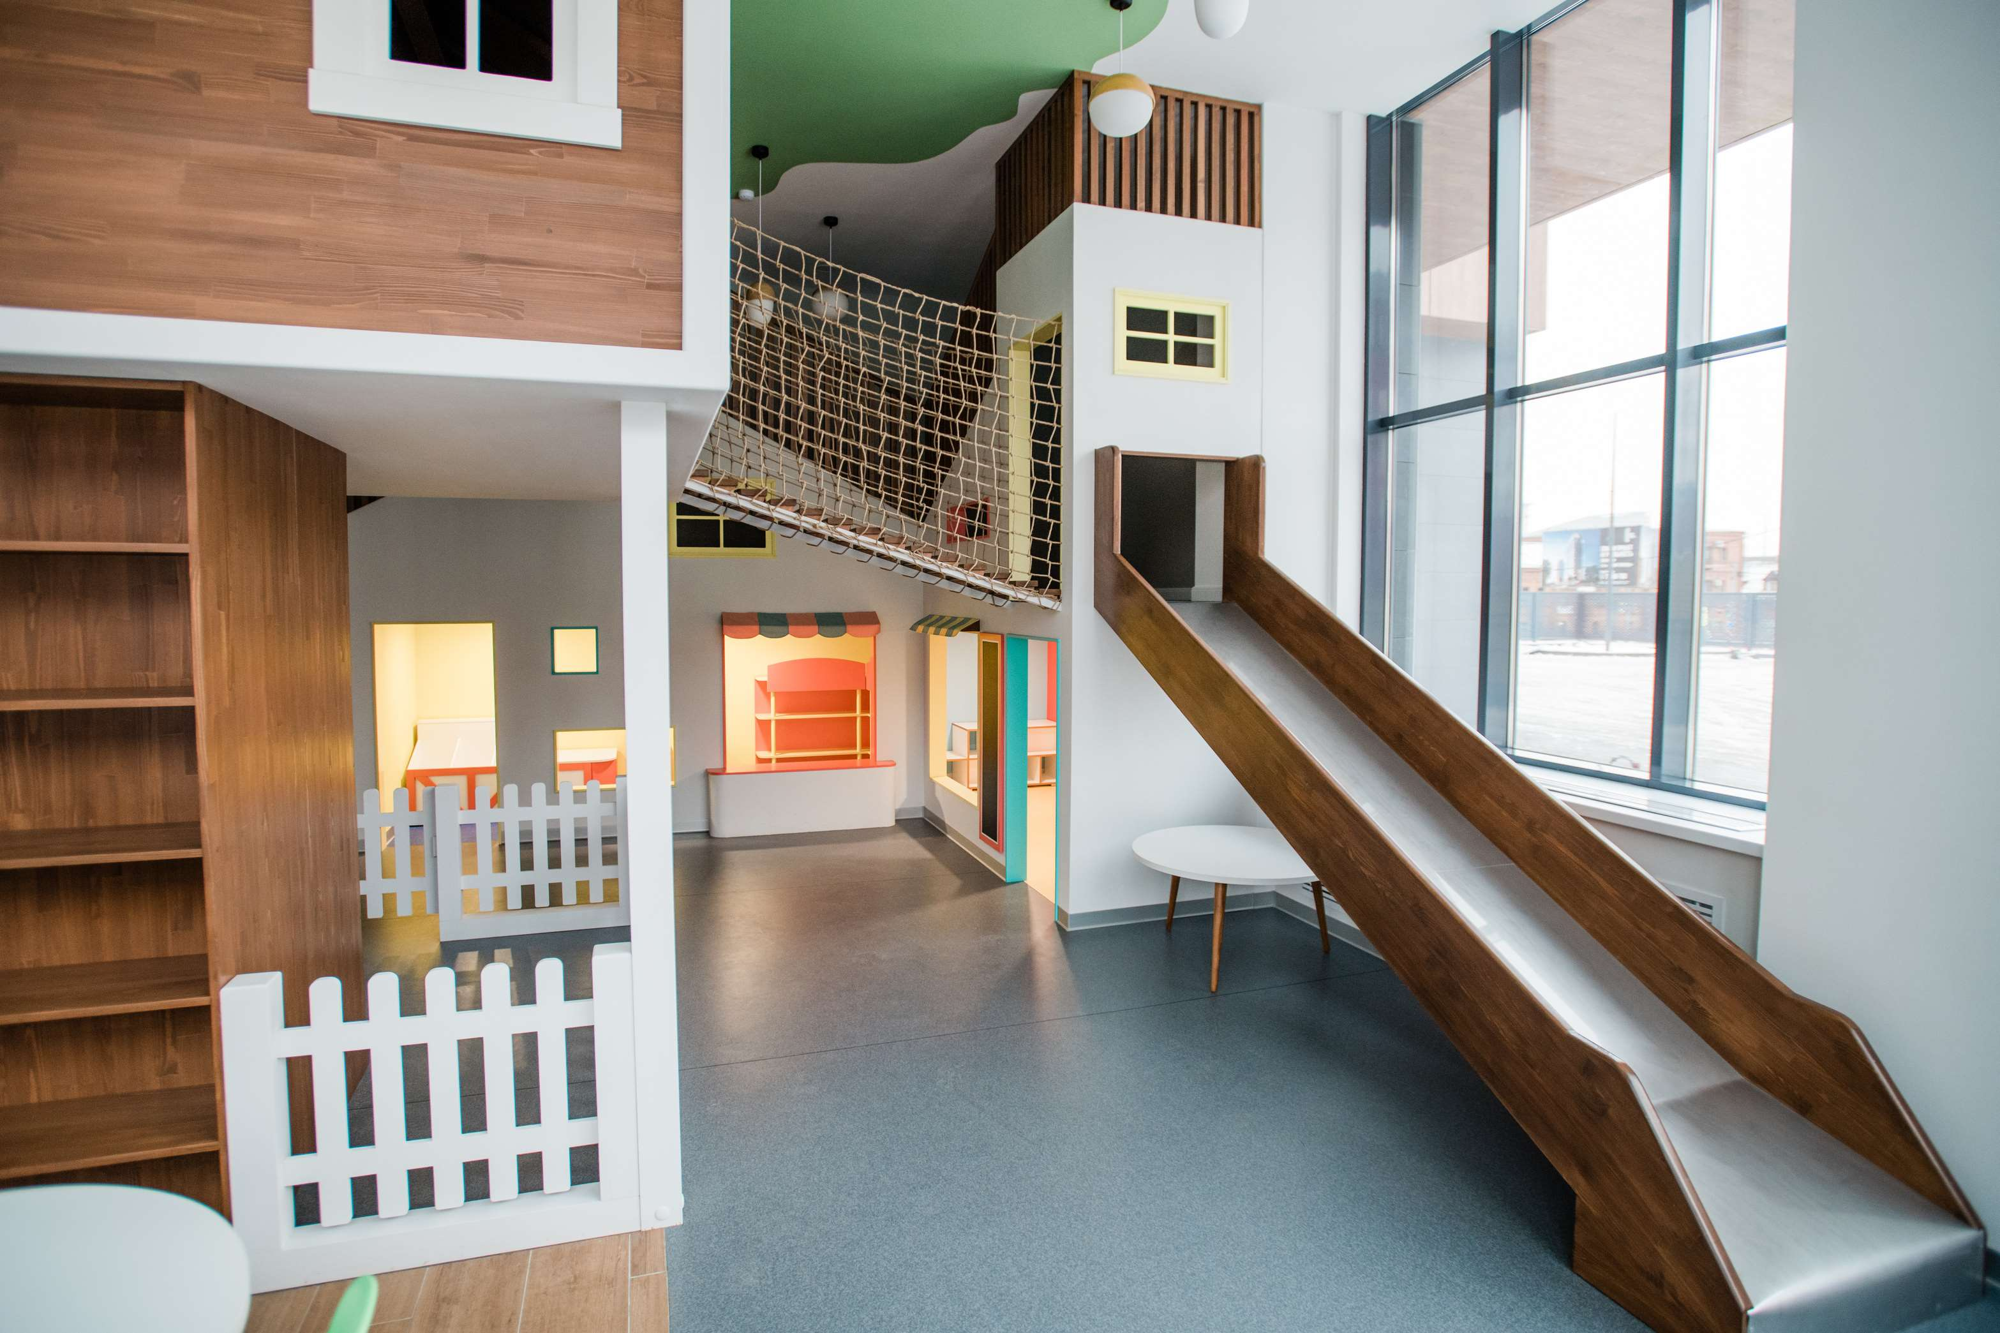
REVENUE MARKET SHARE BY SEGMENTS 2022
  Beds, Cots, & Cribs
  Table & Chair
  Cabinet
  Dressers, & Chests
  Wood
  Polymer
  Metal
Type Segment
Material Segment
  Residential
  Commercial
  Offline Channels
  Online Channels
End User Segment
Sales Channel

Slide 5

Global Children Furniture Market Revenue share for 2024
North America
32%

Slide 6
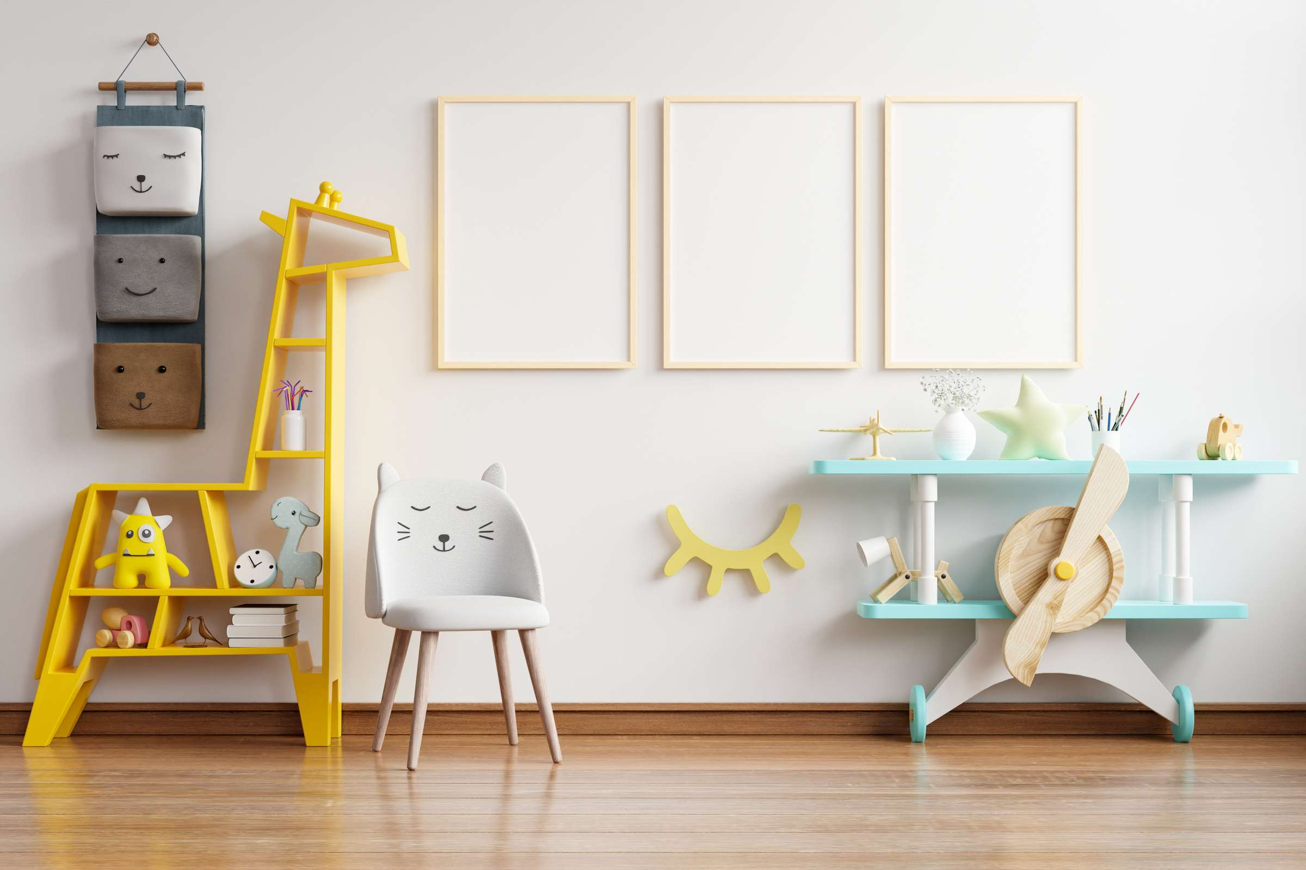
Increased Dual-income Families and Shifting Customer Preferences to Drive Market Growth
Drivers
High Cost of Production and Raw Materials to Limit Market Growth
Restraints

Slide 7
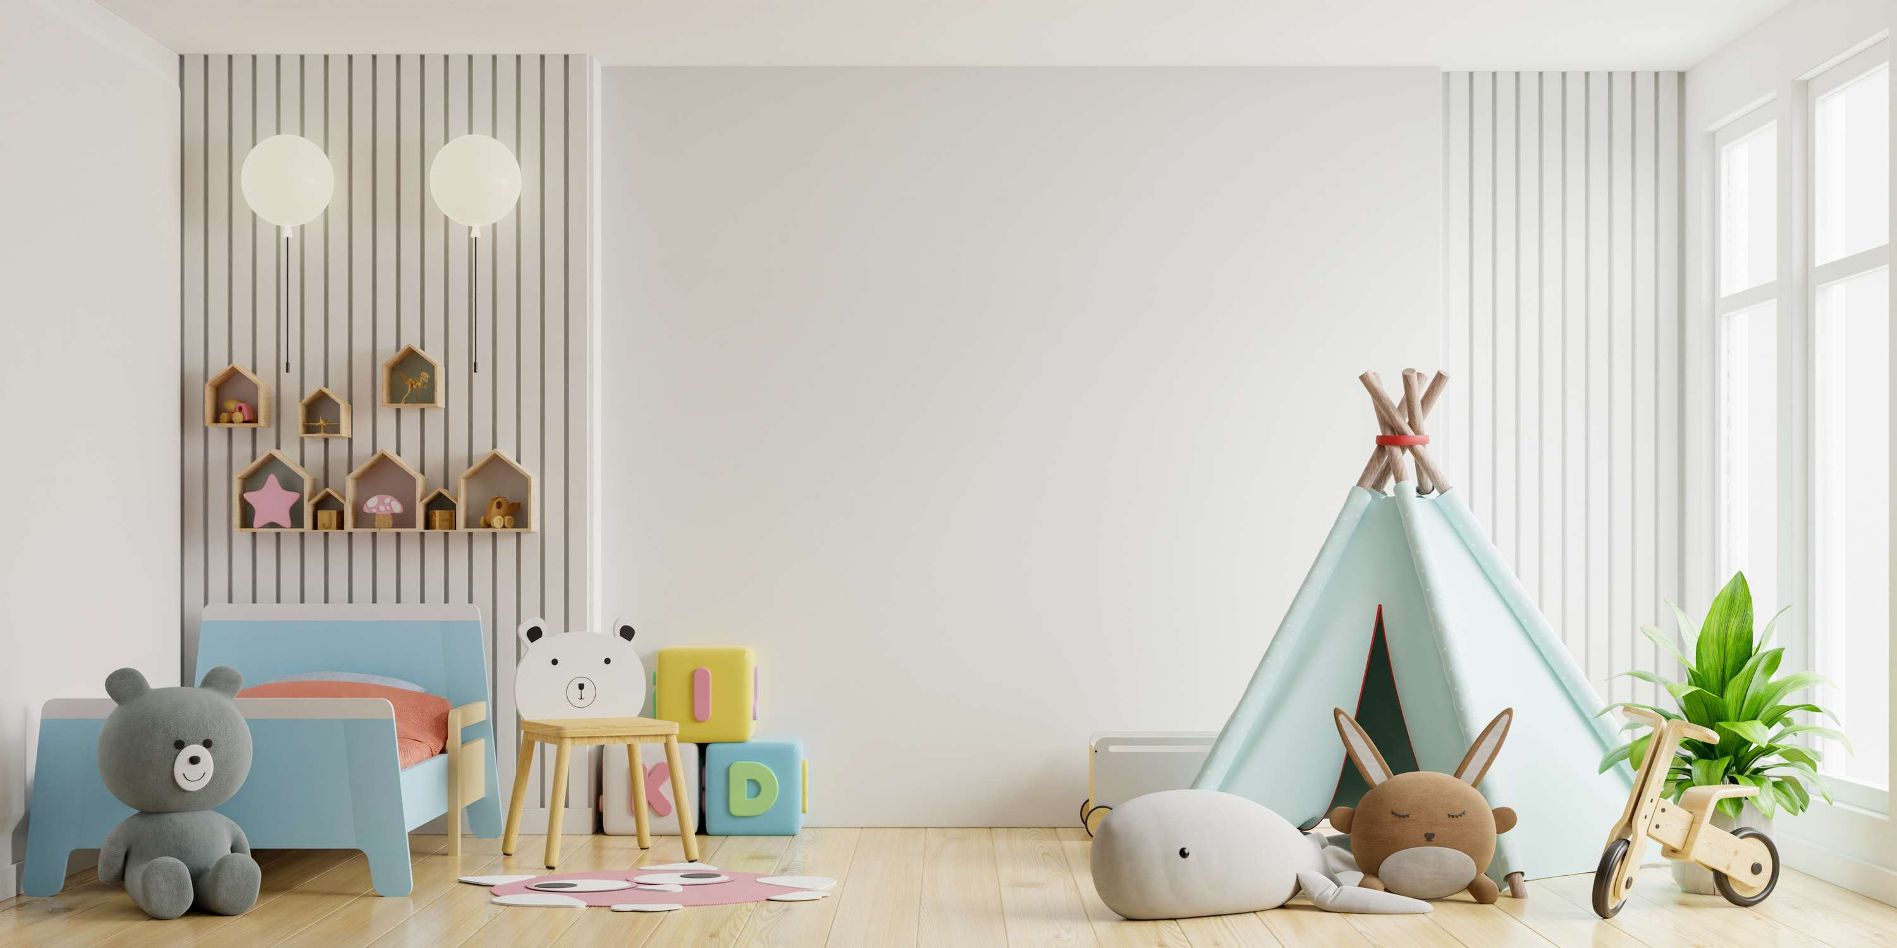
AUTHOR'S PERSPECTIVE
  The Global Children Furniture Market is witnessing significant growth in the near future.
  A baby's ability to grow, learn, and pay attention is all aided by getting enough sleep, which is vital for the physical and mental health of newborns and early children, particularly in the first two years of life.
  Many working parents give their kids less quality time since they have to work longer hours to maintain their level of living and give them a higher education.
  Wood can withstand a greater weight without deteriorating because it is significantly stronger when it comes to load-bearing for tables and chairs.
  Polymer furniture is more reasonably priced when compared to hardwood or metal furniture.

Slide 8
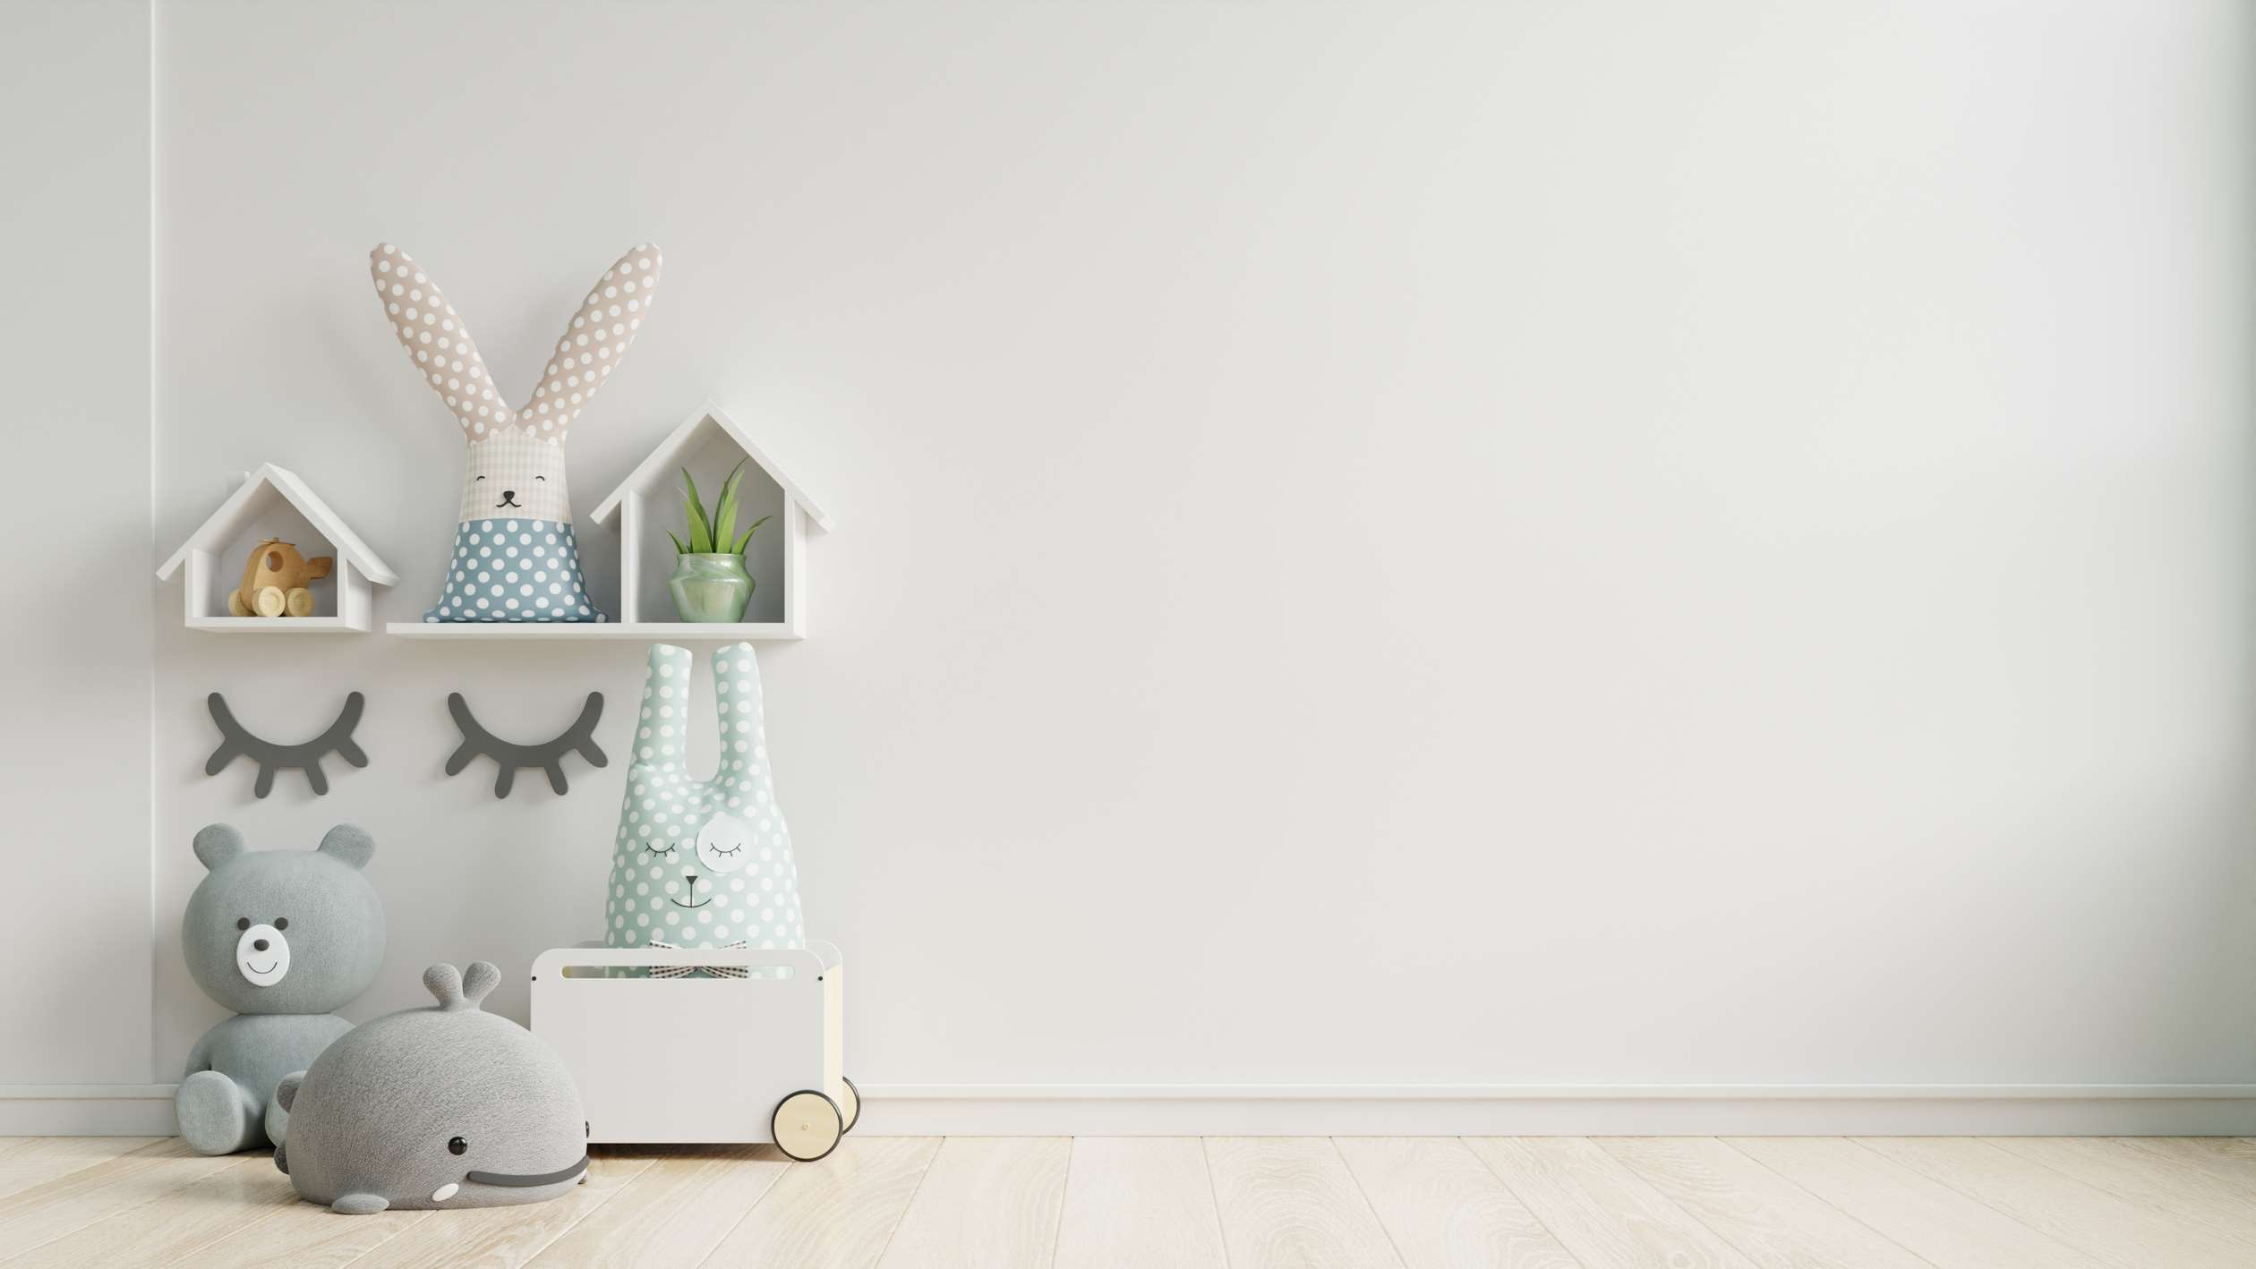









KEY PLAYERS

Slide 9


For Full Report
Contact us
COGNITIVE MARKET RESEARCH
Tel: +1 312-376-8303 | +44 020-8123-0732
India: (+91) 983-496-8611
sales@cognitivemarketresearch.com
Access the Full Report : https://tinyurl.com/hafuyv69
Please visit our website:
https://www.cognitivemarketresearch.com

