Slide 1
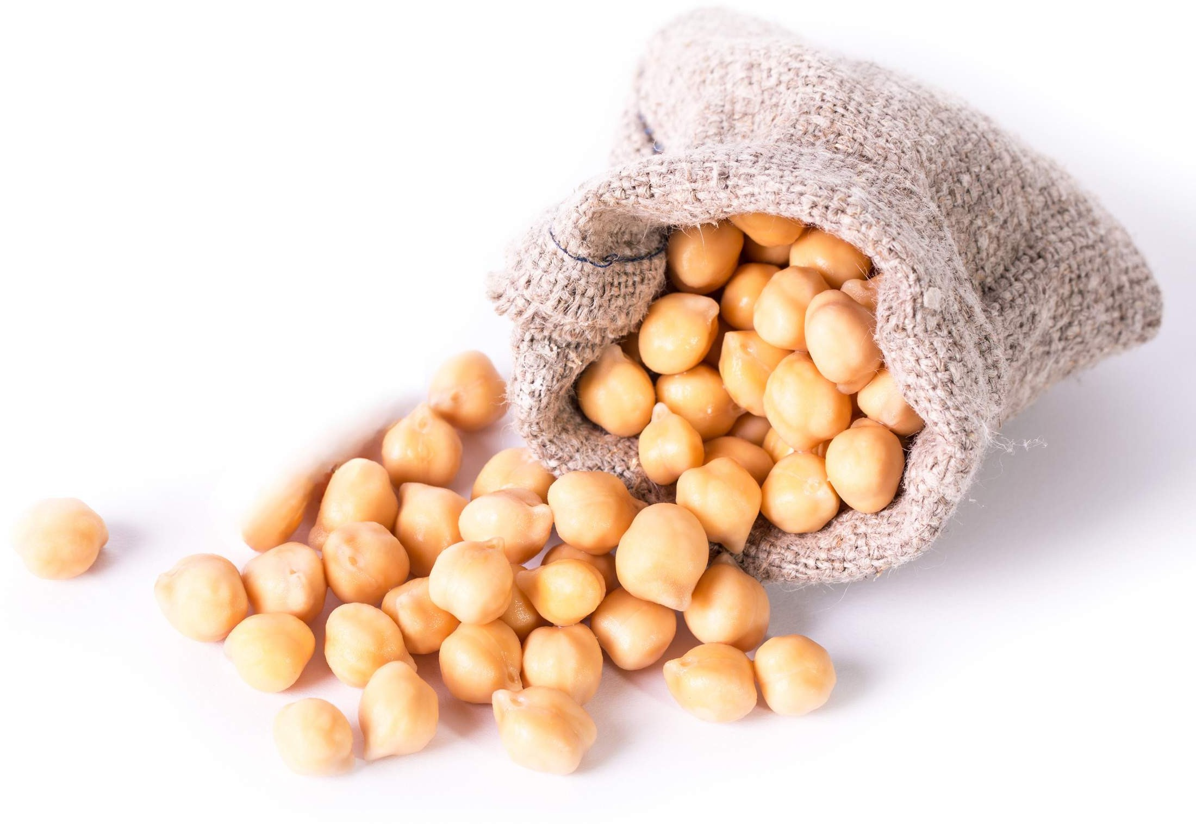
GLOBAL
CHICKPEA PROTEIN
MARKET REPORT 2024
Global,Regional,CountryAnalysis

Slide 2
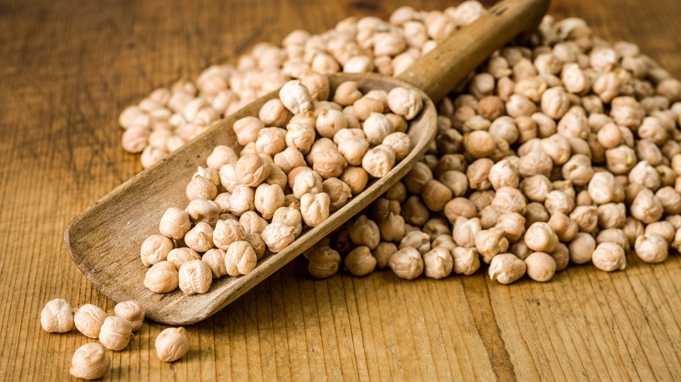
INTRODUCTION
Chickpea protein is derived from chickpeas, which are a part of the legume seed family. Chickpeas have a healthy nutritional composition, with protein content ranging from 16% to 24%, while also comprising other essential nutrients, such as starch, deity fiber, iron, and calcium. Growth is fueled by increasing promotion in the production and consumption of chickpea protein and the rising usage of chickpea protein in the food industry.

Slide 3
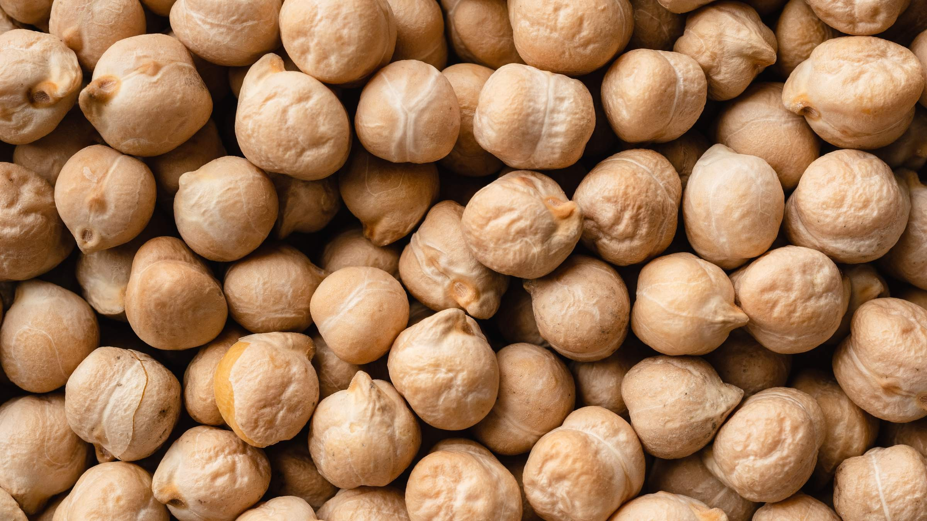

KEY INSIGHTS
MARKET SIZE
USD 0.105 billion
2023
20₋23
CAGR 5.50%
2030

Slide 4




REVENUE MARKET SHARE BY SEGMENTS 2022
Organic Conventional
Type Segment
Food Processing Animal Feed Nutraceuticals
Application Segment

Slide 5
Global Chickpea Protein Market Revenue share for 2022
North America 40%

Slide 6
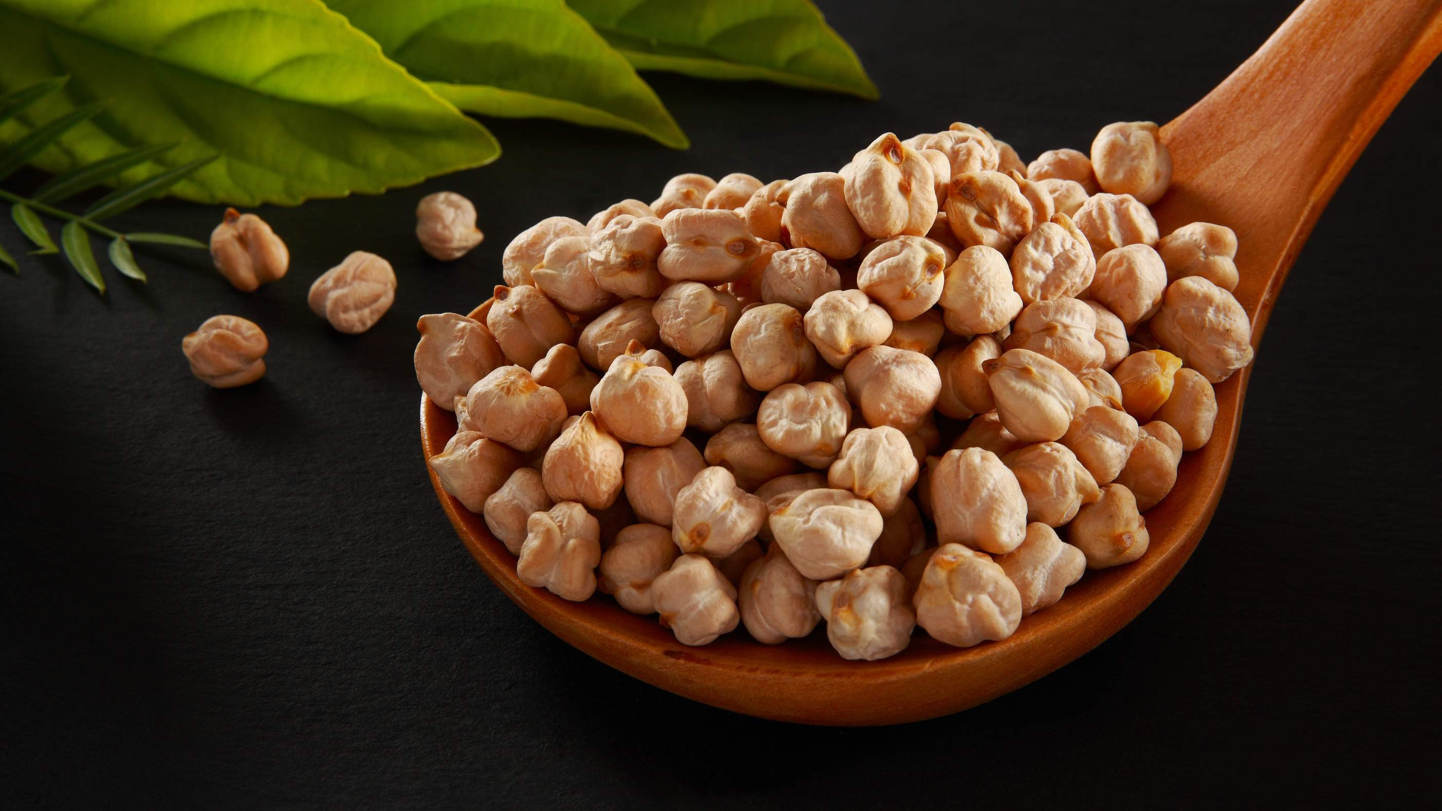
Expanding Health and Wellness Trends to Propel Market Growth
Drivers
Supply Chain Vulnerabilities to Restrict Market Growth
Restraints

Slide 7
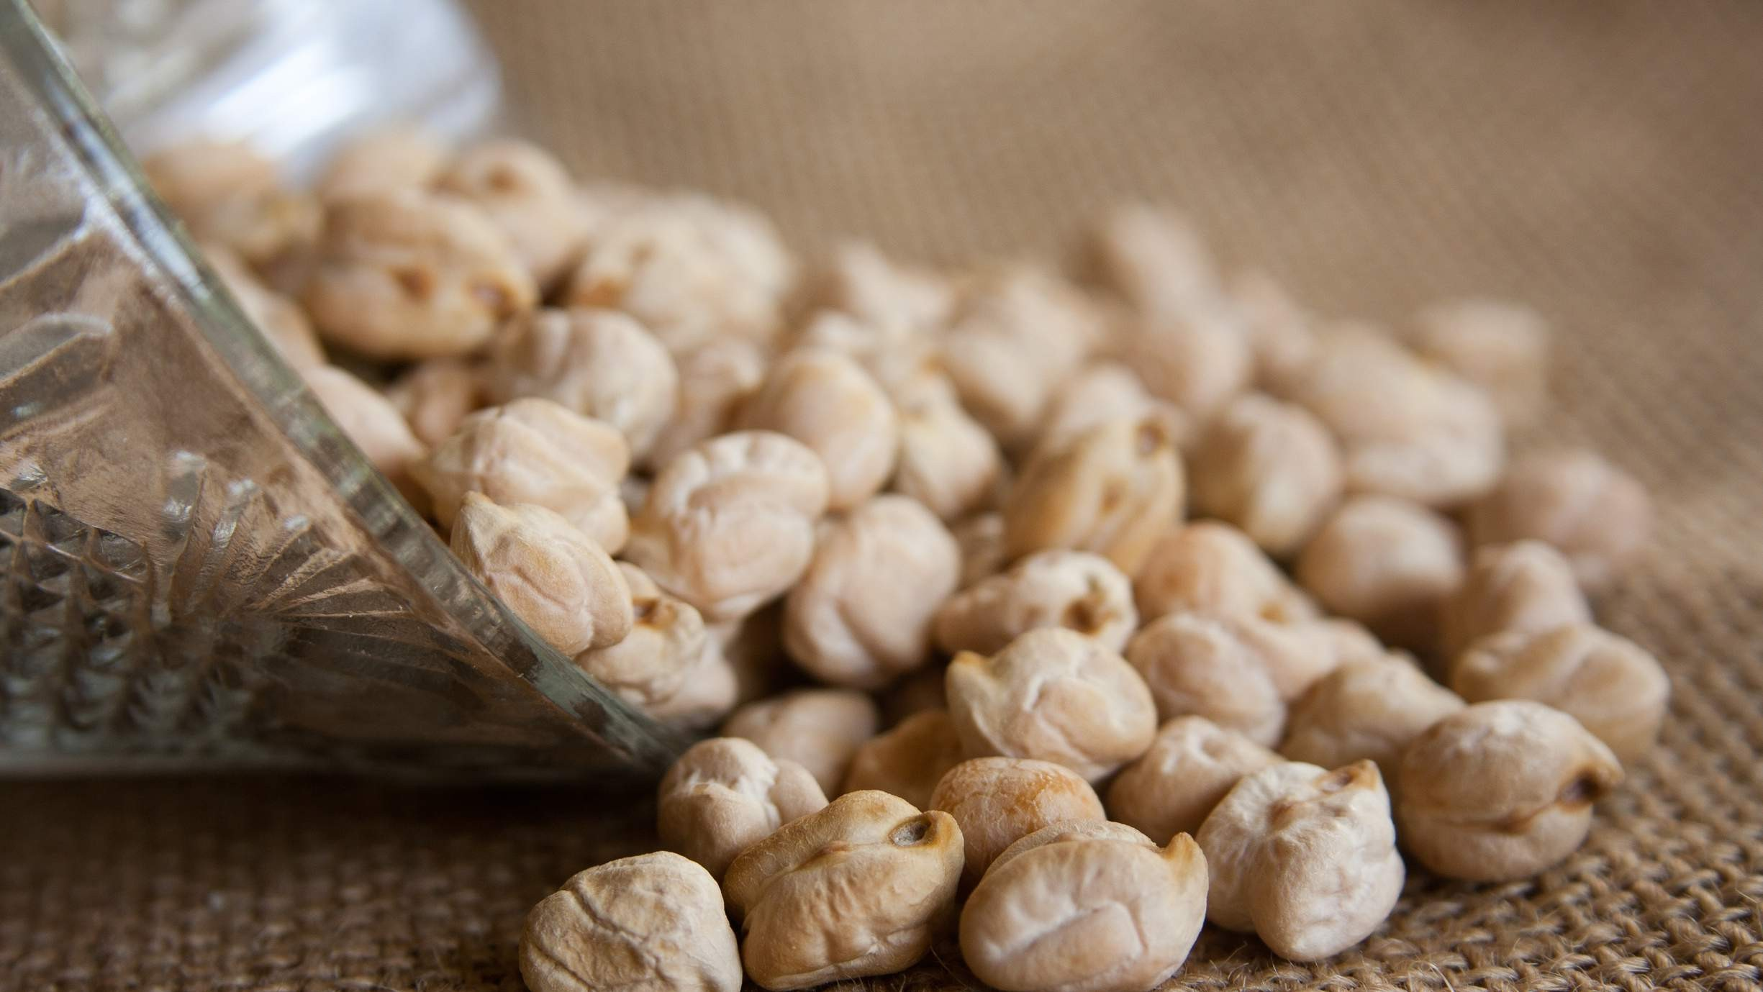
AUTHOR'S PERSPECTIVE
The Global Chickpea Protein Market is witnessing significant growth in the near future. Conventional chickpea protein appeals to a broader consumer base, including mainstream food manufacturers and cost-conscious consumers.
Conventional chickpea protein appeals to a broader consumer base, including mainstream food manufacturers and cost-conscious consumers.
Chickpea protein's rich amino acid profile, including essential amino acids and bioactive peptides, positions it as an ideal ingredient for nutraceutical formulations.
Nutraceutical products, encompassing dietary supplements, protein powders, and functional foods, are witnessing a surge in demand due to the increasing focus on preventive healthcare and wellness.

Slide 8
KEY PLAYERS

Slide 9


Contact us
For Full Report
COGNITIVE MARKET RESEARCH
Tel: + 1 312 - 376 - 8303 | + 44 020 - 8123 - 0732
India: ( + 91 ) 983 - 496 - 8611
sales@ cognitivemarketresearch. com
Access the Full Report : http://tinyurl.com/2c8ksa42
Please visit our website:
https://www.cognitivemarketresearch.com

