Slide 1

GLOBAL
CHICKEN VACCINES MARKET REPORT 2024
Global,Regional,CountryAnalysis

Slide 2
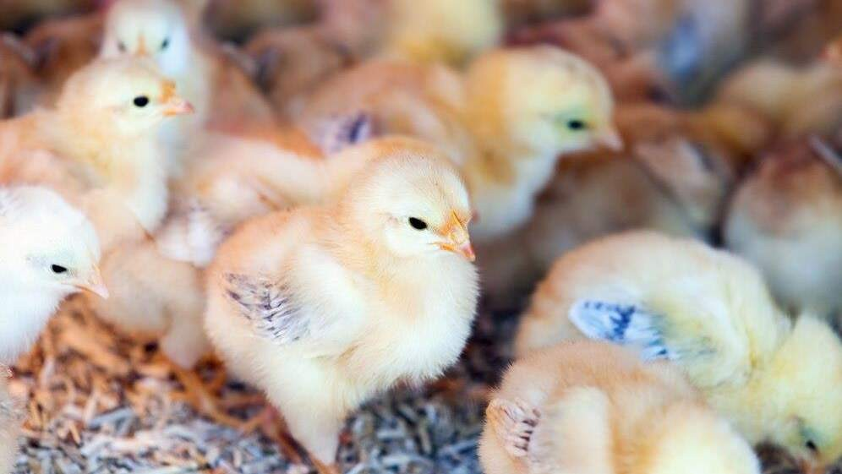
INTRODUCTION
The Chicken Vaccines Market includes various immunization options tailored specifically for poultry, tackling infectious illnesses that can influence chicken populations' health and production. These vaccinations are critical in preventing and treating diseases such as Newcastle disease, infectious bronchitis, and avian influenza. The market includes discovering, manufacturing, and marketing vaccinations suited to chickens' specific immunological needs. The primary goals are safeguarding poultry health, minimizing economic losses in the poultry industry, and ensuring food safety. The Chicken Vaccines Market demonstrates ongoing attempts to maintain biosecurity and sustain the global poultry industry by reducing the spread of dangerous illnesses and improving overall flock immunity.

Slide 3
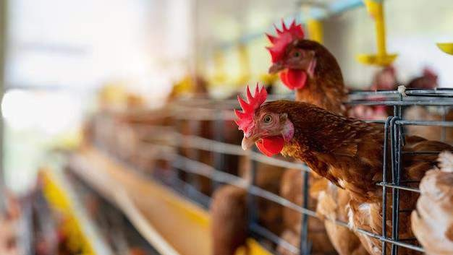

KEY INSIGHTS
CAGR 8.00%
2024
-
2031

Slide 4
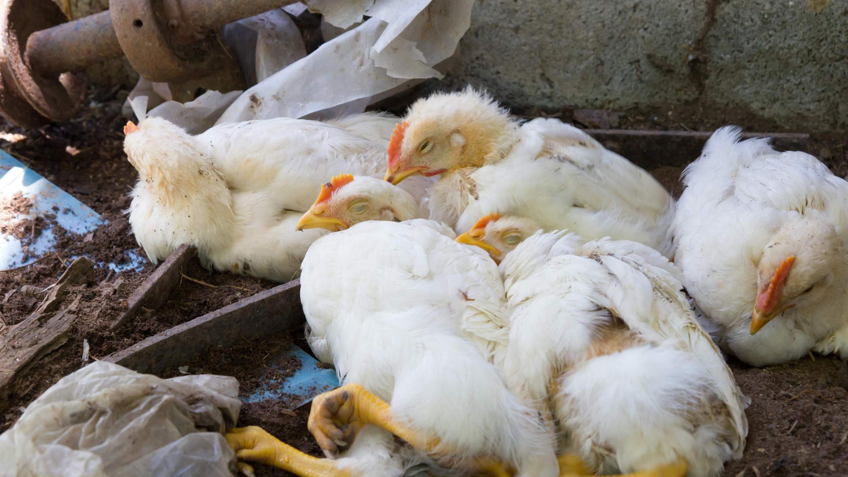
REVENUE MARKET SHARE BY SEGMENTS 2022
Attenuated Vaccine
Inactivated Vaccine
DNA Vaccine
Recombinants Vaccine
Type Segment
Marek’s Disease
Newcastle Disease
Infectious Bronchitis
Avian Influenza
Application Segment

Slide 5
Global Chicken Vaccines Market Revenue share for 2024
North America 40%

Slide 6
Increased Global Population and Protein need to Propel Market Growth
High Vaccine Costs to Restrict Market Growth

Slide 7
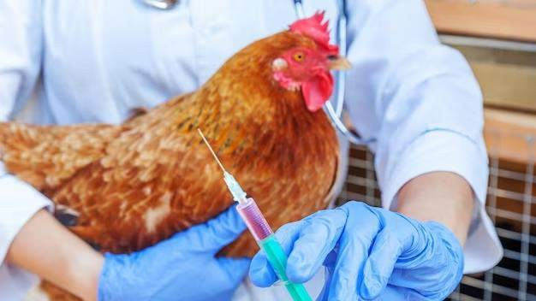
AUTHOR'S PERSPECTIVE
The global Chicken Vaccines market will expand significantly by 8.00% CAGR between 2023 and 2030.
The demand for Chicken Vaccines is rising due to the numerous strategies adopted by key participants.
North American Chicken Vaccines will continue to lead, whereas
the European Chicken Vaccines market will experience the most substantial growth until 2030

Slide 8

KEY PLAYERS

Slide 9


Contact us
For Full Report
COGNITIVE MARKET RESEARCH
Tel: + 1 312 - 376 - 8303 | + 44 020 - 8123 - 0732
India: ( + 91 ) 983 - 496 - 8611
sales@ cognitivemarketresearch. com
Access the Full Report : http://tinyurl.com/4mv3yc9p
Please visit our website:
https://www.cognitivemarketresearch.com

